Slide 1
NeuralNet 101
5. Error Back Propagation

Slide 2
We have a problem..
1
0
0
1

Slide 3
We have a problem..
1
0
0
1

Slide 4
Add complexity on neural network
Let F(X) = WX + b
Let s(x) = sigmoid(x)
Then, we can set new complex function as
G(x) = s(F(s(F(s(F(x))))))
We might be able to solve the problem,
but we cannot define loss function

Slide 5
What is Backpropagation?
=> Another way of Differentiation

Slide 6
Why Backpropagation?
There is an Error in Numerical differentials
that the computer progresses

Slide 7
Why Backpropagation?
There is an Error in Numerical differentials
that the computer progresses
Split into several small, definite differentials
with chain rules

Slide 8

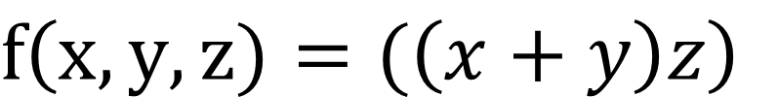
Backpropagation - Basic
$f\left(x,y,z)=(\left(x+y\right)z\right)$
$$x=1, y=5, z=−3$$

Slide 9



Backpropagation - Basic
$f\left(x,y,z)=(\left(x+y\right)z\right)$
$$x=1, y=5, z=−3$$
x
$$p$$
+
$$q$$
y
X
$$f\left(x,y,z\right)$$
z

Slide 10

Backpropagation - Basic
$f\left(x,y,z)=(\left(x+y\right)z\right)$
$$x=1, y=5, z=−3$$
x
$$p$$
+
$$q$$
y
X
$$f\left(x,y,z\right)$$
$$\frac{∂f}{∂q}$$
z

Slide 11
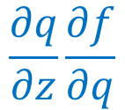
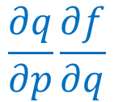
Backpropagation - Basic
$f\left(x,y,z)=(\left(x+y\right)z\right)$
$$x=1, y=5, z=−3$$
x
$$p$$
+
$$\frac{∂q}{∂p}\frac{∂f}{∂q}$$
$$q$$
y
X
$$f\left(x,y,z\right)$$
$$\frac{∂f}{∂q}$$
z
$$\frac{∂q}{∂z}\frac{∂f}{∂q}$$

Slide 12
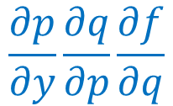
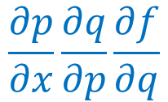
Backpropagation - Basic
$f\left(x,y,z)=(\left(x+y\right)z\right)$
$$x=1, y=5, z=−3$$
x
$$\frac{∂p}{∂x}\frac{∂q}{∂p}\frac{∂f}{∂q}$$
$$p$$
+
$$\frac{∂q}{∂p}\frac{∂f}{∂q}$$
$$q$$
y
X
$$\frac{∂p}{∂y}\frac{∂q}{∂p}\frac{∂f}{∂q}$$
$$f\left(x,y,z\right)$$
$$\frac{∂f}{∂q}$$
z
$$\frac{∂q}{∂z}\frac{∂f}{∂q}$$

Slide 13
Backpropagation - Basic
$f\left(x,y,z)=(\left(x+y\right)z\right)$
$$x=1, y=5, z=−3$$
x
$$\frac{∂p}{∂x}\frac{∂q}{∂p}\frac{∂f}{∂q}$$
$$p$$
1
+
$$\frac{∂q}{∂p}\frac{∂f}{∂q}$$
$$q$$
y
X
5
$$f\left(x,y,z\right)$$
$$\frac{∂p}{∂y}\frac{∂q}{∂p}\frac{∂f}{∂q}$$
$$\frac{∂f}{∂q}$$
z
$$\frac{∂q}{∂z}\frac{∂f}{∂q}$$
-3

Slide 14
Backpropagation - Basic
$f\left(x,y,z)=(\left(x+y\right)z\right)$
$$x=1, y=5, z=−3$$
x
$$\frac{∂p}{∂x}\frac{∂q}{∂p}\frac{∂f}{∂q}$$
$$p$$
1
+
$$\frac{∂q}{∂p}\frac{∂f}{∂q}$$
$$q$$
y
X
5
$$f\left(x,y,z\right)$$
$$\frac{∂p}{∂y}\frac{∂q}{∂p}\frac{∂f}{∂q}$$
$$\frac{∂f}{∂q}$$
z
$$\frac{∂q}{∂z}\frac{∂f}{∂q}$$
-3
1

Slide 15
Backpropagation - Basic
$f\left(x,y,z)=(\left(x+y\right)z\right)$
$$x=1, y=5, z=−3$$
x
$$\frac{∂p}{∂x}\frac{∂q}{∂p}\frac{∂f}{∂q}$$
$$p$$
-3
1
+
$$\frac{∂q}{∂p}\frac{∂f}{∂q}$$
$$q$$
y
X
5
$$f\left(x,y,z\right)$$
$$\frac{∂p}{∂y}\frac{∂q}{∂p}\frac{∂f}{∂q}$$
$$\frac{∂f}{∂q}$$
z
$$\frac{∂q}{∂z}\frac{∂f}{∂q}$$
-3
1
6

Slide 16
Backpropagation - Basic
$f\left(x,y,z)=(\left(x+y\right)z\right)$
$$x=1, y=5, z=−3$$
-3
x
$$\frac{∂p}{∂x}\frac{∂q}{∂p}\frac{∂f}{∂q}$$
$$p$$
-3
1
+
$$\frac{∂q}{∂p}\frac{∂f}{∂q}$$
$$q$$
y
X
5
$$f\left(x,y,z\right)$$
$$\frac{∂p}{∂y}\frac{∂q}{∂p}\frac{∂f}{∂q}$$
$$\frac{∂f}{∂q}$$
-3
z
$$\frac{∂q}{∂z}\frac{∂f}{∂q}$$
-3
1
6
6

Slide 17
Backpropagation - Basic
$f\left(x,y,z)=(\left(x+y\right)z\right)$
$$x=1, y=5, z=−3$$
-3
x
$$\frac{∂p}{∂x}\frac{∂q}{∂p}\frac{∂f}{∂q}$$
$$p$$
-3
1
-3
+
$$\frac{∂q}{∂p}\frac{∂f}{∂q}$$
$$q$$
y
X
5
$$f\left(x,y,z\right)$$
$$\frac{∂p}{∂y}\frac{∂q}{∂p}\frac{∂f}{∂q}$$
-3
$$\frac{∂f}{∂q}$$
-3
z
$$\frac{∂q}{∂z}\frac{∂f}{∂q}$$
-3
1
6
6

Slide 18
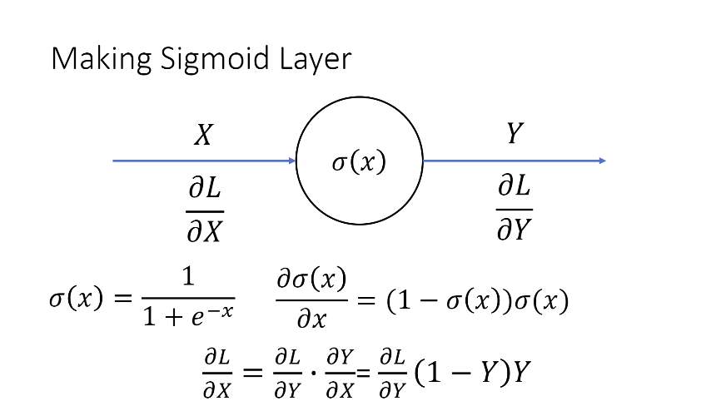

Slide 19

Backpropagation - Real
b2
w11
x1
x
+
S
x
x
w13
w21
b3
+
S
x
w12
w23
x
x2
x
+
S
w22
b1
$$f\left(x,y,z\right)$$

Slide 20
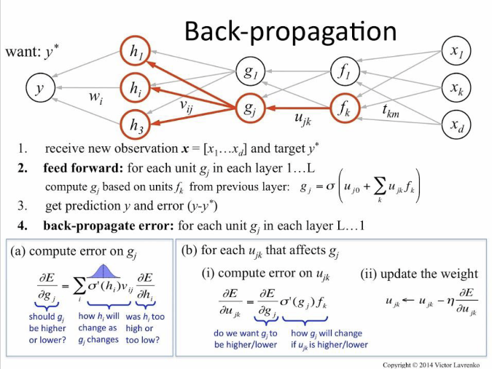
Backpropagation - Real
Sigmoid, bias, weight
added

Slide 21
Lab Session
vlab-kaist/NN101_23S/lab/week5
$$f\left(x,y\right)=sin⁡(x)(x+y)(x^{3}+1)$$

