Slide 1
NeuralNet 101
4. Softmax

Slide 2
We have a problem..

Slide 3
We have a problem..

Slide 4
What is Softmax?
multi-class classification using probability

Slide 5
What is Softmax?
multi-class classification using probability
Cross Entropy Loss

Slide 6
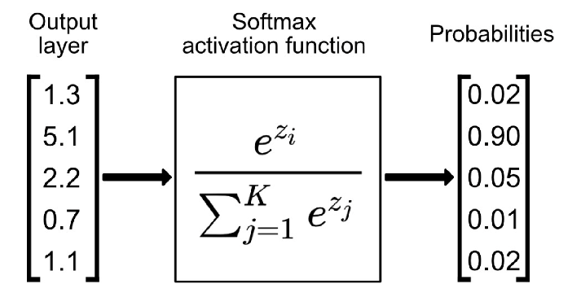
Softmax Function

Slide 7
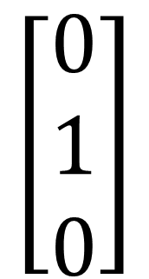
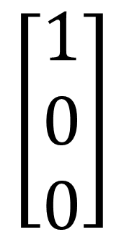

One-Hot Vector
People = {Height, Weight, Foot size}
$$\left[\begin{aligned}1 \\ 0 \\ 0\end{aligned}\right]$$
$$\left[\begin{aligned}0 \\ 1 \\ 0\end{aligned}\right]$$
$$\left[\begin{aligned}0 \\ 0 \\ 1\end{aligned}\right]$$

Slide 8
Error Function – Cross Entropy
?g
Xg
?g
?g

Slide 9
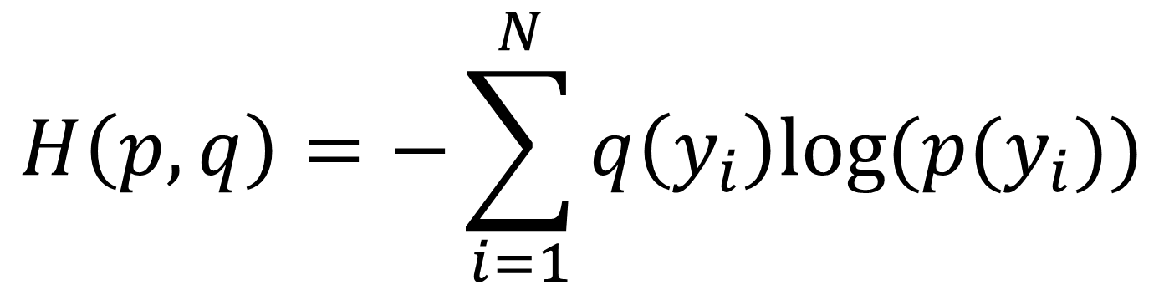
Error Function – Cross Entropy
$$H\left(p,q\right)=−\sum_{i=1}^{N}{q\left(y_{i}\right)log⁡(p(y_{i}))}$$

Slide 10
Error Function – Cross Entropy
$$H\left(p,q\right)=−\sum_{i=1}^{N}{q\left(y_{i}\right)log⁡(p(y_{i}))}$$
Real Data
softmax Result

Slide 11
Error Function – Cross Entropy
$$H\left(p,q\right)=−\sum_{i=1}^{N}{q\left(y_{i}\right)log⁡(p(y_{i}))}$$
Real Data
softmax Result

Slide 12
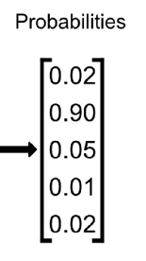
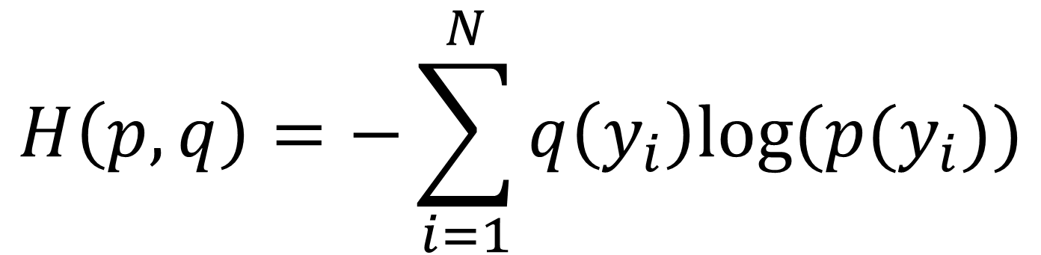
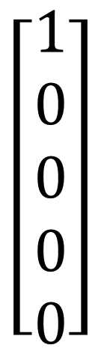
Error Function – Cross Entropy
$$H\left(p,q\right)=−\sum_{i=1}^{N}{q\left(y_{i}\right)log⁡(p(y_{i}))}$$
$$\left[\begin{aligned}1 \\ 0 \\ 0 \\ 0 \\ 0\end{aligned}\right]$$

Slide 13
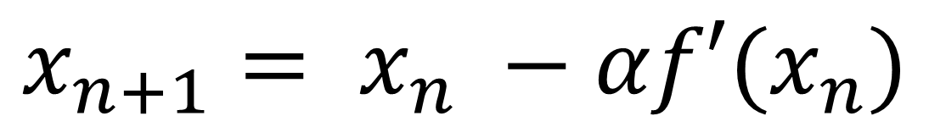
Gradient Descent (Last Lecture)
$$x_{n+1}= x_{n} −αf′(x_{n})$$

Slide 14
Use Pytorch!!

Slide 15
Softmax
https://youtu.be/E5AuqaKFlL4

Slide 16
Lab Session
vlab-kaist/NN101_23S/lab/week4

