Slide 1
CMS TEAM Impact Report
Full Source Audit
104 claims checked against primary sources
Prepared by Kyle McAuliffe · Oct 2026
Rainfall Health report by Christina Keny, PhD · published Jul 27, 2026 (footer reads May 2026)
Notes:
Audit of Rainfall Health's published 'CMS TEAM Impact Report' (Christina Keny, PhD; released Jul 27, 2026; footer says 'May 2026').
104 claim rows on pp.1-11 checked against primary sources. Source: /workspace/source-verify/full-audit.md (Counts by status).

Slide 2
Source audit
Version timeline
Green = caught or fixed. Amber = partly fixed. Red = error added or carried. Grey = file only.
Date · version (PT)
What changed
Result
May 5 · Christina's v4 docx
Original text: no numbered footnotes, only a "Sources:" line at the end
Sources line already lists CMS-5540-F (wrong rule)
Jun 25 · Annabelle's Word draft + Canva
First numbered list (13 refs, bad ones included); Canva text longer than original
Ref list doesn't match the doc's sources
Jun 26 · Kyle's citation pass + memo
"im worried that perplexity made up references"; memo flags 4 bad refs
Caught before publishing
Jun 29 · v3 PDF; Christina's replacements
Tarazi → Ho 2022, Becher → Etzioni 2003, Bandeen-Roche dropped, refs 4-6 added
Fake refs gone; numbers not fixed
Jun 29, 3:13 PM · mid-fix Canva export
Ho added while Tarazi still listed; Bandeen-Roche gone; ³ on 19.1% points at Tarazi
Fixes made in steps
Jul 1 · 120/80 cover rewrite
New cover: "Inside 741 Hospitals… First Mandatory…", "$1.2M… Year 1", "30%… by PY5"
Cover only; phrases were already in the body
Jul 8 · hospital count
741 → 721 hospitals
Fixed
Jul 14 · release file (Carrie)
"CMS TEAM Impact Report.pdf" posted in #aox3
Very likely the published file
Jul 27 · published
PR Newswire, HFMA story, gated download
Footer still says "May 2026"
Notes:
Version timeline (all times PT). Sources: /workspace/source-verify/slack-history/history.md section (a); full-audit.md 'Cover / headline wording by version'.
May 5 9:42 AM: CMS_TEAM_Impact_Report_Companion_v4_05.04.26.docx (F0B1LJTT85R), Christina; Sources line includes 'CMS TEAM Final Rule (CMS-5540-F, August 2024)'.
Jun 25 5:12-5:13 PM: Annabelle sends Kyle a Canva link + 'Impact Report Draft Rainfall Health.docx' (F0BD3R42HSP; Word metadata Jun 25, 1:04 PM). The docx is the earliest numbered version: same 13 refs as draft 02 (updated Oct 8 from earliest drafts).
Jun 26: Kyle's citation pass; 2:56 PM 'im worried that perplexity made up references'; memo dated Jun 26 (shared Jun 29).
Jun 29 2:26 PM: v3 PDF (F0BDJP8RXUP); Christina's replacement refs 3:04 / 3:39 PM.
Jul 1 2:23 PM: 120/80 (Tori) cover rewrite. 'First mandatory', '$1.2M year 1', '30% by PY5' were already in body text in the Jun 25 Word draft and draft 01 (Jun 26); the new cover first appears in the published file.
Jul 8 2:24 PM: 741 -> 721 (F0BG6Q087EG). Jul 14 3:10 PM: CMS TEAM Impact Report.pdf (F0BHG49P7JQ), Carrie, #aox3. Jul 27: published.
17
Jun 29, 3:13 PM PT: Canva export (PDF metadata 22:13:14 UTC), a snapshot partway through the citation fixes: Ho added as #4 while Tarazi still listed as #3, Bandeen-Roche gone, Becher still #2; p.3 superscript 3 on '19.1%' lands on Tarazi. Not the v3 file (F0BDJP8RXUP, 2:26 PM). Source: /workspace/source-verify/ref-history.md section 1.

Slide 3
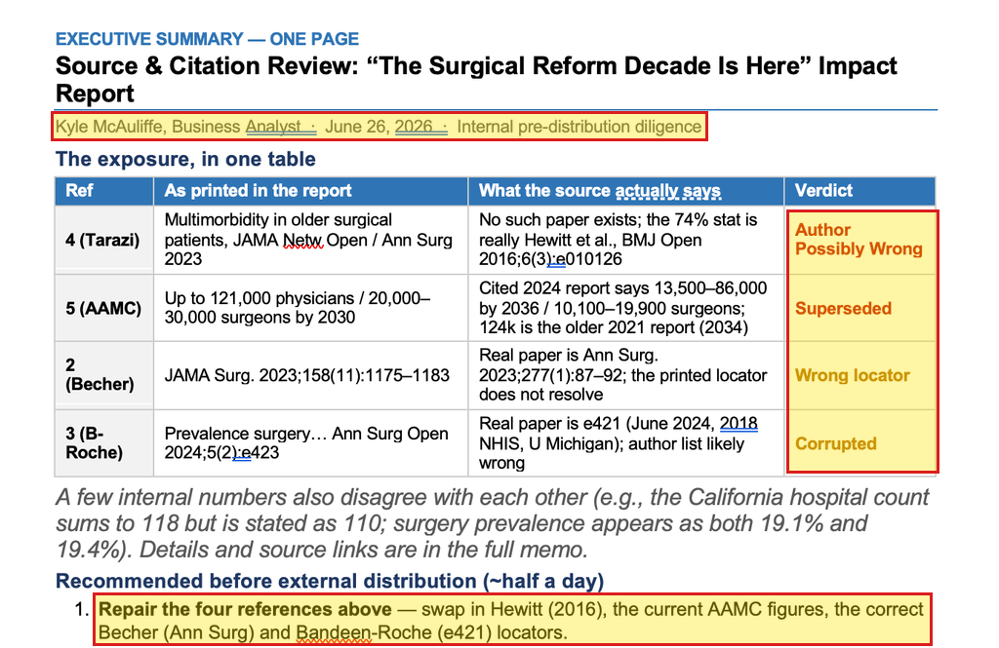
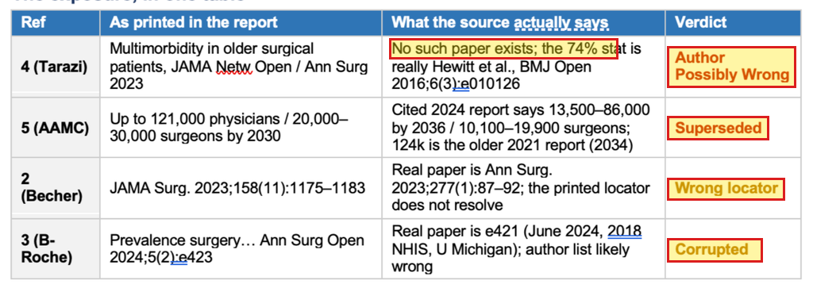
Flagged before publication: Yes
Caught before publishing
Kyle caught 4 bad references on Jun 26
Kyle's Source & Citation Review
dated Jun 26
The 4 bad references
memo table + Tarazi search
Kyle's one-page memo (shared in Slack Jun 29)
Memo table: as printed vs. what the source says, with verdicts
Jun 26, 3:37 PM: Kyle's Tarazi search; results show only other papers
What happened next (Jun 29): Tarazi → Ho 2022 (no 74% in it) · Becher → Etzioni 2003 · Bandeen-Roche deleted, 19.4% left uncited · AAMC kept, numbers never updated
Source: Slack, Kyle's memo screenshots F0BDJRVJ955 / F0BDU327GEP (shared Jun 29, 2:40 / 2:58 PM PT); Tarazi search F0BDJJ6T3GA (Jun 26, 3:37 PM PT); Christina's DMs Jun 29, 3:04 / 3:39 PM PT; published PDF p.11
Notes:
Kyle's 'Source & Citation Review' memo (dated Jun 26, 2026; screenshots shared in Slack Jun 29, 2:40 / 2:58 PM PT; F0BDJRVJ955, F0BDU327GEP).
Verdicts: Tarazi 2023 'No such paper exists' (74% stat is Hewitt 2016); AAMC 'Superseded' (cited 2024 report: 13,500-86,000 by 2036); Becher 'Wrong locator'; Bandeen-Roche 'Corrupted' (real paper e421).
What happened (Christina, Jun 29, 3:04 / 3:39 PM PT): Tarazi -> Ho 2022 (JAMA Surg 2022;157(6):499-506; no 74% or 85+ figure); Becher -> Etzioni 2003 (Ann Surg 2003;238(2):170-177); Bandeen-Roche eliminated, 19.4% now uncited (correct source Bicket 2024 e421); AAMC citation kept, numbers unchanged.
Sources: slack-history/history.md (b); full-audit.md 'Reference list by version'. Ho: https://pmc.ncbi.nlm.nih.gov/articles/PMC9047756/ · Etzioni: https://pmc.ncbi.nlm.nih.gov/articles/PMC1422682/ · Bicket: https://pmc.ncbi.nlm.nih.gov/articles/PMC11191855/

Slide 4
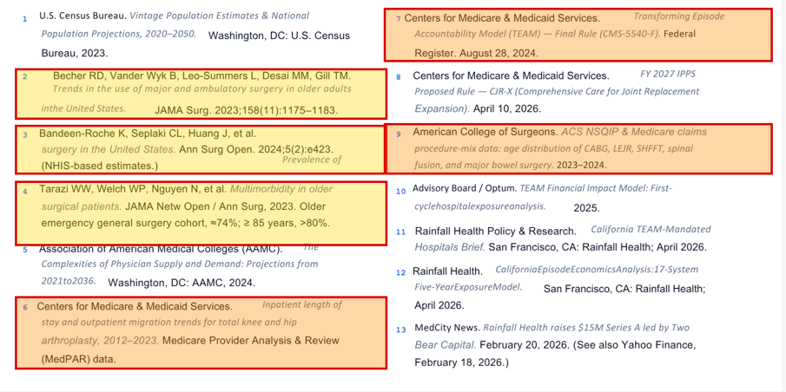
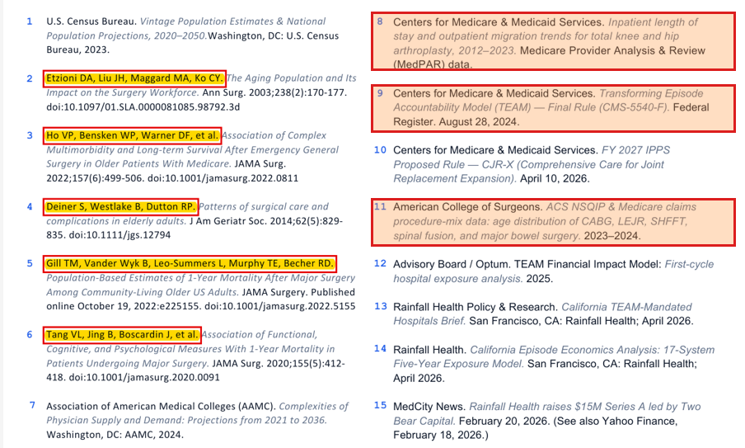
Flagged before publication: Partly
Partly fixed
Reference list: 3 swapped or cut, at least 3 wrong ones kept
Draft 02 · Jun 26, 1:26 PM
13 refs
Draft 03 (Jun 30) = published
15 refs
Matches Jun 25 draft word for word. Yellow = replaced/cut (2-4); orange = still wrong (6, 7, 9)
Published: yellow = new refs 2-6; orange = same 3 wrong refs, now 8, 9, 11
What changed: Tarazi → Ho 2022 and Becher → Etzioni 2003, but neither backs the numbers · Bandeen-Roche cut, so 19.4% is uncited · Deiner, Gill, Tang added · MedPAR, CMS-5540-F and NSQIP carried over word for word, still wrong
Source: drafts/02 (Jun 26, 1:26 PM PT, p.12) vs drafts/03 (Jun 30) and published PDF p.11 (03, 04 and published lists are identical); full-audit.md, Reference list by version
Notes:
Draft 02 (Canva export Jun 26, 1:26 PM PT, 13 refs) vs draft 03 (PDF Jun 30, = Slack F0BF225SU3S) and the published PDF (15 refs; 03, 04 and published lists identical).
Replaced: ref 2 Becher -> Etzioni 2003 (Etzioni's 40% = all hospital discharges, 1999); ref 4 Tarazi -> ref 3 Ho 2022 (no 74%, no 85+ figure; real source Hewitt 2016, PMC4823401).
Removed, not replaced: ref 3 Bandeen-Roche (19.4% now uncited; real source Bicket 2024 e421).
Added Jun 29: refs 4-6 Deiner 2014, Gill 2022, Tang 2020 (cover frailty/dementia only).
Carried over unchanged and still wrong: MedPAR LOS (6->8; real = AJRR 2024 + Burnett 2023), CMS-5540-F (7->9; rule is CMS-1808-F), ACS NSQIP procedure-mix (9->11; not found). AAMC (5->7) also kept with text unchanged.
Note: the brief's '3 fixed on paper' was reworded: only 2 refs were replaced; the third was deleted.
Source: /workspace/source-verify/full-audit.md 'Reference list by version'; evidence/version-reference-list-02-vs-published.png; version-ref2/ref3/ref4 and version-unchanged-refs images.
10
Update (ref-history.md, Oct 8): draft 02's 13-ref list matches the Jun 25 Word draft (the earliest numbered version) word for word. 'At least 3 wrong ones kept': orange marks = MedPAR, CMS-5540-F, NSQIP; the Census title (ref 1) and the Advisory Board title (ref 10 -> 12, issue #10) were also carried word for word and are also wrong. See the next three slides.

Slide 5
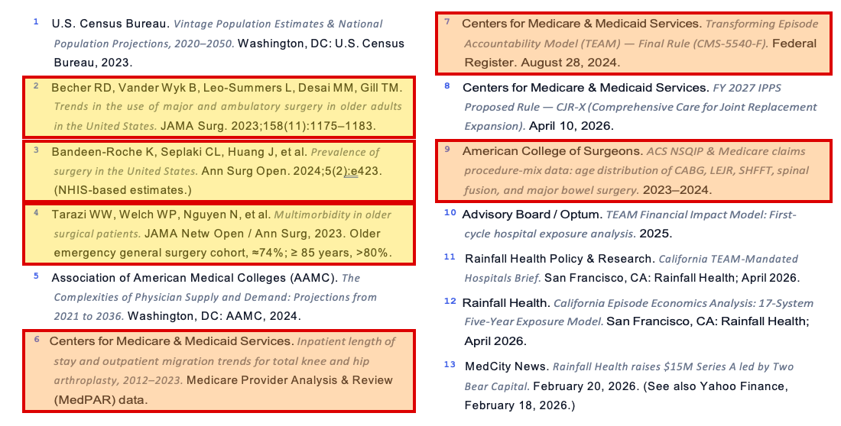
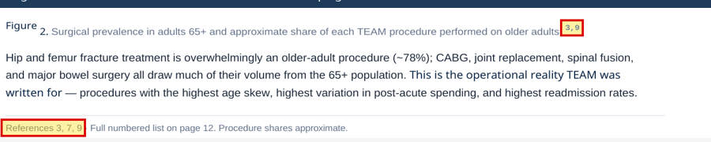
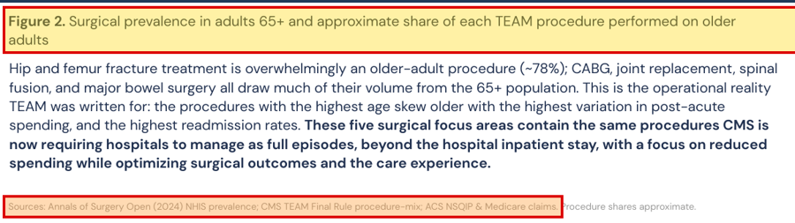
Flagged before publication: Partly
Origin
The bad refs were in the first numbered draft (Jun 25)
Jun 25 Word draft
p.12 · 13 refs
Lost in the move to Canva
p.6 vs pub p.5
Yellow = replaced or cut later (2-4); orange = printed word for word, still wrong (6, 7, 9)
Jun 25 draft p.6: Fig 2 cites refs 3 and 9; page footer "References 3, 7, 9"
Published p.5: no superscript, only an unnumbered "Sources:" line
First numbered list: Jun 25 Word draft (Christina's May draft had none). Draft 02 copied all 13 word for word, including Tarazi, Bandeen-Roche, Becher, MedPAR, CMS-5540-F and NSQIP. The Fig 1 and Fig 2 citations were lost on the way.
Source: Impact Report Draft Rainfall Health.docx (Annabelle → Kyle, Slack Jun 25, 5:13 PM; Word metadata Jun 25, 1:04 PM PT), p.12 and p.6; published PDF p.5
Notes:
Citation history 1 of 3 (ref-history.md sections 1-2, proposed slide 4a). Flagged before publication: Partly (Kyle's Jun 26 memo flagged Tarazi, Becher, Bandeen-Roche and AAMC; MedPAR, CMS-5540-F and NSQIP were never flagged).
Earliest numbered version: 'Impact Report Draft Rainfall Health.docx', DMed by Annabelle to Kyle in Slack (F0BD3R42HSP, Jun 25, 5:13 PM PT). Word metadata: created/modified Jun 25, 1:04 PM PT. 12 pages, 13 numbered refs on p.12. Christina's May 5 v4 docx had no numbered footnotes, only a 'Sources:' line. Our files don't show who wrote the 13 refs.
Canva draft 01 (Jun 26, 10:16 AM) has an empty References page; draft 02 (Jun 26, 1:26 PM) has the same 13 refs word for word. Kyle, Slack Jun 26, 1:59 PM: 'i imported the reference page to more easily copy paste it in'.
Lost in the move to Canva: Jun 25 Fig 2 caption cites 3,9 (Bandeen-Roche + ACS NSQIP), page footer 'References 3, 7, 9'; Fig 1 caption cites 1 (Census, p.5); 7 after '30-day post-discharge window' (p.7). All gone by draft 01; published p.5 Fig 2 has only an unnumbered 'Sources:' line.
Docx pages rendered with LibreOffice (fonts differ from Word); text and superscripts are from the docx.
Sources: /workspace/source-verify/ref-history.md; evidence/refhist-01, refhist-07; refhist-src/00_2026-06-25_Impact-Report-Draft-Rainfall-Health.docx

Slide 6
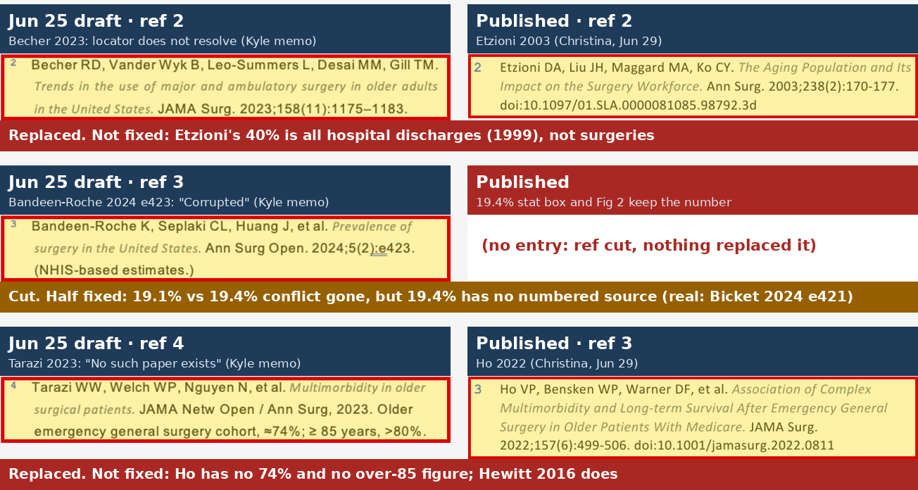
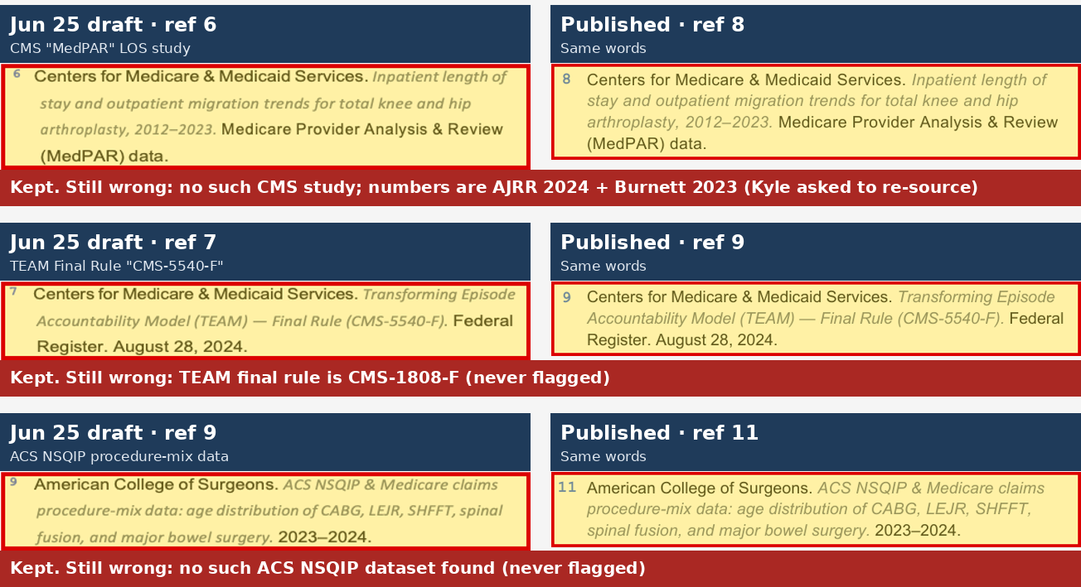
Flagged before publication: Yes
Not fixed
2 swapped, 1 cut, 3 added: no number fixed
Changed (refs 2-4)
Jun 25 → print
Never touched
3 of 10 kept
Refs 2-4, Jun 25 draft vs published, and the verdict on each
Refs 6, 7, 9: same words in print, only renumbered (8, 9, 11)
Did it fix anything? Tarazi→Ho and Becher→Etzioni: real papers, but neither has the number. Bandeen-Roche cut: 19.4% left uncited. Deiner/Gill/Tang added: frailty and dementia only. MedPAR, CMS-5540-F and NSQIP went to print word for word.
Source: Jun 25 docx p.12 vs published p.11; Slack DM Christina→Kyle Jun 29, 3:04/3:39/3:42 PM; full-audit.md issues #2, #4, #5, #8, #9, #15, #16
Notes:
Citation history 2 of 3 (ref-history.md section 2 and proposed slide 4b). Flagged before publication: Yes (Kyle's Jun 26 memo: Tarazi, Becher, Bandeen-Roche, AAMC). Verdicts from full-audit.md (plus Mali's re-check of Ho and Etzioni):
- Tarazi 2023 (J25 ref 4) -> Ho 2022 JAMA Surg 157(6):499-506 (pub ref 3): fake ref gone; NOT fixed - Ho has no 74% and no over-85 figure; Hewitt 2016 has both (issue #2).
- Becher 2023 (J25 ref 2) -> Etzioni 2003 Ann Surg 238(2):170-177 (pub ref 2): bad locator gone; NOT fixed - Etzioni's 40% is all hospital discharges (1999), not surgeries; ~37% is the real figure (issue #4).
- Bandeen-Roche 2024 e423 (J25 ref 3): cut, nothing replaced it. Half fixed - the 19.1% clause was cut by Jun 30, but 19.4% (stat box, Fig 2) has no numbered source; real source Bicket 2024 e421 (issue #16).
- Deiner 2014 / Gill 2022 / Tang 2020 added Jun 29 (pub refs 4-6, 'to be safe'): partly support - frailty and dementia only; nothing backs 'polypharmacy, social vulnerability' (issue #15).
- Carried word for word, only renumbered: MedPAR LOS study 6->8 (no such CMS study; AJRR 2024 + Burnett 2023, issue #8), CMS-5540-F 7->9 (TEAM rule is CMS-1808-F, issue #5), ACS NSQIP 9->11 (not found, issue #9). Also carried unchanged: Census title (1), AAMC (5->7, text still uses 2018 numbers, issue #3), Advisory Board title (10->12, issue #10), the two internal Rainfall refs (11->13, 12->14), CJR-X proposed rule (8->10, outdated), MedCity News (13->15, verified).
Totals J25 -> print: 2 replaced, 1 cut, 3 added, 10 kept word for word.
Sources: /workspace/source-verify/ref-history.md; full-audit.md; evidence/refhist-05, refhist-06; Slack DM Christina->Kyle Jun 29, 3:04 / 3:39 / 3:42 PM PT

Slide 7
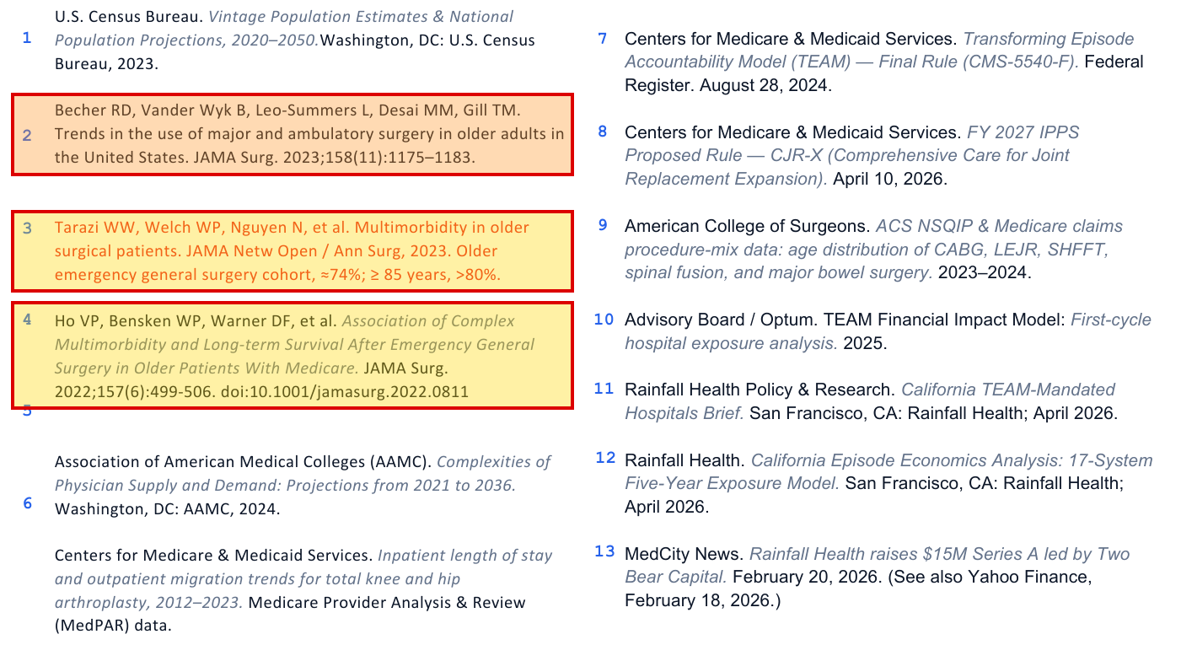
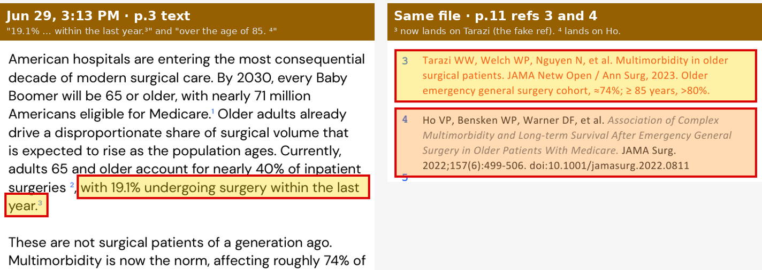
Jun 29, 3:13 PM snapshot
Mid-fix
Mid-fix, the footnote for 19.1% pointed at the fake paper
Jun 29, 3:13 PM · refs
p.11
Same file · p.3
p.3 + p.11
Ho added as #4, Tarazi still #3 (red), Bandeen-Roche gone, Becher still #2
p.3: ³ still on "19.1%", and ref 3 is now Tarazi (the fake ref); ⁴ lands on Ho
At 3:13 PM: Ho added, Tarazi still listed, Bandeen-Roche gone, Becher not yet swapped, refs 4-6 not yet added. ³ on '19.1%' now landed on Tarazi. By Jun 30 the numbering was cleaned up and the 19.1% clause was cut, but the numbers behind the refs never changed.
Source: Canva PDF export, metadata Jun 29, 3:13 PM PT (pp.3, 11); Slack DM between Kyle and Christina, Jun 29
Notes:
Citation history 3 of 3 (ref-history.md section 1, 'What the Jun 29, 3:13 PM snapshot shows', and proposed slide 4c).
File: Canva export 'Surgical Reform Decade is Here', 11 pages; PDF metadata created Jun 29, 3:13 PM PT (22:13:14 UTC). It sits between draft 02 and draft 03: 9 minutes after Christina's Ho message (3:04 PM) and 26 minutes before her Etzioni / 'For reference 3, we can eliminate' message (3:39 PM). It is not the v3 file (F0BDJP8RXUP, posted 2:26 PM): its footers already say 'Prepared by...'.
p.11: Ho 2022 added as #4 while Tarazi is still #3 (red text); Bandeen-Roche already gone; Becher still #2 (Etzioni not yet in); Deiner, Gill, Tang not yet added. Labels out of line: '5' floats with no entry, '6' sits beside AAMC, MedPAR has no number.
p.3: '...19.1% undergoing surgery within the last year.3' - 3 now lands on Tarazi; the 74% sentence's 4 lands on Ho.
Bandeen-Roche was removed before the 3:39 PM message; they were on a call from about 2:19 PM, no transcript, so not confirmed how.
By Jun 30 (draft 03): numbering cleaned up, 19.1% clause cut; the numbers behind the refs unchanged (see previous slide).
Sources: /workspace/source-verify/ref-history.md; evidence/refhist-03, refhist-04; refhist-src/02b_2026-06-29_1513_Surgical-Reform-midfix.pdf

Slide 8
Pre-publication review
What slipped through
Flagged before publication, not fixed
Never flagged
AAMC "121,000 by 2030" still contradicts the cited 2024 report
74% / >80% over 85 now cited to Ho 2022, which has neither
19.4%: bad ref deleted, so the stat is uncited
"40% of inpatient surgeries": Etzioni's 40% is all hospital discharges
Ref 8 still credits a CMS MedPAR study that doesn't exist
California "110 hospitals" (regions sum to 118; CMS lists 107)
p.9 "$14.5" still missing the "M"
Fig 4 "Optum" label and p.6 $14M not marked as Rainfall estimates
Ref 9 "CMS-5540-F": the TEAM rule is CMS-1808-F
Ref 11 "ACS NSQIP procedure-mix" data: not found
Ref 12 "TEAM Financial Impact Model": title doesn't exist
Cover: "First Mandatory" model (CJR was mandatory)
Cover: "30% … by PY5" and p.7 "±30%" (cap is 20% every year)
Cover: "$1.2M … Year 1" loss (the source doesn't say Year 1)
Disclaimer "publicly available data", but refs 13-14 are internal
Ref 8 sits on the left: Kyle's Jun 26 memo asked to re-source the length-of-stay figure. Source: full-audit.md issue list and pre-pub flags; slack-history/history.md (b), (c)
Notes:
Left (flagged before Jul 27, not fixed): AAMC (Kyle memo 'Superseded'); 74%/>80% (Tarazi flag, replaced by Ho 2022); 19.4% (Bandeen-Roche 'Corrupted', ref deleted); 40% (Becher locator + 're-source the 40%'); ref 8 MedPAR (memo rec #3 're-source the length-of-stay'); California 110 vs 118 (memo); missing 'M' (memo); internal estimates (memo rec #3 'Relabel proprietary/internal estimates').
Right (never flagged in Slack/memo): CMS-5540-F (in Christina's May 5 Sources line); ref 11 NSQIP; ref 12 title; cover claims from the Jul 1 120/80 rewrite ('First Mandatory', '$1.2M ... Year 1', '30% ... by PY5'; phrases already in body since draft 01); disclaimer wording added after draft 02.
Change vs brief: ref 8 MedPAR moved from 'never flagged' to 'flagged, not fixed' (full-audit.md issue #8: 'Yes, Kyle memo (re-source the LOS). Not fixed').
Source: /workspace/source-verify/full-audit.md; slack-history/history.md.

Slide 9
Scorecard
104 claims: 74 need a fix
Red = wrong. Amber = unsupported, internal-only or outdated. Green = verified. Grey = not checked.
Status · claims
What it means
Pages with the most
Wrong · 41
False, misquoted, wrong source or wrong citation
p.3 (9) · p.11 (7) · p.7 (6)
Unsupported · 17
No source given, or the source doesn't back it
p.5 (4) · p.10 (4) · p.3 (3)
Unverifiable (internal) · 9
Rests on Rainfall's own internal or self-reported material
p.9 (3) · p.10 (2) · p.11 (2)
Outdated · 7
True when written, superseded now
p.3 (3) · p.4 (2)
Verified · 28
Checks out against the primary source
p.3 (6) · p.6 (5) · p.11 (5)
Not checked · 2
Not verified in this audit
p.4 (1) · p.6 (1)
Need a fix · 74 of 104
Wrong + unsupported + internal-only + outdated
p.3 (15) · p.11 (10)
Verified, citation still needed · ~9
True, but uncited, loosely cited, or the ref doesn't back it
e.g. 19.4%, 71M, Age-Friendly measure
Fixes needed, by page
p.1: 4 · p.2: 5 · p.3: 15 · p.4: 6 · p.5: 7 · p.6: 4 · p.7: 7 · p.8: 3 · p.9: 6 · p.10: 7 · p.11: 10
Notes:
Counts: full-audit.md 'Counts by status (104 claim rows, 1.1-11.15; primary status of each row)': wrong 41, unsupported 17, unverifiable-internal 9, outdated 7, verified 28, not checked 2 (4.9 1980 '26 million'; 6.4 'stacked on other P4P programs').
74 of 104 = wrong + unsupported + unverifiable-internal + outdated. About 9 verified rows still need a citation fix (6 verified-but-uncited/loosely cited: 3.2, 3.14, 3.19, 4.1, 5.1, 6.6; plus reference entries 11.2, 11.3, 11.5 and partly 11.4 that don't support their claims).
Per-page counts computed from the row IDs in that section (page = number before the dot).

Slide 10

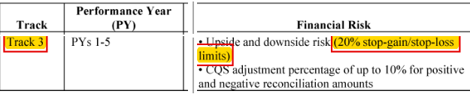
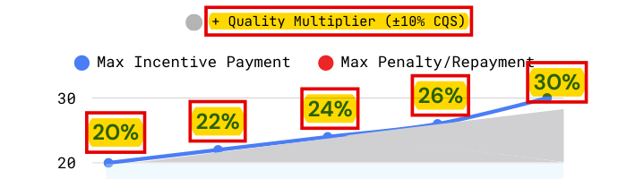
Flagged before publication: No
Wrong
The risk cap is 20%, not ±30%
What the report says
p.7
What the source says
89 FR 69661 + 42 CFR 512.550
p.7 headline (also on the cover, p.1, and contents, p.2)
TEAM Final Rule, Table X.A.-02 (89 FR 69661; eligibility column omitted)
p.7, Fig 4: Track 3 band climbs from 20% to 30%
42 CFR 512.550(e): cap applied after the quality adjustment
Same page contradicts it: p.7 subhead says “up to 20% … by PY3”
Fix: Track 3 gains and losses are capped at 20% in every year (2026-2030). Drop ±30%, the 20-to-30% climb in Fig 4, the ‘60-point spread’ (max is 40) and ‘30% of Medicare revenue at risk’.
Source: TEAM Final Rule, 89 FR 68986 (Table X.A.-02), https://www.federalregister.gov/d/2024-17021 ; 42 CFR 512.550
Notes:
Issue #1 (full-audit.md): '±30% / 30% of Medicare revenue at risk by PY5' (p.1 cover, p.2 contents, p.7 headline + Fig 4). Status: wrong. Pre-pub flag: No.
Track 3 = 20% stop-loss/stop-gain in PY1-PY5 (TEAM Final Rule Table X.A.-02, 89 FR 69661). CQS adjusts the reconciliation amount first; the 20% cap is applied after (42 CFR 512.550(d)-(e)). The '60-point spread' is at most 40 points.
The headline was already the p.8 headline (and TOC item) in the Jun 25 Word draft; missing from Canva drafts 01/02; back in the Jun 29, 3:13 PM export and in 03 (Jun 30). The 20->30% Fig 4 chart was already in the Jun 25 Word draft and draft 01 (updated Oct 8).
Sources: https://www.federalregister.gov/d/2024-17021 ; https://www.ecfr.gov/current/title-42/chapter-IV/subchapter-H/part-512 (512.550)

Slide 11
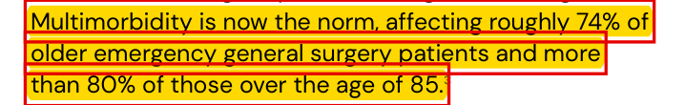

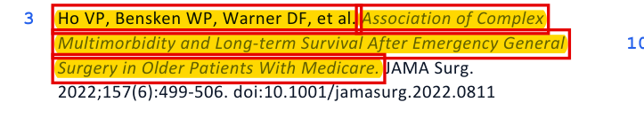
Flagged before publication: Yes
Wrong
Ref 3: Ho 2022 doesn't have the 74%; Hewitt 2016 does
What the report says
p.3, p.11
What the source says
Ho 2022 vs Hewitt 2016
p.3
Ho 2022 (cited): no 74%, no figure for over 85
p.11: ref 3, swapped in for Tarazi on Jun 29
Hewitt 2016, UK (the real source): 74% overall
Hewitt 2016: 83.7% (77/92) of those over 85
Kyle's Jun 26 memo: Tarazi flagged, Hewitt named
Fix: Cite Hewitt J, et al. BMJ Open 2016;6(3):e010126 and add "in a UK cohort". Ho's 42.3% + 38.2% = 80.5% (2+ domains) covers all older patients, not those over 85.
Source: Ho VP et al. JAMA Surg 2022, https://pmc.ncbi.nlm.nih.gov/articles/PMC9047756/ ; Hewitt J et al. BMJ Open 2016, https://pmc.ncbi.nlm.nih.gov/articles/PMC4823401/ ; Kyle's memo (Slack F0BDU327GEP)
Notes:
Issue #2 (full-audit.md): p.3 'roughly 74% of older emergency general surgery patients and more than 80% of those over the age of 85.3'. Status: wrong (wrong source). Pre-pub flag: Yes, Kyle Jun 26 memo ('No such paper exists; the 74% stat is really Hewitt et al., BMJ Open 2016;6(3):e010126'). Christina replaced Tarazi with Ho 2022 on Jun 29, 3:04 PM PT; Hewitt was not used.
Ho 2022: '383 (19.5%) had no multimorbidity, 829 (42.3%) had 2 multimorbidity domains, and 748 (38.2%) had all 3 domains present'. 42.3 + 38.2 = 80.5% across all older EGS patients, not 85+. No 74%.
Hewitt 2016 (UK): 'Multimorbidity was present in 74%'; 83.7% (77/92) of patients over 85 (Parent note, Mali re-verification Oct 8).
https://pmc.ncbi.nlm.nih.gov/articles/PMC9047756/ · https://pmc.ncbi.nlm.nih.gov/articles/PMC4823401/

Slide 12

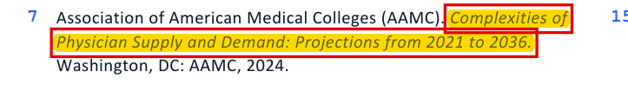
Flagged before publication: Yes
Wrong
AAMC: 2018 numbers, cited to the 2024 report
What the report says
p.3, p.11
What the source says
AAMC 2024 vs 2018
p.3
AAMC 2024 (cited): 13,500-86,000 physicians by 2036
p.11: ref 7 is the 2024 AAMC report
AAMC 2024: surgeons 10,100-19,900
AAMC 2018 update (the real origin): 42,600-121,300 by 2030
Kyle's Jun 26 memo: flagged as "Superseded"
AAMC 2018: surgeons 20,700-30,500 in 2030
Fix: Use the cited 2024 report: a shortage of up to 86,000 physicians by 2036 (13,500-86,000), including up to 19,900 surgeons (10,100-19,900).
Source: AAMC, Projections from 2021 to 2036 (March 2024), https://www.aamc.org/data-reports/workforce/report/physician-workforce-projections ; AAMC/IHS Markit 2018 Update (2016-2030)
Notes:
Issue #3 (full-audit.md): p.3 'AAMC projects a shortage of up to 121,000 physicians by 2030, including 20,000-30,000 surgeons,7'. Ref 7 = AAMC 2024 report. Status: wrong. Pre-pub flag: Yes, Kyle Jun 26 memo ('Superseded'). Not fixed.
AAMC 2024 (cited): 13,500-86,000 physicians by 2036; surgical specialties 10,100-19,900.
AAMC 2018 update (origin of the report's numbers): 42,600-121,300 physicians by 2030; surgical specialties 20,700-30,500 in 2030. (Parent note: Mali re-verified Oct 8.)
https://www.aamc.org/data-reports/workforce/report/physician-workforce-projections · mirror of 2024 PDF: https://www.aans.org/wp-content/uploads/2024/05/aamc-2023-workforce-projections-report.pdf · 2018 press release: https://www.aamc.org/news/press-releases/new-research-shows-increasing-physician-shortages-both-primary-and-specialty-care

Slide 13


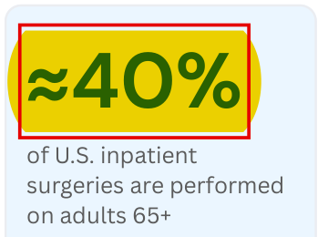
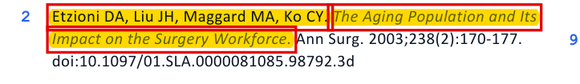
Flagged before publication: Yes
Wrong
40%: Etzioni counts all hospital stays, not surgeries
What the report says
p.3, p.11
What the source says
Etzioni 2003 + AHRQ HCUP
p.3 text
Etzioni 2003 (cited): 40% of all hospital discharges in 1999
p.3 stat box
Etzioni 2003 methods: surgery rates from 1996 survey data
AHRQ HCUP SB #281 (2018): 65-74 = 19.7% + 75+ = 16.8% = 36.5% of surgical stays
p.11: ref 2, swapped in for Becher on Jun 29
Fix: Say adults 65+ account for "more than a third (~37%) of inpatient surgical stays", cite AHRQ HCUP Statistical Brief #281 (2018 data), and change the ≈40% stat box to ~37%.
Source: Etzioni DA et al. Ann Surg 2003, https://pmc.ncbi.nlm.nih.gov/articles/PMC1422682/ ; AHRQ HCUP SB #281, https://hcup-us.ahrq.gov/reports/statbriefs/sb281-Operating-Room-Procedures-During-Hospitalization-2018.pdf
Notes:
Issue #4 (full-audit.md): p.3 'adults 65 and older account for nearly 40% of inpatient surgeries.2' and stat box '≈40%'. Status: wrong. Pre-pub flag: Yes, Kyle Jun 26 memo (Becher 'Wrong locator'; rec #3 're-source the length-of-stay and 40% figures'). Christina swapped ref 2 to Etzioni 2003 on Jun 29, 3:39 PM PT; number not fixed.
Etzioni 2003: 'in 1999, patients aged 65 years or older comprised 12% of the population, but constituted 40% of hospital discharges and 48% of days of inpatient care' (all stays, not surgeries; Parent note re-verified). Methods use the 1996 NHDS.
Deiner 2014 (the report's own ref 4): 65+ = 35.3% of all inpatient procedures (2006). HCUP SB281 (2018): 65-74 19.7% + 75+ 16.8% = 36.5% of stays with an OR procedure.
https://pmc.ncbi.nlm.nih.gov/articles/PMC1422682/ · https://hcup-us.ahrq.gov/reports/statbriefs/sb281-Operating-Room-Procedures-During-Hospitalization-2018.pdf

Slide 14

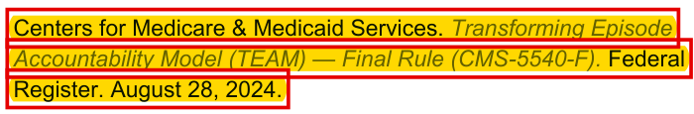
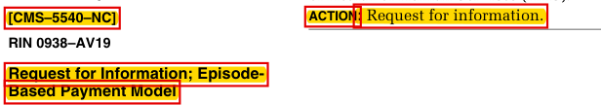
Flagged before publication: No
Wrong
Ref 9: CMS-5540-F doesn't exist; TEAM is CMS-1808-F
What the report says
p.11
What the source says
CMS-1808-F + 2023 RFI
TEAM Final Rule, 89 FR 68986 (first page)
p.11 (reference list)
CMS-5540 was a 2023 request for information (88 FR 45872)
Fix: CMS. FY 2025 IPPS/LTCH PPS final rule (CMS-1808-F). Fed Regist. 2024;89(167):68986-70046. Aug 28, 2024. The wrong number was already in Christina's May 5 Sources line and was never caught.
Source: TEAM Final Rule (CMS-1808-F), 89 FR 68986, https://www.federalregister.gov/d/2024-17021
Notes:
Issue #5 (full-audit.md): ref 9 'TEAM — Final Rule (CMS-5540-F)'. Status: wrong. Pre-pub flag: No. Carried unchanged from Christina's May 5 v4 docx Sources line ('CMS TEAM Final Rule (CMS-5540-F, August 2024)') through draft 02 (ref 7) to the published ref 9.
Rule header: [CMS-1808-F] Final rule, Wednesday, August 28, 2024, 89 FR 68986. CMS-5540 = [CMS-5540-NC] Request for Information; Episode-Based Payment Model, 88 FR 45872, July 18, 2023.
https://www.federalregister.gov/d/2024-17021 · PDF https://www.govinfo.gov/content/pkg/FR-2024-08-28/pdf/2024-17021.pdf

Slide 15
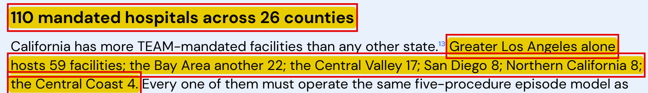
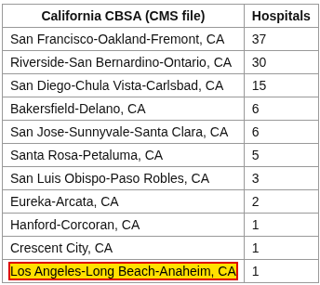

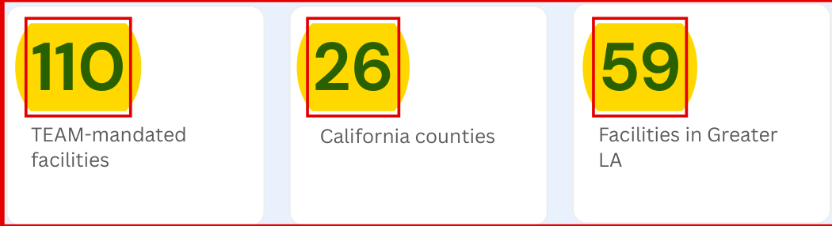
Flagged before publication: Yes
Wrong
California: 107 hospitals in 11 metro areas, not 110 in 26 counties
What the report says
p.8
What the source says
CMS TEAM Participant List
p.8 (California section)
CMS TEAM Participant List (Aug 18, 2026), California rows tallied from the CMS file
p.8 (stat boxes)
Fix: 107 mandated hospitals in 11 metro areas. LA-Long Beach-Anaheim isn't a mandatory area (Cedars-Sinai joined voluntarily). Rebuild the regional counts (they sum to 118). Kyle flagged 110 vs 118 on Jun 26; not fixed.
Source: CMS TEAM Participant List spreadsheet (Aug 18, 2026); counts tallied from the CMS file. https://www.cms.gov/team-model-participant-list
Notes:
Issue #6 (full-audit.md): p.2 and p.8 '110 mandated hospitals across 26 counties', 'Greater Los Angeles alone hosts 59 facilities…'. Status: wrong. Pre-pub flag: Yes, Kyle Jun 26 memo (count sums to 118 but stated as 110). Not fixed.
CMS TEAM participant list (Aug 18, 2026 file): 107 California hospitals in 11 CBSAs (<=18 counties); Bay Area 48, Inland Empire 30, San Diego 15, Central Valley 7, Central Coast 3, North Coast 3, LA 1 (Cedars-Sinai, voluntary). Rainfall's own page also says 107: https://www.rainfallhealth.com/cms-team/participating-hospitals/california/
Regions in the report: 59+22+17+8+8+4 = 118. Ref 13 (Rainfall CA brief) not found.
https://www.cms.gov/team-model-participant-list

Slide 16
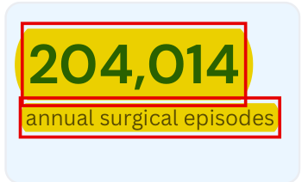
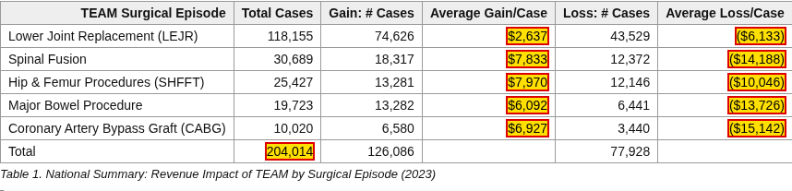
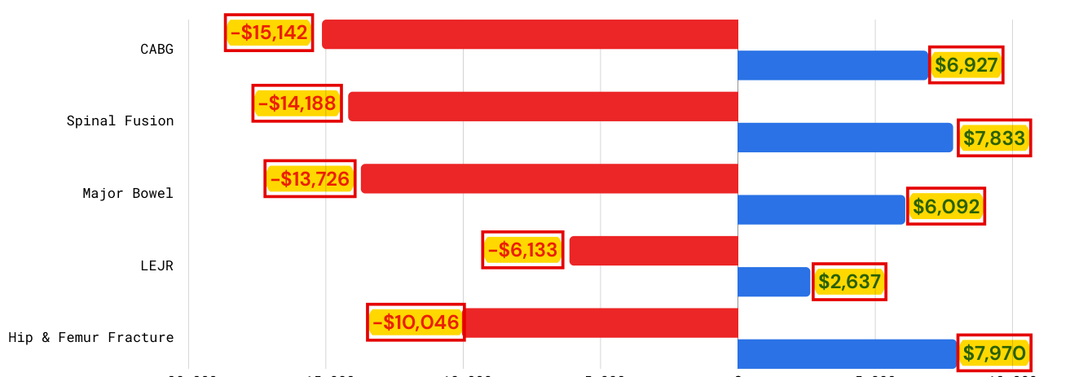
Flagged before publication: Partly
Wrong
Fig 3 & 204,014: ACS averages, labeled as max win/loss
What the report says
p.6
What the source says
ACS / IAC Table 1 (2023)
ACS / Institute for Accountable Care, Table 1 (2023 Medicare data)
p.6 stat box: “204,014” has no citation
p.6, Fig 3 (caption cites refs 9 and 12)
All 10 Fig 3 dollar figures are this table's average gain or loss per case, with no caps, not "max" amounts. 204,014 is the table's 2023 case total, not annual episodes.
Fix: Retitle Fig 3 "Average gain vs loss per case (2023, uncapped)" and cite ACS/IAC; label 204,014 as "~204,000 qualifying Medicare episodes in 2023 (ACS/IAC)". Kyle asked to confirm the episode count on Jun 26; not done.
Source: ACS / IAC, Transforming Episode Accountability Model: How TEAM could impact revenues, https://www.facs.org/advocacy/transforming-episode-accountability-model/
Notes:
Issue #7 (full-audit.md): p.6 Fig 3 'Per-Procedure economic swing… Max win/loss per case' (-$15,142/$6,927 … -$10,046/$7,970), caption 'model the full Track 1 / Track 3 range.9,12'; p.6 stat box '204,014 annual surgical episodes'; p.7 subhead '204k episodes annually'. Status: wrong.
All 10 values = ACS/IAC Table 1 average gain/loss per case (2023), 'not the stop-gain/stop-loss caps'. 204,014 = Table 1 Total Cases (2023 Medicare FFS cases at TEAM hospitals).
Pre-pub flag: Partly. Kyle's Jun 26 memo rec #4 asked to confirm 'the precise episode count' with the authors; not done.
https://www.facs.org/advocacy/transforming-episode-accountability-model/

Slide 17
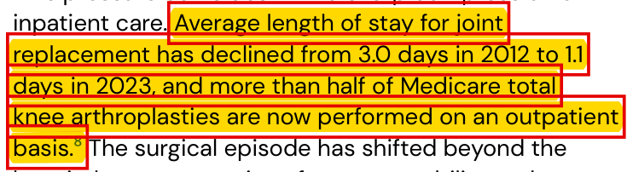
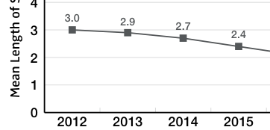
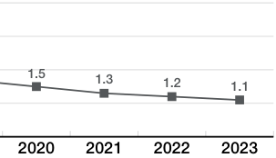
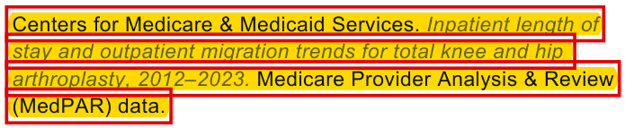

Flagged before publication: Yes
Wrong
Ref 8: right numbers, a CMS study that doesn't exist
What the report says
p.3, p.11
What the source says
AJRR 2024 + Burnett 2023
p.3
AJRR 2024 Annual Report, Fig 2.3 (p.26)
…
2016-2019
omitted
p.11 (reference list)
Burnett RA et al. J Arthroplasty. 2023 (abstract)
Fix: Cite AJRR 2024 Annual Report (Fig 2.3) for 3.0 → 1.1 days and Burnett RA et al. J Arthroplasty 2023;38(6):992-997 for 57.2% of Medicare knee replacements billed as outpatient by 2020. Kyle flagged it Jun 26; not fixed.
Source: AJRR 2024 Annual Report, https://www.aaos.org/registries/publications/ajrr-annual-report/ ; Burnett RA et al. J Arthroplasty. 2023, doi:10.1016/j.arth.2022.12.029
Notes:
Issue #8 (full-audit.md): p.3 'Average length of stay for joint replacement has declined from 3.0 days in 2012 to 1.1 days in 2023, and more than half of Medicare total knee arthroplasties are now performed on an outpatient basis.8'; ref 8 'CMS… Medicare Provider Analysis & Review (MedPAR) data'. Status: wrong (citation); numbers true.
AJRR 2024: THA mean LOS 3.0 (2012) -> 1.1 (2023); TKA 2.9 -> 1.1 (all-payer registry, not MedPAR). Burnett 2023: 'by 2020, 57.2% of Medicare TKA patients were classified as outpatients' (billing status).
Pre-pub flag: Yes, Kyle Jun 26 memo rec #3 're-source the length-of-stay and 40% figures'. Not fixed; ref 8 carried unchanged from draft 02 (ref 6).
https://www.aaos.org/registries/publications/ajrr-annual-report/ · https://pubmed.ncbi.nlm.nih.gov/36535441/

Slide 18
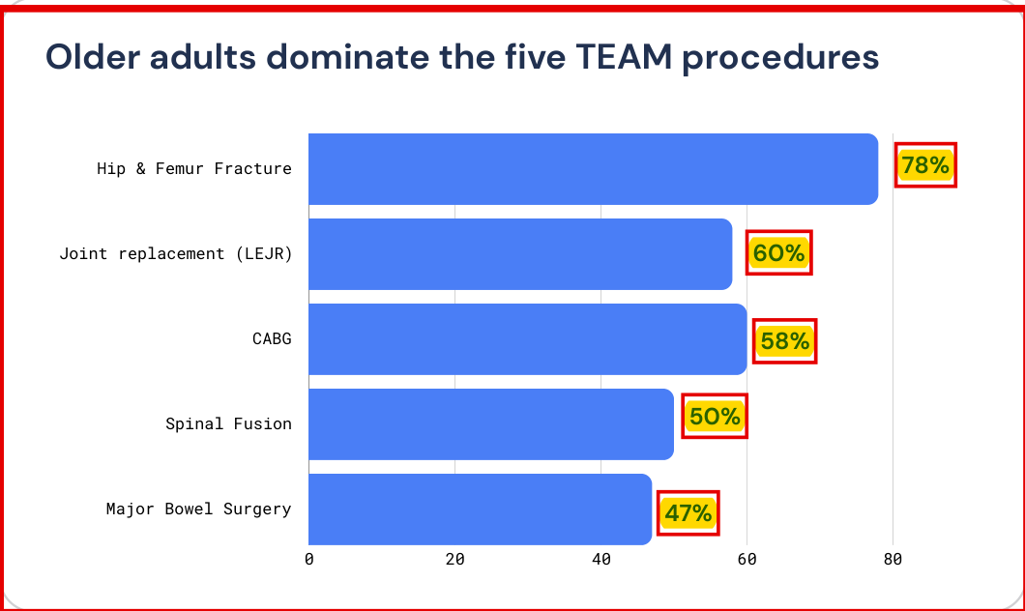
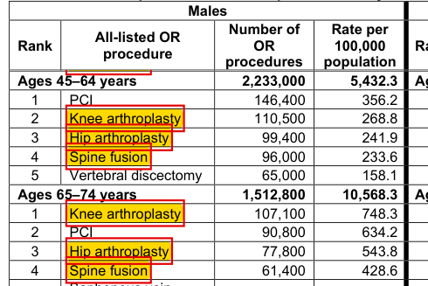
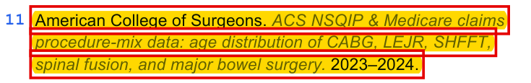
Flagged before publication: No
Wrong
Ref 11: source not found, not cited in the text
What the report says
p.5, p.11
What the source says
AHRQ HCUP Statistical Brief #281
p.5, Fig 2
AHRQ HCUP Statistical Brief #281, Table 3 (2018), males
Ref 11 isn't cited in the published text: no superscript 11; the numbering jumps from 10 to 12.
p.5, Fig 2 “Sources:” line (the only place ACS NSQIP is named)
p.11, ref 11 entry (source not found)
Fix: Cite AHRQ HCUP Statistical Brief #281 and add the missing superscript 11 on the Fig 2 source line. Keep joint replacement ~60%; lower spinal fusion to ~30-40%; source or drop hip fracture 78%, bowel 47%, CABG 58%; drop "majority of all five".
Source: AHRQ HCUP Statistical Brief #281, https://hcup-us.ahrq.gov/reports/statbriefs/sb281-Operating-Room-Procedures-During-Hospitalization-2018.jsp
Notes:
Issue #9 (full-audit.md): ref 11 'ACS NSQIP & Medicare claims procedure-mix data… 2023-2024' not found; no in-text superscript 11 in any Canva version (only Fig 2's 'Sources:' line, p.5); the Jun 25 Word draft cited it as 3,9 on the Fig 2 caption (updated Oct 8). Fig 2 shares mostly unverified; 'majority of all five' contradicts its own chart (spinal fusion 50%, major bowel 47%). Status: wrong / unsupported. Pre-pub flag: No.
HCUP SB281 (2018): knee 60.2%, hip 63.7% (65+); spinal fusion 28-44%; femur fixation 75+ alone 53.7%.
https://hcup-us.ahrq.gov/reports/statbriefs/sb281-Operating-Room-Procedures-During-Hospitalization-2018.jsp

Slide 19
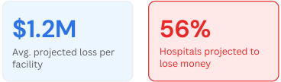

Flagged before publication: Partly
Wrong
Ref 12: 56% and $1.2M are real; the rest isn't Optum's
What the report says
p.6, p.7
What the source says
Advisory Board + Rainfall PR
p.6: 56%, "first reconciliation cycle", $1.2M and $14M, all cited to ref 12
Advisory Board, Nov 25, 2025: 56% and $1.2M are real
p.6 stat boxes
Same article: no mandatory downside risk for 2026
Rainfall's Jul 27 press release: the $14M is Rainfall's own projection
p.7 Fig 4 caption: −$6M credited to Optum
Fix: Cite Nation R, et al., Advisory Board, Nov 25, 2025 for 56% and $1.2M; drop "Year 1" and "first reconciliation cycle"; label the $14M and the −$6M "Optum" figure as Rainfall estimates. The ref 12 title doesn't exist.
Source: https://www.advisory.com/topics/policy-and-payment/hospitals-need-to-know-team ; https://www.prnewswire.com/news-releases/rainfall-health-outlines-multi-million-dollar-opportunity-for-hospitals-impacted-by-cms-team-mandate-302834322.html
Notes:
Issue #10 (full-audit.md): ref 12 'Advisory Board / Optum. TEAM Financial Impact Model: First-cycle hospital exposure analysis. 2025' - title doesn't exist. 56%/$1.2M are real (Advisory Board), but 'Year 1' / 'first cycle' are not, and $14M / ±$14.5M / 'Optum −$6M' aren't Optum's. Status: wrong / unverifiable-internal.
Advisory Board (Nov 25, 2025): '56% of mandatory participants are projected to lose money under current criteria unless they meaningfully improve performance. These losses average $1.2 million per facility.' Also: 'There is no mandatory downside risk for 2026.'
Rainfall PR (Jul 27, 2026): 'Rainfall projects $1.2 million average revenue loss for mandated facilities in the first year. This rises to $14 million after five years.'
Pre-pub flag: Partly - Kyle's Jun 26 memo rec #3 'Relabel proprietary/internal estimates as such'. Not fixed. The ref 12 title itself was not flagged.
https://www.advisory.com/topics/policy-and-payment/hospitals-need-to-know-team

Slide 20
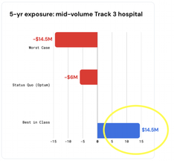
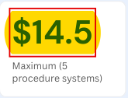
Flagged before publication: No
Unverifiable
$14.5M: one number, three meanings
What the report says
p.6, p.7, p.9
What Slack shows
Jun 29, layout note only
p.6: "$14M" five-year exposure for a system (cited to ref 12)
Mia Kelly, Jun 29 (v3 draft): the $14.5M label runs past the chart border
p.7 Fig 4: ±$14.5M for one mid-volume hospital, −$6M "Optum"
Kyle replied "Omg I noticed the 14.5 M overlap too" and fixed the label on Jun 30.
That was about the label overflowing the chart. Nobody flagged that $14.5M means three different things.
p.9: $14.5M peak across 17 California systems (ref 14)
p.9 stat box: "$14.5" maximum
Fix: Pick one definition, attribute it to Rainfall's internal model (ref 14) with a method note, drop "Optum", and add the missing "M" on p.9.
Source: published report pp.6, 7, 9; Slack DM Jun 29, 6:50 PM / 7:51 PM PT (Mia Kelly, Kyle), screenshot F0BEVQY5YM6; full-audit.md issue #11
Notes:
Issue #11 (full-audit.md): one $14.5M number, three definitions and attributions: p.6 '$14M' five-year exposure for systems performing all five procedures (cited to ref 12); p.7 Fig 4 ±$14.5M for a single mid-volume hospital with 'Status Quo (Optum)' −$6M (cites 9,12); p.9 $14.5M peak five-year impact across 17 California systems (ref 14, internal). Status: unverifiable-internal. Pre-pub flag: No.
Slack: Mia, Jun 29, 6:50 PM PT: 'the $14.5 M text exceeds the border of the graph'. Kyle, 7:51 PM PT: 'Omg I noticed the 14.5 M overlap too'. That was the label running past the chart border (fixed Jun 30), NOT the number reuse. Nothing in Slack shows anyone flagged the reuse before publication.
Sources: slack-history/messages.md lines 85-87; history.md (c).

Slide 21

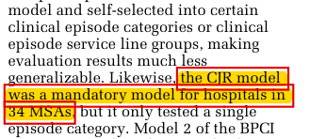

Flagged before publication: No
Wrong
"First mandatory": CJR was mandatory from 2016
What the report says
p.1, p.3
What the source says
TEAM Final Rule, 89 FR 69636
p.1 (cover)
TEAM Final Rule, 89 FR 69636
p.3
Fix: Say "CMS's first mandatory multi-procedure surgical episode model" (cover, p.2) and drop "first wave" (p.3). The phrase was on p.2 since the Jun 25 Word draft; 120/80 put it on the cover Jul 1.
Source: TEAM Final Rule, 89 FR 68986 (CJR passage at 89 FR 69636), https://www.federalregister.gov/d/2024-17021
Notes:
Issue #12 (full-audit.md): 'A Financial Field Guide for the First Mandatory Surgical Episode Model' (cover), 'preparing for the first mandatory surgical episode model' (p.2), 'CMS TEAM is the first wave of mandated participation' (p.3). Status: wrong. Pre-pub flag: No.
TEAM Final Rule 89 FR 69636: 'the CJR model was a mandatory model for hospitals in 34 MSAs'. CJR ran 2016-2024.
Version history: phrase on p.2 since the Jun 25 Word draft and draft 01 (Jun 26, 10:16 AM PT); 120/80 cover rewrite Jul 1 (Slack); new cover first appears in the published file.
https://www.federalregister.gov/d/2024-17021

Slide 22
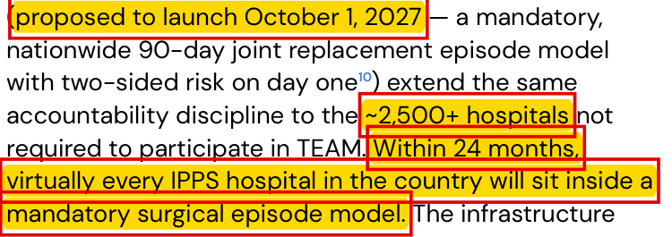
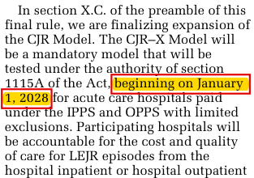


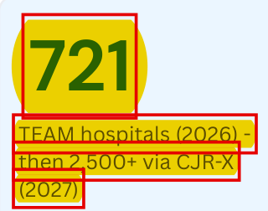
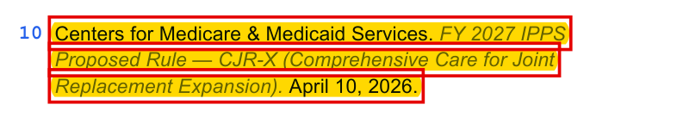
Flagged before publication: No
Outdated
CJR-X now starts Jan 1, 2028
What the report says
p.3, p.11
What the source says
CJR-X Final Rule, Aug 4, 2026
p.3: written before the final rule (Aug 4, after the Jul 27 release)
CJR-X Final Rule (CMS-1849-F), 91 FR 49574, Aug 4, 2026
Same page, next column
91 FR 50439: CMS's own estimate
p.3 stat box
p.11 ref 10: still the Apr 10 proposed rule
Fix: Say CJR-X was finalized (CMS-1849-F, Aug 4, 2026) to start Jan 1, 2028 with ~2,200 hospitals (2,217 on the Sept 30 list, not 2,500+); stat box "~2,200 via CJR-X (2028)"; cite the final rule, not the Apr 10 proposed rule.
Source: CJR-X Final Rule (CMS-1849-F), 91 FR 49574, 50439, Aug 4, 2026, https://www.federalregister.gov/d/2026-15833 ; ref 10 = proposed rule CMS-1849-P
Notes:
Issue #13 (full-audit.md): p.3 'CJR-X (proposed to launch October 1, 2027 ...)', '~2,500+ hospitals', 'Within 24 months, virtually every IPPS hospital ...'; stat box '721 TEAM hospitals (2026) - then 2,500+ via CJR-X (2027)'. Ref 10 = 'FY 2027 IPPS Proposed Rule - CJR-X. April 10, 2026' (CMS-1849-P). Status: outdated. Pre-pub flag: No (the final rule came out Aug 4, after the Jul 27 release).
Final rule CMS-1849-F (Aug 4, 2026): 'beginning on January 1, 2028'. Mandatory, 90-day and two-sided still true. CMS estimate 'approximate 2,500 CJR-X participants'; actual CJR-X list (Sept 30, 2026) = 2,217. '24 months' overstated: ~720 TEAM + 2,217 CJR-X by Jan 2028 (~2,900); CJR-X is LEJR only; Maryland and low-volume hospitals excluded.
https://www.federalregister.gov/d/2026-15833

Slide 23
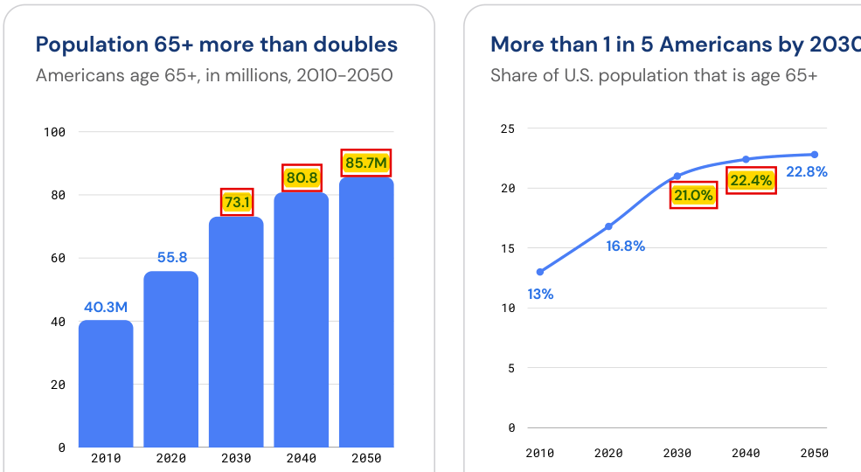
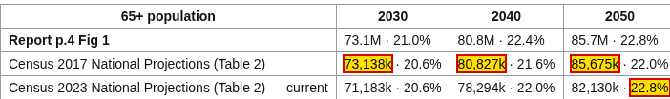
Flagged before publication: No
Outdated / Wrong
Fig 1: 2017 Census numbers; 21.0% and 22.4% match neither
What the report says
p.4
What the source says
U.S. Census Bureau projections
p.4 Fig 1: 73.1 / 80.8 / 85.7M and 21.0% / 22.4% / 22.8%
Census 2017 vs 2023 projections, Table 2 (65+, millions and share)
What it shows
p.4 text: "exceed 73 million" (p.3 says "nearly 71 million")
Fix: Redraw Fig 1 with the 2023 series (71.2M / 78.3M / 82.1M; 20.6% / 22.0% / 22.8%), say ≈71M by 2030 to match p.3, change "cross 21% before this decade ends" to "exceed 20% by 2030", and add a Census citation.
Source: U.S. Census Bureau 2023 and 2017 National Population Projections, Table 2 (np2023-t2.xlsx, np2017-t2.xlsx), www2.census.gov; shares = 65+ ÷ total
Notes:
Issue #14 (full-audit.md): p.4 Fig 1 uses the 2017 Census projections (73.1M / 80.8M / 85.7M for 2030/2040/2050; 2017 Table 2 = 73,138k / 80,827k / 85,675k). Current 2023 series = 71.2M / 78.3M / 82.1M. Shares: 2023 = 20.6% / 22.0% / 22.8%; 2017 = 20.6% / 21.6% / 22.0%; the chart's 21.0% and 22.4% match neither (Mali re-verified Oct 8). 'Cross 21% before this decade ends' is false (20.6% in 2030). p.3 says nearly 71M, p.4 says 73M. No citation on p.4. Status: outdated / wrong. Pre-pub flag: No.
2010 40.3M and 2020 55.8M are verified (Census C2020BR-07).
https://www2.census.gov/programs-surveys/popproj/tables/2023/2023-summary-tables/np2023-t2.xlsx

Slide 24
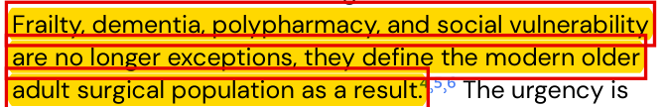
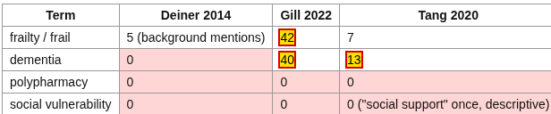
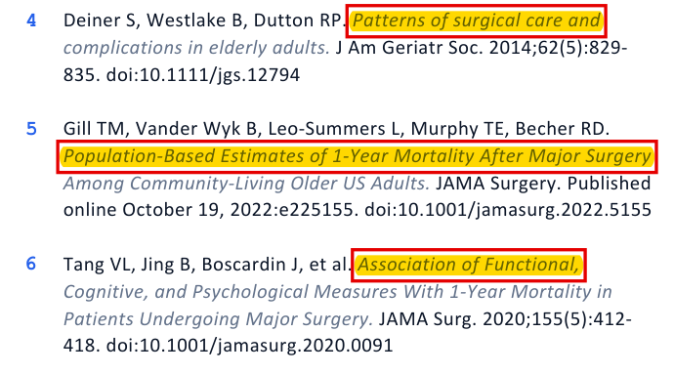

Flagged before publication: No
Unsupported
Refs 4-6: frailty and dementia, not polypharmacy
What the report says
p.3, p.11
What the source says
Deiner 2014 · Gill 2022 · Tang 2020
p.3: the sentence refs 4-6 were added to
Term counts in each paper's full text
p.11: refs 4-6, added by Christina on Jun 29
Gill 2022, Key Points: frailty and dementia, 1-year mortality
Tang 2020, Results: dementia
Fix: "Frailty, dementia and polypharmacy are common and sharply raise surgical risk"; add Hewitt 2016 for polypharmacy (67.9%); drop "social vulnerability" or source it; update Gill to JAMA Surg. 2022;157(12):e225155.
Source: Deiner 2014 PMC4024102; Gill 2022 https://pmc.ncbi.nlm.nih.gov/articles/PMC9582971/ ; Tang 2020 https://pmc.ncbi.nlm.nih.gov/articles/PMC7066523/ ; Slack Jun 29, 3:41 PM PT, Christina: "lets cite this to be safe...." (not reviewed)
Notes:
Issue #15 (full-audit.md): p.3 'Frailty, dementia, polypharmacy, and social vulnerability are no longer exceptions, they define the modern older adult surgical population as a result.4,5,6' Status: unsupported (partly). Pre-pub flag: No. The sentence was uncited in draft 02; Christina added refs 4-6 on Jun 29 (Slack, 3:41 PM PT: 'lets cite this to be safe....'). Not reviewed.
Gill 2022: 'More than 1 of 4 community-living older US adults who were frail and nearly 1 of 3 who had probable dementia died in the year after major surgery.' Tang 2020: dementia '21% vs 12%'. Deiner 2014: frailty background only. None mentions polypharmacy or social vulnerability; all three are outcome/mortality studies, not prevalence studies. Hewitt 2016 reports polypharmacy 67.9%.
https://pmc.ncbi.nlm.nih.gov/articles/PMC9582971/ · https://pmc.ncbi.nlm.nih.gov/articles/PMC7066523/

Slide 25
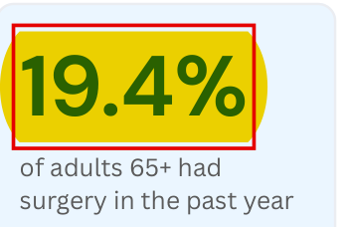
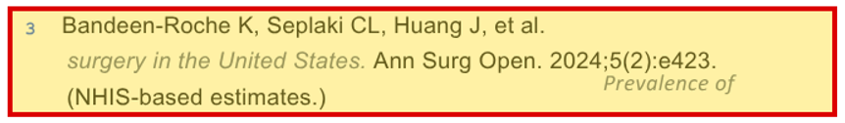

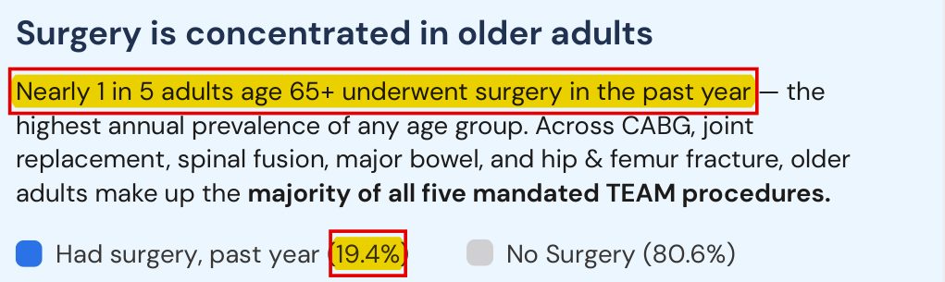
Flagged before publication: Yes
Verified, uncited
19.4%: right number, but the ref was cut
What the report says
p.3, p.5
What the source says
Kyle's memo + Bicket 2024
p.3 stat box (no ref)
Draft 02 ref 3 (Jun 26), deleted Jun 29
Kyle's Jun 26 memo, ref 3 (Bandeen-Roche) row: "Corrupted"
p.5: "highest annual prevalence", named only in the Fig 2 source line
Bicket et al., Ann Surg Open 2024;5(2):e421, Results
Bicket 2024, Discussion: "The highest prevalence was identified among …"
Fix: Add a numbered ref for the p.3 stat box and p.5: Bicket MC, et al. Prevalence of Surgery Among Individuals in the United States. Ann Surg Open. 2024;5(2):e421 (2018 NHIS). Kyle flagged the ref Jun 26; it was deleted instead of corrected.
Source: Bicket MC et al. Ann Surg Open 2024, https://pmc.ncbi.nlm.nih.gov/articles/PMC11191855/ ; Kyle's memo (Slack F0BDU327GEP); draft 02 (Jun 26) vs published reference list
Notes:
Issue #16 (full-audit.md): p.3 stat box '19.4% of adults 65+ had surgery in the past year' and p.5 'Nearly 1 in 5 adults age 65+ underwent surgery in the past year - the highest annual prevalence of any age group' (19.4% vs 80.6%). Status: verified, uncited. Pre-pub flag: Yes - Kyle's Jun 26 memo: ref 3 Bandeen-Roche 'Corrupted', real paper is e421. The 19.1% figure was removed (fixed); the ref was deleted on Jun 29, not corrected (not fixed).
Bicket 2024: 'age 65 years and over (19.4%, 95% CI = 18.3%-20.4%)'; 'The highest prevalence was identified among persons 65 years and older'. 2018 NHIS.
https://pmc.ncbi.nlm.nih.gov/articles/PMC11191855/

Slide 26
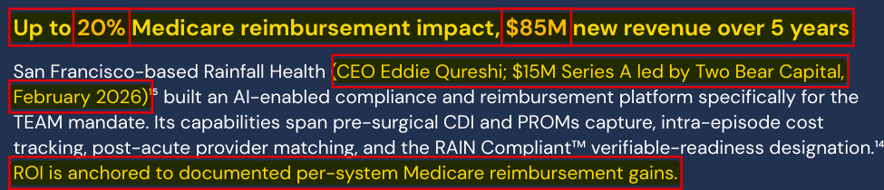


Flagged before publication: No
Unverifiable / Unsupported
"Platform results": Rainfall's own claims, no data
What the report says
p.10, p.2
What the source says
MedCity + Rainfall press releases
p.10 headline and body
MedCity, Feb 20, 2026 (ref 15): $85M is the CEO's own claim
MedCity: "up to 20%" misreads TEAM's 20% stop-gain
p.10 stat boxes
Rainfall PR, Feb 18, 2026: "more than $100 million" per system
Rainfall PR, Jul 27, 2026: "up to $85M"
p.2 contents, item 8
Fix: Label $85M as a Rainfall projection with a method, or drop it; say "TEAM reconciliation can reach ±20% of target price"; drop "70–80% Readmission ID rate" and "documented gains" (no source found); retitle "Rainfall Health platform".
Source: MedCity News, Feb 20, 2026, https://medcitynews.com/2026/02/rainfall-health-funding/ ; Rainfall PR Newswire releases Feb 18 and Jul 27, 2026
Notes:
Issue #17 (full-audit.md): p.10 'Platform results': 'Up to 20% Medicare reimbursement impact', '$85M new revenue over 5 years', '70-80% Readmission ID rate', 'ROI is anchored to documented per-system Medicare reimbursement gains'; p.2 contents 'Rainfall Health platform results & next steps'. Status: unverifiable-internal / unsupported. Pre-pub flag: No.
MedCity (Feb 20, 2026): CEO Eddie Qureshi: 'unlocking up to $85 million in new Medicare revenue over the next five years'; 'up to a 20% revenue increase' (a misreading of TEAM's 20% stop-gain). Rainfall PR Feb 18: 'gain 20% in increased revenue', 'more than $100 million in new revenue per Health System'. Jul 27 PR: 'up to $85M'. No model or method cited. 70-80% readmission ID rate: no source found anywhere (PRs, MedCity, Rainfall site, Slack). Company facts ($15M Series A, Two Bear Capital, SF) are verified.
https://medcitynews.com/2026/02/rainfall-health-funding/

Slide 27




Flagged before publication: No
Unsupported
"Proven Results": no results on the page
What the report says
p.8, p.2
What the page shows
p.8, the rest of the page
p.8 stat boxes: hospital counts
p.8 header
p.8 map and region table: counts again, no cases or outcomes
p.2 contents, item 6
Fix: Retitle p.8 "California: where TEAM hits hardest" and the contents entry "California – 107 mandated hospitals"; drop "Proven Results" and "Case examples", or add real case examples.
Source: published report pp.2 and 8; full-audit.md issue #18 (8.1, 2.3)
Notes:
Issue #18 (full-audit.md): p.8 '05 | PROVEN RESULTS / What AI-enabled TEAM operations look like in practice / Case examples from California'; p.2 contents 'Proven Results - California'. Status: unsupported. Pre-pub flag: No. The page shows only hospital counts (stat boxes, map, region table). No case examples, operations, or results. (The counts themselves are wrong too: see issue #6.)
Fix: retitle 'California: where TEAM hits hardest'; contents 'California - 107 mandated hospitals'.

Slide 28



Flagged before publication: No
Wrong
Disclaimer: "public sources", but refs 13–14 are internal
What the report says
p.11
What the source says
Draft 02 + reference list
Draft 02 disclaimer (Jun 26): no claim about public sources
p.11 disclaimer (published)
Same p.11 reference list: refs 13-14 are Rainfall's own, not found
Fix: Say "…using public data, published sources, and internal Rainfall Health analyses (refs 13–14)". The "publicly available" phrase was added after draft 02 (Jun 26); ref 15's revenue figures are company claims.
Source: published report p.11; draft 02 (Jun 26, 1:26 PM PT) vs published disclaimer and reference list; full-audit.md 11.11, 11.12, 11.14
Notes:
Issue #19 (full-audit.md): disclaimer '...using publicly available data and published sources available at the time of analysis'. Status: wrong. Pre-pub flag: No (wording added after draft 02). Refs 13 (Rainfall 'California TEAM-Mandated Hospitals Brief', Apr 2026) and 14 (Rainfall 'California Episode Economics Analysis: 17-System Five-Year Exposure Model', Apr 2026) are internal Rainfall analyses, not found in Drive or Slack; ref 15's revenue figures are company claims.
Draft 02 disclaimer: 'All figures and analyses in this report were independently compiled by Christina Keny, PhD, MHA, RN, CPHQ for Rainfall Health. Procedure-share estimates are approximate...' 03/04/published add the public-sources phrase.
Fix: '...using public data, published sources, and internal Rainfall Health analyses (refs 13-14)'.

Slide 29


Flagged before publication: No
Wrong
"20% by PY3": Track 3 is 20% from PY1
What the report says
p.7
What the source says
TEAM Final Rule, 89 FR 69661
TEAM Final Rule, Table X.A.-02 (89 FR 69661): Track 3 = 20% in PYs 1-5
p.7 headline and subhead
Fix: Say "…up to 20% at risk from PY1 (Track 3)". Track 3's 20% stop-gain/stop-loss applies in every year, PY1 through PY5. (The "204k episodes" in the same line is mislabeled too; see Fig 3.)
Source: TEAM Final Rule, 89 FR 68986, Table X.A.-02 at 89 FR 69661, https://www.federalregister.gov/d/2024-17021
Notes:
Issue #20 (full-audit.md 7.2): p.7 '721 mandated hospitals, 204k episodes annually, and up to 20% of episode revenue at risk by PY3.' Status: wrong. Pre-pub flag: No.
TEAM Final Rule Table X.A.-02 (89 FR 69661): Track 3, PYs 1-5, all TEAM participants: 'Upside and downside risk (20% stop-gain/stop-loss limits)'. So 20% applies from PY1, not 'by PY3'. 204k is mislabeled (see issue #7 / 6.5).
Fix: '...up to 20% at risk from PY1 (Track 3)'.
https://www.federalregister.gov/d/2024-17021

Slide 30




Flagged before publication: No
Unsupported
p.5: three "highest" claims, no source
What the report says
p.5
What the source says
TEAM Final Rule, 89 FR 69711
CABG: ~22% post-acute
LEJR: more than 40%
p.5: the sentence, no citation
SHFFT: more than 63%
Fix: Rewrite as "these episodes have high post-acute spending (22–63% of episode cost⁹)" or drop it. The final rule's post-acute shares vary by procedure but don't rank them "highest".
Source: TEAM Final Rule, 89 FR 69711 (BPCI Advanced episode data), https://www.federalregister.gov/d/2024-17021
Notes:
Issue #21 (full-audit.md 5.8): p.5 'the procedures with the highest age skew older with the highest variation in post-acute spending, and the highest readmission rates'. Status: unsupported. Pre-pub flag: No. Garbled sentence, no citation.
TEAM Final Rule p.69711 (BPCI Advanced data): CABG approximately 22 percent of spending in the post-acute period; LEJR 204,160 episodes, more than 40 percent; SHFFT more than 63 percent. The rule doesn't rank them 'highest'.
Fix: 'these episodes have high post-acute spending (22-63% of episode cost9)' or drop.

Slide 31
Flagged before publication: Partly
Wrong (minor)
Cosmetic: four leftovers still in the PDF
What the report says
pp.1-11
Who noticed
Kyle's memo + Slack
p.9 stat box: "$14.5", no M
Kyle's Jun 26 memo: missing "M" and footer text noted, "can wait"
Jul 27: published with the "May 2026" footer (content was edited through Jul 14).
Aug 26 (after release), Mia: "the fonts and text colors are off for each column of references". Carrie: "we can update the PDF". Not done.
CPHQ on the cover and disclaimer but not the footers: never flagged.
Footer, every page (here p.9): "May 2026" and no CPHQ
p.11 disclaimer (and cover): with CPHQ
p.11 references: refs 1-7 and 8-15 in different fonts
Fix: Make p.9 "$14.5M"; change the footer to "July 2026"; use CPHQ the same way on the cover, disclaimer and footers; set refs 1-15 in one font and color.
Source: published report p.9 and p.11; Kyle's memo (Slack F0BDJRVJ955); Slack Jul 27 and Aug 26, 11:48 AM PT (Mia, Carrie, Kyle); full-audit.md 1.5, 2.5, 9.4, 11.15
Notes:
Issue #22 (full-audit.md): cosmetic leftovers. Status: wrong (minor). Pre-pub flag: Partly.
- p.9 stat box '$14.5' missing 'M': Kyle's Jun 26 memo: 'Cosmetic/template items (a missing "M," footer text, pagination) are low priority and can wait.' Not fixed.
- Footer 'May 2026' on every page; content edited through Jul 14, released Jul 27 (2.5). Not flagged.
- CPHQ on cover and disclaimer but not in footers (1.5). Not flagged.
- Reference-list fonts: refs 1-7 vs 8-15 (11.15). Mia, Aug 26, 11:48 AM PT (post-pub): 'the fonts and text colors are off for each column of references'; Carrie: 'we can update the PDF'. Not fixed.

Slide 32
Prioritized fix list
What to change
Text fixes, in priority order
Corrected citations (published ref numbers)
Risk cap: 20% in every year from PY1 (cover, p.2, p.7 headline and subhead, Fig 4)
74% / 83.7% over 85: cite Hewitt 2016 (UK cohort). AAMC: 13,500–86,000 by 2036
"40% of inpatient surgeries" → ~37% of surgical stays
California: 107 hospitals in 11 metro areas; fix regions; retitle "Proven Results"
Fig 3: average per-case gain/loss (ACS/IAC, 2023). Fig 2: spinal fusion ~30–40%
$1.2M: drop "Year 1"; give $14.5M one meaning; mark $14M and "Optum" as Rainfall estimates
"First mandatory multi-procedure model"; drop "first wave"
CJR-X: Jan 1, 2028, ~2,200 hospitals. Fig 1: 2023 Census series (≈71M)
p.10: label $85M, drop 70–80%. Disclaimer: name internal analyses. p.3/p.5: fix uncited sentences
Cosmetic: "$14.5M", "July 2026" footer, CPHQ, one ref font
1. U.S. Census Bureau. 2023 National Population Projections, Table 2. Nov 2023.
2. McDermott KW, Liang L. HCUP Statistical Brief #281. AHRQ; 2021.
3. Hewitt J, et al. BMJ Open. 2016;6(3):e010126.
5. Gill TM, et al. JAMA Surg. 2022;157(12):e225155.
8. AJRR 2024 Annual Report; Burnett RA, et al. J Arthroplasty. 2023;38(6):992-997.
9. CMS-1808-F. Fed Regist. 2024;89(167):68986-70046.
10. CMS-1849-F (final). Fed Regist. 2026;91(148):49570-50461.
11. HCUP SB #281 (as ref 2); add the in-text 11 at Fig 2.
12. Nation R, et al. Advisory Board, Nov 25, 2025; ACS/IAC TEAM revenue analysis (2023 data).
13. CMS TEAM participant list (Aug 18, 2026 file).
14. Internal model: get the file or label it internal.
New Bicket MC, et al. Ann Surg Open. 2024;5(2):e421 (19.4%).
Order follows full-audit.md's issue list (#1-#22). Ref 2 replaces Etzioni; ref 3 replaces Ho 2022; ref 13 replaces the unfound California brief.
Notes:
What to change (full-audit.md fixes column, issues #1-#22, in the audit's priority order). Counts: 74 of 104 claim rows need a fix; about 9 verified rows still need a citation.
Citations: ref 1 Census 2023 projections (3.2, 11.1); ref 2 HCUP SB281 for ~37% (3.3); ref 3 Hewitt 2016 (3.4); ref 5 Gill final issue (11.4); ref 8 AJRR 2024 + Burnett 2023; ref 9 CMS-1808-F; ref 10 CMS-1849-F final rule, 91 FR 49570 (verification-report.md); ref 11 HCUP SB281; ref 12 Advisory Board + ACS/IAC; ref 13 CMS participant list (11.11); ref 14 internal model (11.12); new Bicket 2024 e421 (3.19).

