Slide 1
Overview of Randomization Methods Paper

Slide 2
Motivation
Unbalanced randomization is problematic
In some settings (i.e. nursing home trials) significant information is known about randomization units prior to trial
Many methods are available to perform ‘restricted’ randomizations and decrease likelihood of unbalanced randomization
Which to choose?

Slide 3
Manuscript goals:
Brief report, one table, one figure
Supplement to describe methods in details
All code on github, public data
Target Journal?
Clinical trial methods?

Slide 4
Methods
Use the LTCFocus dataset, ~15000 U.S. nursing homes
Randomly select groups of homes for ‘trials’
With each ‘trial’
Perform A/B randomization using different methods
Simple (No balancing)
Stratified (1 balancing variable)
Pair-matched (5 balancing variables)
K-means cluster stratified (5 balancing variables)
PCA K-means cluster stratified (All variables -> PCA)
Re-randomization (5 balancing variables)

Slide 5
Methods
Dataset contains 43 variables
Scaled and centered at mean for comparison
Many of methods use Mahalanobis distance

Slide 6
Simple Randomization
No balancing assessment
Permuted blocks to ensure equal sample sizes

Slide 7
Stratified Randomization
Randomly select 1 variable for stratification
Break into quintiles
Randomize within quintile

Slide 8
Pair-matched Randomization
Randomly select 5 variables for matching
Same 5 used in each trial for pair-matching, K-means and re-randomization
Perform 1:1 match using Mahalanobis distance matrix with 5 variables
Randomize within pair

Slide 9
K-means stratification
Randomly select 5 variables for cluster
Same 5 used in each trial for pair-matching, K-means and re-randomization
Perform K-means cluster analysis using 5 variables
Nstarts = 1000 (still deciding on this)
Niters = 100
Number of clusters
We iteratively re-run the algorithm starting at 2, and continue until eiterh one cluster has 2 observations or a maximum of 40 clusters is reached.
The only reason I can think of to limit clusters is that any analysis should include them as a covariate so more clusters < degrees of freedom
Perform a stratified randomization using the cluster as a strata

Slide 10
PCA K-means stratification
Perform PCA on all 43 variables; rationale: allows you to be agnostic on which predictors matter for your trial
Weight the PC by their eigenvalues (i.e. PC*eigenvalues)
This gives higher weight to initial PC with greater % explained variance because everything has unit variance and distance is mahalanobis
K-means cluster analysis using PC
Same iterative procedure
Perform a stratified randomization using the cluster as a strata

Slide 11
Re-randomization
Randomly select 5 variables for matching
Perform re-randomizations
Choose the cutoff with acceptance probability (Pa) 0.01 empirically (Morgan paper)
Mahalanobis distance for comparison
Iteratively randomize, assess Mahalanobis
Take first randomization meeting acceptance criteria

Slide 12
Method comparison
For each trial randomization
Compute the between group mean difference (MD)
Across all randomizations compute standard deviation of MD
All report across different sample sizes
Standard deviation viewed as a measure of dispersion, where optimal randomizations will achieve tighter distributions of MD
Compare the % change in SD(MD) vs. simple randomization
“How much does this method reduce the chance of an unbalanced randomization relative to simple randomization”

Slide 13
Simulation
15,000 nursing homes
5000 trials per sample size
Sample size:
8, 10, 12, …20,…500
Test performance across small -> big studies.

Slide 14
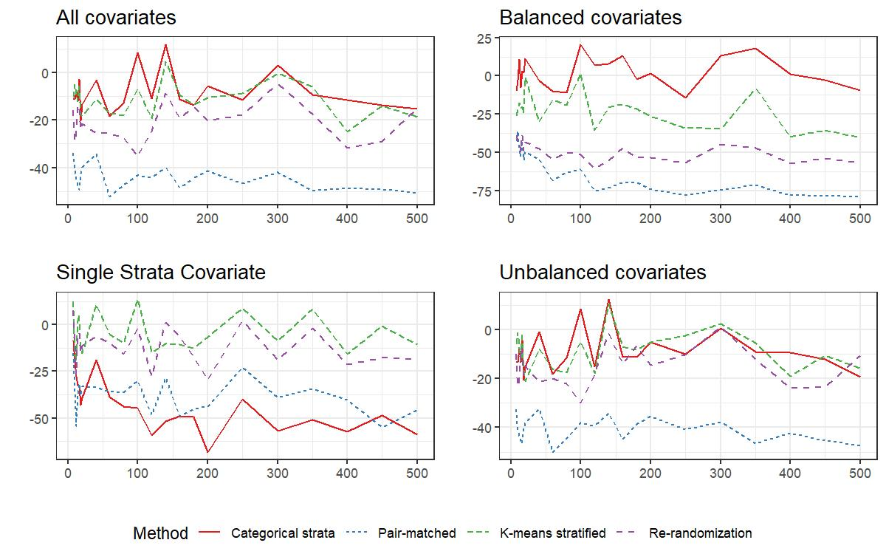
Simulation
15,000 nursing homes
5000 trials per sample size
Sample size:
8, 10, 12, …20,…500
Test performance across small -> big studies.

