Slide 1
Husky Interface Computer
(Ubuntu)
Main Husky Computer
(Ubuntu)
Data Collection Computer
(Windows)
Husky Microcontroller

Slide 2
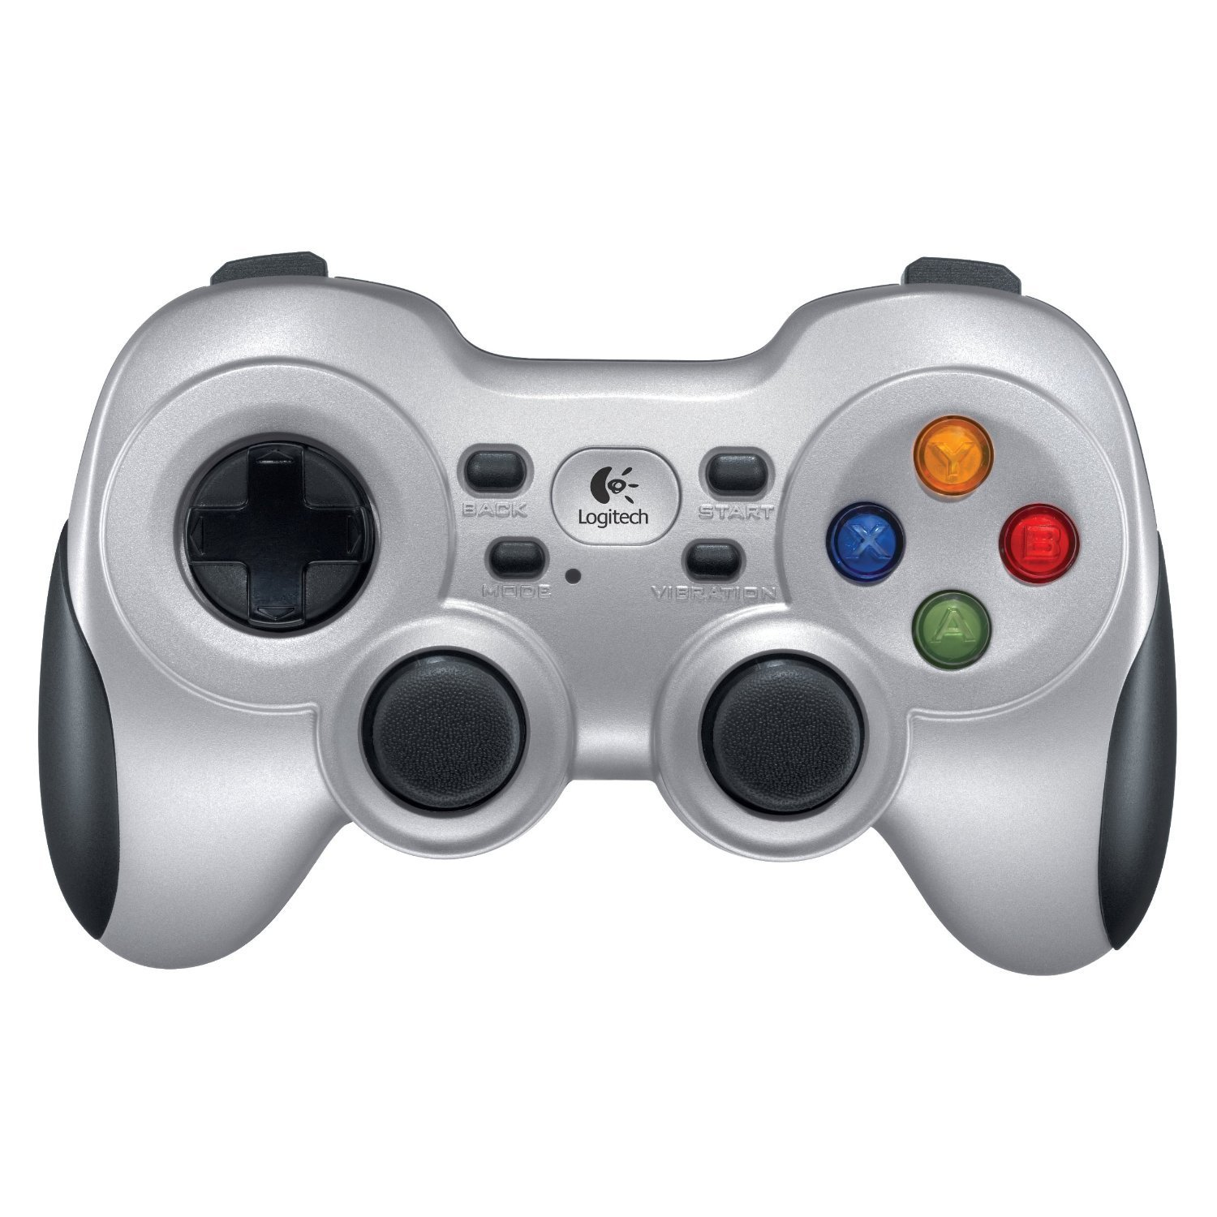
Enable 1
Resume
Preset
Enable 2
Increase
Speed
Override
Decrease
Speed
Cancel
Turn
Override speed

Slide 3
Left
Camera
Robot
Right
Camera

