Slide 1
Husky Interface Computer
(Ubuntu)
Main Husky Computer
(Ubuntu)
Data Collection Computer
(Windows)
Husky Microcontroller

Slide 2
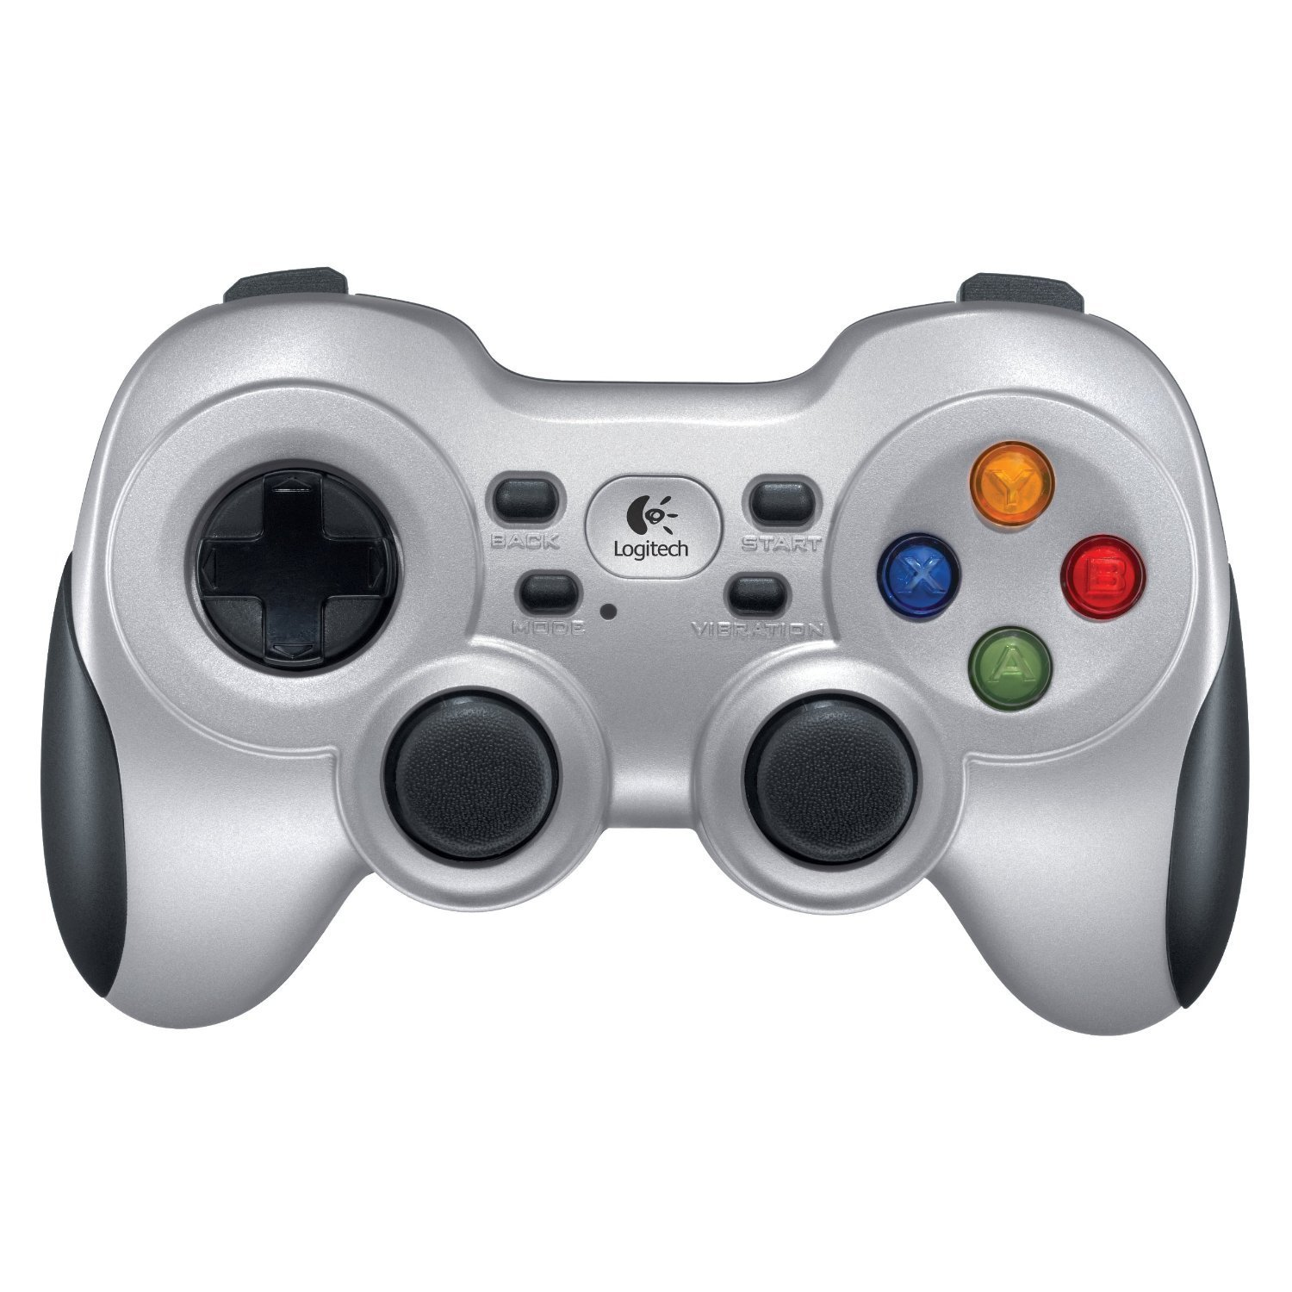
Enable 1
Resume
Preset
Enable 2
Increase
Speed
Override
Decrease
Speed
Cancel
Turn
Override speed

Slide 3
Robot
Left
Camera
Right
Camera

Slide 4
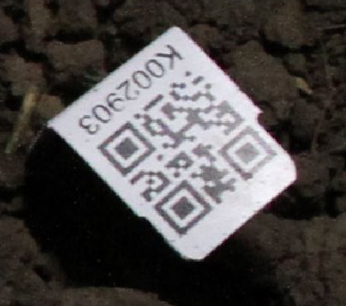
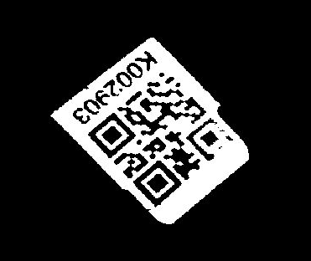
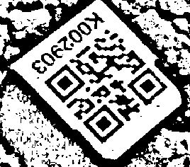
Code with Glare
Global Threshold
(not readable)
Adaptive Threshold
(readable)

Slide 7
2
5
Legend
6
Possible plant
1
3
7
Actual plant
8
Created plant
4
QR Code
9

Slide 8
Row: 1 2 3
3
4
9
2
5
8
1
6
7

Slide 9








8
8
(.12, 1.0)
($\frac{e}{2}$, 1.0)
(2.5$e$,1.0)
P (penalty)
C (penalty)
(3.5$e$,1.0)
L (penalty)
(.07, .1)
($\frac{e}{4}$, .1)
Lateral Error (m)
Projection Error (m)
Closeness (m)
8
8
-1.0
-1.0
-1.0
L (penalty)
P (penalty)
C (penalty)
-0.1
-0.1
.07
.12
0.25$e$
0.5$e$
2.5$e$
3.5$e$
Lateral Error (m)
Projection Error (m)
Closeness (m)

Slide 10
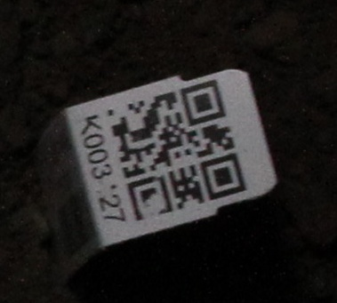
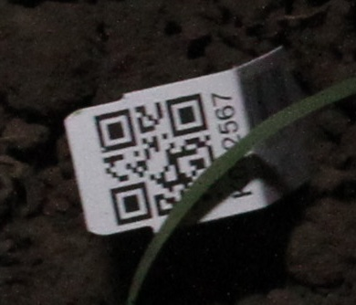
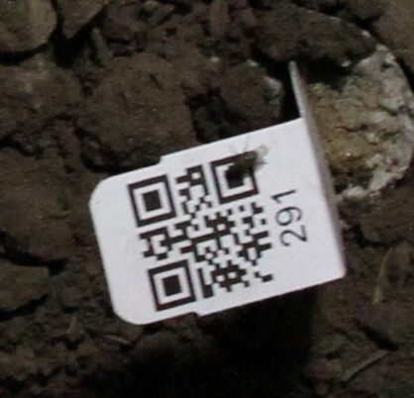
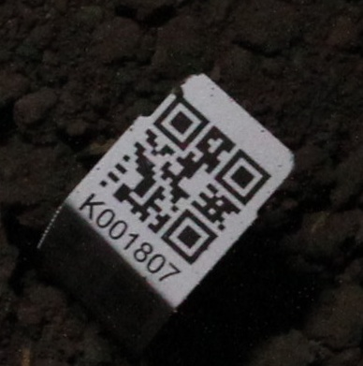
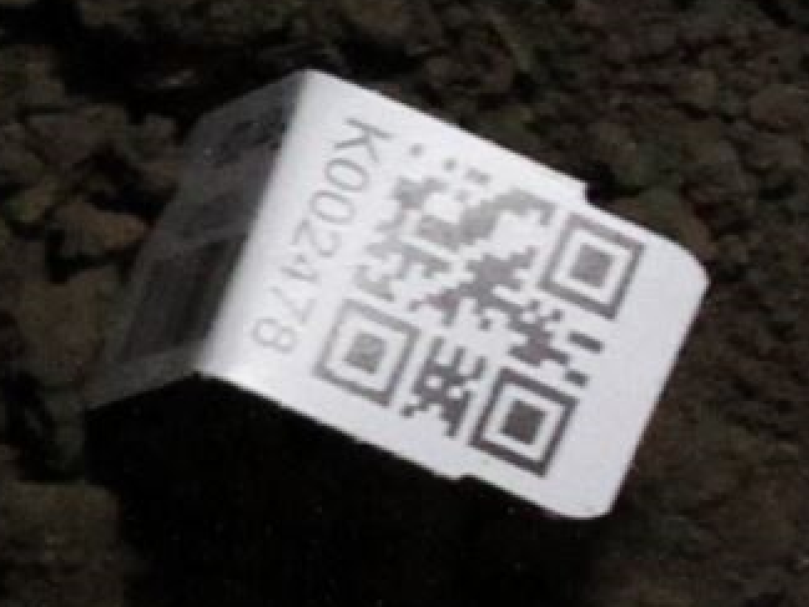

Slide 11
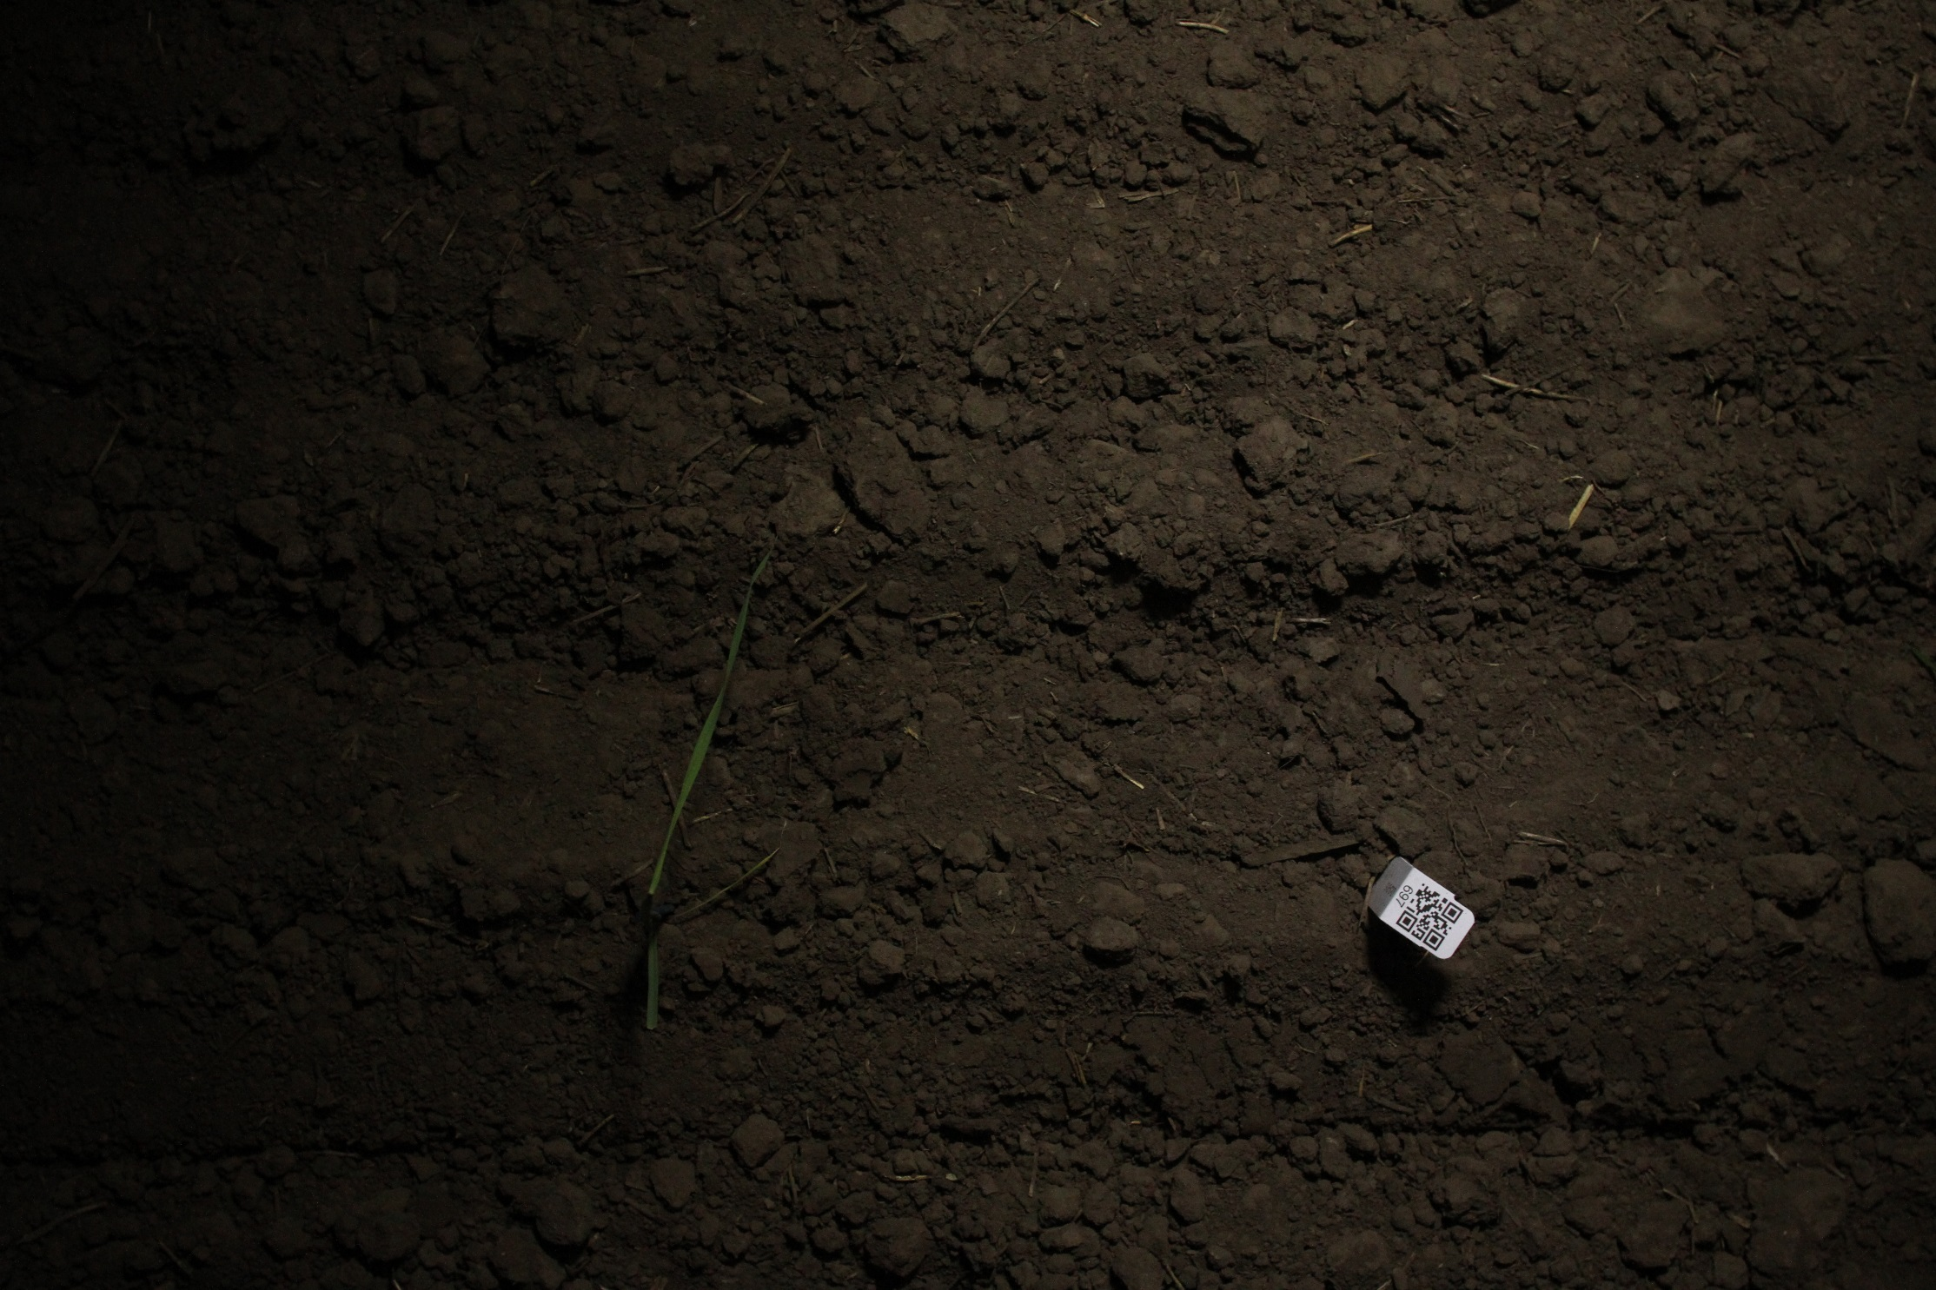
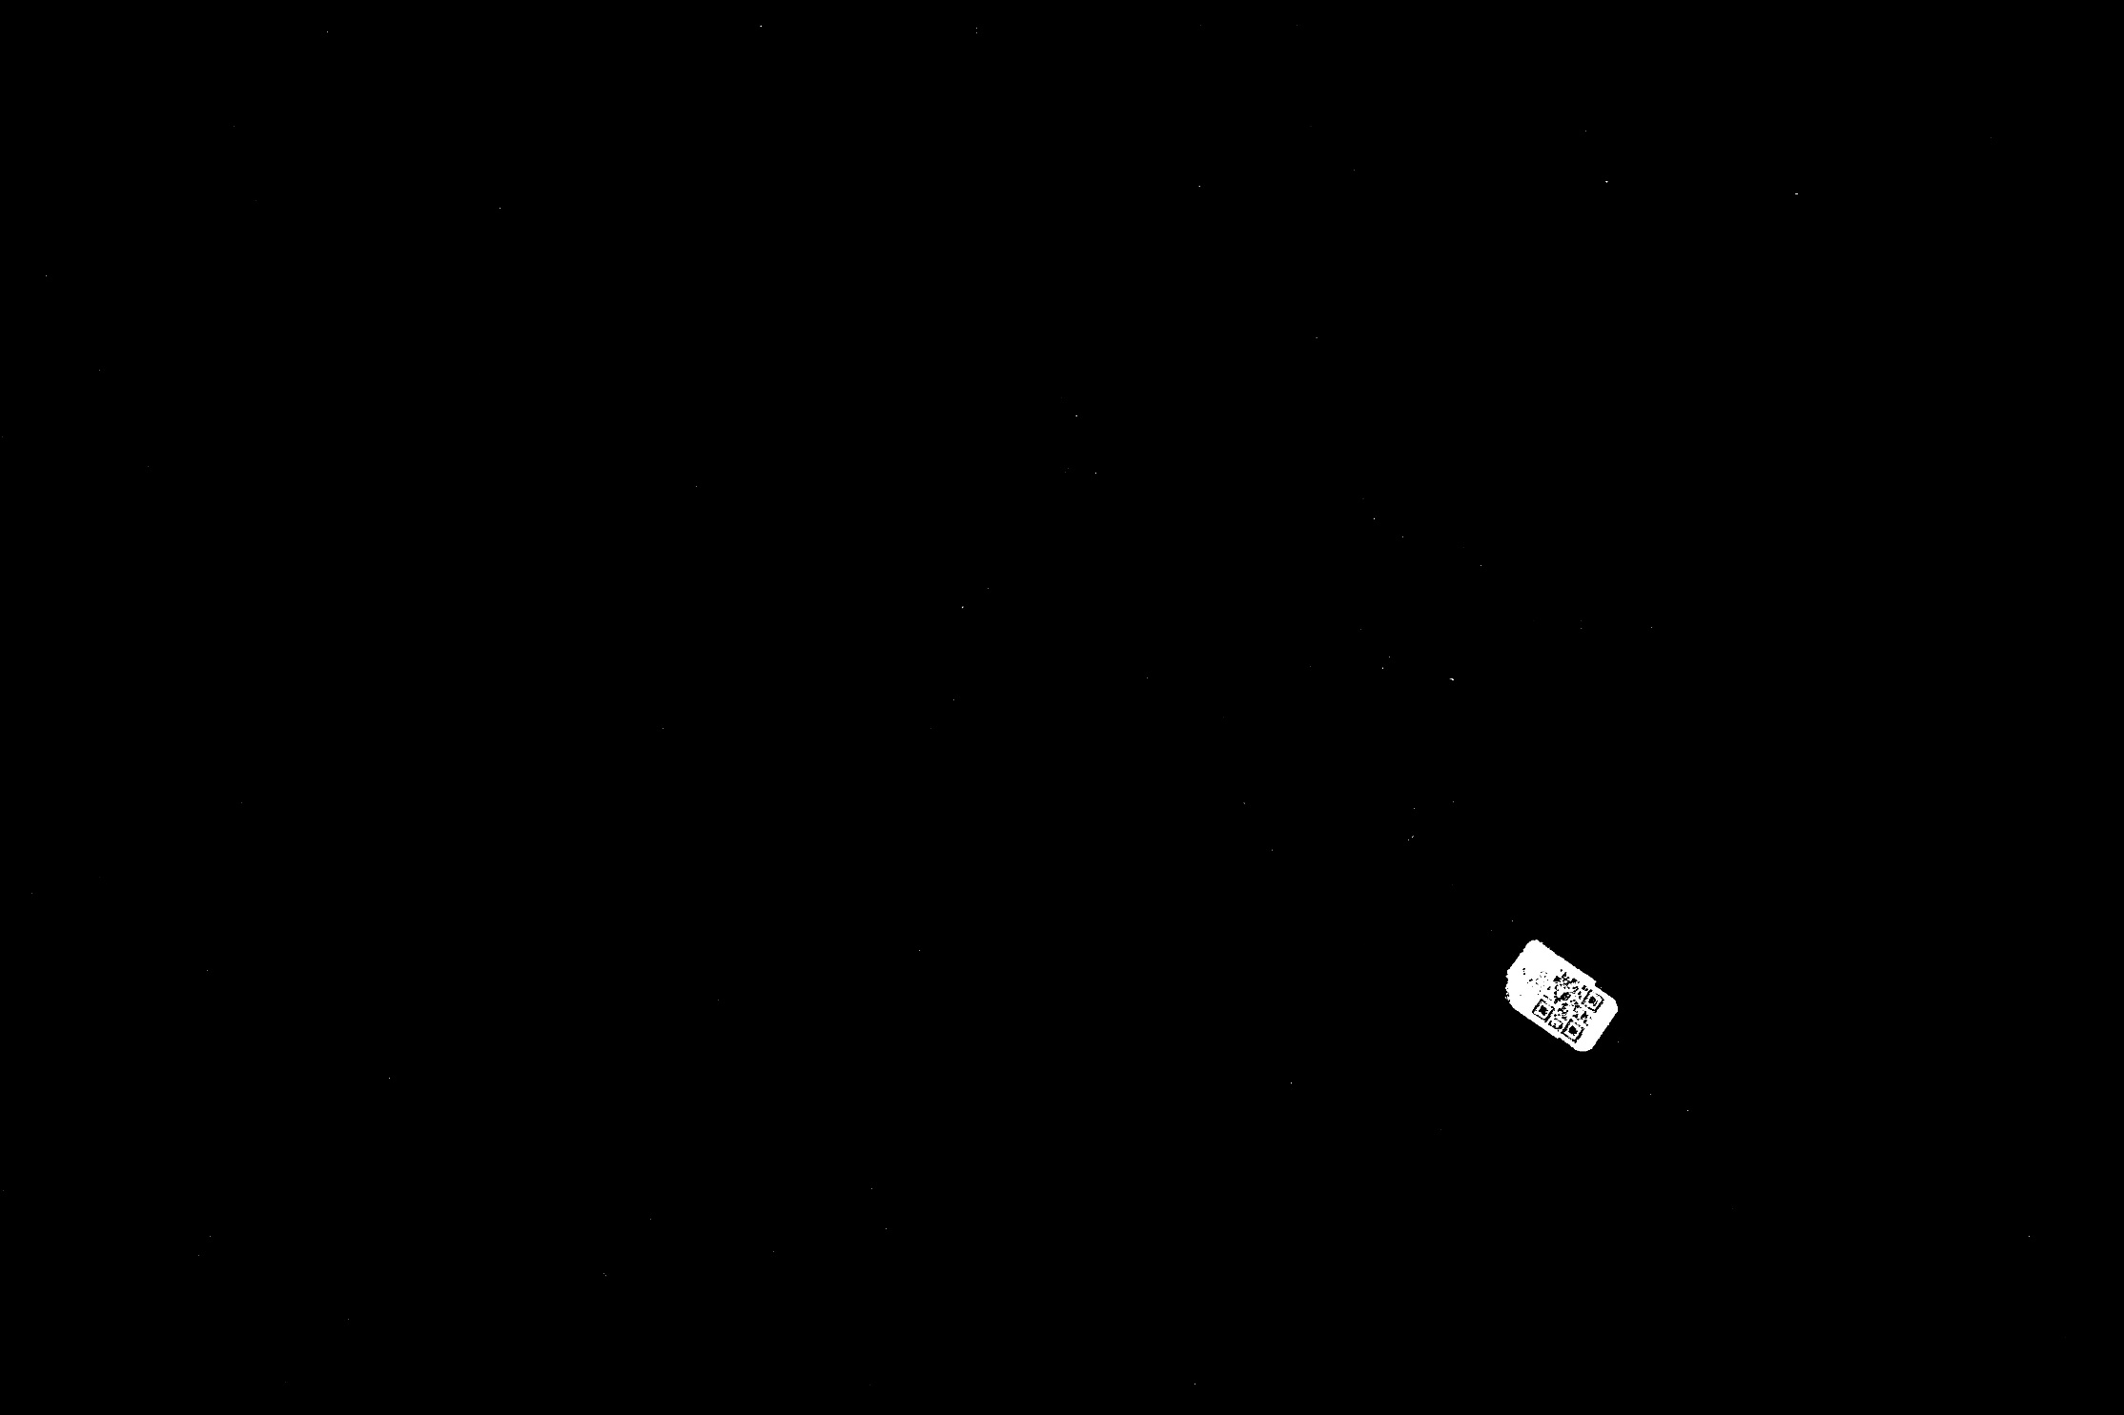
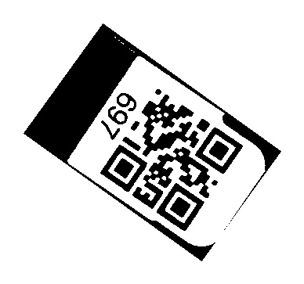
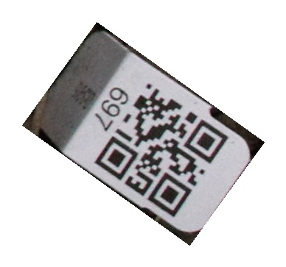
(1)
(2)
(3)
(4)
ZBar Reader
(5)
697

Slide 12
ZBar Reader
697
(4)
(5)

Slide 13
