Slide 1
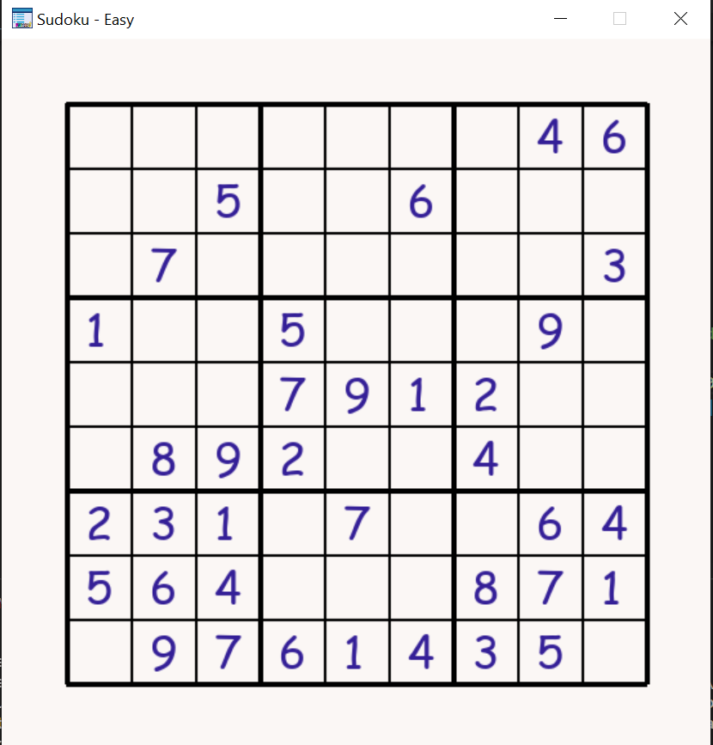
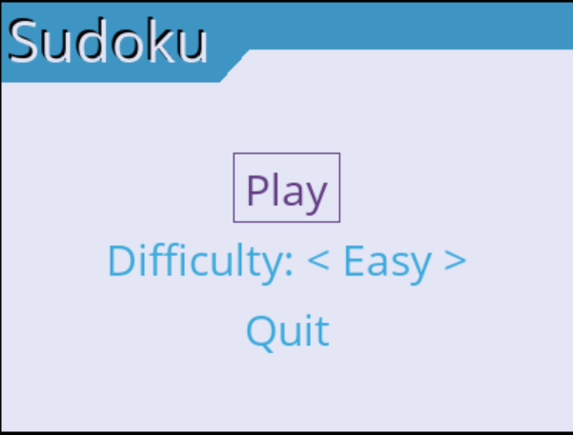
Earth toned Sudoku
The classic sudoku game but with a modern earth toned color palette.

