Slide 1
Outfit Recommender using Machine Learning
By Joseph Mckeown

Slide 2

The Idea
The average person can find it difficult to
choose what to wear.
Today we are often overwhelmed by the
amount of choice.
Modern technology can be used to streamline
this process.

Slide 3
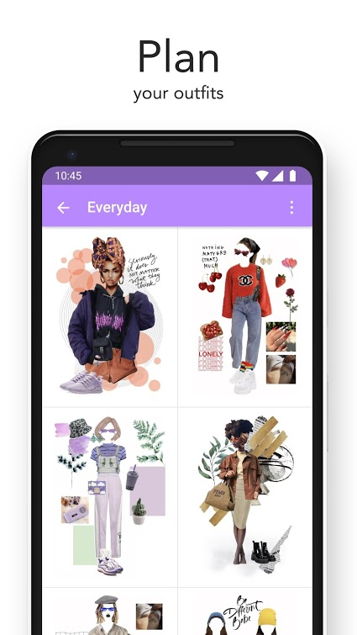
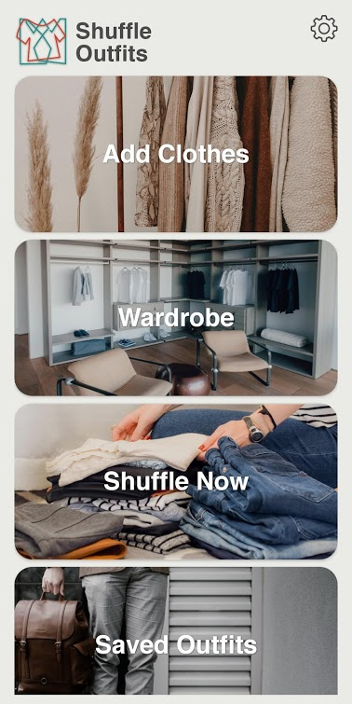
Similar Existing Apps
Combyne’s outfit display screen
Main Screen of Shuffle Outfits

Slide 4
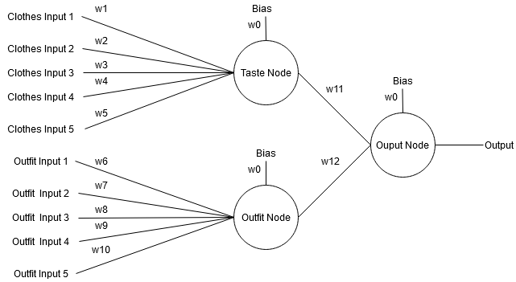
The Neural Network
The basic model of the neural network which is implemented in the app

Slide 5
Success of Neural Network
Graph of results from testing the Accuracy of the NN

Slide 6
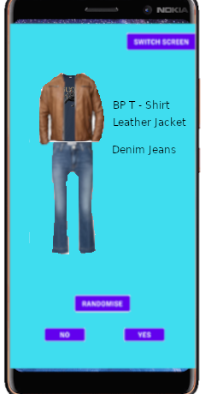
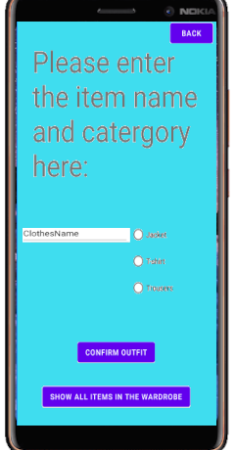
App Design
Main Screen Mock-up
Item addition Mock-up

