Slide 1
Outfit Recommender using Machine Learning
By Joseph Mckeown

Slide 2
The Idea
In the modern day, we are confronted by lots decisions which causes decision fatigue
Barack Obama once said “I don't want to make decisions about what I'm eating or wearing. Because I have too many other decisions to make.” [1]
How can this everyday decision be streamlined and automated for the busy modern day?

Slide 3
The Idea
A Outfit randomiser is the solution to this problem.
An application which decided outfits for you based on your tastes.
The goal is to improve user satisfaction through the apps convenience.

Slide 4
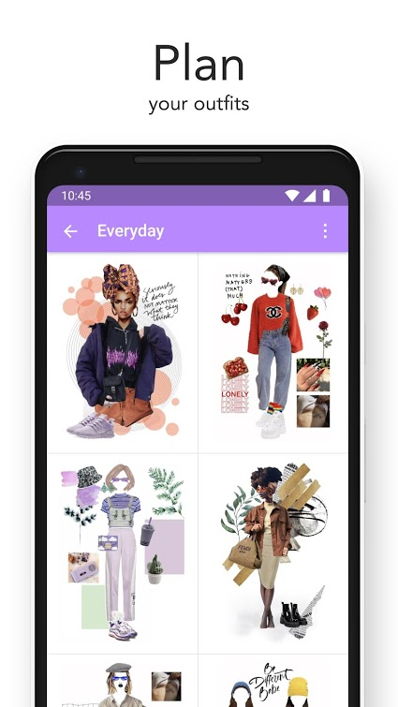
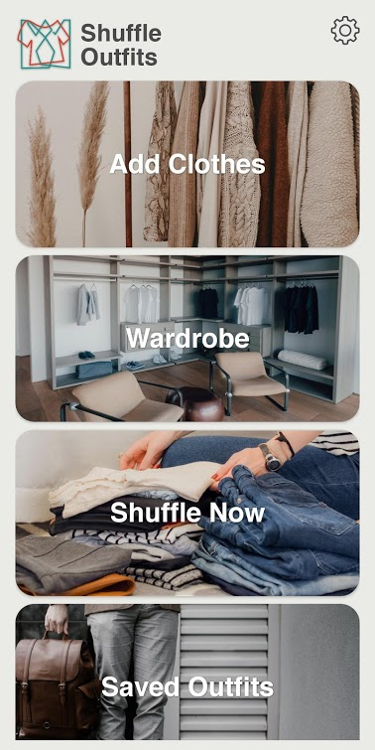
Existing Apps
Combyne[2]
Social media for outfits
Uses a virtual Wardrobe
Shuffle Outfits[3]
Randomly picks an outfit
Saving preferred outfits
Combyne
Shuffle Outfits

Slide 5
The App
The application is made for android devices as it is the most used OS in the world[4]
The App comprises of 3 main features:
Neural network based outfit randomisation
Wardrobe customisation
Adding items of clothing

Slide 6
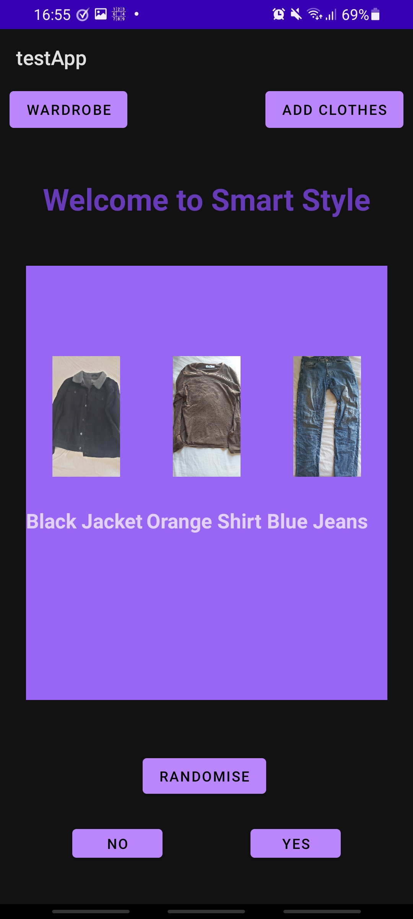
Outfit Randomisation
When an outfit is randomised, the results are shown on the main screen.
The user decided if the outfit is good or bad.
The user decision dictate how the Neural Net learns

Slide 7
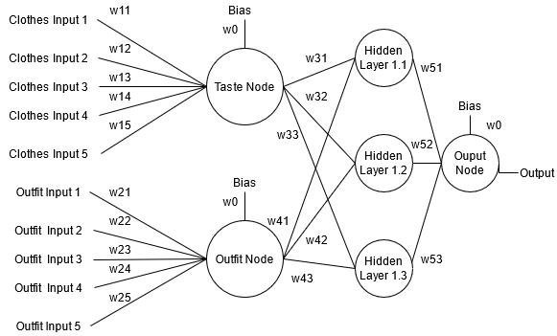
The Neural Network
The basic model of the neural network which is implemented in the app

Slide 8
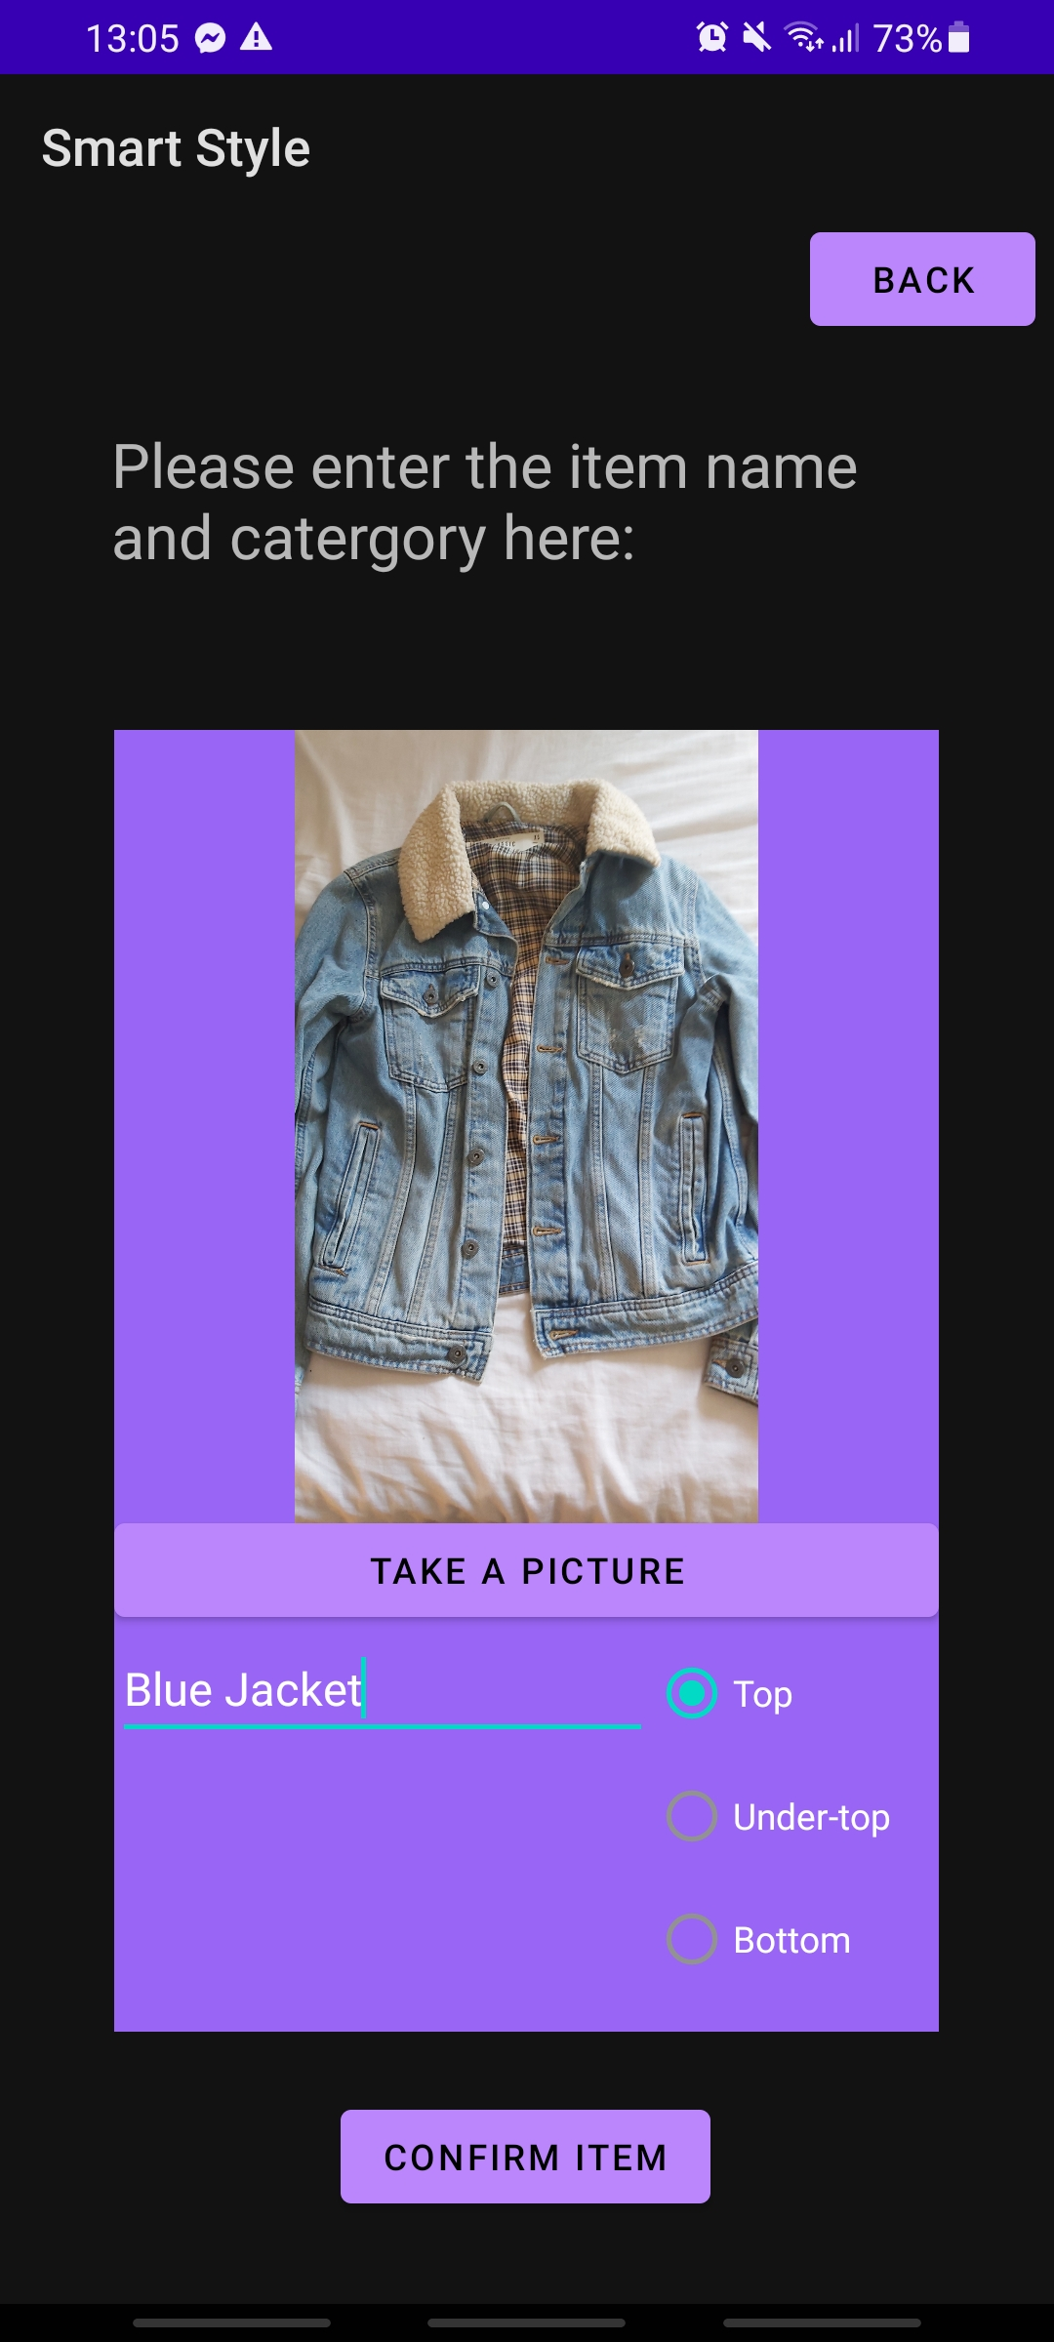
Adding Clothes
Each item of clothing has 3 main Attributes:
Name
Type
Picture
When an item is confirmed it is stored in the virtual Wardrobe

Slide 9
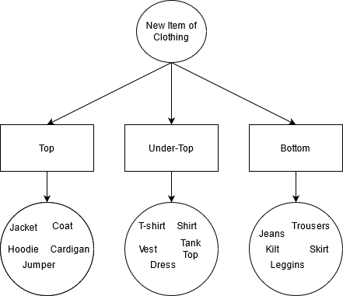
Adding Clothes
Item of clothing added to the app are sorted into 3 categories:
Tops e.g. Jackets, Coats
Under-Tops e.g. Shirts, Vests
Bottoms e.g. Trousers, Jeans
1 of each type is needed to create an outfit
Clothing item categories

Slide 10
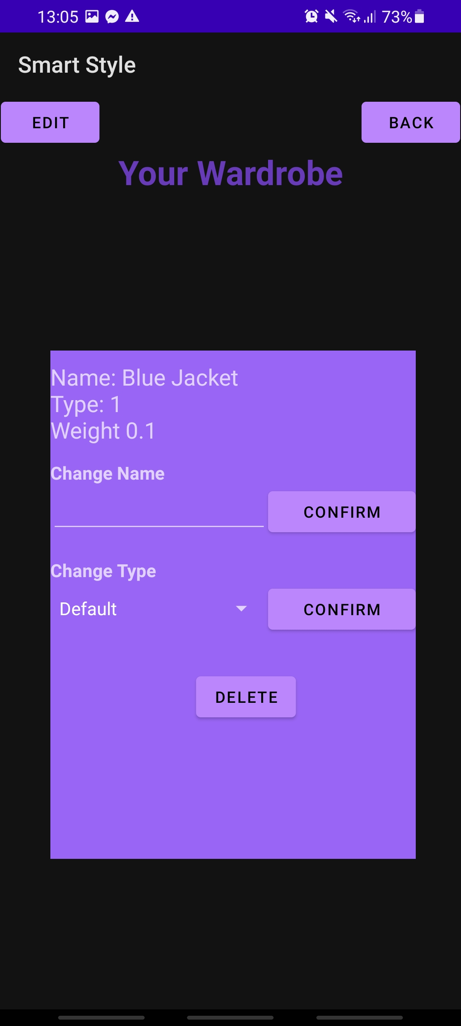
Editing Wardrobe
Shows the information about each item in the wardrobe
The user can change the item attributes.
They can:
Change the Name
Chang the Type
Delete The item

Slide 11
FUNCTIONING APP
INSERT SLIDE WITH VIDEO DEMONSTACTION OF THE APP RUNNING

Slide 12
Testing the Neural Network
The goal of the app is to improve the users satisfaction through positively outfit predictions
Success is measured by the percentage of outfits which the user prefers
The Neural Network was tested against a personal profile’s wardrobe

Slide 13
Testing the Neural Network
The Results show an upward trend in accuracy
This indicated the Neural Net is learning the tastes
Graph of results from testing the Accuracy of the NN

Slide 14
Conclusion
The app was able to learn the tastes of the user over time
A virtual wardrobe was able to produce recommendations to the user
This can be expanded to include more types of clothes
More positive aspects from similar apps can be implemented

Slide 15
Conclusion
[1] (Baer, 2021) Baer, D., 2021. The scientific reason why Barack Obama and Mark Zuckerberg wear the same outfit every day. [online] Business Insider Australia. Available at: <https://www.businessinsider.com.au/barack-obama-mark-zuckerberg-wear-the-same-outfit-2015-4/> [Accessed 19 April 2021].
[2](combyne, 2021) Combyne.com. 2021. combyne. [online] Available at: <https://www.combyne.com/> [Accessed 19 April 2021].
[3](Shuffle Outfits, 2021)Play.google.com. 2021. Shuffle Outfits. [online] Available at: <https://play.google.com/store/apps/details?id=net.robos.shuffleoutfit> [Accessed 19 April 2021].
[4] (101+ Android Stats You Should Know in 2021 [Infographic], 2021) TechJury. 2021. 101+ Android Stats You Should Know in 2021 [Infographic]. [online] Available at: <https://techjury.net/blog/android-market-share/> [Accessed 19 April 2021].

