Slide 1
Outfit Recommender using Machine Learning
By Joseph Mckeown

Slide 2
The Idea

Slide 3
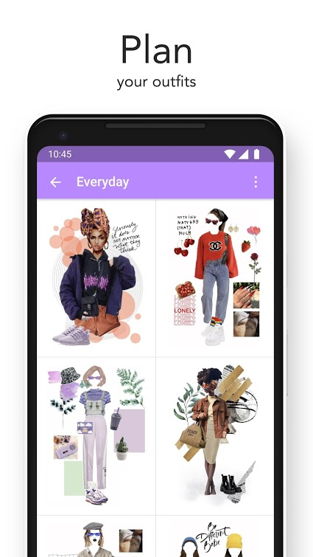
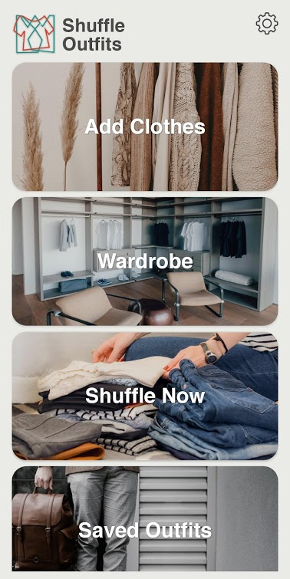
Similar Existing Apps
Combyne’s outfit display screen
Main Screen of Shuffle Outfits

Slide 4
My Innovation

Slide 5
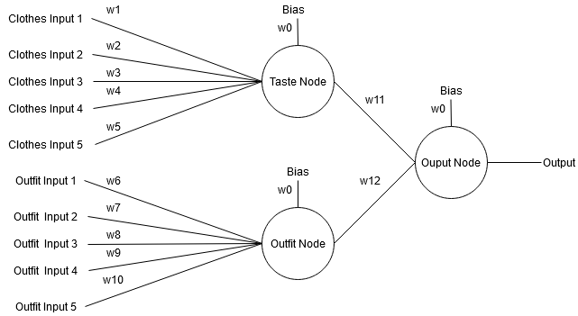
The Neural Network
The basic model of the neural network which is implemented in the app

Slide 6
Success of Neural Network
Graph of results from testing the Accuracy of the NN

Slide 7
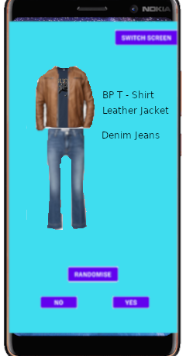
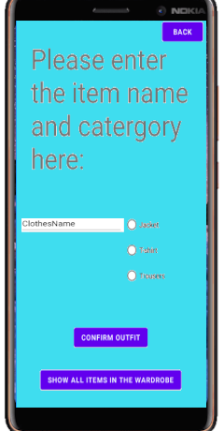
App Design
Main Screen Mock-up
Item addition Mock-up

