Slide 1
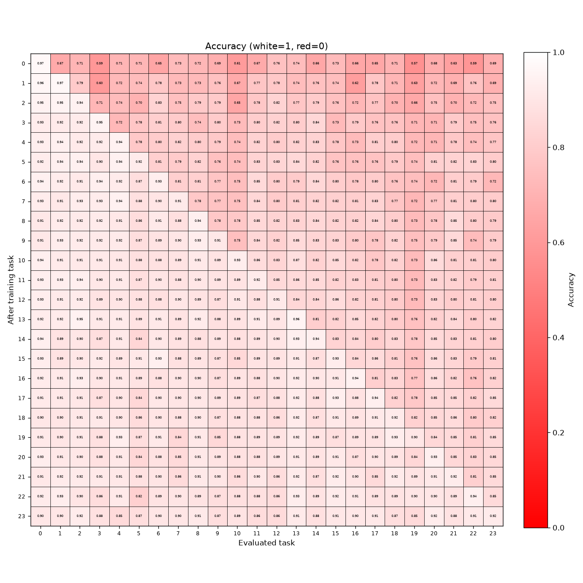
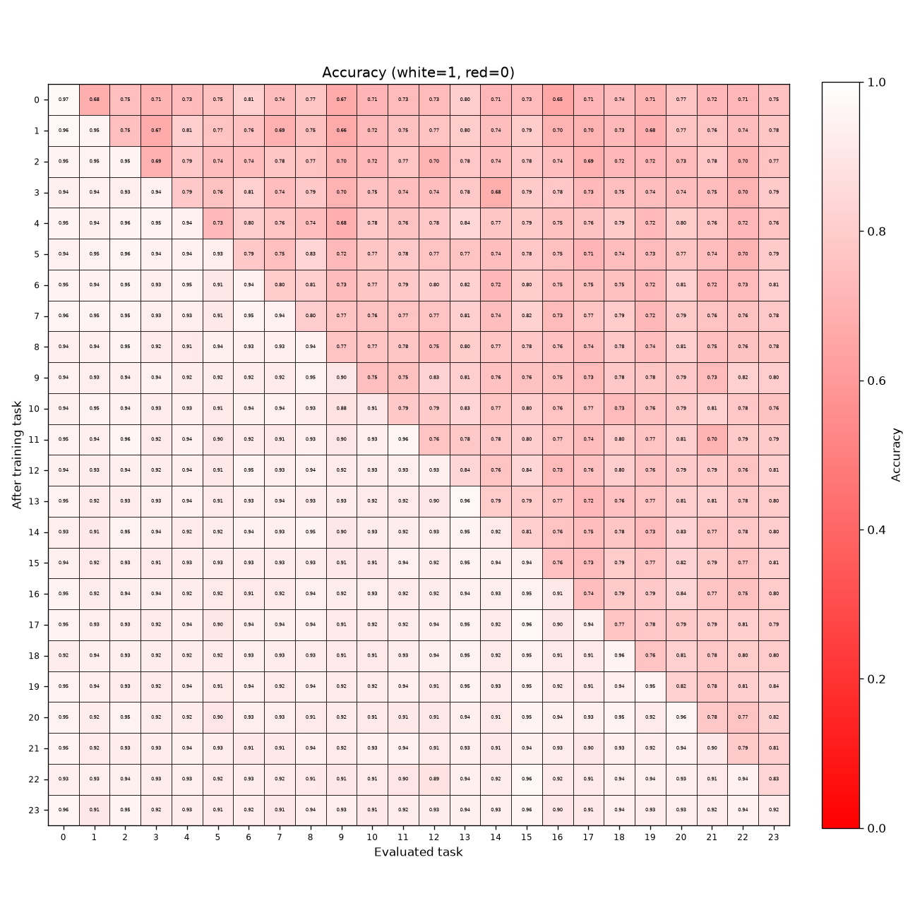
Default configuration
Reactive_Low+Large — reference values
CONCEPT SHIFT
DEFAULT (held constant)
Reactive_Low
RECONFIG_REACTIVE = True
RECONFIG_REACTIVE_SD = 5.0
RECONFIG_REACTIVE_EMA = 0.9
RECONFIG_EVERY = 0
Replay: ON
N_SAMPLE_PER_TASK = 10
REPLAY_BATCH_SIZE = 256
REPLAY_MAXLEN = 240
Model: dim96, 8 layers, k1024
N_TASK=24, DUR=2500, LR=0.0003, SEED=123
MATRIX ROWS
Top = concept shift (DOMAIN_SHIFT=False)
Bottom = domain shift (DOMAIN_SHIFT=True)
axes: after-train task x eval task
LATER SLIDES
each lists only the config keys that
differ from this default.
DOMAIN SHIFT

Slide 2
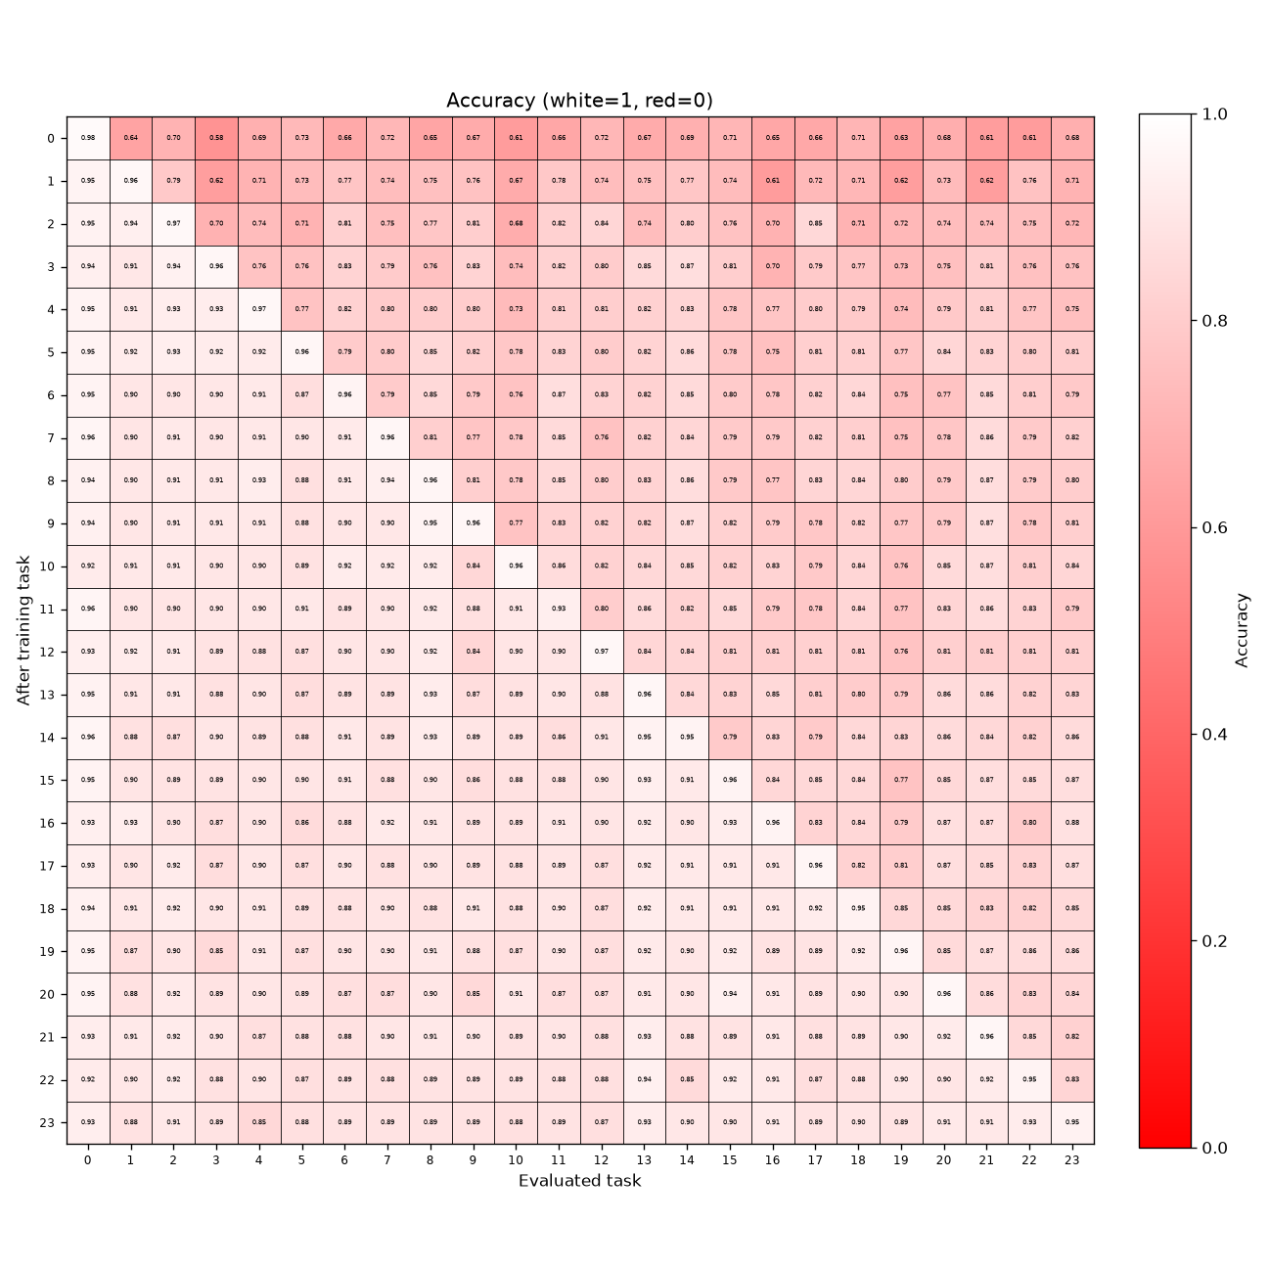
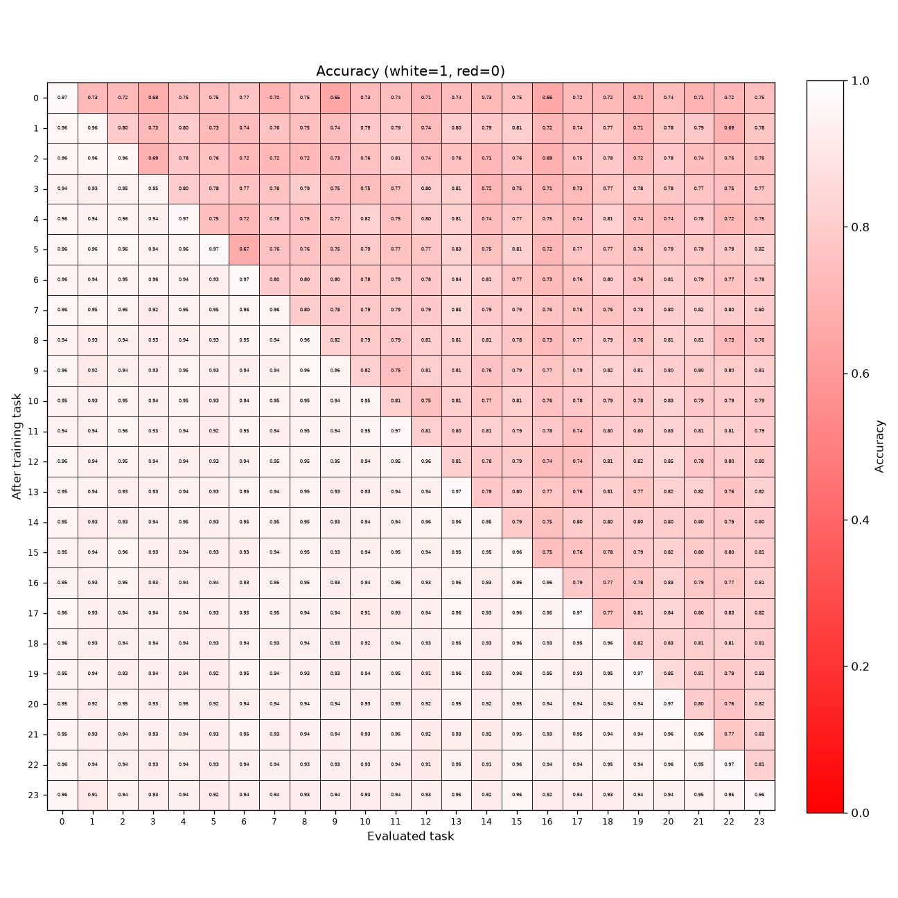
Reactive_High
Reactive_High+Large
CONCEPT SHIFT
Δ FROM DEFAULT
RECONFIG_REACTIVE_SD:
5.0 -> 1.0
DOMAIN SHIFT

Slide 3
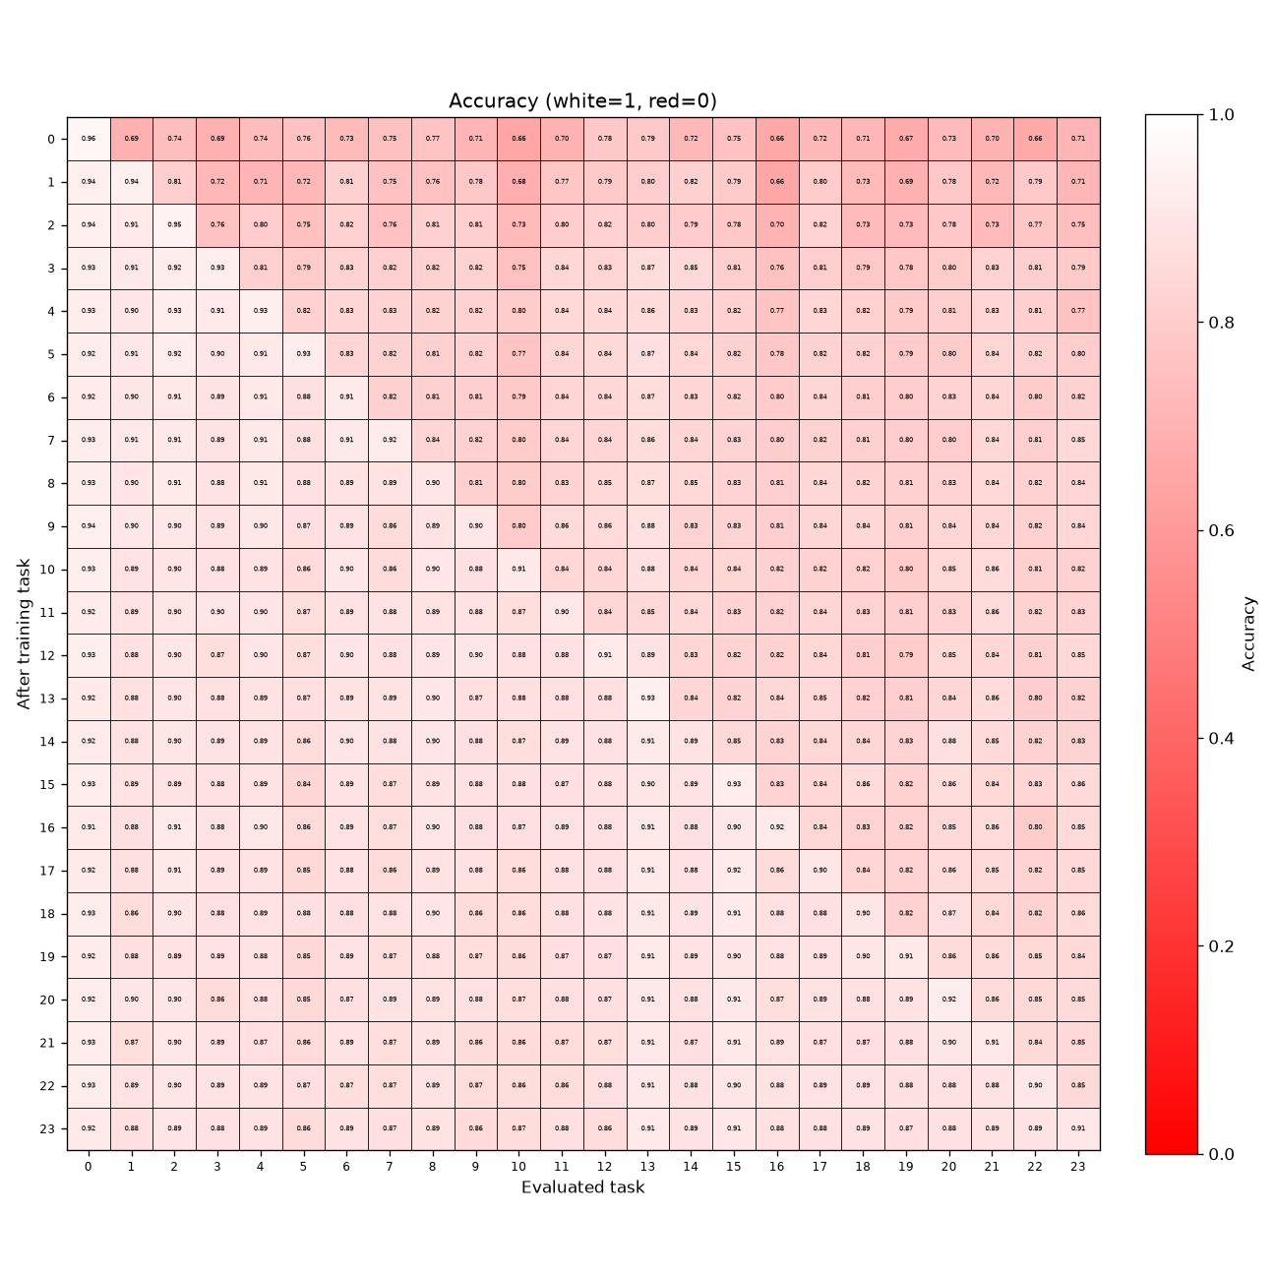
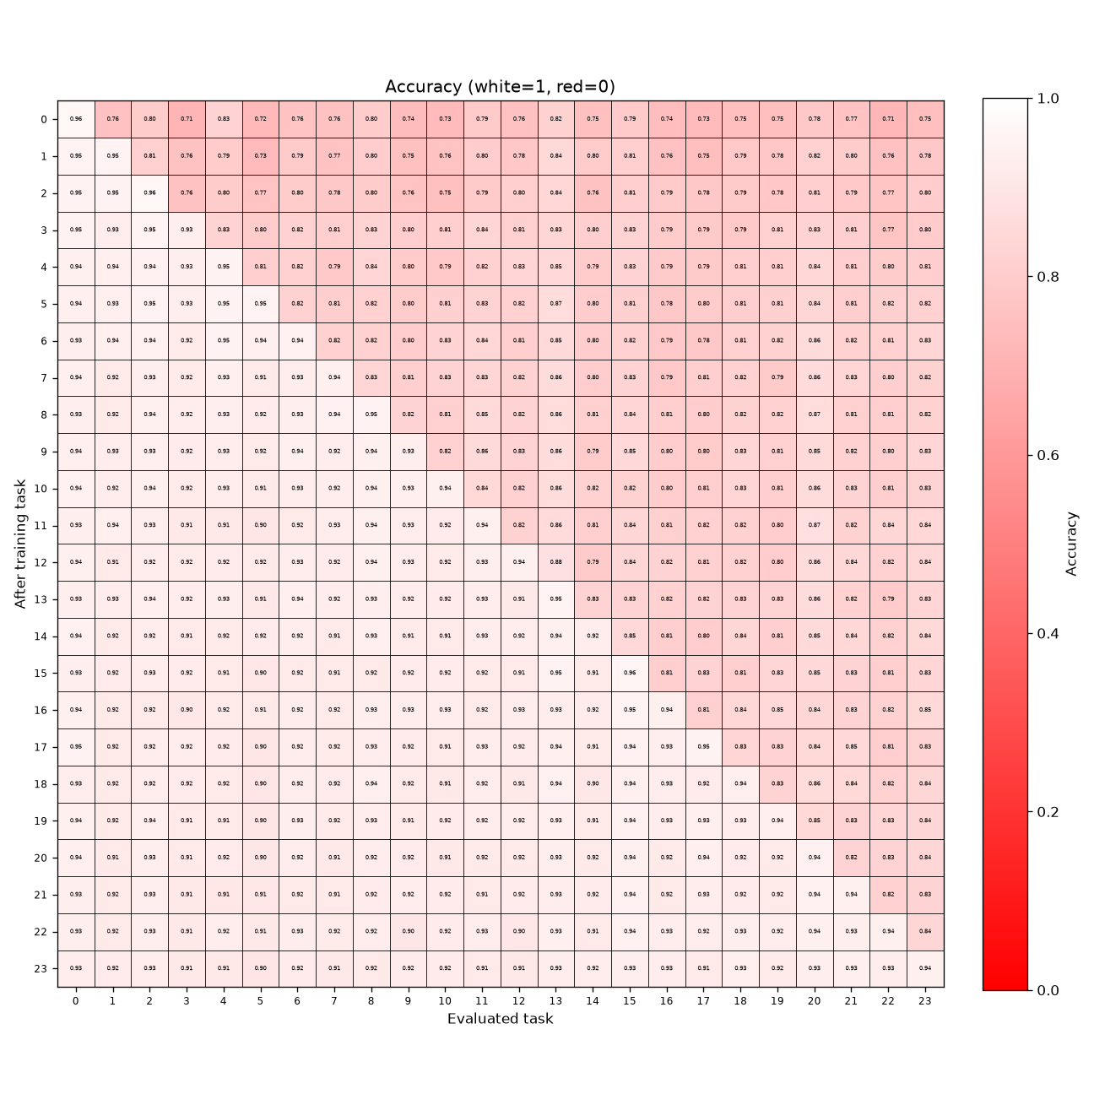
Reconfig every 1 step
Large
CONCEPT SHIFT
Δ FROM DEFAULT
RECONFIG_EVERY:
0 -> 1
RECONFIG_REACTIVE:
True -> False
RECONFIG_REACTIVE_EMA:
0.9 -> 0.95
DOMAIN SHIFT

Slide 4
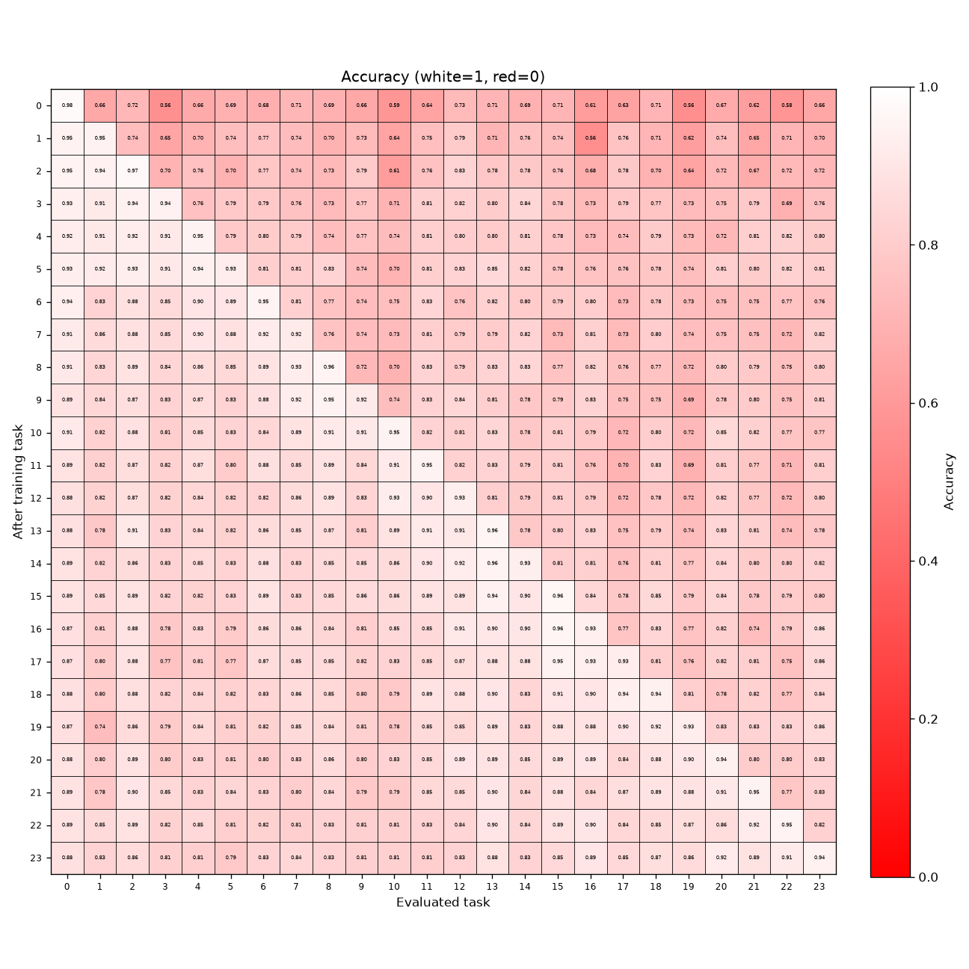
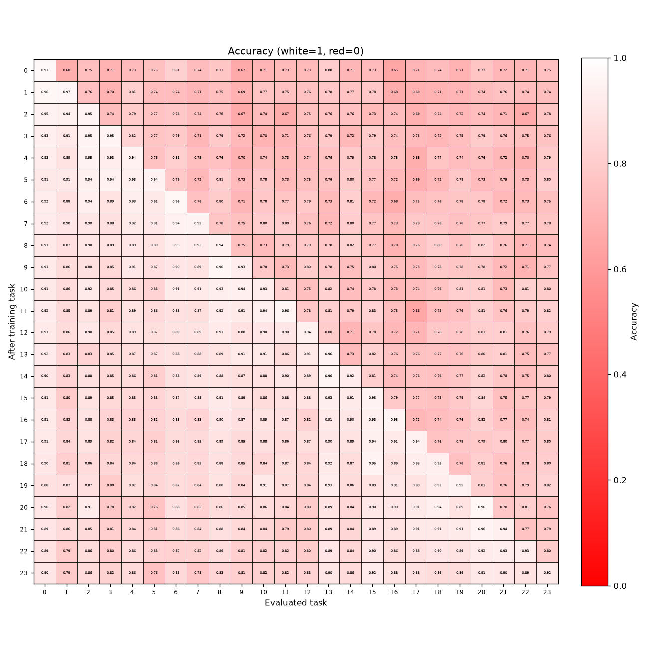
No replay
Reactive_Low+NoReplay+Large
CONCEPT SHIFT
Δ FROM DEFAULT
N_REPLAY_SAMPLES:
1 -> 0
N_SAMPLE_PER_TASK:
10 -> 0
REPLAY_BATCH_SIZE:
256 -> 0
REPLAY_MAXLEN:
240 -> 0
DOMAIN SHIFT

Slide 5
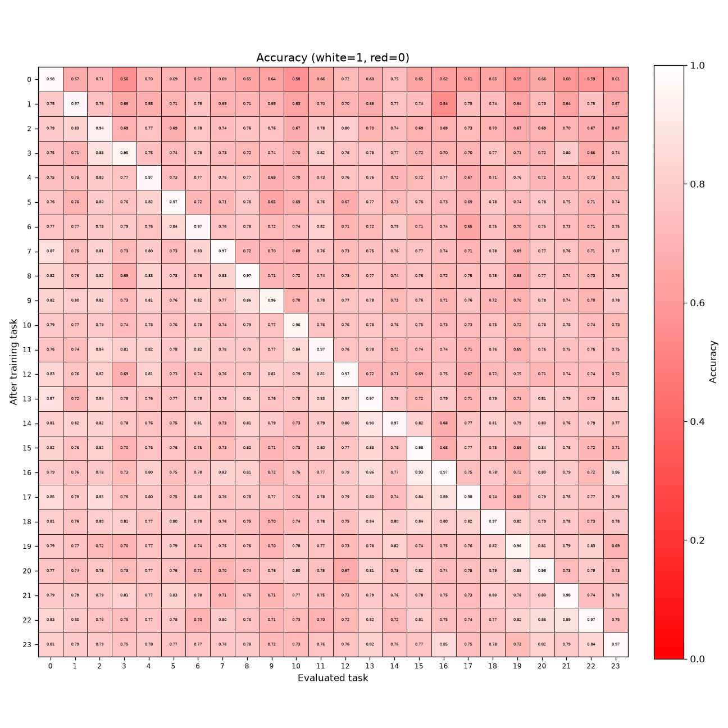
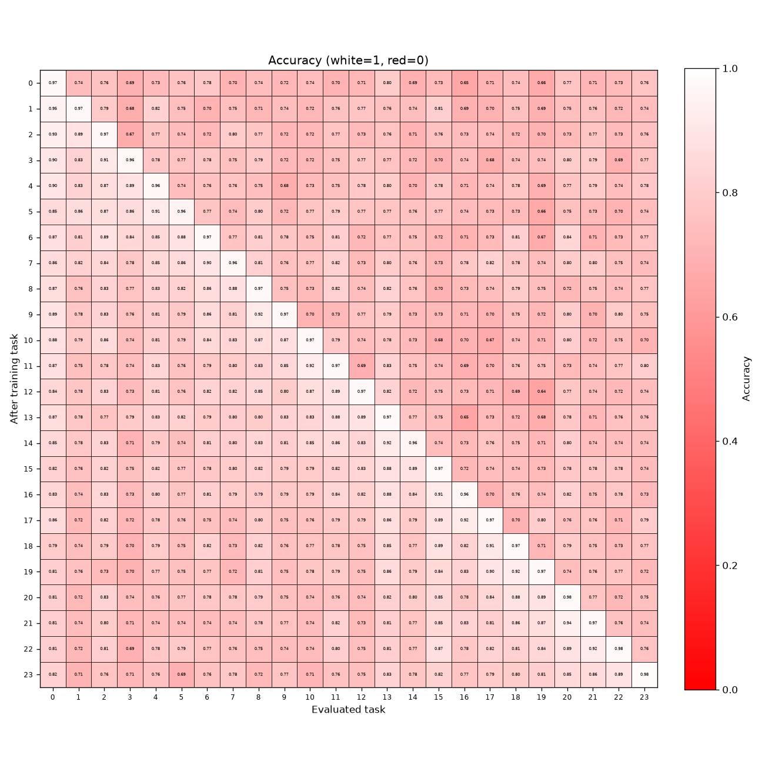
Reactive_High + No replay
Reactive_High+NoReplay+Large
CONCEPT SHIFT
Δ FROM DEFAULT
N_REPLAY_SAMPLES:
1 -> 0
N_SAMPLE_PER_TASK:
10 -> 0
RECONFIG_REACTIVE_SD:
5.0 -> 1.0
REPLAY_BATCH_SIZE:
256 -> 0
REPLAY_MAXLEN:
240 -> 0
DOMAIN SHIFT

