Slide 1
Compositional Program Induction with Functional Task Networks
An abelian task-grid testbed: composing never-trained algorithms by spatial selection alone
FTN / NAR experiment · nar/ subproject · July 2026
Full writeup: nar/RESULTS.md · code: nar/ftn_nar/ · runs: nar/results/

Slide 2
The question
A Functional Task Network specializes one fixed bank of neurons per task with a binary top-k mask. Trained block-sequentially, with task identity NEVER given as input, can it COMPOSE solutions to algorithms it was never trained on — with full out-of-distribution correctness, verified against the data-generating program?
Program-induction framing:
• each task = an algorithm (a program)
• the mask = the program's address in the bank
• the test = are never-trained programs reachable by spatial selection alone, with zero weight updates?
Two failure modes the design must rule out: (1) the task family is already solved by ordinary representation learning; (2) success reflects generic function approximation rather than structure. Both are tested with controls.

Slide 3
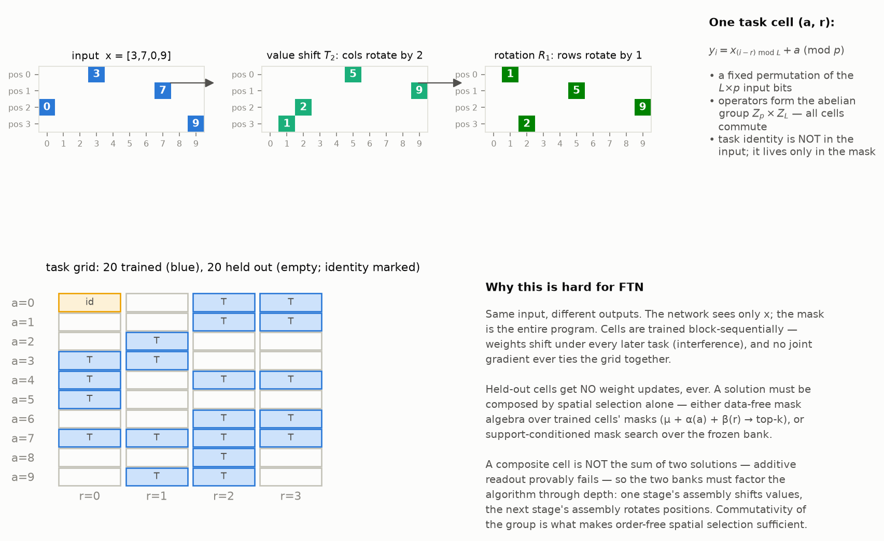
The task family: an abelian operator grid
y_i = x_(i−r mod L) + a (mod p) — value shift × cyclic rotation on one-hot sequences

Slide 4
Why this is the right minimal testbed
Every cell is a fixed permutation of the 40 input bits
→ trivially expressible by the backbone; every result is about the mask mechanism, never about expressivity.
The operators form the abelian group Z₁₀ × Z₄
→ all cells commute, so 'compose these operators' is well-defined WITHOUT an order — exactly what order-free spatial selection can express.
Task identity is never in the input
→ the same x maps to different y under different cells; the mask is the entire program.
Grid split: 20 / 40 cells trained; 20 held out (incl. the identity)
→ coverage constraints keep every factor level identifiable.
Input split: train on 50% of all 10⁴ sequences, evaluate on the other 50%
→ trained-cell numbers are already input-OOD; held-out-cell numbers are OOD on both axes at once. Chance = 0.10 per position, 10⁻⁴ exact-match.

Slide 5
Model: FTN² — two canonical FTN stages in series
h = W_mid( Dropout(bank₁(x)) ⊙ m₁ )
ŷ = W_out( Dropout(bank₂(h)) ⊙ m₂ )
• each bank: H = 2048 deep neuron-MLPs (depth 4 × width 8, scalar output)
• per-bank top-k mask, k = 256; mask (m₁, m₂) ∈ {0,1}⁴⁰⁹⁶
• 64-dim interface code between stages; dropout 0.2; 7.4M params
• everything else canonical (paper Algorithm 1): AnnealSTE support-conditioned configurer, per-batch reconfiguration, mask-overlap-filtered replay ρ∈(0.2, 0.8], optimizer reset per block
The one deviation, and why it is forced
A single additive readout Σ zᵢ(x)wᵢ cannot express these composites:
if h(x; a, r) = f(x; a) + g(x; r), then h(x;a,r) − h(x;0,r) would be independent of r — but it equals (Sʳ ⊗ (Sᵃ − I))x, which depends on r. ∎
So composition must happen THROUGH DEPTH while selection stays purely spatial. FTN² is the minimal extension: two unchanged FTN stages stacked; mask semantics untouched. Commutativity of the task group is what licenses order-free spatial selection.

Slide 6
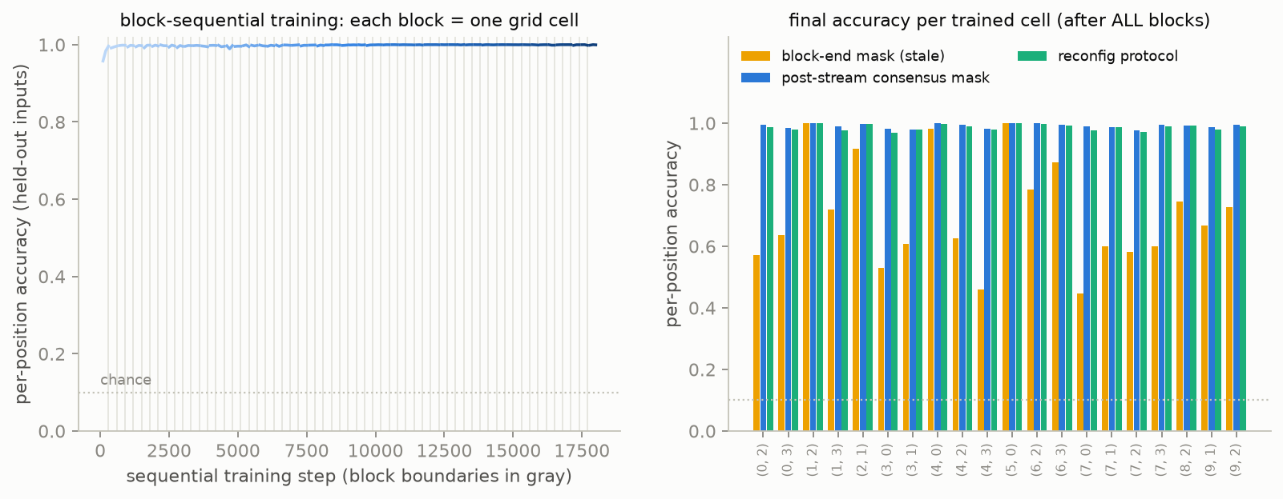
Training protocol, and the iteration that got it working
Block-sequential stream over 20 cells, 3 cycles × 300 Adam steps per visit (lr 1e-3), primitives-first curriculum, optimizer reset every block.
Every minibatch: configure the mask from a 128-example support batch (θ frozen, S=15 inner steps), one gradient step through the active mask, ≤8 replay slots.
Two design findings (single-cell sweep):
• large k is THE decisive lever: k = 25% of H took one-cell accuracy 0.62 → 1.00
• per-batch masks overlap near chance within a block → solutions are POPULATIONS; masks must be read out against final weights (block-end snapshots go stale)
run | change | trained | held-out
main0 | single pass, lr 3e-3 | 0.65 | 0.56
main1 | lr 1e-3, more replay, consensus masks | 0.72 | 0.60
main2 | 3 cycles + curriculum | 0.99 | 0.97
reconfig-protocol per-position accuracy; all runs preserved under nar/results/

Slide 7
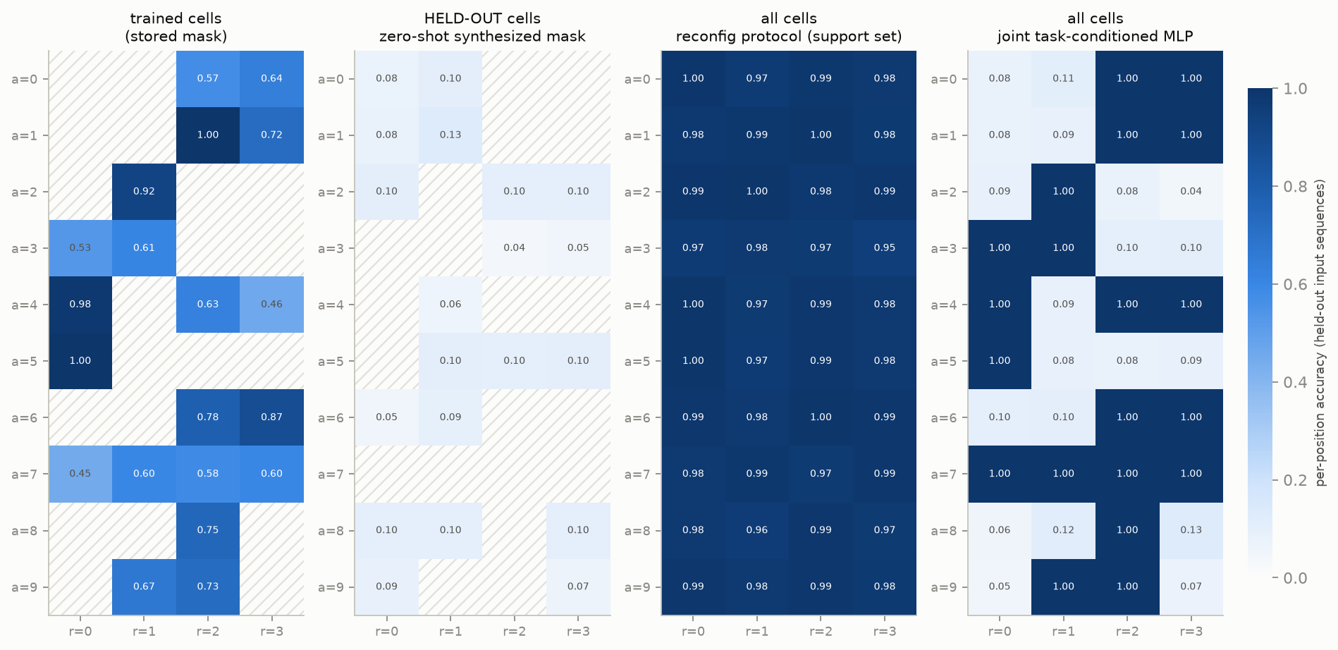
Headline: all 20 never-trained cells solved by spatial selection
frozen weights · 128 labeled examples · 60 gradient steps on mask logits only · evaluated on 5,000 never-seen inputs

Slide 8
Headline numbers (3 seeds, mean ± sd)
metric | result
trained cells — post-stream consensus mask | 0.990 ± 0.001 (exact-match 0.963)
trained cells — reconfig protocol | 0.986 ± 0.001
HELD-OUT cells — reconfig protocol | 0.973 ± 0.005 (exact-match 0.901)
held-out composites — zero-shot temporal iteration | 0.977 ± 0.003
held-out cells — data-free mask algebra | 0.086 ± 0.005 (chance)
joint task-conditioned MLP — held-out cells | 0.096 ± 0.010 (chance)
The never-trained identity cell (0,0): 0.996 per-position / 0.984 exact.
Retention is fully solved by the recurring stream + curriculum — no recency gradient remains across the 20 blocks.
Chance: 0.10 per position; 10⁻⁴ exact-match.

Slide 9
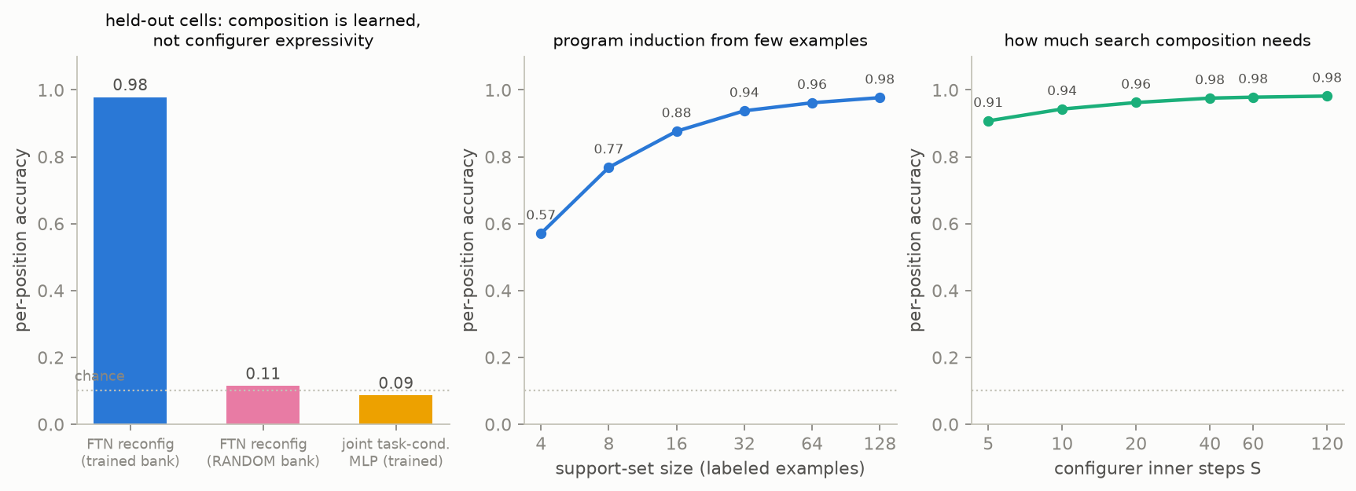
The controls that make it a result
Random-bank control (decisive): same configurer, same budget, untrained weights → 0.115 ≈ chance. Composition was LEARNED, not searched into existence.
Joint task-conditioned MLP: task ID as input + joint i.i.d. training (both denied to FTN) → 0.997 trained / 0.086 held-out. Combinatorial generalization on this family is NOT free — 'already solved by representation learning' is empirically false here.
Few examples, little search: 16 examples → 0.88, 32 → 0.94; S=5 steps → 0.91 — the bank is close to containing the composite; the configurer's job is nearly retrieval.

Slide 10
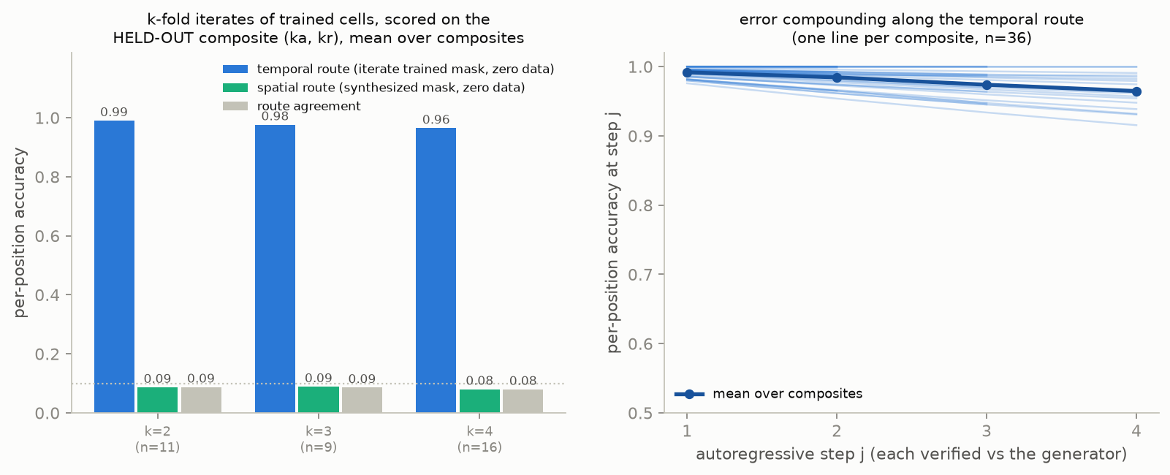
Two routes to the same held-out algorithm
abelian structure ⇒ iterating cell (a, r) k times must equal cell (ka, kr) — arranged to be held out
Temporal route (iterate a TRAINED mask, re-encode argmax between steps): reaches the held-out composite at 0.96–0.99, verified step-by-step against the generator — fully zero-shot, no data from the composite cell.
Spatial route via data-free mask algebra: chance (next slide explains why).

Slide 11
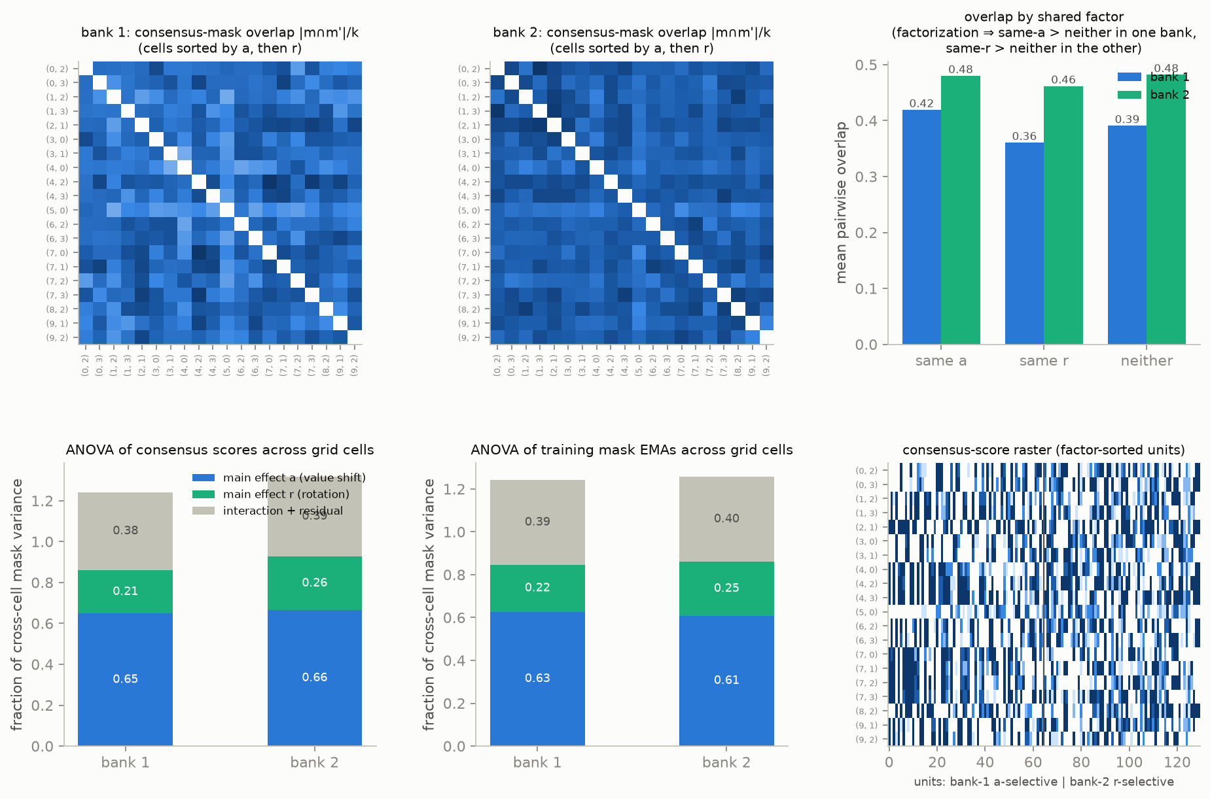
The honest negative: data-free mask ALGEBRA fails
additive completion μ + α(a) + β(r), majority unions, hard bank-to-factor assignment — all at chance (0.04–0.09), every seed
Why: solutions are non-unique POPULATIONS (restarts find partially disjoint assemblies), and no depth specialization emerged — both banks are a-dominated in the ANOVA; the functional circuit lives in the interaction residual, exactly the part grid-averaging destroys.
The compositional basis exists in the weights — addressable by search, not by closed-form arithmetic on masks. 'Masks as factored symbols' remains open.

Slide 12
Algorithm learned, or generic function approximation?
off-group probe: bijections at matched complexity and budget, graded by algebraic distance from the trained family
tier | probe class | trained bank | random bank
0 | held-out cells of the trained group Z₁₀×Z₄ | 0.982 (0.96–1.00) | 0.11
1 | product maps S₄×S₁₀ outside the abelian subgroup (negation 0.93, reversal 0.85, random elements ~0.55) | 0.733 (0.51–0.93) | 0.11
2 | non-product bit-permutations (per-position value maps) | 0.497 | 0.12
A generic routing basis would make all tiers equal — they are not (clean staircase).
A memorized cell library would put tier 1 at the random floor — it is not (never-trained operator TYPES like value-negation and position-reversal reach 0.85–0.93).
Supported reading: the bank learned the family's OPERATOR SCHEMA — one uniform value bijection everywhere × one position bijection — strongest on the trained subgroup, partial on the schema's wider orbit, collapsing when the schema breaks.
Caveats: tier-1 spread partly reflects proximity to trained cells; tier 2 still beats the random floor, so schema-specific and generic components coexist — the probe measures the mix.

Slide 13
What this establishes — and what it doesn't
Established
• frozen FTN² holds a compositional basis: all 20 never-trained cells at 0.97 / 0.90 exact, from ~16 examples, ~5 mask-gradient steps, full OOD
• composition is learned (random bank at chance)
• not already solved by standard rep. learning (joint conditioned MLP at chance)
• cyclic composites reachable zero-shot by temporal iteration
• reachability ordered by algebraic structure (operator schema, not generic fitting)
• retention under extreme concept shift solved by recurring stream + curriculum
Not established
• masks as factored symbols: data-free mask algebra fails — solutions are non-unique populations; no bank-to-factor specialization emerged
Next steps
• canonicalization pressure on masks during training (consistency regularization, warm-started configurer)
• synthesis in configurer-prior space rather than raw binary masks
• non-commutative operator sets (add vs multiply mod p): where spatial selection provably cannot suffice — the concrete motivation for TEMPORAL selection in FTN

Slide 14
Reproduction
# on the actl pod `nar`, from /home/dev/workspace
uv run python run_experiment.py --config full --run main2 --seed 0 # ~20 min, 1×H100
PYTHONPATH=. uv run python scripts/controls.py --run main2
PYTHONPATH=. uv run python scripts/offgroup_probe.py --run main2
PYTHONPATH=. uv run python scripts/refigure.py main2
Full writeup with all figures: nar/RESULTS.md
Code: nar/ftn_nar/{config, data, model, configurer, train, synthesis, baselines, evals, viz}.py
Artifacts per run under nar/results/<run>/ — checkpoints, consensus masks, results.json, controls.json, offgroup_probe.json, figures; main0/main1 preserved as iteration history; seeds main2_s1/s2.
Repo: github.com/Astera-org/functional_task_networks

