Slide 1
Recurrent FTN: Temporal Selection for Non-Commutative Program Induction
One weight-tied bank, a mask per time step — the mask sequence is the program. Inferring operator sequences AND their length from a support set, with length generalization far beyond training.
FTN / NAR experiment II · nar/temporal/ · July 2026
Writeup: temporal/RESULTS.md · predecessor: abelian/RESULTS.md

Slide 2
Why this experiment: what the abelian grid couldn't test
Experiment I (abelian grid) showed FTN composes never-trained algorithms by spatial selection — but commutativity meant ORDER never mattered, and fixed architecture meant program LENGTH was capped by depth.
The temporal question:
• non-commutative composition — order must be represented and executed
• variable, autonomously inferred program length (halting)
• scale OOD — programs LONGER than any ever trained
The answer is temporal selection: position in TIME encodes order, one weight-tied stage means an operator learned once is reusable at every step of every program (loops = repeated masks), and the trace is searched, not stored — the algorithm is represented only by being run.

Slide 3
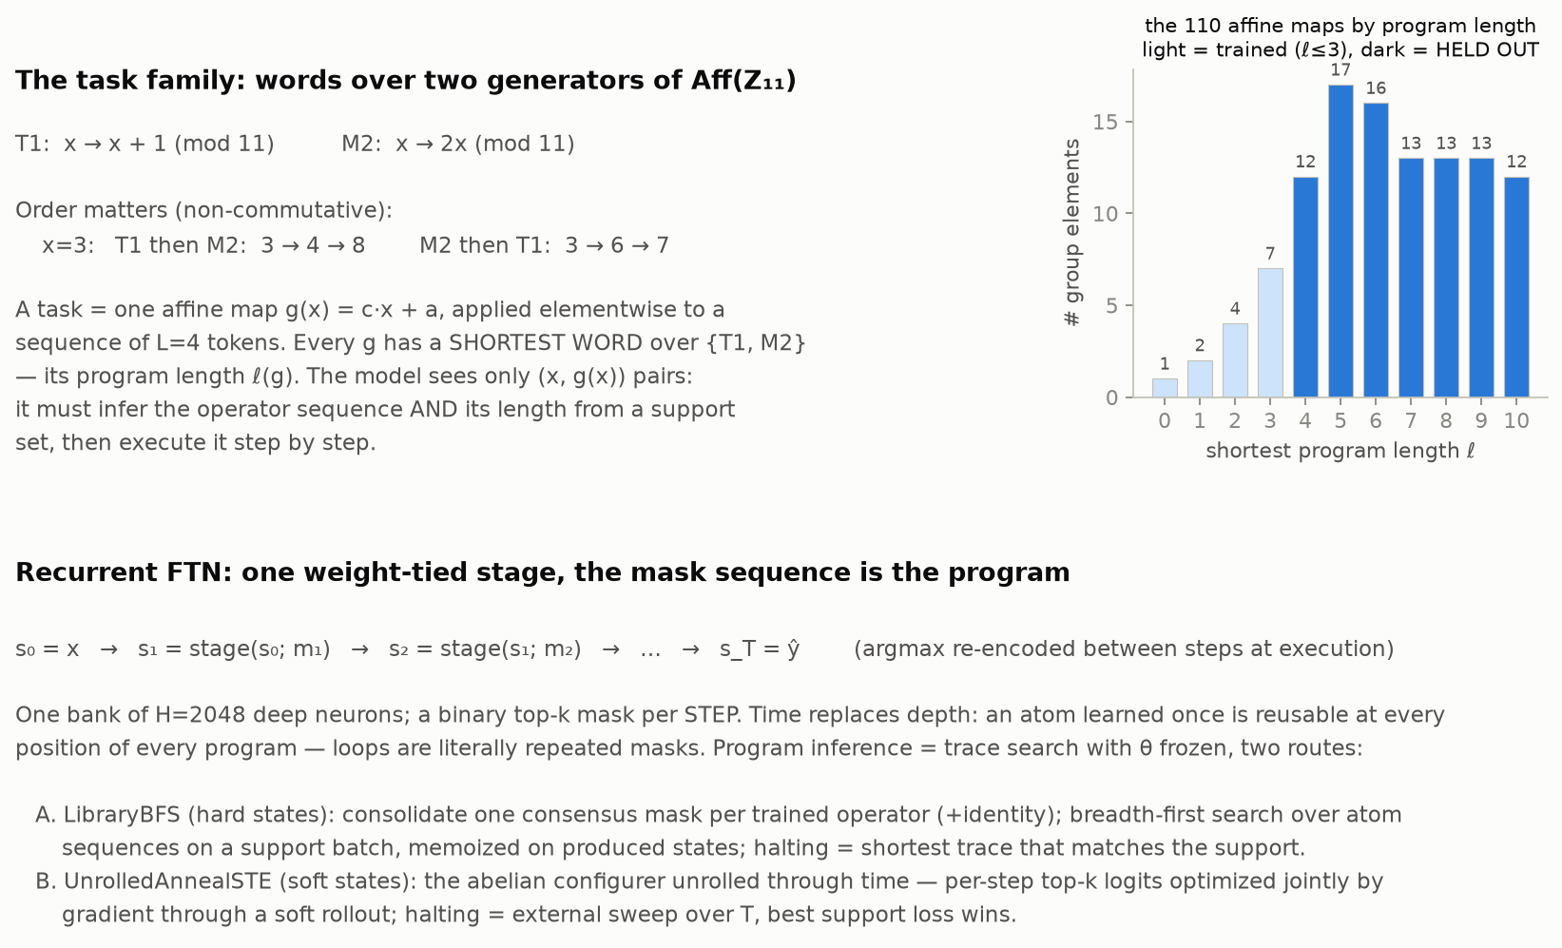
Task family and architecture

Slide 4
Training: two trainers, same block-sequential stream, no task identity
Stream: 14 tasks with shortest programs ℓ ≤ 3 (identity + generators + short composites), 3 cycles, curriculum by ℓ. 84 tasks with ℓ = 4…9 are never trained.
V1 — library / EM (hard states)
Atom blocks train like single FTN tasks (per-batch reconfig). Composite blocks alternate: E-step = BFS trace search over consolidated atom masks on a support batch; M-step = BPTT through the soft rollout with the trace's masks FIXED.
V2 — BPTT-configured (soft states, fully general)
Every batch: UnrolledAnnealSTE configures all per-step masks by gradient (length swept, no hints), then a weight step through the soft rollout. No library, no privileged atoms.
Program inference at evaluation (θ frozen, support only):
A. LibraryBFS — consensus atom masks; BFS memoized on support states; halting = shortest trace matching the support
B. UnrolledAnnealSTE — gradient trace search through soft rollouts; halting = external T-sweep, hard exact-match selects
C. GreedyGrow — library-free hill climbing, one step at a time; halting = saturation/patience
All three routes are pure spatial-selection-through-time: zero weight updates at evaluation, ever.

Slide 5
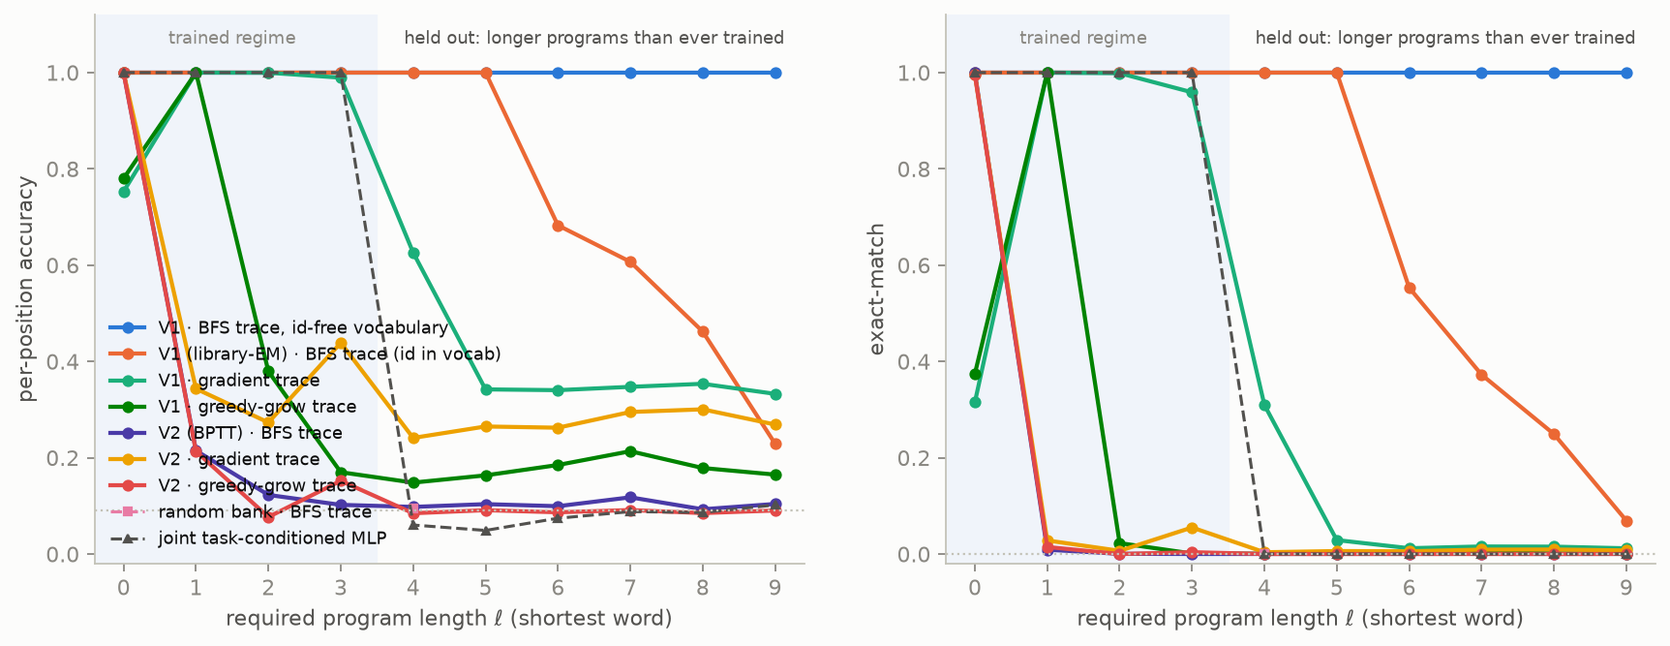
Headline: length generalization
accuracy vs required program length — shaded region is the training regime; everything right of it needs programs longer than any ever trained

Slide 6
Held-out tasks (ℓ = 4…9): the numbers
model · route | per-position | exact-match
v1 · library (id-free vocabulary, FINAL) | 1.000 | 1.000
v1 · library | 0.676 | 0.558
v1 · gradient | 0.383 | 0.059
v1 · greedy | 0.176 | 0.001
v2 · library | 0.103 | 0.000
v2 · gradient | 0.272 | 0.007
v2 · greedy | 0.088 | 0.000
random bank · library | 0.094 | —
joint task-conditioned MLP | 0.075 | 0.000
Trained-task retention after the full stream: library route 1.000 (V1) / 0.188 (V2).
Chance: 0.091 per position, ~7·10⁻⁵ exact-match.

Slide 7
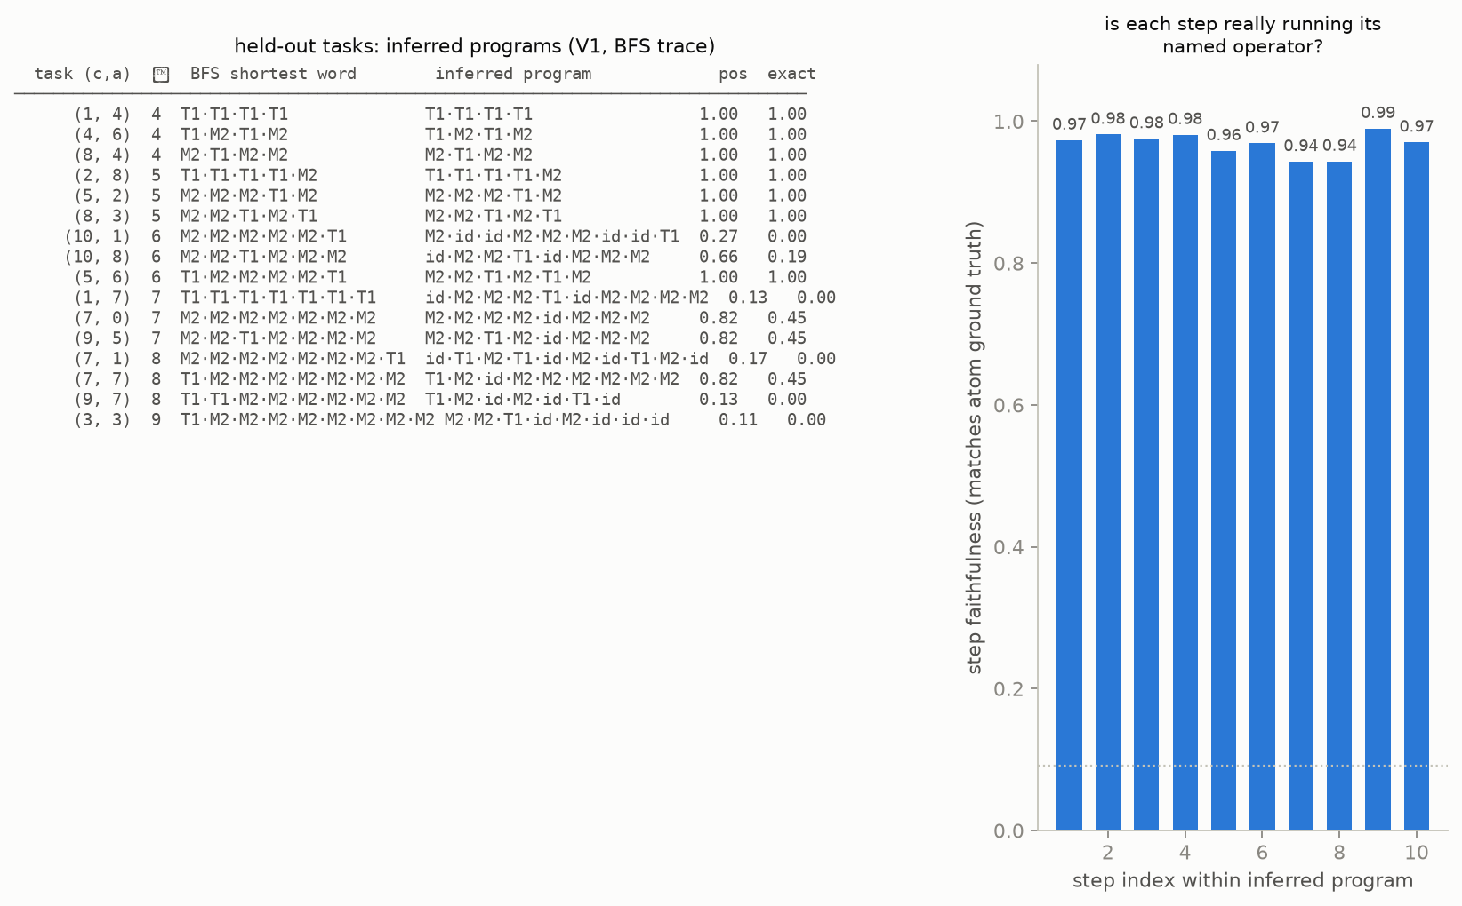
The inferred programs are symbolic, minimal, and correctly halted
Halting: 84/84 held-out tasks get EXACTLY the shortest-word length. Step faithfulness: each executed step matches its named operator's ground truth — the traces are real executions, not just right answers.

Slide 8
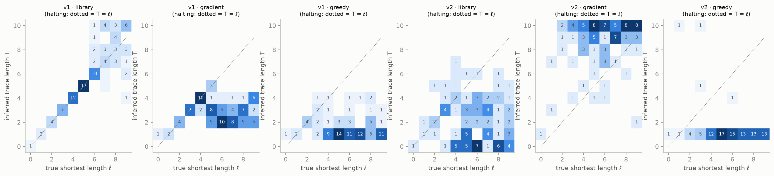
Halting: inferred trace length vs required program length

Slide 9
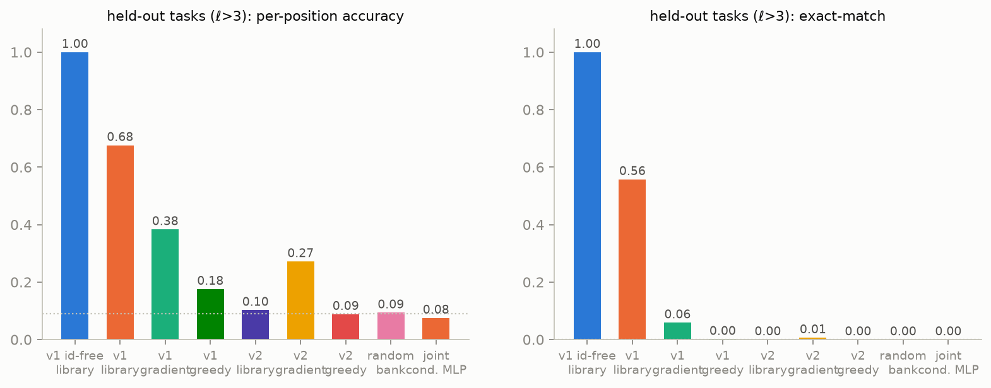
Three trace-inference routes: what works and why
LibraryBFS wins: consolidated atoms + memoized search = symbolic planning over learned operators. Perfect length generalization, exact halting.
Gradient trace search works on trained tasks and degrades with length — joint coupling across steps compounds; banks TRAINED under gradient configuration (V2) are markedly more gradient-searchable than V1's.
GreedyGrow fails: CE toward the final target is flat along partial programs — hill climbing has nothing to climb. Trace search needs either library structure or joint optimization; this negative is the evidence.

Slide 10
What this establishes
Established
• temporal selection works: a mask sequence over ONE weight-tied bank represents and executes non-commutative programs
• COMPLETE length generalization: 1.000/1.000 on all 84 never-trained programs, up to 3× the training horizon, from 32 examples
• autonomous halting, exact: inferred length = shortest-word length 84/84
• the traces are faithful symbolic programs (step-level verification)
• controls hold: random bank at chance; joint task-conditioned MLP at chance on held-out tasks
Open / next
• gradient-only trace search degrades with length — the algorithm-vs-execution-trace coupling Kevin predicted; library consolidation is the current fix, amortized/learned trace proposers the next step
• richer generator sets and non-group algorithms (conditionals, data-dependent branching)
• internal halting (halt atom / ponder signals) vs the current external verification
• trace libraries as task memory: prefix sharing as task similarity

Slide 11
Reproduction
# on the actl pod `nar`, from /home/dev/workspace/temporal
uv run python run_temporal.py --config full --run main --variant both
uv run --with python-pptx --with pillow python scripts/make_deck.py main
Code: temporal/ftn_temporal/{config, tasks, model, configurer, train, evals, viz}.py — shared primitives in nar/ftn_core/.
Artifacts: temporal/results/<run>/ (models, results.json, train_log, figures).
Repo: github.com/Astera-org/functional_task_networks

