Slide 1
Hidden Markov Models for Decision Processes Part 1. Mice alternate between discrete strategies during perceptual decision-making Part 2. Hierarchical Hidden Markov Models with State Prediction

Slide 2
Mice alternate between discrete strategies during perceptual decision-making
Zoe C. Ashwood , Nicholas A. Roy, Iris R. Stone , The International Brain Laboratory, Anne E. Urai, Anne K. Churchland, Alexandre Pouget and Jonathan W. Pillow

Slide 3
Aims
Determine whether multiple underlying decision-making strategies are at play.
Test whether “lapse” behavior reflects alternative strategies.

Slide 4
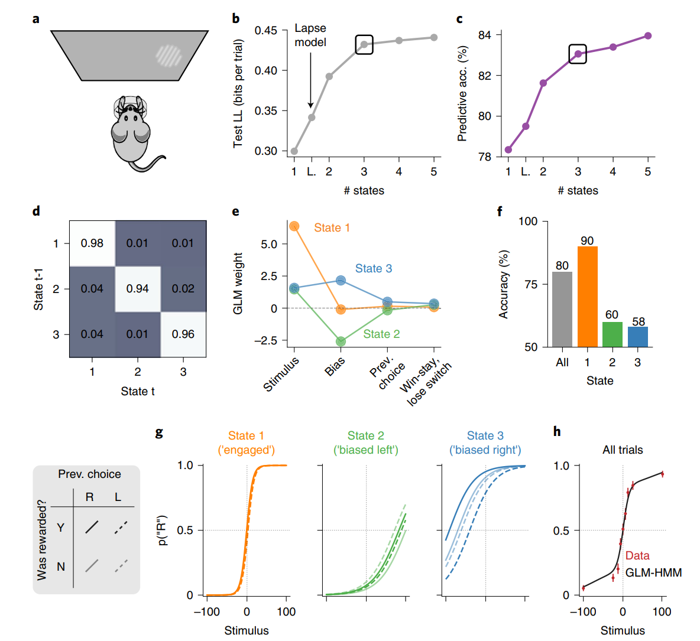
Task Data
Visual detection decision-making
Pattern with contrast 0-100% appears left / right
Correct: Water
Incorrect: Noise burst, 1s timeout
Trial 1-90, 50/50 chance
Trial >90, 80/20 blocks of 20-100
Data
N=37 mice
Used only first 90 trials from mice with 3000+ trial training

Slide 5
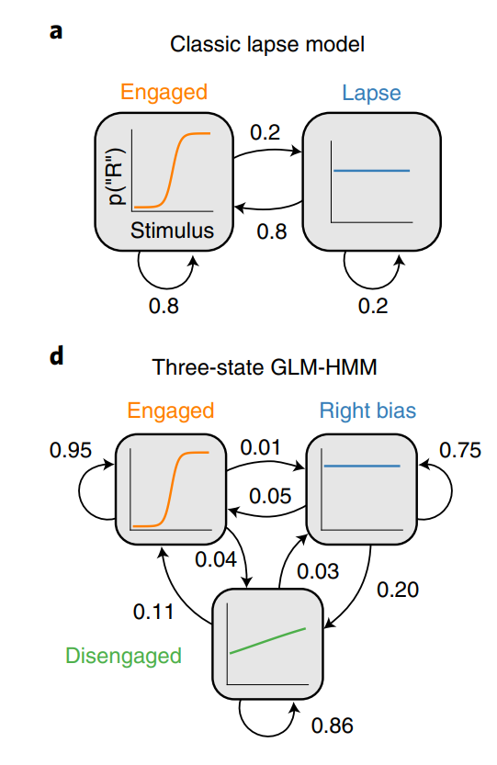
Hidden Markov Model
2-part structure:
Between strategy: Markov Chain
k strategies
k x k Transition matrix
Within strategy: GLM
Inputs:
Stimulus
Bias
Previous choice
Win-stay lose-switch (previous stimulus)

Slide 6
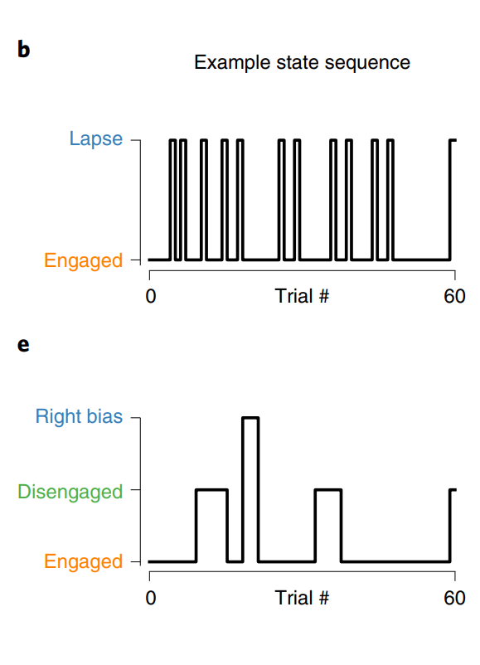
Hidden Markov Model
2-part structure:
Between strategy: Markov Chain
k strategies
k x k Transition matrix
Within strategy: GLM
Inputs:
Stimulus
Bias
Previous choice
Win-stay lose-switch (previous stimulus)

Slide 7
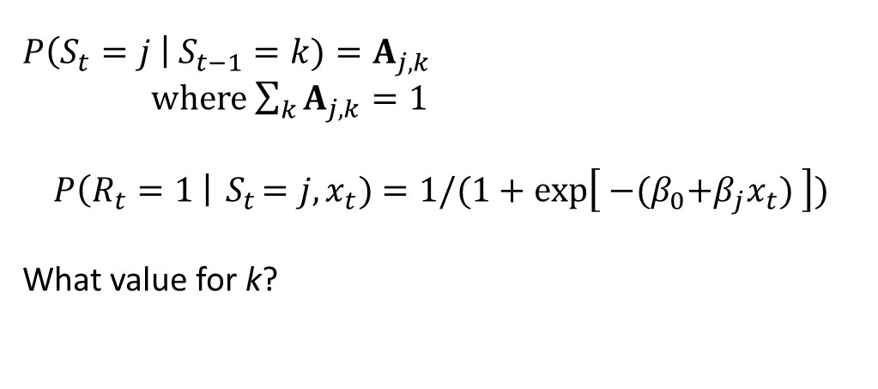

Hidden Markov Model
2-part structure:
Between strategy: Markov Chain
k strategies
k x k Transition matrix
Within strategy: GLM
Inputs:
Stimulus
Bias
Previous choice
Win-stay lose-switch (previous stimulus)
$$P\left(S_{t}=j \right| S_{t−1}=k)=A_{j,k}$$
where $\sum_{k}{A_{j,k}}=1$
$$P\left(R_{t}=1 \right|{ S}_{t}=j, x_{t})=1/(1+\exp\left[{ −(β}_{0}+β_{j}x_{t}) \right])$$
What value for k?
$A$ matrix
Logistic regressions

Slide 8
Results (Mouse)
3 states (strategies) best
Engaged
Biased left
Biased right

Slide 9
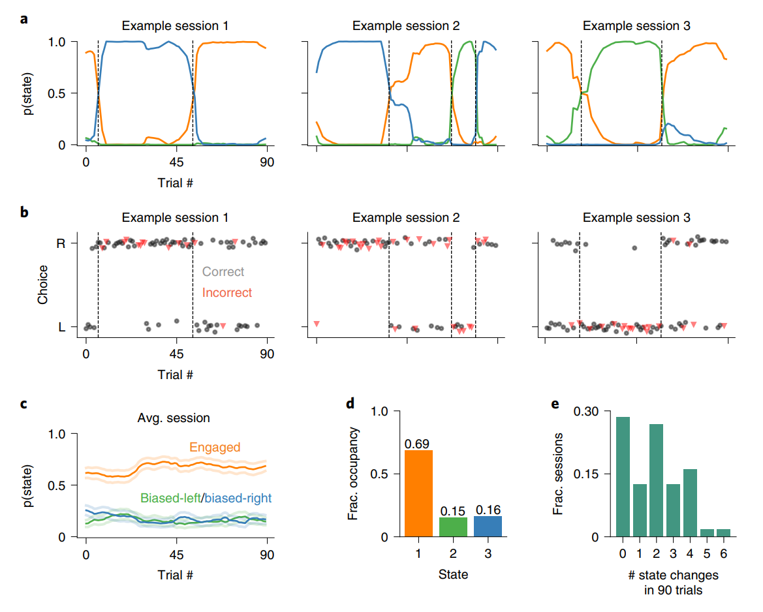
Results (Mouse)

Slide 10
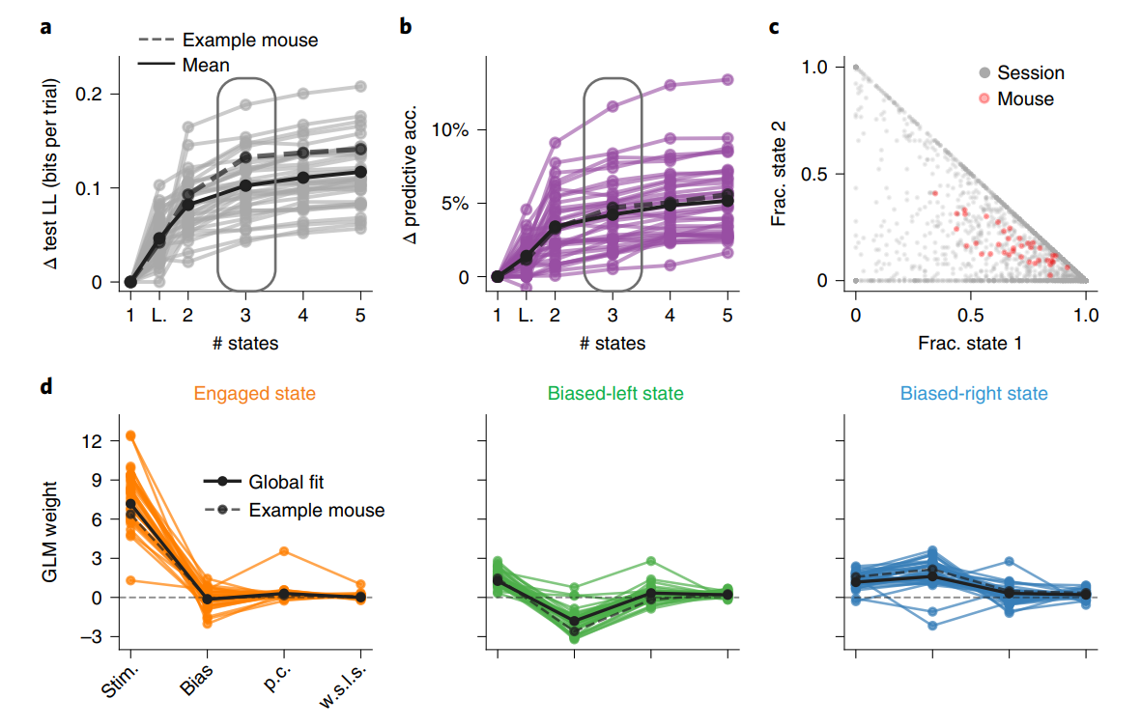
Results (Mouse)

Slide 11
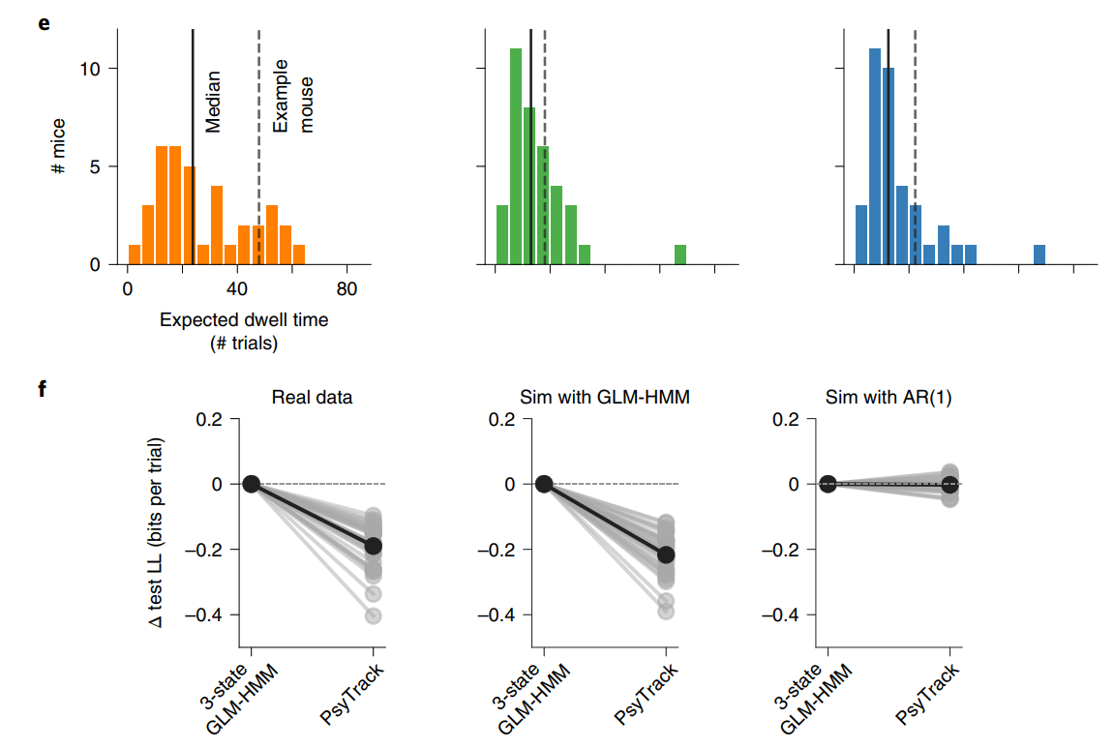
Results (Mouse)
Psytrack: GLM with drifting weights
Compared discrete vs continuous decision states.

Slide 12
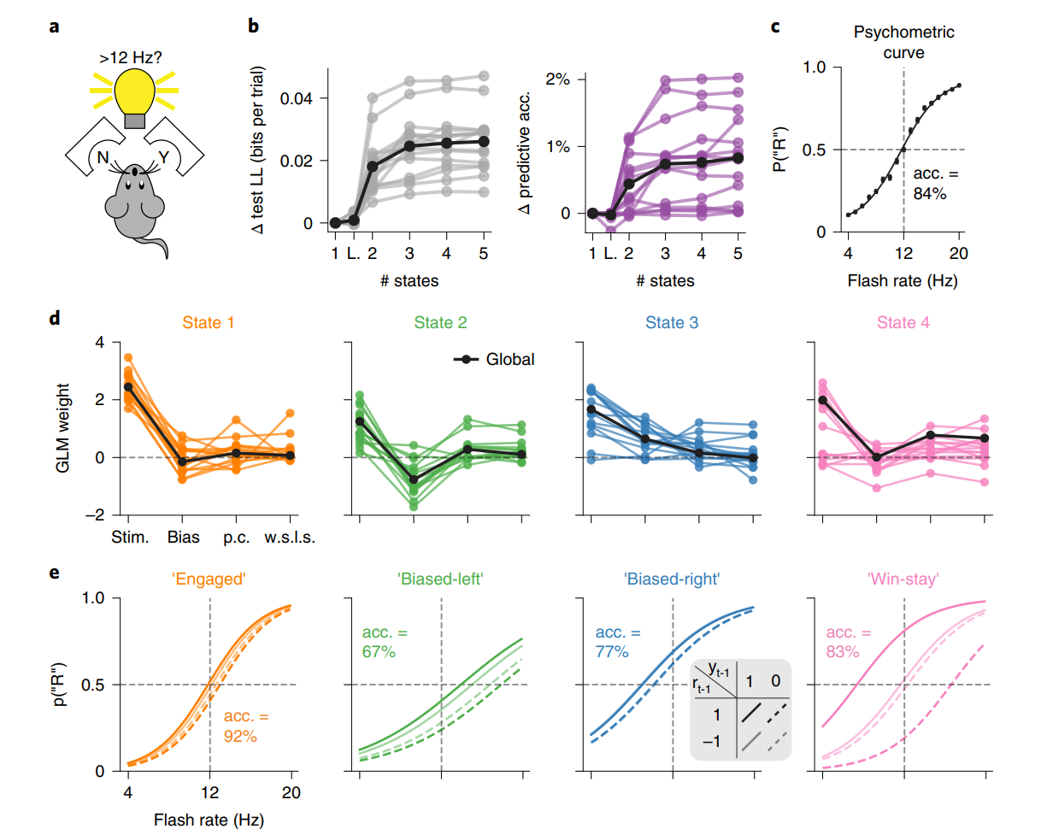
Task Data
Light flash above or below 12hz?
Poke left (Yes) or right (No)
N=15 mice
T>200 trials per mouse

Slide 13
Results (Mouse)

Slide 14
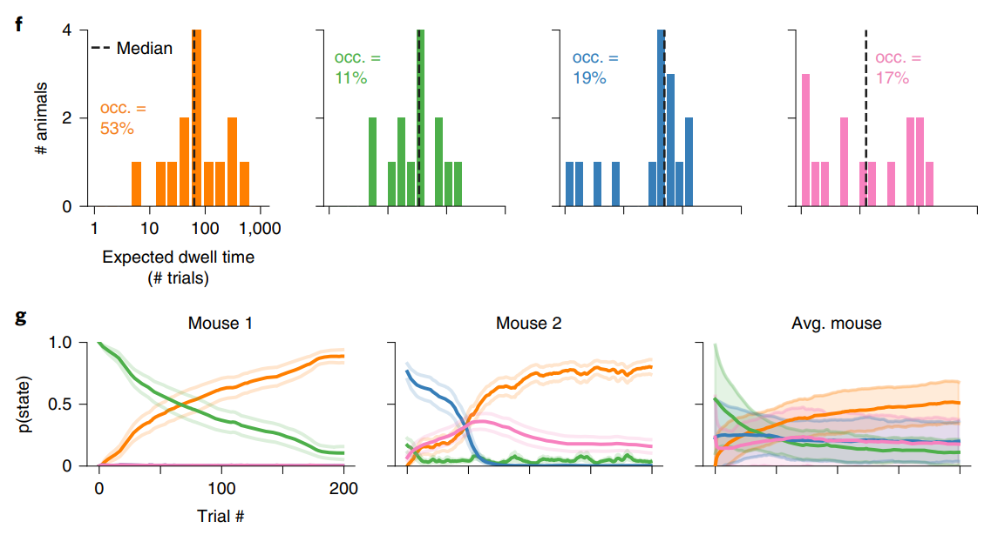
Results (Mouse)

Slide 15
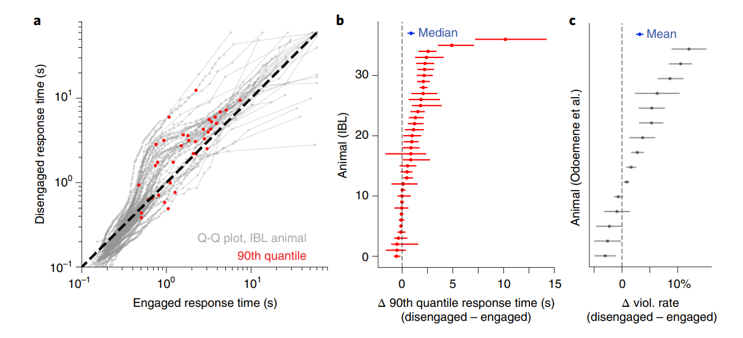
Results (Mouse)

Slide 16
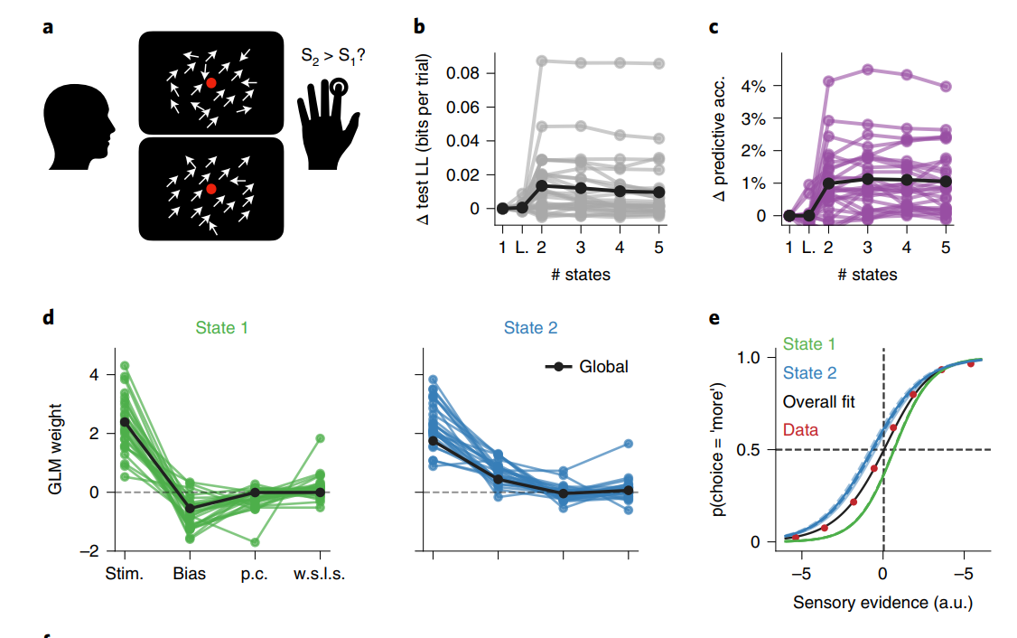
Human data
Visual motion discrimination
First diagram: 70% motion coherence
Second diagram: Random
Press button to indicate which more coherent
Data
27 humans
Median session length: 500 trials

Slide 17
Results (Human)
Task
Model fit (likelihood)
Modle fit (prediction)
State 1 weights
Motion coherence (Stim)
Bias
Prev. choice (p.c.)
Reward*Choice (w.s.l.s)
State 2 weights
e. Sensory evidence

Slide 18
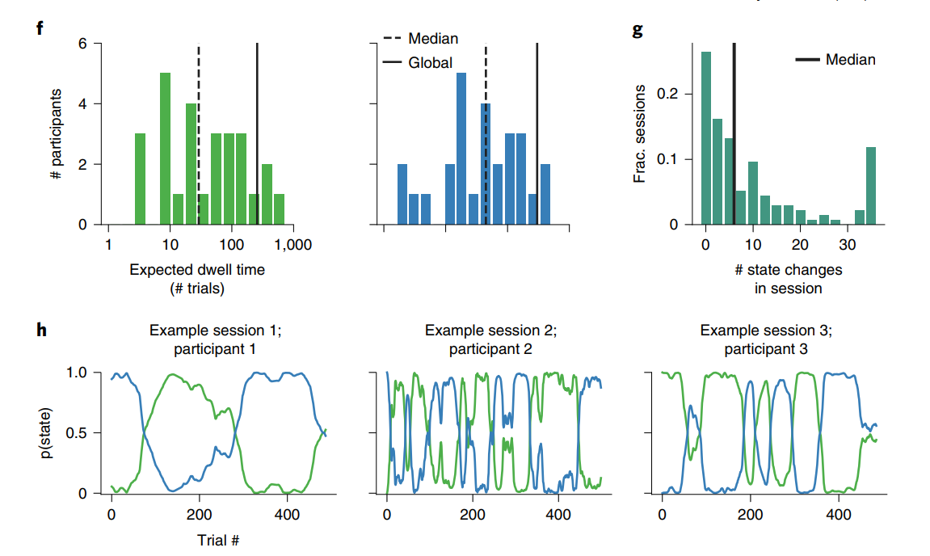
Results (Human)
Dwell time
State 1 (blue)
State 2 (green)
State changes
Example state probabilities

Slide 19
Hierarchical Hidden Markov Models with State Prediction
Kevin McKee klmckee@ucdavis.edu

Slide 20
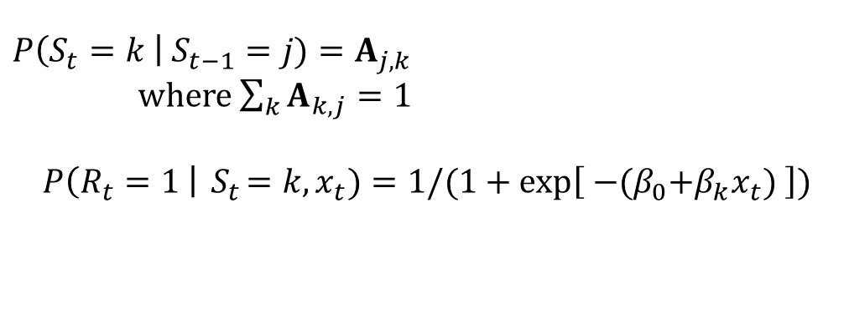

Hidden Markov Model
Logistic regressions
$A$ matrix
$$P\left(S_{t}=k \right| S_{t−1}=j)=A_{j,k}$$
where $\sum_{k}{A_{k,j}}=1$
$$P\left(R_{t}=1 \right|{ S}_{t}=k, x_{t})=1/(1+\exp\left[{ −(β}_{0}+β_{k}x_{t}) \right])$$
Base model:
Hidden states give rise to
observed patterns.

Slide 21
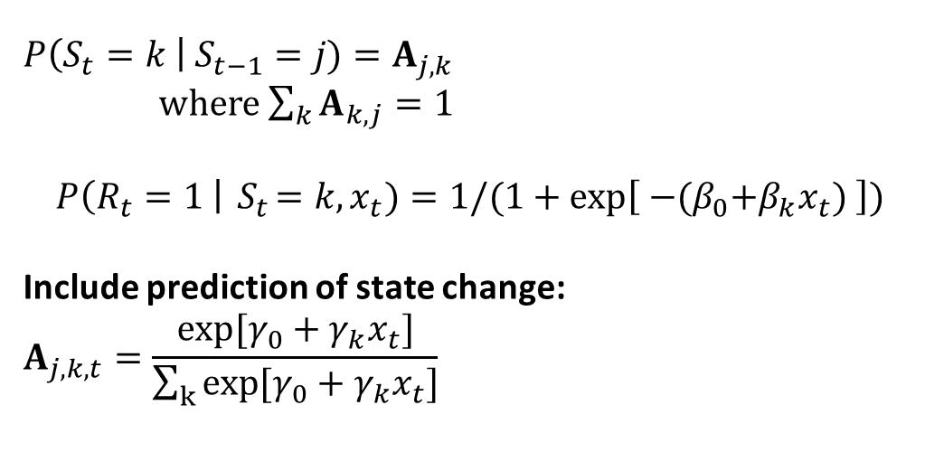
Hidden Markov Model
Logistic regressions
$A$ matrix
$$P\left(S_{t}=k \right| S_{t−1}=j)=A_{j,k}$$
where $\sum_{k}{A_{k,j}}=1$
$$P\left(R_{t}=1 \right|{ S}_{t}=k, x_{t})=1/(1+\exp\left[{ −(β}_{0}+β_{k}x_{t}) \right])$$
Include prediction of state change:
$$A_{j,k,t}=\frac{exp[γ_{0}+γ_{k}x_{t}]}{\sum_{k}{exp[γ_{0}+γ_{k}x_{t}]}}$$
Extended model:
Hidden states predicted using
covariate information.

Slide 22
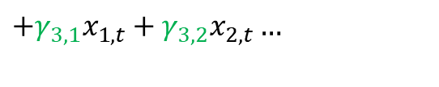
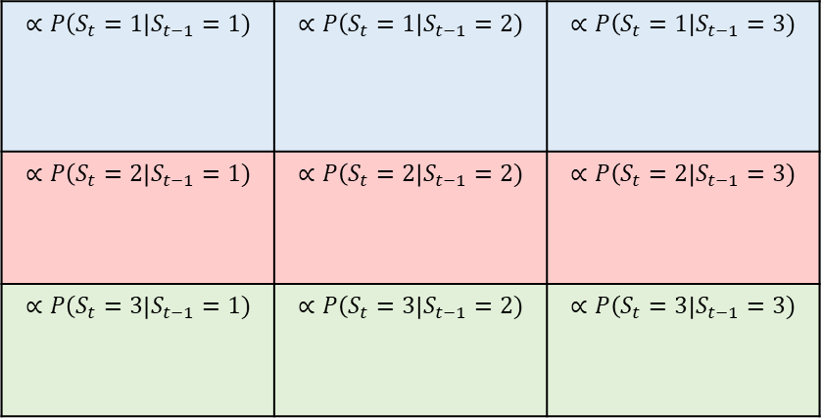
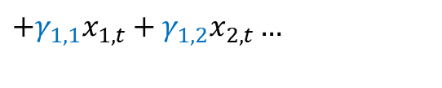
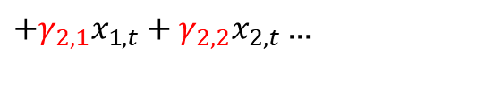
Predicting states
Including multinomial regression in the transition matrix (A):
Add covariate effects to rows:
$$∝P\left(S_{t}=1\right|S_{t−1}=1)$$ | $$∝P\left(S_{t}=1\right|S_{t−1}=2)$$ | $$∝P\left(S_{t}=1\right|S_{t−1}=3)$$
$$∝P\left(S_{t}=2\right|S_{t−1}=1)$$ | $$∝P\left(S_{t}=2\right|S_{t−1}=2)$$ | $$∝P\left(S_{t}=2\right|S_{t−1}=3)$$
$$∝P\left(S_{t}=3\right|S_{t−1}=1)$$ | $$∝P\left(S_{t}=3\right|S_{t−1}=2)$$ | $$∝P\left(S_{t}=3\right|S_{t−1}=3)$$
$$+γ_{1,1}x_{1,t}+γ_{1,2}x_{2,t}…$$
$$+γ_{2,1}x_{1,t}+γ_{2,2}x_{2,t}…$$
$$+γ_{3,1}x_{1,t}+γ_{3,2}x_{2,t}…$$

Slide 23
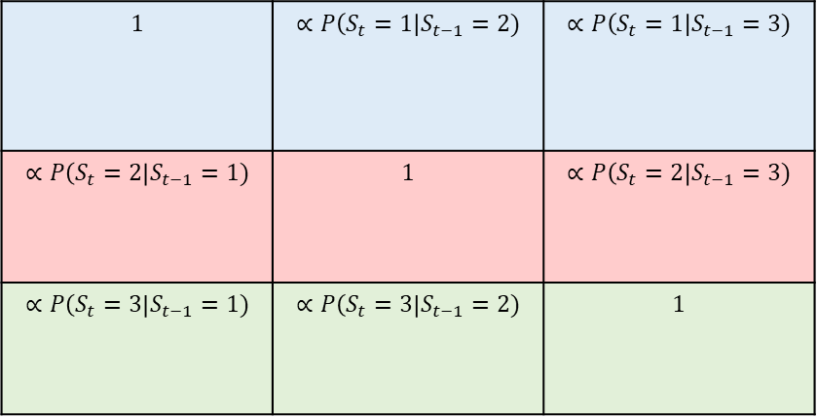
Predicting states
Including multinomial regression in the transition matrix (A):
Need to constrain reference transition cells. Fixed diagonals are one option:
$$1$$ | $$∝P\left(S_{t}=1\right|S_{t−1}=2)$$ | $$∝P\left(S_{t}=1\right|S_{t−1}=3)$$
$$∝P\left(S_{t}=2\right|S_{t−1}=1)$$ | $$1$$ | $$∝P\left(S_{t}=2\right|S_{t−1}=3)$$
$$∝P\left(S_{t}=3\right|S_{t−1}=1)$$ | $$∝P\left(S_{t}=3\right|S_{t−1}=2)$$ | $$1$$
$$+γ_{1,1}x_{1,t}+γ_{1,2}x_{2,t}…$$
$$+γ_{2,1}x_{1,t}+γ_{2,2}x_{2,t}…$$
$$+γ_{3,1}x_{1,t}+γ_{3,2}x_{2,t}…$$

Slide 24
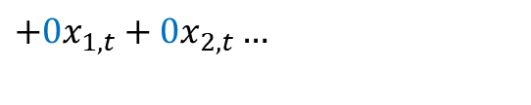
Predicting states
Including multinomial regression in the transition matrix (A):
Need to constrain reference covariate effects. Can fix first set of effects to zero:
$$1$$ | $$∝P\left(S_{t}=1\right|S_{t−1}=2)$$ | $$∝P\left(S_{t}=1\right|S_{t−1}=3)$$
$$∝P\left(S_{t}=2\right|S_{t−1}=1)$$ | $$1$$ | $$∝P\left(S_{t}=2\right|S_{t−1}=3)$$
$$∝P\left(S_{t}=3\right|S_{t−1}=1)$$ | $$∝P\left(S_{t}=3\right|S_{t−1}=2)$$ | $$1$$
$$+0x_{1,t}+0x_{2,t}…$$
$$+γ_{2,1}x_{1,t}+γ_{2,2}x_{2,t}…$$
$$+γ_{3,1}x_{1,t}+γ_{3,2}x_{2,t}…$$

Slide 25

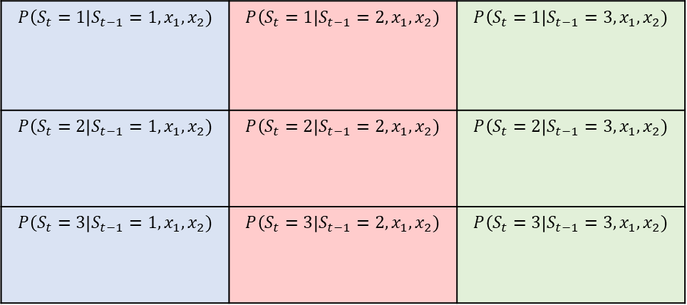
Predicting states
Including multinomial regression in the transition matrix (A):
Normalize final columns to get probabilities conditional on $x_{1}, x_{2}$:
$$P\left(S_{t}=1\right|S_{t−1}=1,x_{1}, x_{2})$$ | $$P\left(S_{t}=1\right|S_{t−1}=2,x_{1}, x_{2})$$ | $$P\left(S_{t}=1\right|S_{t−1}=3,x_{1}, x_{2})$$
$$P\left(S_{t}=2\right|S_{t−1}=1,x_{1}, x_{2})$$ | $$P\left(S_{t}=2\right|S_{t−1}=2,x_{1}, x_{2})$$ | $$P\left(S_{t}=2\right|S_{t−1}=3,x_{1}, x_{2})$$
$$P\left(S_{t}=3\right|S_{t−1}=1,x_{1}, x_{2})$$ | $$P\left(S_{t}=3\right|S_{t−1}=2,x_{1}, x_{2})$$ | $$P\left(S_{t}=3\right|S_{t−1}=3,x_{1}, x_{2})$$

Slide 26

Hidden Markov Model
$$P\left(S_{i,t}=k \right| S_{i,t−1}=j)=A_{i,j,k}$$
where $\sum_{k}{A_{i,k,j}}=1$
$$P\left(R_{i,t}=1 \right|{ S}_{i,t}=k, x_{i,t})=1/(1+\exp\left[{ −(β}_{i,0}+β_{i,k}x_{i,t}) \right])$$
Include prediction of state change:
$$A_{i,j,k,t}=\frac{exp[γ_{i,0}+γ_{i,k}x_{i,t}]}{\sum_{k}{exp[γ_{i,0}+γ_{i,k}x_{i,t}]}}$$
Hierarchical priors:
$$β_{i,k}∼N\left(β_{μ,k}, β_{σ,k}\right)$$
$$β_{i,k}∼N(β_{μ,k}, β_{σ,k})$$
$$γ_{i,k}∼N\left(γ_{μ,k}, γ_{σ,k}\right)$$
$$γ_{i,k}∼N(γ_{μ,k}, γ_{σ,k})$$
Hierarchical model:
Leverage group avg. to identify
individual parameters.

Slide 27
Hidden Markov Model
Other possible models:
-No information to predict state transitions?
- Predict by “dwell time”
- Predict by real time / trial number
- Cumulative values of covariates, rewards, etc.

Slide 28
Hidden Markov Model
Other possible models:
- Predict subject-level parameters / effects?
- Condition the hierarchical priors on subject-level covariates
-e.g., does age predict strategy?
- Model correlations among parameters
-e.g., twin correlations for genetic/environmental influence on lapsing probability.

Slide 29
Hidden Markov Model
Other possible models:
-Predict number of sub-models / strategies?
- Difficult but possible!

