Slide 1
Mice alternate between discrete strategies during perceptual decision-making
Zoe C. Ashwood , Nicholas A. Roy, Iris R. Stone , The International Brain Laboratory, Anne E. Urai, Anne K. Churchland, Alexandre Pouget and Jonathan W. Pillow

Slide 2
Aims
Determine whether multiple underlying decision-making strategies are at play.
Test whether “lapse” behavior reflects alternative strategies.

Slide 3
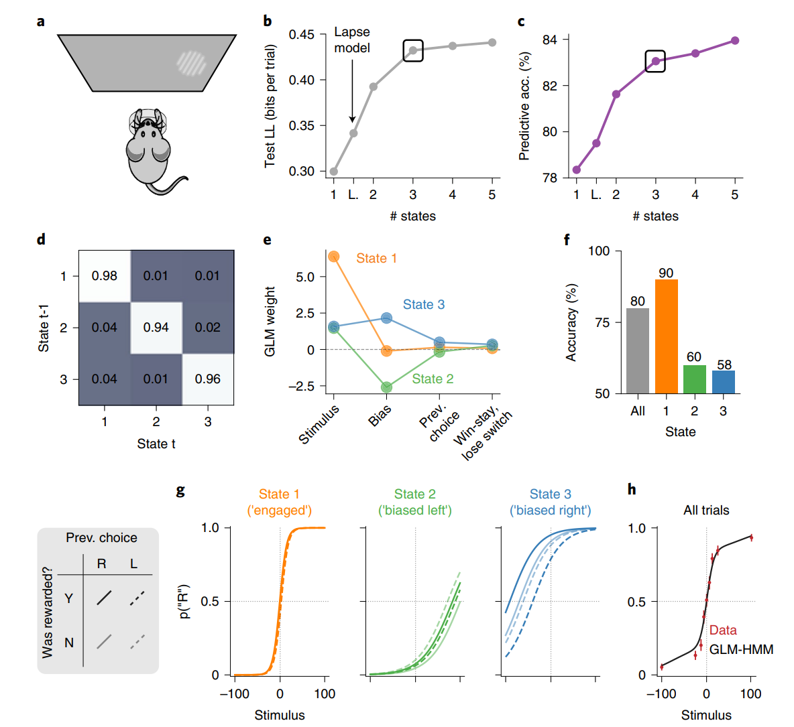
Task Data
Visual detection decision-making
Pattern with contrast 0-100% appears left / right
Correct: Water
Incorrect: Noise burst, 1s timeout
Trial 1-90, 50/50 chance
Trial >90, 80/20 blocks of 20-100
Data
N=37 mice
Used only first 90 trials from mice with 3000+ trial training

Slide 4
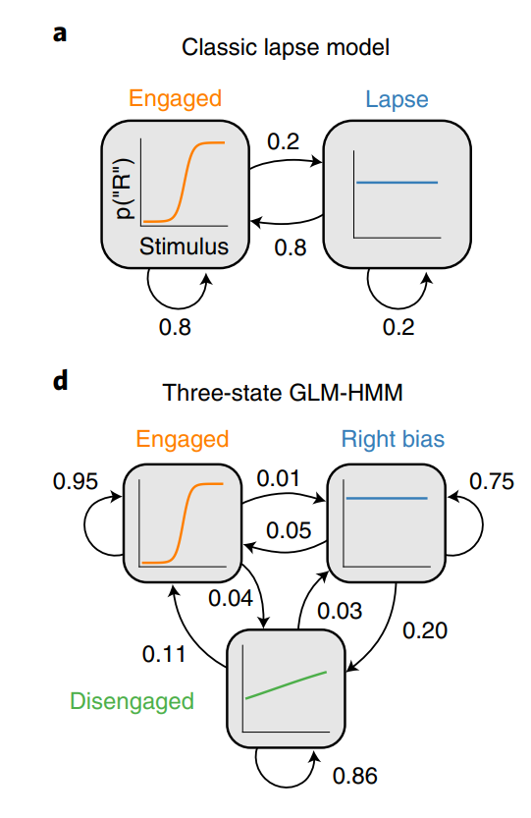
Hidden Markov Model
2-part structure:
Between strategy: Markov Chain
k strategies
k x k Transition matrix
Within strategy: GLM
Inputs:
Stimulus
Bias
Previous choice
Win-stay lose-switch

Slide 5
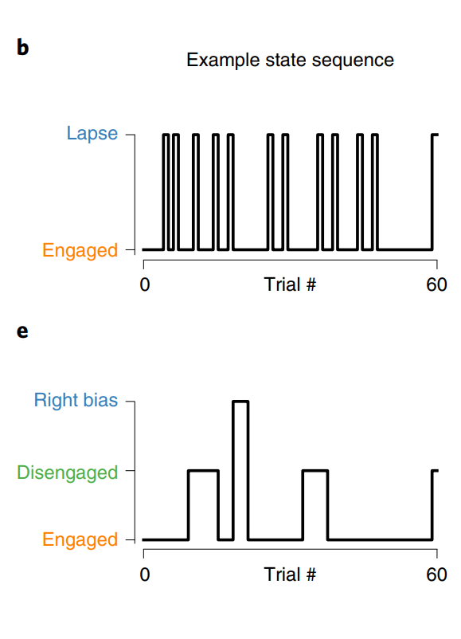
Hidden Markov Model
2-part structure:
Between strategy: Markov Chain
k strategies
k x k Transition matrix
Within strategy: GLM
Inputs:
Stimulus
Bias
Previous choice
Win-stay lose-switch

Slide 6
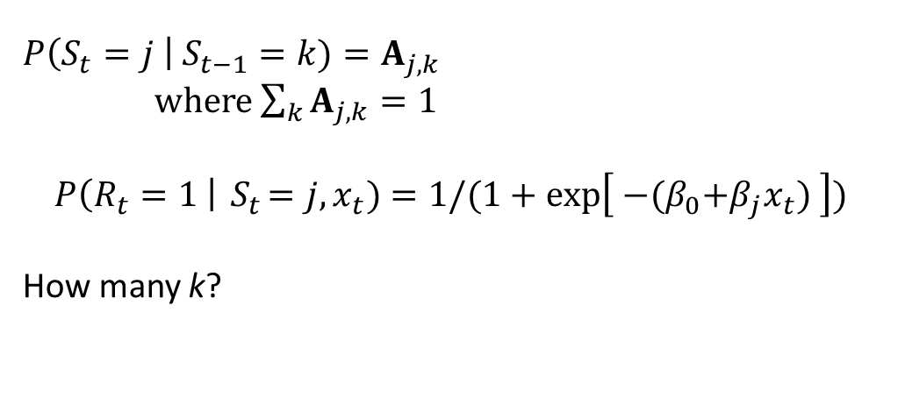
Hidden Markov Model
2-part structure:
Between strategy: Markov Chain
k strategies
k x k Transition matrix
Within strategy: GLM
Inputs:
Stimulus
Bias
Previous choice
Win-stay lose-switch
$$P\left(S_{t}=j \right| S_{t−1}=k)=A_{j,k}$$
where $\sum_{k}{A_{j,k}}=1$
$$P\left(R_{t}=1 \right|{ S}_{t}=j, x_{t})=1/(1+\exp\left[{ −(β}_{0}+β_{j}x_{t}) \right])$$
How many k?

Slide 7
Results (Mouse)
3 states (strategies) best
Engaged
Biased left
Biased right

Slide 8
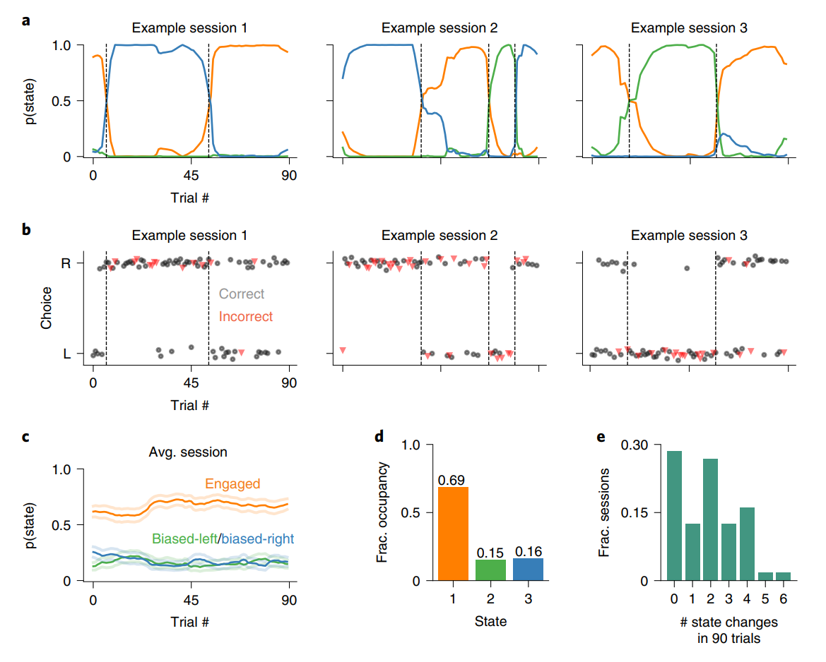
Results (Mouse)

Slide 9
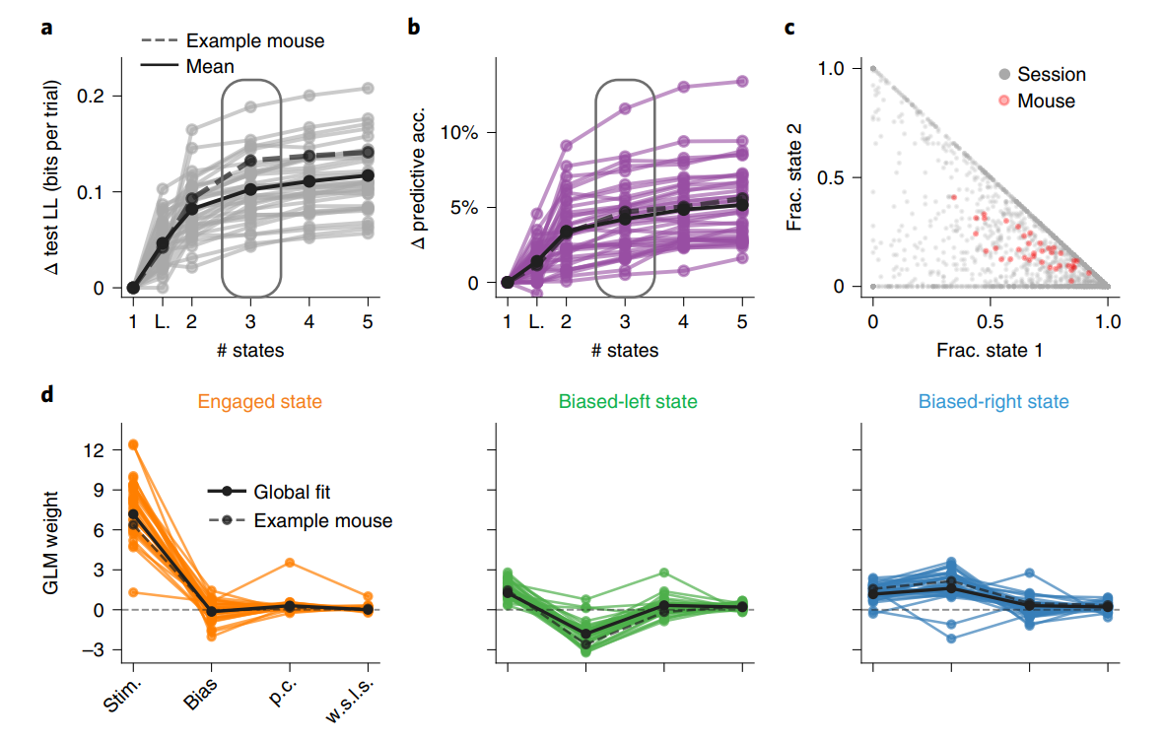
Results (Mouse)

Slide 10
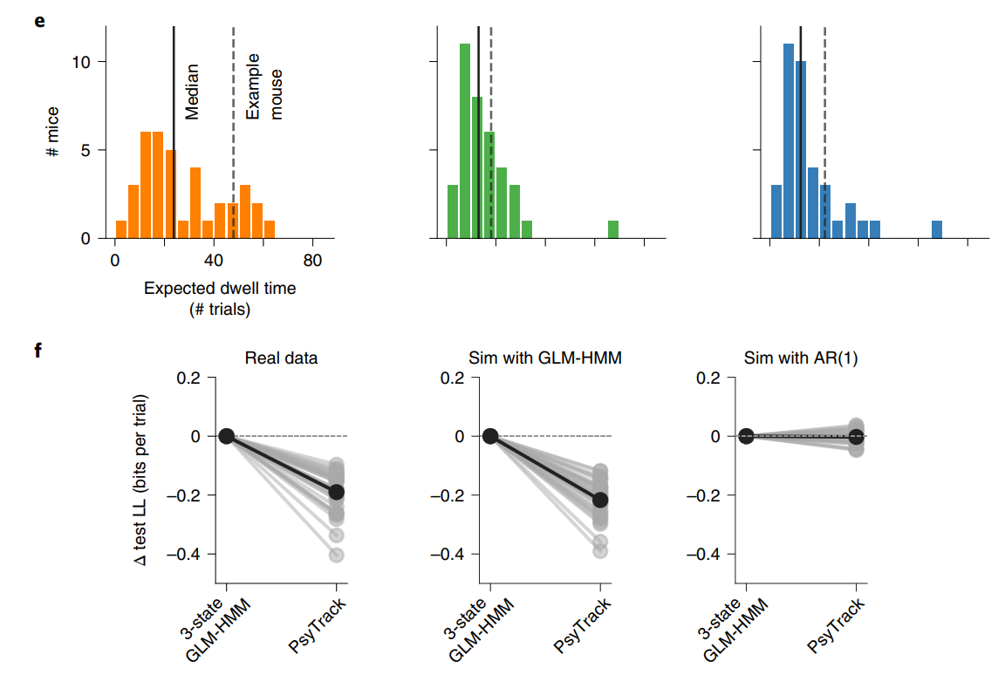
Results (Mouse)
Psytrack: GLM with drifting weights
Compared discrete vs continuous decision states.

Slide 11
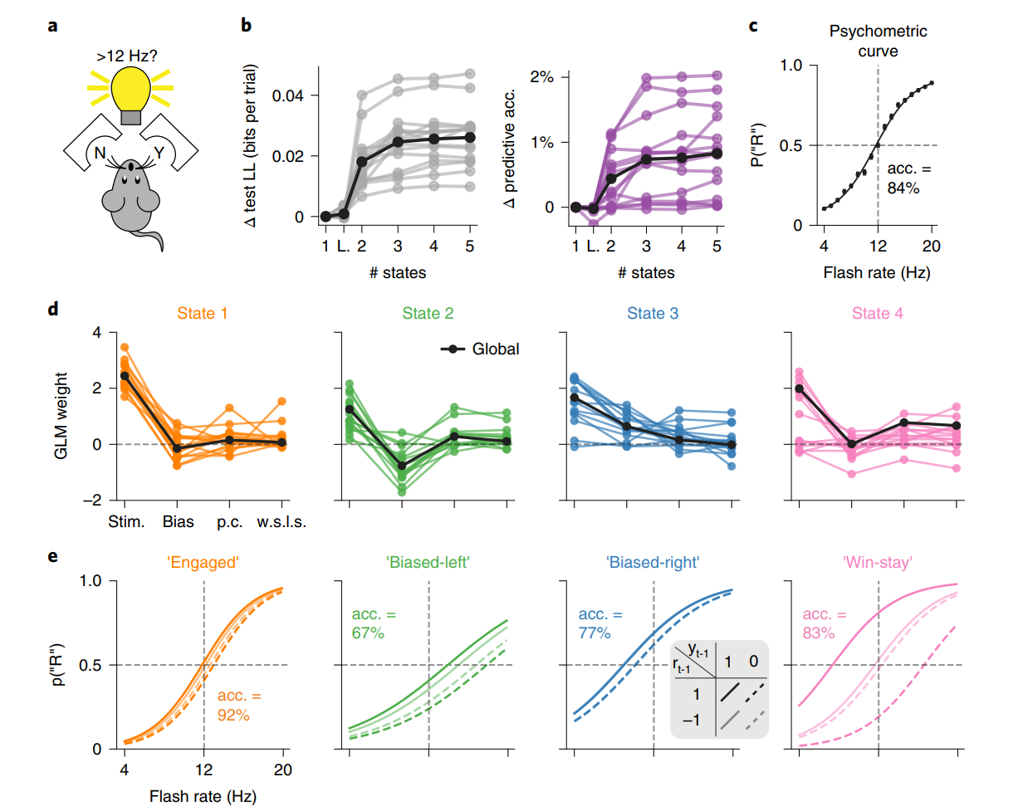
Task Data
Light flash above or below 12hz?
Poke left (Yes) or right (No)
N=15 mice
T>200 trials per mouse

Slide 12
Results (Mouse)

Slide 13
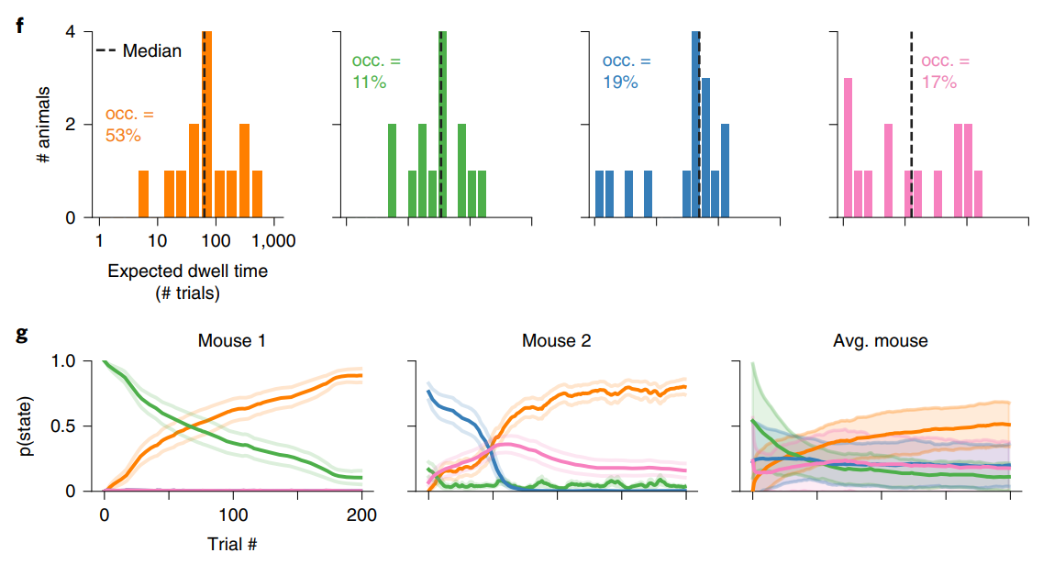
Results (Mouse)

Slide 14
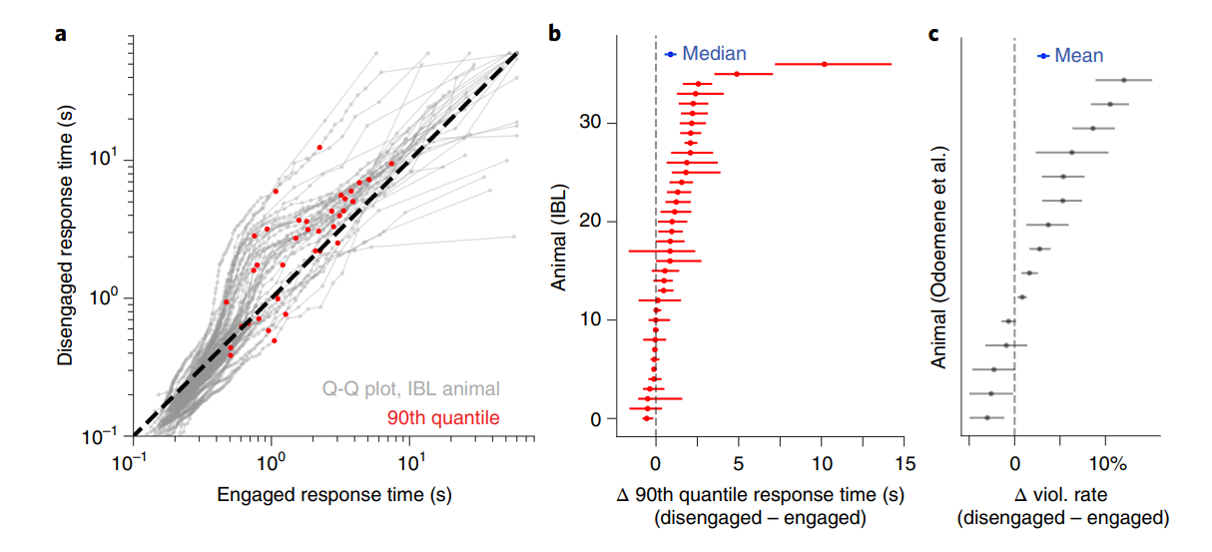
Results (Mouse)

Slide 15
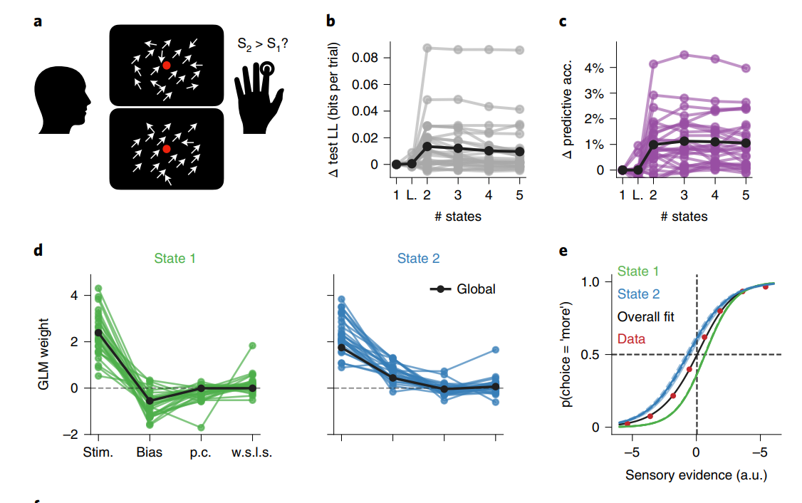
Human data
Visual motion discrimination
First diagram: 70% motion coherence
Second diagram: Random
Press button to indicate which more coherent
Data
27 humans
Median session length: 500 trials

Slide 16
Results (Human)
Task
Model fit (likelihood)
Modle fit (prediction)
State 1 weights
Motion coherence (Stim)
Bias
Prev. choice (p.c.)
Reward*Choice (w.s.l.s)
State 2 weights
e. Sensory evidence

Slide 17
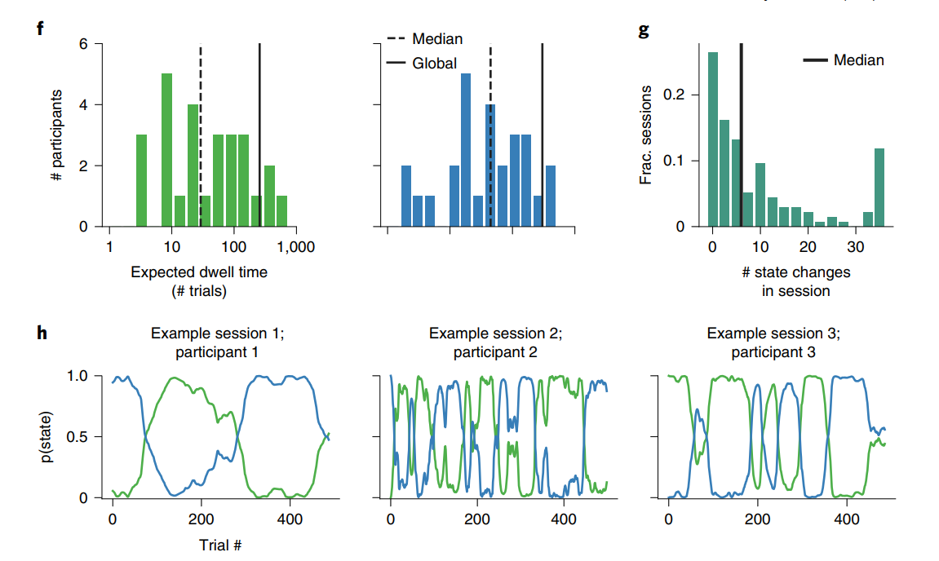
Results (Human)
Dwell time
State 1 (blue)
State 2 (green)
State changes
Example state probabilities

Slide 18
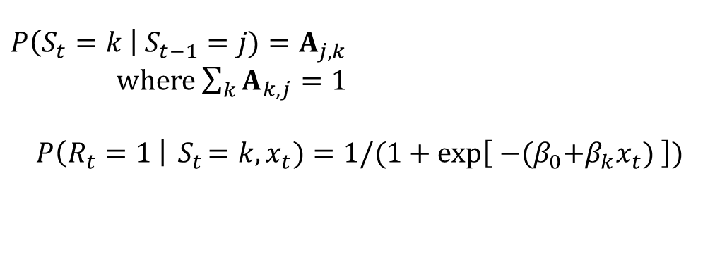
Possible model extensions
$$P\left(S_{t}=k \right| S_{t−1}=j)=A_{j,k}$$
where $\sum_{k}{A_{k,j}}=1$
$$P\left(R_{t}=1 \right|{ S}_{t}=k, x_{t})=1/(1+\exp\left[{ −(β}_{0}+β_{k}x_{t}) \right])$$
Base model:

Slide 19
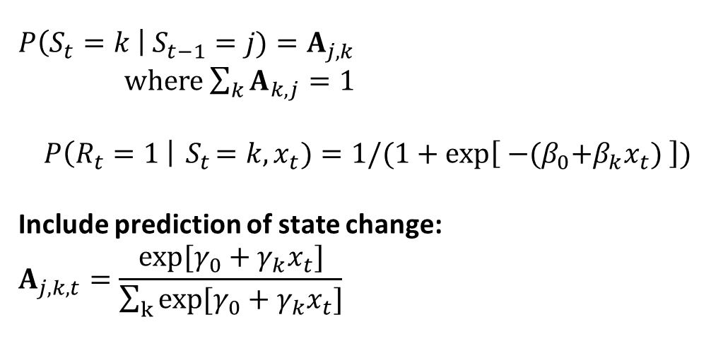
Possible model extensions
$$P\left(S_{t}=k \right| S_{t−1}=j)=A_{j,k}$$
where $\sum_{k}{A_{k,j}}=1$
$$P\left(R_{t}=1 \right|{ S}_{t}=k, x_{t})=1/(1+\exp\left[{ −(β}_{0}+β_{k}x_{t}) \right])$$
Include prediction of state change:
$$A_{j,k,t}=\frac{exp[γ_{0}+γ_{k}x_{t}]}{\sum_{k}{exp[γ_{0}+γ_{k}x_{t}]}}$$
State change sparse, persistent

Slide 20

Possible model extensions
$$P\left(S_{i,t}=k \right| S_{i,t−1}=j)=A_{i,j,k}$$
where $\sum_{k}{A_{i,k,j}}=1$
$$P\left(R_{i,t}=1 \right|{ S}_{i,t}=k, x_{i,t})=1/(1+\exp\left[{ −(β}_{i,0}+β_{i,k}x_{i,t}) \right])$$
Include prediction of state change:
$$A_{i,j,k,t}=\frac{exp[γ_{i,0}+γ_{i,k}x_{i,t}]}{\sum_{k}{exp[γ_{i,0}+γ_{i,k}x_{i,t}]}}$$
Hierarchical priors:
$$β_{i,k}∼N\left(β_{μ,k}, β_{σ,k}\right)$$
$$β_{i,k}∼N(β_{μ,k}, β_{σ,k})$$
$$γ_{i,k}∼N\left(γ_{μ,k}, γ_{σ,k}\right)$$
$$γ_{i,k}∼N(γ_{μ,k}, γ_{σ,k})$$
State change sparse, persistent
Hierarchical model:

