Slide 1
Introducing NHibernate 3
Rock Solid Data Access
Kevin McKelvin
kevin@mcdev.za.net
@kmckelvin
www.mcdev.za.net

Slide 2


The Problems
SQL Injection
The Impedance Mismatch
Objects
(Hierarchical)
Rows
(Relational)

Slide 3
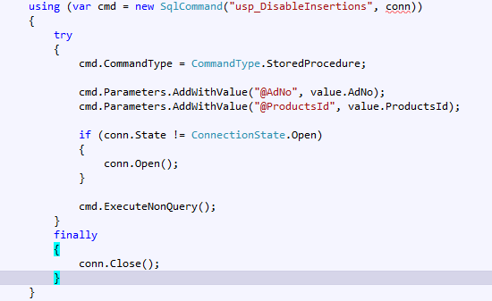
My Biggest Pet-Peeve
Boilerplate Code

Slide 4
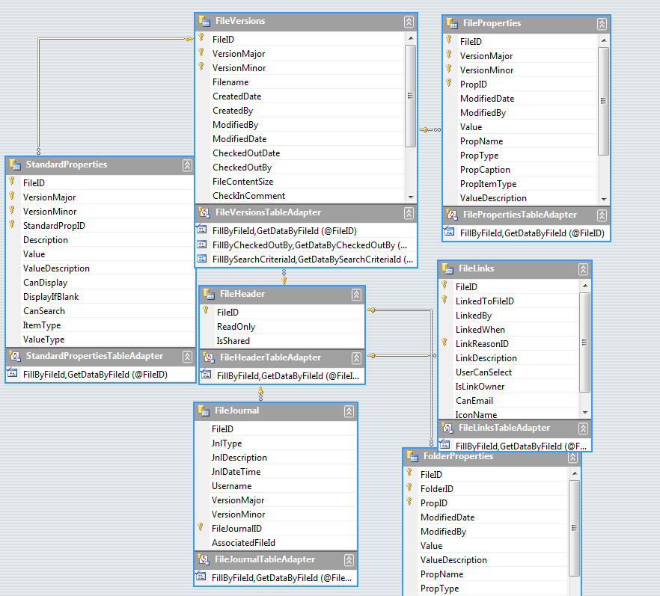
Typed Datasets anyone?

Slide 5

.NET port of the Hibernate project (Java)
Mature Codebase
Pluggable Architecture
Proven Concepts & Patterns
Used in many large scale Java & .NET applications
Cross platform – fully supported on Mono
Very popular choice on the .NET platform

Slide 6
Today… NHibernate 3
Coming up to .NET 3.5 / Mono 2.4
IQueryable LINQ Implementation
Strong typing => Lambdas
QueryOver API
Strongly typed code based configuration
Lazy-load of columns

Slide 7
The NHibernate Ecosystem
NHibernate.Validator
NHibernate.Spatial
NHibernate.Shards
NHibernate Profiler (NHProf)
NHibernate Visual Designer
HQL Workbench

Slide 8
NHibernate 3 Code Demo
Get your code aawn!

Slide 9
Where?
www.nhforge.org
http://groups.google.com/group/nhusers

Slide 10


Contact Me
Email: kevin@mcdev.za.net
Twitter: @kmckelvin
Blog: www.mcdev.za.net

