Slide 1
jQuery PJAX
Speeding up the Client
Kevin McKelvin – Devs4Devs – 13 August 2011
Blog: http://mcdev.za.net
Twitter: @kmckelvin
Email: kmckelvin@gmail.com

Slide 2
this.Speaker.ToString();
Kevin McKelvin
C#, Ruby, JavaScript developer
Blog: http://mcdev.za.net
Twitter: @kmckelvin
Email: kmckelvin@gmail.com

Slide 3
The Interactive Web

Slide 4

The First Evolution
AJAX
Partial Refreshes
#!

Slide 5


Slide 6
Interactive Web (AJAX)
$.ajax({
url: url,
data: {id: 1},
success: function(data)
{ ... },
dataType: ‘html’
});

Slide 7
The Problems
Permalinks
Unpredictable Back Button
#! In URLs
window.location.hash

Slide 8


The Solution
pushState + AJAX = PJAX

Slide 9
PJAX
Bookmarkable Permanent Links
Fully degradable in unsupported browsers
Supported in major browsers
Firefox 4+
Safari 5+
Chrome 8+
Android 2.2+
Opera 11.5+

Slide 10
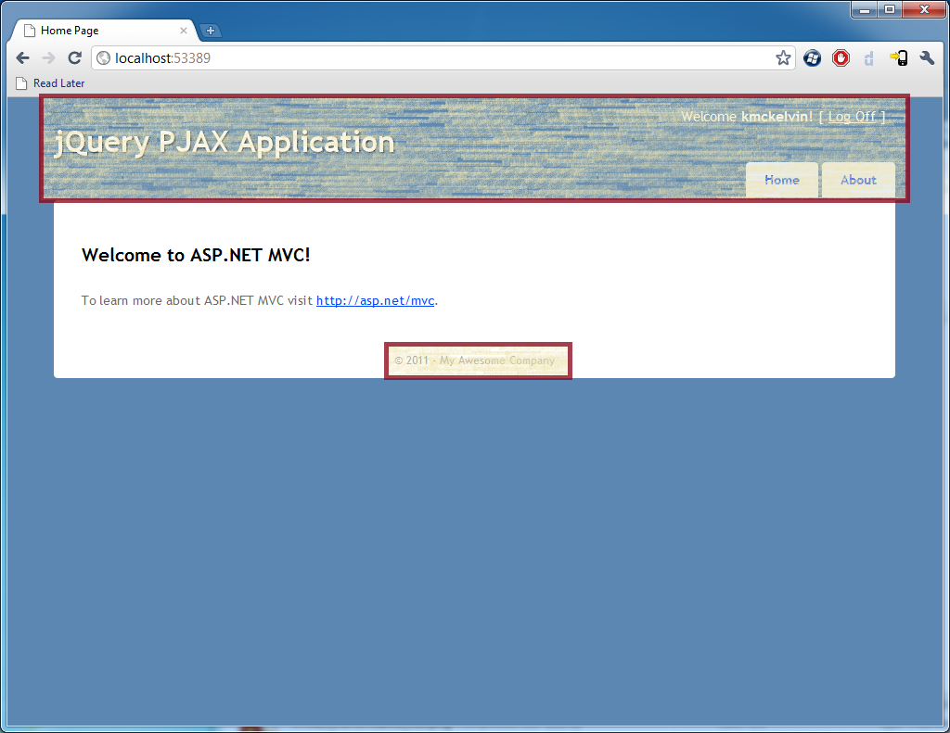
Sample
Static Content

Slide 11


Resources
jQuery: http://jquery.com
jQuery PJAX plugin: http://github.com/defunkt/jquery-pjax
The McDev Blog: http://mcdev.za.net

Slide 12
More JavaScript
Backbone.js http://documentcloud.github.com/backbone/
Node.js (Asynchronous Servers in JavaScript) http://nodejs.org/
Schalk Neethling – “Watcher” @ 11:30 in Room 1
Martin Cronje – “RIA the way it was supposed to be” – Next in Room 2

