Slide 1
Predicting Ideal Location for Restaurant
By: Kyle McLester

Slide 2
Being able to understand a market is powerful
Knowing a market allows investors and business decision makers to accurately assess risk vs reward
Understanding which areas are already saturated informs stakeholders to stay away since there will be a high barrier to entry against well-established brands in the area
Helps with targeted marketing demographics

Slide 3
Data Acquisition
Toronto postal codes, neighborhoods, boroughs were scraped from https://en.wikipedia.org/wiki/List_of_postal_codes_of_Canada:_M
Toronto postal codes and corresponding latitude/longitude coordinates were provided per the assignment
Locations of venues were pulled from the Foursquare API
Map data was pulled from Folium

Slide 4


Methodology

Slide 5
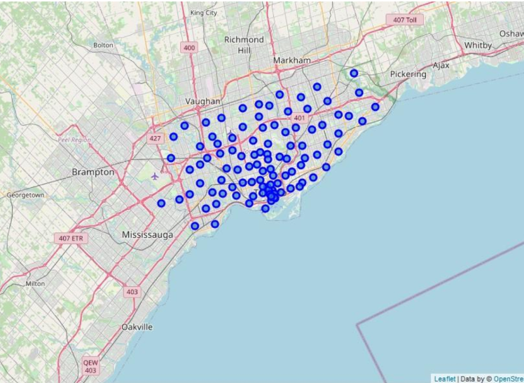
Exploring the Data
Using a combination of the Foursquare API, Folium, and the table of postal codes, a map of Toronto was able to be rendered
Each blue mark indicates a borough, which is often made up of several neighborhoods

Slide 6
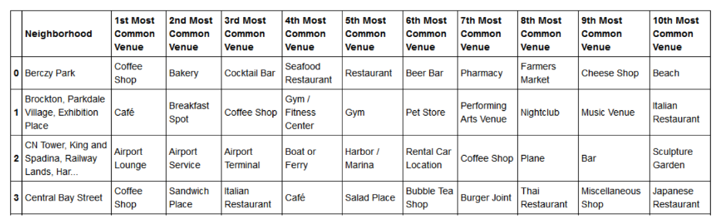
Current Market Composition
Compiled a list of all the different types of venues, the locations, and the frequency with which they occupy each region

Slide 7
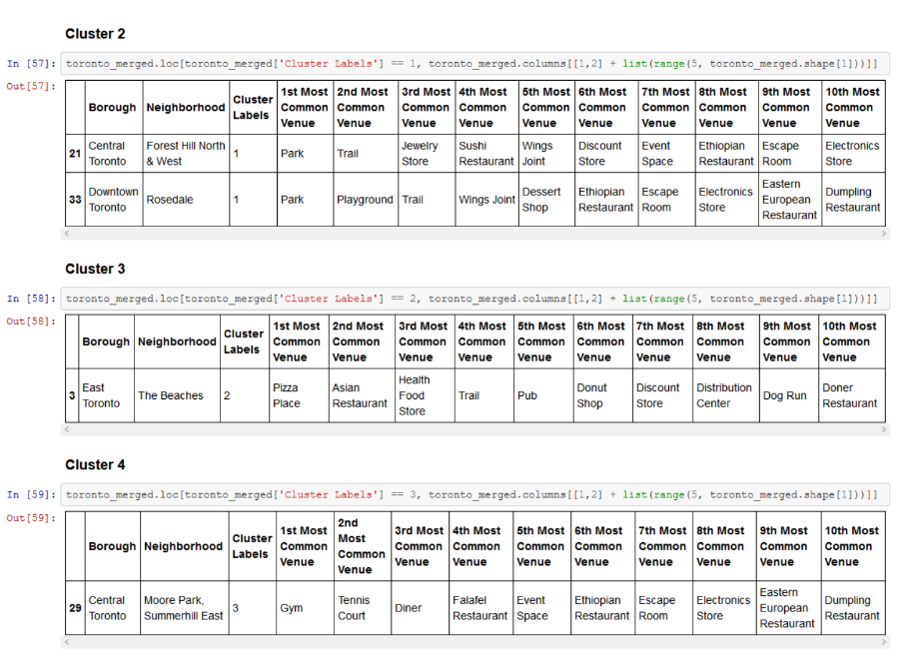
K-Means Clustering
Clusters were formed based on the frequency of venues and their proximity to each other
The proximity was measured using standard Euclidean distance

Slide 8
Conclusion
The best locations to open restaurant are currently in the Eastern Toronto Business district , James Town, or Cabbagetown
Each area demonstrated a lack of multi-cultural food but also an increased desire to-go style restaurants which many Asian eateries excel at given the nature of how the food is cooked

