Slide 1
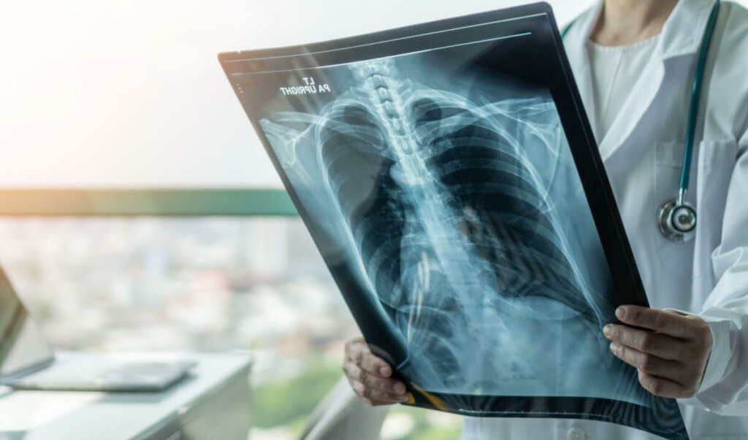
Pneumonia Detection in Chest X-Rays
Kacey Clougher, Rachel Goldstein, Irwin Lam, & Kendall McNeil
October 27, 2023
Notes:
INTRO – Kacey
Hi everyone! We’re happy to kick things off with our project that uses deep learning to detect pneumonia on chest x-ray images

Slide 2
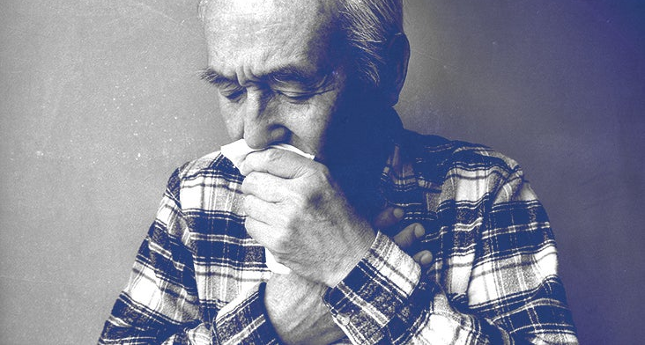
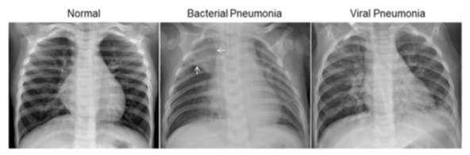
Notes:
KACEY
As you may know, Pneumonia is an infection that affects one or both lungs by causing the air sacs of the lungs to fill up with fluid or pus. Traditionally, pneumonia detection hinges on the examination of chest x-ray radiographs which is a rather labor intensive process. It also commonly results in discordant interpretations.
As a group, we’re looking to use the deep learning technique of convolutional neural networks to develop a model for pneumonia detection. By automating the diagnosis process, it aids healthcare professional in providing timely and accurate treatment.
The architecture of the model was designed using Keras API and was implemented by using Python and Tensorflow.
The dataset comprised of radiograph images, categorized into two classes: one depicting healthy lungs, and the other showing lungs afflicted with pneumonia.

Slide 3
Model Timeline
+ Normalization
+ Regularization
*First Simple Model*
+ Image Generation
+ Relu
+Layers
Notes:
Rachel. How we got here.
We started out by looking at the distribution of pneumonia compared to normal images in our dataset and found that 75% were pneumonia and 25% were normal. This was our baseline accuracy that we needed to beat. We then created a first simple model, instantiating a sequential model, adding a 2D convolutional layer with relu activation, a flattening layer, and a final dense output layer with sigmoid activation as this was a binary classification. It had 123,905 parameters, train accuracy of 1 and test accuracy of 73. As this was super overfit, we started to play around with it, starting with adding hidden layers, both 2D convolutional and max pooling 2D, and tested out different numbers of input units for each layer. We also changed the activation functions, playing around with tanh, and optimizers, testing out adam, nadam, and sgd, to test out the best combination. We tried other techniques including adjusting the learning rates and adding different regularization techniques such as L2 and dropout to address the overfitting. Finally, we decided to test out image generation. (next slide!)

Slide 4
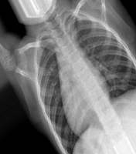
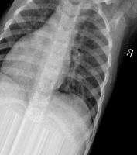
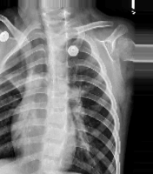
Image Generation
Notes:
RACHEL!
We used ImageDataGenerator to load in our dataset because it allowed us to apply different data transformations to the images. These transformations can include scaling, rotating, flipping, zooming, or shifting the data, amongst others, that create synthetic images and overall increase the size of the dataset. With each batch of images generated during model training, these transformations are applied randomly to the original images, introducing some variety into our model. We started with rescaling the data to normalize it, then turned on the following filters: we flipped the images horizontally so that we get mirrored images, shifted the height and width of the images by a maximum of 20% per image, rotated the images +- 45 degrees in any direction, changed the brightness to be somewhere within the range of 0.2 and 1, and zoomed in by a maximum of 20% per image. We used this augmented dataset to get our final model, which I will let Irwin explain.

Slide 5
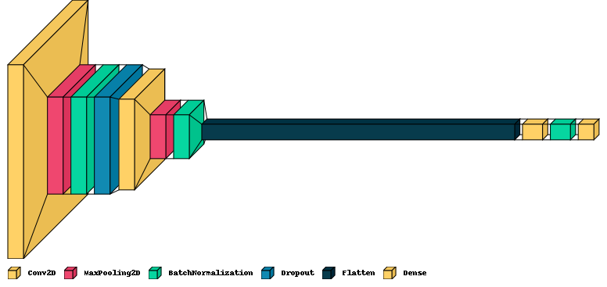
Final Model
Notes:
Irwin. Here is the glimpse of our final model. I will give you a moment to take a look.

Slide 6
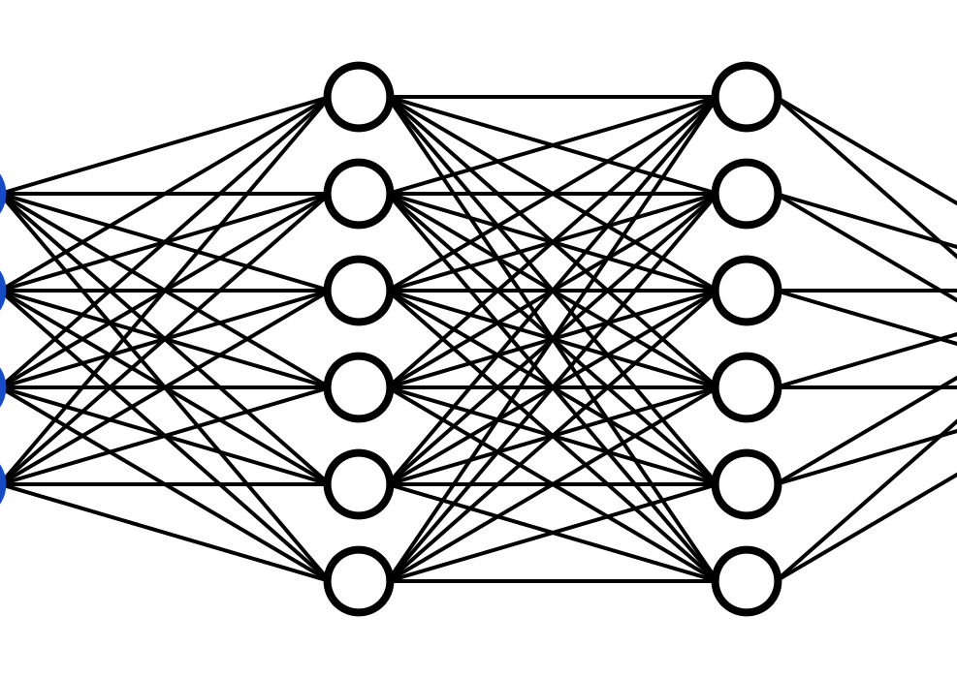
Accuracy
Train: 88%
Test: 90%
Notes:
Irwin
EXPLANATION OF THE FINAL MODEL. We used a convolutional neural network in order to predict whether or not someone had pneumonia based on their chest x-ray. Here are the results. Let’s dive into how we got there.

Slide 7

Next Steps
Notes:
Kendall
NEXT STEPS. MORE DATA! BETTER COMPUTERS MONEY MONEY MONEY.

Slide 8




*Project GitHub*
Kacey Clougher
Email | LinkedIn | Github
Rachel Goldstein
Email | LinkedIn | Github
Irwin Lam
Email | LinkedIn | Github
Kendall McNeil
Email | LinkedIn | Github
Notes:
Kendall

