Slide 1
WebDev
Workshop
Kelly Cole
kmcole2@illinois.edu

Slide 2
Just to better serve you all — what do you seek to get out of this workshop? Why are you here right now? Is it just to have a portfolio online? Do you want to make a stand alone website of your own. Just seeking a better understanding of how to program in general?

Slide 3

(first off) What is Involved in Web Development?
pretty much it consists of a client server relationship as depicted in this image:
The client gets webpages from the server which holds all the pages & content.

Slide 4
BUT.

Slide 5
What is a client? Which is the browser or the mobile application that makes page requests as needed. Us, the users are what trigger the page requests when we do things like submit a form, click on a link, etc.
What is a server? well… the server is actually a machine, a computer that stores and provides the html pages to the client. It’s literally a server.
The server serves it.

Slide 6
“So.. I always hear programmers talking about being full stack developers or individuals with a focus on front end/back end/UI/UX/another abbrev. whose meaning is a mystery to me….

Slide 7
two main parts.
Front End (Client-side), Related to the web browser itself which consists of the User Interface (UI). ie. the html pages themselves, the part that makes pages responsive and interactive.
Backend (Server-side), Deals with the data, logic and is usually more computation heavy where much of the processing is done. ie. the guts that process user inputs, manages data storage (databases), executes insert, delete operations on data sets.
**UX - User Experience, really an umbrella term that describes all end user interactions with a system or application.

Slide 8
…what we actually doing today
For our purposes we’ll be doing a client-side programming, more specifically dealing with:
HTML
CSS
Javascript (Intro to Bootstrap framework)

Slide 9
HTML
Hyper Text Markup Language, series of markup tags that group content
<html>
Content in between
</html>
Beginning
Ending

Slide 10
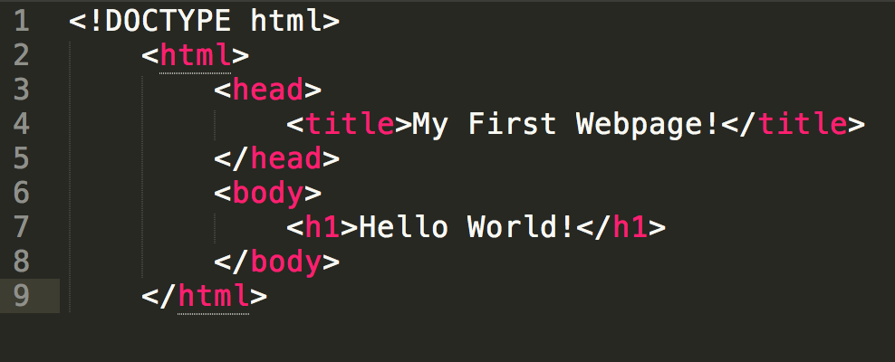
HTML

Slide 11
Common HTML tags
<head></head>, document information
<title></title>, title of the page
<body></body>, content that will be visible for users to see
<h1></h1>, <h2></h2>, <h3></h3>….<h6></h6>, header tags of varying size
<p></p> - paragraphs
<i></i> italics
<b></b> bold
<ul></ul> & <li></li> unorder, list items
<img src = “”> for images
<a href = “”></a> links
<br> line breaks
<div></div>, <span></span> dividers group text
https://computerservices.temple.edu/commonly-used-html-tags

Slide 12
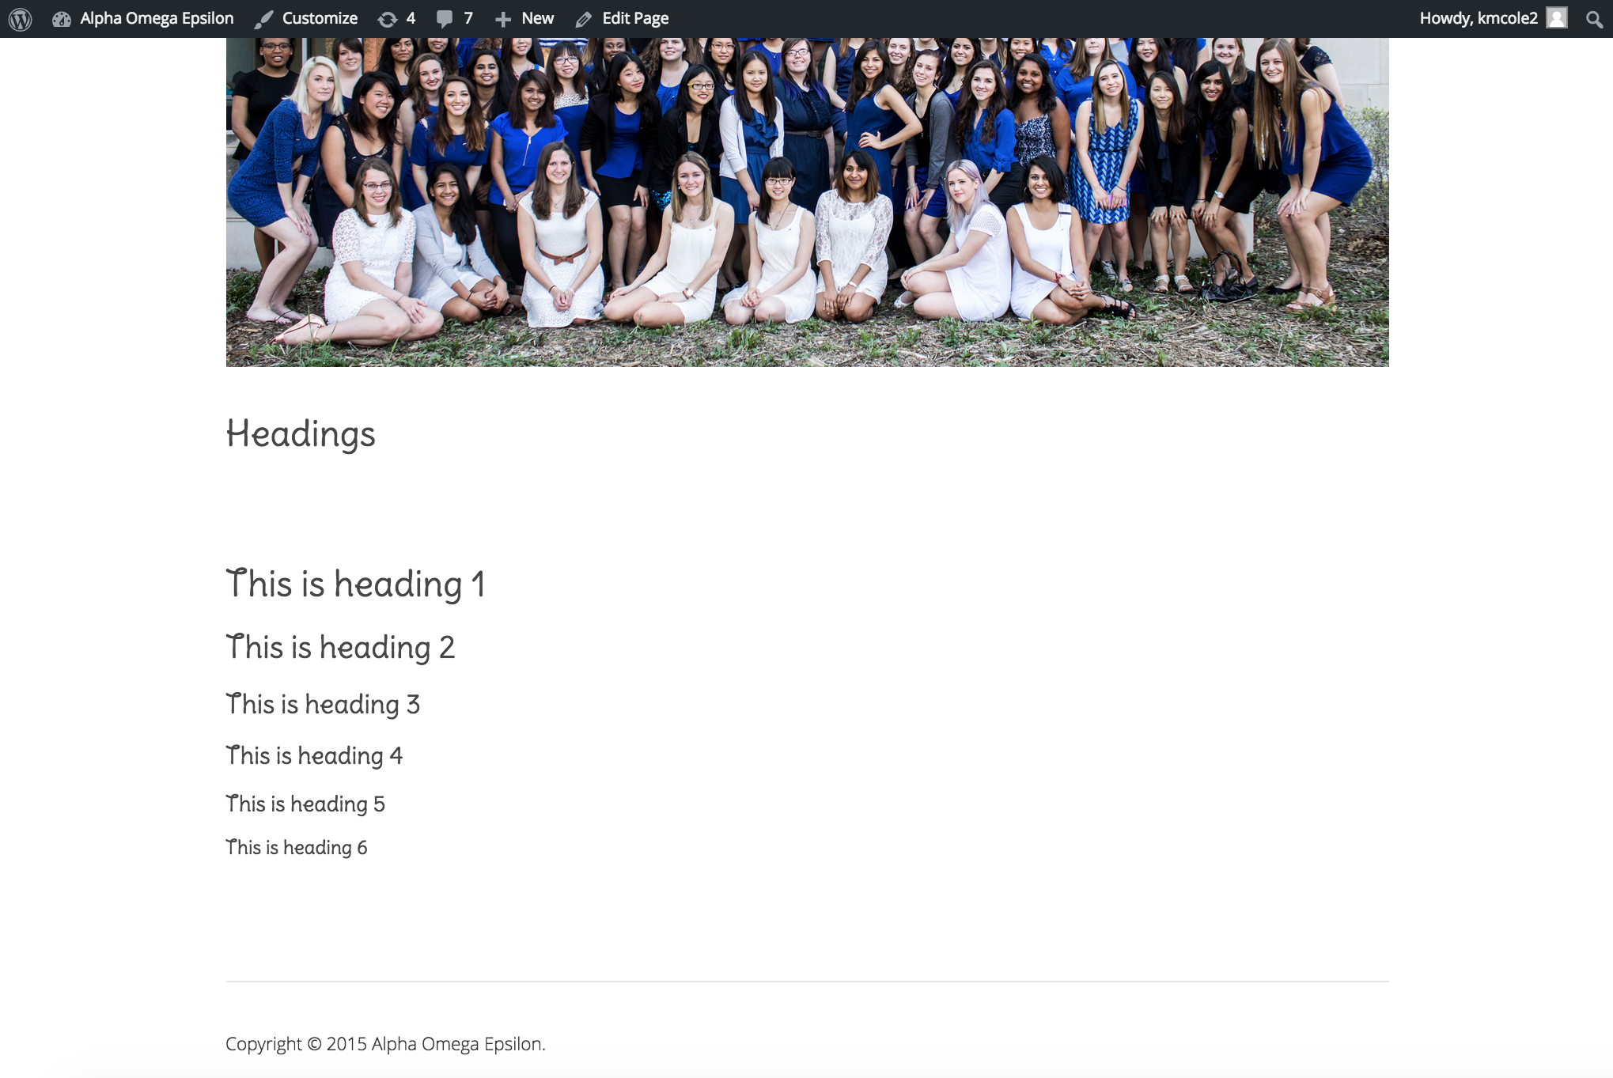
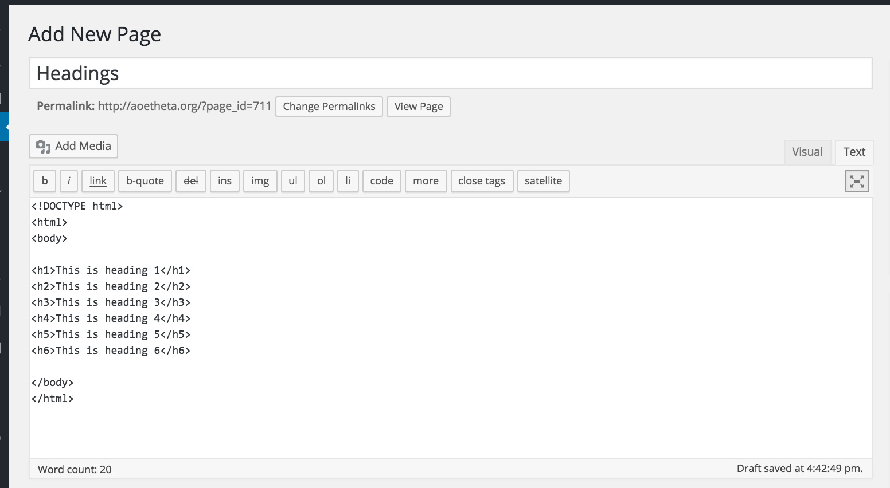
Headers

Slide 13
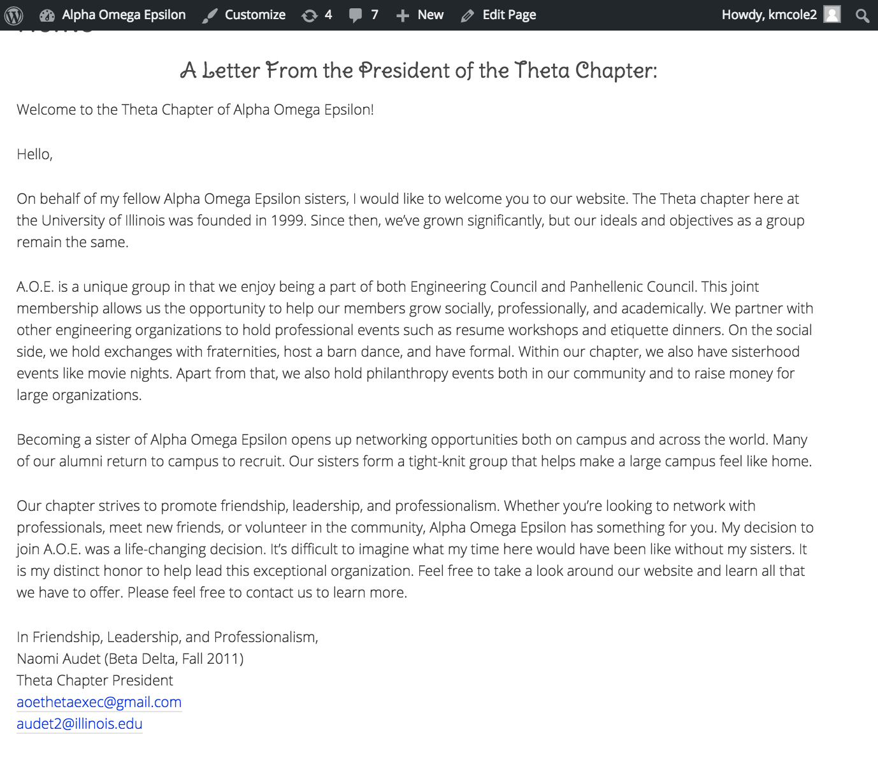
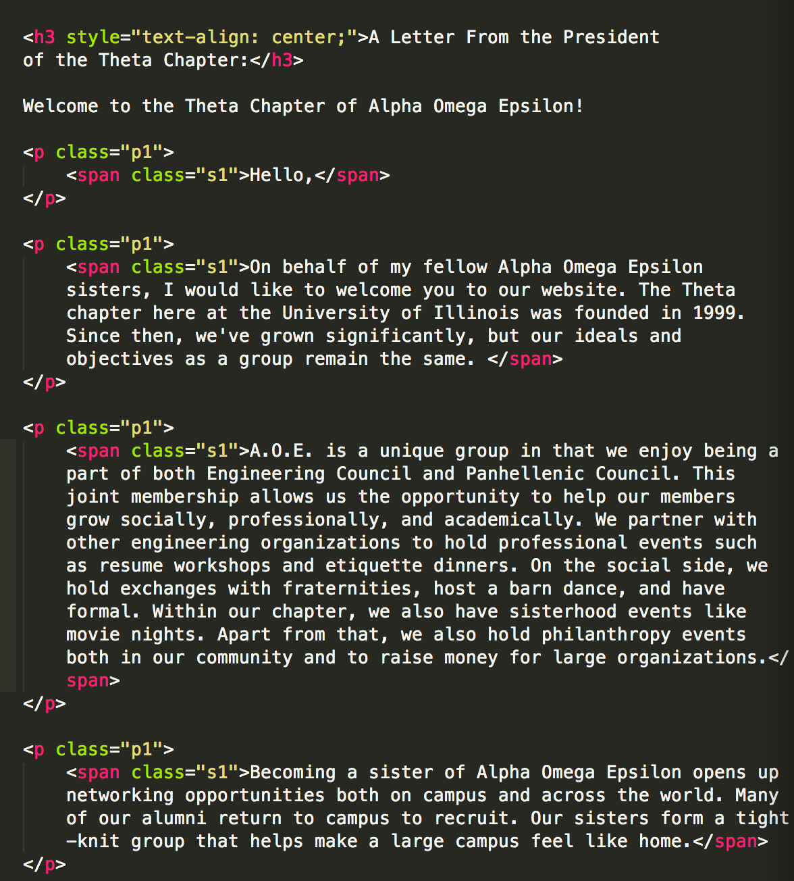
Let’s Dissect the homepage!

Slide 14
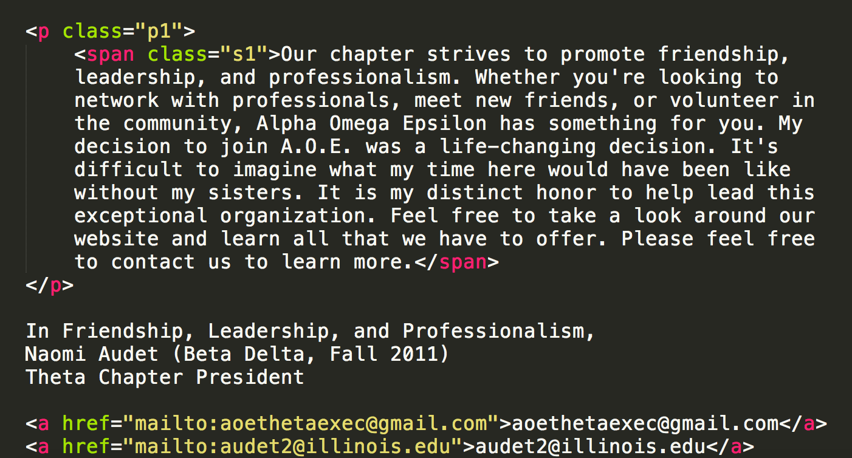
Let’s Dissect the homepage!

Slide 15
CSS
Cascading Style Sheets
defines how html elements will be displayed and formatted on the page
internal vs external definitions
keep like pages similar
can apply css to a particular id (single instantiation), class, or elements of a particular type

Slide 16
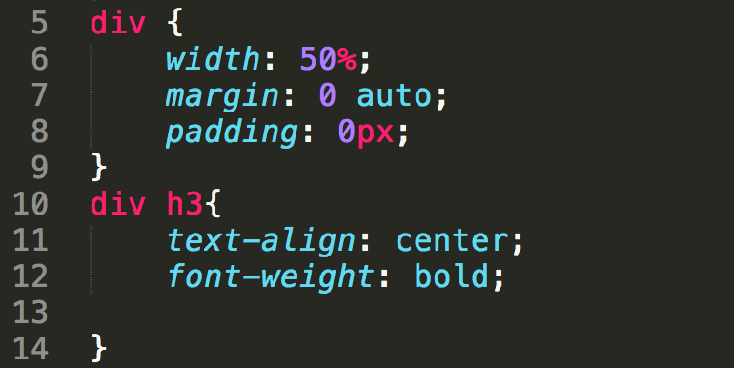
CSS
selector {
propertyName: value;
propertyName: value;
}

Slide 17
Common CSS Properties
display: {block, inline-block, inline, none}
width: & height: {_px; _em;}
margin: & padding:
color: {hex values, rgb value (ie. rgb(255,0,255)), string (ie. red, blue, green, grey, etc.}
background:
background-color:
background-image:
font
font-size:
font-weight
font-family:
http://www.zell-weekeat.com/9-important-css-properties-you-must-know/

Slide 18
Javascript
added functionality
moving banners
sliding menus

Slide 19
Bootstrap
Bootstrap is a open-source front end framework that provide a uniform and modern
means or organizing elements
makes interfaces more dynamic
responsive sites lower overhead

Slide 20
HTML, CSS guides & tutorials
http://www.w3schools.com/default.asp
Bootstrap website,
http://getbootstrap.com/

