Slide 1
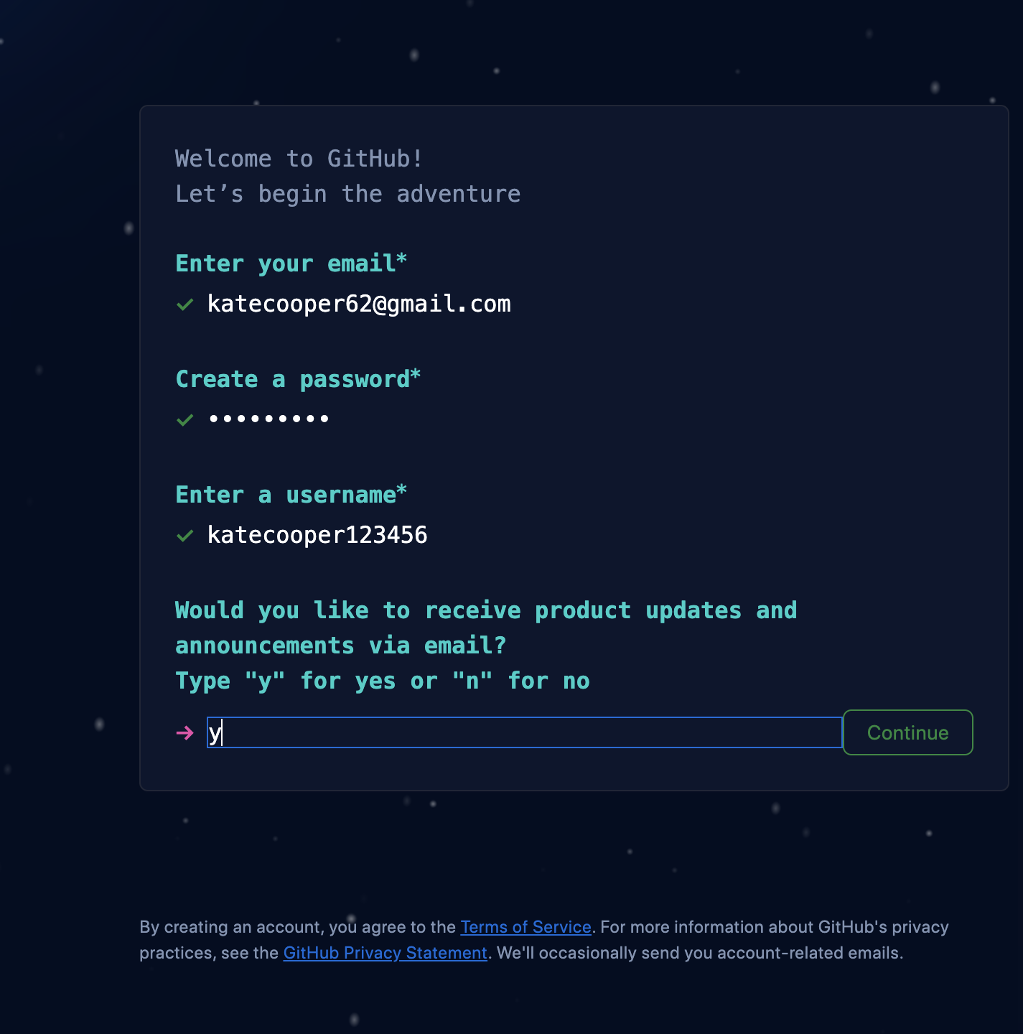
Welcome! Get started while we wait:
Go to www.github.com
Click "Sign Up"
Follow the instructions to create a new GitHub account

Slide 2

Making a Code Portfolio on GitHub
Workshop: MINK WIC 2023
Dr. Kate Cooper
Associate Professor
University of Nebraska at Omaha

Slide 3
Objectives:
Understand what GitHub is and what its used for
Identify components of an effective GitHub repository
Create (fork) a simple GitHub repository from a template
Write a simple Markdown file
Improve a simple Python script

Slide 4
What is GitHub?
An online tool that is used to store, develop, and manage code
Uses Git (software version control) as a foundation
A good place to create and store a coding portfolio for others to see examples of your coding work
A place for collaboration

Slide 5
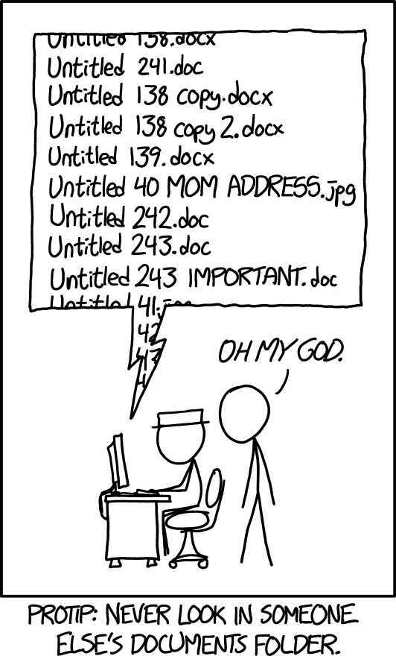
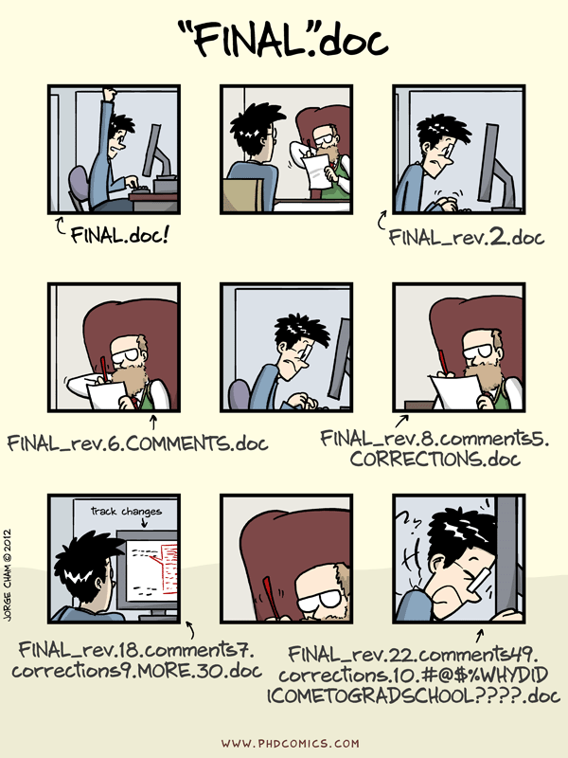
What is Version Control???
XKCD #1451 "Documents"
PhD Comics #1531

Slide 6
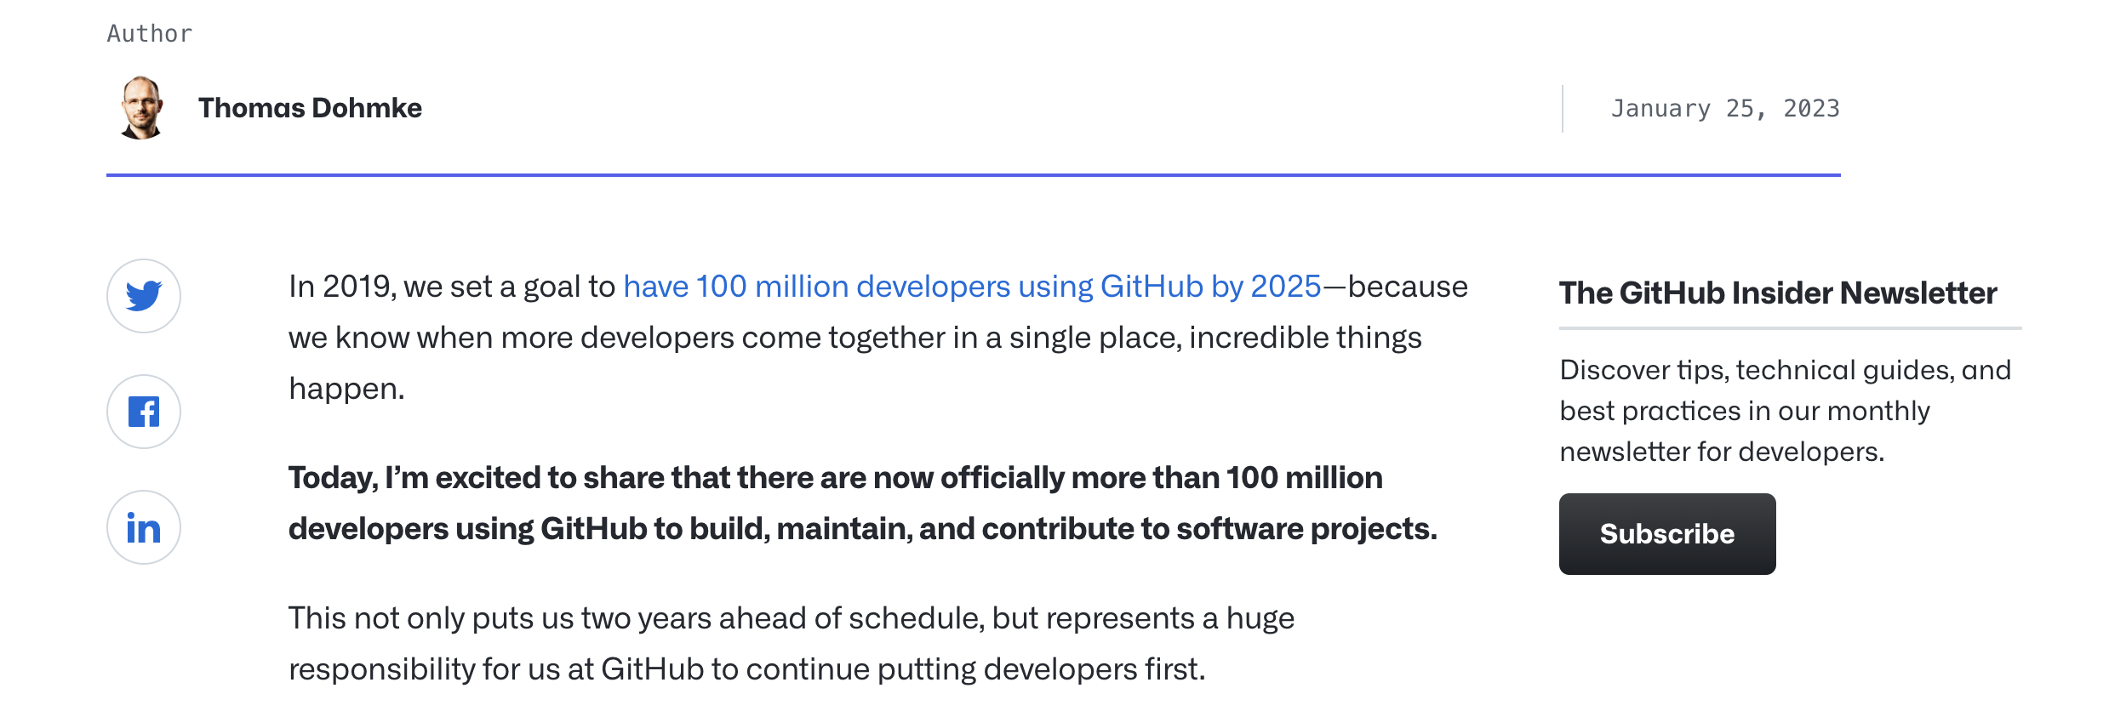
Why should I have a GitHub account?

Slide 7
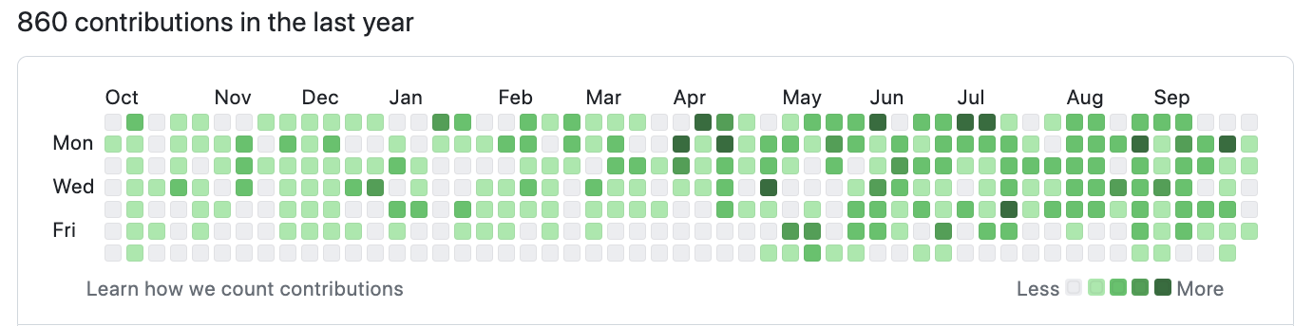
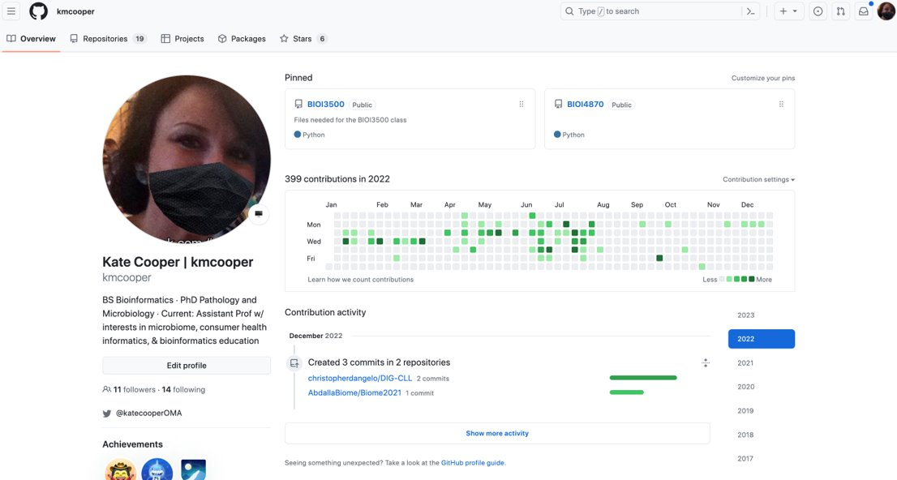
Why should I have a GitHub account?

Slide 8
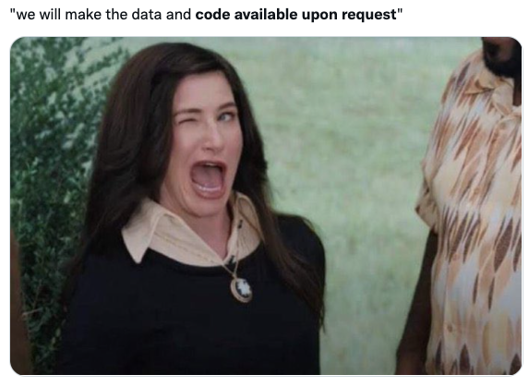
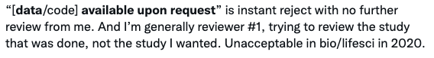
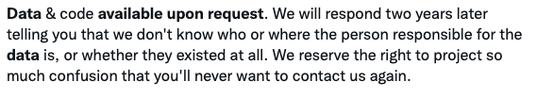





DEPARTMENT NAME

Slide 9
What should I put on my GitHub?
Good: Code that you wrote!
Better: Code that you wrote with comments and good formatting
Best: Code that you wrote with comments, good formatting, and documentation/annotation

Slide 10
Welcome! Get started while we wait:
Go to www.github.com
Click "Sign Up"
Follow the instructions to create a new GitHub account

Slide 11
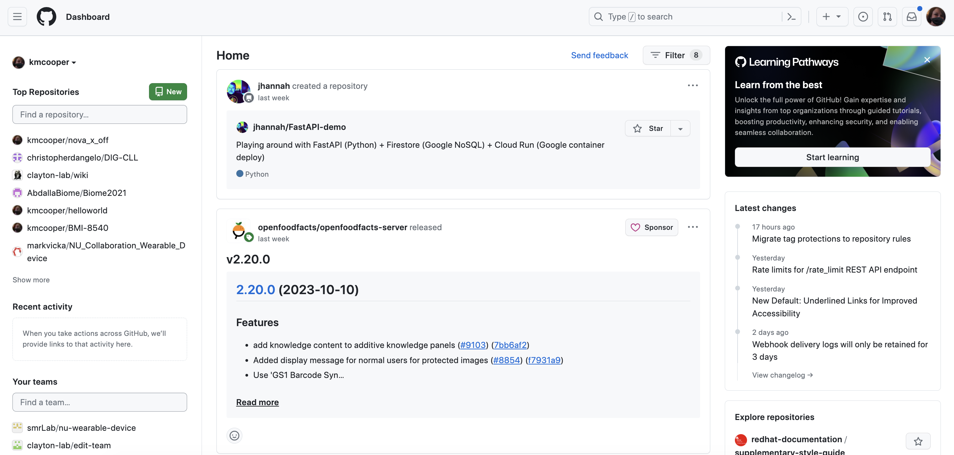
Your Dashboard

Slide 12
Once logged in to GitHub, please go to this site:
https://tinyurl.com/minkwic23github

Slide 13
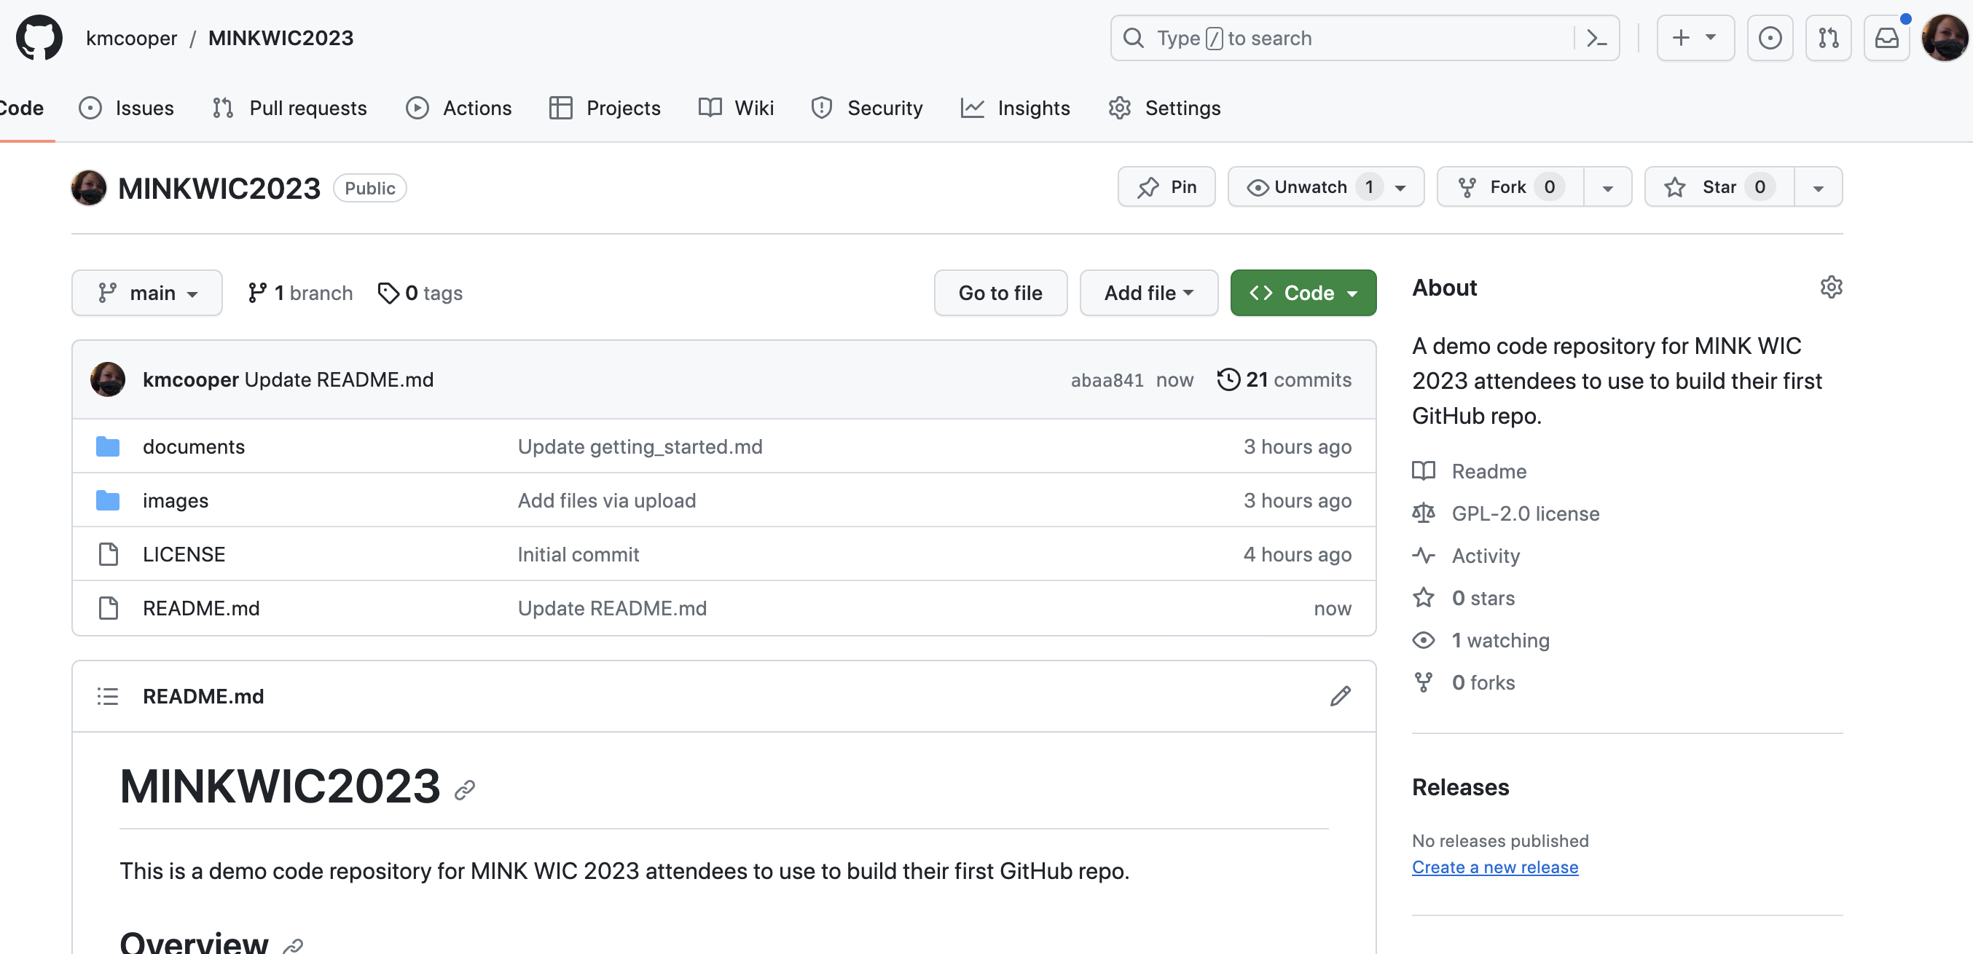
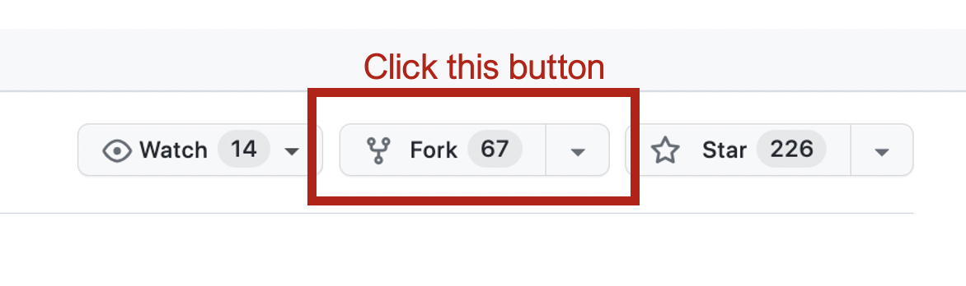

Slide 14
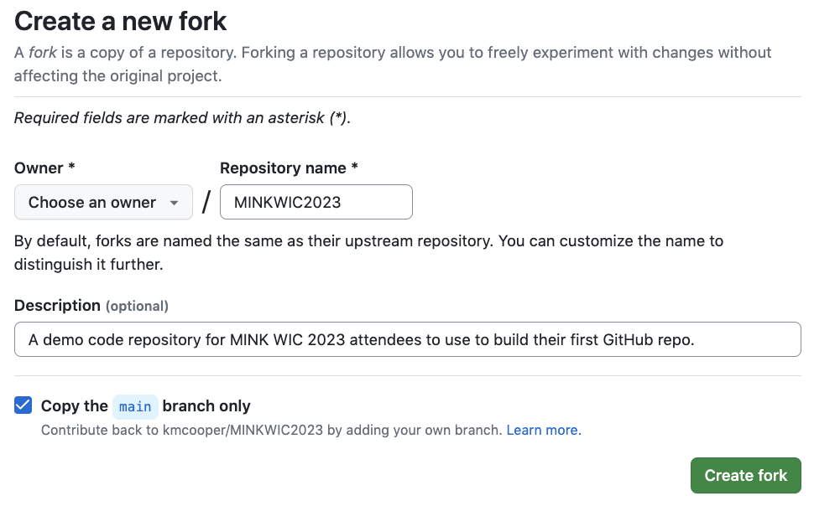

Slide 15
Markdown Language (.md files)
Markdown is "a lightweight markup language for creating formatted text using a plain-text editor" [Wikipedia]
Tell GitHub to use Markdown by ending your filename with .md
Let's make a new Markdown file!

Slide 16
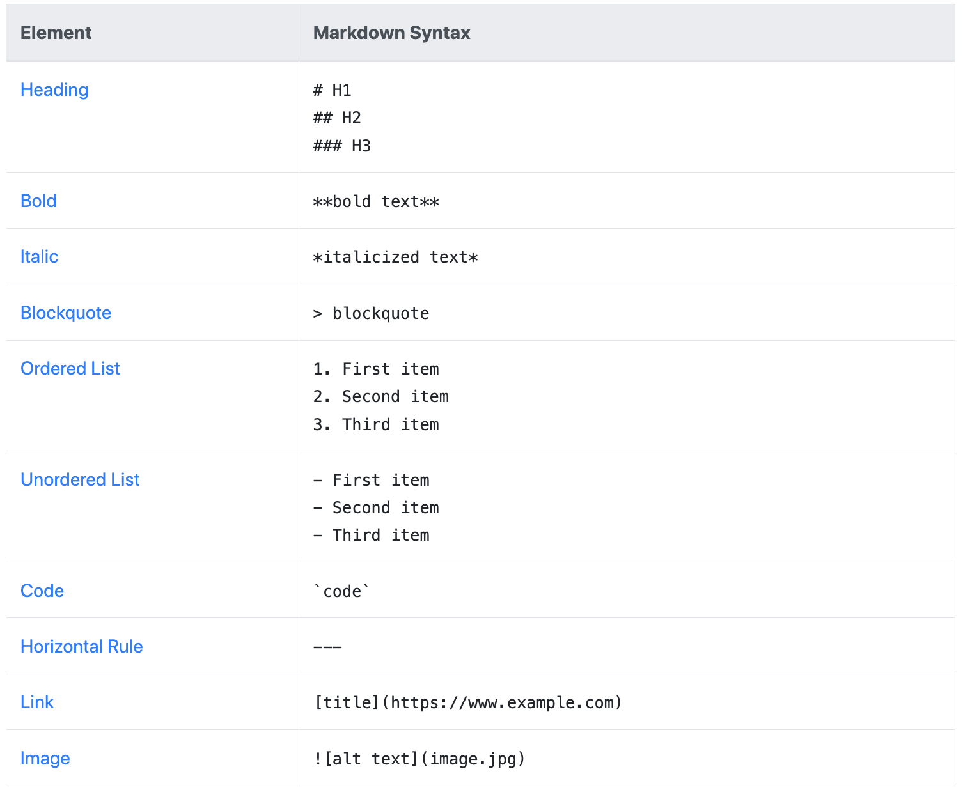
Markdown Cheat Sheet

Slide 17
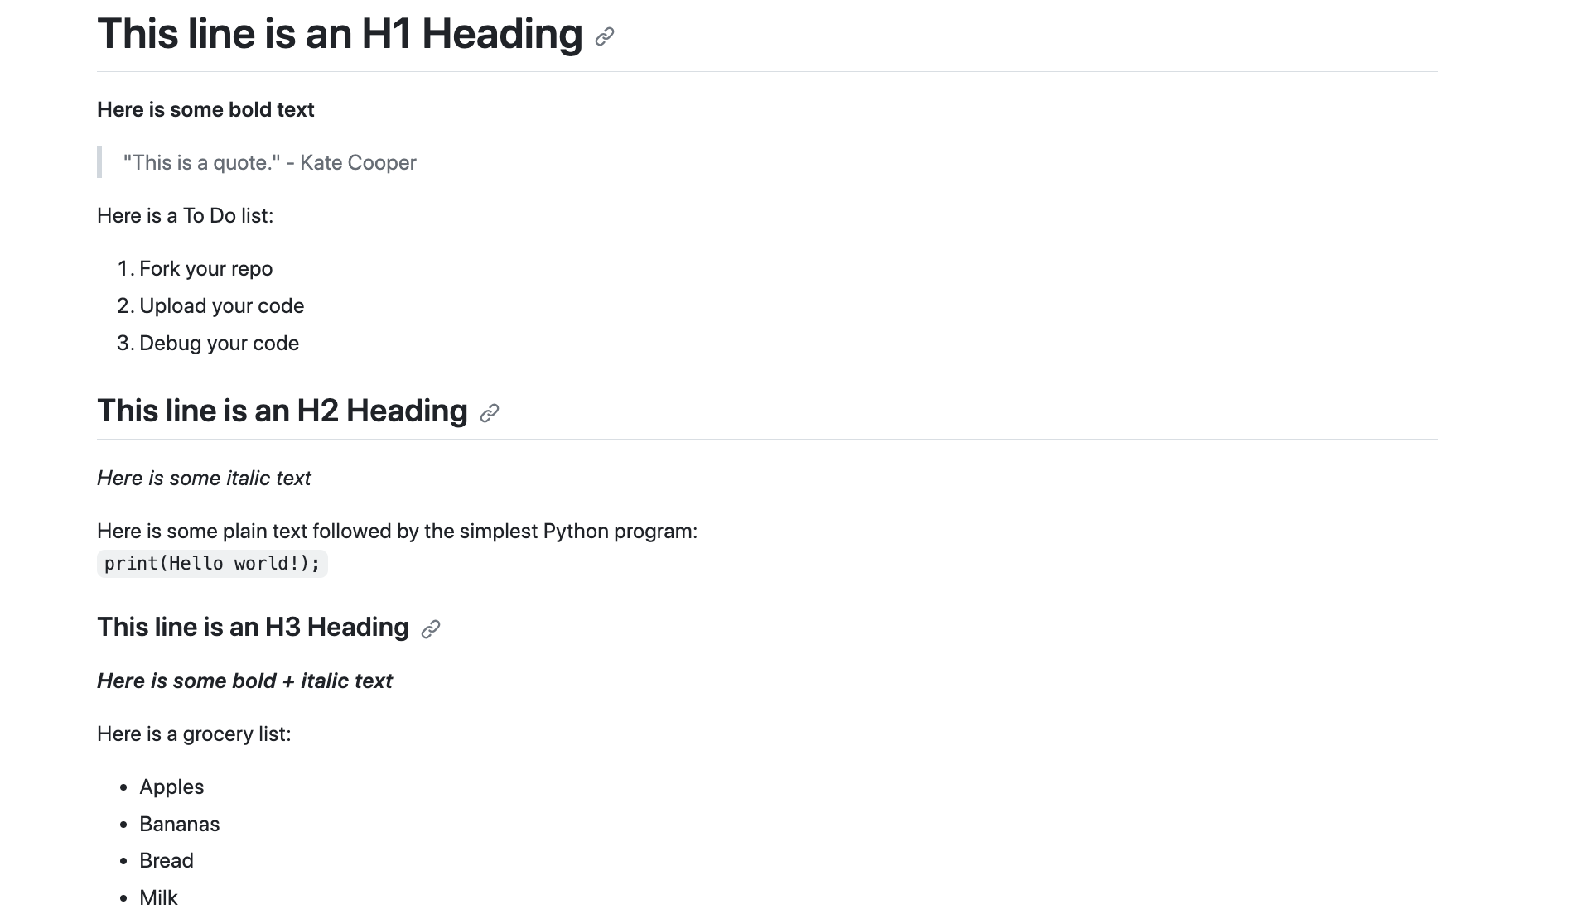
Can you replicate my Markdown file?

Slide 18

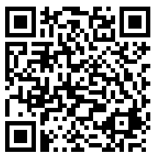
Thank you!
Questions? Comments?
kmcooper@unomaha.edu
@KateCooperOMA
Discussion
Aggregation of tutorials, workshops, case-studies, and more is needed both for computing trainees and educators as a means to enhance learning and bolster research, and provides a foundation for community database that might support enhancement of trainee knowledge.
We are developing free, self-paced modules to teach computing trainees about reproducibility – sign up for more information if you are interested!
DEPARTMENT NAME

