Slide 1

BIOS 635 Machine Learning Final Project
Presentators: Jose Lopez, Chris Moore, Tian Wang, Alice Yu

Slide 2
Predicting serious events post COVID-19 vaccination via Machine Learning: comparing applicability of logistic regression and random forest algorithms

Slide 3
Outline
1. Introduction
2. Data
3. Methods
4. Results
5. Discussion

Slide 4
Introduction

Slide 5
Background
Long-term management of COVID-19 in part is reliant on COVID-19 vaccination alongside implementation of mask wearing and social distancing strategically
However, in the United States there has been an increasing trend of vaccine hesitancy and there is a need of various modes of assuaging vaccine fears
Efforts to combat vaccine hesitancy
Government trust
Strong vaccine campaigns
Culturally targeted communication
COVID States Project
50-state COVID-19 survey to test the effectiveness of two communication strategies

Slide 6

Research Purposes
Develop and test the accuracy of a logistic LASSO regression (LLR) and RF algorithm to determine whether a serious event is likely to occur
Assess which of the two algorithms would be better applicable to determine whether an individual could require additional monitoring and care.

Slide 7
Previous ML Analyses
Previous study -- Adverse effects of COVID-19 vaccination: machine learning and statistical approach to identify and classify incidences of morbidity and post-vaccination reactogencity by Ahamad et al.
Analyses used:
Random Forest
SVM
Gradient Boosting Machine
Purpose
Identify significant features and determine an algorithm to distinguish between various group of patients for various outcomes

Slide 8
Method

Slide 9

Data

Slide 10
Method: Dataset Description
Vaccine Adverse Event Reporting System (VAERS): voluntary, national, passive surveillance system was established in 1990 and is operated jointly by FDA and CDC
Submitted by health care professionals, patients, manufacturers
Domestic reports (primarily) and international reports
Uses a clinically validated, internationally standardized terminology, the Medical Dictionary for Regulatory Activities (MedDRA) to code reported symptom
We analyzed COVID-19 vaccine domestic reports received by VAERS from 12/14/2020, through 4/5/2021

Slide 11
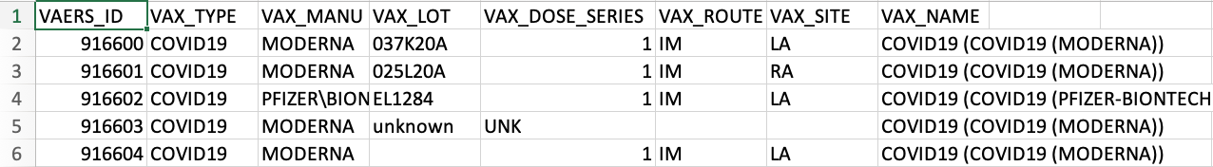
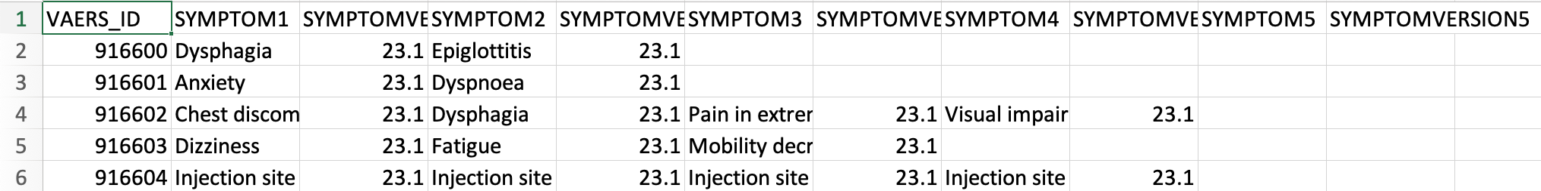
VAERSVAX
VAERSDATA
VAERSSYMPTOMS

Slide 12
Method: Exclusion Criteria
Adverse event onset date before vaccine
Hospice care
Missing COVID-19 vaccination type
Prior COVID-19 diagnosis before vaccination
Days between event and vaccination >6
For congenital anomaly or birth defect cases require Female gender Age < 50
> 2 doses of COVID-19 vaccine

Slide 13
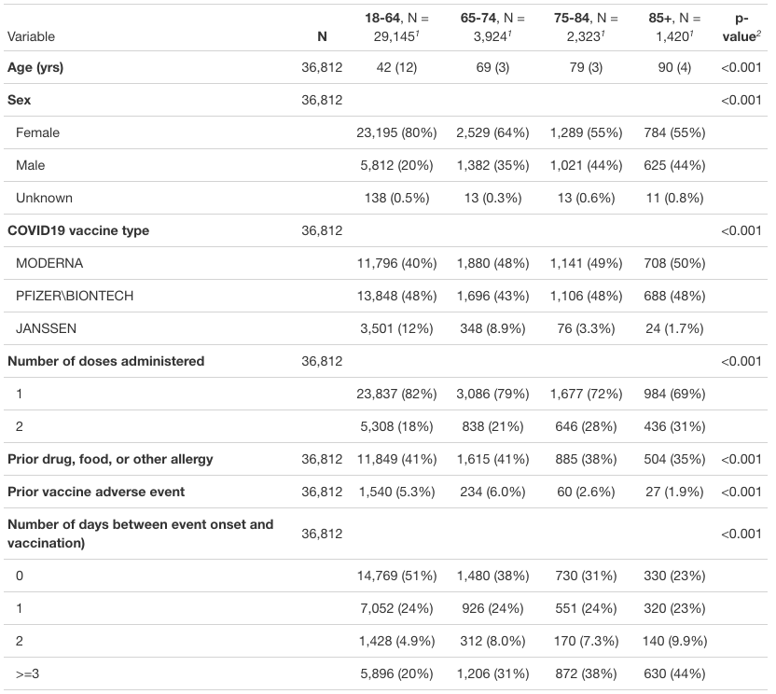
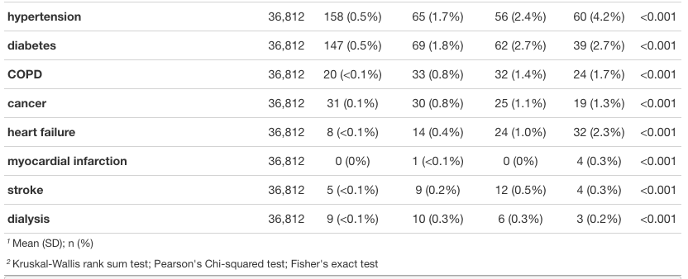
Method: Predictors

Slide 14
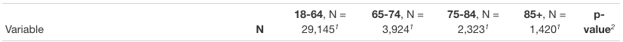
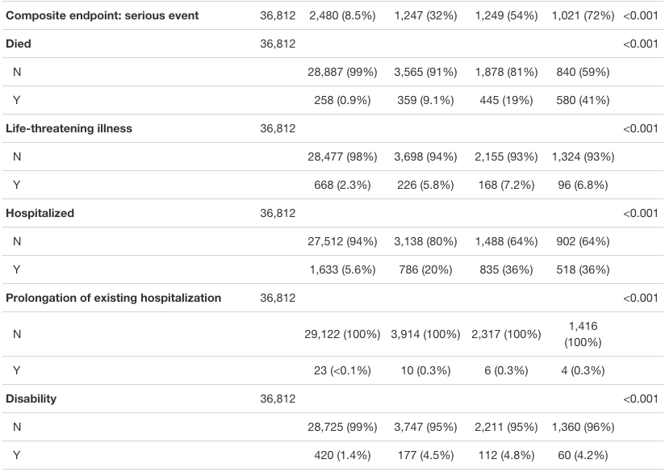
Method: Outcome
Onset <= 4 days

Slide 15

Methods: Random Forest
Total Sample
5-fold cross-validation
Out-of-bag classification
error
Sensitivity
Specificity
Accuracy
# trees (B) | 250, 500, 750
# predictors (m) | 4, 6, 8, 12, 16
Notes:
2 animations - click after I say something like
- “Then, within the training folds, we tuned the algorithm…”
- “…and out-of-bag classification error was used to select the final RF algorithm:

Slide 16
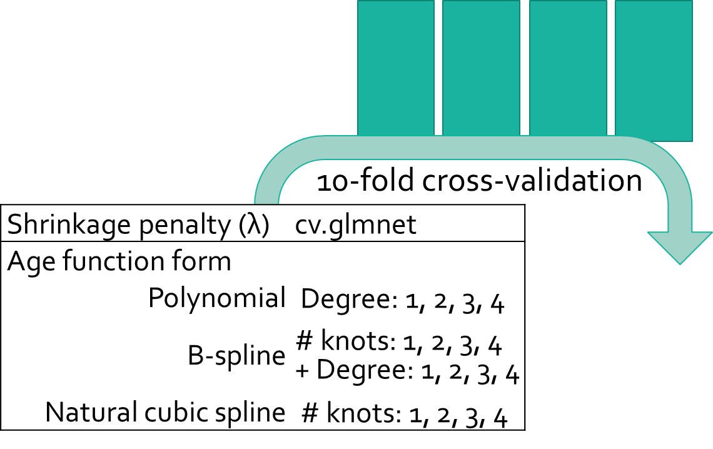
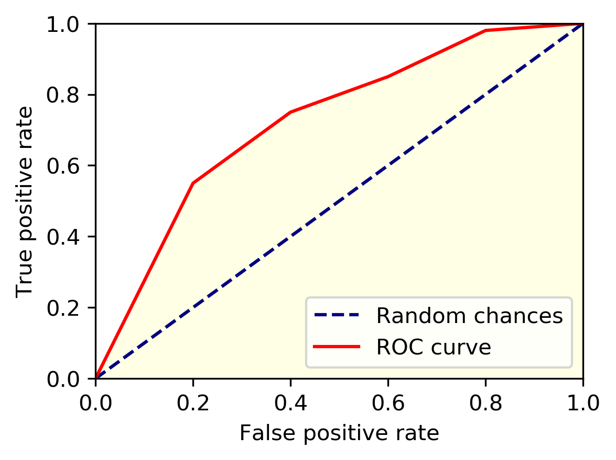

Methods: Logistic LASSO
Total Sample
5-fold cross-validation
10-fold cross-validation
Shrinkage penalty (λ) |  | cv.glmnet
Age function form
 | Polynomial | Degree: 1, 2, 3, 4
 | B-spline | # knots: 1, 2, 3, 4 + Degree: 1, 2, 3, 4
 |  | Degree: 1, 2, 3, 4
 | Natural cubic spline | # knots: 1, 2, 3, 4
Notes:
1 animations - click after I say something like
“…and then the tuned and trained logistic LASSO was used to….”

Slide 17

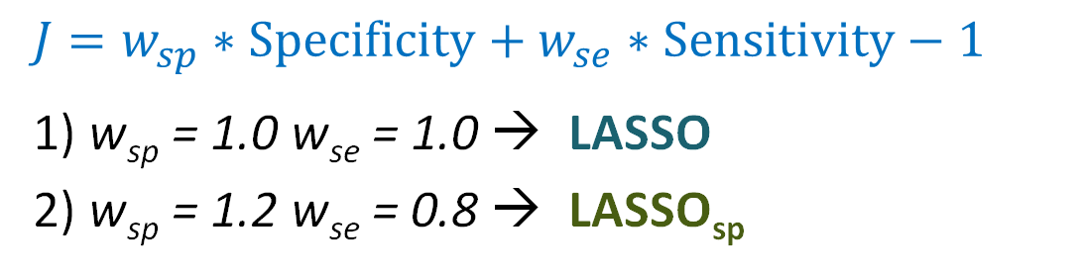
Methods: Logistic LASSO
Total Sample
5-fold cross-validation
p(Y)
Sensitivity
Specificity
Accuracy
$$J=w_{sp}∗Specificity+w_{se}∗Sensitivity−1$$
1) w_{sp} = 1.0 w_{se} = 1.0 → LASSO
2) w_{sp} = 1.2 w_{se} = 0.8 → LASSO_{sp}
Notes:
1 animations - click after I say something like
“…and finally both of these thresholds for the LASSO…”

Slide 18
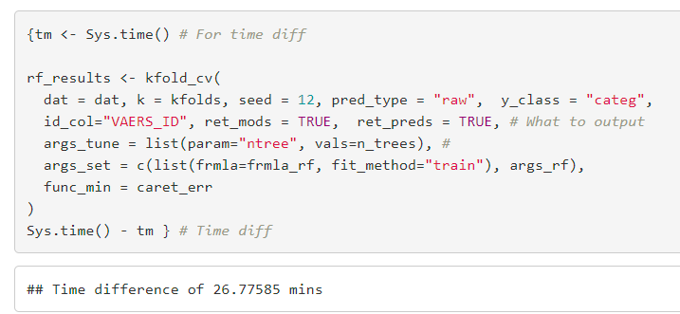


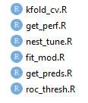
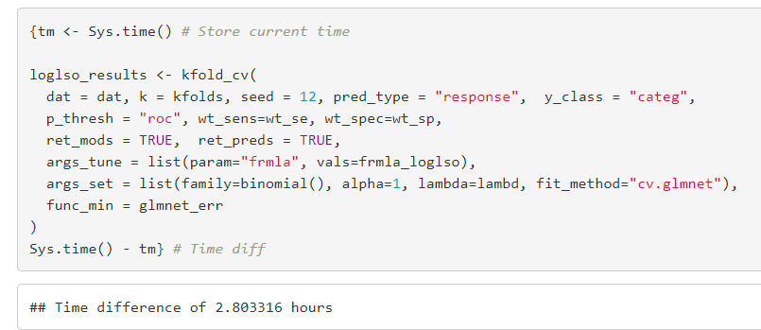
Methods: Algorithm Computation

Slide 19

Results

Slide 20
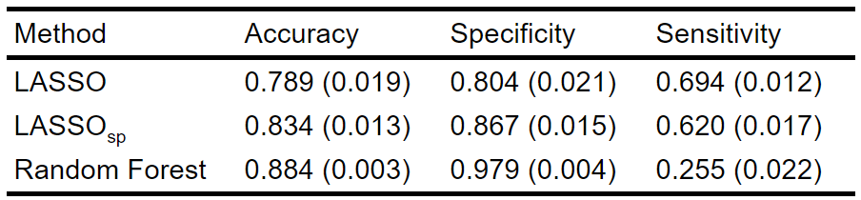
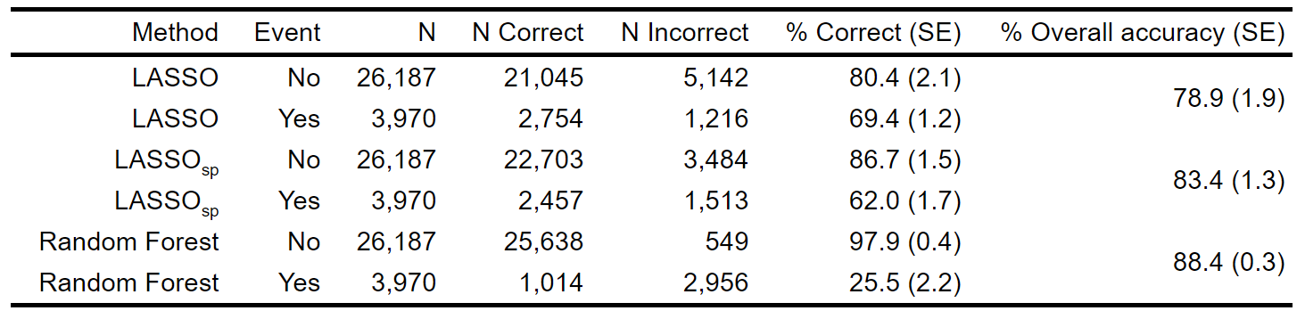

Slide 21
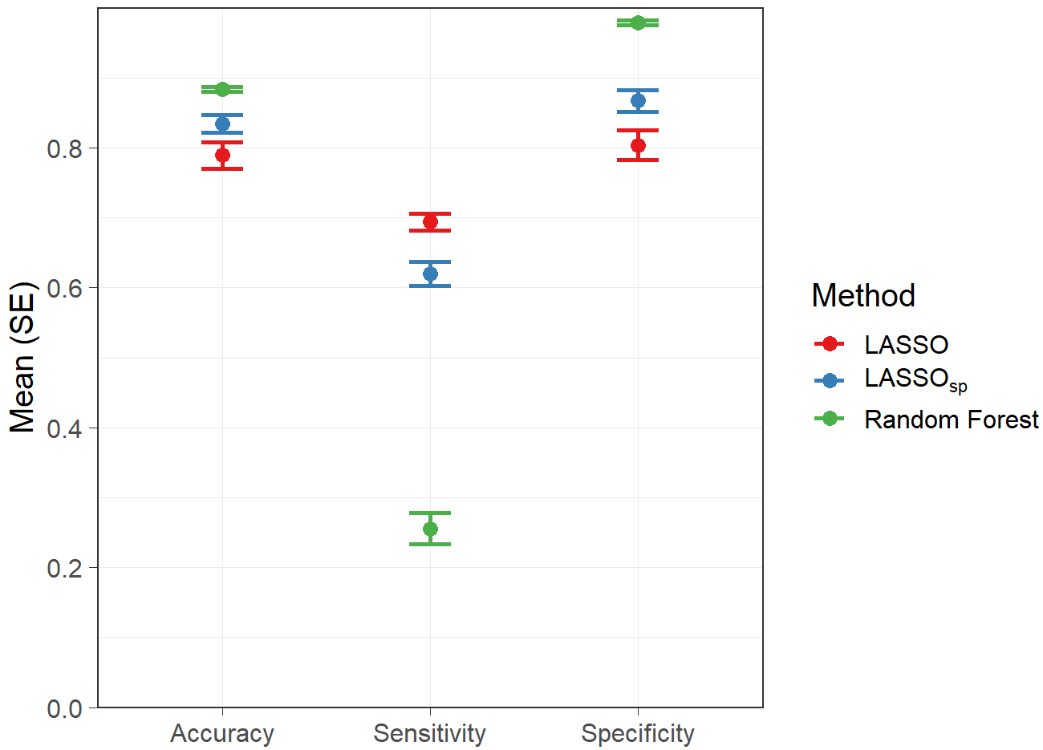

Slide 22
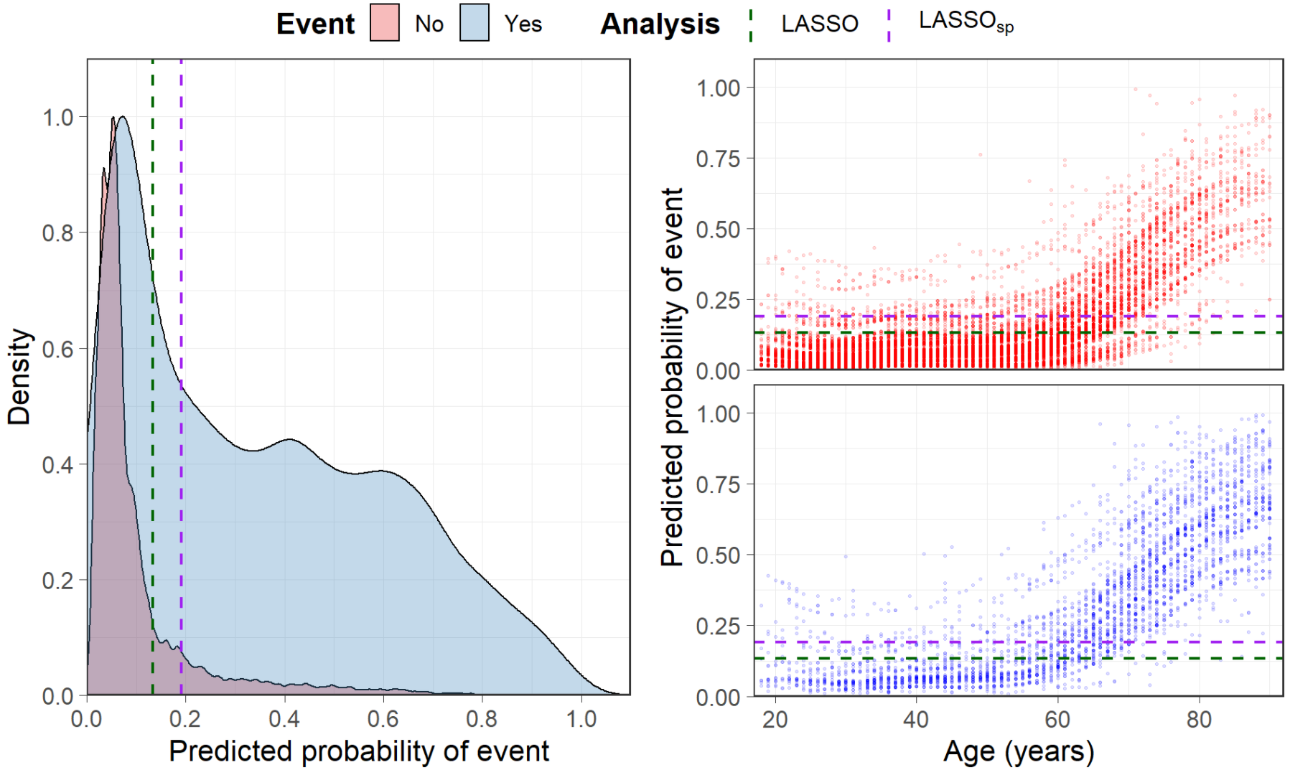
Results

Slide 23
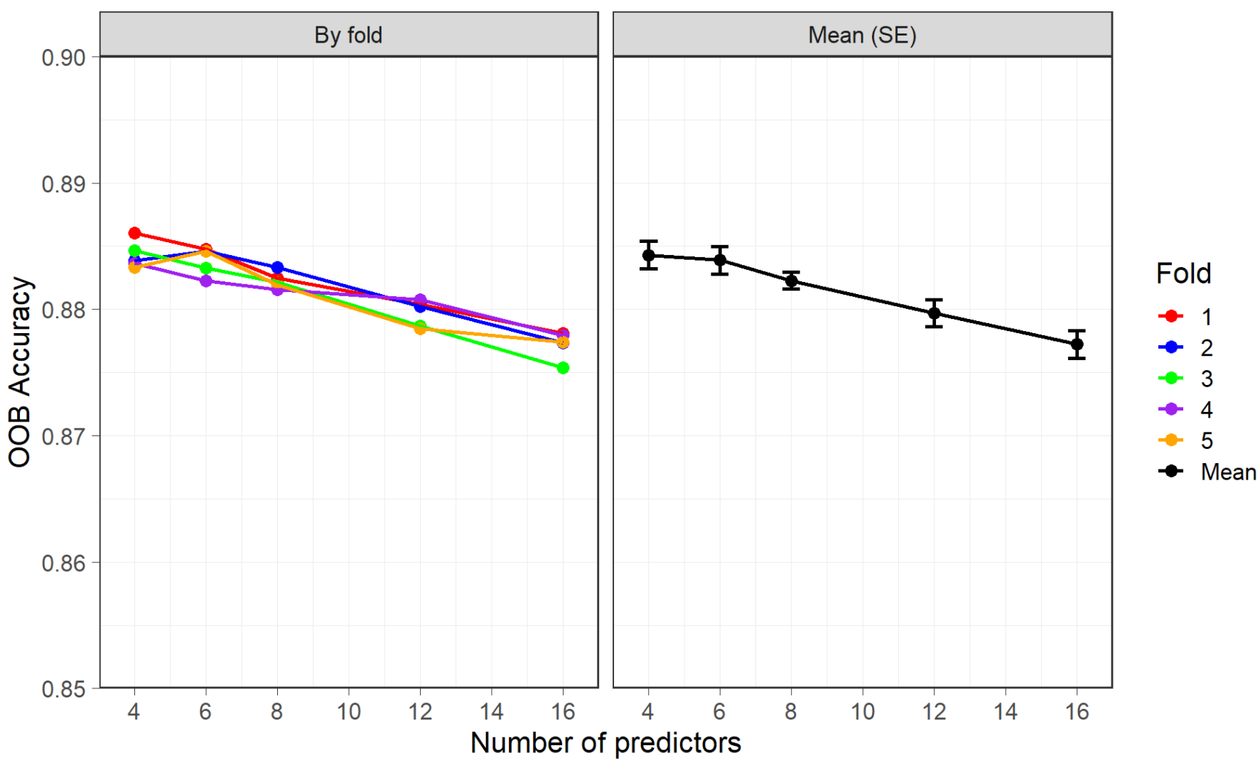
Results

Slide 24
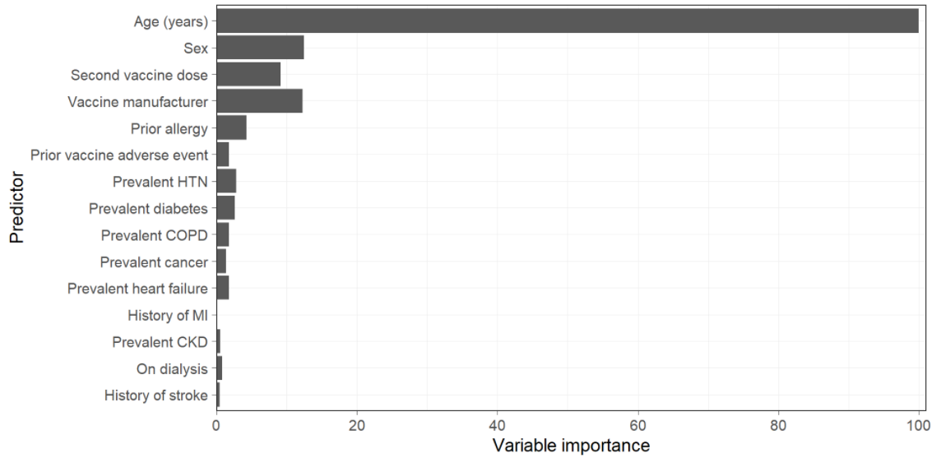
Results

Slide 25
Discussion

Slide 26

Public Health Importance
Combating vaccine hesitancy
Need to evolve methods for reassuring individuals
Machine learning algorithms is one avenue that may be useful if right algorithms can be developed and framed correctly to the public

Slide 27
Interpretation
Both algorithm methods (LLR and RF) achieved overall respectable accuracies largely because of strong specificities
Sensitivities were not as strong and averaged sensitivity for the RF method was particularly poor

Slide 28
Limitation
ML algorim based on reported data in VAERS, may not be generalizable to overall population
Should only be used for hypothesis generation
Algorithms are not specific to a particular event and consequently makes interpretation about the outcome unspecific as well
Should be interpreted with caution due to the multiple limitations of a passive reporting system
Predictors such as current diseases may be undereported.

Slide 29

Conclusion
Possible to use medical information to predict whether an individual getting their vaccine should get additional monitoring and care
Further investigation would need to be conducted using data that is not subject to reporting bias and is well defined with regards to what is reported
Only represents a first step towards developing a tool to combat vaccine hesitancy

Slide 30

Thank You!!
Any Questions??

