Slide 1
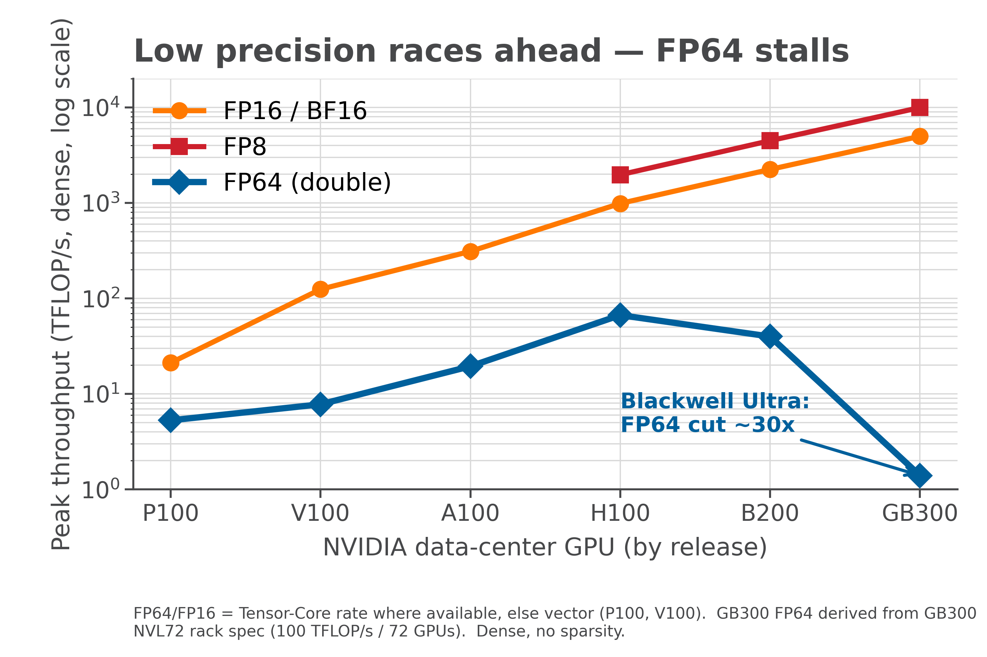
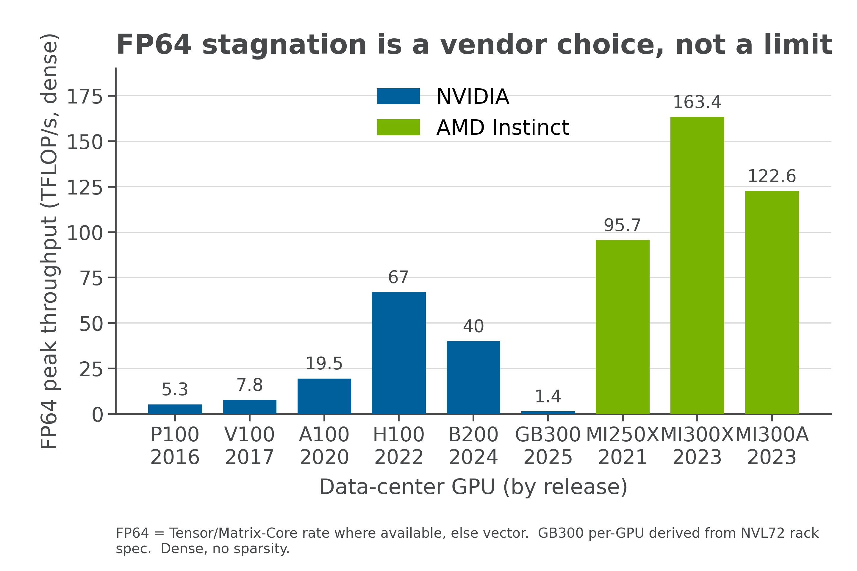
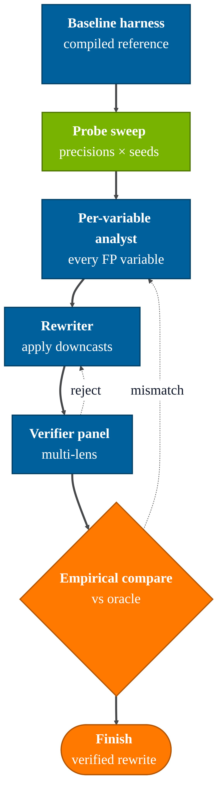
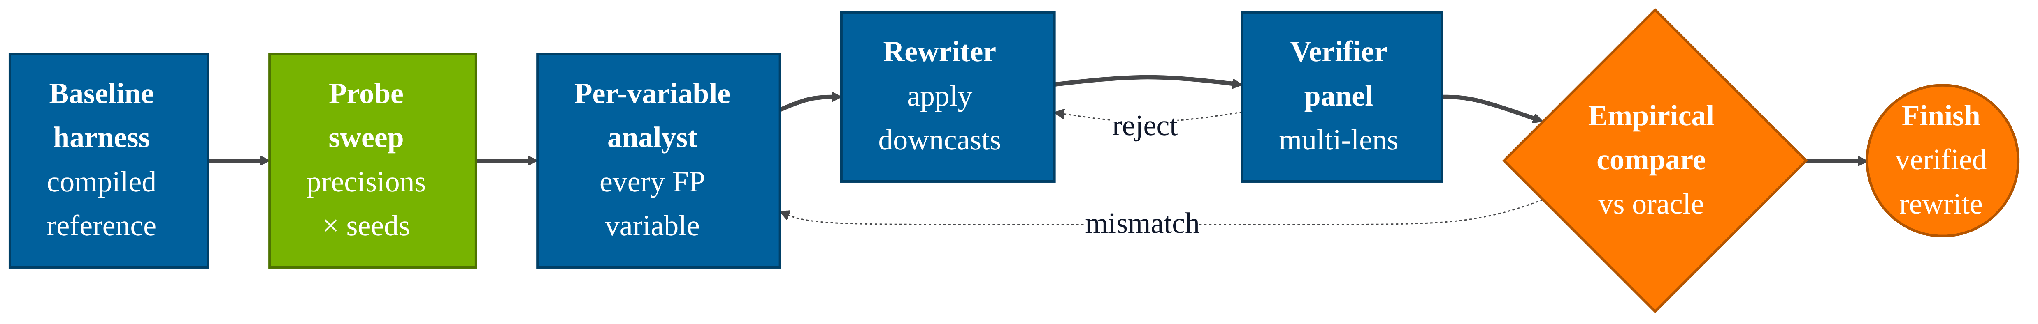
Faster Kernels, Same Answers: Agent-Driven Precision Tuning
July 30, 2026
Kim Meagher
Lowering a simulation's arithmetic from double to float can significantly cut runtime and memory traffic on modern HPC hardware, but doing it safely requires knowing exactly which variables tolerate reduced precision and which will silently corrupt your results. That expertise is scarce, and one wrong downcast can wreck an answer without an obvious error.
I present an agentic workflow that does this analysis for you. Given a Kokkos or CUDA kernel and an accuracy target, an LLM orchestrator reasons about every floating-point variable, then empirically tests each proposed precision change against a compiled reference, keeping only the downcasts that provably meet your tolerance. The goal: let domain scientists reap mixed-precision speedups without becoming floating-point experts.
GPU vendors have poured their transistor budget into low-precision throughput: FP16 and FP8 tensor performance has grown by orders of magnitude across recent generations, while peak FP64 has stalled, and on the newest parts it is actively shrinking [1–4]. NVIDIA’s Blackwell Ultra cuts hardware FP64 sharply relative to Hopper, and the gap between vendors is now a design choice, not a physical limit [3–5].
To keep exploiting this hardware, simulations must move work off FP64, but only where accuracy allows. Deciding which variables can safely drop precision is exactly the expertise this workflow automates.
Abstract
Motivation
Methods
An LLM orchestrator drives a fixed pipeline: it generates a compiled reference harness, then empirically probes the kernel at quad (FP128), double (FP64), and single (FP32) precision, using the quad run as a high-precision oracle. It then reasons about every floating-point variable; each proposed downcast is tested against the oracle and kept only if it meets the accuracy target. A verifier panel and a final numerical comparison gate the result.
Orchestrator and agents built on the Anthropic Claude SDK (claude-sonnet-4-6).
Conclusions
Next Steps
[1] NVIDIA, “NVIDIA A100 Tensor Core GPU Architecture,” product datasheet, nvidia.com.
[2] NVIDIA, “NVIDIA H100 Tensor Core GPU Datasheet,” nvidia.com.
[3] NVIDIA, “NVIDIA Blackwell / GB200 & GB300 NVL72 Datasheet,” nvidia.com.
[4] NVIDIA, “NVIDIA B200 Tensor Core GPU,” product specifications, nvidia.com.
[5] AMD, “AMD Instinct MI250X / MI300X / MI300A Accelerator Datasheets,” amd.com.
References

