Slide 1
CodeGenie
An AI companion for effortless code

Slide 2
Research Paper Observation
Abstract
To tackle the predominance of closed source models , DeepSeek coder series is introduced
Model sizes from 1.3B to 33B , 2 trillion tokens
Types of models
1.3B,6.7B,33B instruct
1.3B,6.7B,33B base
data Collection (87% source code , 10% English , 3% Chinese)
Data crawling : Collecting data from GitHub
Rule Filtering : applying various sets of rules to filter out unwanted/bad data
Dependency Parsing : Recognizing relationships between files
Repo level Deduplication : Removing repetitive files
Quality Screening and Decontamination : Filter out low quality data

Slide 3
4. Training Policy
Features like next token prediction and FIM technology
Tokenizer : HuggingFace tokenizer library
Optimization : AdamW
Environments : HAI-LLM framework
Long context : Linear scaling with seq length upto 16K (can process upto 64K)
Instruction Tuning
5. Benchmark Testing
HumanEval & MBPP – Achieves 66.0% accuracy.
LeetCode Contest Benchmark – Surpasses GPT-3.5-Turbo
DS-1000 (Data Science Benchmark) – Excels in applying libraries like NumPy, Pandas, and PyTorch
CrossCodeEval – Demonstrates state-of-the-art performance in cross-file code understanding

Slide 4
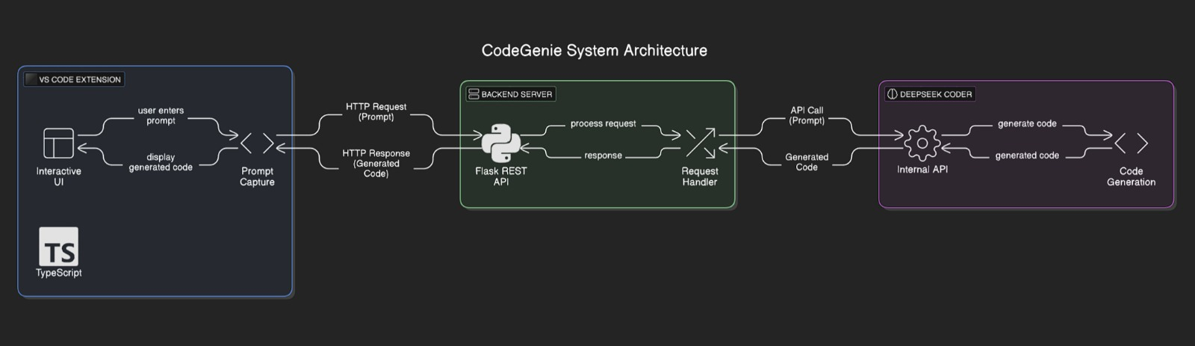
Project Architecture

Slide 5
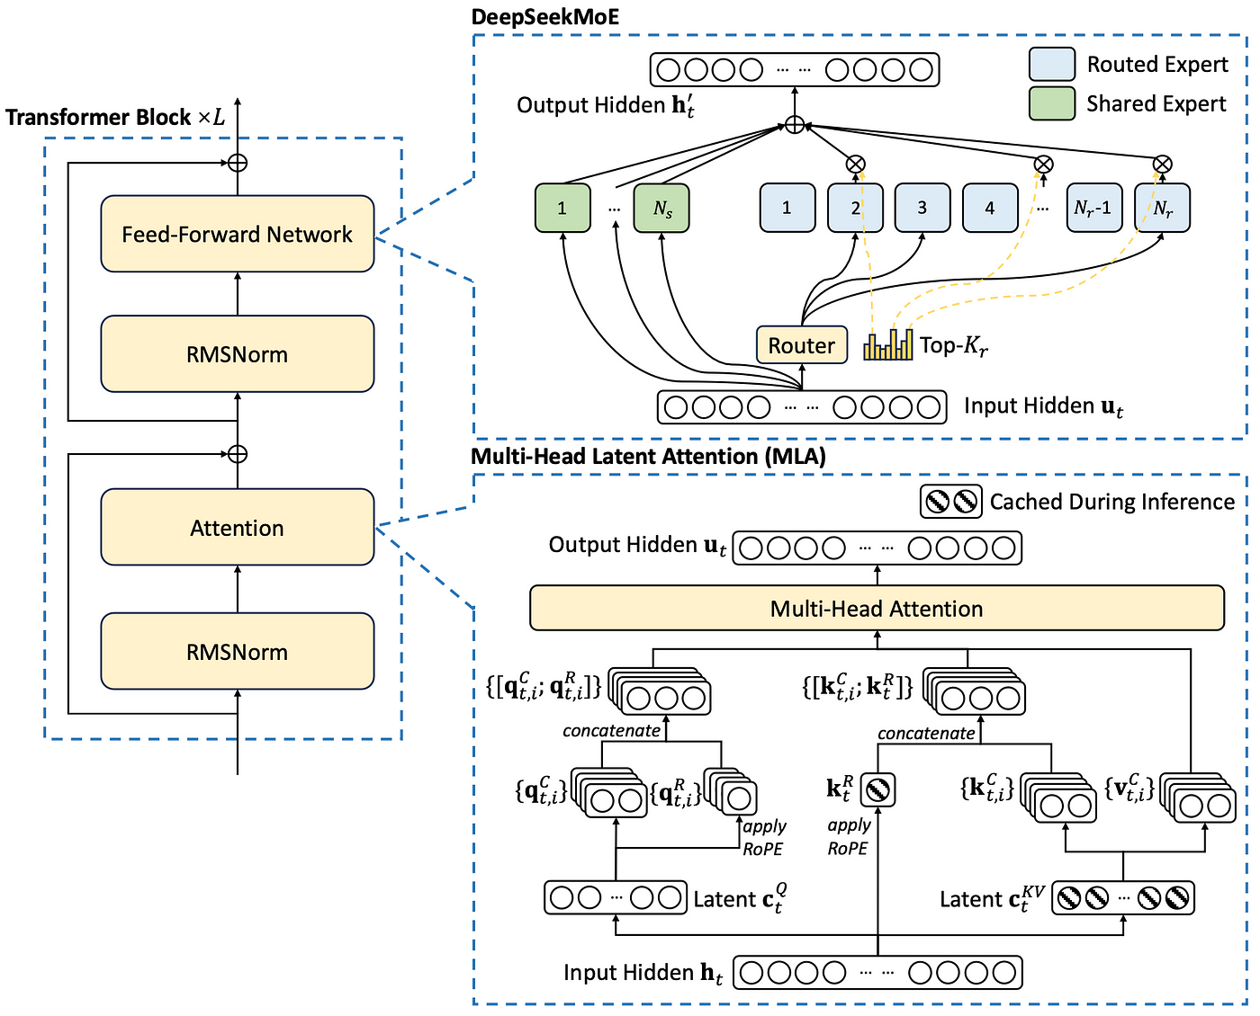
Model Architecture

Slide 6
Technology Stack
Extension UI (Frontend):
TypeScript/JavaScript
VS code extension using Yeoman
Flask API Server(Backend):
Python
Endpoints using Flask
Communication :HTTP + JSON
Transformer model : DeepSeek Coder Instruct 1.3B

Slide 7
Thank you
G-413
Omkar M Shewalkar
CSE(AIML) 245523748110

Slide 8
About the Project
CodeGenie is a VS Code extension powered by DeepSeek-Coder and accelerated by a GPU.
It provides intelligent code suggestions, autocompletion, and context-aware code snippets to enhance developer productivity.
The tool aims to streamline coding by understanding the context and offering real-time AI-powered assistance.
DeepSeek-Coder is an open-source large language model (LLM) specifically designed for coding tasks
It can generate, complete, debug, and explain code in multiple programming languages.
Trained on a massive dataset of code and natural language, it understands programming context and provides intelligent, real-time coding assistance.

