Slide 1




CODEGENIE
AI companion for effortless code creation
Name: K.Sathwika
Group Name: G413
Mentor Name: Ms.Sripooja
01

Slide 2

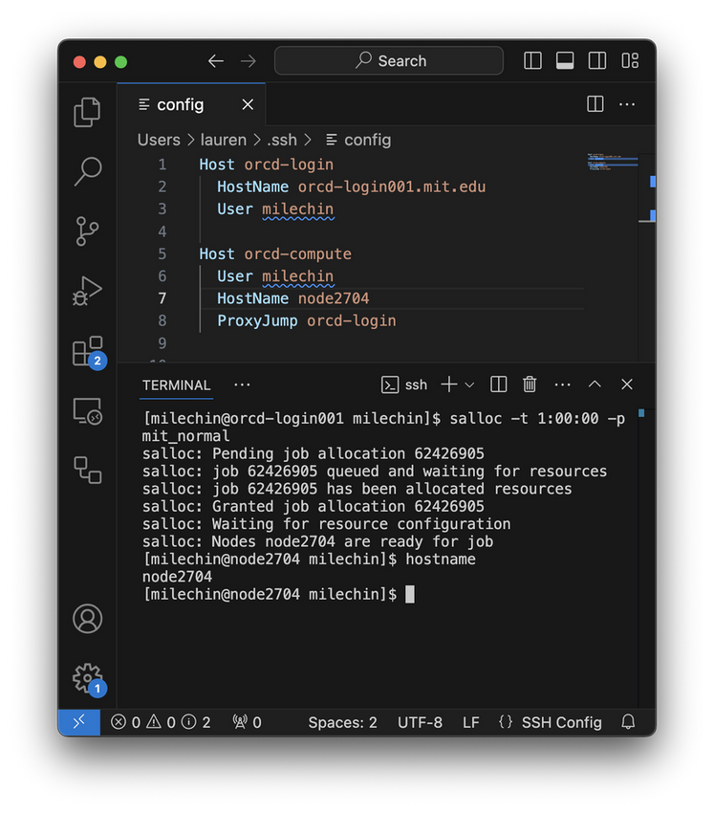

INTRODUCTION
Isn’t it frustrating to constantly switch between ChatGPT and VS Code, searching for the right code snippet, copying, pasting, and tweaking it just to make it work?
Introducing CodeGenie, an intelligent VS Code extension that brings the power of AI-driven code generation directly into your development workflow! No more context-switching — just real-time assistance right inside your editor.
CodeGenie which is built with deepseek coder ,empowers to :
Code suggestion
Autocompletions
Intelligent snippets
CodeGenie has your back — making your development journey faster, smarter, and way more efficient as it is running on RTX 4090 GPU.
02

Slide 3



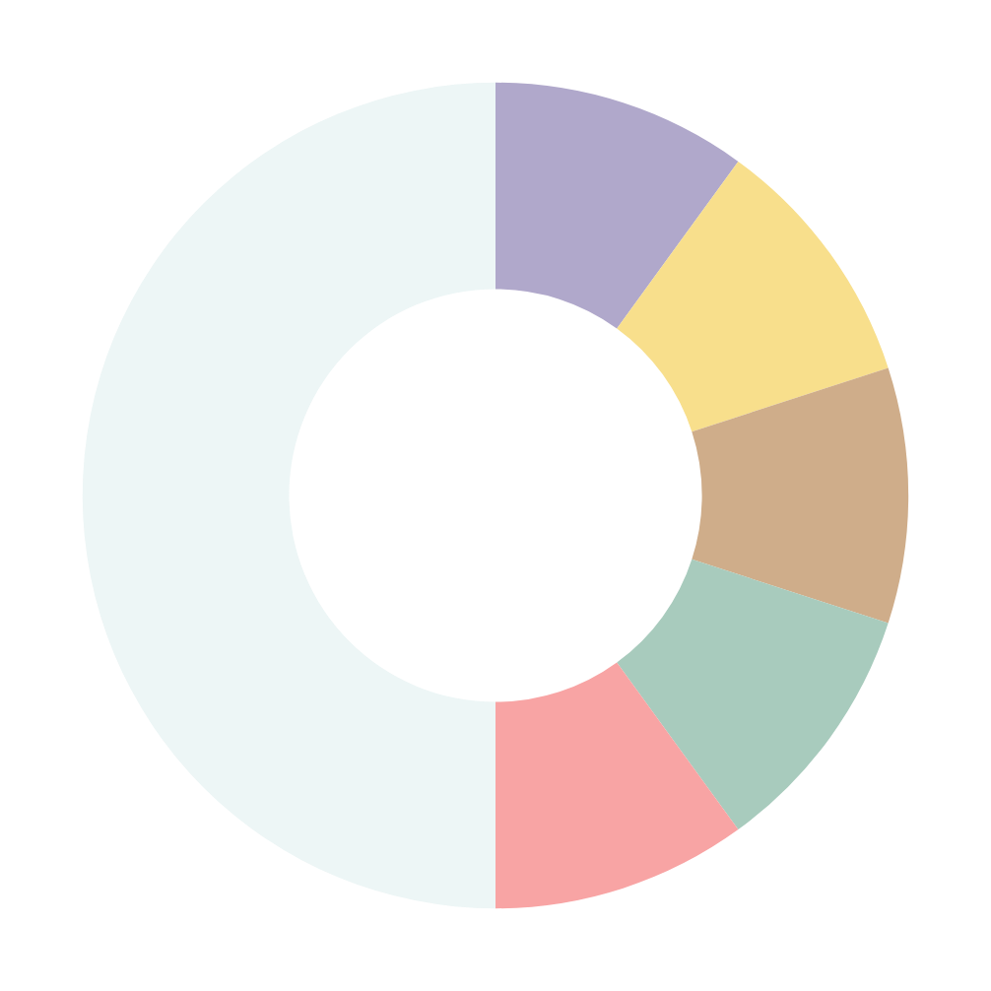



WHAT WILL THE APPLICATION DO?
BUSINESS PROBLEMS ADDRESSED
Generate real-time, intelligent code suggestions in VS Code.
Provide context-aware autocompletions for Python, JavaScript, Java, and more.
Optimize developer workflow using DeepSeek Coder’s advanced capabilities.
Enable user customization for languages, snippet styles, and shortcuts.
Ensure fast, efficient inference using a high-performance RTX 4090 GPU.
Reduces time spent searching for code solutions with AI-powered suggestions.
Guides beginners with best practices and code structure support.
Boosts performance using RTX 4090 for fast, local inference.
Solves privacy issues by avoiding cloud-based processing.
3
Data Scientists and Machine Learning Engineers
4
Students and Learners
Open Source Contributors
2
5
USE
RS
Professional Developers
Freelancers and Consultants
03
1

Slide 4













USER ROLES
HOW IT HELPS USERS BE MORE PRODUCTIVE?
Speeds up coding with intelligent autocompletions and snippet suggestions.
Enhances focus by reducing the need to switch between IDE and browser.
Reduces bugs with accurate code suggestions and syntax awareness.
Increases consistency in team codebases through smart formatting and templates.
Developers writing code.
End Users
For managing preferences, usage tracking, or model updates.
Admins
USER INTERACTION
System maintainers
INPUTS
OUTPUTS
For GPU management and infrastructure.
Code written or selected by the user
User-defined preferences or model settings.
Real-time code suggestions
Autocompletions inline
Smart snippets and refactoring recommendations
04
01
02

Slide 5
















DATASETS & SOURCES
Data is taken from Pre-trained model-Deepseek Coder
Open-source code repositories like GitHub and StackOverflow
DATA COMPOSITION
87% source code
10% English code-related text (e.g., GitHub Markdown, StackExchange)
3% unrelated high-quality Chinese text
DATA COLLECTION PIPELINE:
STEP1
STEP 2
STEP3
STEP4
DATA Crawling & Filtering:
Dependency Parsing:
Repo-Level Deduplication:
Quality Screening & Decontamination:
Crawled GitHub repositories (87 languages).
Filtered low-quality code (line length, characters, file types).
Dependency parsing orders project files.
Topological sorting arranges based on dependencies.
Near-deduplication removes repeated content.
Ensures unique data for efficient learning.
Quality model and heuristics filter bad code.
N-gram filtering avoids test data contamination.
05

Slide 6






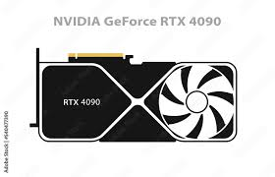

TECH STACK
FRONTEND:
Language: TypeScript
Framework: VS Code Extension API
UI Components: HTML, CSS, React
BACKEND:
Model Hosting: Flask API
Framework: VS Code Extension API
API Integration: RESTful API
AI:
Model: DeepSeek-Coder (LLM)
Library: Hugging Face Transformers (for loading and utilizing the model)
GPU Acceleration: CUDA (to leverage RTX 4090 GPU)
DEPLOYMENT:
Deploy: vscode
Version Control: Git & GitHub
06

Slide 7


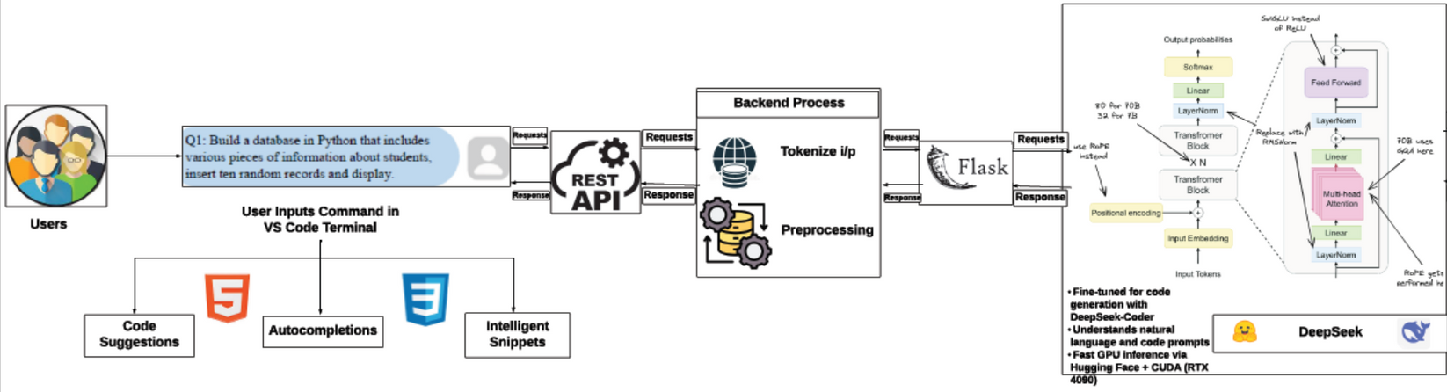
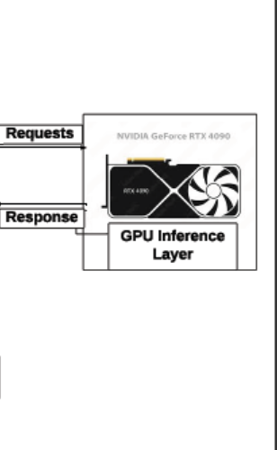

PROJECT ARCHITECTURE
07

Slide 8


THANK YOU
08

