Slide 1

Strategic Compensation Insights:
Data-Driven Equity & Market Alignment Proposal
Prepared by: Keshin Mehta

Slide 2
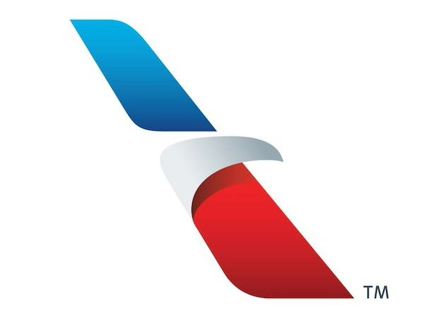
Executive Summary
American Airlines faces mounting compensation challenges across frontline, union, and contract roles.
This project provides a data-driven framework to:
- Address internal pay inequities
- Benchmark compensation to market standards
- Build governance around compliance and automation
- Align compensation improvements with operational KPIs

Slide 3
Current Compensation Landscape
Flight attendants have wide pay disparities: $32K–$90K, entry- level pay up to 32% below median.
Contract workers earn $13.40–$14.83/hr, 40% below Dallas County’s living wage ($23.06/hr).
Compensation compliance concerns include recent ERISA fiduciary cases and ADA fines.
Manual payroll processes improved via EPI-USE automation tools.

Slide 4
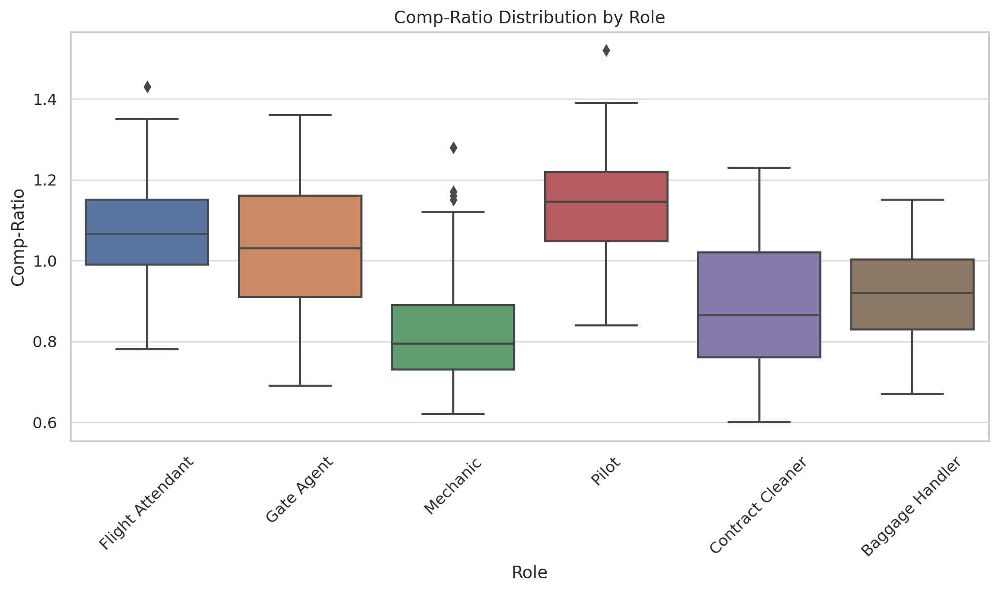
Equity Analysis: Comp-Ratio Distribution

Slide 5
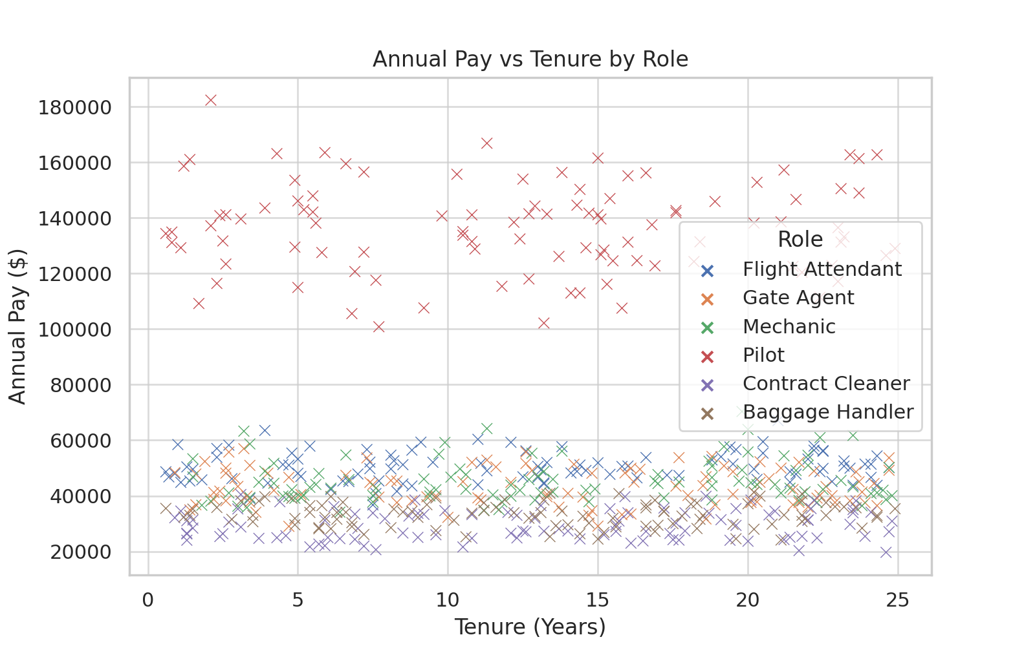
Pay vs Tenure: Internal Equity Concerns

Slide 6
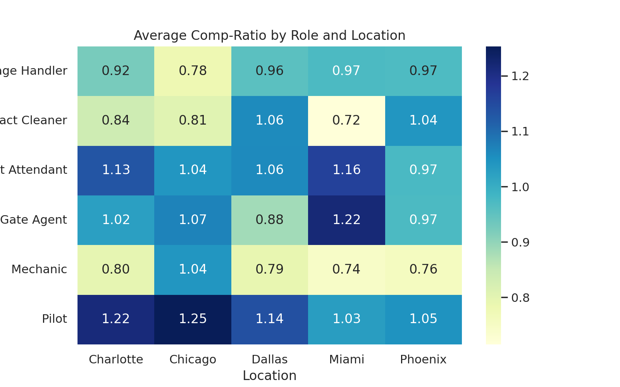
Location-Based Pay Alignment

Slide 7
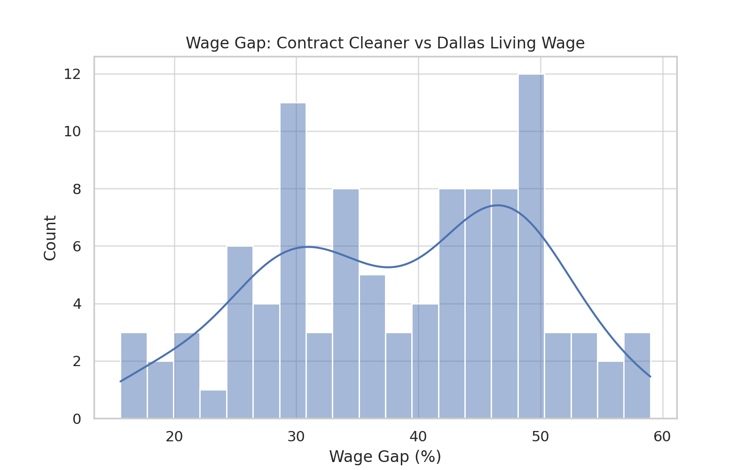
Contractor Pay Gap: Urgency for Adjustment

Slide 8
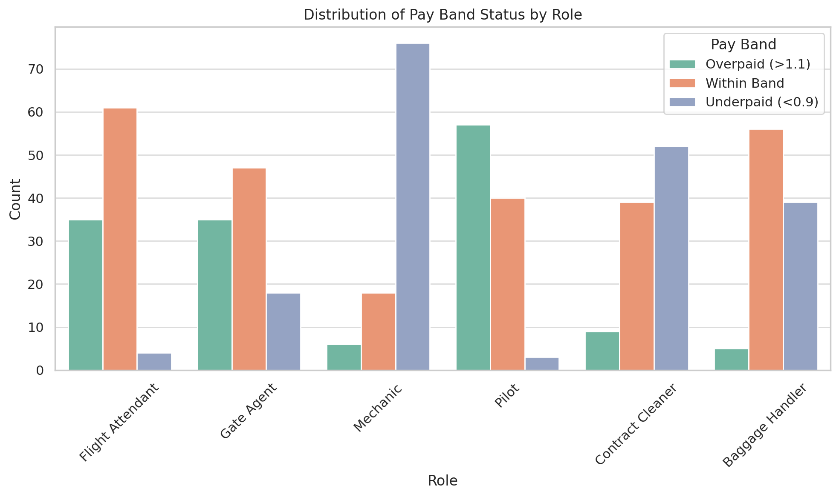
Compensation Band Classification

Slide 9
Strategic Recommendations
Create compensation-ratio dashboards to highlight internal compression.
Benchmark all hourly roles using market data (e.g., Mercer, WTW).
Implement a phased wage uplift plan for contract staff.
Align incentive structures with operational KPIs (like boarding time).
Automate compliance tracking for compensation policies and exceptions.

Slide 10
Expected Impact
Reduce regrettable attrition by 10 – 15% via equity adjustments.
Improve contract worker retention by 40% with phased living wage alignment.
Mitigate legal risk with proactive ERISA and wage compliance tracking.
Boost frontline morale and operational KPIs (like on-time departures).

Slide 11
References
https://www.ziprecruiter.com/Salaries/American-Airline-Flight-Attendant-Salary
https://aviationa2z.com/index.php/2024/11/08/american-airlines-flight-attendant-salary-in-2024
https://www.chron.com/culture/article/airline-workers-poverty-wages-texas-20314989.php
https://flightattendant.pro/american-delta-united-hourly-pay-comparison
https://www.prnewswire.com/news-releases/seiu-over-a-thousand-contracted-airport-workers-to-strike-at-united--american-airlines-largest-hubs-300486176.html

