Slide 1
Neural network for Kuzushiji-MINST
by Team Entropy
Team Member:
Keer Mei, Yujie Zhou, Adanna Akwataghibe, Tayfun Karaderi

Slide 2
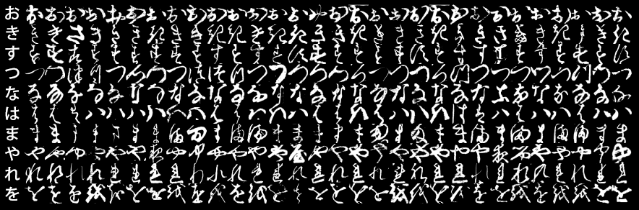
Introduction to KMNIST
LeNet5 AlexNet PCA

Slide 3
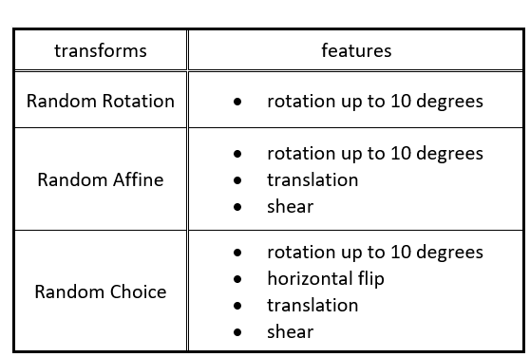
Data Pre-processing
Normalization
once-per-epoch
Random Affine VS Random Rotation
98.5% > 98.1%
Data Augmentation
multiple-per-epoch
Random Choice
validation accuracy → 100 % in as early as the 10th epoch
COST?
Increased computation time!

Slide 4
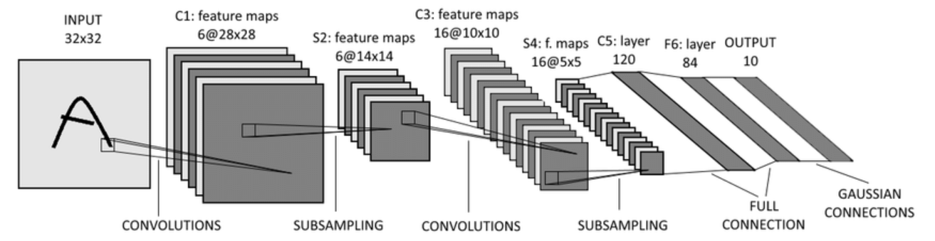
LeNet5
k = 3: 16@6×6
k = 7: 16@4×4
add C6
k = 5, p = 2
k = 5
output multiplied by 3
output multiplied by 3
dropout
k = 3, p = 1
k = 7, p = 3
k = 3
k = 7

Slide 5
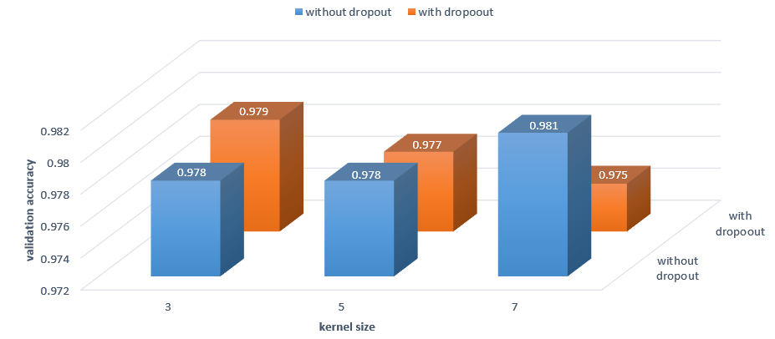
LeNet5 cont. – dropout, kernel size
momentum = 0.5, weight decay = 0.

Slide 6
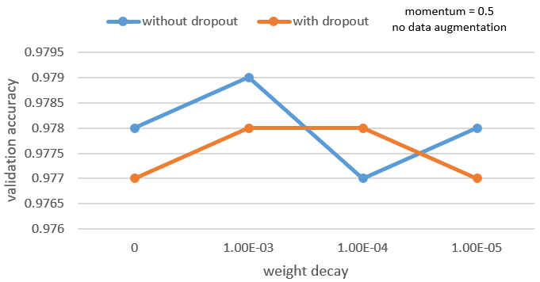
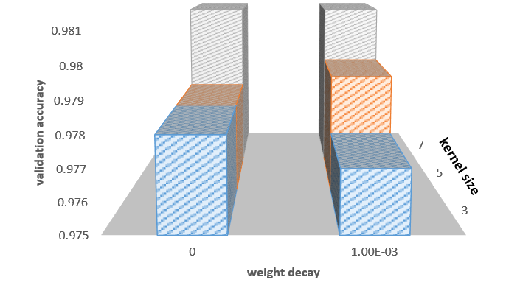
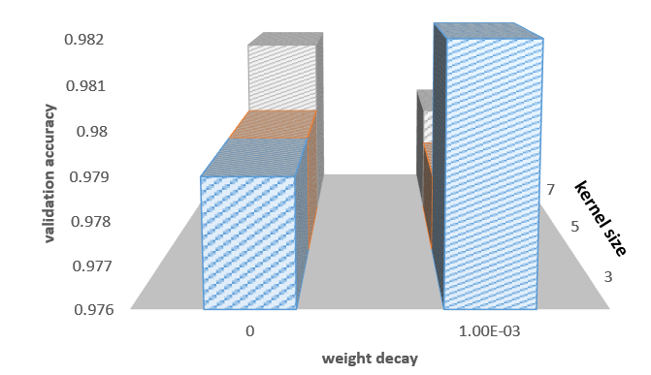
Hyperparameter - weight decay
Kernel Size
Epoch

Slide 7
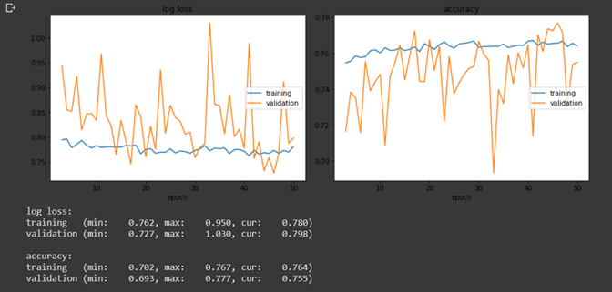
LeNet5 cont.
training accuracy did not noticeably improve
validation accuracy became unpredictable
Transfer Learning
a model that had previously been trained on MNIST
unfavourable
results
first: on augmented data
then: once on the original KMNIST data set.
the basis of our final competition model submission
Retraining
train a model more than once
allow the model to be trained on a larger sized data set.

Slide 8
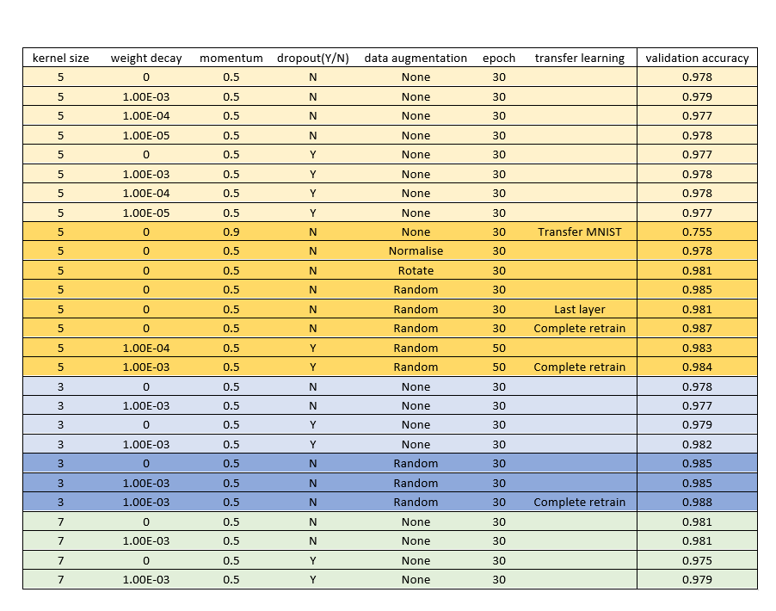
LeNet5 Results

Slide 9
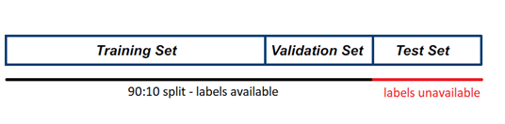
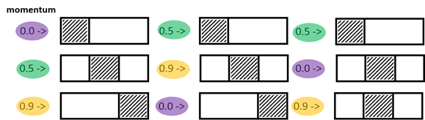
Validation Approach
Shuffled split
K-fold Cross validation
k_split
k_fold_optimisation

Slide 10
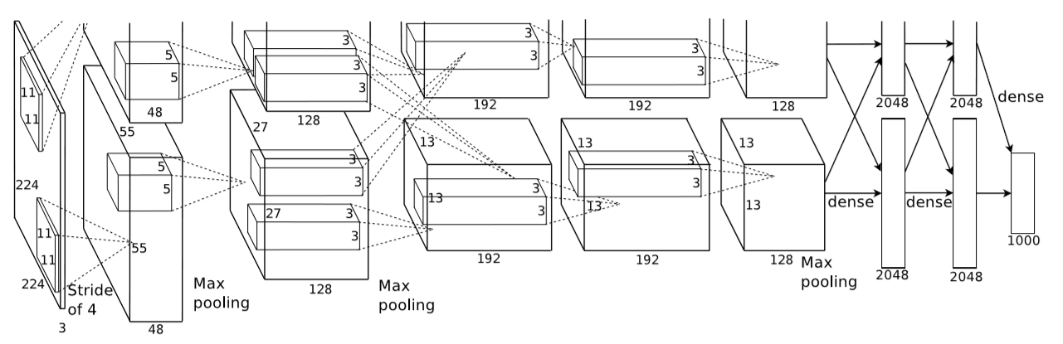
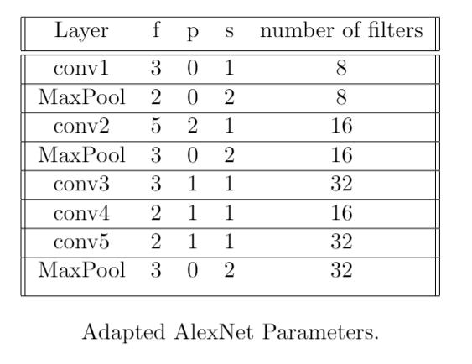
AlexNet

Slide 11
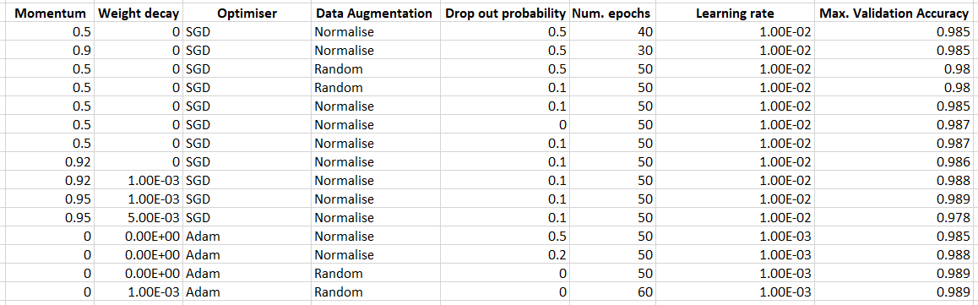
AlexNet cont.

Slide 12
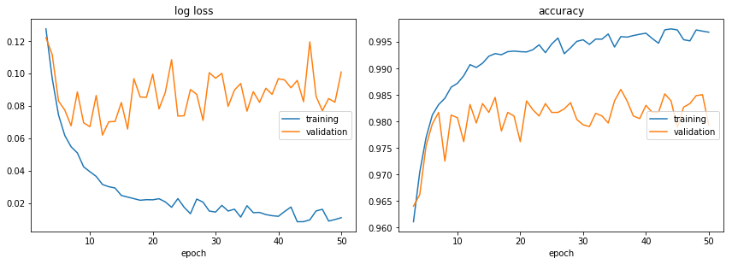
SGD, no weight decay, 0.1 dropout
98.5%

Slide 13
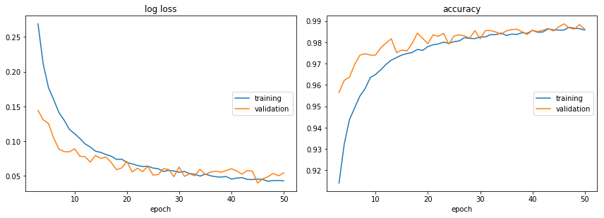
Adam, random data augmentation no dropout
98.9%

Slide 14
Unsupervised Approach
1
PCA
KNN Algorithm
1
97.7%
…
…
Predictions
80
784

Slide 15
Model averaging
Averaged Prediction
Lenet
Predictions
98.0%
on test set
+
Lenet
Predictions
+
AlexNet
Predictions
+
Lenet
Predictions
+
Lenet
Predictions

Slide 16
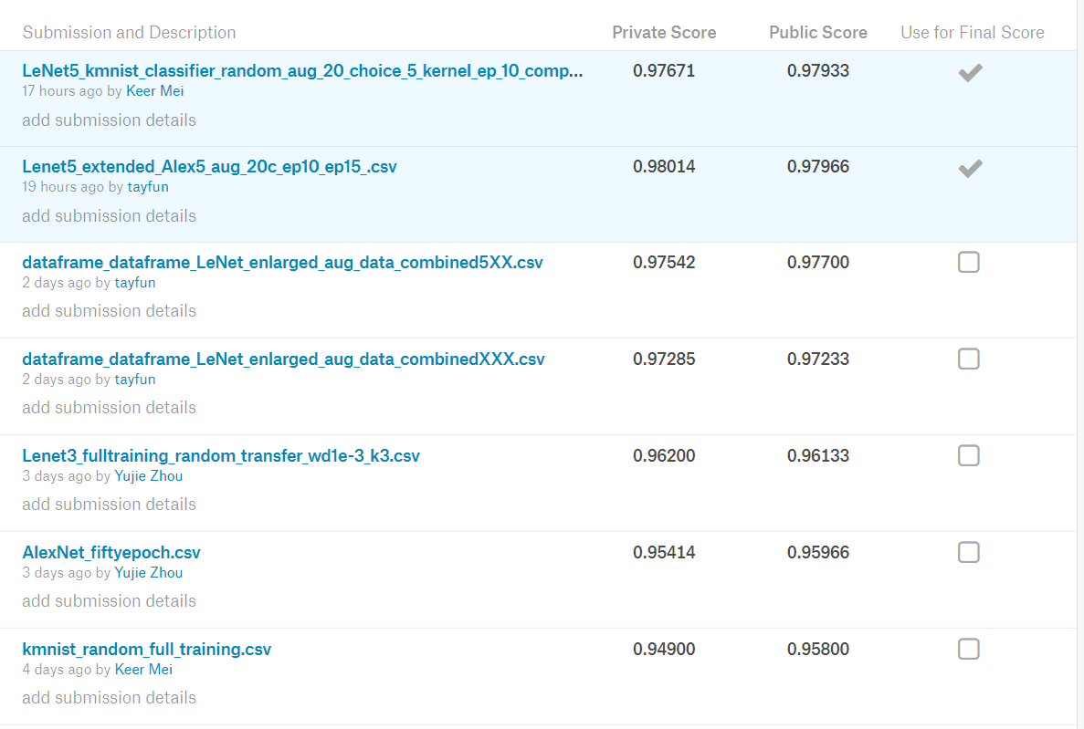
Competition Results

Slide 17
Conclusion
Retraining
Multiple-per-epoch augmentations
Architecture Extensions
Model averaging

Slide 18
Thank you!
Questions?

