Slide 1

Evaluating Volumetric Water Benefits with SWAT: A Case Study
By: Katie Mendoza

Slide 2


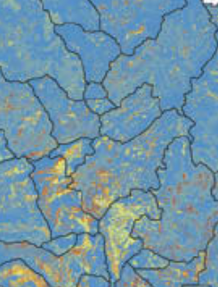



Model Used:
SWAT- Soil and Water Analysis Tool
Semi-distributed watershed scale ecosystem model
Watershed Subbasins HRUs
Areas of unique properties
Land Scape
Soil
Land Use
Elevation
River flow
Sediments
Evapotranspiration

Slide 3
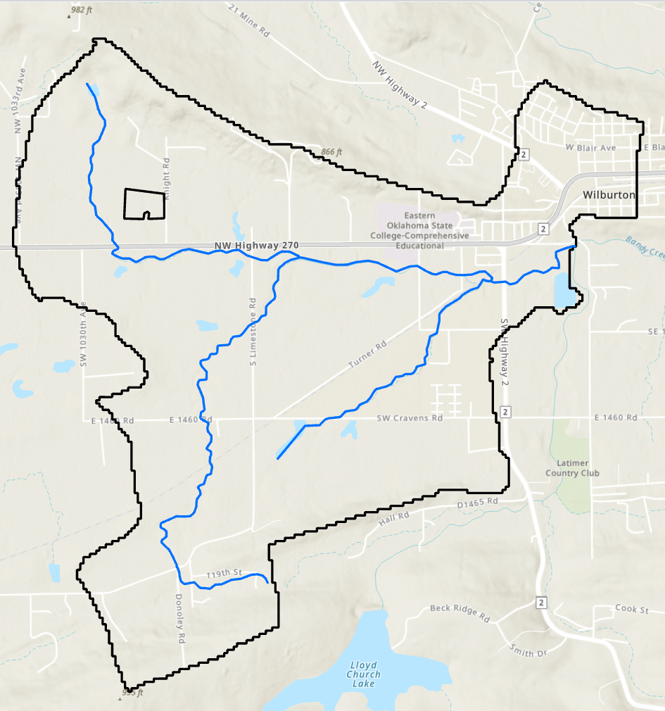
SWAT Model:
Area of Interest:
0.092 km² field within the Bandy Creek watershed, southeast of Wilburton in Latimer County, Oklahoma.
Modeling Approach:
SWAT model generated using the web-based Hydrologic and Water Quality System (HAWQS).
Watershed Characteristics:
Bandy Creek watershed delineated with an area of 18.18 km².

Slide 4
Publicly Available
Input Datasets:
Input Dataset | Source | Specifications
Weather | PRISM | 1981 – 2022
Soil | USDA National Resources Conservation Service (NRCS) Soil Survey Geographic (SSURGO) Database | 2018
Land Use | National Land Cover Database (NLCD) | 2016
 | USDA National Agricultural Statistics Service (NASS) Cropland Data Layer (CDL) | 2014 – 2017
 | USDA NASS Fields | 2006 – 2010
 | U.S. Fish and Wildlife Service (FWI) National Wetlands Inventory (NWI) | 2018
Aerial Deposition | National Atmospheric Deposition Program (NADP) | 1980 – 2020
Watershed Boundaries and Stream Networks | EPA NHDPlus v2 | 2019
Elevation | USGS National Elevation Dataset (NED) 10-meter DEM | 2018
Management Data | USDA NRCS crop management zone data | 2010
Water Use | USGS Water Use in the United States | 2015

Slide 5
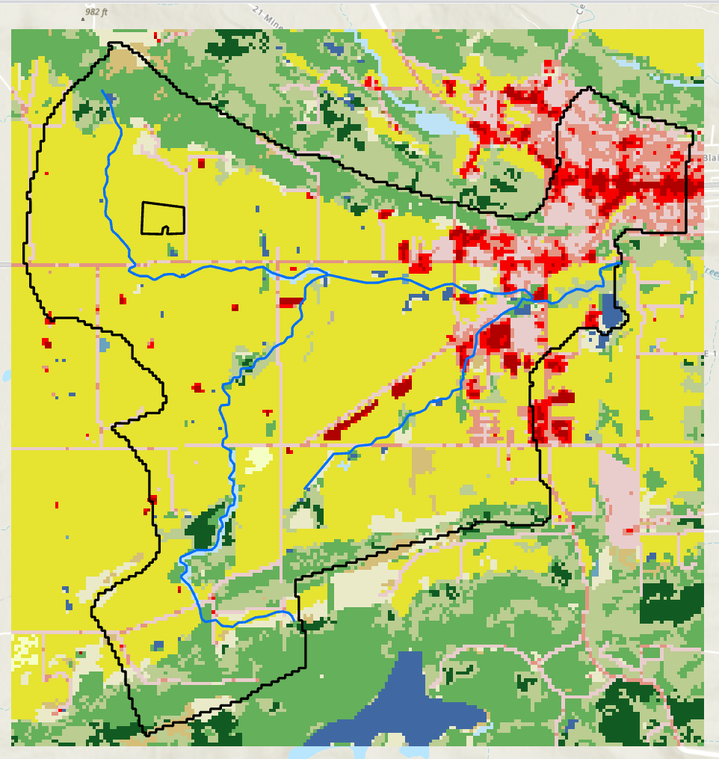
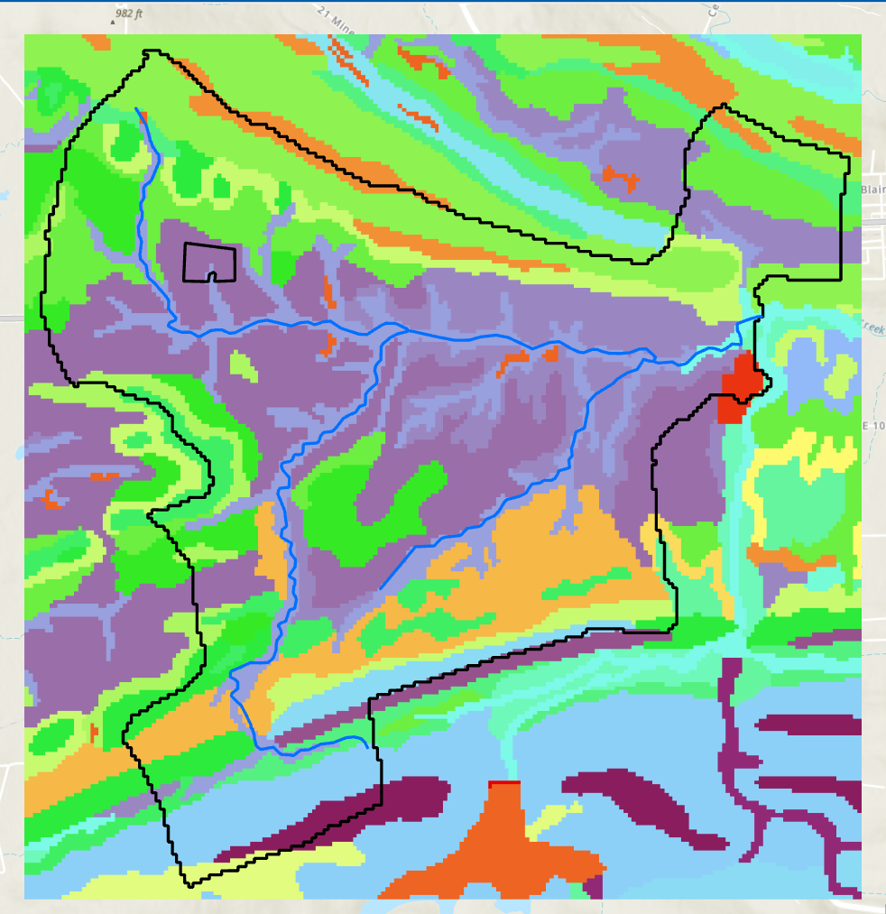
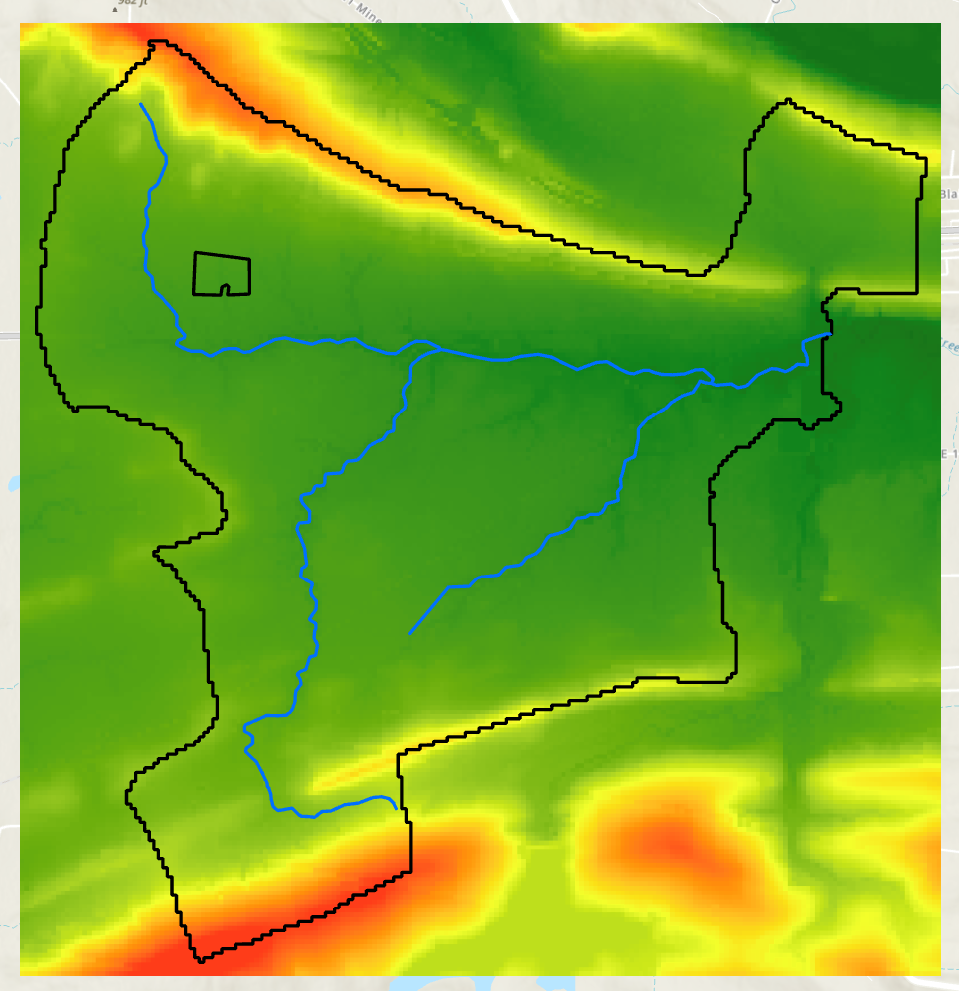
AOI HRU Selection :
HRU Creation: The SWAT model generated 102 unique hydrologic response units (HRUs) from the combination of soil, slope, and land use.
HRU Selection: Scenarios were focused on a pasture HRU with Counts soil and ~1% slope.
Land Use = Pasture
Soils = 571483 Counts (Deep soil)
Hydrologic Group D
(High Surface Runoff Potential)
Slope = ~1%

Slide 6
Baseline Scenario:
Selected matching HRU for land use, soil, and slope
Adjusted the area of the matching HRU to same area as AOI
Adjusted the area of an HRU with land use = Fescue, same soil, and slope to maintain area of watershed
Ran SWAT to generate Baseline output
Used Python code (updated_hru_fr.py) to modify areas in the hru files
Land use = Pasture
Soil = Counts
Slope = 1%
Output file output.hru contains monthly output from 2001-2022 for the AOI HRU
Monthly timestep from 1999 – 2022 with a 2-year spin-up

Slide 7
Cover Crop Scenario:
Used Python code (add_WWHT_cover_crop_mgt.py) to simulate a cover crop on the AOI HRU
Modify management of AOI HRU to simulate winter wheat as a cover crop on the pasture
Ran SWAT to generate Cover Crop Output
Output file output.hru contains monthly output from 2001-2022 for the AOI HRU
Monthly timestep from 1999-2022 with 2-year spin-up
What happens when a cover crop is added:
Improved infiltration
Vegetative cover
Leaves and residues physically slow down water flow, allowing more time for infiltration.
Roots from cover crops create more channels in the soil so less water runs off the surface.
Evapotranspiration
Cover crops take up more water through evapotranspiration, reducing the volume available for runoff.

Slide 8
Volumetric Water Benefit (VWB):
Average Annual VWBs from a Cover Crop
Scenario | Surface Runoff (mm) | Water Yield (mm) | Evapotranspiration (mm)
Baseline | 388.3 | 472.5 | 710.1
CoverCrop | 305 | 352.1 | 833.1
Benefit | 83.3 | 120.3 | -123.1
Sediment Yield (t/ha)
3.5
0.3
3.3
Surface runoff: Cover crops reduce runoff by 83 mm/year (VWB) within the AOI.
Water yield: The total reduction increases to 120 mm/year when considering overall AOI water yield.
Evapotranspiration: Higher ET reduces available water by 123 mm/year (VWB), limiting potential runoff.
Sediment benefit: Cover crops substantially reduce sediment yield, providing an additional benefit for erosion control and water quality.
Used R code (compile_hru_output.R) to generate figure of VWBs from the cover crop scenario

Slide 9
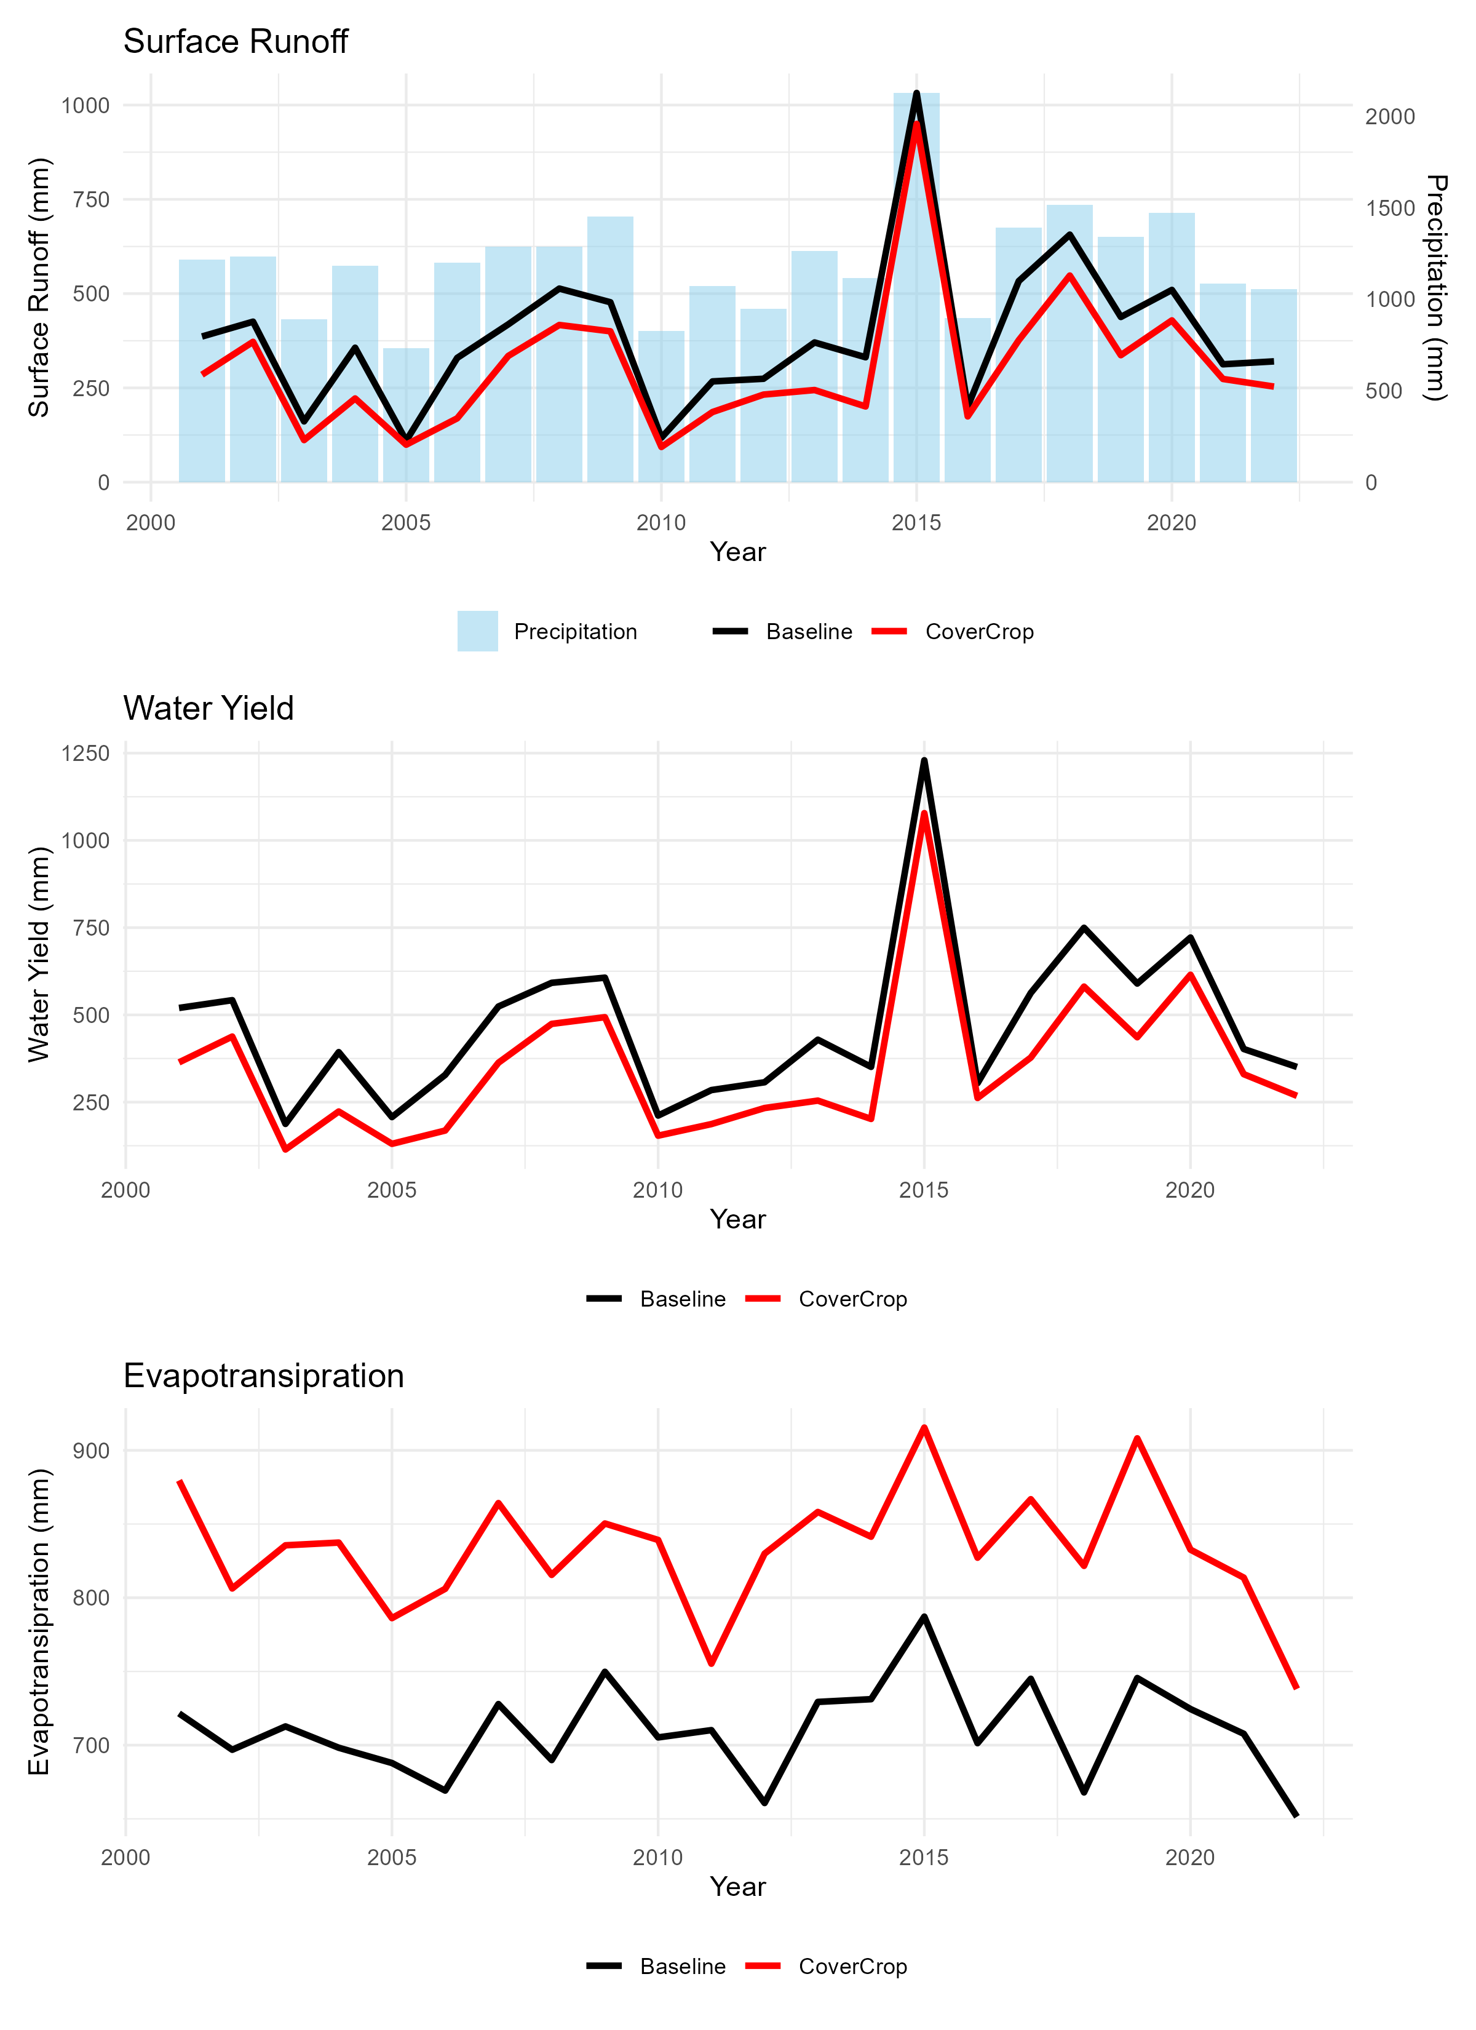
Cover Crop Annual VWB:
Consistent VWB: Cover crops provide yearly volumetric water benefits.
Resilience in wet years: Even during high-flow years, cover crops reduce surface runoff.
Surface runoff dominates: Runoff reduction contributes most to overall water yield benefits.
Higher ET: Increased evapotranspiration from cover crops lowers the water available for runoff.
Used R code (compile_hru_output.R) to generate figure of VWBs from the cover crop scenario

