Slide 2


Slide 4
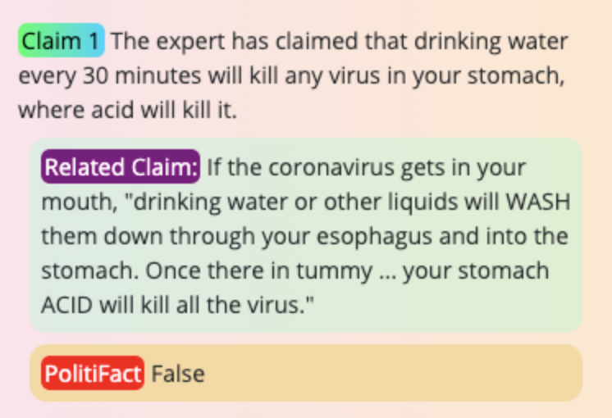
Indicates that the Google API has found related claims
Full text of related claim
Button color depends on verdict stance
Button links to full fact-check report from trusted source

