Slide 1
FutureSystems and OpenStack
Andrew J. Younge
For CSCI-P434 Distributed Systems Fall 2015

Slide 2
#1 - Apply for Account on FutureSystems Portal

Slide 3
Apply for Account on FS Portal
Register a FutureSystems account on the portal page:
https://portal.futuresystems.org/user/register
Make sure you fill in the username as your IU email username, e.g. <username>@indiana.edu
Adviser's Contact Information
FG-486, Professor Judy Qiu, xqiu@indiana.edu

Slide 4
Apply for Account
Email will be sent to confirm your account
Also wait for FG admins to approve your account
Once account is created, join FG-486 project
https://portal.futuresystems.org/projects/486
Click “Request Join” on right column
Wait for confirmation email

Slide 5
Apply for Account on FS Portal
Need to have SSH keypair to log into system servers
If you have an existing keypair, use public key now
Generate a ssh keypair for cluster login
Use any UNIX OS (Linux, Mac OS X) and type: ssh-keygen –t rsa
Keys will default be created at ~/.ssh/id_rsa and ~/.ssh/id_rsa.pub for private and public keys, respectively
Can give –f filename flag to name the key a special name

Slide 6
Apply Account on FS Portal
Display public key (id_rsa.pub) in terminal:
cat ~/.ssh/id_rsa.pub
Copy and paste (add a new key) the public key to FS portal
My Portal Account -> SSH Keys -> Add public key
NOTE: be careful not to include newlines when you c/p!

Slide 7
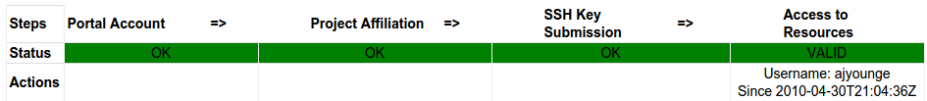
Account on FS Portal
Check to make sure your account is all set up
My Portal Account -> Portal Account
https://portal.futuresystems.org/manage-my-portal-account
If all blocks GREEN, you’re all set!
May have to wait up to a few hours for final setup to complete (Access to Resources)

Slide 8
FS Portal Account Help
For more help, please follow the following detailed guides:
Step 1: Create a portal account http://cloudmesh.github.io/introduction_to_cloud_computing/accounts/details.html#s-account-create-account
Step 2: Join a project or create http://cloudmesh.github.io/introduction_to_cloud_computing/accounts/details.html#join-a-project
Step 3: Upload a SSH Public Key http://cloudmesh.github.io/introduction_to_cloud_computing/accounts/details.html#upload-a-ssh-public-key

Slide 9
#2 - Using FutureSystems India OpenStack

Slide 10
Using FutureSystems’ India OpenStack
Make sure you can log into FutureSystemsIndia cluster
ssh -i <private key path> <username>@india.futuresystems.org
ex: ssh –i ~/fg-key fguser1@india.futuresystems.org
Otherwise, please apply for an account on FutureSystems Portal
https://portal.futuresystems.org/user/register
If you lost your ssh private key, please generate a new set, copy and add it to the portal
https://portal.futuresystems.org/manage-my-portal-account

Slide 11
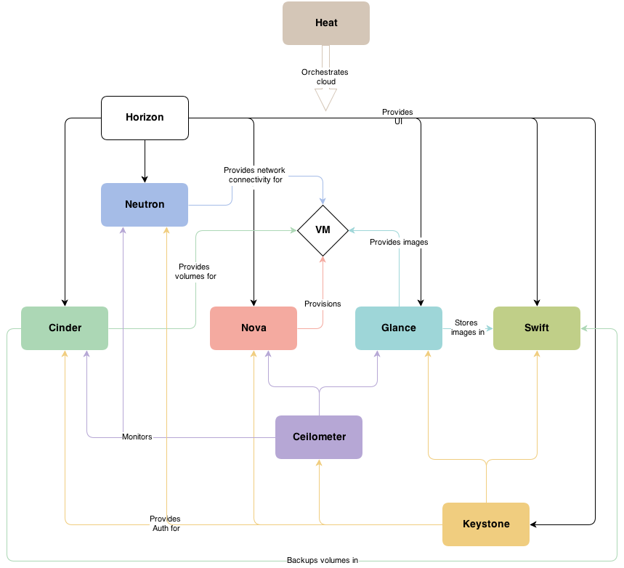
FutureSystems OpenStack Cloud
An open source virtual machine (VM) management environment.
Provides virtual compute nodes, snapshots, object storage, monitoring interfaces, and other features.
We mainly use Nova as compute resources for our class, which pertains to booting VMs
http://docs.openstack.org/admin-guide-cloud/content/ch_getting-started-with-openstack.html

Slide 12
Commands for OpenStack
# 1. Load the OpenStack tool
module load openstack
# 2. Find and load your OpenStack Nova security credentials
source ~/.cloudmesh/clouds/india/kilo/openrc.sh
# 3. See available virtual images
nova image-list
# 4. See available instance types
nova flavor-list
Official Tutorial - http://manual.futuresystems.org/openstackhavana.html

Slide 13
Commands for OpenStack (cont.)
# 5. Create your own Nova ssh keypair for your future started instance
NOTE: do this only for the first time!
nova keypair-add $USER-fg486-vm-sshPublickey > ~/.ssh/$USER-fg486-vm-sshPrivatekey
chmod 600 ~/.ssh/$USER-fg486-vm-sshPrivatekey
nova keypair-list
# 6. Add security group for SSH connection
NOTE: Do this only for the first time!
nova secgroup-add-rule default icmp -1 -1 0.0.0.0/0
nova secgroup-add-rule default tcp 22 22 0.0.0.0/0
nova secgroup-list-rules default
Official Tutorial - http://manual.futuregrid.org/openstackhavana.html

Slide 14
Commands for OpenStack (cont.)
# 7. Set the net list variable for using the internal network
NET_ID=$(nova net-list| awk '/ fg486-net / {print $2}')
# 8. Boot an OpenStack Nova virtual compute node!
NOTE: $USER-001 is the name of the VM. This must be unique for every VM you want to boot.
nova boot --flavor m1.medium \
--image "fg486/ubuntu-mpj" \
--nic net-id=$NET_ID \
--key_name $USER—fg486-vm-sshPublickey \
$USER-001
# 9. Check to see when your VM is in ACTIVE state
nova list
# Image size
# Select an image to use
# Network type (internal)
# Select your key
# VM name (make unique)

Slide 15
Commands for FG-OpenStack (cont.)
# 9. Log into the VM with your Nova ssh private key
NOTE: change XX to the VM IP addr from nova list
ssh -i ~/.ssh/$USER-fg486-vm-sshPrivatekey ubuntu@10.0.4.XX
# 10. Terminate your own instances once you finish your work
nova list
nova delete $USER-001
For additional help and a generalized tutorial, please consult the FutureSystems OpenStack Juno tutorial at: http://cloudmesh.github.io/introduction_to_cloud_computing/iaas/openstack.html

Slide 16
#3 - Run Hadoop Applications on running OpenStack VM instances

Slide 17
Overview
Configure VM working environment
Change “/etc/hosts” on all VM nodes
Configure Hadoop
Start Hadoop
Check Hadoop status
Run Hadoop applications

Slide 18
Commands
# 1. Make /etc/hosts inside VMs based on nova list
NOTE: Run from india login node
nova list
+--------------------------------------+--------------+--------+------------+-------------+-----------------------+
| ID | Name | Status | Task State | Power State | Networks |
+--------------------------------------+--------------+--------+------------+-------------+-----------------------+
| 3a79c5a5-7747-4947-8dc5-4750bbc313b1 | <username>-001 | ACTIVE | None | Running | int-net=10.23.0.251 |
| c3be9d71-fe7f-4c6f-886f-7869d3e09f8c | <username>-002 | ACTIVE | None | Running | int-net=10.23.0.252 |
+--------------------------------------+--------------+--------+------------+-------------+-----------------------+
Edit VM $USER-001’s /etc/hosts file, add IPs and hostnames for all nodes
NOTE: Replace <username> with your VM names
sudo vi /etc/hosts
10.23.0.251 <username>-001
192.23.0.252 <username>-002
Repeat for all nodes, or scp /etc/hosts to each VM

Slide 19
Commands (Cont.)
# 2. Edit $HADOOP_HOME/nodes on the first login nodes
vi ~/software/hadoop-1.1.2/nodes
10.23.0.251
192.23.0.252
# 3. Start Hadoop
NOTE: Make sure you only run the following commands from the first node in your node file. In this case, that’s the node with IP 10.23.0.251
NOTE: You may have to answer “yes” to accept the ssh fingerprint.
cd $HADOOP_HOME
. ./MultiNodesOneClickStartUp.sh $JAVA_HOME nodes

Slide 20
Commands (Cont.)
# 2. Edit $HADOOP_HOME/nodes on the first login nodes
vi ~/software/hadoop-1.1.2/nodes
10.23.0.251
192.23.0.252
# 3. Start Hadoop
NOTE: Make sure you only run the following commands from the first node in your node file. In this case, that’s the node with IP 10.23.0.251
NOTE: You may have to answer “yes” to accept the ssh fingerprint.
cd $HADOOP_HOME
. ./MultiNodesOneClickStartUp.sh $JAVA_HOME nodes

Slide 21
Commands (Cont.)
# 4. Check Hadoop Status
Please use: lynx 192.168.205.5:9001 to see HDFS status
Please use: lynx 192.168.205.5:9003 to see MapReduce Daemon status
# 5. Run Hadoop Applications
cd ~/MoocHomeworks/HadoopWordCount
cp input/Word_Count_input.txt input/Word_Count_input2.txt
hadoop fs -rmr output
hadoop fs -rmr input
hadoop fs -put input input
./build.sh
hadoop jar wordcount.jar WordCount input output
hadoop fs -cat output/*

