Slide 1
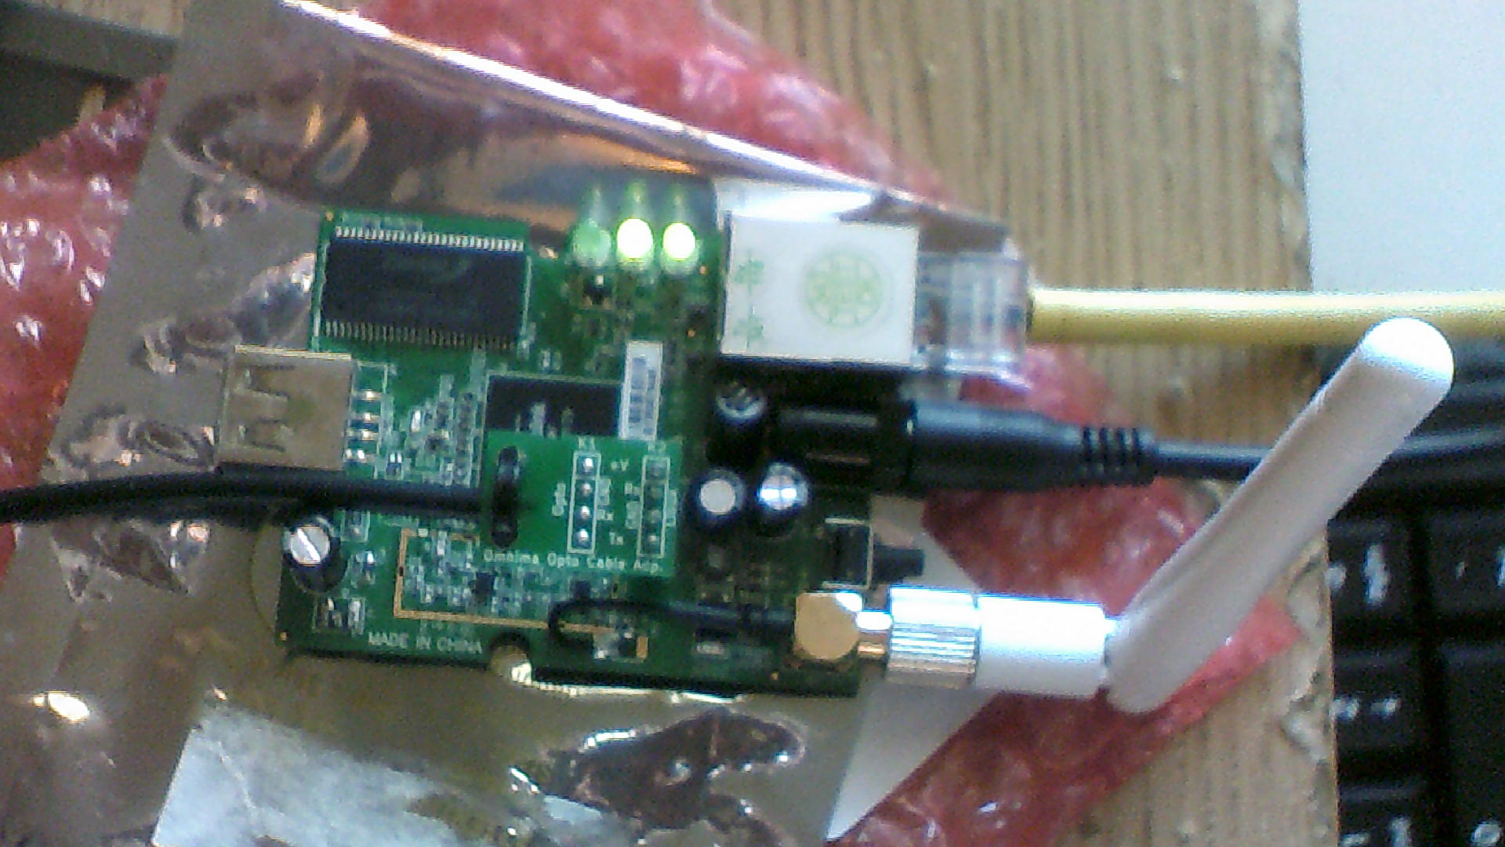
OpenWRT MiniEMBWifi Dev Build
Purpose
Install OpenWrt distribution as a build environment without the Lua web interface and not as a router but as more of a general purpose device
Build fresh install of firmware
Capability to develop in other languages
Supporting libraries for minimal development
Retain capabilities of on-board peripherals

Slide 2
Hardware
Ralink RT3050 based board
MIPS 24KEc 320 Mhz CPU
1 UART serial port
8MB NOR Flash
32MB DRAM
1 USB2.0 port
1 WAN/LAN Port 10/100M
1 WLAN 802.11a,b,g access point or station modes
Operating Temperature: 0 – 50 Deg Celsius, Storage: -20 – 50 Deg Celsius
Certification: FCC, CE
USB to Serial 4-PIN header for programming/serial console
Antenna 3dBi Dipole detachable antenna
Power Adaptor 5 V 2.5 Amps

Slide 3
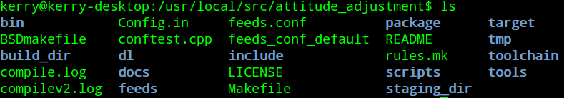
Software
Host System
Ubuntu 12.04 32-bit Linux 3.2.60-generic kernel
Target Build System
ATTITUDE ADJUSTMENT (Attitude Adjustment, r40877) OpenWrt 12.09 Linux 3.3.8
* OpenWrt is a custom embedded linux distribution integrated with buildroot
eliminating need to find correct package combinations when cross-compiling
for example
1. svn co svn://svn.openwrt.org/openwrt/branches/attitude_adjustment
2. Added following lines to feeds.conf in main source directory:
src-svn packages svn://svn.openwrt.org/openwrt/branches/packages_12.09
src-svn xwrt http://x-wrt.googlecode.com/svn/trunk/package
3. According to README file in main source directory:
./scripts/feeds update -a
./scripts/feeds install -a
Brings in all packages from sources in feeds.conf

Slide 4
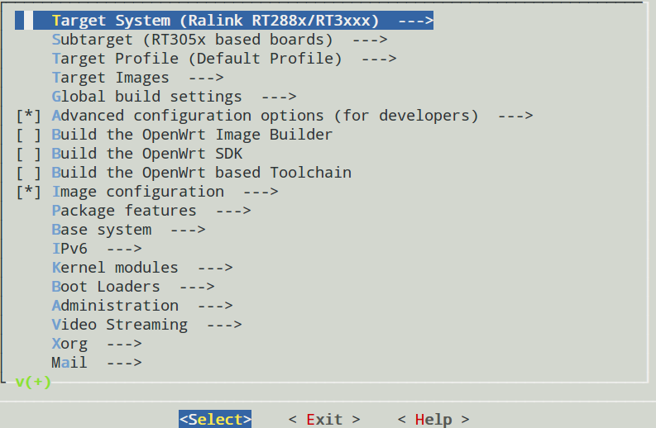
4. make menuconfig
* menu abbreviated for brevity
5. make
make[1] world
make[2] target/compile
make[3] -C target/linux compile
. . . .
OpenWRT 3,10.36
BARRIER BREAKER (Bleeding Edge, r40891)
Linux Kernel 3.10.18
-----------------------------------------------------
OpenWrt BARRIER BREAKER (Bleeding Edge, r38695)
-----------------------------------------------------

Slide 5
Kernel Build Options
CONFIG_KERNEL_DEBUG_FS=y
# CONFIG_KERNEL_PERF_EVENTS is not set
# CONFIG_KERNEL_PROFILING is not set
# CONFIG_KERNEL_KALLSYMS is not set
# CONFIG_KERNEL_FTRACE is not set
# CONFIG_KERNEL_DEBUG_KERNEL is not set
# CONFIG_KERNEL_DEBUG_INFO is not set
# CONFIG_KERNEL_AIO is not set
CONFIG_KERNEL_MAGIC_SYSRQ=y
CONFIG_KERNEL_ELF_CORE=y
# CONFIG_KERNEL_PROVE_LOCKING is not set
CONFIG_KERNEL_PRINTK_TIME=y
CONFIG_USES_SQUASHFS=y
CONFIG_TARGET_ROOTFS_JFFS2=y
CONFIG_TARGET_ROOTFS_SQUASHFS=y
CONFIG_TARGET_OPTIMIZATION=-Os -pipe -mips32r2 -mtune=24kec -fno-caller- saves -mdsp”
CONFIG_SOFT_FLOAT=y
CONFIG_GCC_VERSION=”4.7.0”
CONFIG_ULIBC_VERSION=”0.9.33.2”
CONFIG_USE_UCLIBCXX=y
CONFIG_GPIO_SUPPORT=y
CONFIG_USB_SUPPORT=y
CONFIG_mipsel=y
CONFIG_ARCH="mipsel"

Slide 6
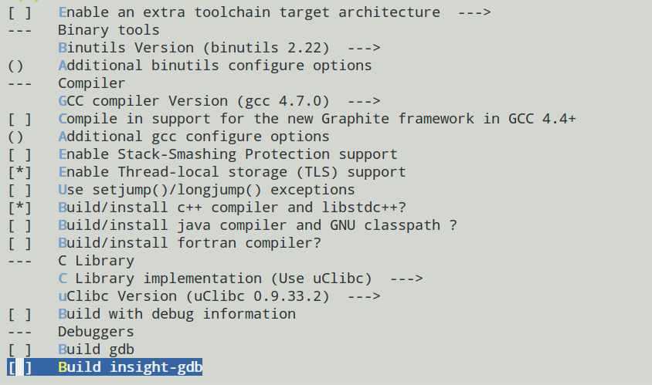
Toolchain
BARRIER BREAKER (Bleeding Edge, r40891)
Linux Kernel 3.10.18
-----------------------------------------------------
OpenWrt BARRIER BREAKER (Bleeding Edge, r38695)
-----------------------------------------------------

Slide 7
Installed Packages
binutils - 2.22-5
busybox - 1.19.4-6
dropbear - 2011.54-2
hostapd - 20131120-1
hotplug2 - 1.0-beta-4
iptables - 1.4.10-5
iw - 3.6-1
jshn - 2013-10-19
kmod-button-hotplug - 3.3.8-3
kmod-cfg80211 - 3.3.8+2014-01-23.1-1
kmod-crypto-aes - 3.3.8-1
kmod-crypto-arc4 - 3.3.8-1
kmod-crypto-core - 3.3.8-1
kmod-eeprom-93cx6 - 3.3.8-1
kmod-fs-ext4 - 3.3.8-1
kmod-fs-vfat - 3.3.8-1
kmod-hid - 3.3.8-1
kmod-input-core - 3.3.8-1
kmod-input-evdev - 3.3.8-1
kmod-input-gpio-keys-polled - 3.3.8-1
kmod-input-polldev - 3.3.8-1
kmod-ipt-conntrack - 3.3.8-1
kmod-ipt-core - 3.3.8-1
kmod-ipt-nat - 3.3.8-1
kmod-ipt-nathelper - 3.3.8-1
kmod-leds-gpio - 3.3.8-1
kmod-ledtrig-usbdev - 3.3.8-1
kmod-lib-crc-ccitt - 3.3.8-1
kmod-lib-crc-itu-t - 3.3.8-1
kmod-lib-crc16 - 3.3.8-1
kmod-mac80211 - 3.3.8+2014-01-23.1-1
kmod-nls-base - 3.3.8-1
kmod-nls-cp437 - 3.3.8-1
kmod-nls-iso8859-1 - 3.3.8-1
kmod-ppp - 3.3.8-1
kmod-pppoe - 3.3.8-1
kmod-pppox - 3.3.8-1
kmod-rt2800-lib - 3.3.8+2014-01-23.1-1
kmod-rt2800-mmio - 3.3.8+2014-01-23.1-1
kmod-rt2800-soc - 3.3.8+2014-01-23.1-1
kmod-rt2x00-lib - 3.3.8+2014-01-23.1-1
kmod-rt2x00-mmio - 3.3.8+2014-01-23.1-1
kmod-scsi-core - 3.3.8-1
kmod-usb-core - 3.3.8-1
kmod-usb-hid - 3.3.8-1
kmod-usb-ohci - 3.3.8-1
kmod-usb-rt305x-dwc_otg - 3.3.8-1
kmod-usb-storage - 3.3.8-1
libblkid - 2.21.2-1
libblobmsg-json - 2013-10-19
libc - 0.9.33.2-1
Libgcc – 4.7.0-1
libip4tc - 1.4.10-5
libjson-c - 0.11-2

Slide 8
Installed Packages Cont.
libmount - 2.21.2-1
libnl-tiny - 0.1-3
libopenssl - 1.0.1g-1
librpc - 0.9.32-rc2
librt - 0.9.33.2-1
libubox - 2013-10-19
libubus - 2013-08-08
libuci - 2013-06-11.1-1
libuuid - 2.21.2-1
libxtables - 1.4.10-5
lsof - 4.86-1
netifd - 2013-07-16
objdump - 2.22-5
opkg
ppp - 2.4.5-10
ppp-mod-pppoe - 2.4.5-10
python-mini - 2.7.3-2
sed - 4.2.1-1
ubus - 2013-08-08
ubusd - 2013-08-08
wget - 1.13.4-1
wireless-tools - 29-5
wpad-mini - 20131120-1
zlib - 1.2.7-1

Slide 9
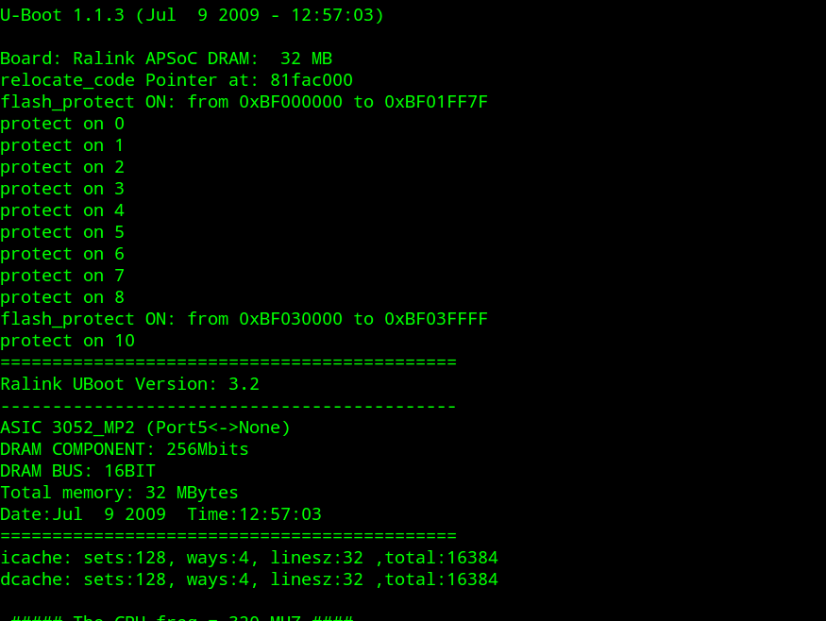
Final Build

Slide 10
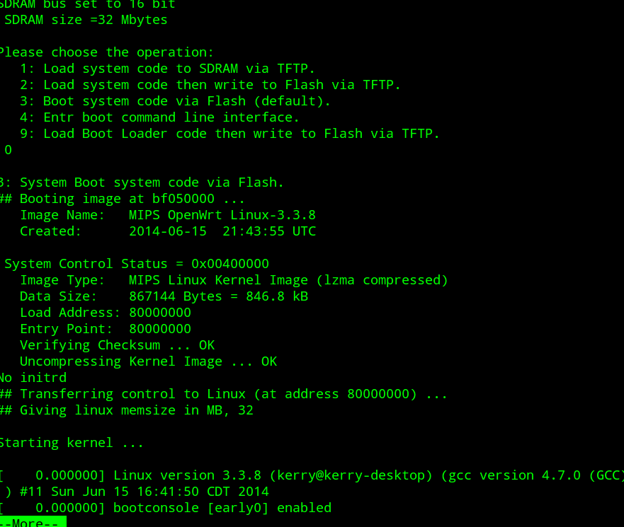
Final Build Cont.

Slide 11
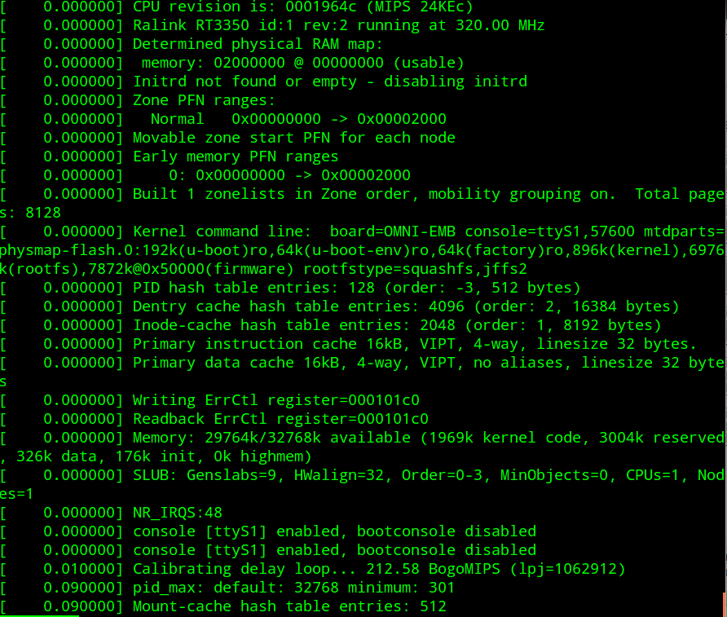
Final Build Cont.

Slide 12
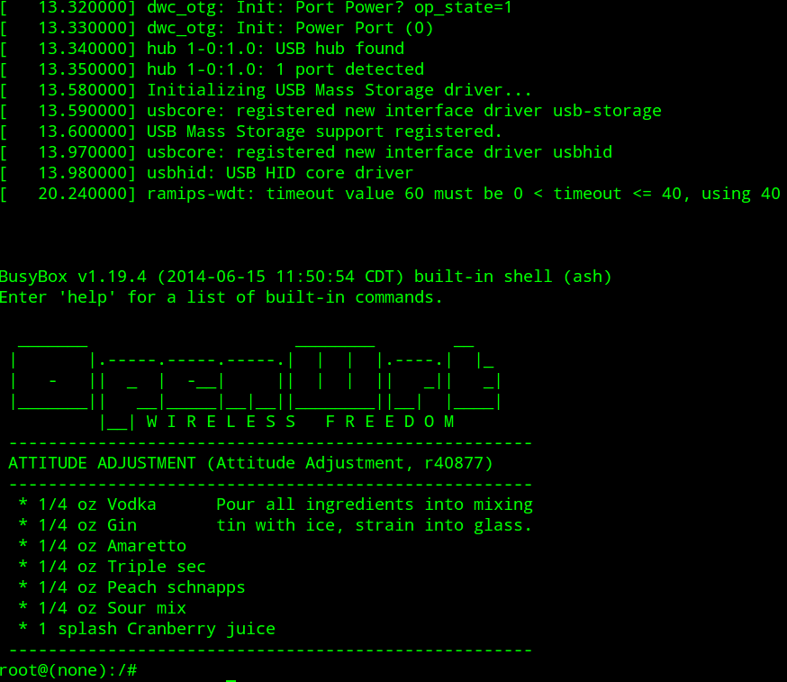
Final Build Cont.

Slide 13
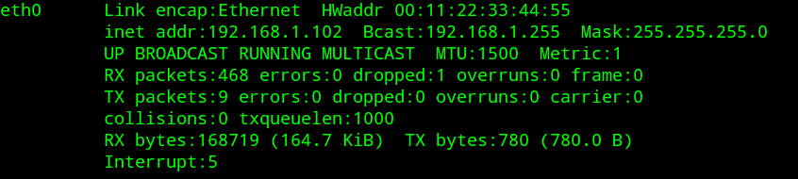

Network Working

Slide 14


Python Working

Slide 15
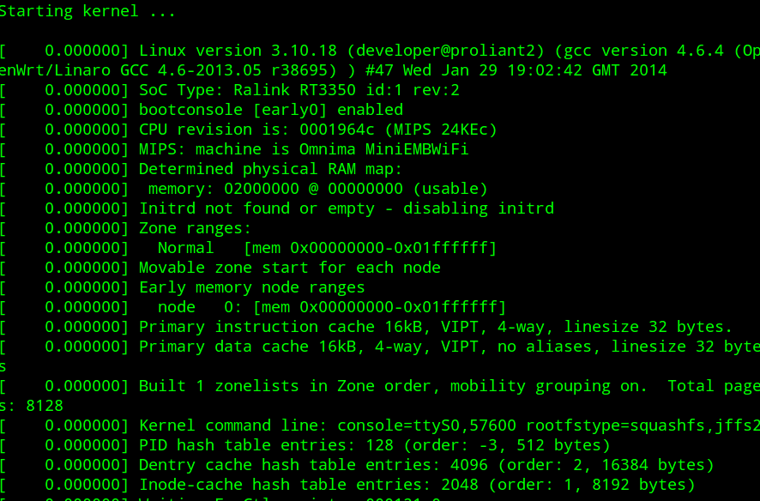
Previous Build

Slide 16
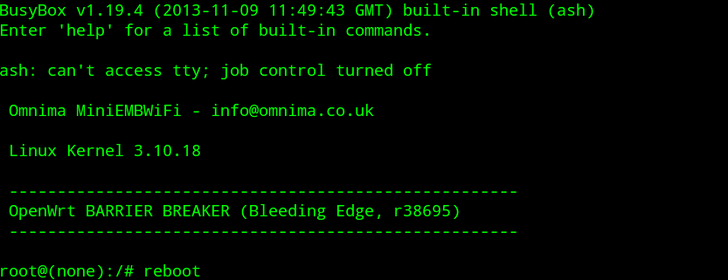
Previous Build Cont.

Slide 17
Problems and Resolution
Many problems but the greatest one:
1. Finding an image that worked correctly
First I tried the “Bleeding Edge” distribution like indicated in the guide.
I had problems with the image generating only a squashfs filesystem.
I took it upon myself to download the “Attitude Adjustment” distribution as indicated on openwrt.org.
After sucessfully building and indicating in the menuconfig both a squashfs, jffs2 filesystem be built, I found a testable image.
I tested it by loading it into RAM first as indicated below:

Slide 18
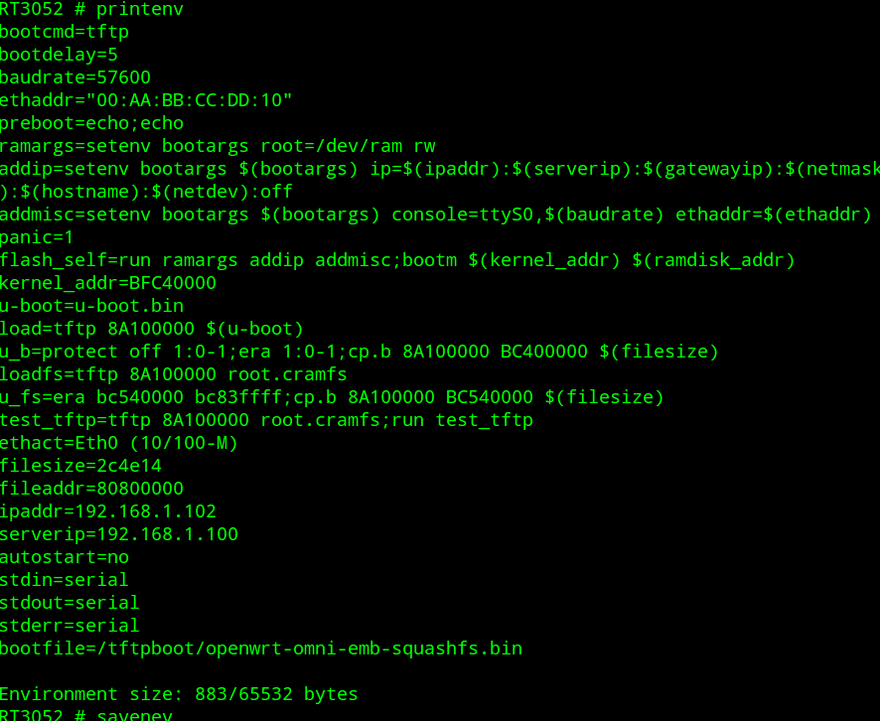

Slide 19
Results
I found by using the squashfs, jffs2 image with “attitude adjustment” worked and I could actually edit the filesystem and have it stay persistent.

Slide 20
References
www.openwrt.org
http://www.omnima.co.uk/store/catalog/MiniEMBWiFi-p-16180.html

