Slide 1
Data Mining Academic Emails to Model Employee Behaviors and Analyze Organizational Structure
Kayla Straub
GSA Research Symposium 2016

Slide 2
Problem Overview
Email is everywhere!
Difficult to research email because of inherent privacy concerns
Lack of modern email datasets with accurate job title labels
What information about an organization is embedded in the organizational email communication?
Organic vs. official organizational charts
What information about an organization can be extracted from emails?
Notes:
Organic: under/over performing, social relationships, project work

Slide 3




Applications
Overall methods can be applied to any communication system
Cell phone, website links, social media, network connections
This particular type of analysis could benefit:
In Dec. 2015, GE completed downsize and merger of subsidiary General Electric Capital Corporation
On Jan. 1 2016, Northrop Grumman combined two of its four business sectors, Electronic Systems and Information Systems
In late 2016, the merger of two major chemical companies: DuPont and Dow will be finalized before splitting into three new companies

Slide 4
Hume Email Data Collection
Enron email dataset is the benchmark, but outdated
Worked with Virginia Tech’s Internal Review Board (IRB) to approve data collection procedures and privacy concerns
All subject and body text was hashed using MD5 algorithm
Data collection process was performed using automated scripts
No identifying information is revealed in analysis
All data stored on secure, password-protected Hume Center server
Hashing example:
b4dabd5884ecd175283065dc605c2172
Employment Opportunity at Doosan Fuel Cell America

Slide 5
Collected Data From Each Email
Destination and source email address
Email time stamp
Subject prefix (e.g., Re:, Fwd:)
Hash of subject after removing prefix
Hash of body text
Length of subject in characters
Length of body text in characters
Number of attachments
Indicator if email was digitally signed
Indicator if email was encrypted

Slide 6
Dataset Description and Statistics
37 volunteers in the study
Plus 32 additional employees from the data
585,096 emails over 3 years
6 job categories:
Director
Graduate Student
Operations
Outreach
Project Management (PM)
Research

Slide 7
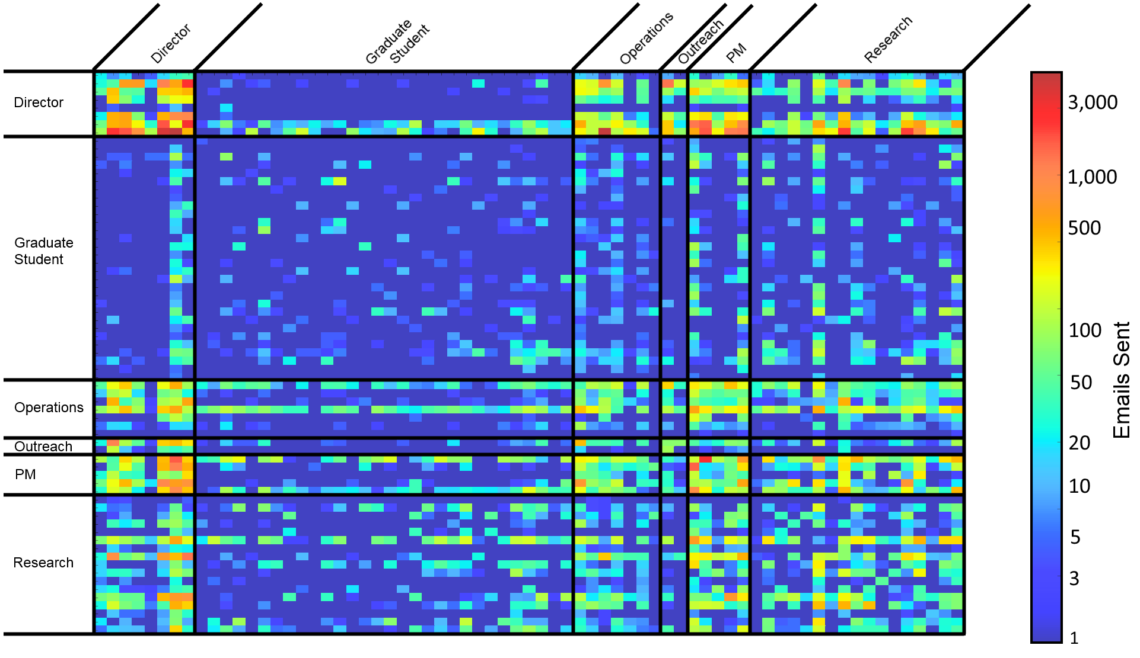
Adjacency Matrix

Slide 8
Features
Features quantify information extracted from the email metadata
Two categories:
Traffic-based – 84 features
Social-based – 30 features
Total features: 114
Calculated using bash, MySQL, and python scripts
Used as input to the machine learning algorithm

Slide 9
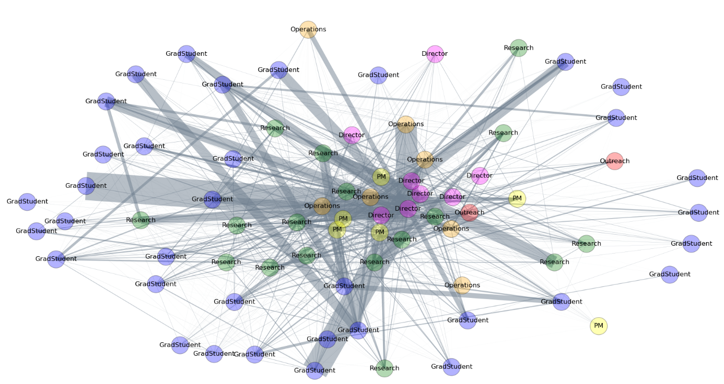
Social Graph
Nodes represent people
Edges are directed and represent emails exchanged between people

Slide 10
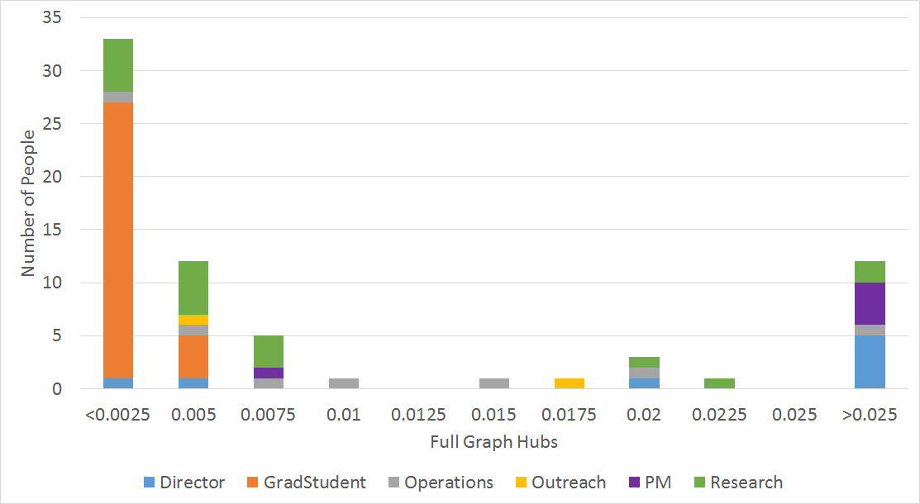
Example Social Feature

Slide 11
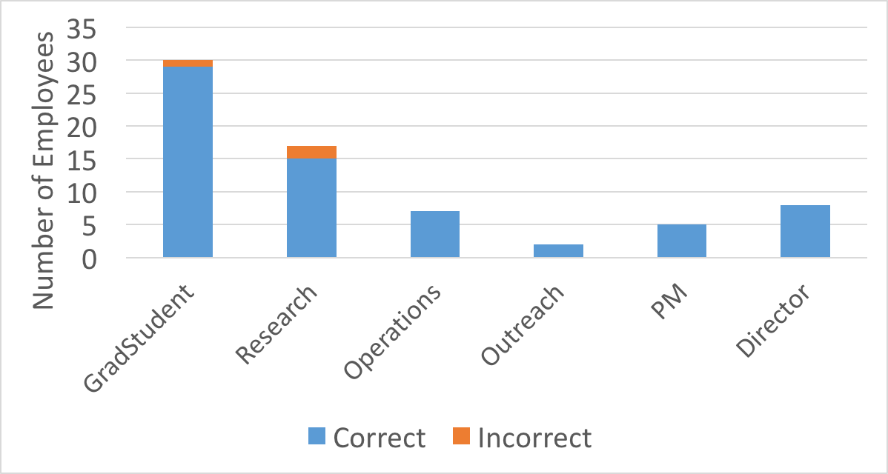
Classification Results
Overall very accurate: 95.7%
Confusion between graduate students and researchers
These errors are understandable
Some doctoral students have been working at the center for 3-5 years
Some research faculty are also graduate students

Slide 12
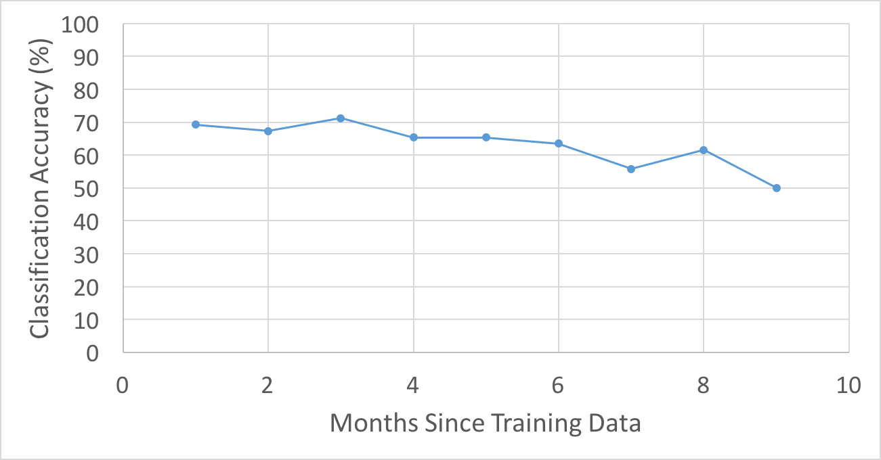
Behavior Over Time
Considered employees with at least 10 months of emails
Procedure:
Data split into 1-month segments
First month used as training
Months 2-10 used as test data
Confirms assumption that email behavior is constant in time

Slide 13
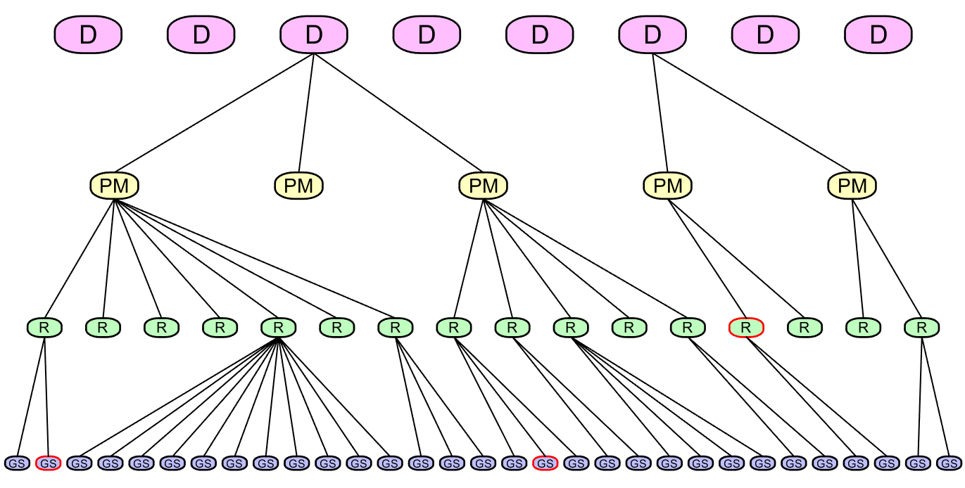
Algorithm-Generated Organic Org Chart

Slide 14
Conclusions
Created a brand new email dataset from raw emails
Thorough privacy precautions
This dataset is meant to be representative of data any company could collect without violating the privacy of their employees
Highly accurate classification results based on historical data
Showed that email behavior is constant with time
An organic organization chart was produced that represented the email relationships of the center

Slide 15
Questions?

