Slide 1
Data Mining Academic Emails to Model Employee Behaviors and Analyze Organizational Structure
Kayla Straub
Master’s Defense

Slide 2
Outline
Problem statement and contributions
Email dataset
Feature extraction
Algorithm design
Performance analysis
Future work and conclusions

Slide 3
Problem Overview
Email is everywhere!
Difficult to research email because of inherent privacy concerns
Lack of modern email datasets with accurate job title labels
What information about an organization is embedded in the organizational email communication?
Organic vs. official organizational charts
Automatically determine the organic organizational chart from academic email
Notes:
Organic: under/over performing, social relationships, project work

Slide 4
Contributions
Present a new email dataset based on academic emails of the center
Adding new features to the realm of email analysis
Job title classification results that surpass previous work
A method to automatically generate organic hierarchy from analyzing emails
Proven that using machine learning on academic emails can divulge information about the company

Slide 5
Email Dataset

Slide 6
Enron Dataset
Benchmark dataset for email analysis
Released in 2004
Used for research into spam classification, email categorization, and recipient prediction
Issues with the dataset
99.99% overlap between emails sent as “CC” and those sent as “BCC”
Some emails addresses, folders, and names are misspelled
Inconsistent email address formats make mapping to employees difficult
Issues with job title labels
No labels for 29 employees
Clear mislabeling errors for at least 4 employees

Slide 7
Prior Work
Prior work in hierarchy analysis often uses the text of the emails with natural language processing to generate features, mainly on Enron
Historically, email analysis without text uses two types of features:
Traffic-based: statistical features based solely on email traffic patterns
Social-based: model emails as social network and calculate features using graph structure
Success in determining community structures has been found using the two types separately
Namata et al. 2006 used traffic-based features to predict Enron job titles
Wilson and Banzhaf 2009 found Enron’s social networks from strictly social features
Rowe et al. 2005 used a combination of features to automatically construct the Enron social hierarchy

Slide 8
Hume Email Data Collection
Worked with Virginia Tech’s Internal Review Board (IRB) to approve data collection procedures and privacy concerns
All subject and body text was hashed using MD5 algorithm
Data collection process was performed using automated scripts
No identifying information is revealed in analysis
All data stored on secure, password-protected Hume Center server

Slide 9
Email Parsing Process
Challenge: Email formats are inconsistent
Forwards are expressed as “Fw:” or “Fwd:” or “FW:”
Email address encoded with Unicode, which is incompatible with MySQL
Some emails have HTML- needed to identify, then parse
Process:
Write a python script to extract data
Test on personal emails to find inconsistent formatting issues
Ran script on mail server and saved all email metadata into MySQL database

Slide 10
Collected Data From Each Email
Destination and source email address
Email time stamp
Subject prefix (e.g., Re:, Fwd:)
Hash of subject after removing prefix
Hash of body text
Length of subject in characters
Length of body text in characters
Number of attachments
Indicator if email was digitally signed
Indicator if email was encrypted

Slide 11
Dataset Description and Statistics
37 volunteers in the study
Plus 32 additional employees from the data
585,096 emails over 3 years
6 job categories:
Director
Graduate Student
Operations
Outreach
Project Management (PM)
Research

Slide 12
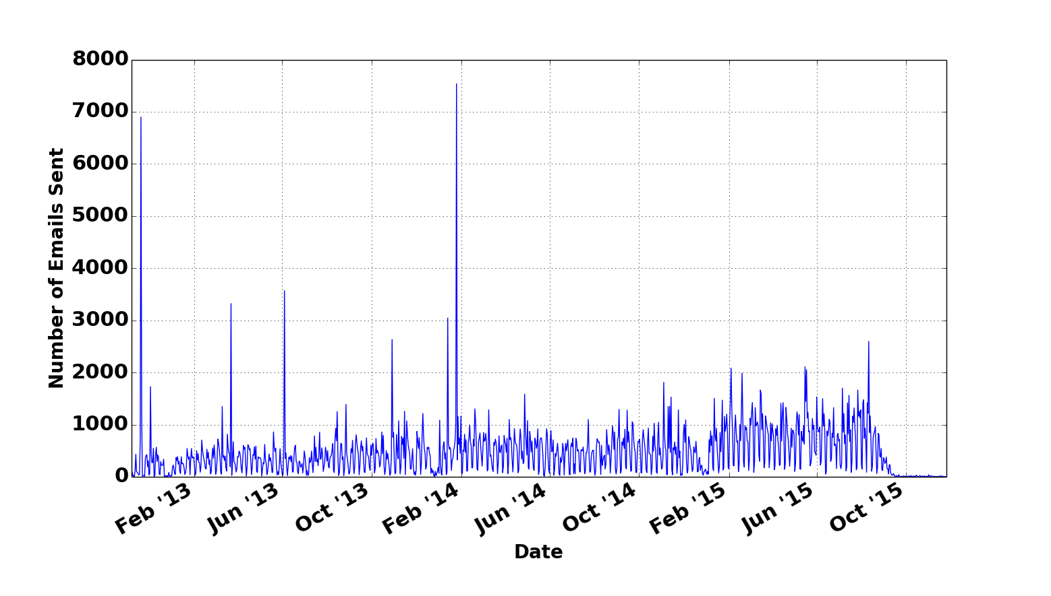
Hume Email Visualization

Slide 13
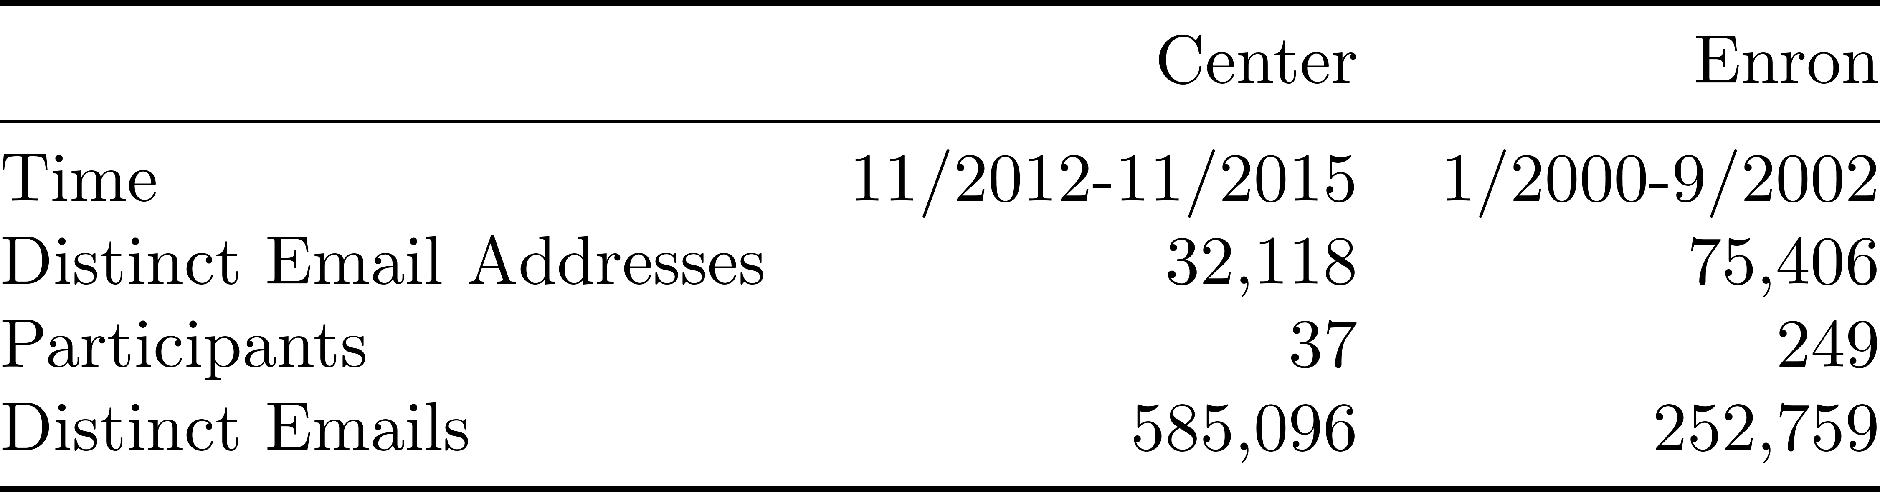
Hume vs. Enron Dataset Comparison
Center dataset:
More modern
More distinct emails
Longer time period
Enron dataset:
More employees
More distinct email addresses

Slide 14
Feature Extraction

Slide 15
Features
Features quantify information extracted from the email metadata
Two categories:
Traffic-based – 84 features
Social-based – 30 features
Total features: 114
Calculated using bash, MySQL, and python scripts
Used as input to the machine learning algorithm

Slide 16
Traffic-Based Features
Generated directly from the collected metadata
Example Raw features:
Unique subjects received
Number of signed emails received
Number of emails received as carbon copies
Average number of emails received per day
Number of emails sent within VT
Number of emails sent within Hume
Number of emails sent after normal business hours
Also converted raw features as percentages

Slide 17
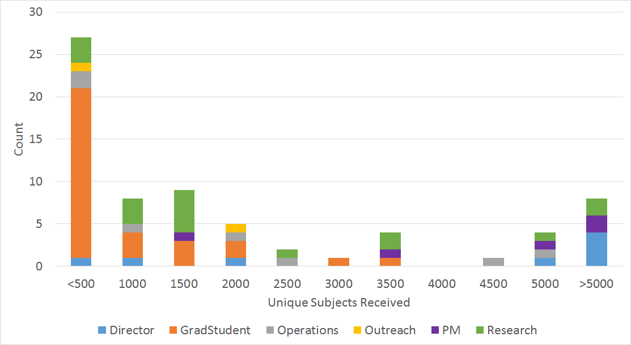
Example Traffic-based Feature

Slide 18
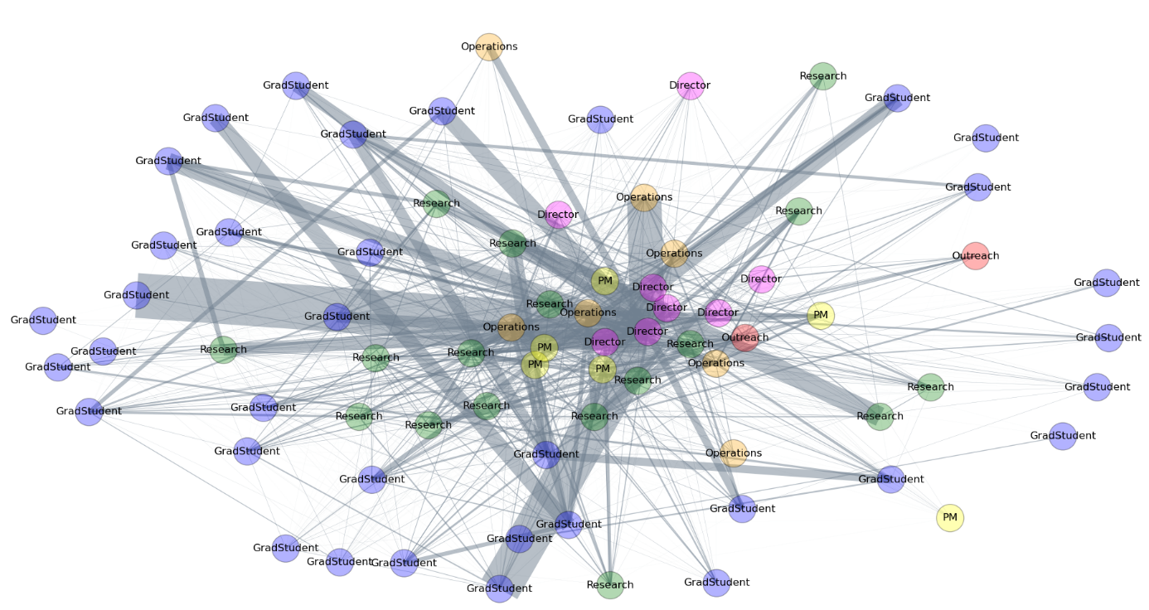
Social Graph
Nodes represent people
Edges are directed and represent emails exchanged between people
Two different graphs used
Full graph draws edge between all people who exchanged at least one email
Partial graph draws edge between all people who exchanged at least 10 emails

Slide 19
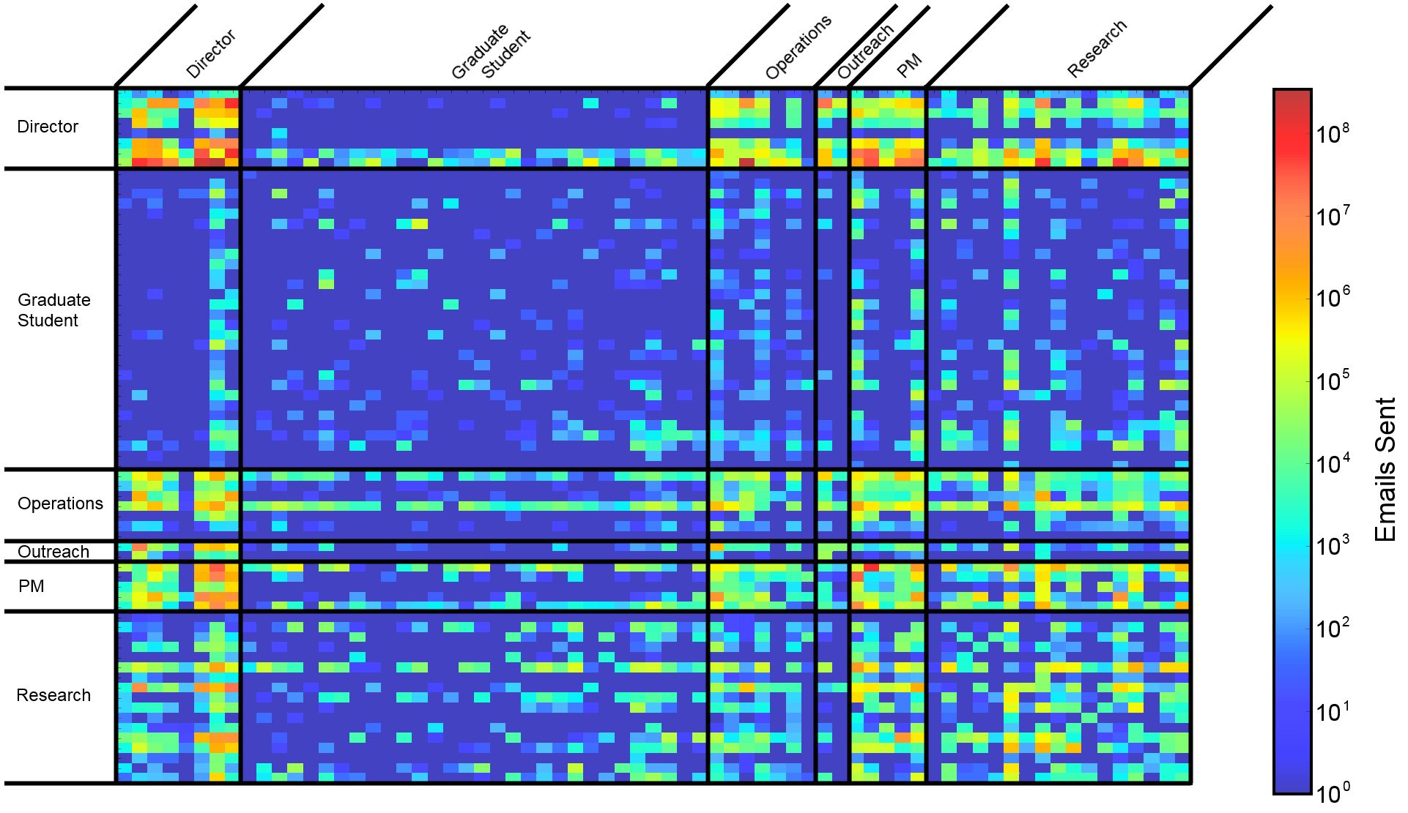
Alternative Social View - Adjacency Matrix

Slide 20
Social-Based Features
Degree measures
Degree of a node
Average neighbor degree
Cliques
Clustering Metrics
Centrality Measures
Closeness centrality
Betweenness centrality
Search Engine Algorithms
All features calculated for both the full and partial graph
Notes:
Closeness centrality is the normalized inverse of the sum of shortest path distances from node I to all other nodes in the graph
Betweenness centrality is the percentage of all shortest paths in a graph the traverse node i

Slide 21
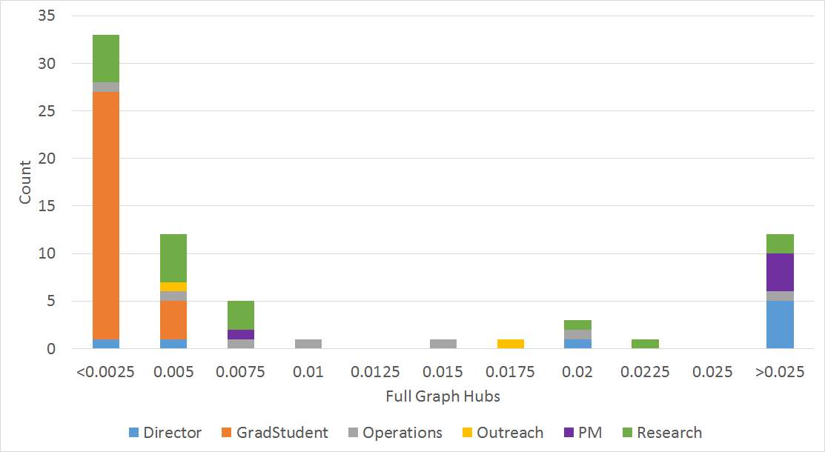
Example Social Feature

Slide 22
Algorithm Design

Slide 23
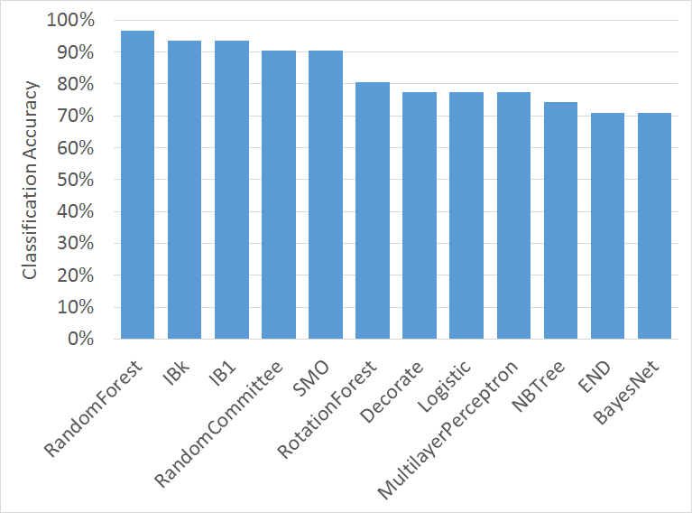
Algorithm Selection
Used limited number of employees:
29 participants
Removed people with less than 100 emails
Removed the two outreach employees
Randomly split emails into train and test sets
Using Weka, evaluated classification accuracy of several algorithms with default parameters
Notes:
IBk = k-NN
IB1 = Nearest neighbor
RandomCommittee = Average prediction of a committee of base classifiers – in this case the base classifier was random tree
SMO = Support vector machine using sequential minimal optimization, for multiclass it uses 1 vs 1 pairwise classification
RotationForest =

Slide 24
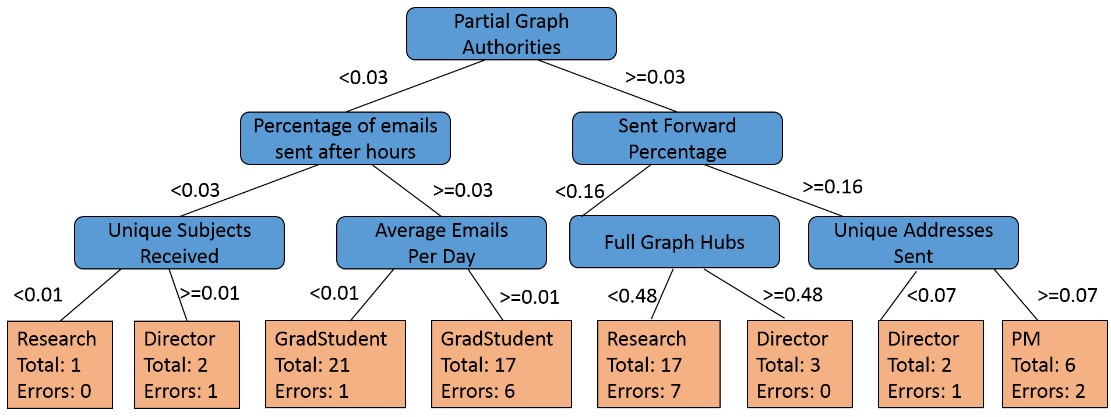
Random Trees
Used to learn a series of rules for classification
Learned using a greedy heuristic
Starting at the top, split on the best feature
Tree-based classifiers are prone to overfitting

Slide 25
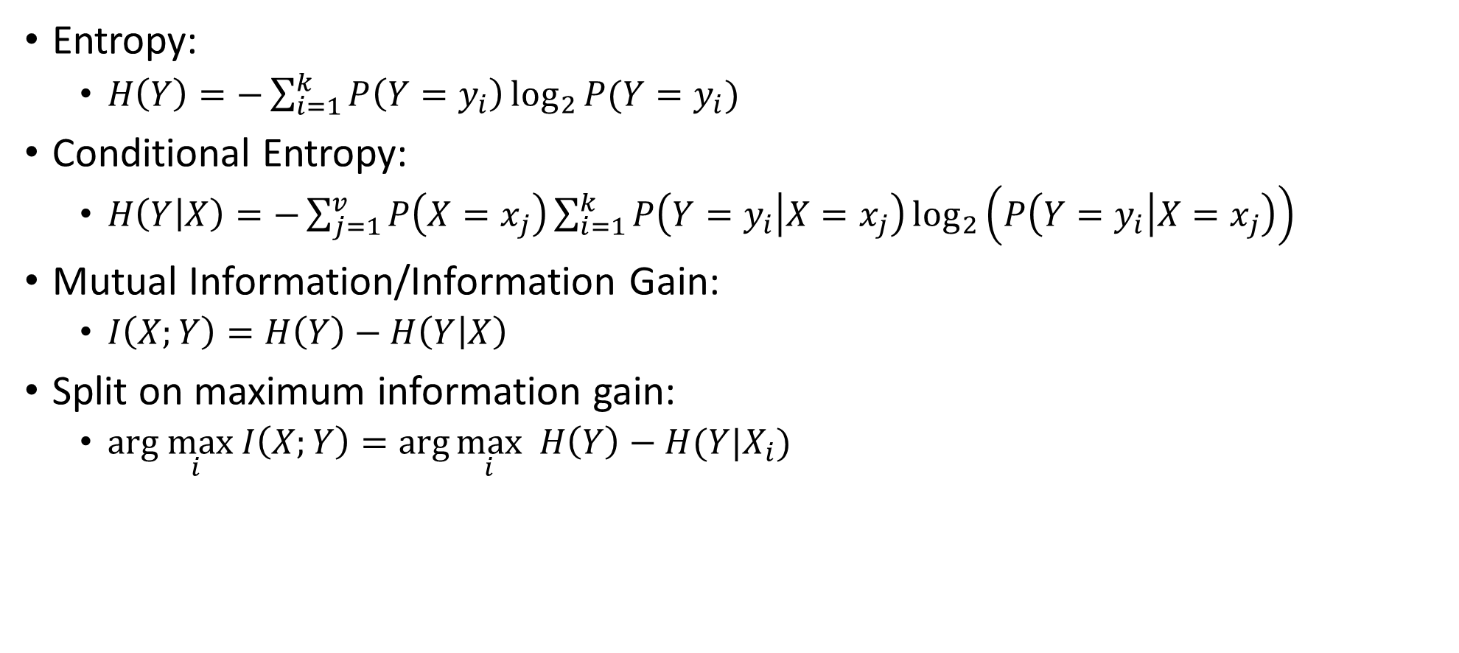
Determining the Best Split
Entropy:
$H\left(Y\right)=−\sum_{i=1}^{k}{P\left(Y=y_{i}\right)\log_{2}{P(Y=y_{i})}}$
Conditional Entropy:
$H\left(Y | X\right)=−\sum_{j=1}^{v}{P\left(X=x_{j}\right)\sum_{i=1}^{k}{P\left(Y=y_{i} | X=x_{j}\right)\log_{2}\left(P\left(Y=y_{i} | X=x_{j}\right)\right)}}$
Mutual Information/Information Gain:
$I\left(X;Y\right)=H\left(Y\right)−H\left(Y | X\right)$
Split on maximum information gain:
$arg\max_{i} I\left(X;Y\right)=\arg{\max_{i} H\left(Y\right)−H(Y|X_{i})}$

Slide 26
Random Forests
Random forests use bagging and are robust to overfitting
Work well with data that has a high number of features and low number of observations
Bagging = Boostrap Aggregating

Slide 27
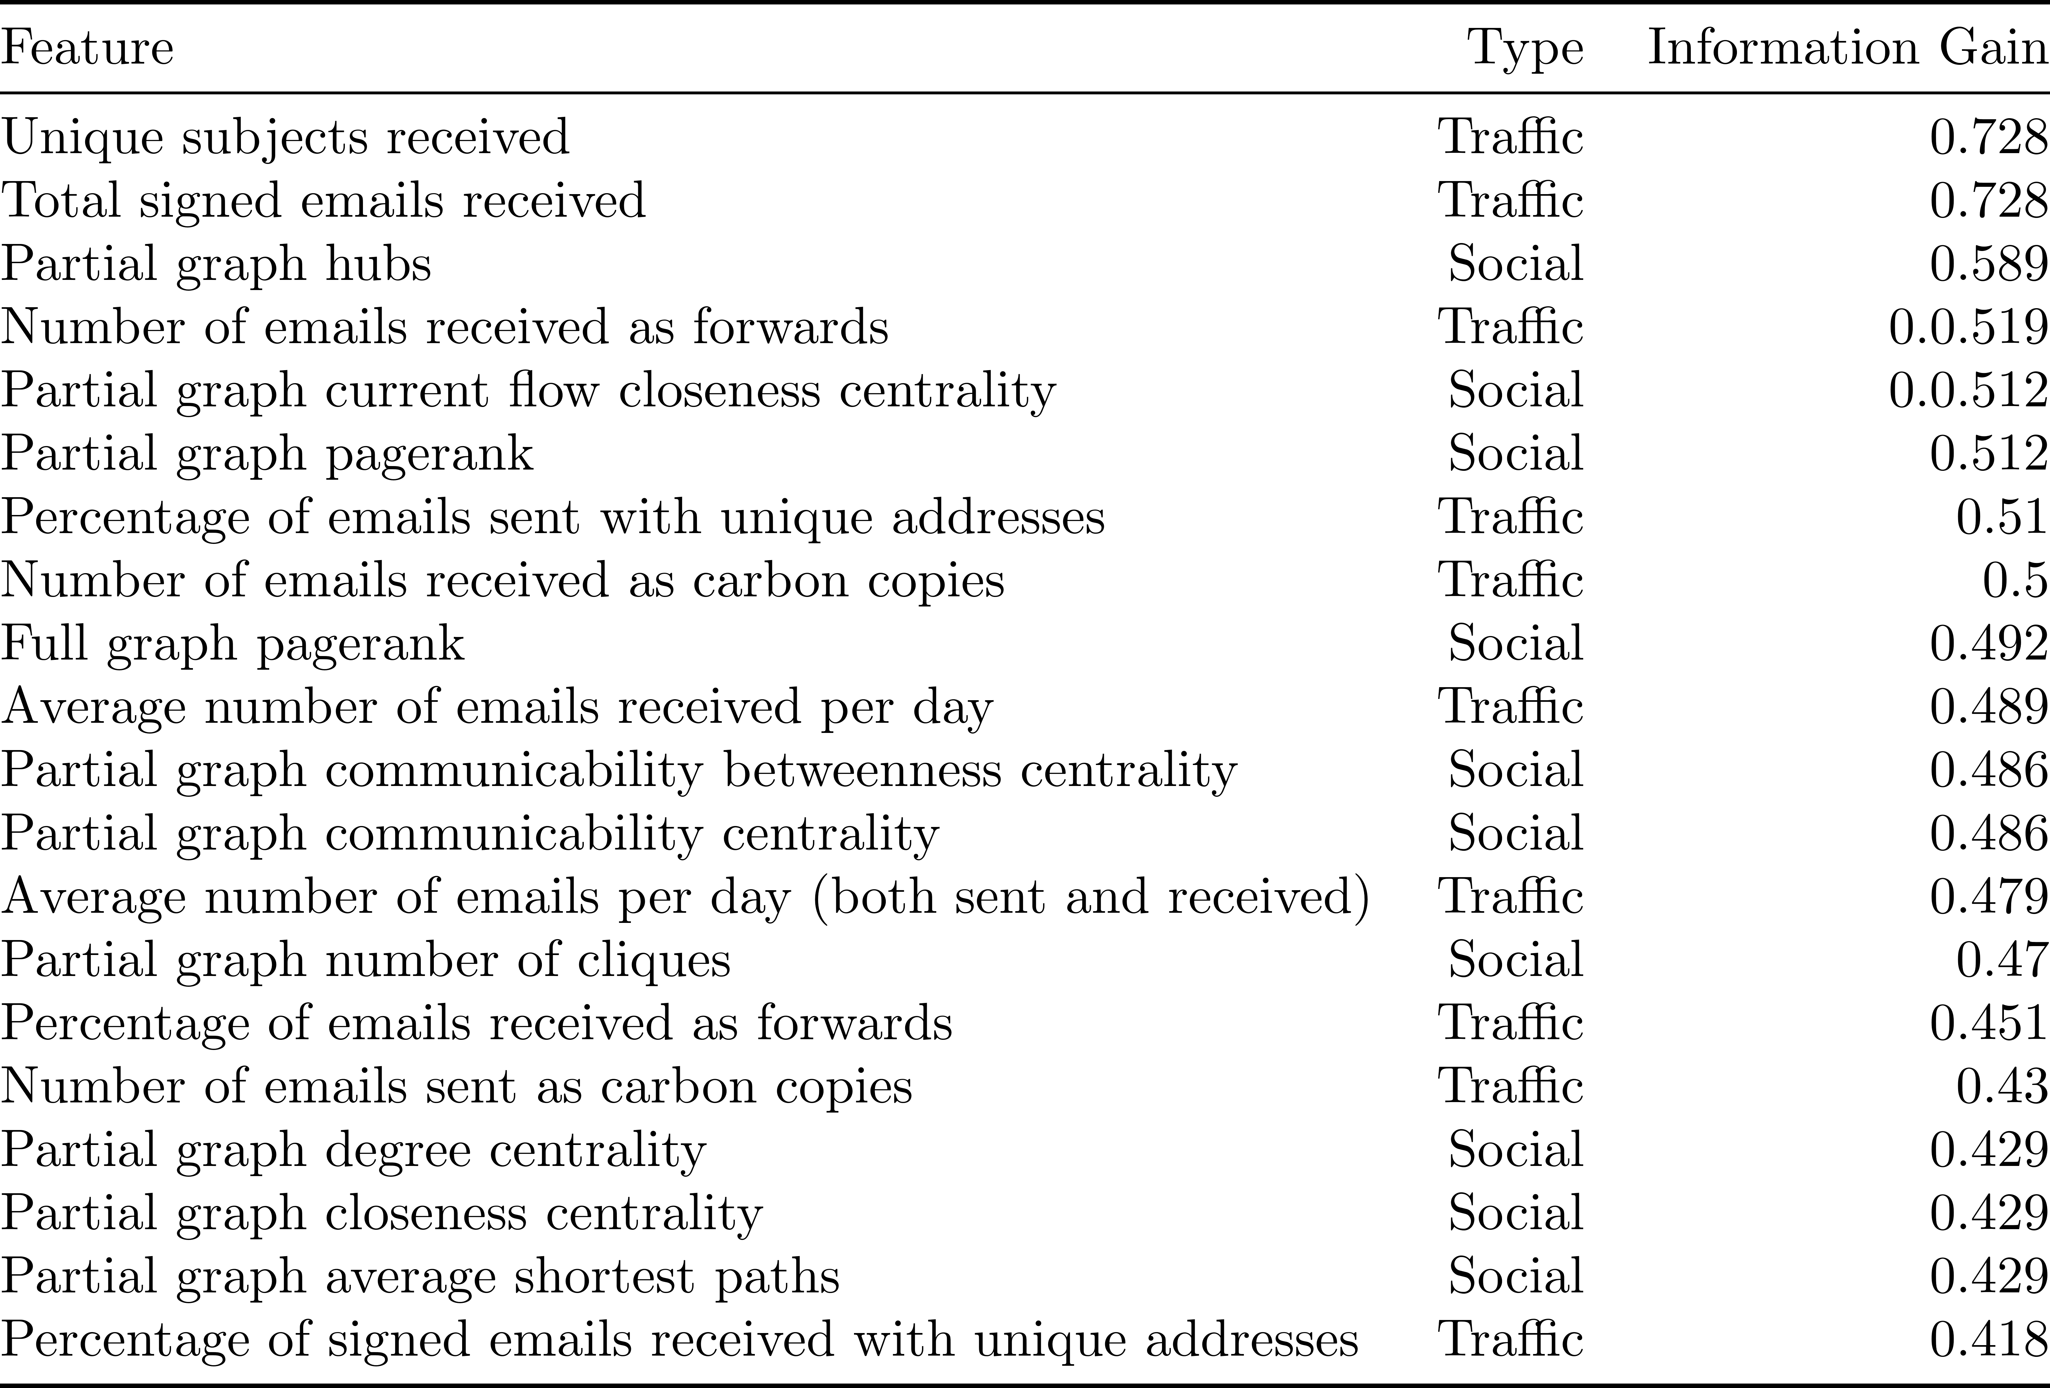
Feature Selection
Notes:
Features ranked by Info gain
15 features – still 90% classification accuracy

Slide 28
Performance Analysis

Slide 29
Testing Procedures

Slide 30
Classification Results

Slide 31
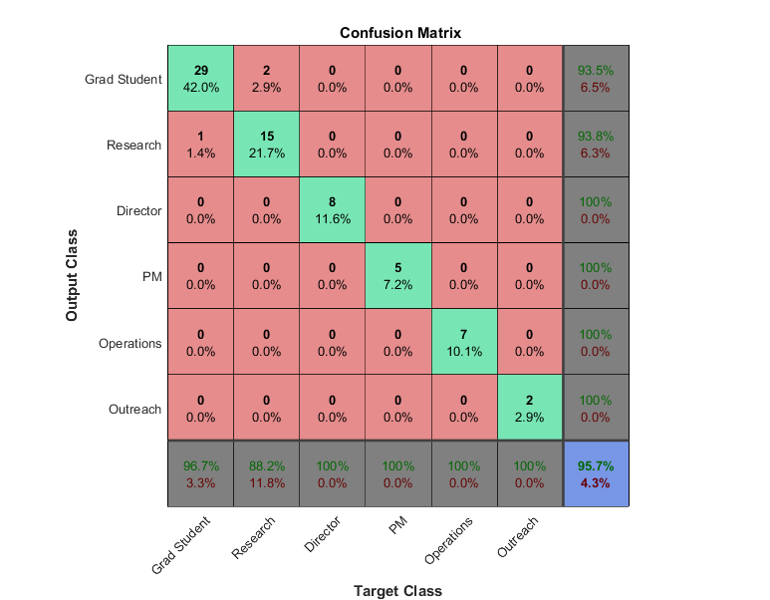
Classification Results

Slide 32
Leave-One-Out Cross-Validation
Concerned about bias from training and testing on same people
Procedure
Train on all but one sample
Test on that sample
Repeat for all samples
Removed Outreach for this test because only contains two samples

Slide 33
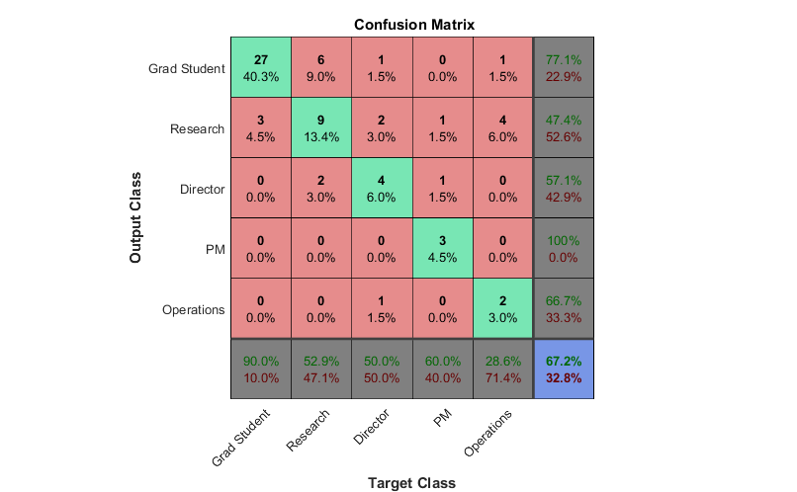
LOOCV Classification Results

Slide 34
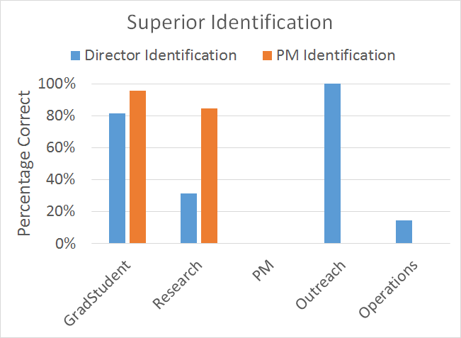
Hierarchy Analysis

Slide 35
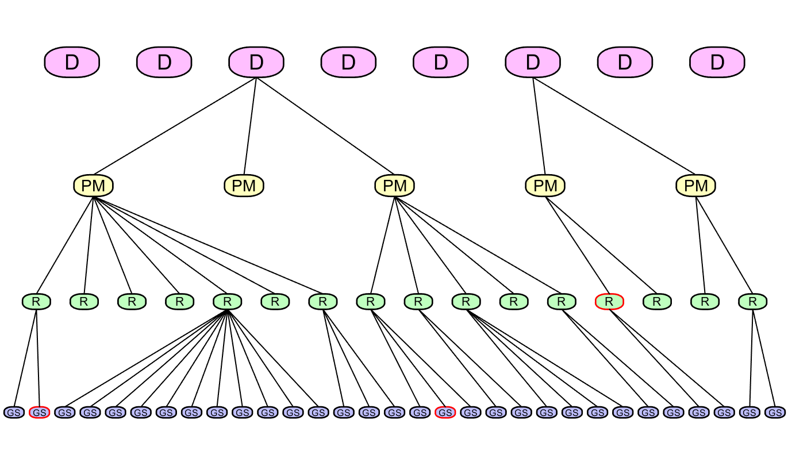
Algorithm-Generated Organic Org Chart

Slide 36
Conclusions and Future Work

Slide 37
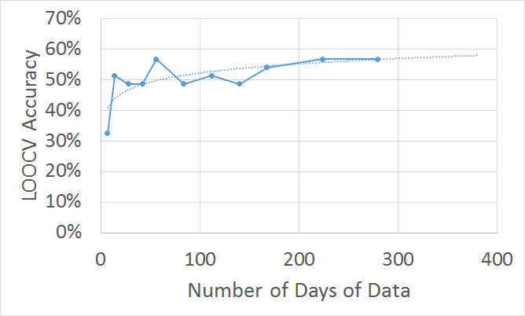
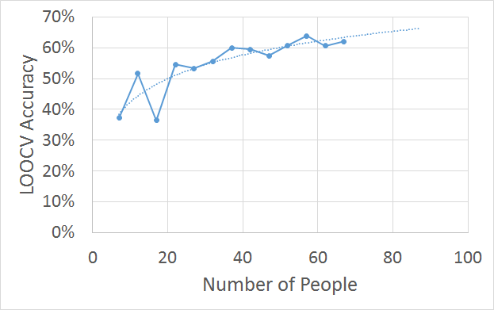
More Data would Improve

Slide 38
Future Work and Deep Learning Applications
Apply to larger datasets and/or different types of data
Enron corpu
Twitter dataset
Potential Deep Learning Application
With much more semi-supervised data, more sophisticated algorithms could be used
Deep Belief Networks
Unsupervised pre-training
Supervised back propagation

Slide 39




Applications
Overall methods can be applied to any communication system
Cell phone, website links, social media, network connections
This particular type of analysis could benefit:
In Dec. 2015, GE completed reorganization of General Electric Capital Corporation
On Jan. 1 2016, Northrop Grumman combined two of its four business sectors, Electronic Systems and Information Systems
In late 2016, the merger of two major chemical companies: DuPont and Dow will be finalized before splitting into three new companies

Slide 40
Conclusions
Created a brand new email dataset from raw emails
With accurate job title labels
Approximately the size of Enron, but with fewer people
Privacy precautions
This dataset is meant to be representative of data any company could collect without violating the privacy of their employees
Highly accurate classification results based on historical data
Showed that email behavior is constant with time
Small dataset lead to low LOOCV accuracy
An organic organization chart was produced that represented the email relationships of the center

Slide 41
Questions?

Slide 42
Thank You
Committee: Dr. McGwier, Dr. Beex, Dr. Buehrer, Dr. Huang
Dr. Ernst and Dr. Headley
Faculty, staff, and graduate students of the Hume Center

Slide 43
Backup

Slide 44
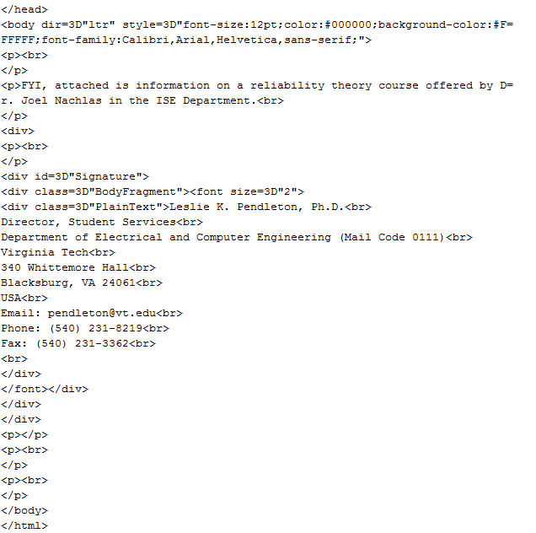
HTML Example

