Slide 1



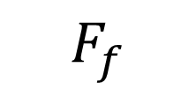

0˚
$$F_{thrust}$$
$$θ_{b}$$
$$θ_{f}−θ_{b}$$
$$F_{d}$$
$$F_{f}$$

Slide 2

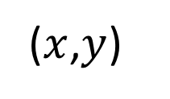

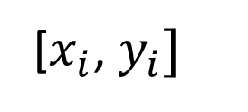

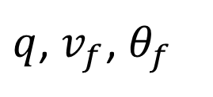
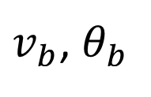
$q$, $v_{f}$, $θ_{f}$
Environment
($x$,$y$)
[$x_{i}$, $y_{i}]$
Path-Following
Controller
$v_{b}$, $θ_{b}$
Global
Waypoint
A*
Vehicle
$$v_{b}$$
$$v_{b}$$
$$v_{b}$$
Speed Controller

Slide 3
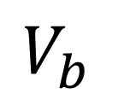


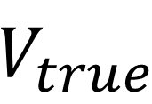
$$V_{b}$$
$$V_{f}$$
$$Θ$$
$$V_{true}$$

