Slide 1
Predictive Velocity Trajectory Control for a Persistently Operating Solar-Powered Autonomous Surface Vessel
ACC 2023 – June 1, 2023
Kavin M. Govindarajan¹, Ben Haydon², and Chris Vermillion³
¹Undergraduate Research Assistant, ²Graduate Research Assistant, ³Associate Professor with the Department of Mechanical and Aerospace Engineering at North Carolina State University
Notes:
National Science Foundation, “Persistent Mission Planning and Control for Renewably Powered Robotic Systems”
American Control Conference 2022 - Date of Presentation

Slide 2
Outline
Motivation/Context
Problem Formulation
MPC-Based Velocity Planning w/ Infinite-Horizon Reward
Comparison Strategies
Results
Moving Forward
June 1, 2023

Slide 3
Motivation/Context
June 1, 2023

Slide 4
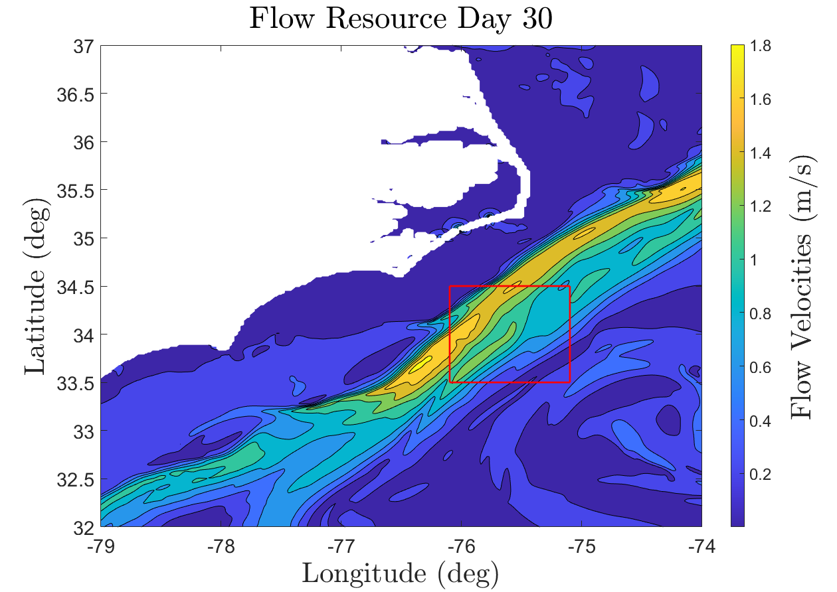
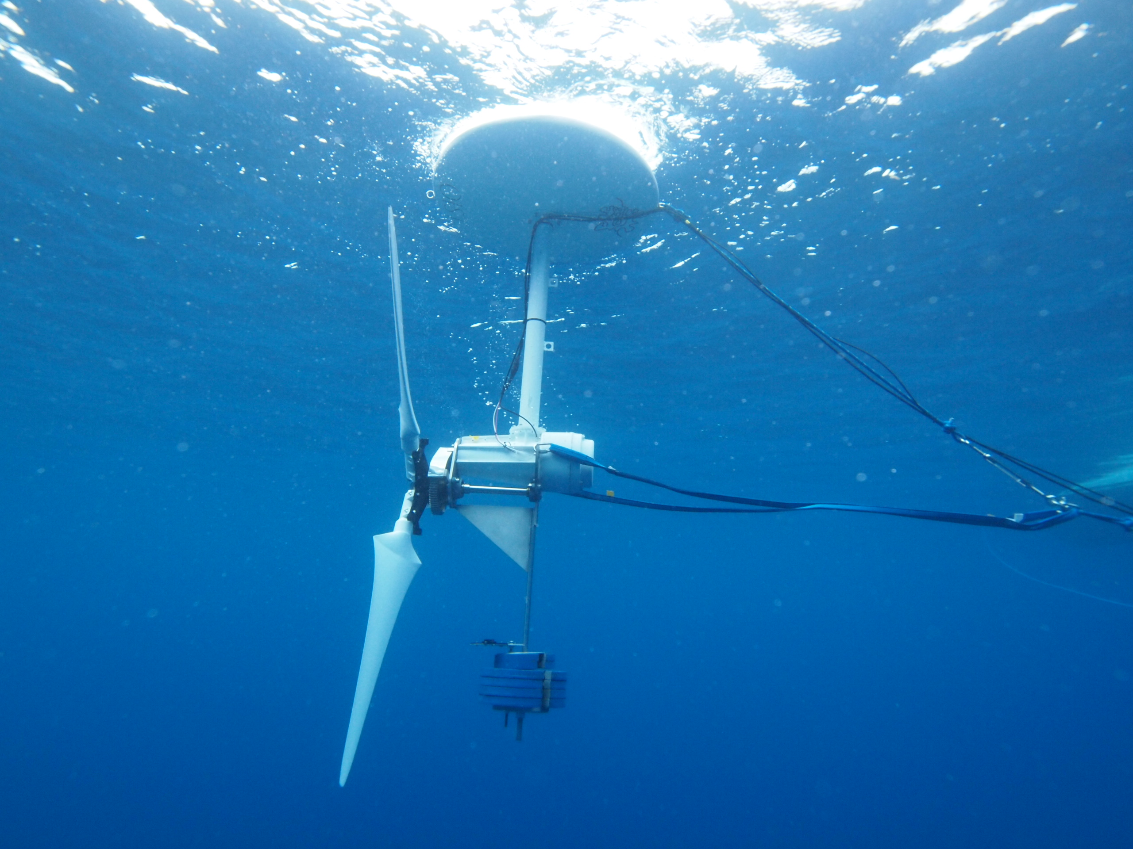
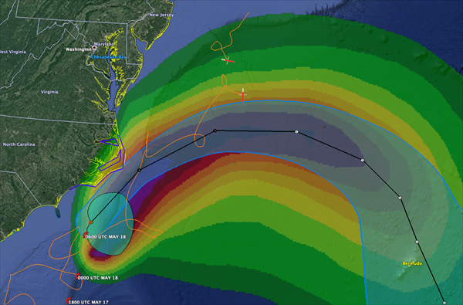
Why is Ocean Data Useful?
Hurricane Forecasting - Temperature Data
Marine Hydrokinetic Energy -
Flow Velocity vs Depth Data
NOAA
160 TWh/yr of Technical Energy Capacity ~ 14.5 million homes
K. Haas, “Assessment of energy production potential from ocean currents along the United States coastline,” Georgia Inst. of Technology, Atlanta, GA (United States), Tech. Rep., 2013.
June 1, 2023
Notes:
Tropical Storm Arthur had improved predicting thanks to Gliders collecting Temperature data
NOAA - National Oceanic & Atmospheric Administration
Gulf Stream has 160 TwH/yr of usable energy capacity… enough to power 14.5 million homes each year.

Slide 5
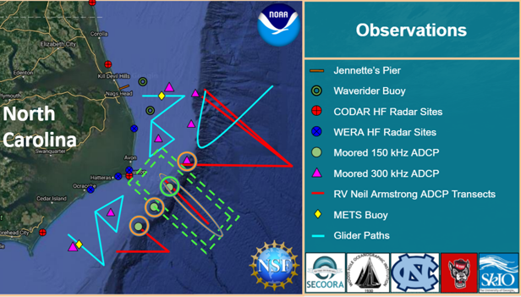
Current Sensing Resources
100km - 60 mi
Provided by: Dr. Mike Muglia, ECU
June 1, 2023
Notes:
Include Scale Factor

Slide 6
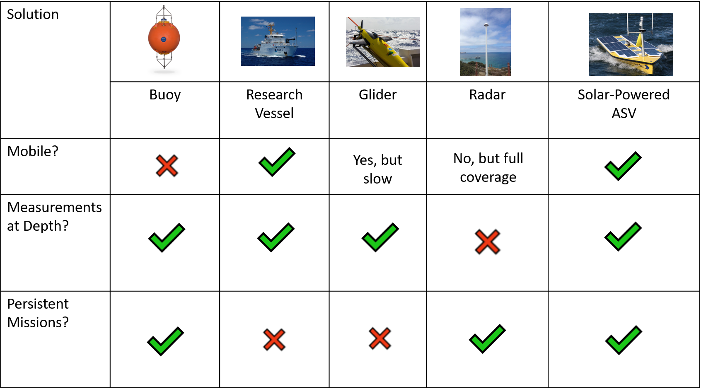
Comparison of Measurement Methods
June 1, 2023
Notes:
“ADCP - equipped Buoy/Radar”

Slide 7
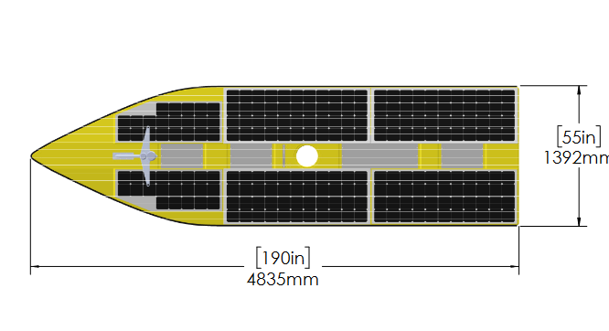
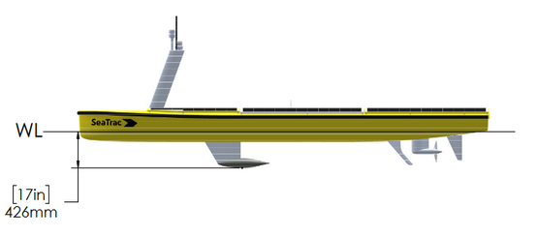
Solar-Powered ASV
Attribute | Value
Length | 4.8 meters
Beam | 1.39 meters
Draft | 0.42 meters
Weight | 300 kilograms
Solar Panel Area | 4.17 meters²
Brushless Motor | 500 Watts
Battery Capacity | 6.75 kiloWatt Hours
Top Speed | 4.5 knots
Cruise Speed | 3 knots
Sea-Trac SP-48
June 1, 2023

Slide 8
How Do We Plan a Velocity Trajectory?
June 1, 2023

Slide 9
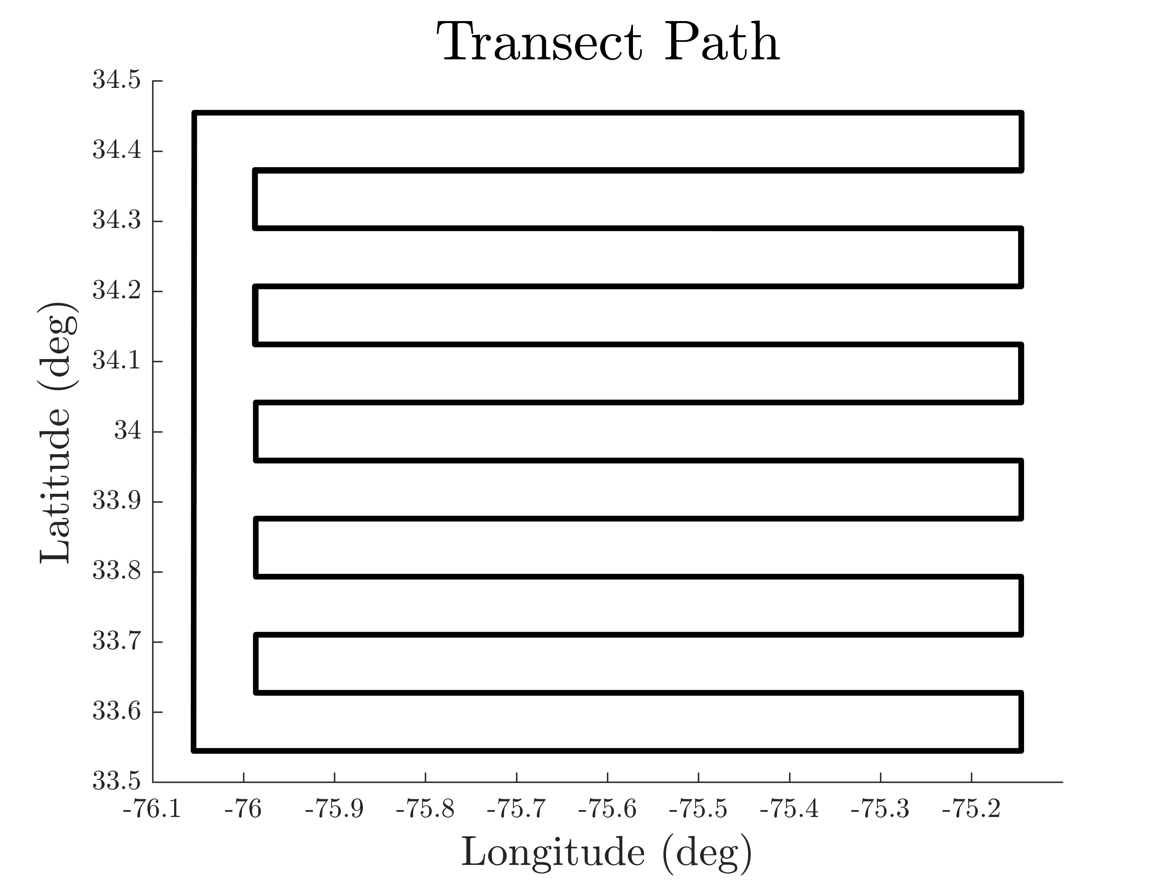
Goal: Maximize Distance Travelled Along Fixed Path

Slide 10
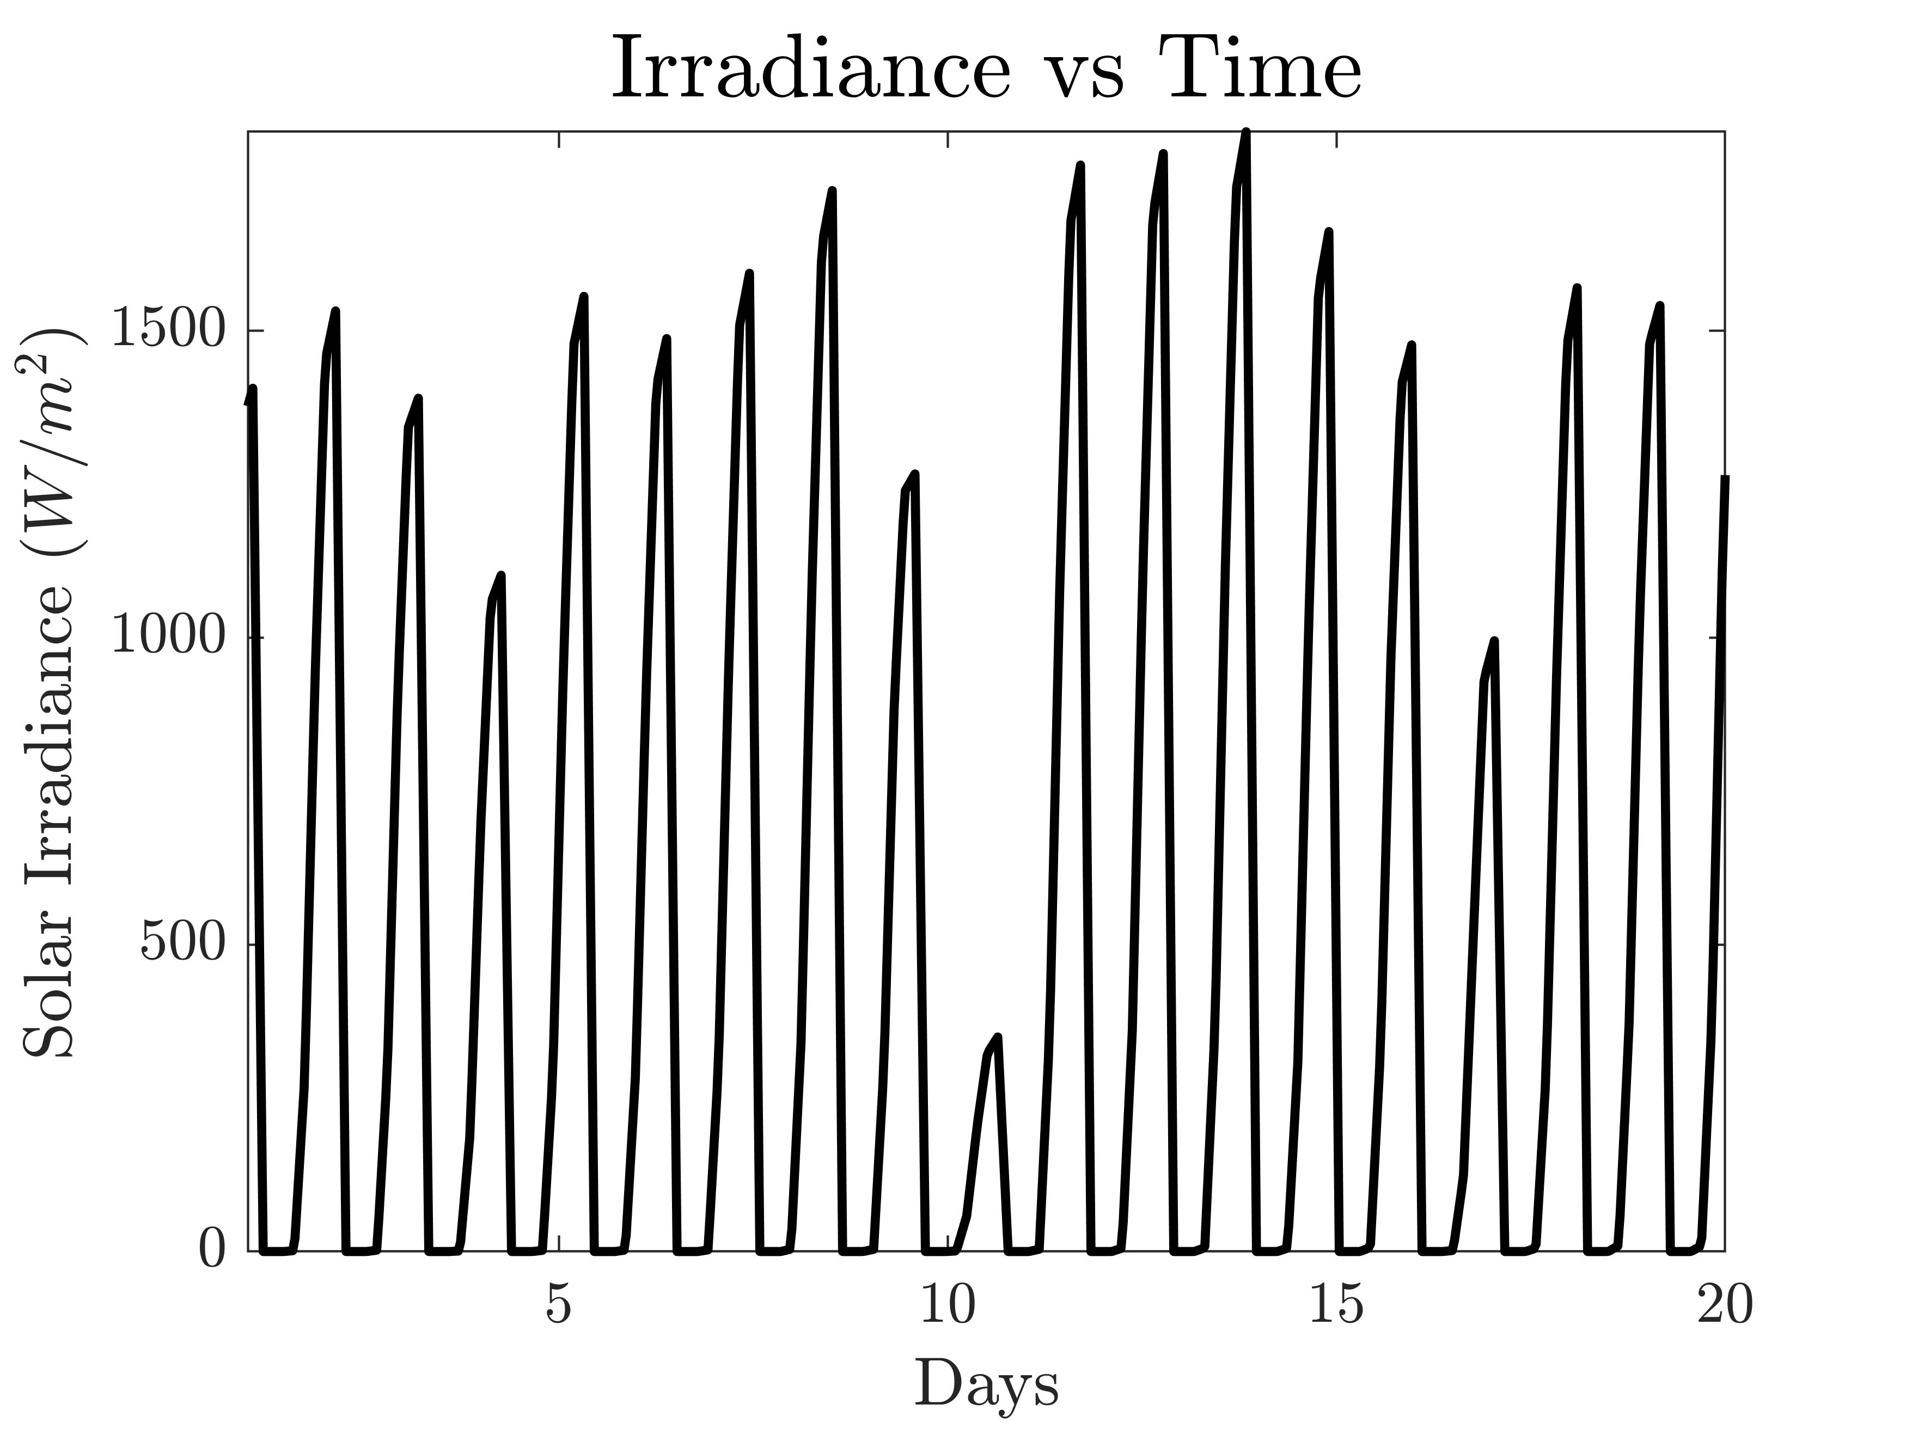
Environmental Constraints
Ocean Current Data: Mid-Atlantic Bight- South-Atlantic Bight - Regional Ocean Model (MAB-SAB-ROM)
Solar Irradiance Data: ERA-Interim Model
June 1, 2023

Slide 11
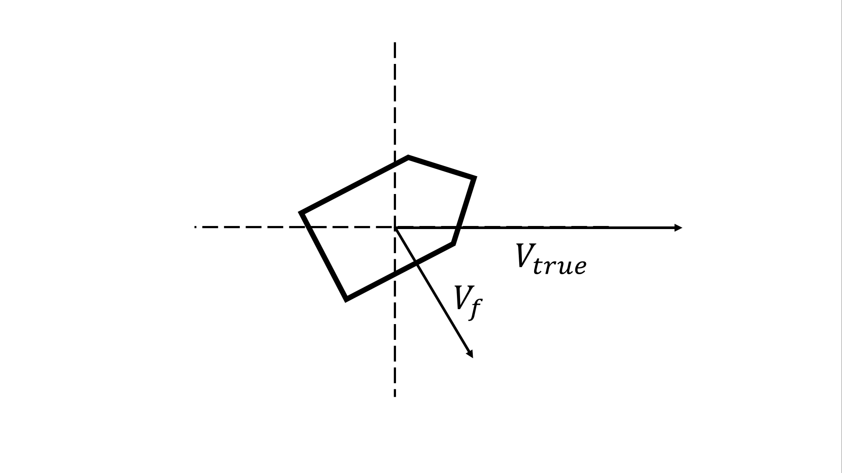
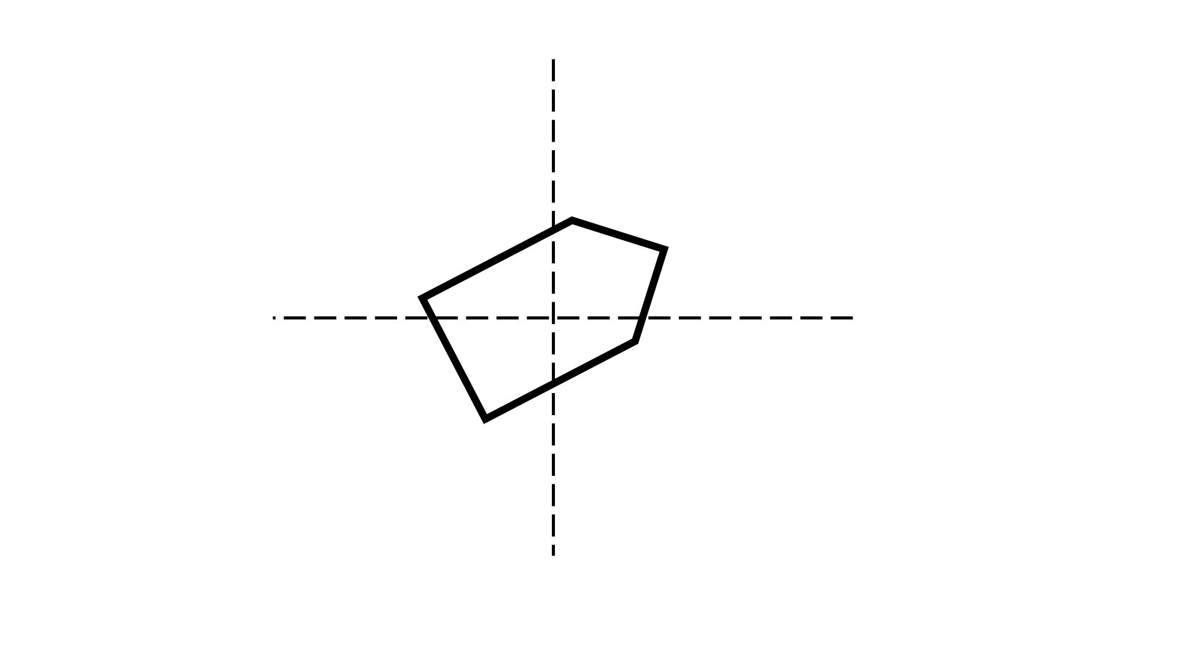
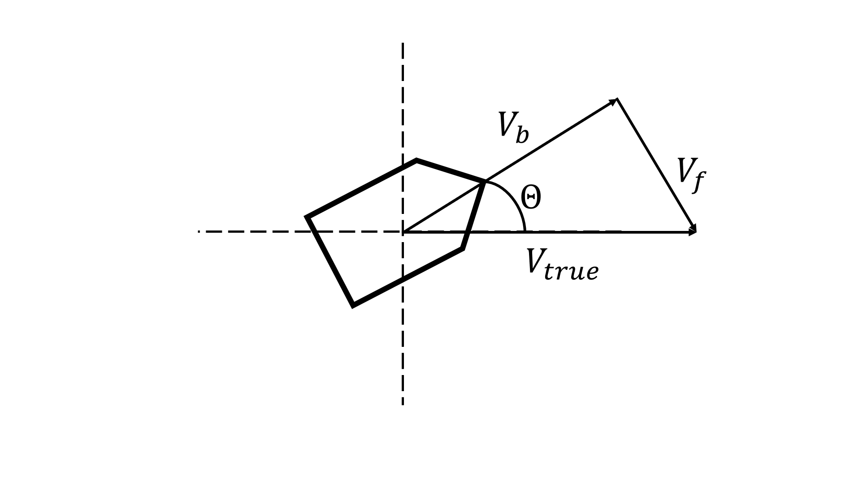
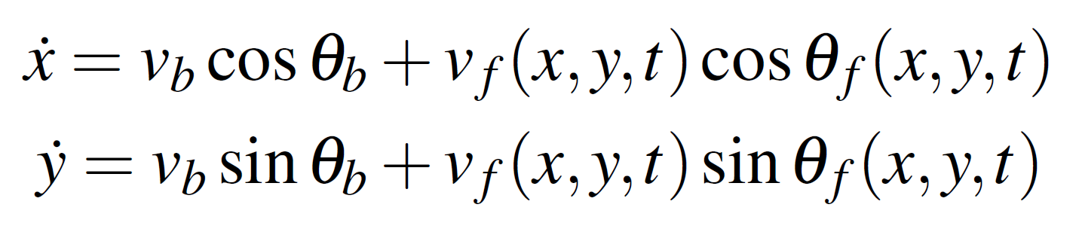
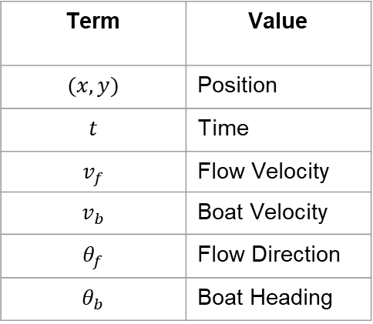
Path-Following Controller & Vehicle Kinematics
Term | Value
$$(x,y)$$ | Position
$$t$$ | Time
$$v_{f}$$ | Flow Velocity
$$v_{b}$$ | Boat Velocity
$$θ_{f}$$ | Flow Direction
$$θ_{b}$$ | Boat Heading
June 1, 2023

Slide 12
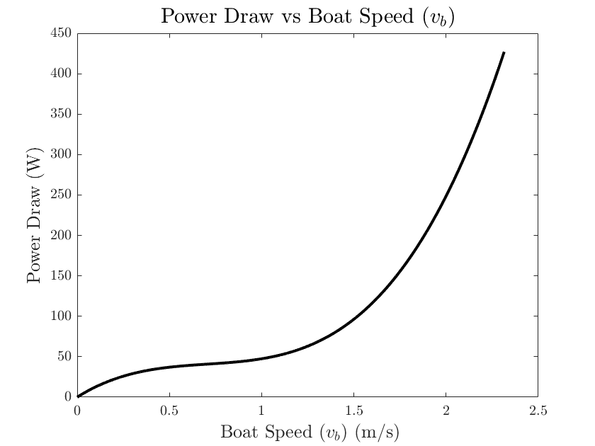
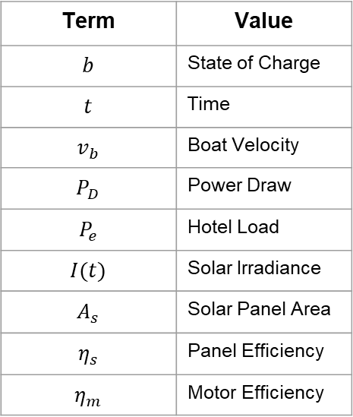



Battery Dynamics/Constraints
Term | Value
$$b$$ | State of Charge
$$t$$ | Time
$$v_{b}$$ | Boat Velocity
$$P_{D}$$ | Power Draw
$$P_{e}$$ | Hotel Load
$$I(t)$$ | Solar Irradiance
$$A_{s}$$ | Solar Panel Area
$$η_{s}$$ | Panel Efficiency
$$η_{m}$$ | Motor Efficiency
$$\dot{b}=η_{s}A_{s}I\left(t\right)−η_{m}P_{D}\left(v_{b}\right)−P_{e}$$
$$b_{min}≤b≤b_{max}$$
$$v_{min}≤v_{b}≤v_{max}$$
June 1, 2023

Slide 13
How Do We Solve This?
June 1, 2023

Slide 14
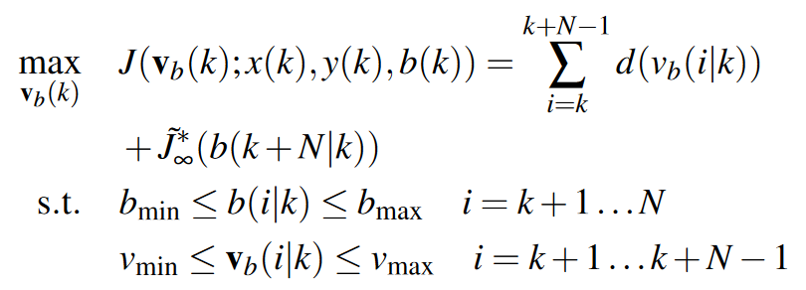
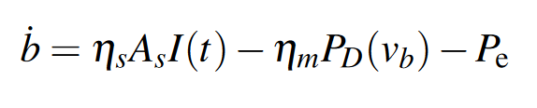
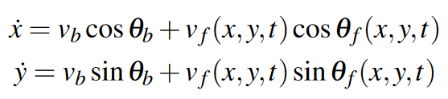
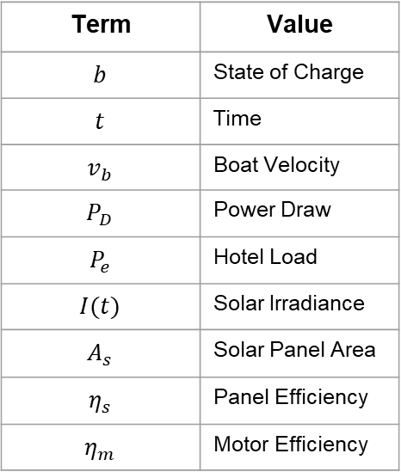
Model Predictive Control (MPC)
Term | Value
$$b$$ | State of Charge
$$t$$ | Time
$$v_{b}$$ | Boat Velocity
$$P_{D}$$ | Power Draw
$$P_{e}$$ | Hotel Load
$$I(t)$$ | Solar Irradiance
$$A_{s}$$ | Solar Panel Area
$$η_{s}$$ | Panel Efficiency
$$η_{m}$$ | Motor Efficiency
June 1, 2023

Slide 15



Model Predictive Control (MPC)
$$v_{b}$$
$$v_{b}$$
$$t$$
$$t$$
$$N$$
$$N$$
$$∞$$
June 1, 2023

Slide 16
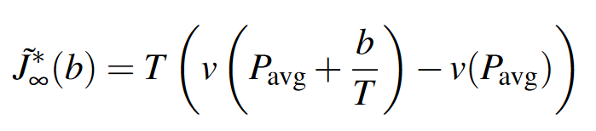






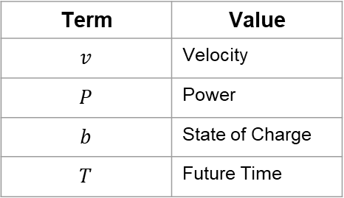
Baseline Infinite Horizon Reward
Term | Value
$$v$$ | Velocity
$$P$$ | Power
$$b$$ | State of Charge
$$T$$ | Future Time
$$v_{b}$$
$$P_{avg}$$
$$T$$
$$t$$
$$N$$
$$∞$$
June 1, 2023

Slide 17
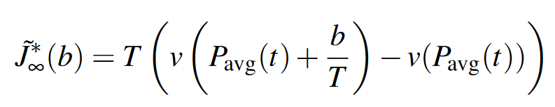

Scheduled Infinite Horizon Reward
Term | Value
$$v$$ | Velocity
$$P$$ | Power
$$b$$ | State of Charge
$$T$$ | Future Time
$$v_{b}$$
$$P_{avg}$$
$$T$$
$$t$$
$$N$$
$$∞$$
June 1, 2023
Notes:
The previous MPC formulation doesn’t account for variations in solar irradiance. This does.

Slide 18
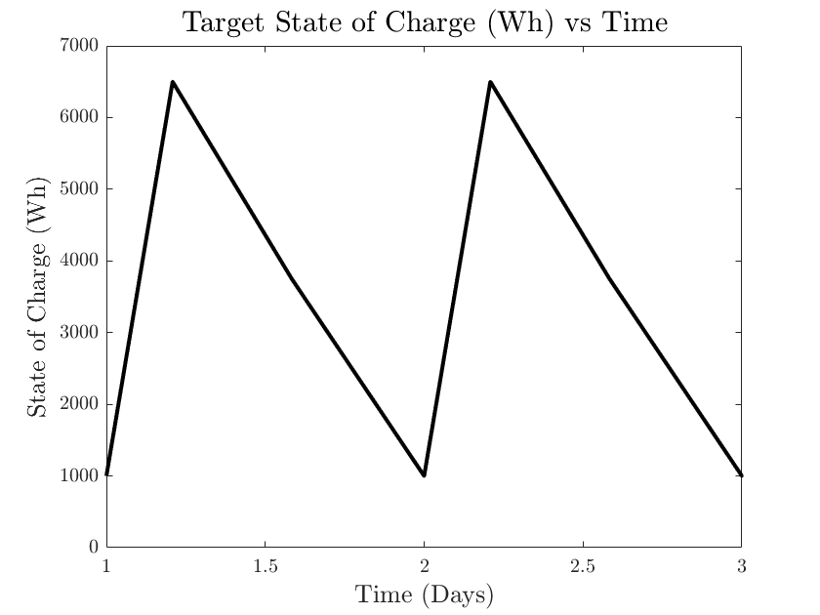
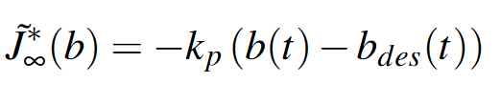
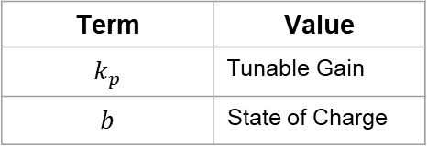

Infinite Horizon Terminal Cost
Term | Value
$$k_{p}$$ | Tunable Gain
$$b$$ | State of Charge
$$N$$
June 1, 2023

Slide 19
Comparison Benchmark Strategies
June 1, 2023

Slide 20
Benchmarks
- Constant SoC
- Prescribed SoC
- Constant Relative Velocity
June 1, 2023
Notes:
Use graphics on this page

Slide 21




Constant Speed Infinite Battery Benchmark
$$b$$
$$v_{b}$$
$$b_{max}$$
$$b_{0}$$
$$t$$
$$t$$
June 1, 2023
Notes:
Use graphics on this page

Slide 22
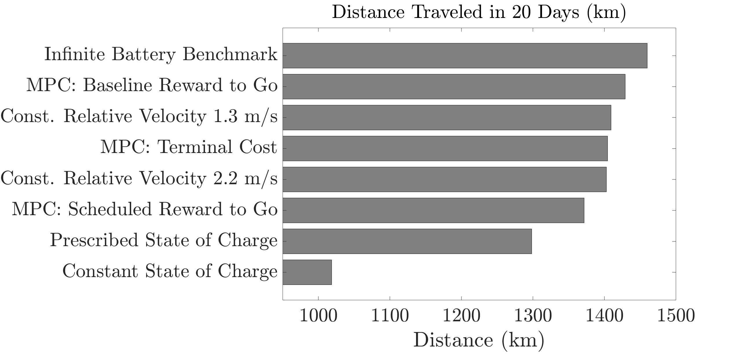

Slide 23
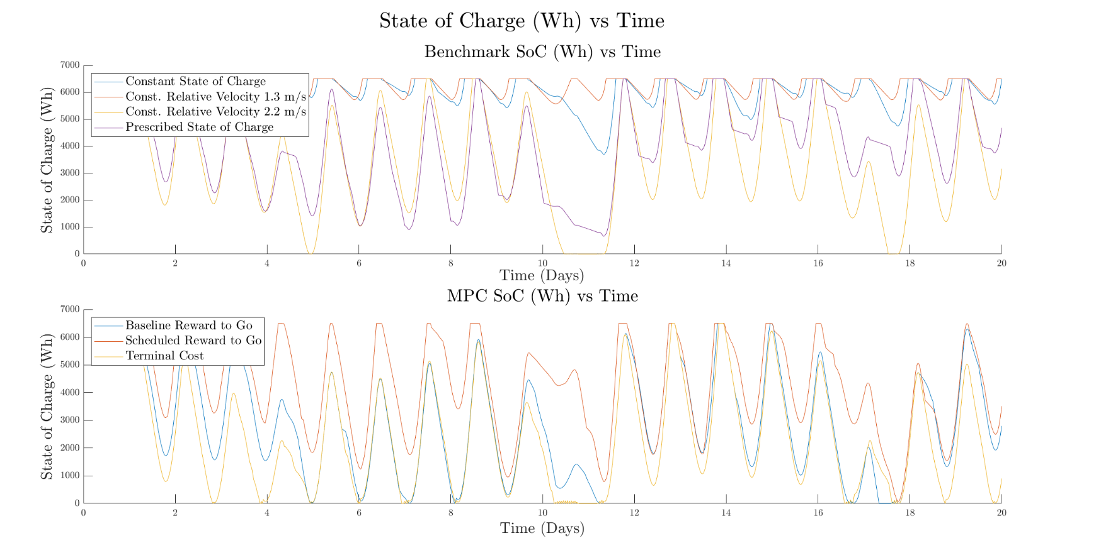

Slide 24
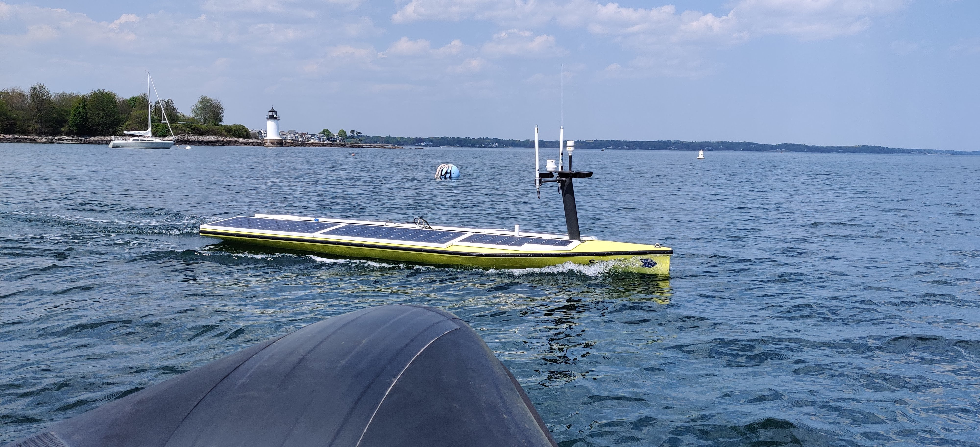
Summary/Future Work
Contribution:
Infinite Horizon Reward to Evaluate Distance Value of Energy
Current Simplifications/Drawbacks:
Assume omniscience of environment
Distance used as a proxy for information
Next Goal:
Information Value of Energy based upon oceanographic phenomena
Combine path and velocity planning
Remove omniscience
Experimental validation
June 1, 2023

Slide 25

Questions?
Funded By:
National Science Foundation, “Persistent Mission Planning and Control for Renewably Powered Robotic Systems”
June 1, 2023
Notes:
Add NSF Logo

Slide 26
Appendix

Slide 27
Infinite Horizon Predictions
- Baseline
- Scheduled
- Terminal Cost
June 1, 2023

Slide 28
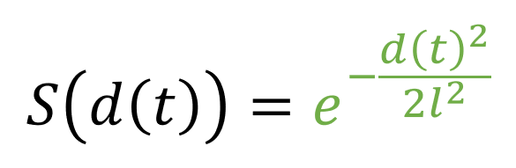
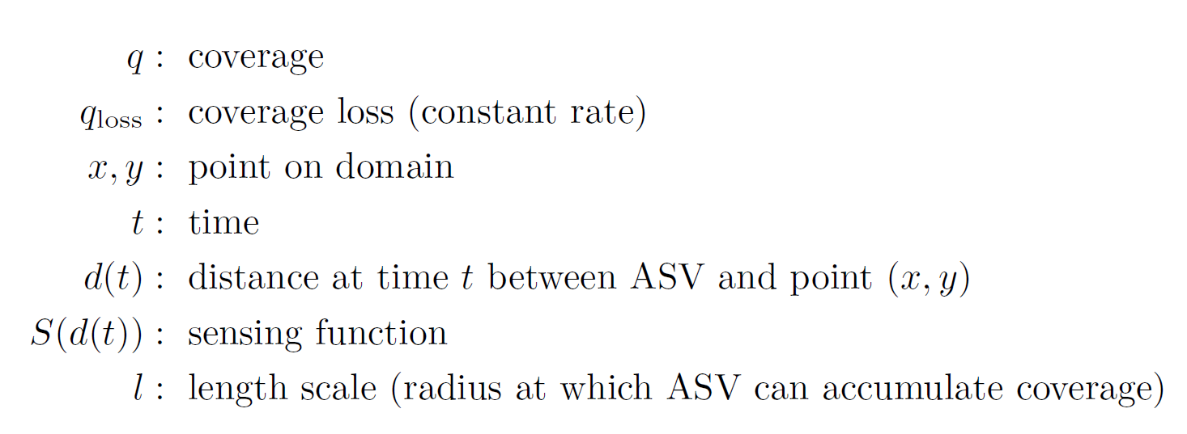
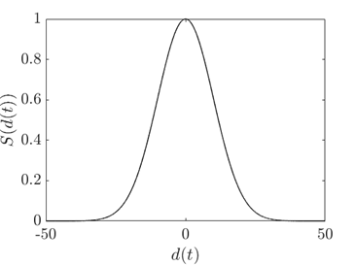
Improving Coverage Model
Current Drawbacks:
Does not account for oceanographic model features
Is information impacted by a flow resource?
How can coverage loss be better modeled?
Coverage: how much you know about a location
Coverage Gain (by visiting location)
Lose Coverage proportional to time (flat rate)

Slide 29
160 TwH/yr of Technical Energy Capacity
K. Haas, “Assessment of energy production potential from ocean currents along the United States coastline,” Georgia Inst. of Technology, Atlanta, GA (United States), Tech. Rep., 2013.
Notes:
Gulf stream location most consistent (outside of florida), one of the best locations for current power (mention the 160 TWh/YR)
Note that whitespace is North Carolina

Slide 30
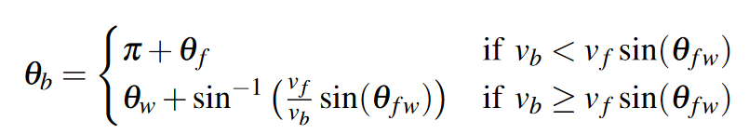
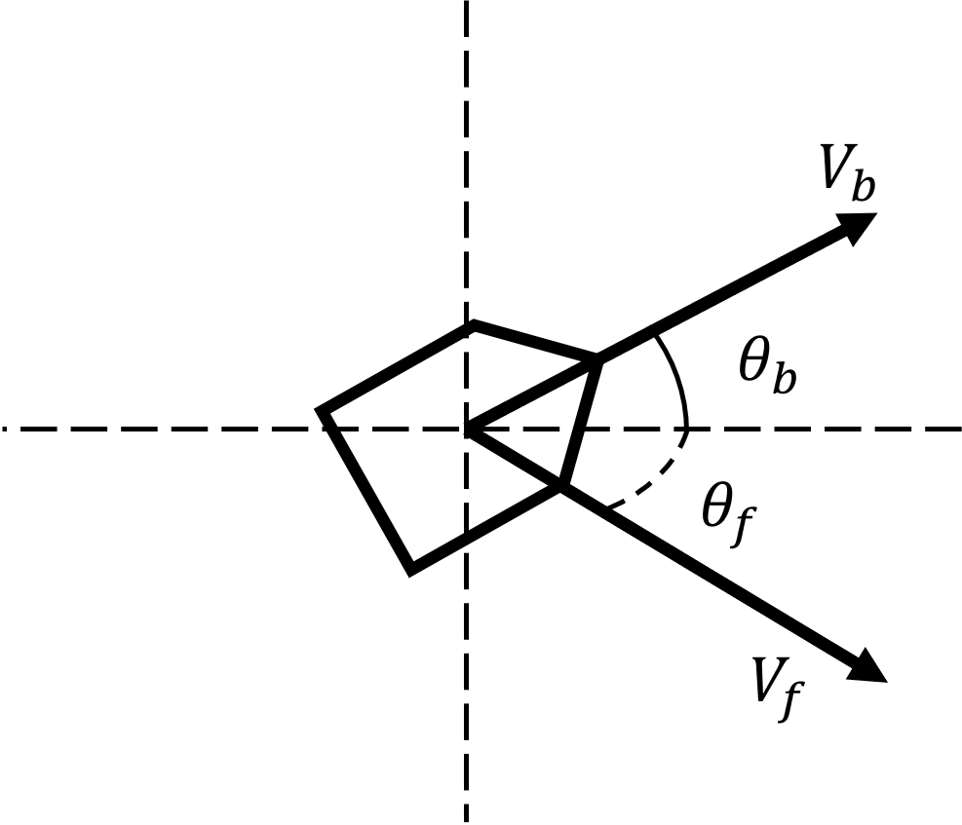



$$v_{b}$$
$$t$$
$$N$$
$$∞$$

