Slide 1
Resilient Rendezvous for Heterogeneous
Marine-Aerial Teams Under Communication
Uncertainty
Kavin M. Govindarajan, Sanyam Mehta
April 29, 2026 - ROB 516 Mini Project 5

Slide 2
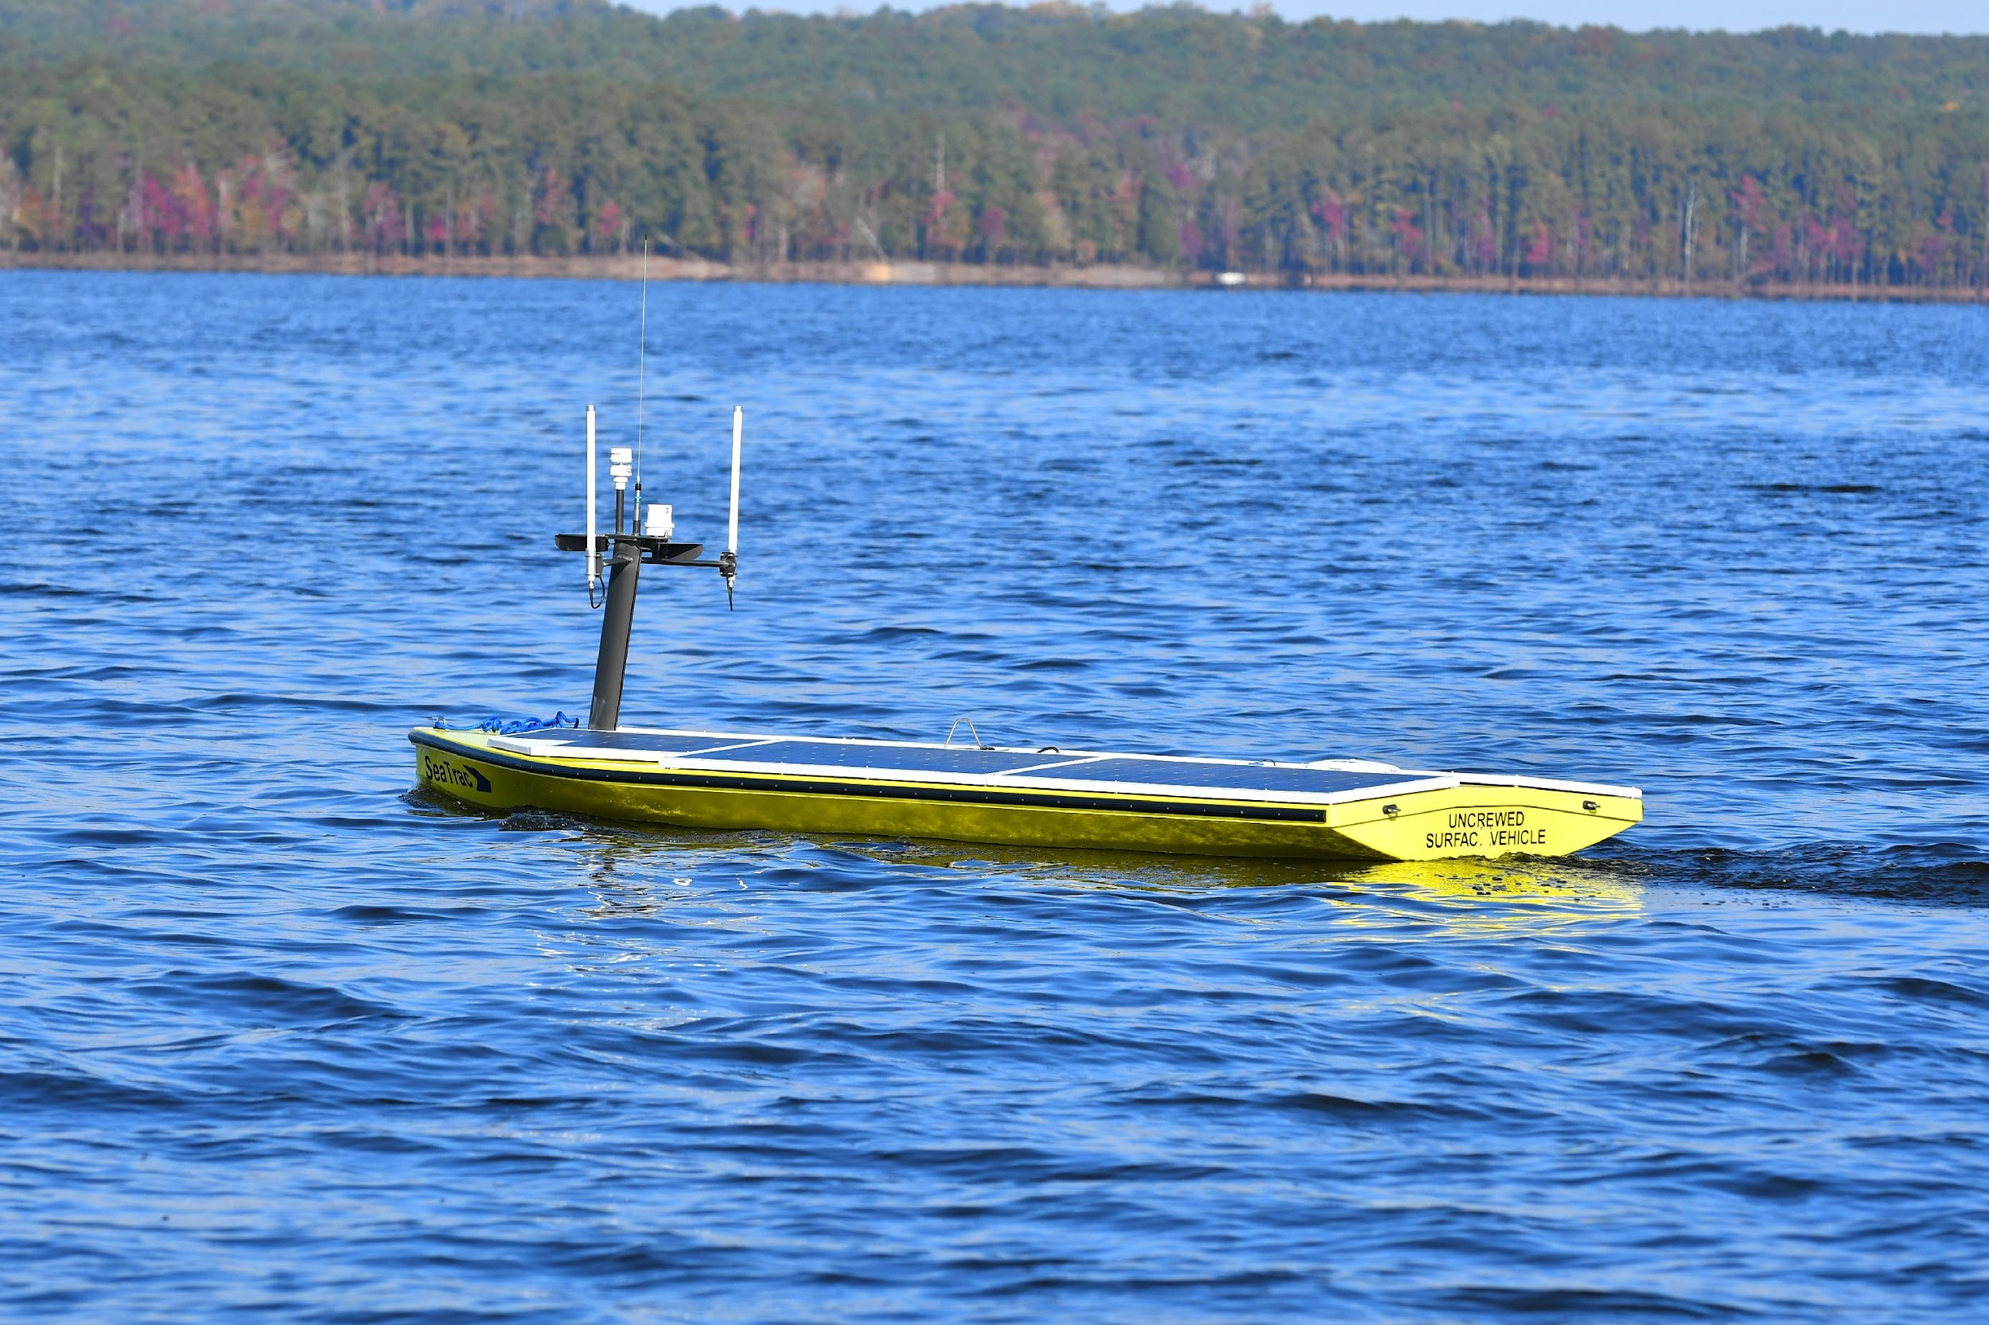
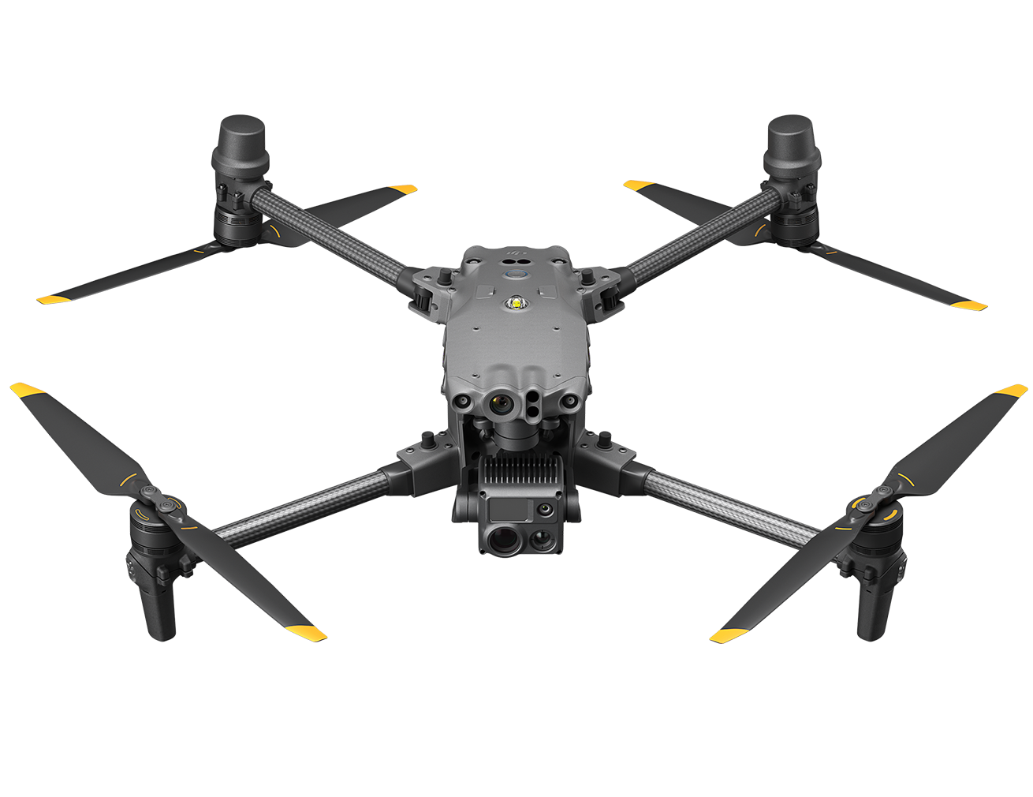
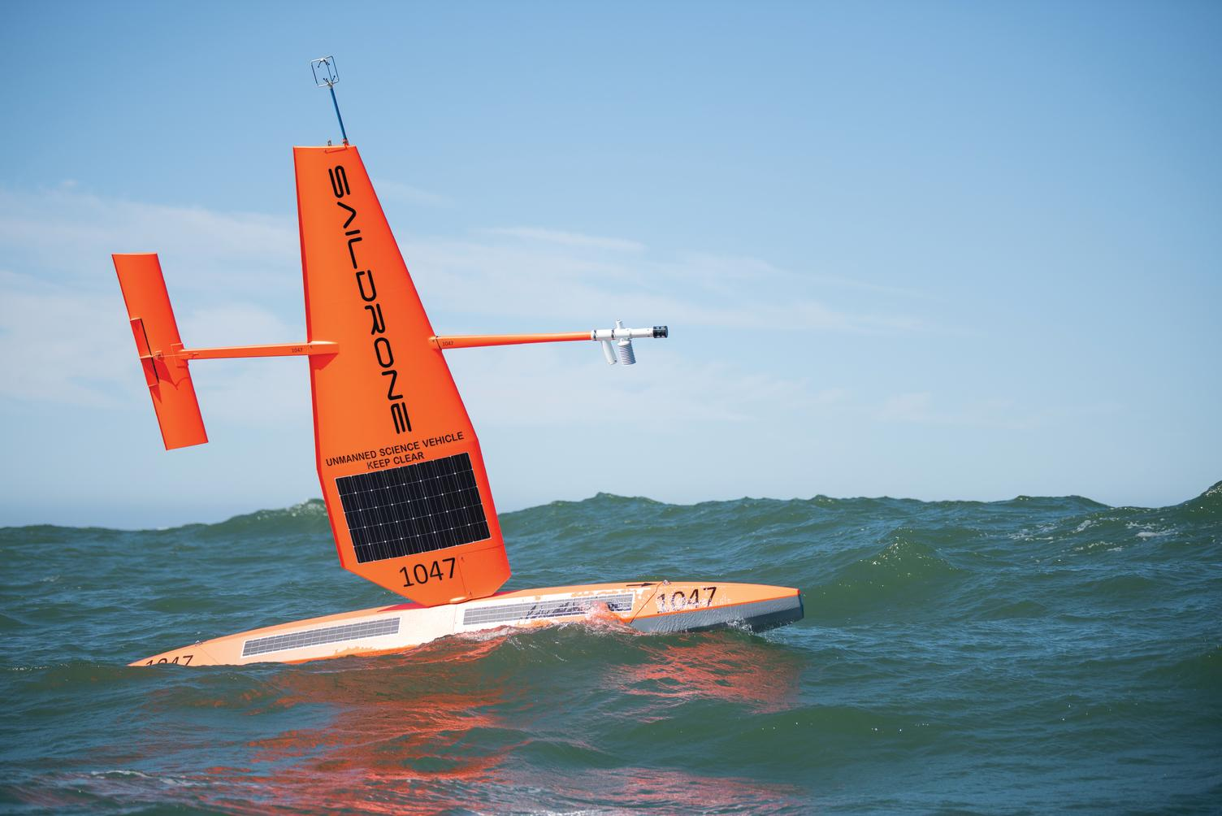
Marine-Aerial Teams for Maritime Sensing
Why are heterogeneous teams useful?
Persistent sensing
Surveillance
USVs:
Long endurance
Energy harvesting
Mobile communication relay
UAVs:
Rapid localization of transient events
High-resolution sensing
Flexible revisit of targets
Combining the two enables persistent, adaptive monitoring
Sustainably powered USVs
UAV Team
Solar-powered autonomous surface vessel (ASV)
Saildrone
Notes:
Marine-Aerial Teams are useful in many mission scenarios: from search & rescue to persistent maritime observation.
One benefit of using heterogeneous teams is that they’re able to leverage the strengths of each platform.
Unmanned Surface Vessels are capable of long duration missions, especially if they are sustainably-powered and capable of harvesting energy from their environments. Further, they can serve as communication hubs and relays.
Given their capabilities to store energy and serve as communication hubs or relays while still conducting information-gathering missions, they serve as a good platform for deploying teams of unmanned aerial vehicles, which are better suited at high resolution sensing and rapidly capturing information of transient events (for example surfacing animals).

Slide 3
The challenge? Synchronized Rendezvous
Rendezvous enables:
Data transfer
Battery recharge/servicing
Task reassignment between sorties
Why is this difficult?
Heterogeneous agents (i.e differing dynamics)
Unreliable marine communication
Intermittent connectivity
Time-varying interaction graphs
Moving leader (USV)
Synchronization alone is insufficient
It is possible for UAVs to achieve consensus yet still miss the USV
Sustainably powered USVs
UAV Team
Solar-powered autonomous surface vessel (ASV)
Saildrone
Notes:
While using heterogeneous marine-aerial teams provide many advantages, one of the challenges is that the UAV team must “rendezvous” with the USV host in order to offload data, recharge, and potentially receive new tasks. In a worst case scenario, it may be necessary for the entire aerial team to synchronously rendezvous with the USV host.
This is challenging because each agent has differing dynamics, can be at various locations, and have varying energy states.
Further, communication is a large challenge, particularly in maritime environments where connectivity can be intermittent and the network representing the communication interactions between the vehicles can vary with time.
To further increase the complexity of this challenge, the USV is also a mobile agent executing it’s own tasks, so all the UAVs must not only coordinate with each other, but also with the USV.

Slide 4
Related Work
Multi-Agent Consensus & Network Coordination
Formation Control & Multi-Agent Coordination
J. A. Fax and R. M. Murray, “Information flow and cooperative control of vehicle formations,” IEEE Transactions on Automatic Control, vol. 49,no. 9, pp. 1465–1476, 2004.
R. Olfati-Saber and R. M. Murray, “Consensus problems in networks of agents with switching topology and time-delays,” IEEE Transactions on Automatic Control, vol. 49, no. 9, pp. 1520–1533, 2004.
W. Ren and R. W. Beard, “Consensus seeking in multi-agent systems under dynamically changing interaction topologies,” IEEE Transactions on Automatic Control, vol. 50, no. 5, pp. 655–661, 2005.
L. Moreau, “Stability of multiagent systems with time-dependent communication links,” IEEE Transactions on Automatic Control, vol. 50, no. 2, pp. 169–182, 2005.
R. Olfati-Saber, J. A. Fax, and R. M. Murray, “Consensus and cooperation in networked multi-agent systems,” Proceedings of the IEEE, vol. 95, no. 1, pp. 215–233, 2007.
K.-K. Oh, M.-C. Park, and H.-S. Ahn, “A survey of multi-agent formation control,” Automatica, vol. 53, pp. 424–440, 2015.
R. Olfati-Saber, J. A. Fax, and R. M. Murray, “Consensus and cooperation in networked multi-agent systems,” Proceedings of the IEEE, vol. 95, no. 1, pp. 215–233, 2007
Leader-Follower Tracking
Marine-Aerial Coordination & Rendezvous
J. Hong, J. Hu, and L. Gao, “Tracking control for multi-agent consensus with an active leader and variable topology,” Automatica, vol. 42, no. 7, pp. 1177–1182, 2006.
[10] Y. Hong, L. Gao, D. Cheng, and J. Hu, “Lyapunov-based approach to multiagent systems with switching jointly connected interconnection,” IEEE Transactions on Automatic Control, vol. 52, no. 5, pp. 943–948, 2007.
W. Ni and D. Cheng, “Leader-following consensus of multi-agent systems under fixed and switching topologies,” Systems & Control Letters, vol. 59, no. 3–4, pp. 209–217, 2010.
J. Hu and G. Feng, “Distributed tracking control of leader-follower multi-agent systems under noisy measurement,” Automatica, vol. 46, no. 8, pp. 1382–1387, 2010.
K. Xue and T. Wu, “Distributed consensus of USVs under heterogeneous UAV-USV multi-agent systems cooperative control scheme,” Journal of Marine Science and Engineering, vol. 9, no. 11, p. 1314, 2021.
D. Li, K. M. Govindarajan, and C. Vermillion, “Clarity-driven ergodic control for persistent tip-and-cue missions with synchronized rendezvous,” in 2025 IEEE 64th Conference on Decision and Control (CDC), 2025, pp. 6394–6399.
Notes:
While formation control, leader-following tracking, and even rendezvous problems have been studied in the existing literature (shown on the slide), existing literature fails to consider the full combination of the challenges we laid out in the previous slide. Motivated by this gap, we formulate the initial problem studied in this work with a USV and UAV team.

Slide 5
Problem Formulation: Leader-Follower Coordination
The System: We are coordinating a swarm of 10 drones (followers) to track a single Unmanned Surface Vehicle (the leader) in a 2D environment.
Drone Dynamics: Each drone operates on a direct velocity-control model. Their positions are updated 20 times per second (20 Hz).
Leader Behavior: The USV leader acts as our target reference. It moves autonomously in a continuous circular path (radius of 5 meters, moving at 1 m/s).
The Objective: Implement a consensus-tracking approach where the drones adjust their control inputs to successfully follow the USV's trajectory.
Notes:
The system is modeled as a leader follower specification task. Specifically, we are coordinating a swarm of 10 drones to track a USV in a 2D environment.
Each drone operates on a velocity control model and the positions are updated at 20Hz
The USV moves autonomously in a continuous circular path and the objective is is to implement a consensus tracking algorithm where the drones adjust their control inputs to successfully follow the USV’s trajectory

Slide 6



Communication Model
Time-Varying Network: Inter-drone communication is modeled as a directed graph where the switching signal
Bernoulli Switching: The nominal graph is fully connected (no self-loops). At each update step, edges are independently retained with a probability of 0.6 and dropped with a probability of 0.4
Leader Pinning: Leader-visibility is fixed. Only Drones 1, 2, and 3 are pinned to the USV with unit gain, represented by the pinning matrix:
captures intermittent link failures
Notes:
What makes the problem challenging is that the intra-drone communication links can drop randomly at a rate sigma(t). This leads to a time varying network that captures link failures.
In our case, the edges are dropped with a probability of 0.4
Additionally, only three drones out of the ten have a direct access to the USV’s true location at all times

Slide 7
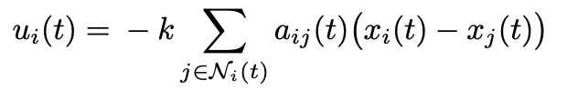


Objective Function: Baseline
Baseline Control Law: The controller relies on a common correction gain (k = 1.5) to penalize disagreement with neighbors and pull pinned drones toward the USV:
Error Dynamics: In stacked form, the system error induced by this controller is:
Even if the network topology is stable, the leader's velocity injects a continuous disturbance. This guarantees a steady-state offset, meaning the drones will always lag behind the target.
Notes:
The baseline objective function consists of two parts:
The first objective is to minimize the intradrone disagreement
The second objective is to minimize the disagreement between the positions of the pinned drones and the USV’s known location
Together, they define the error in the system at time t and can be converted to a control input using a proportional gain k (which we set to 1.5 in our system)
The , hence, can be described as the disagreement between the control input at time t and the USV’s nominal velocity, v0(t). What this implies is that even if the network topology were to remain stable, there will always be a steady state offset between the drone’s and the USV due to the continuous disturbances in the USV’s trajectory (v

Slide 8
Objective Function: Baseline
Baseline Control Law: The controller relies on a common correction gain (k = 1.5) to penalize disagreement with neighbors and pull pinned drones toward the USV:
Intra-UAV distance
USV tracking
The controller achieves 2 goals:
Getting the UAVs to group together
For the UAVs that know the USV’s position, tracking the USV
However, since the USV tracking portion only acts on the USV’s current position, it can lead to lag if the USV is moving.
Notes:
The baseline objective function consists of two parts:
The first objective is to minimize the intradrone disagreement
The second objective is to minimize the disagreement between the positions of the pinned drones and the USV’s known location
Minimizing this equation would bring all the drones together, and also bring the drones closer to the USV.
However, the USV itself is moving which adds a steady state offset in the system, which means the drones will always lag behind the target.

Slide 9



Objective Function: Feedforward Compensation
To cancel the common-mode motion of the USV, the implemented controller augments every agent with the exact leader velocity
In the corresponding error coordinates, the moving-reference term cancels exactly and the closed-loop dynamics become
The correction term still depends only on local relative-state information plus pinning. The exact analytic leader velocity is injected directly as a shared feedforward input to all drones, while the leader position enters only through the pinning term for drones with Gi = 1
Assumption: Exact leader velocity is available and known to all drones, however position is only known to some drones

Slide 10
Objective Function: Feedforward Compensation
To cancel the common-mode motion of the USV, the implemented controller augments every agent with the exact leader velocity
Feedforward
Intra-UAV distance
USV tracking
The correction term still depends only on local relative-state information plus pinning. The exact analytic leader velocity is injected directly as a shared feedforward input to all drones, while the leader position enters only through the pinning term for drones with Gi = 1
Assumption: Exact leader velocity is available and known to all drones, however position is only known to some drones
Notes:
To close this steady-state offset, we use a feedforward compensation. Under the assumption that the exact leader velocity is known to all drones (this can be something that is agreed upon before the UAVs are deployed), we add a correction term to the controller

Slide 11
Switching Topology
The active graph may change because of packet drops or temporary loss of line-of-sight.
The Convergence Condition: The swarm does not require continuous connectivity. It converges as long as the union of communication graphs over a time window T forms a directed spanning tree rooted at a pinned agent.
Evaluating Stability: In this directed setting, the key diagnostic is repeated joint reachability over time.
Dropout Behavior: During temporary disconnections, unpinned agents lose relative-state data, while pinned agents maintain direct anchoring to the leader.
The Resilience Mechanism: When links recover, leader-position data diffuses back through the network via the pinned agents. If recoveries are frequent enough, the swarm successfully achieves rendezvous.
Notes:
While the control strategies described on the previous slides are quite simple, they actually encode some quite useful properties and exhibit robustness to the disturbances we mentioned earlier.
When the communication between the UAVs is represented as a graph, any communication dropouts between the UAVs is represented as a change in this graph via a severed connection.
However, because of the nature of the proposed controller, even if the connections can change with time, so long as the union of communication graphs over some period of time T forms a directed spanning tree that is rooted at an agent that is “pinned” (or in other words an agent that can see the USV), the swarm is guaranteed to converge.
When communication dropouts do occur, agents can lose the relative-state data; however, as soon as communication links recover, this information can propagate through the network again.
Thus, once again, as long as the graph forms a directed spanning tree over some window of time T, all necessary information can be communicated among the network, and the controllers are able to achieve their goals of the drones grouping together and tracking the USV.

Slide 12
Results
Feedforward
Baseline
Notes:
Here, we can see the the results of our controller.
As we established, we can see that the drones are driven to group together (enforced by the intradrone distance minimization portion of the objective), and because a subset of the drones in the system are capable of and attempting to track the USV’s position, the entire group follows.
In the baseline, while the drones all achieve a consensus and group together… without the feedforward term, they end up lagging behind the USV as a group, as we theorized earlier. Now, when the feedforward term is included, the group is able to compensate for the motion of the USV and succesfully rendezvous.

Slide 13
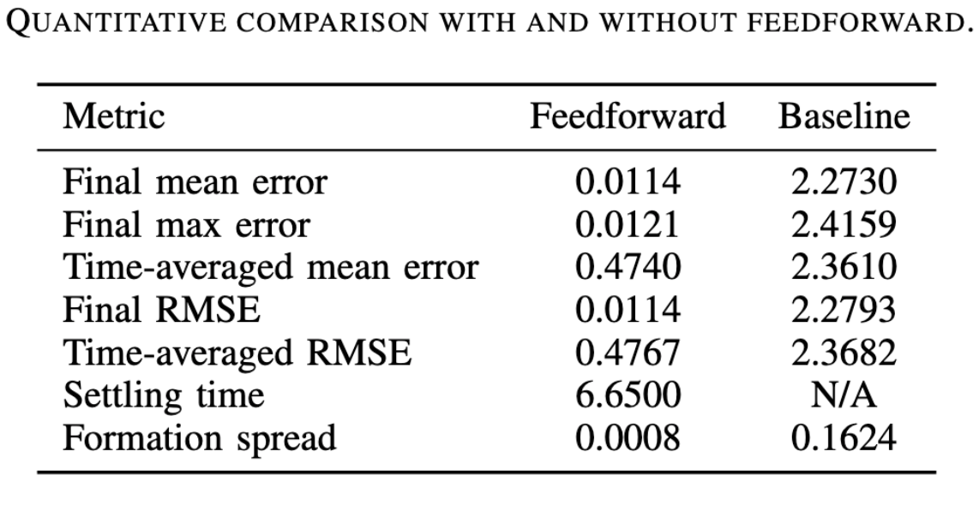
Results
Feedforward
Notes:
Further, we can see that because the feedforward term is propagated through the group, the terminal spread of the group is lower, and convergence is achieved.

Slide 14
Interpretations, Performance and Future Directions
Resilience: The swarm can survive severe communication dropouts as long as the network periodically reconnects.
Motion Compensation: You cannot just use a basic consensus model for a moving target. Explicitly compensating for the leader's movement is a hard requirement.
Performance:
Our proposed approach maintained an error (RMSE) below 0.012.
The baseline approach failed to stabilize, drifting with an error above 2.279.
Future Directions:
Scale the simulation beyond the current 10-drone limit.
Remove knowledge of USV speeds and disturbances
Stress-test the system to find the exact failure thresholds for extreme dropout rates and higher leader speeds.
Notes:
In sum, our controller and associated results show that the we’re resilient to communication dropouts and are capable of compensating for a moving target.
Through the inclusion of the feedforward term, we’re able to significantly reduce the positional error as well.
That being said, the assumptions made in this work represent a simplified first step. Moving forward, we would seek to scale this simulation and implementation beyond the current 10pdrone limit.
We further assume that the failure rates and USV velocities are known in this work. Moving forward, we could seek to improve our controller to be robust to uncertainties in those failures/disturbances.
Finally, we would liek to stress-test the system to find the exact failure thresholds. In other words, we would like to see just how much communication can drop out and how severe disturbances can be before the controller fails to converge.

Slide 15
Conclusion
The Framework: Combining leader-following consensus with velocity feedforward successfully separates two objectives: swarm agreement and moving-target tracking.
The Resilience: Switched-system analysis proves the swarm tolerates substantial dropouts, strictly requiring only periodic joint connectivity over time.
Future Scope:
System Fidelity: Incorporate higher-order dynamics, estimation errors, and physical actuator limits.
Robustness Testing: Evaluate against varied leader trajectories, aggressive dropout rates, and massive team sizes.
Energy-Awareness: Integrate Information Value of Energy (IVE) to prioritize critical communication when drone battery reserves run low.
Notes:
To recap, our contribution consists of a leader-following consensus model that is capable of handling heterogeneous marine-aerial swarms and solves the rendezvous problem under communication dropouts and disturabances.
We were able to show that rendezvous is possible, even when the communication topology changes with time.
In addition to the improvements discussed on the previous slide, we would also be interested in incorporating higher-order dynamics, making the controller more robust to disturbances and varied USV path, and integrating the notion of persistence into rendezvous (looking at how energy can dictate decision-making and modify the consensus protocol).

