Slide 1
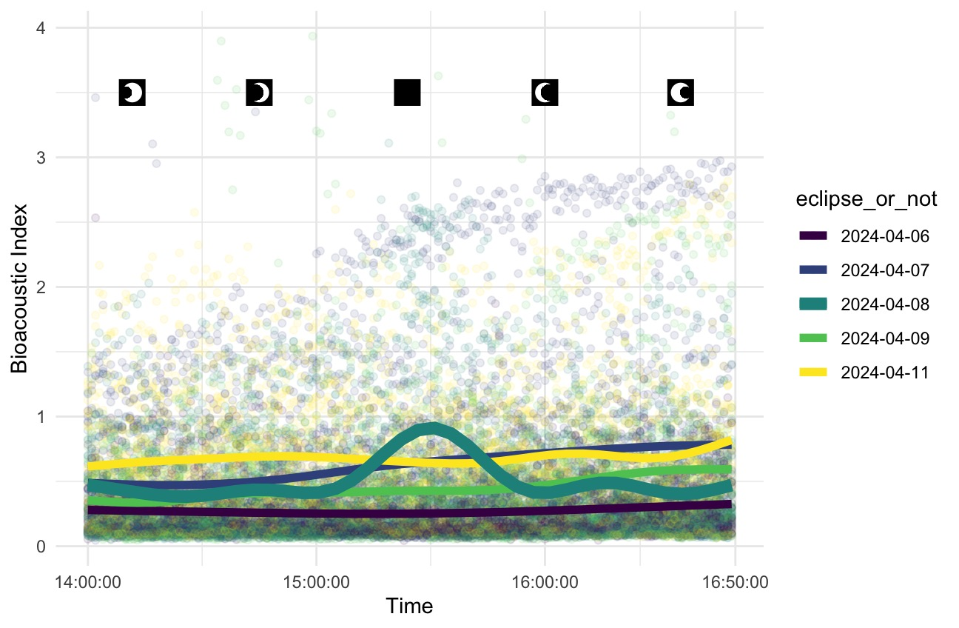
Analyzing Audio Patterns from the 2024 Total Solar Eclipse
Kaitlin Heintzman ‘25

