Slide 1
Red-Black Tree
Submitted By -
CSE 225 LAB
E.M.K. Fahmidur Rahman [1620535042]
Afshaan Md. Shaan [1620910042]
K.M.H. Mubin [1621802042]
Group Project
Group No - 03

Slide 2
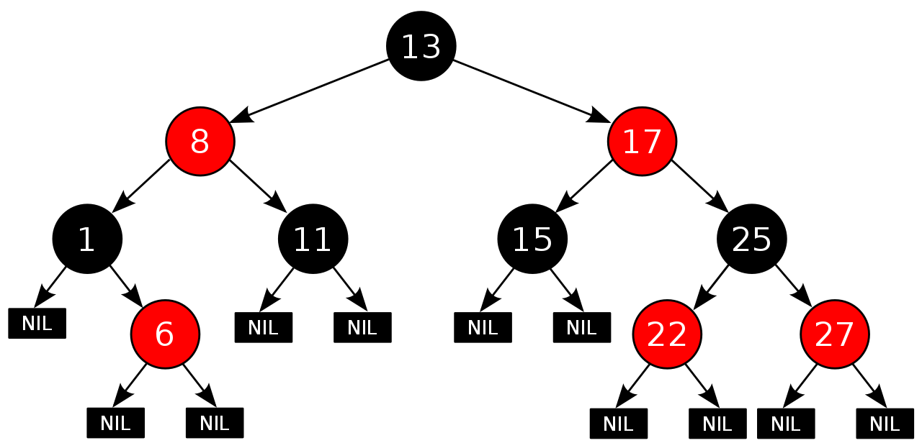
Red-Black Tree
A red-black tree is a self-balancing binary search tree in which each node is colored red or black. For example here is a red-black tree diagram.
Properties:
The root node will always be black.
The incoming node is always red.
Every node is either red or black.
Every leaf (null) is black.
If a node is red then both its children are black.
A red node can’t have a red child.
A double red violation will occur if a child and parent are both red.
Resolve a violation with recoloring and /or a rotation/restructure.
Every simple path from a node to a descendent leaf contains the same number of black nodes.

Slide 3
Operations of Red-Black Tree
There are three main operation in Red-black tree. Those are
Insert
Delete
Search
In red black tree insert and delete require rotation/restructure and recoloring
Other operations like search, print etc. follows the BST algorithms.

Slide 4
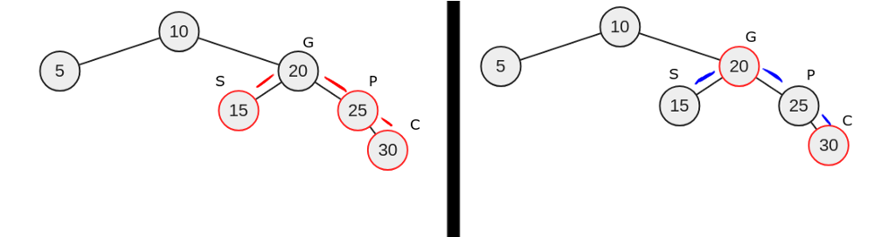
Recoloring and Rotation
Recoloring
Rotation / Resturcture
Recoloring occurs whenever a double red violation and parent’s sibling is red.
For example: the child and the parent are red as well as the sibling. Therefore this is a double red violation. So we can resolves with recoloring.
Paint the parent and the sibling black. Paint the grandparent red but if the grandparent is the root, the root remain black.
Alters the structure of a tree by rearranging subtrees
Goal is to decrease the height of the tree
Red-black tree: maximum height of O(log n)
Larger subtrees up and smaller subtrees down
Dose not affect the order of elements
There are four type of rotations. Those are
Left-left rotate
Right-right rotate
Left-right rotate
Right-left rotate

Slide 5
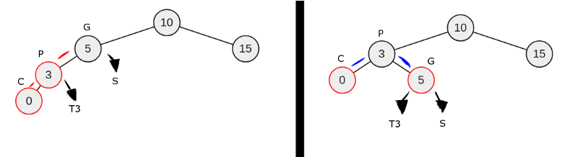
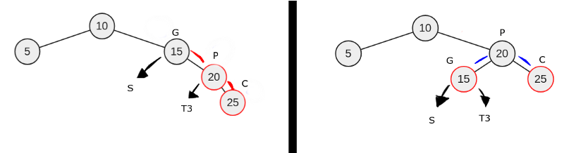
Rotation / Restructure
Left –left Rotate
Right-right Rotate
Left-left a single rotation the parent is to the left of the grandparent and the child is to the left of the parent. For example: here left child and the left parent are red.
The p recolors to black, G recolor to red and p right now points at g. The left child C stays same at the p left. Now reattach t3 from p right to g left.
Right-right a single rotation when the parent is to the right of the grandparent and the child is to the right of the parent. For example: here right child and right parent are red.
Again p recolors to black, g to red and now p left points at g. This time t3 reattaches from p left to g right.

Slide 6
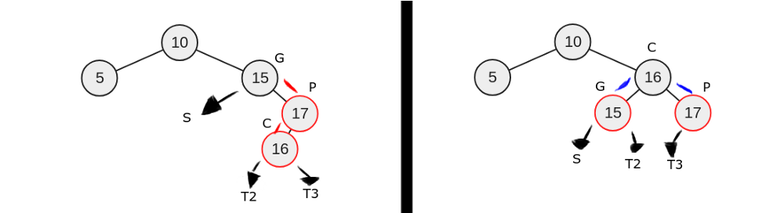
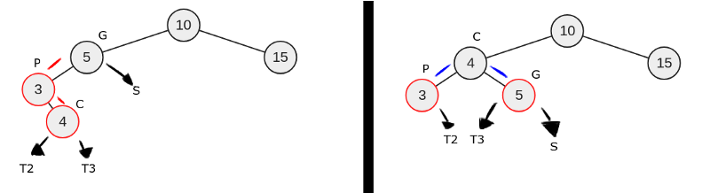
Rotation / Restructure
Left-Right Rotate
Right-Left Rotate
A double rotation. The parent is to the left of the grandparent and the child is to the right of the parent. For example the left child and the right parent are red.
G left points at p and p right points at c. The sibling, s is either black or null. If p and c were to swap positions, but also maintain order. C left would then point at p, because three is less than four and g left would then point at c not p.
Recolor g to red and c to black. Now point c right to g. reattach t2 from c left to p right and t3 from c right to g left.
Occurs when the parent is to the right of the grandparent and the child is to the left of the parent. For example: the right child and left parent are red.
If p and c were to change positions to maintain order, c right would then point a p. then a right-right rotation would make c left point at g and lead to a recoloring of g to red and c to black. Now reattach t2 from c left to g right and t3 from c right to p left.

Slide 7
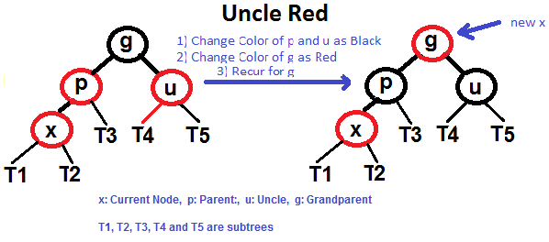
Insertion
Insert algorithm has following steps:
Insert the node using BST insertion algorithm, the inserted node will be colored red.
Check for violations
If violation exists then perfume rotations or/and recoloring based on several conditions.
Insertion concerns mostly with the uncle of the inserted node.
Case 1: Where a red node has a red parent and a red uncle.
Recoloring the parent, uncle and grandparent to their complement color(red becomes black, and black becomes red)
Check whether new violation occurs.
Case2: Where a red node has a red parent and a black uncle and is and inner leaf
Perform rotation to the direction opposite of its position to itself and its parents circle.
# Left Right Rotation
left-rotation requied
if(pt==parent_pt->right)
{ rotateLeft(root,parent_pt);
Pt=parent_pt;
Parent_pt = pt->parent; }
# Right Left rotation
right rotation required
if(pt==parent_pt->left)
{ rotateRight(root,parent_pt);
Pt = parent_pt;
Parent_pt = pt->parent; }

Slide 8
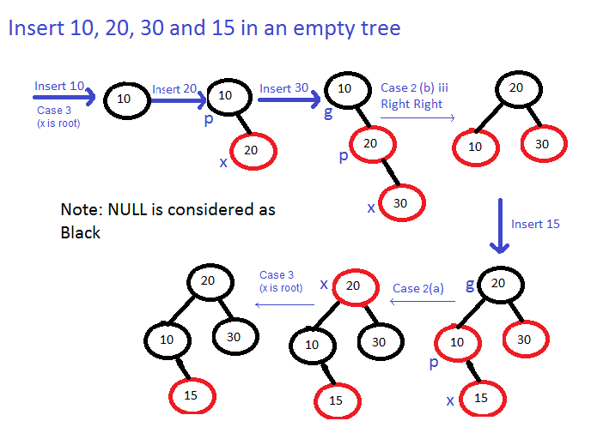
Insertion
Case 3: Where a red node has a red parent and a black uncle and is an outer leaf
Perform rotation to the direction opposite of its parent’s position to its parent’s and its grandparent’s circle
Swap the color of former parent and grandparent.
# Left-Left Rotation (p is left child of g and x is left child of p)
- right -rotation required
- rotateRight(root,grandparent-pt)
- swap(parent_pt->color,grandparent-pt->color)
-pt=parent-pt;
# Right-Right rotation (Mirror of case a)
Left rotation required
rotateLeft(root,grandparent_pt);
swap(parent_pt->color,grandparent_pt->color);
pt= parent_pt;
Example diagram of the Insertion

Slide 9
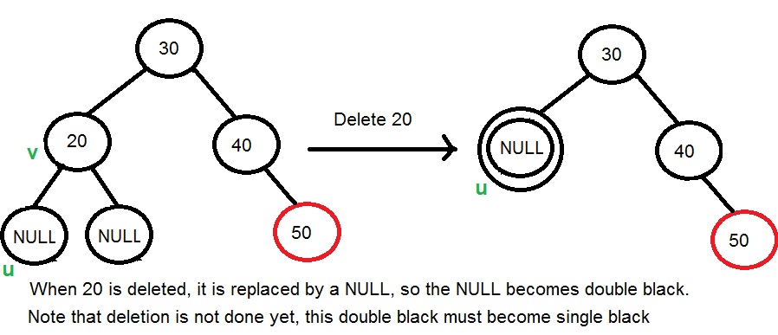
Deletion
Deletion has following algorithms:
Deletion of node is firstly performed as in BST.
Then it comes down to a case where we must delete a node with either 0 or 1 nodes below it.
CASE 1: The node to be deleted is RED.
Simply delete the node.
If node has a child , then replace it with the child.
CASE 2:The node to be deleted is black but has a red child.
Replace the node with its child.
Recolor the child into black.
CASE 3: The node to be deleted is black but has a black child
Replace the node with its child
The child will now be what is called a double black node, which will need to be transformed into a normal black node through 6 different cases
Insertion focuses on the uncle of the target node, while deletion here will focus one its sibling.
Go through the cases ascendingly until a suitable node is found.

Slide 10
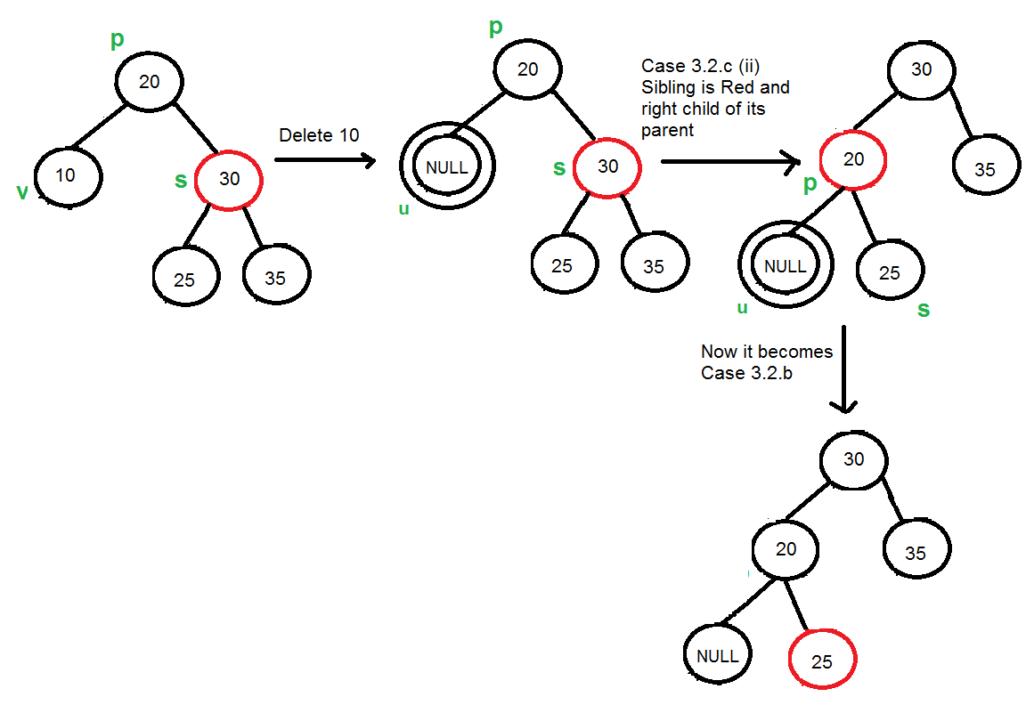
Deletion
Those 6 case are:
#The node to be deleted is black and is a root node.
#The node to be deleted is black and has a black parent and a red sibling.
# The node to be deleted is black has a black parent and a black sibling with 2 black children.
# The node to be deleted is black and has a red parent.
# The node to be deleted is black and has a black parent and a black sibling with 1 inner red child.
# The node to be deleted is black and has a don’t care parent and a black sibling with 1 outer red child along with 1 don’t care child
Example of deletation

Slide 11
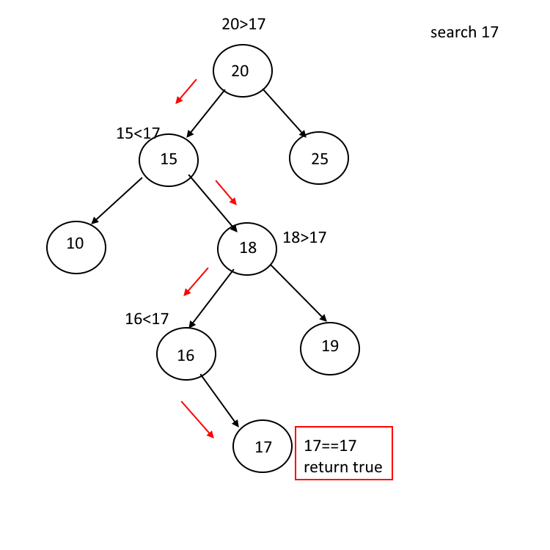
Searching
In red-black tree search is same as Binary search tree searching.To search a given key in binary search tree we first compare it with root.
If the key is present at root we return root. If key is greater than root’s key, we recur for right subtree of root node.
BST search algorithm is
Root is null or key is present at root
If(root == null || root->==key)
Return root
Key is greater then root’s key
If(root->key<key)
Return search(root->right,key)
If Key is smaller then root’s key
Return search(root->left,key)

Slide 12
Red-Black Trees Time Complexity
Time Complexity in Big ( O ) notation
 | Average | Worst Case
Space | O ( n ) | O ( n )
Search | O ( log n ) | O ( log n )
Insert | O ( log n ) | O ( log n )
Delete | O ( log n ) | O ( log n )

