Slide 1
An Empirical Study of Location Truncation on Android
Kristopher Micinski
Philip Phelps
Jeffrey S. Foster
University of Maryland, College Park

Slide 2
Location-Based Services
Many apps provide targeted services
In exchange for user location
Do they really need precise location?
Many proposed location privacy mechanisms
Our work:
How does location privacy affect utility?

Slide 3
Contributions
Studied large set of apps from Google Play
Found 6 categories of location usage
CloakDroid: retrofit apps with location truncation
Via Dalvik bytecode rewriting
Ran on 6 apps at 60 locations and 10 truncation amounts
All apps provide list output, e.g., nearest restaurants
Three utility metrics: edit distance, set intersection size, additional distance
Let us study utility in a direct way (looking at app’s GUI)
Result: apps can have their inputs truncated
Most 5-20 km before much real difference

Slide 4
Location Truncation
Snap location to grid
User-controlled spacing
Pros
Simple to understand
No prior data needed
No domain knowledge
Cons
Defeats only localization attacks
Not anonymity or tracking
Can eventually localize user
If you take traces of data over time
Won’t work for all apps

Slide 5
Why Do Apps Use Location?
Looked at top 750 free apps in Google Play
Pulled from market in April 2012
275 request location
Installed and used each app
Why does app request location permission?
Found six main uses of location in apps

Slide 6






Why Do 275 Apps Use Location?
Ads (58)
Listing nearby objs (43)
Fine-grained uses (34)
Nearest city (22)
Weather (21)
Tagging (28)
Unsure (17)
Unable to Test (52)
Notes:
Say which 275 apps were covered

Slide 7

Implementation
Dalvik bytecode rewriting to instrument APK
Location calls go through new API (CloakDroid)
Truncated locations returned to app
org.apk
install time
runtime
Dr. Android
CloakDroid
services
enh.apk
RefineDroid
Process boundary

Slide 8
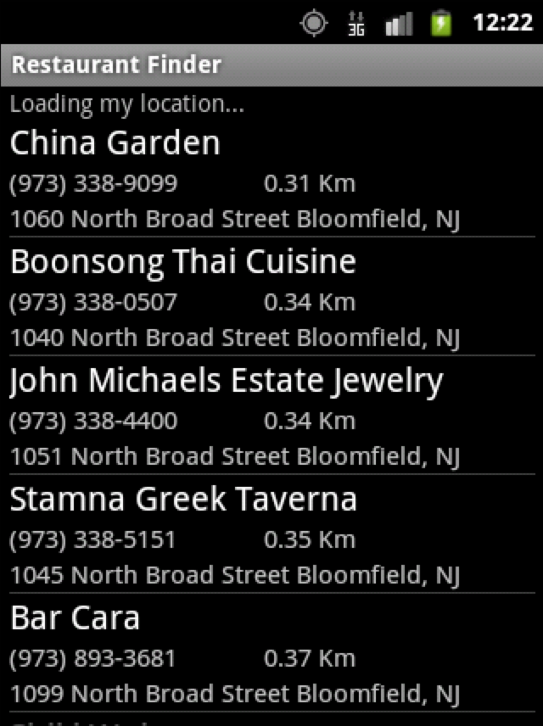
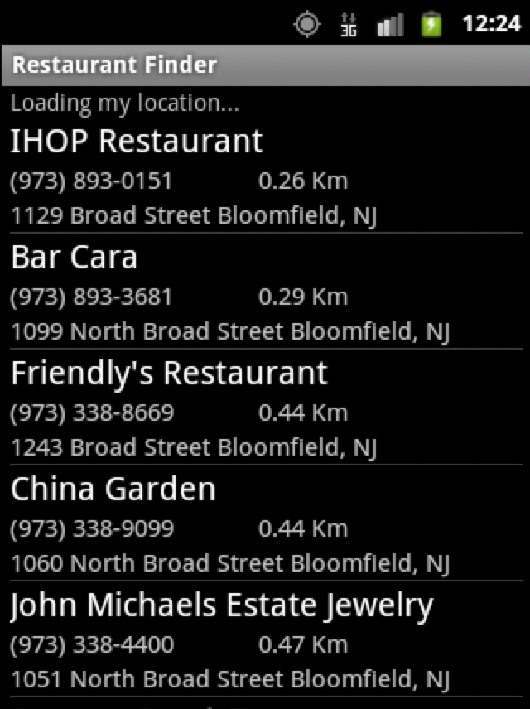
Example of Truncation on Apps
Original
Truncated

Slide 9
Edit Distance
# of additions, deletions, or swaps
Edit distance of 4
A (1.4)
Delete 2
C (1.6)
B (1.6)
D (2.1)
C (1.8)
E (2.5)
D (2.4)
F (2.9)
E (2.7)
G (3.0)
Add 2

Slide 10
Set Intersection Size
# of common elements
Set intersection size 3
A (1.4)
C (1.6)
B (1.6)
D (2.1)
C (1.8)
E (2.5)
D (2.4)
F (2.9)
E (2.7)
G (3.0)

Slide 11
Additional Distance
How much farther 1st elt is, on original list
1.8 – 1.4 = 0.4
A (1.4)
C (1.6)
B (1.6)
D (2.1)
C (1.8)
E (2.5)
D (2.4)
F (2.9)
E (2.7)
G (3.0)

Slide 12
May Need to Scroll for Metrics
Original
Truncated
???

Slide 13
Experimental Design
Tested 6 different list-based apps
6 different cities
Decatur, TX (pop. 6k) to New York, NY (pop. 8.2M)
10 points per city
Chosen at random such that all apps work at locs
Measured where
Edit distance is > 20% of size of list
Set intersection is < 80% of size of list
Additional distance is > 1 km

Slide 14
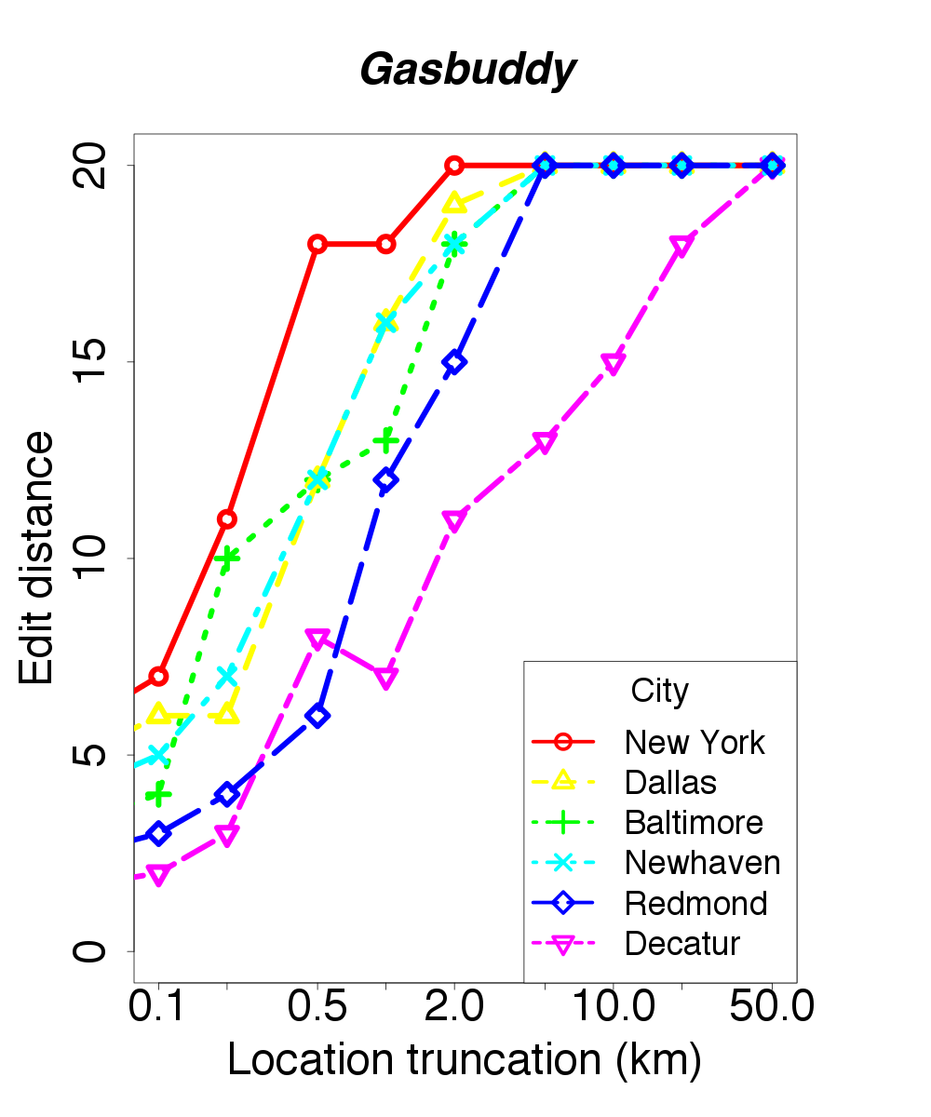
Edit Distance
Increases quickly even with minimal truncation

Slide 15
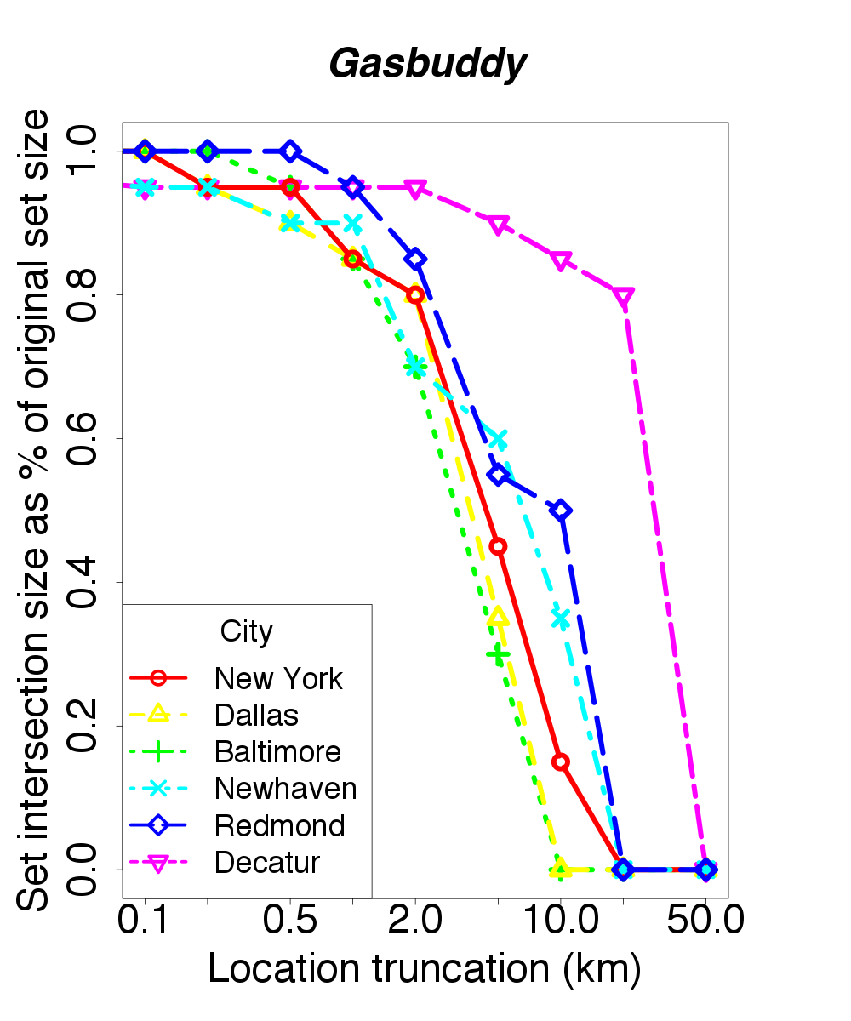
Set Intersection
Truncate 2 km before losing many common elements
Truncate more in less populated areas

Slide 16
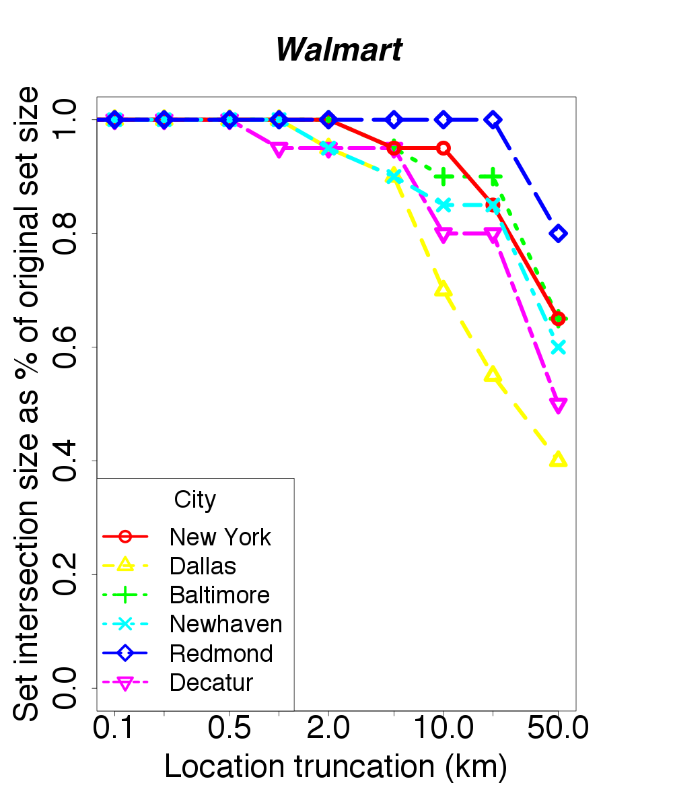
Set Intersection
Fewer Walmarts than gas stations,
so more truncation okay
Truncate up to 20km

Slide 17
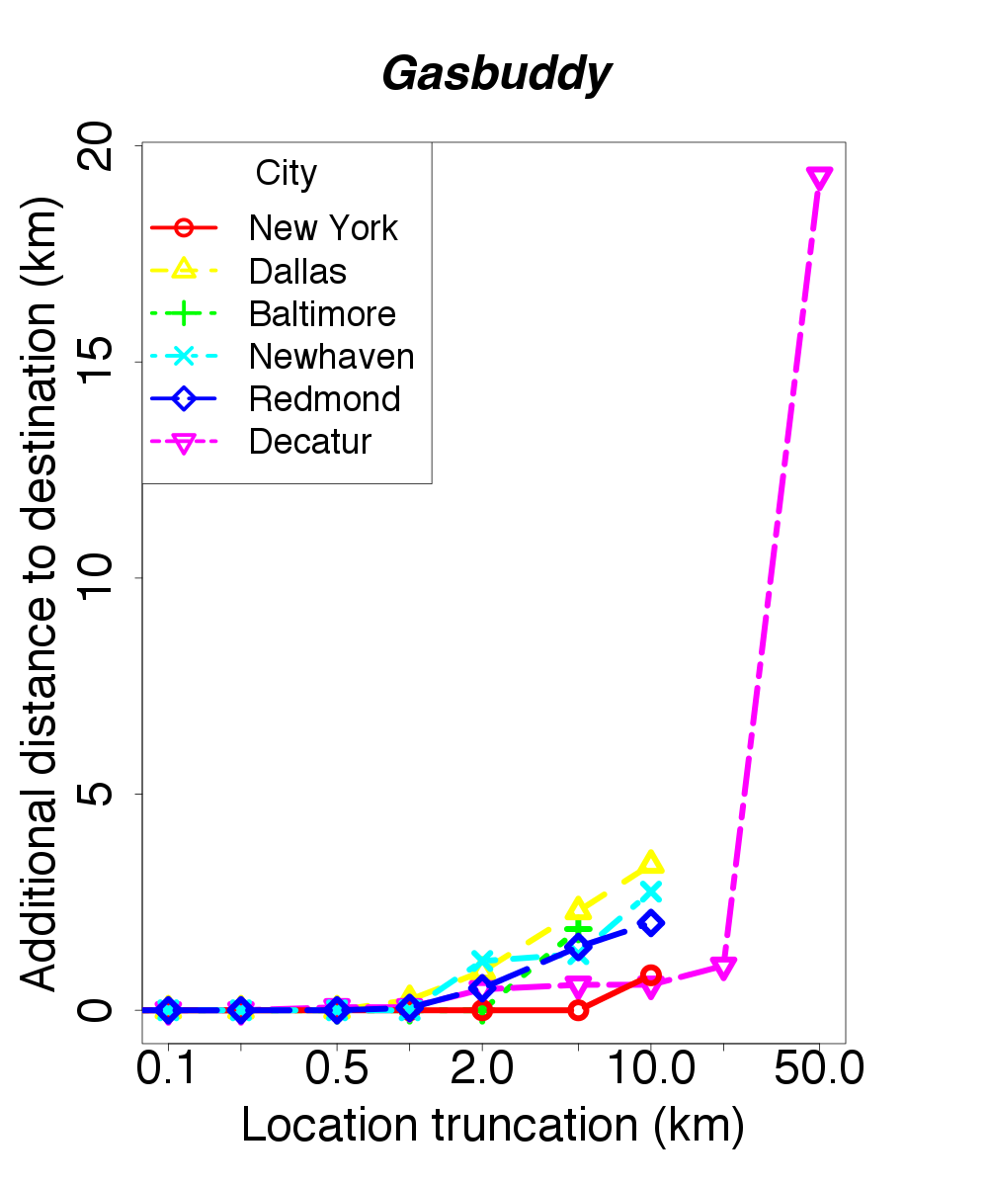
Additional Distance
Undefined for some locations.
Truncate up to 2 km

Slide 18
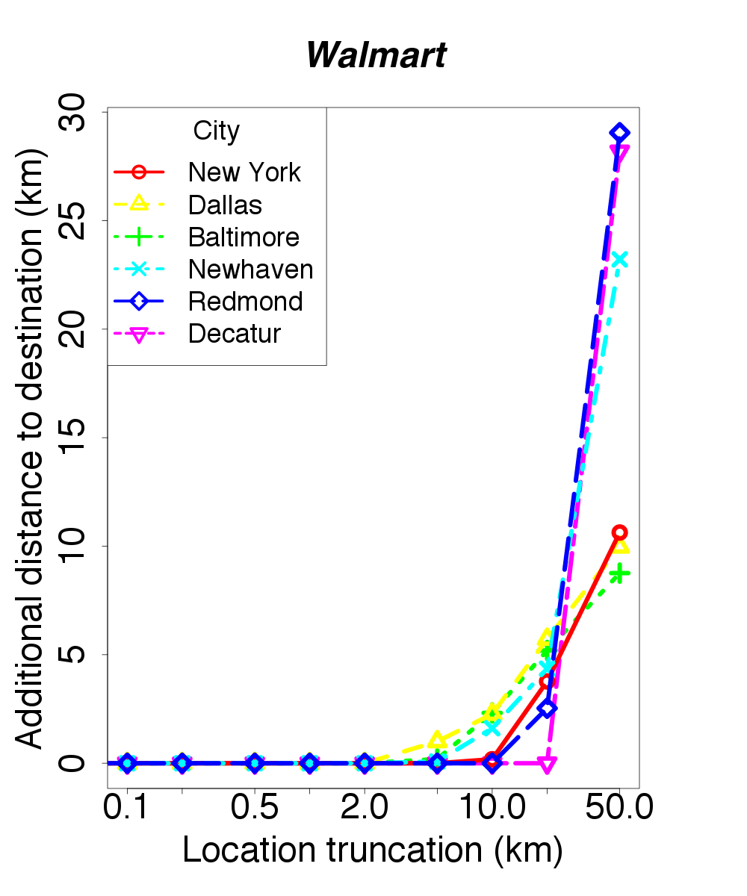
Additional Distance
Can truncate up to 5-20 km before utility decreases a lot

Slide 19
Summary
5-20 km truncation acceptable for many apps
Ability to truncate varies with
Object density
Which is often correlated with population
Metric
Edit distance least forgiving (also unnatural)
Set intersection size in the middle
Additional distance most forgiving

Slide 20
Conclusion
Studied how location is used in 275 apps
Instrumented using CloakDroid
Three utility metrics
Edit distance, set intersection, additional distance
5-20 km truncation acceptable for many apps
Ability to truncate varies with object density
Future work
More apps, more location-privacy mechanisms

