Slide 1
An Empirical Study of Location Truncation on Android
Kristopher Micinski
Philip Phelps
Jeffrey S. Foster
University of Maryland, College Park

Slide 2
Location Based Services
Many apps provide us targeted services
In exchange for our location
Why do these apps need our location?
Why give them any more than they need?
What can we do to get back our privacy?

Slide 3
Contributions
Study a large set of real apps
How is location used?
Retrofit apps to use location truncation
Via Dalvik bytecode rewriting
Metrics for utility of apps
Study for list based apps, based on ground truth
Study utility in a direct way (looking at app’s GUI)
Run on six apps using automated framework
Apps can have their inputs truncated
Most 5-20 km before much real difference

Slide 4
Location Privacy-Enhancing Techniques
Some apps use location for fine grained purposes
But many do not!
Study location truncation
Snap user to grid
Vary truncation amount

Slide 5
Pros and Cons of Truncation
Pros
Cons
Simple to understand
Clear mapping for user
No prior data needed
No domain knowledge
But can help
Works for many apps
Only localization attacks
Not anonymity
Tracking
Can eventually localize user
If you take traces of data
Won’t work for all apps

Slide 6
Why Do Apps Use Location?
Looked at top 750 apps in Google Play (free)
Studied the 275 which requested location
Pulled from market in April 2012
Installed and used each app:
Why does app request location permission?
We found six main uses of location in apps.

Slide 7


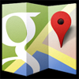



Why Do Apps Use Location?
Ads (58)
Lists (43)
Fine (34)
Close cities (22)
Weather (21)
Tagging (28)
Unsure (17)
Unable to Test (52)
Total (275)
Notes:
Say which 275 apps were covered

Slide 8

Implementation
Dalvik bytecode rewriting to instrument the APK
Location calls go through new API (CloakDroid)
When app requests location, it is first truncated
org.apk
install time
runtime
Dr. Android
CloakDroid
services
enh.apk
RefineDroid
Process boundary

Slide 9
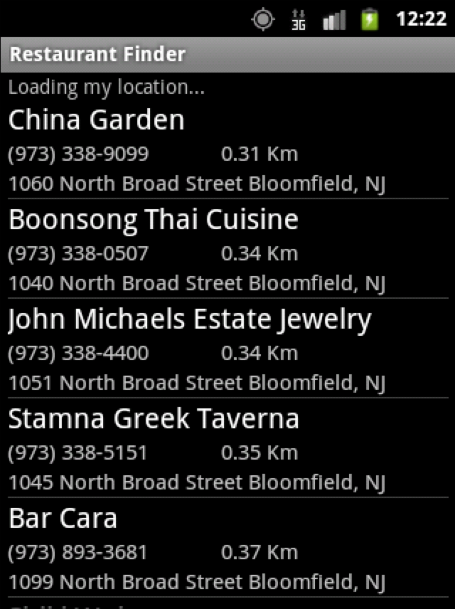
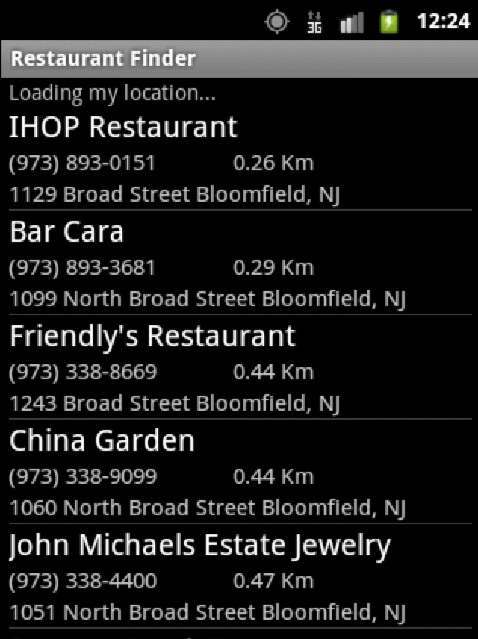
Example of Truncation on Apps
Original
Truncated

Slide 10
Edit Distance
4 for this example
Push list up two
Insert two elements

Slide 11
Set Intersection
3 shared

Slide 12
Additional Distance
1.8 – 1.4
= .4

Slide 13
Additional Distance Undefined
Original
Truncated
???

Slide 14
Experimental Design
Tested six different apps
Variety of location uses
Tested apps in six different cities
6k to 8.2 million people
For each city picked 10 points
Studied where
Edit distance is >20% of size of list
Set intersection is <80% of size of list
Additional distance is > 1 km

Slide 15
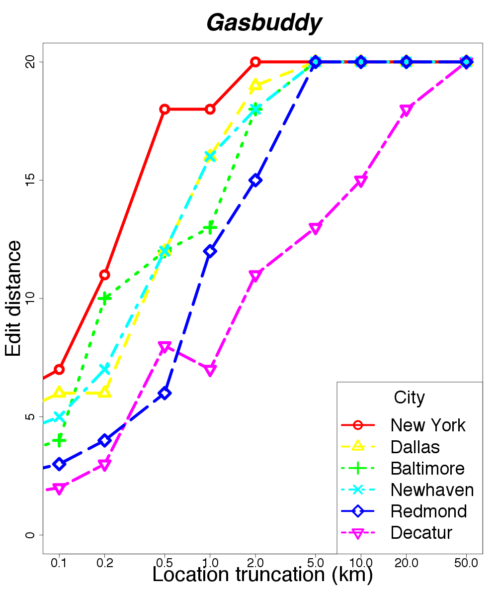
Edit Distance
Pretty bad, without much truncation

Slide 16
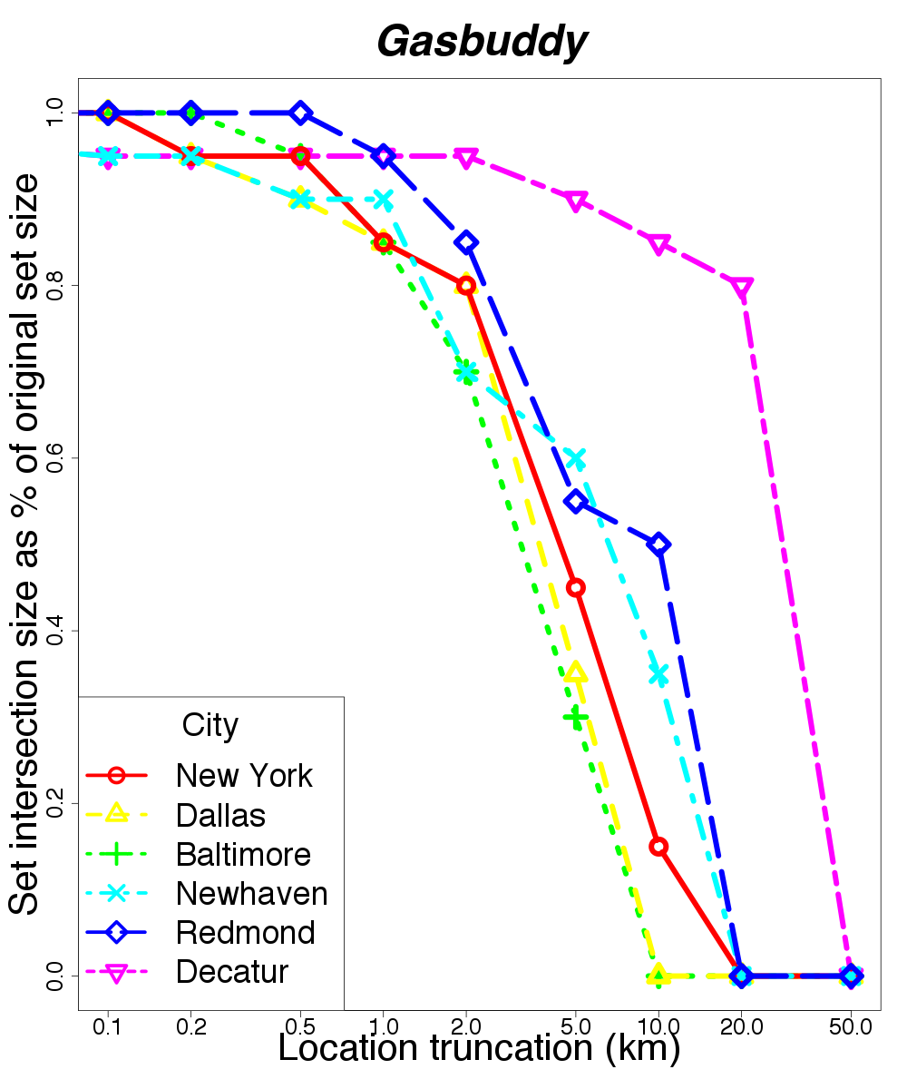
Set Intersection
Truncate 2 km before losing many common elements
Truncate more in less populated areas

Slide 17
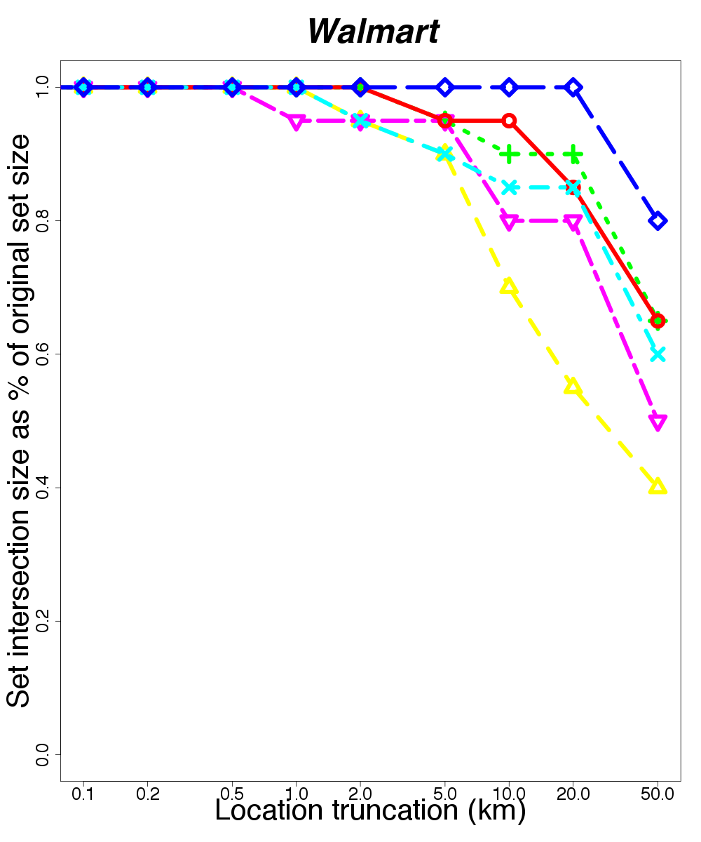
Set Intersection
Fewer Walmarts than gas stations
Truncate up to 20km

Slide 18
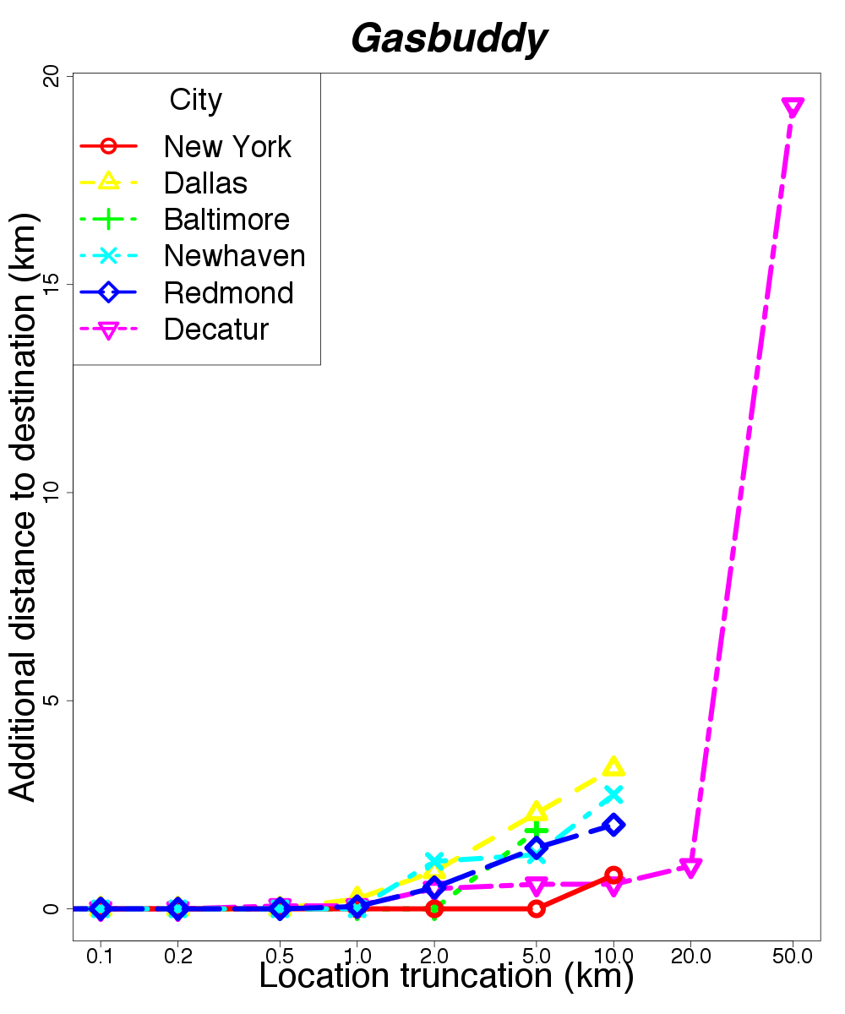
Additional Distance
Undefined for some locations.

Slide 19
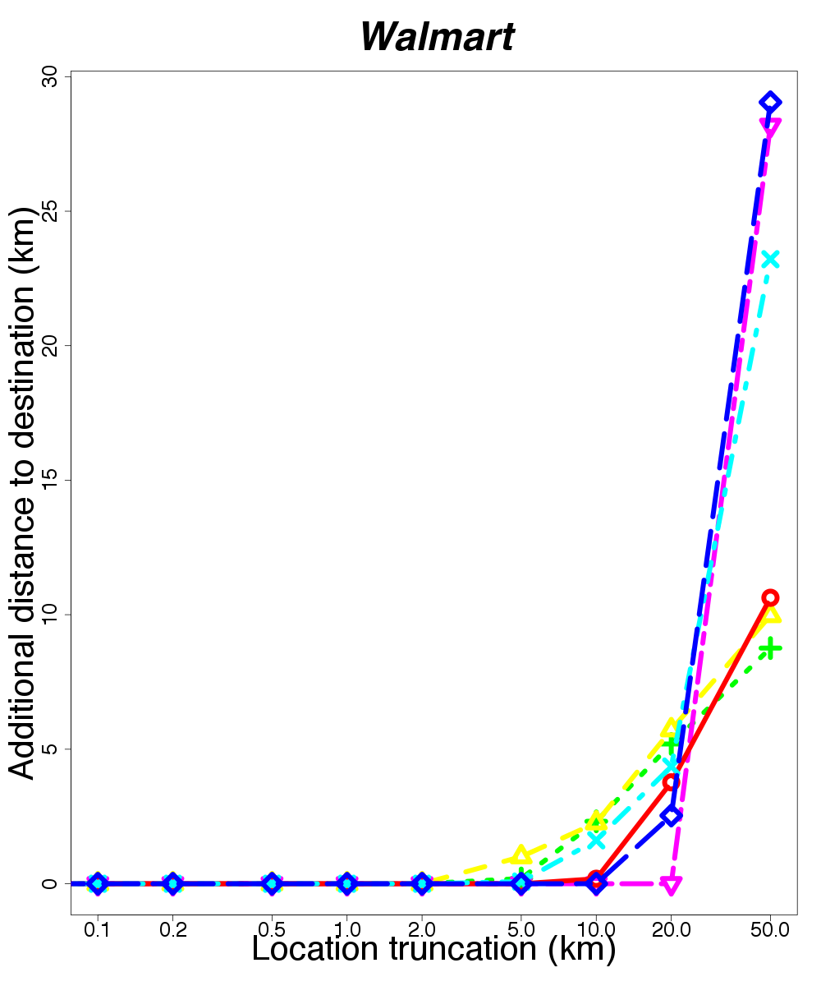
Additional Distance
Can truncate up to 5-10 km before results become bad

Slide 20
Summary of Results
Many apps can have their input truncated 5 to 20km before their utility declines a good amount.
The ability to truncate inputs to apps varies on the density of the objects being measured.
Also varies based on the population of the area in which the app is used.

Slide 21
Which Metric Works Best?
Each metric has its uses
Edit distance enforces exact similarity
Usually don’t care about small permutations
Set intersection for a selection
Of possible choices nearby
Additional distance for visiting the first location

Slide 22
Conclusion
Studied how location is used in 275 apps.
Take off the shelf apps
Instrument them to use CloakDroid effectively.
Study three metrics to measure utility.
Can truncate inputs and get slight utility loss
Depends on distribution of data app presents
Questions?

