Slide 1
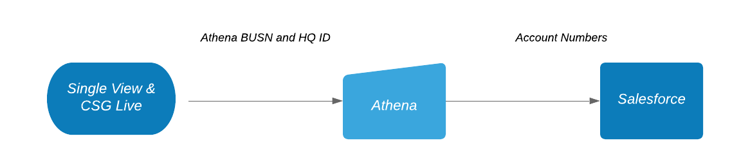
Process Flow
Family ID

Slide 2
Overview
Criteria:
Accounts with open opportunities
1- Sales Accepted Vs. Closed Won
SMB BAE – after closed-won
SMB SBAE – 6+ months
EAE – 12+ months after initial closed-won date
2 – Within that list, are there current open opportunities:
- Qualified – post 90 days (created date = qualified date)
- Solution Proposal Accepted – post 90 days
Filter out*:
AM Module field already populated with AM
Cage field populated with EAE or SBAE
MDU, GovEd, Named, Strategic, Channel Partners
Closed-lost Accounts
Indirect (SP) accounts – check to see if labeled SP under Opportunity Owner
Notes:
Challenges: dual managed accts
When an acct goes into a module:
SMB BAE – after closed-won
SMB SBAE – 6+ months
ENT – 12+ months after initial closed-won date
Clarification BAE protected timeframe w/out mgr extension, 65 days – GOC, way migration to base is written

Slide 3
Quick FYI
There is no real concept of “owner” in SFDC
Except AM Module and CAGE field
Winner is usually the last person with Closed-Won Opportunity
Duplicate accounts increases the difficulty of owner resolution
i.e. SP sells on a Comcast account
Some SFDC accounts with no biller link
Notes:
Challenges: dual managed accts
When an acct goes into a module:
SMB BAE – after closed-won
SMB SBAE – 6+ months
ENT – 12+ months after initial closed-won date
Clarification BAE protected timeframe w/out mgr extension, 65 days – GOC, way migration to base is written

Slide 4
Salesforce Hierarchy
accounts
Opportunity
Merge the SFDC data with biller
summary
Find the winning account
Resolve winner at Opportunity level

Slide 5
Python Implementation
opportunity | Closed date | Agent
O-KFC | 2019-12-12 | David
O-PHO | 2018-04-19 | Leon
ABC PLUMBERS
(sfdc_id: 123
acct_id: abc)
Winner?
ABC PLUMBING
Since it is the most
recent
ABC PLUMBING
(sfdc_id: 456
acct_id: abc)
opportunity | Closed date | Agent
O-BW3 | 2013-09-04 | Ram
O-BBQ | 2020-08-03 | Hiruy

Slide 6
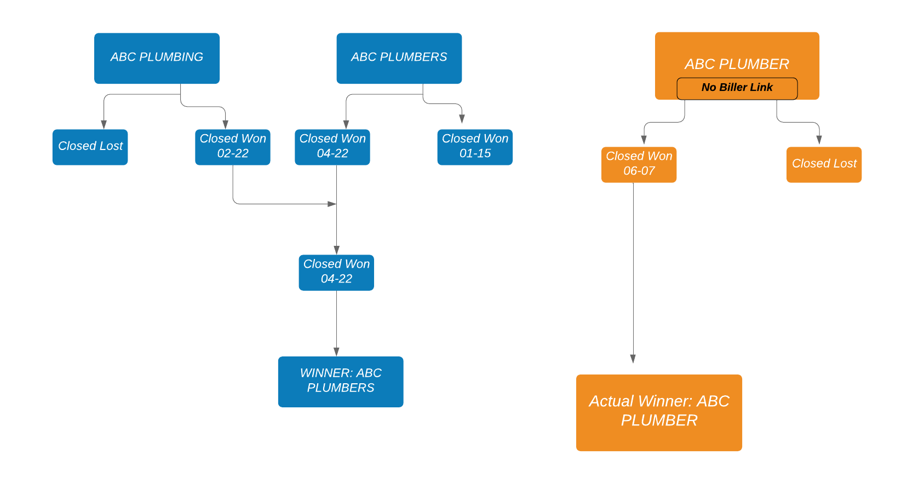
If no biller link to Salesforce…
ABC PLUMBER is not tied with the other ABC Plumbers via biller or Athena data.
The winning account with the latest Closed – Won is missed

Slide 7
Scoring Tables
**Change Weighting to?
Category Weight
% Wallet Share Remaining 10%
Estimated Telco spend 10%
Comcast Billing 20%
# Sites 25%
Tenure 10%
AV/EDI/Data Only 25%
Seattle Used these 4 categories (% of Wallet remaining, Estimated Telco, Comcast billing, and sites). You can change these, either the bands, or the categories all together. If the bands are changed you just need to make sure they are still sorted in ascending order. And if a category is changed you would just need to update the formula on Family ID summary tab to the columns you know want to score.

Slide 8
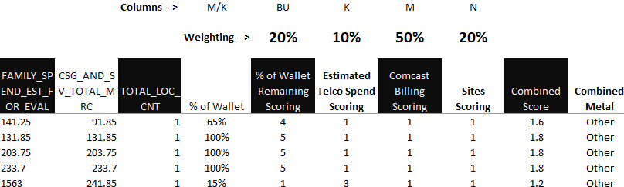
Applying the Scoring
% to Wallet Remaining -- Column M/K (CSG and SV Total MRC/Est Family Spend)
% to Wallet Remaining Scoring -- Vlookup off column BU to the corresponding scoring table. =VLOOKUP(BU9,Scoring!$F$5:$H$9,3,1)
Estimated Telco Spend Scoring -- Vlookup off column K to the corresponding scoring table. =VLOOKUP(K10,Scoring!$L$5:$N$9,3,1)
Comcast Billing Scoring -- Vlookup off column M to the corresponding scoring table. =VLOOKUP(M9,Scoring!$R$5:$T$9,3,1)
Sites Scoring -- Vlookup off column N to the corresponding scoring table. =VLOOKUP(N9,Scoring!$X$5:$Z$9,3,1)
The Combined score column is then taking the score from each column you are scoring, multiplying it by that items weighting, and then summing together to get a final score. The Weighting percentage is linked to the scoring table, so if you adjust it there, it will automatically adjust the scoring on the Family ID Summary Tab. =(BV9*$BV$7)+(BW9*$BW$7)+(BX9*$BX$7)+(BY9*$BY$7)
Note on the Vlookup formula: You need to do an approximate look up. This is done by setting the look up range in the formula to 1 or True, which is approximate match. You then need to make sure your tables are sorted in ascending order.

