Slide 1
A Unified Framework for Graph Integration in Transformers
Minha Kwon

Slide 2
Motivation
Transformers: Lack structural awareness
Structural Information → Enhance Transformer Performance
Integrate Graphs into Transformers
Utilizing Self-Attention Mechanisms: Graphormer, Attention bias
Positional Encoding (PE): Encoding structural/topological information of nodes
→ Most studies focus only on specific components or propose isolated architectures.
Objective of This Study
Establishing a Unified Framework for Graph Integration in Transformers.

Slide 3
Graph Integration in Transformers
Graph Type
Graph Representation Strategy
Positional Encoding
Integration Strategy
Model Architecture

Slide 4
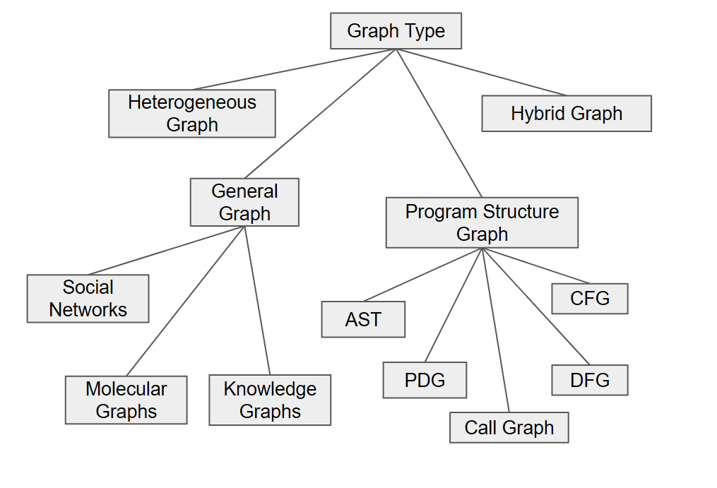
Graph Integration in Transformers
Graph Type
General Graph
Homogeneous relational entity
Program Structure Graph
Code structure dependency graph
Heterogeneous Graph
Multi-type node edges
Hybrid Graph
Multiple graphs combined

Slide 5
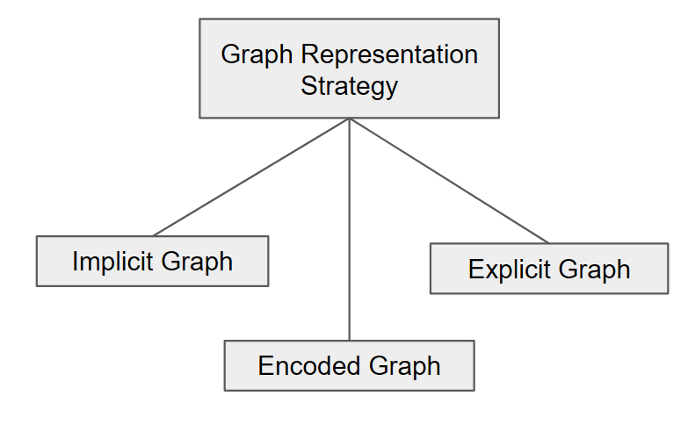
Graph Integration in Transformers
Graph Representation Strategy
Implicit Representation
Learn graph structure indirectly through the computation process inside the network
Explicit Representation
Captures the overall graph structure in embeddings that preserve topology
Encoded Representation
Graph structure is converted into simple numeric features

Slide 6
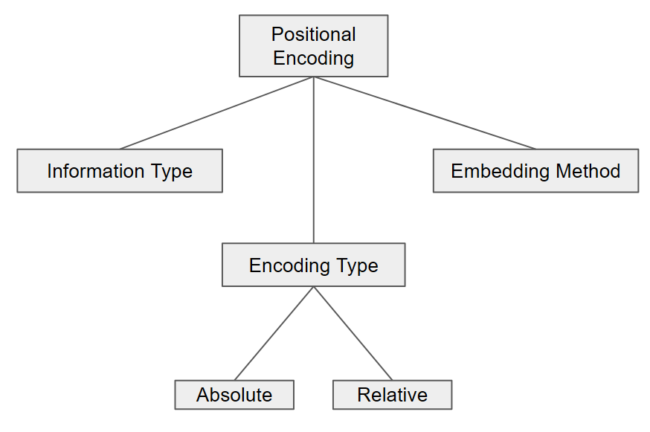
Graph Integration in Transformers
Positinal Encoding
Encoding Type
Positions represented per node (absolute)
or between node pairs (relative)
Information Type
Which structural information is used
Embedding Method
How structural information is converted
into vector representations

Slide 7
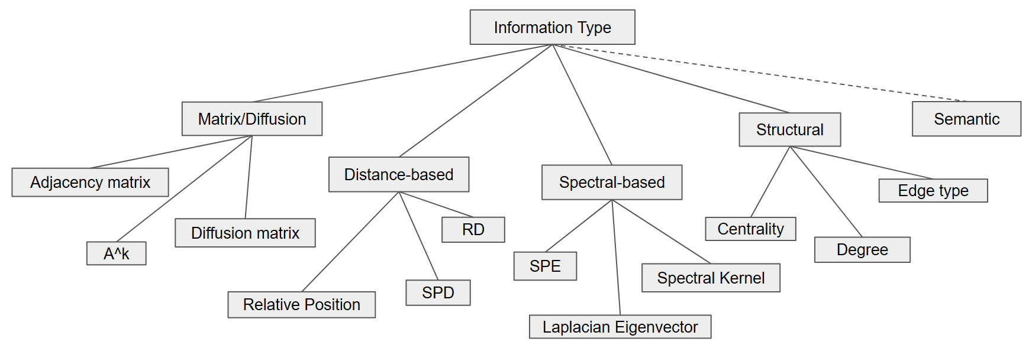
Graph Integration in Transformers
Positinal Encoding

Slide 8
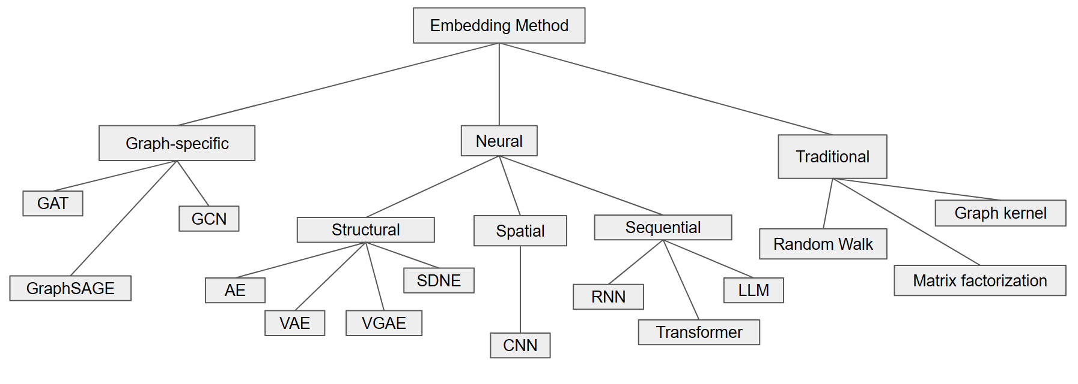
Graph Integration in Transformers
Positinal Encoding

Slide 9
Graph Integration in Transformers
Integration Strategy
Strategy | Integration Level | Representative Examples
Graph Tokenization | Pre-processing | Node-token transformer, linearized graph models
Input-level Integration | Input Embedding | PE-based models, feature augmentation
Attention-level Integration | Attention Score | Graphormer
QKV-level Integration | Attention Representation | Relational Attention, edge-aware QKV
Edge-level Integration | Full Model (Node + Edge) | Relational Transformer, edge update models

Slide 10
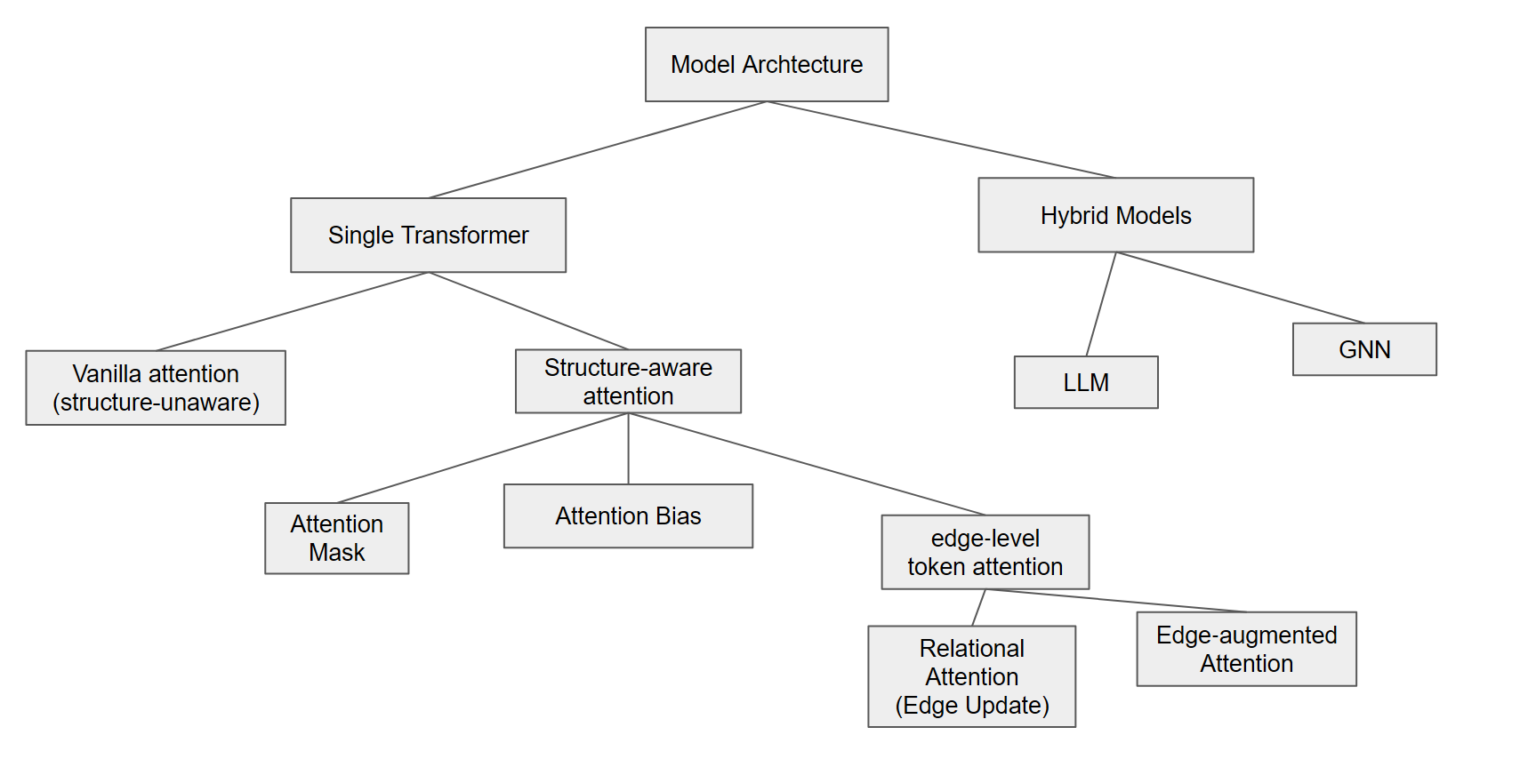
Graph Integration in Transformers
Model Archtechture

Slide 11
Case Analysis
All graph-transformer approaches can be systematically described by five dimensions
Model/Type | Graph Type | Representation | Positional Encoding | Integration | Architecture
Graphormer | Molecular Graph | Encoded | None | Attention-level | Attention Bias
Allamanis (GGNN) | AST, CFG, DFG | Implicit + Explicit | Structural (edge type) | Input-level | Hybrid (GNN)
RelGT | Heterogeneous Graph | Explicit | Relative distance + type encoding | QKV-level + Tokenization | Relational
GENN | General Graph | Explicit | None | Input-level | Hybrid

Slide 12
Discussion
Design Diversity
Models : combine these five dimensions rather than introducing entirely new mechanism
Trade-off
- Simpler strategies (encoded + bias) : efficient
- Deeper integration (relational attention) : higher expressiveness
Practical Guideline
- Attention bias : large graph, low complexity
- Relational Attention : complex graph data

Slide 13
Conclusion
Unify graph-transformer models with five design dimensions
Explain how existing methods differ and relate
Graph integration is not a single technique, but a combination of design choices
Understanding these dimensions helps design better, task-specific models.

Slide 14
Thank You

