Slide 1
IMDB Genre Analysis
Exploring Rating Trends Across Film Genres (2010–2019)
Source: IMDB | Prepared by: Miring’u Kamau | 2026
Data Science — Exploratory Analysis

Slide 2
01 | Initial Exploration Findings
22
7.33
5.00
Unique Genres
Identified
Highest Avg Rating
(Documentary)
Lowest Avg Rating
(Horror)
Documentary, News, and Biography genres consistently outperform all others in average audience rating across the decade.
Drama dominates in sheer volume — 11,600+ films — and total audience engagement (8.4M+ votes).
High-volume genres (Action, Horror, Thriller) cluster at the bottom of the ratings table despite large production output.
Genres with fewer films (Biography, History, Music) show stronger critical reception, suggesting quality-over-quantity dynamics.
The genre column stores comma-separated combinations — requiring data transformation before accurate per-genre analysis.
A minimum vote threshold (10,000+) was applied to filter statistically unreliable ratings from low-visibility films.

Slide 3
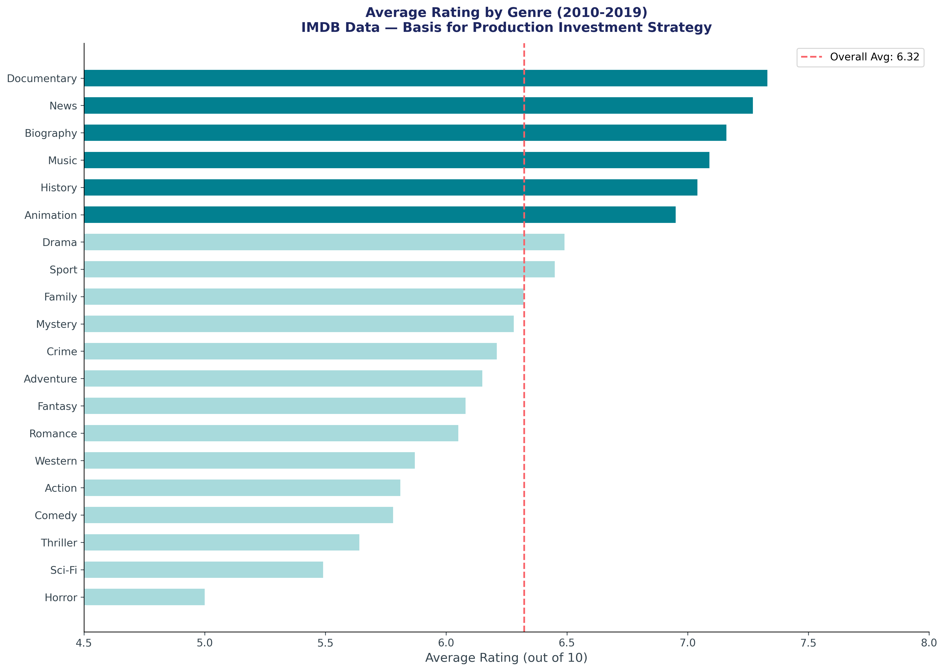
02 | Business Question & Supporting Evidence
Business Question: Should studios shift production investment toward Biography, Documentary, and History content — and away from high-volume low-rated genres like Action and Horror — to improve critical standing and long-term audience trust?

Slide 4
03 | Data Cleaning Tasks Identified
Critical
Critical
Genre Column Normalisation
Minimum Vote Threshold
The genres field stores multiple values as a comma-separated string (e.g. 'Action,Drama,Thriller'). This must be split and exploded into individual rows before any per-genre aggregation can be accurate.
Films with very few votes (e.g. 5–50) produce unreliable average ratings. A minimum threshold (10,000+ votes recommended) must be applied to filter statistically insignificant entries.
Required
Required
Year Range Enforcement
Null Value Exclusion
The dataset includes titles beyond 2019 with incomplete or inaccurate data. A strict BETWEEN 2010 AND 2019 filter must be applied consistently across all queries.
Several fields including genres, averagerating, and numvotes contain null values. These must be explicitly excluded using IS NOT NULL conditions rather than filled or imputed.

Slide 5
Key Takeaway
Prestige factual content — Documentary, Biography, History — consistently outperforms high-volume genres in audience ratings. Studios optimising for critical standing and long-term trust should consider rebalancing investment toward these categories.
Further analysis recommended with full genre normalisation and financial production cost data.

