Slide 1
Halide & TVM seminar
김도희
2021-02-16

Slide 2
논문 읽은 시간
수(21.2.10) | 목(21.2.11) | 금(21.2.12) | 토(21.2.13) | 일(21.2.14) | 월(21.2.15) | 화(21.2.16)
3 | - | - | - | 3 | - | 5
2020-02-16

Slide 3
Agenda
Halide
What is Halide?
What Halide can do?
inlining
tiling
vectorization
Halide example
TVM
What is TVM?
TVM overview
Optimizing computational graphs

Slide 4
1. Halide

Slide 5
(1-1) Halide – What is Halide? – DSL
Halide: A Language and Compiler for Optimizing Parallelism, Locality, and Recomputation in Image Processing Pipelines
Domain-Specific Languages
A DSL is a language that is specialized and restricted to meet the needs of some domain.
Goals: faster performance, easier maintenance, safety guarantees, etc.

Slide 6
(1-1) Halide – What is Halide?
DSL staged in C++: “just” a library
Helps you write high-performance array, image, and tensor processing kernels
Separate algorithm from optimization.
Open source, MIT licensed.
Notes:
That brings us to Halide, which is the subject of this talk. So Halide is a hybrid of the internal and external DSL approaches. It’s embedded in C++ so in that sense it’s “just” a library like Eigen is. But on the other hand, it executes code by JITting or by producing C-ABI compatible object files, so in that sense it’s more external.
The problem it helps you solve is optimizing dense numerical kernels like those found in image processing, computer vision, machine learning, and AI. It does this through a powerful application of separation of concerns. In Halide, you define what you want to compute separately from how you want to optimize it.

Slide 7
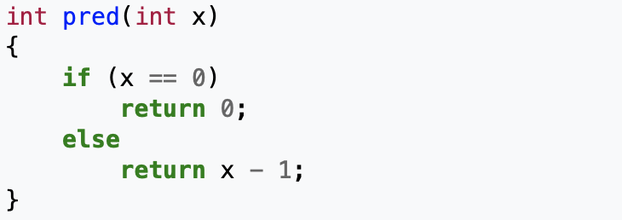
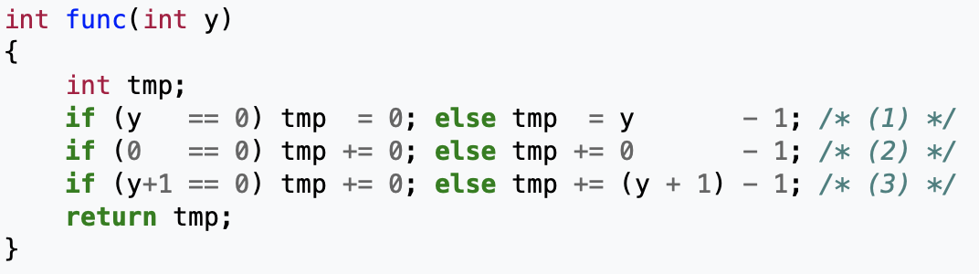
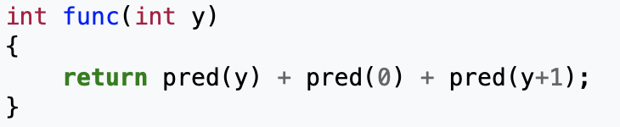
(1-2) Halide – What Halide can do? – Auto inlining
inlining?
inlined code consuming too much of the instruction cache
wikipedia-inline expansion : https://en.wikipedia.org/wiki/Inline_expansion
Notes:
That brings us to Halide, which is the subject of this talk. So Halide is a hybrid of the internal and external DSL approaches. It’s embedded in C++ so in that sense it’s “just” a library like Eigen is. But on the other hand, it executes code by JITting or by producing C-ABI compatible object files, so in that sense it’s more external.
The problem it helps you solve is optimizing dense numerical kernels like those found in image processing, computer vision, machine learning, and AI. It does this through a powerful application of separation of concerns. In Halide, you define what you want to compute separately from how you want to optimize it.

Slide 8
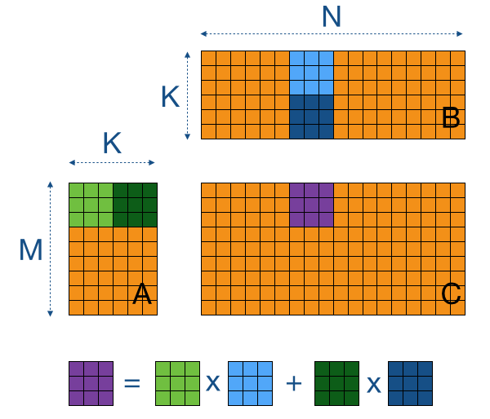
(1-2) Halide – What Halide can do? – tiling
Notes:
That brings us to Halide, which is the subject of this talk. So Halide is a hybrid of the internal and external DSL approaches. It’s embedded in C++ so in that sense it’s “just” a library like Eigen is. But on the other hand, it executes code by JITting or by producing C-ABI compatible object files, so in that sense it’s more external.
The problem it helps you solve is optimizing dense numerical kernels like those found in image processing, computer vision, machine learning, and AI. It does this through a powerful application of separation of concerns. In Halide, you define what you want to compute separately from how you want to optimize it.

Slide 9
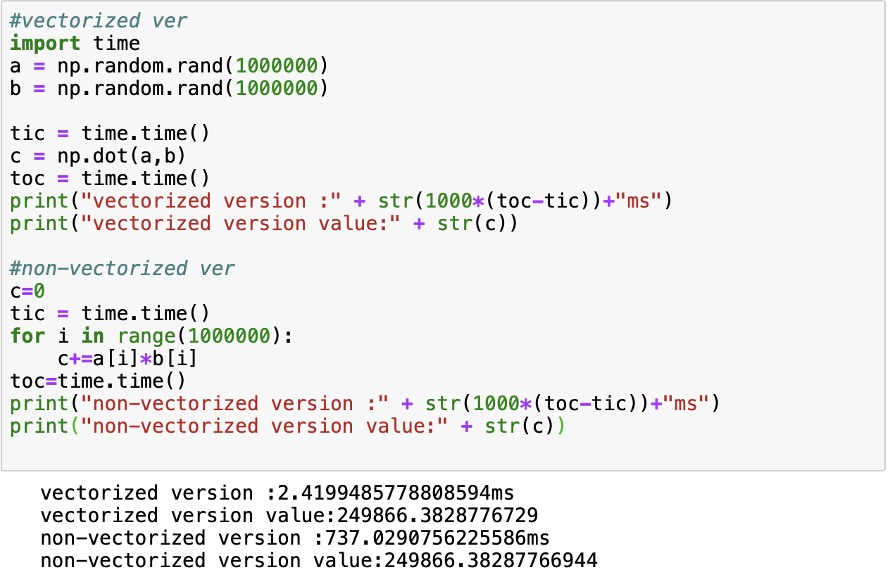
(1-2) Halide – What Halide can do? – vectorization
Notes:
That brings us to Halide, which is the subject of this talk. So Halide is a hybrid of the internal and external DSL approaches. It’s embedded in C++ so in that sense it’s “just” a library like Eigen is. But on the other hand, it executes code by JITting or by producing C-ABI compatible object files, so in that sense it’s more external.
The problem it helps you solve is optimizing dense numerical kernels like those found in image processing, computer vision, machine learning, and AI. It does this through a powerful application of separation of concerns. In Halide, you define what you want to compute separately from how you want to optimize it.

Slide 10

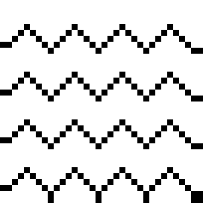


(1-3) Halide – Halide example – Two stage blur
input
extend boundary
horizontal blur
vertical blur
Notes:
Now, as with all things in computer science, there are edge cases. But in image processing, they’re very literal. If you’re trying to blur the pixels around the edge of the image, you’ll find that some values are missing. You could skip those pixels, but it would crop a 1-pixel border off the image. We don’t want that to happen, so we just extend the boundary by repeating the outer edge to keep the image size the same.

Slide 11
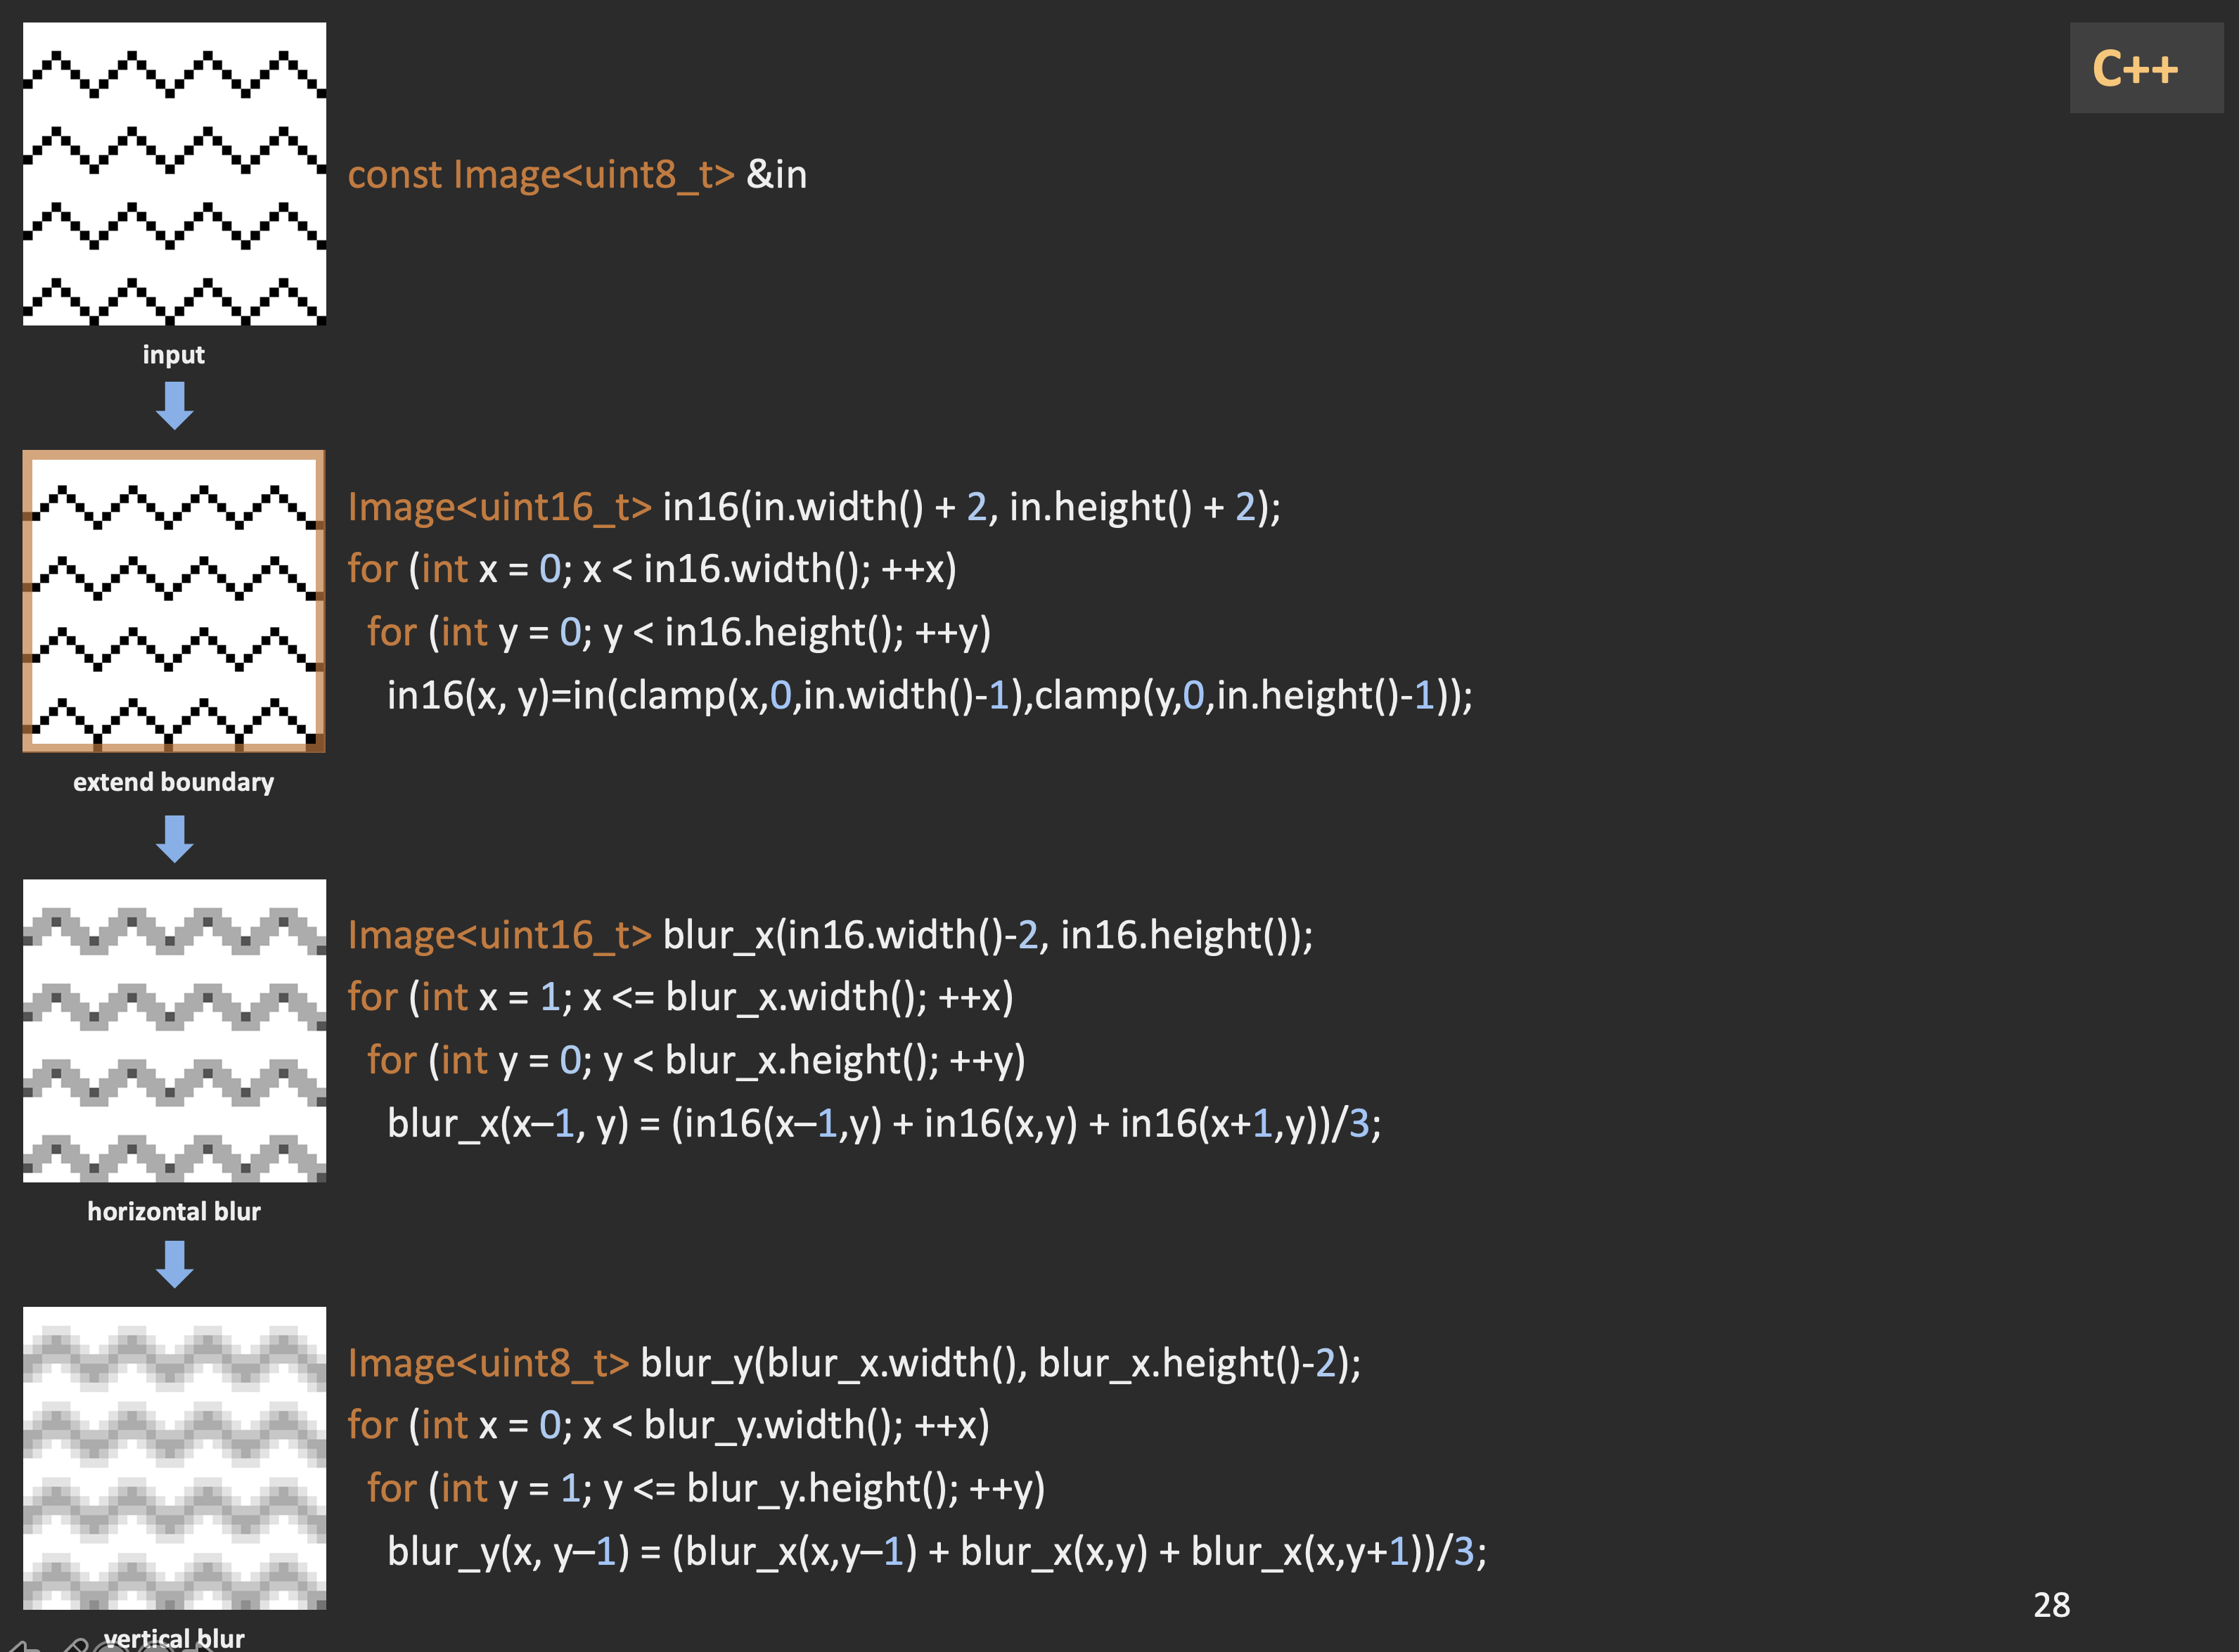
If images are row-major, this will write to a different cache line on every iteration
Benchmark on 4-megapixel image. Run on Intel i9-7900X, 32 GB RAM
100ms
Notes:
Now, as with all things in computer science, there are edge cases. But in image processing, they’re very literal. If you’re trying to blur the pixels around the edge of the image, you’ll find that some values are missing. You could skip those pixels, but it would crop a 1-pixel border off the image. We don’t want that to happen, so we just extend the boundary by repeating the outer edge to keep the image size the same.

Slide 12
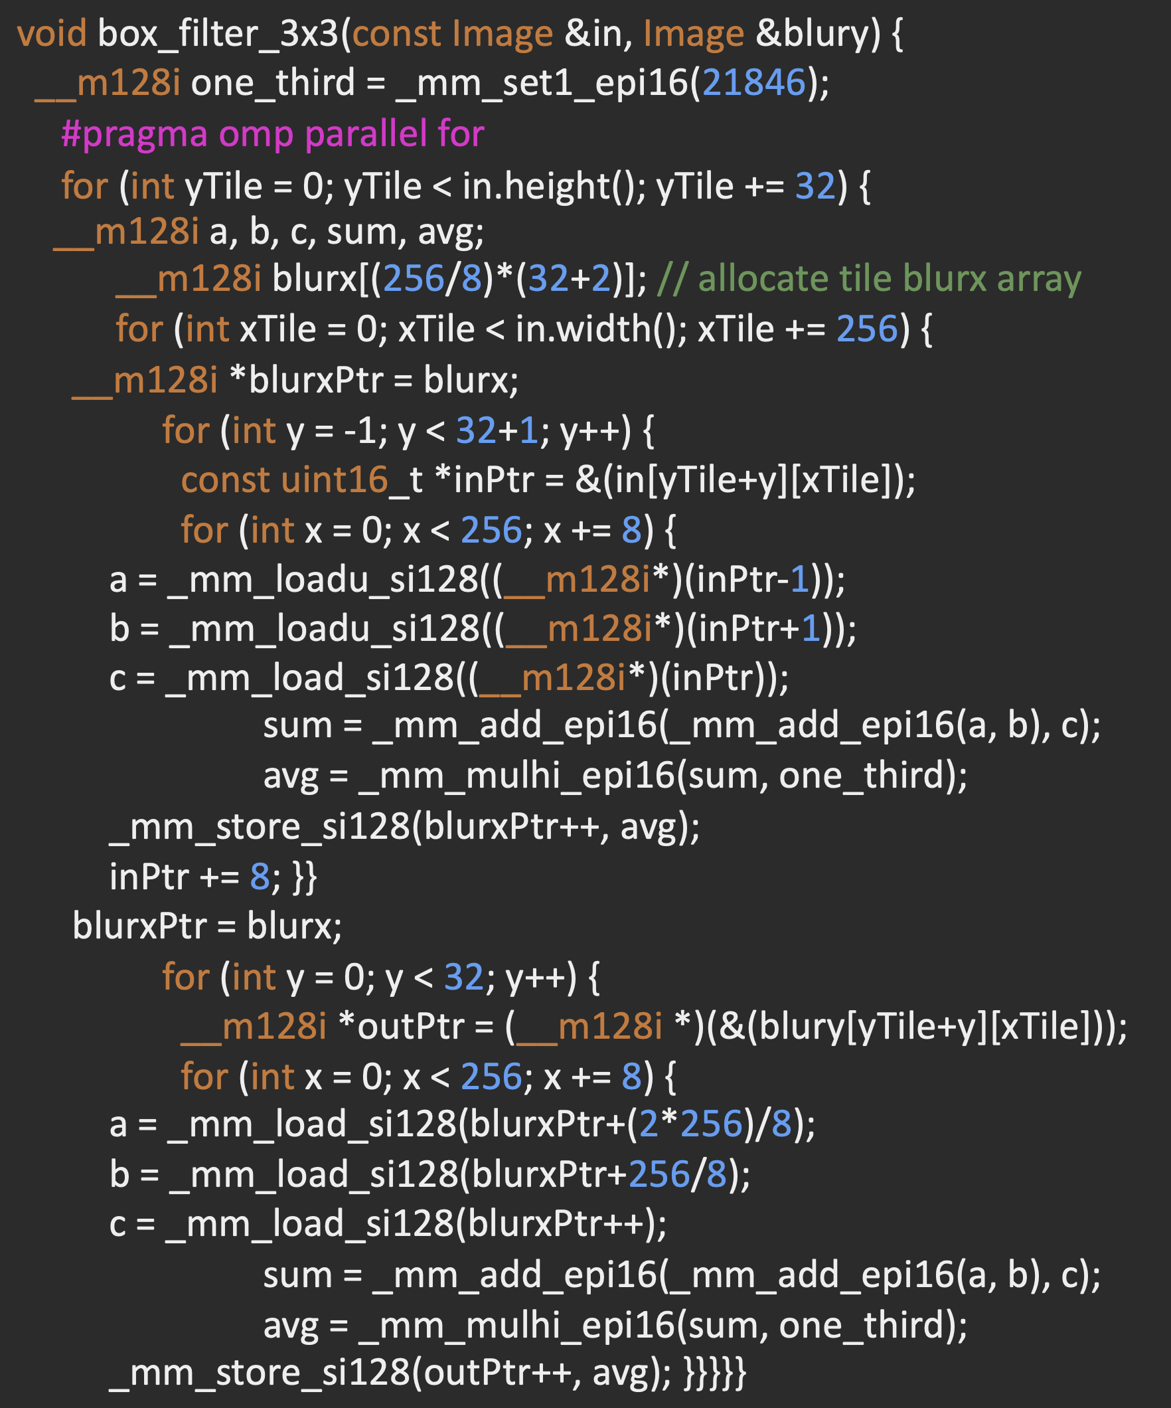

Notes:
Now, as with all things in computer science, there are edge cases. But in image processing, they’re very literal. If you’re trying to blur the pixels around the edge of the image, you’ll find that some values are missing. You could skip those pixels, but it would crop a 1-pixel border off the image. We don’t want that to happen, so we just extend the boundary by repeating the outer edge to keep the image size the same.

Slide 13
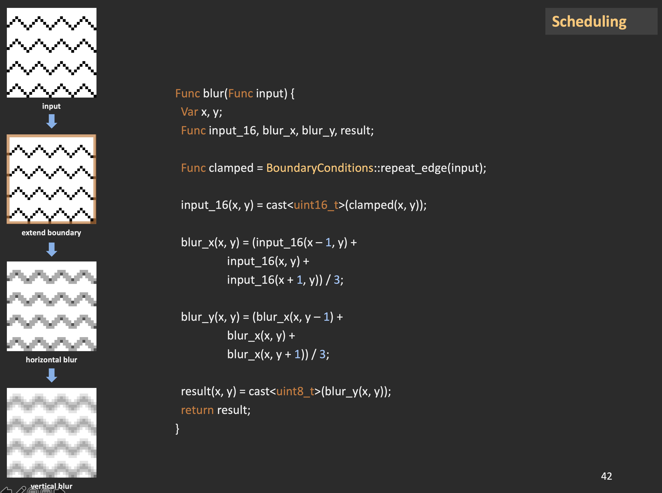
Serial = 8ms / 13x
Just inlining…
Notes:
Now, as with all things in computer science, there are edge cases. But in image processing, they’re very literal. If you’re trying to blur the pixels around the edge of the image, you’ll find that some values are missing. You could skip those pixels, but it would crop a 1-pixel border off the image. We don’t want that to happen, so we just extend the boundary by repeating the outer edge to keep the image size the same.

Slide 14
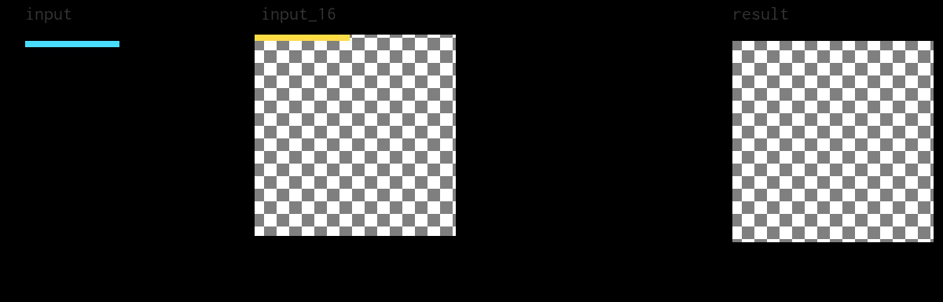
(1-3) Halide – Halide example – Two stage blur
Vector = 3.3ms / 30x
result.compute_root()
allocate input_16; blur_x;
.vectorize(x, 32);
for y:
blur_x.compute_root()
for x:
.vectorize(x, 32);
input_16(x:x+32, y) = ...
input_16.compute_root()
for y:
.vectorize(x, 32);
for x:
blur_x(x:x+32, y) = ...
for y:
for x:
result(x:x+32, y) = ...
Notes:
Halide provides another directive that automatically vectorizes loops for a given vector width, helpfully named “vectorize”. In this case, we mark every inner loop to be vectorized with a 32-element-wide vector. Remember that our funcs operate on uint16’s, which are two bytes wide and AVX-512 has 64-byte wide vector registers. Halide transparently handles alignment and instruction selection issues for every supported architecture.
Notice in the animation that for tail cases, Halide will do some redundant work. When padding and converting the input to the 16-bit form, the vector shifts inwards and overlaps the previous one on each row. This is the same optimization I described at the beginning of the talk, for free. Because these are vector instructions, this is more efficient than switching to serial code for the tail case. The generated assembly has fewer branches and is smaller overall.
This schedule is already pretty good, and it clocks in around 3ms and a 30x boost over the most naïve code we’ve considered. This is the kind of performance you would expect to get if you were using a SIMD template library to optimize the inner loops

Slide 15
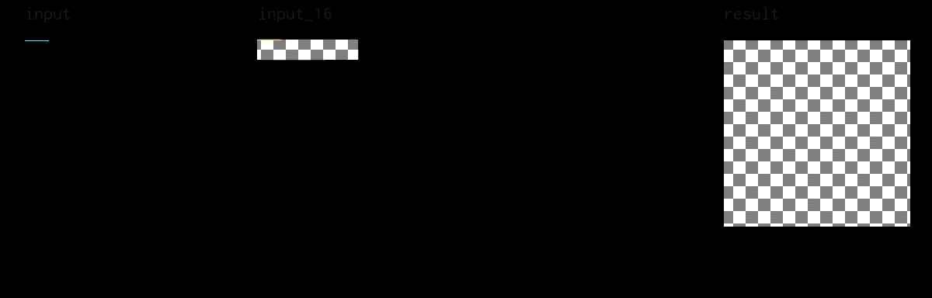
(1-3) Halide – Halide example – Two stage blur
Tiled = 1.2ms / 86x
result.compute_root()
allocate input_16[130 * 26];
.tile(x, y, xi, yi, 128, 24)
allocate blur_x[128 * 26];
.vectorize(x, 32);
for result.y:
blur_x.compute_at(result, x)
for result.x:
.vectorize(x, 32);
for input_16.y:
input_16.compute_at(result, x)
for input_16.x:
.vectorize(x, 32);
input_16(x:x+32, y) = ...
for blur_x.y:
for blur_x.x:
blur_x(x:x+32, y) = ...
for yi in [0..24]:
for xi in [0..128]:
result(x:x+32, y) = ...
Notes:
As a bonus, Halide’s bound inference engine is able to determine that fixed size allocations are suitable for the intermediate buffers because the tile size is fixed. It will malloc them at the start of the pipeline, but because they are constant size, you could ask for them to be placed on the stack with a special directive.
I’ll let this play for a minute. You should notice that the overall pattern of computation resembles the abstracted one we saw earlier on in the talk. Within each tile, we go left to right and top to bottom by vectors and overall, we process tiles in the same way.
This schedule is as fast as I could find for a single core on my workstation CPU. It processes an image in 1.2 milliseconds, or 86 times faster than the worst schedule we saw.

Slide 16
Automatic scheduling
Mullapudi2016:
Get a decent schedule quickly.
Good for developing the algorithm.
Li2018:
Specialized to gradient descent features (ML)
Supports GPUs / CUDA
Adams2019:
Uses deep learning
Competitive with experts on x86
Notes:
Now, finding these schedules is a bit of an art form and does require some expert knowledge to understand what is fast or slow about a schedule. But a nice feature of having a decoupled scheduling language is that we can define a search space over those schedules and write programs called autoschedulers to go through them automatically. The current release of Halide has three and they’re all named after the academic papers that published the algorithms.
One that’s been around for a while is called Mullapudi 2016 and gives you a decent schedule very quickly. It’s good to use while you’re still developing the algorithm and making sure that it’s correct.
The next one, Li 2018, is optimized for machine learning and optimization tasks where you use Halide’s automatic differentiation features to perform gradient descent. This is a more advanced use case, but it’s currently the only autoscheduler that searches for GPU schedules.
Finally, there’s the Adams 2019 autoscheduler that uses deep learning to produce CPU schedules that are competitive with human experts in x86. There’s ongoing work to bring it to ARM and GPUs, too.

Slide 17
2. TVM

Slide 18
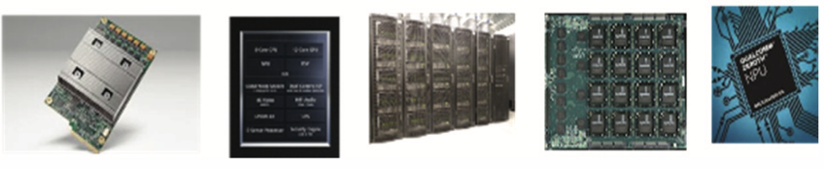
(2-1) What is TVM?
Compiler for Deep Learning
Motivation : more and more Hardware to optimize, can’t do for hand!
Contribution : present new compiler that can optimize for certain device

Slide 19
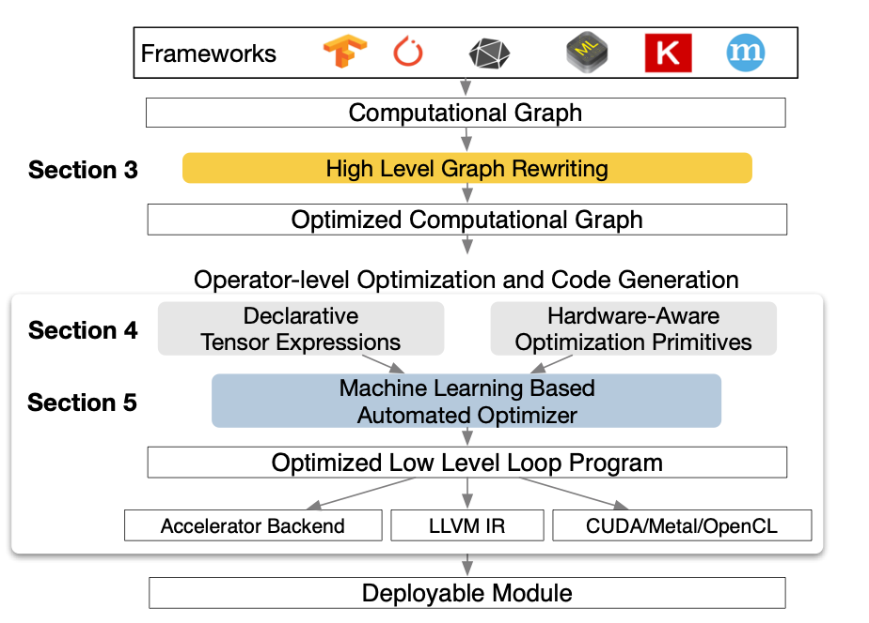
(2-2) TVM overview

Slide 20
(2-3) Optimizing computational graphs
Get network structure from DL framework(TensorFlow, PyTorch…)
Separate operator into 4 (injective, reduction, complex out fusable, opaque)
Injective : fusion injective and another operator
Reduction : sum
Complex out fusable : can fuse element-wise map to output (e.g., conv2d)
Opaque : can’t fuse

Slide 21
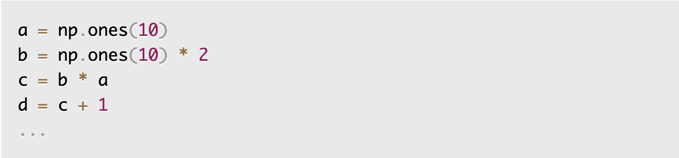
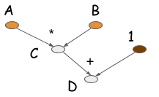
(2-3) Optimizing computational graphs

Slide 22
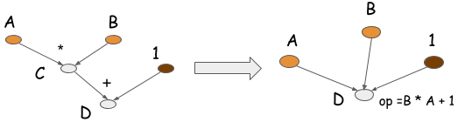
(2-3) Optimizing computational graphs
4 * 10 * 8 = 320 bytes -> 2 * 10 * 8 = 160 bytes

Slide 23
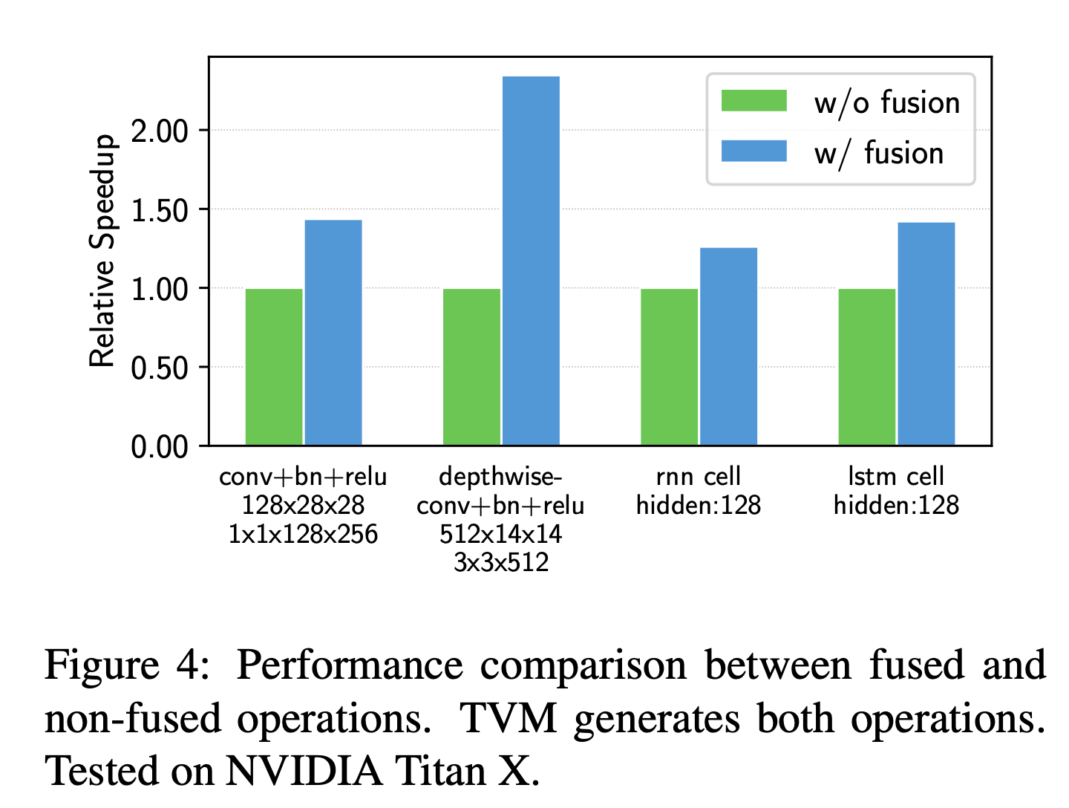
(2-3) Optimizing computational graphs

