Slide 1
Introduction to DBMS
Data Base:
Collection of related data
Ex. the names, telephone numbers and addresses of all the people you know.
DBMS:
A DBMS is a set of programs that controls creation, storage, management, and retrieval of data in a database.
Ex: MS-Access, Oracle, MY SQL, Sybase, IBM DB2, Ingres etc

Slide 2
Popular DBMS Software Here, is the list of some popular DBMS system:
MySQL
Microsoft Access
Oracle
PostgreSQL
dBASE
FoxPro
SQLite
IBM DB2
LibreOffice Base
MariaDB
Microsoft SQL Server etc.

Slide 3
Application of DBMS
Banking | For customer information, account activities, payments, deposits, loans, etc.
Airlines | For reservations and schedule information.
Universities | For student information, course registrations, colleges and grades.
Telecommunication | It helps to keep call records, monthly bills, maintaining balances, etc.

Slide 4
Sales | Use for storing customer, product & sales information.
Manufacturing | It is used for the management of supply chain and for tracking production of items. Inventories status in warehouses.
HR Management | For information about employees, salaries, payroll, deduction, generation of paychecks, etc.

Slide 5
Purpose of Database System
In the early days, database applications were built on top of file systems
Drawbacks of using file systems to store data:
Data redundancy and inconsistency
✔Multiple file formats, duplication of information in different
files
Difficulty in accessing data
✔Need to write a new program to carry out each new task
Data isolation — multiple files and formats
Integrity problems
✔Integrity constraints (e.g. account balance > 0) become part of
program code
✔Hard to add new constraints or change existing ones

Slide 6
Drawbacks of using file systems (cont.)
Atomicity of updates.
✔Failures may leave database in an inconsistent state with partial
updates carried out .
– E.g.: Transfer of funds from one account to another should
either complete or not happen at all.
Concurrent access by multiple users.
✔Concurrent accessed needed for performance.
✔Uncontrolled concurrent accesses can lead to inconsistencies.
– E.g.: Two people reading a balance (say 100) and updating it
by withdrawing money (say 50 each) at the same time
Security problems.
Database systems offer solutions to all the above problems

Slide 7
Database Languages
Database languages are used for read, update and store data in a database.
Types of DBMS languages:
Data Definition Language (DDL): DDL is used for specifying the database schema. Let’s take SQL for instance to categorize the statements that comes under DDL.
To create the database instance – CREATE
To alter the structure of database – ALTER
To drop database instances – DROP
To delete tables in a database instance – TRUNCATE
To rename database instances – RENAME

Slide 8
Database Languages Continued
Data Manipulation Language (DML): DML is used for accessing and manipulating data in a database.
To read records from table(s) – SELECT
To insert record(s) into the table(s) – INSERT
Update the data in table(s) – UPDATE
Delete all the records from the table – DELETE

Slide 9
Database Languages Continued
Data Control language (DCL): DCL is used for granting and revoking user access on a database –
To grant access to user – GRANT
To revoke access from user – REVOKE

Slide 10
Data Models
A collection of tools for describing
Data
Data relationships
Data constraints.
Or
A Data Model is the concept of tools that are developed to summarize the description of the database.
Or
A data model shows the logical structure of a database, including the relationships and constraints that determine how data can be stored and accessed

Slide 11
Types of Data Models
Entity-relationship model
Relational model
Hierarchical model
Network model
Object-oriented database model

Slide 12
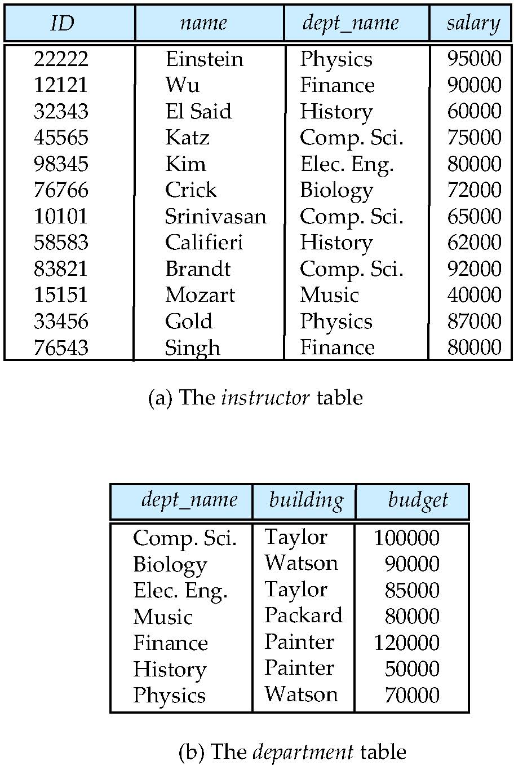
Relational Model
The most common model, the relational model sorts data into
tables also known as relations, each of which consists of columns and rows . Each column lists an attribute of the entity in question. Each row in the relation is called as a tupple.

Slide 13
Entity-Relationship Model
Entity Relationship Model (ER Modeling) is a graphical approach to database design.
An ER model is used to represent real-world objects.
An Entity is a thing or object in real world that is distinguishable from other objects.
An entity has a set of properties called attributes and each of these can have values.
Entity is represented using a rectangle and attributes using ellipses and lines for connecting attributes to entities etc.
Relationship is represented using a diamond.

Slide 14
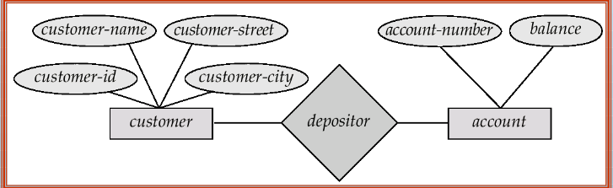
Example of ER Diagram

Slide 15
Hierarchical model in DBMS
In hierarchical model, data is organized into a tree like structure with each record is having one parent record and many children. It is one of the oldest type of data model.
It contains nodes which are connected by branches.
Topmost node is called root node.
Each node has exactly one parent.
One parent may have many child.
It allows one to many relationships.

Slide 16
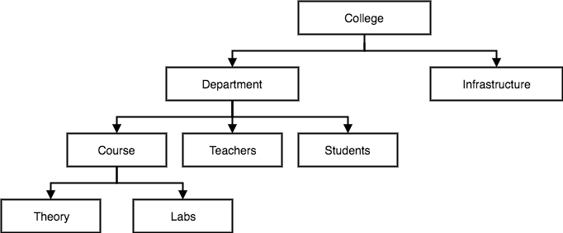

Slide 17
Network Model
This is an extension of the Hierarchical model. In this model data is organised more like a graph, and are allowed to have more than one parent node.
In this database model data is more related as more relationships are established as the data is more related, hence accessing the data is also easier and fast.
It allows many to many relationships.
It was most popular in the 1970s

Slide 18
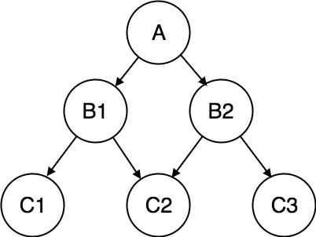

Slide 19
Object-oriented database model
OODM represents the real world problems easily .
In OODM both data and their relationships are contained in a single structure called as an object.
In OODM real world problems are represented as objects with different attributes and all the objects have multiple relationships between them.
Components of Object Oriented Data Model
Objects
Attributes
Methods
Class

Slide 20
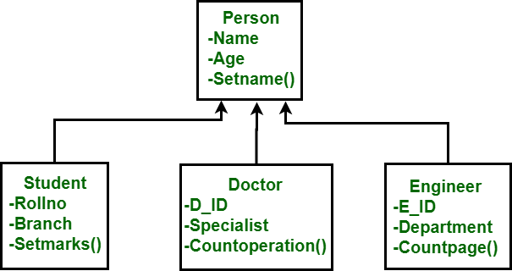

Slide 21
Data Abstraction
Database systems are made-up of complex data structures. To ease the user interaction with database, the developers hide internal irrelevant details from users. This process of hiding irrelevant details from user is called data abstraction.
We have three levels of abstraction:
Physical level: This is the lowest level of data abstraction. It describes how data is actually stored in database. You can get the complex data structure details at this level.
Logical level: This is the middle level of 3-level data abstraction architecture. It describes what data is stored in database.
View level: Highest level of data abstraction. This level describes the user interaction with database system.

Slide 22
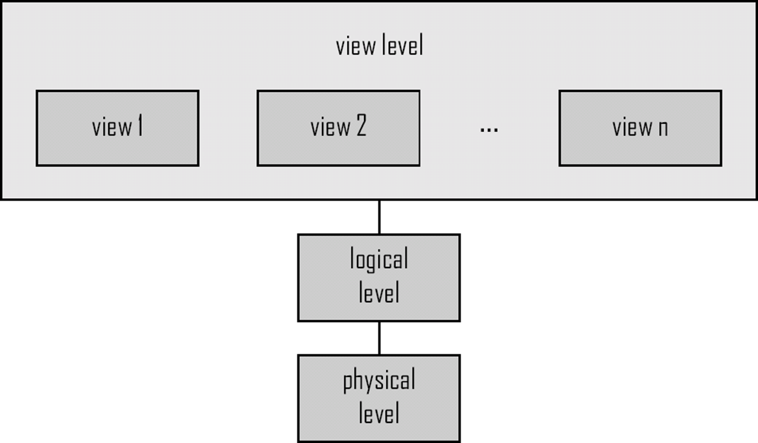
View of data

Slide 23
Example
Let’s say we are storing customer information in a customer table. At physical level these records can be described as blocks of storage (bytes, gigabytes, terabytes etc.) in memory. These details are often hidden from the programmers.
At the logical level these records can be described as fields and attributes along with their data types, their relationship among each other can be logically implemented. The programmers generally work at this level because they are aware of such things about database systems.
At view level, user just interact with system with the help of GUI and enter the details at the screen, they are not aware of how the data is stored and what data is stored; such details are hidden from them.

Slide 24
Data Independence
Data Independence is defined as a property of DBMS that helps you to change the Database schema at one level of a database system without requiring to change the schema at the next higher level.
Types of Data Independence
Logical data independence
Physical data independence
Logical data independence
Logical data independence refers characteristic of being able to change the conceptual schema without having to change the external schema.

Slide 25
If we do any changes in the conceptual view of the data, then the user view of the data would not be affected.
Physical Data Independence
Physical data independence can be defined as the capacity to change the internal schema without having to change the conceptual schema.
If we do any changes in the storage size of the database system server, then the Conceptual structure of the database will not be affected.

Slide 26
Structure of DBMS
A database system is partitioned into modules that deal with responsibilities of the overall system.
components of a database system can be broadly divided into the storage manager and the query processor components.
The storage manager is important because databases typically require a large amount of storage space.
The query processor is important because it helps the database system simplify and facilitate access to data.

Slide 27
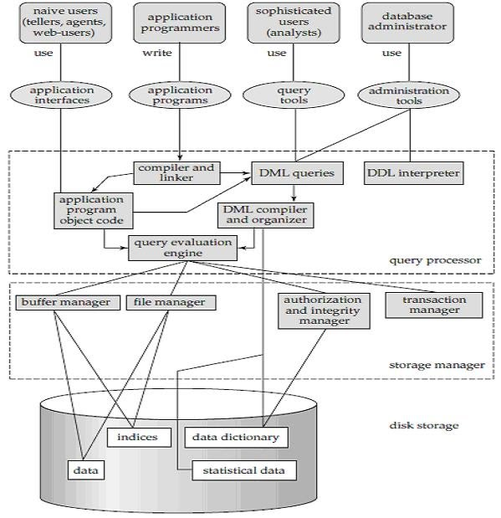

Slide 28
Query Processor
The query processor components include
DDL interpreter, which interprets DDL statements and records the definitions in the data dictionary.
DML compiler, which translates DML statements in a query language into an evaluation plan consisting of low-level instructions that the query evaluation engine understands.
A query can usually be translated into any of a number of alternative evaluation plans that all give the same result. The DML compiler also performs query optimization, that is, it picks the lowest cost evaluation plan from among the alternatives.
Query evaluation engine, which executes low-level instructions generated by the DML compiler.

Slide 29
Storage Manager
A storage manager is a program module that provides the interface between the low level data stored in the database and the application programs and queries submitted to the system
The storage manager components include:
Authorization and integrity manager, which tests for the satisfaction of integrity constraints and checks the authority of users to access data.
Transaction manager, which ensures that the database remains in a consistent (correct) state despite system failures, and that concurrent transaction executions proceed without conflicting.

Slide 30
File manager, which manages the allocation of space on disk storage and the data structures used to represent information stored on disk.
Buffer manager, which is responsible for fetching data from disk storage into main memory, and deciding what data to cache in main memory. The buffer manager is a critical part of the database system, since it enables the database to handle data sizes that are much larger than the size of main memory.

Slide 31
Types of users in DBMS
Native Users – these are the users who use the existing application to interact with the database. For example, online library system, ticket booking systems, ATMs etc which has existing application and users use them to interact with the database to fulfill their requests.
Sophisticated Users – They are database developers, who write SQL queries to select/insert/delete/update data. They do not use any application or programs to request the database. They directly interact with the database by means of query languages like SQL.
Application Programmers-A technical person who writes database application programs.

Slide 32
They write programs by using computer programming languages and development tools.
Application programs that interact with database are developed as per the user requirements and include functionalities of CRUD operations

Slide 33
Database Administrator
Also know as DBA.
Roles of DBA
1. DBA is responsible for every thing that is related to database
2. Schema definition and modification
3. Granting of authorization for data access
4. DBA is responsible for taking the database backup periodically
5. New software installation
6. Monitoring performance
7. Specifying integrity constraints

Slide 34
Disk Storage
Data dictionary: Stores metadata about the structure of the database.
Indices: Provide fast access to data items.
Data : It stores the databases
Statistical data: it stores statistical information about the data in the database and this information is used by query processor to select efficient ways to execute query.

Slide 35
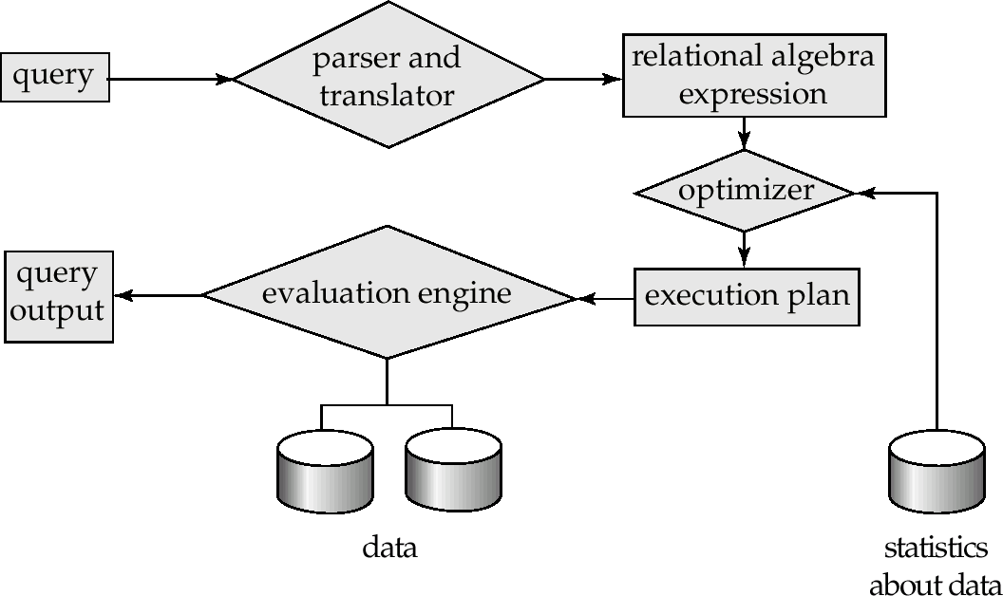
Query Processor

Slide 36
High level query (SQL) into low level language
The basic steps in Query processing
Does parsing and translation
Optimization
Evaluation

Slide 37
Process:
Query is in high level language
Parsing and translation
Translate the query into its internal form. This is then translated into relational algebra.
– Parser checks syntax, verifies relations
Translator
transform query into an internal form (similar to relational algebra)
We may have more then one equivalent relation algebraic expression.

Slide 38
select salary from Employee where salary>10000;
Thus, to make the system understand the user query, it needs to be translated in the form of relational algebra. We can bring this query in the relational algebra form as:
σ_{salary>10000} (π_{salary} (Employee))
π_{salary} (σ_{salary>10000} (Employee))
After this the expression will be optimized using optimizer
ie it selects the best query

Slide 39
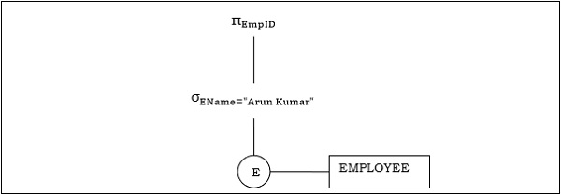
Statistics about data is used to help optimizer for the best evaluation of query.
After evaluating the best query this would be given to execution plan
The execution plan will be send in form of a tree.

Slide 40
Evaluation engine takes the best plan and returns the result as an output using the data

Slide 41
Database Design and ER Model
A good database design starts with a list of the data that you want to include in your database and what you want to be able to do with the database later on.
ER Diagram
ER Diagram stands for Entity Relationship Diagram, also known as ERD
ER diagrams help to explain the logical structure of databases.
ER diagrams are created based on three basic concepts: entities, attributes and relationships.

Slide 42
Why use ER Diagrams?
Helps to describe entities, attributes, relationships
ER diagrams are translatable into relational tables which allows you to build databases quickly
Following are the main components and its symbols in ER Diagrams:
Rectangles: This Entity Relationship Diagram symbol represents entity types
Ellipses : Symbol represent attributes
Diamonds: This symbol represents relationship
Lines: It links attributes to entity types and entity types with other relationship types
Primary key: attributes are underlined
Double Ellipses: Represent multi-valued attributes

Slide 43

Entity:
An entity may be any object, class, person or place. In the ER diagram, an entity can be represented as rectangles.
Consider an organization as an example- manager, product, employee, department etc. can be taken as an entity.
Attribute
The attribute is used to describe the property of an entity. Eclipse is used to represent an attribute.
For example, id, age, contact number, name, etc. can be attributes of a student.

Slide 44
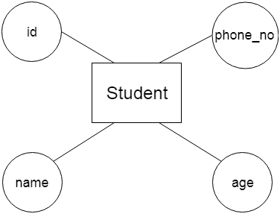

Slide 45
.
Types of Entity type
Strong Entity Type
Weak Entity Type
Strong Entity Type: Strong entity are those entity types which has a key attribute. The primary key helps in identifying each entity uniquely. It is represented by a rectangle. In the below example, Roll_no identifies each element of the table uniquely and hence, we can say that STUDENT is a strong entity type.

Slide 46
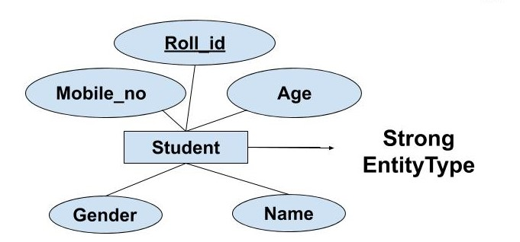
.

Slide 47
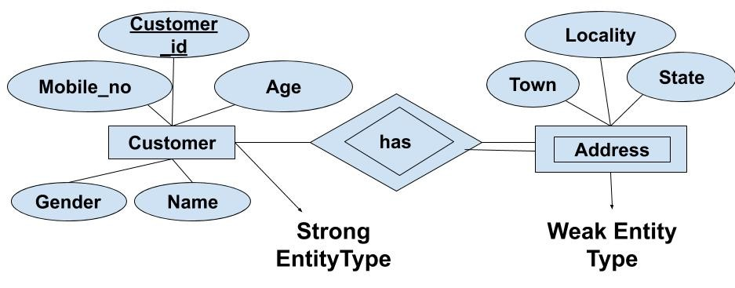
.
Weak Entity Type: Weak entity type doesn't have a key attribute. Weak entity type can't be identified on its own. It depends upon some other strong entity for its distinct identity.

Slide 48
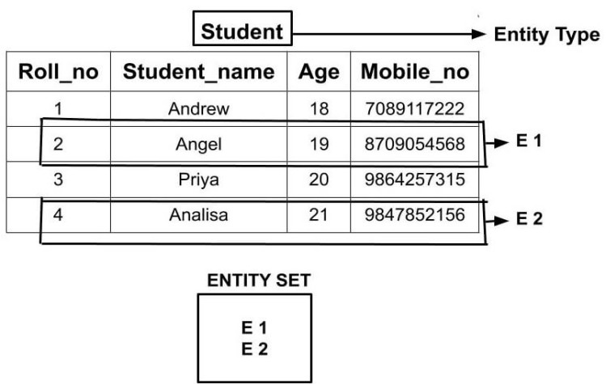
Entity Set
Entity Set is a collection of entities of the same entity type. In the above example of STUDENT entity type, a collection of entities from the Student entity type would form an entity set.

Slide 49
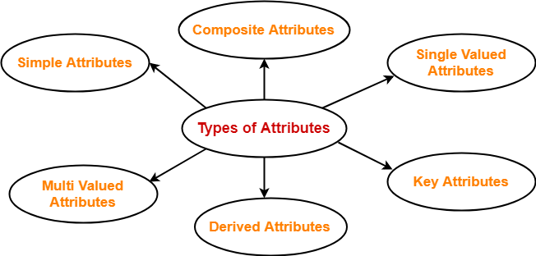
Types of attributes in ERD

Slide 50
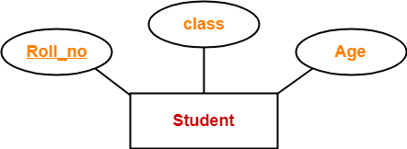
.
Simple attribute
Is one which cannot be divided further
Composite attribute
Composite attributes are those attributes which are composed of other simple attributes

Slide 51
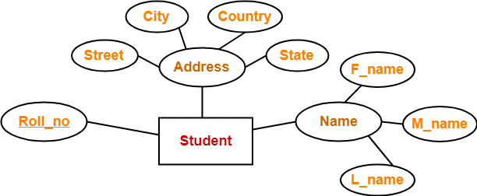
.
Single valued attributes
Are those attributes that can take only one value for a given for a given entity.

Slide 52
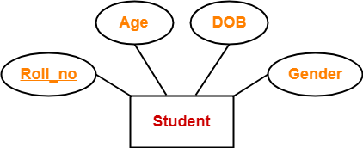
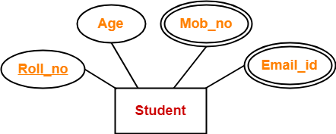
.
Multi valued attribute
Multi valued attributes are those attributes which can take more then one value for a given entity.

Slide 53
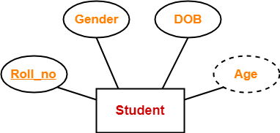
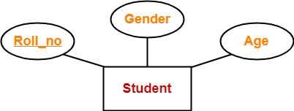
.
Derived attribute
Are those attributes that can be derived from other attributes
Key attribute
Are those which can uniquely identify an entity in entity set

Slide 54
.
Relationship
A relationship is represented by diamond shape in ER diagram, it shows the relationship among entities.
OR
The association among entities is called a relationship. For example, an employee works_in department,
Relationship Set
A set of relationships of similar type is called a relationship set. Like entities, a relationship too can have attributes. These attributes are called descriptive attributes.

Slide 55
.
Degree of Relationship
The number of participating entities in a relationship defines the degree of the relationship.
Binary = degree 2
Ternary = degree 3
n-ary = degree

Slide 56
Generalization, Specialization and Aggregation in ER Model
Generalization, Specialization and Aggregation in ER model are used for data abstraction in which abstraction mechanism is used to hide details of a set of objects.
Generalization – Generalization is the process of extracting common properties from a set of entities and create a generalized entity from it. It is a bottom-up approach in which two or more entities can be generalized to a higher level entity if they have some attributes in common.
For Example, STUDENT and FACULTY can be generalized to a higher level entity called PERSON as shown.

Slide 57
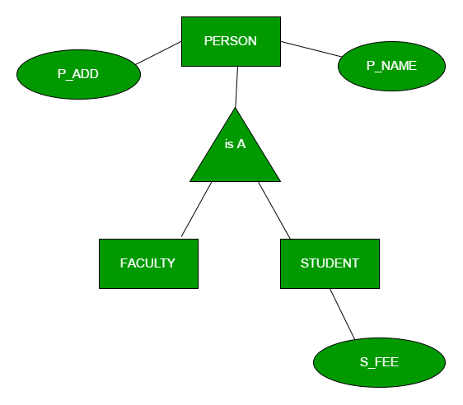
In this case, common attributes like P_NAME, P_ADD become part of higher entity (PERSON) and specialized attributes like S_FEE become part of specialized entity (STUDENT).

Slide 58
Specialization – In specialization, an entity is divided into sub-entities based on their characteristics. It is a top-down approach where higher level entity is specialized into two or more lower level entities.
For Example, EMPLOYEE entity in an Employee management system can be specialized into DEVELOPER, TESTER etc. as shown in Figure 2. In this case, common attributes like E_NAME, E_SAL etc. become part of higher entity (EMPLOYEE) and specialized attributes like TES_TYPE become part of specialized entity (TESTER).

Slide 59
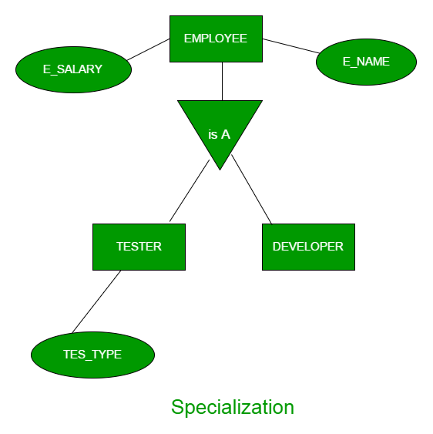

Slide 60
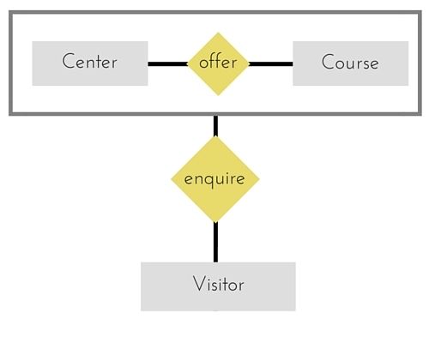
Aggregation
Aggregation is a process in which a single entity alone is not able to make sense in a relationship so the relationship of two entities acts as one entity.
Or
Aggregration is a process when relation between two entities is treated as a single entity.

Slide 61
In the diagram above, the relationship between Center and Course together, is acting as an Entity, which is in relationship with another entity Visitor. Now in real world, if a Visitor or a Student visits a Coaching Center, he/she will never enquire about the center only or just about the course, rather he/she will ask enquire about both.

Slide 62
Cardinality Ration
Is the number of relationship instance that an entity can participate in.
Or
Expresses the number of entities to which other entity can be related via a relationship
Types
One to One (1-1)
One to Many (1-M)
Many to One (M-1)
Many to many (M-N)

Slide 63
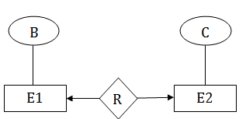
One to One : When every entity of the first entity set can be related to atmost one entity of the second entity set and vice versa then it is one to one mapping.
One to many : an entity in E1 is associated with any number of entities in E2, and an entity in E2 is associated with at most one entity in E1.

Slide 64
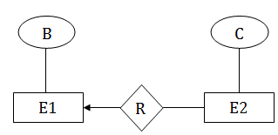
E1– citizen E2– Mobile
One citizen has more then one mobile no
Many to one : an entity in E1 is associated with atmost one entity in E2, and an entity in E2 is associated with any number of entities in E1.

Slide 65
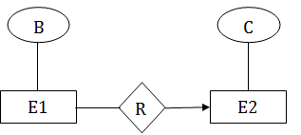
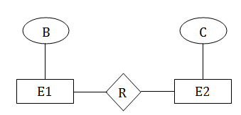
Many to many- an entity in E1 is associated with any number of entities in E2, and an entity in E2 is associated with any number of entities in E1.

Slide 66
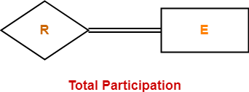
Participation Constraints
There are two types
Total participation
Partial participation
Total Participation-
It specifies that each entity in the entity set must compulsorily participate in at least one relationship instance in that relationship set.
Total participation is represented using a double line between the entity set and relationship set.

Slide 67

Double line between the entity set “Student” and relationship set “Enrolled in” signifies total participation.
It specifies that each student must be enrolled in at least one course.
Partial Participation-
It specifies that each entity in the entity set may or may not participate in the relationship instance in that relationship set.
Partial participation is represented using a single line between the entity set and relationship set.

Slide 68
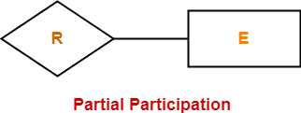
Single line between the entity set “Course” and relationship set “Enrolled in” signifies partial participation.
It specifies that there might exist some courses for which no enrollments are made.

Slide 69
Sample scenerios
1. Design a schema to record information about reality shows on TV.
Database needs to record the following information:
For each reality show, its name, genre, basic_info and participants name. Any
reality show has at least two or more participants.
For each producer, the company name, company country. A show is produced by
exactly one producer and one producer produces exactly one show.
For each television, its name, start year, head office. A television may broadcasts
multiple shows. Each show is broadcasted by exactly one television.
For each user, his/her username, password, and age. A user may rate multiple
shows, and a show may be rated by multiple users. Each rating has a score of 0 to
10.

Slide 70
A library wants to design a database to manage its operations. The library stores information about books, authors, members, and loans. Each book has a unique BookID, title, publisher, and year of publication. Authors are identified by AuthorID and have a name and country. A book can be written by multiple authors, and each author can write multiple books. Members have a unique MemberID, name, and the date they joined the library. Members can borrow books, and each borrowing event (loan) has a unique LoanID, along with the loan date and return date. A member can borrow multiple books, and a book can be borrowed by multiple members over time.

Slide 71
An e-commerce company wants to build a database to manage customers, products, orders, and payments. Each customer has a CustomerID, name, email, and address. Products have a ProductID, name, description, price, and stock quantity. Customers place orders, each with an OrderID, order date, and status. Each order can include multiple products with quantities. Payments are linked to orders, including PaymentID, payment amount, payment method, and payment date.
Draw an ER diagram showing entities, attributes, keys, and relationships, with cardinalities.
Convert the ER model to relational tables with keys and constraints.
Write SQL queries to: a) Find all products ordered by a specific customer. b) List orders that include a particular product. c) Retrieve payment details for an order. d) Find customers who have spent more than $1000. e) Get the total quantity sold for each product.

