Slide 1
GRAPH THEORY
Graphs are considered as discrete mathematical structures consisting of vertices and edges connecting vertices.
Graph theory began in 1736, when Leonhard Euler solved a problem that has been puzzling the citizens of the town of Konigsberg in Prussia. The river pugel divides the town into 4 sections and seven bridges that connected these sections.

Slide 2
Applications
Graph theory is applied in several areas of computer science such as switching theory, logic design, artificial intelligence , formal languages, operating systems, data structures, Software engineering, Image processing, computer graphics and compiler writing.

Slide 4
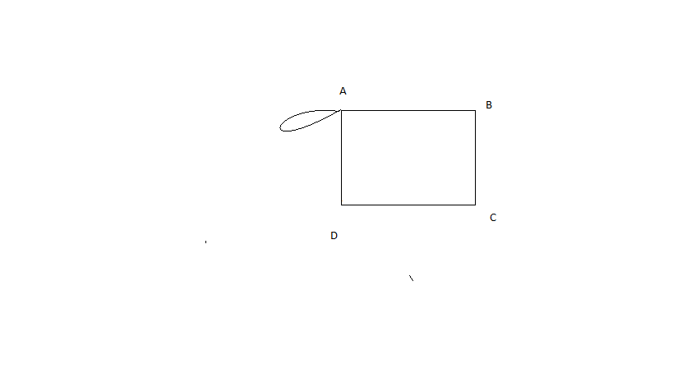
The pair of nodes that are connected by an edge are called “adjacent nodes”. In the above figure A is adjacent to B and D.
A node of a graph which is not adjacent to any other node i.e. which is not connected to any other node is called an “isolated node” . In the above figure G is an isolated node.
A graph containing only isolated vertices is called a “null graph”.
. .
An edge of a graph which joins a vertex to itself is called a “loop”.

Slide 5
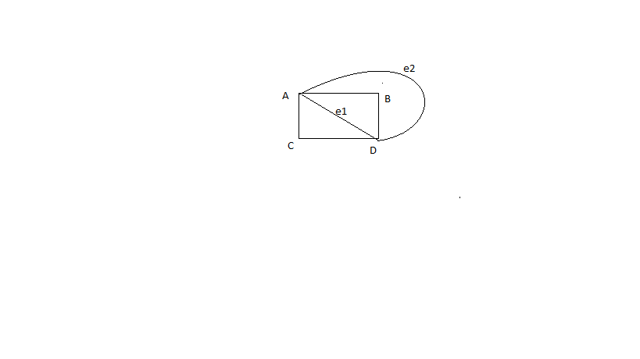
.
A graph with a finite vertex set is called a finite graph.
In a graph , if some pair of vertices are joined by more than one edge, then those edges are called “parallel edges”
A graph which contains some parallel edges but no loops is called as “ Multigraph”. OR Graphs that have multiple edges connecting the same vertices are called multi graphs

Slide 6
A graph which contains parallel edges or loops or both is called as “ General graph”.
A graph without any parallel edges and loops is known as “Simple graph”. A B
A graph with weights(numbers) assigned to each edge is called a “Weighted Graph

Slide 9
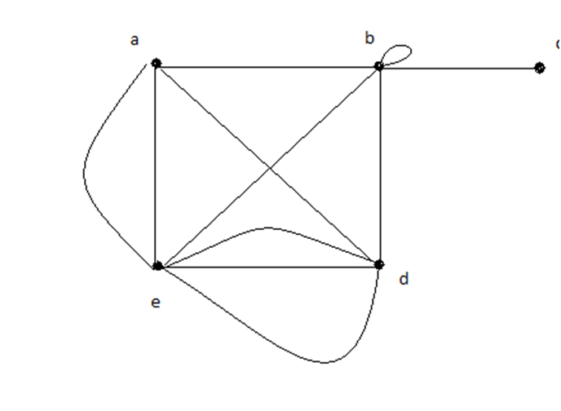

Slide 12
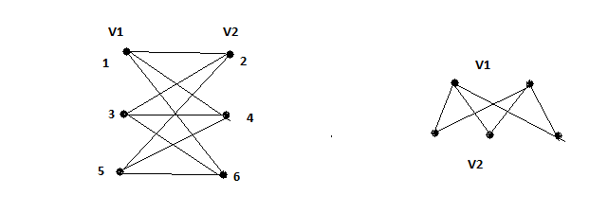

Slide 18
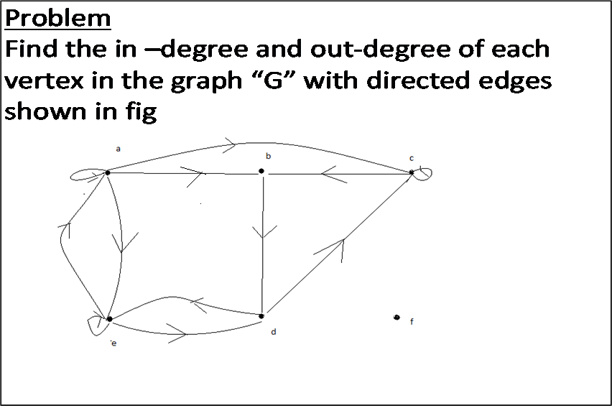

Slide 21
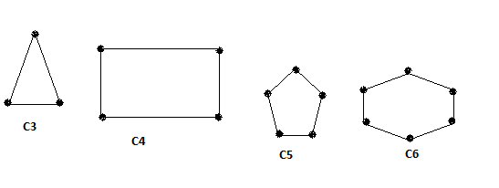

Slide 22
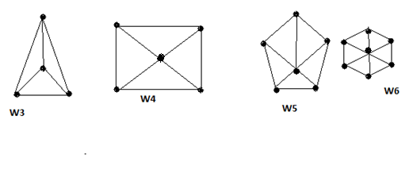

Slide 23
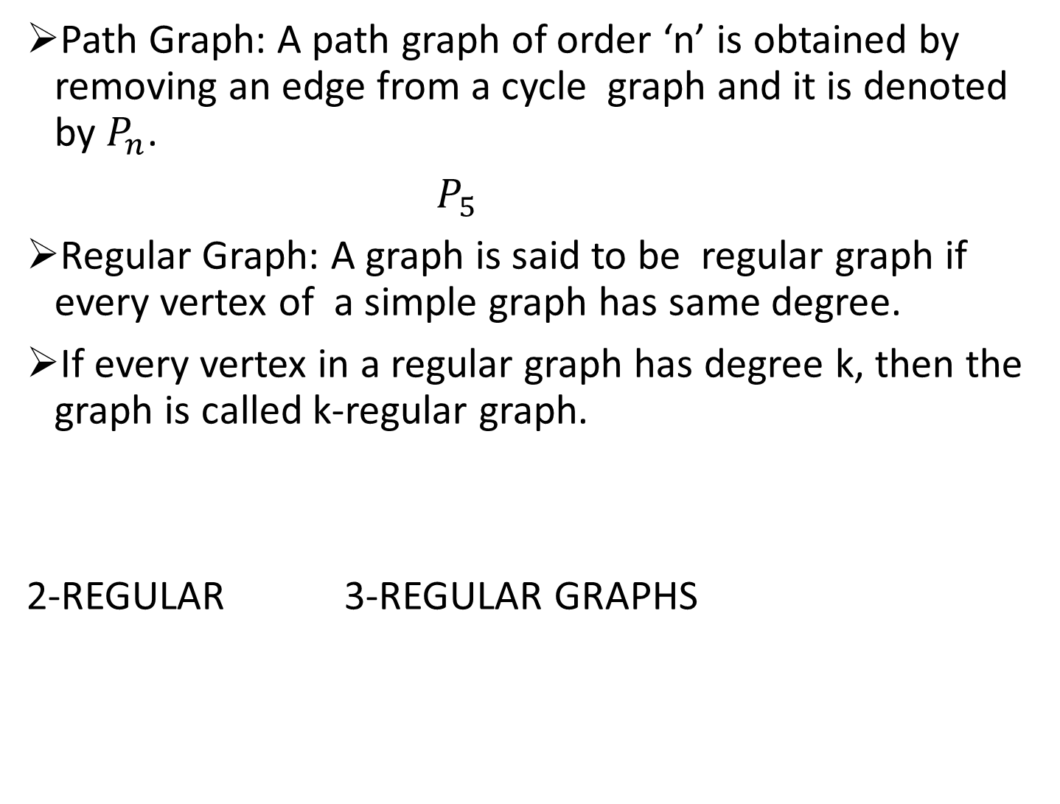
Path Graph: A path graph of order ‘n’ is obtained by removing an edge from a cycle graph and it is denoted by $P_{n}$.
$P_{5}$
Regular Graph: A graph is said to be regular graph if every vertex of a simple graph has same degree.
If every vertex in a regular graph has degree k, then the graph is called k-regular graph.
2-REGULAR 3-REGULAR GRAPHS

Slide 27
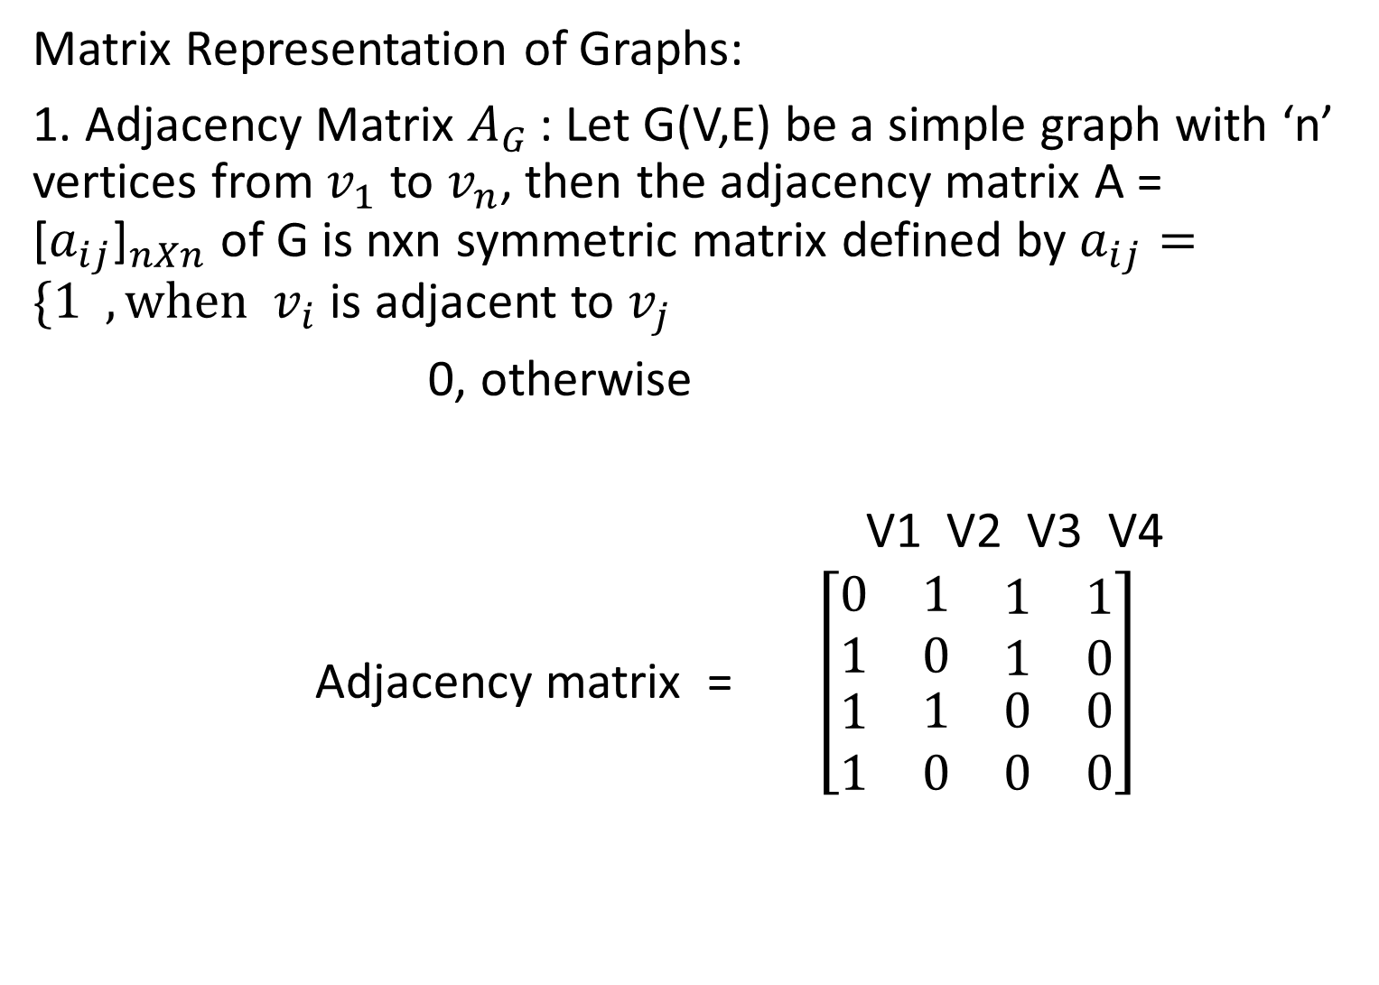
Matrix Representation of Graphs:
1. Adjacency Matrix $A_{G }$: Let G(V,E) be a simple graph with ‘n’ vertices from $v_{1}$ to $v_{n}$, then the adjacency matrix A = ${\text{[}a_{ij}\text{]}}_{nXn}$ of G is nxn symmetric matrix defined by $a_{ij}=\{1 , when v_{i}$ is adjacent to $v_{j}$
0, otherwise
V1 V2 V3 V4
Adjacency matrix = $\left[\begin{matrix}0 & 1 & \begin{matrix}1 & 1\end{matrix} \\ 1 & 0 & \begin{matrix}1 & 0\end{matrix} \\ \begin{matrix}1 \\ 1\end{matrix} & \begin{matrix}1 \\ 0\end{matrix} & \begin{matrix}\begin{matrix}0 \\ 0\end{matrix} & \begin{matrix}0 \\ 0\end{matrix}\end{matrix}\end{matrix}\right]$

Slide 28
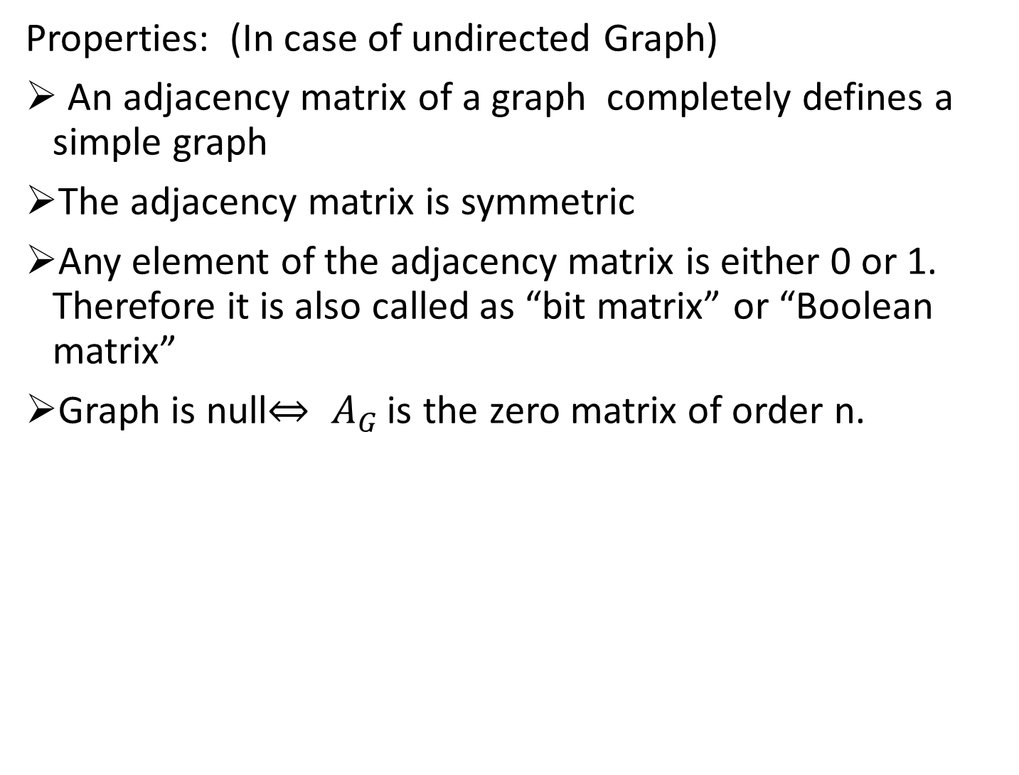
Properties: (In case of undirected Graph)
An adjacency matrix of a graph completely defines a simple graph
The adjacency matrix is symmetric
Any element of the adjacency matrix is either 0 or 1. Therefore it is also called as “bit matrix” or “Boolean matrix”
Graph is null$⇔ A_{G }$is the zero matrix of order n.

Slide 29
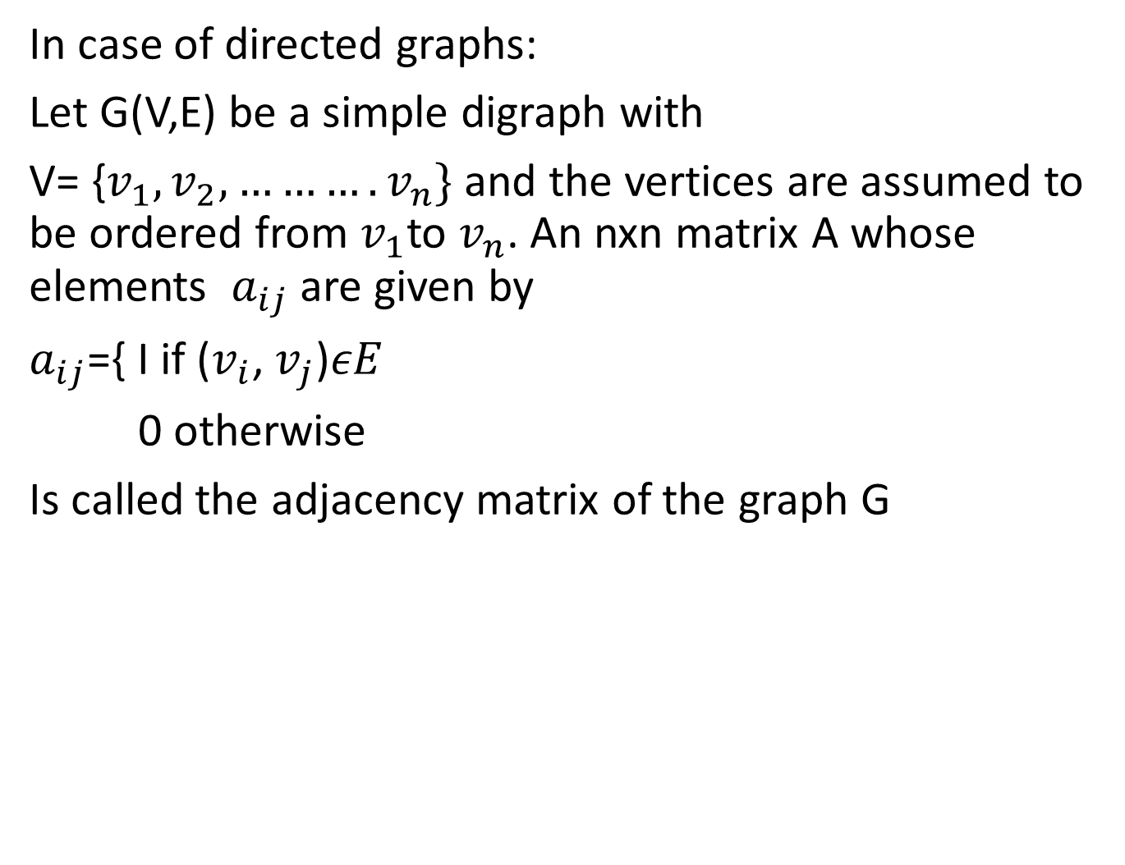
In case of directed graphs:
Let G(V,E) be a simple digraph with
V= {$v_{1},v_{2},……….v_{n}\}$ and the vertices are assumed to be ordered from $v_{1}$to $v_{n}$. An nxn matrix A whose elements $a_{ij}$ are given by
$a_{ij}$={ I if ($v_{i}$, $v_{j}$)$εE$
0 otherwise
Is called the adjacency matrix of the graph G

Slide 30
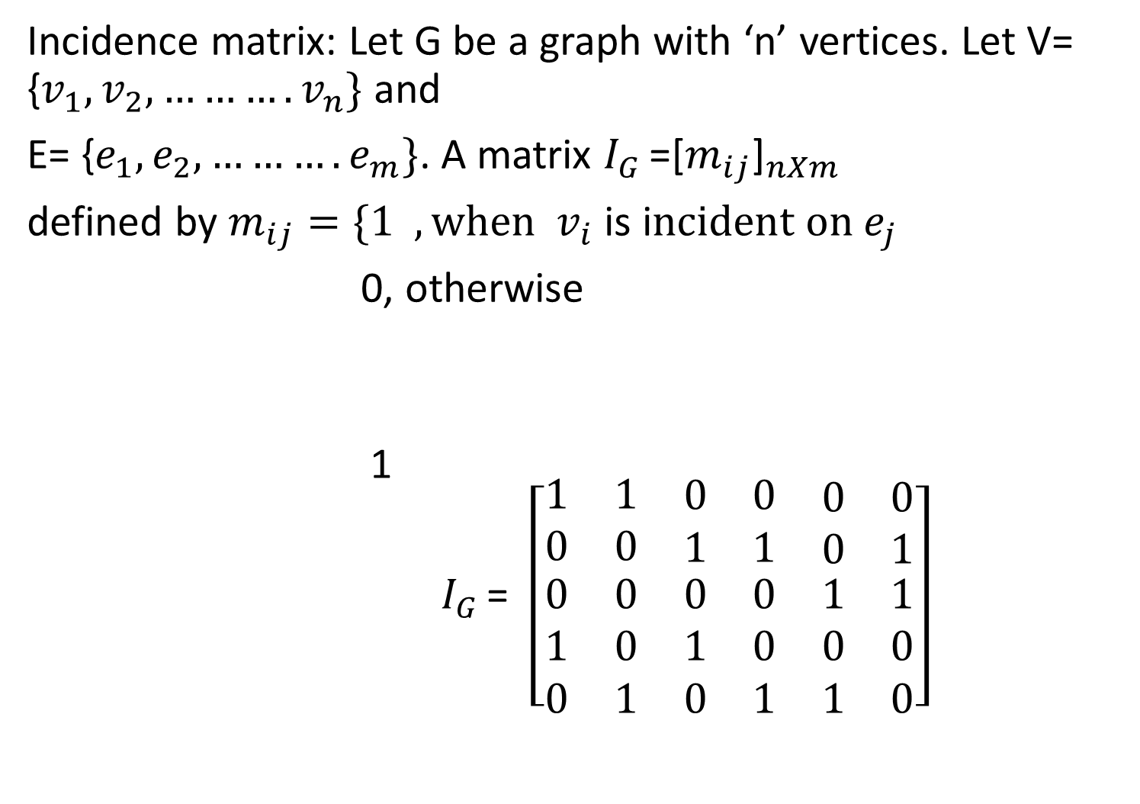
Incidence matrix: Let G be a graph with ‘n’ vertices. Let V= {$v_{1},v_{2},……….v_{n}\}$ and
E= {$e_{1},e_{2},……….e_{m}\}$. A matrix $I_{G }$=${\text{[}m_{ij}\text{]}}_{nXm}$
defined by $m_{ij}=\{1 , when v_{i}$ is i$ncident on e_{j}$
0, otherwise
1 $I_{G }$= $\left[\begin{matrix}1 & 1 & \begin{matrix}0 & 0 & \begin{matrix}0 & 0\end{matrix}\end{matrix} \\ 0 & 0 & \begin{matrix}1 & 1 & \begin{matrix}0 & 1\end{matrix}\end{matrix} \\ \begin{matrix}0 \\ 1 \\ 0\end{matrix} & \begin{matrix}0 \\ 0 \\ 1\end{matrix} & \begin{matrix}\begin{matrix}0 \\ 1 \\ 0\end{matrix} & \begin{matrix}0 \\ 0 \\ 1\end{matrix} & \begin{matrix}\begin{matrix}1 & 1\end{matrix} \\ \begin{matrix}0 & 0\end{matrix} \\ \begin{matrix}1 & 0\end{matrix}\end{matrix}\end{matrix}\end{matrix}\right]$

Slide 31
Properties:
1.The incidence matrix contains only 0’s and 1’s
2.The no. of 1’s in each row equals to the degree of the corresponding vertex.
3.A row with all 0’s represent an isolated vertex
4.Every edge is incident on exactly two vertices , each column of the incidence matrix has exactly two ones except the loop.

Slide 32
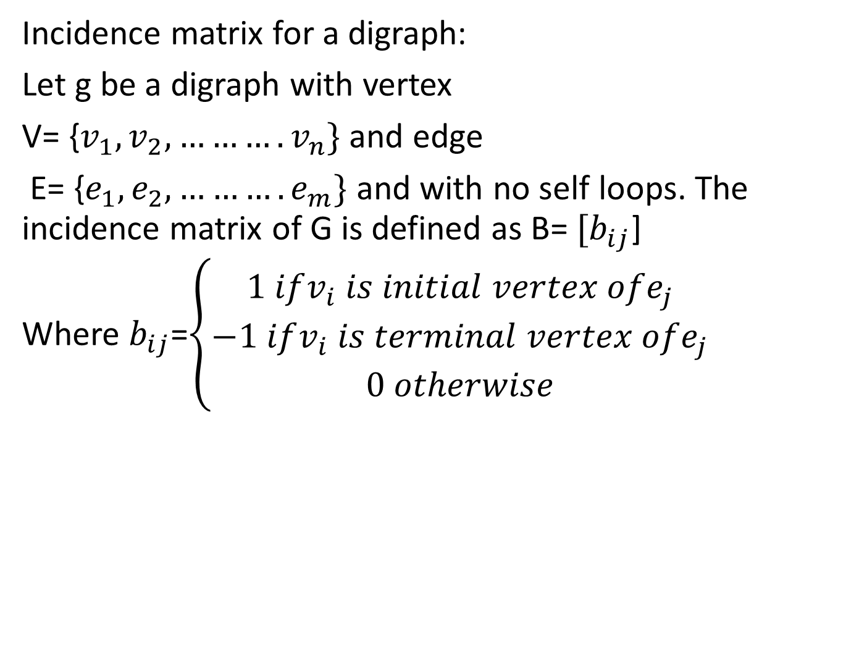
Incidence matrix for a digraph:
Let g be a digraph with vertex
V= {$v_{1},v_{2},……….v_{n}\}$ and edge
E= {$e_{1},e_{2},……….e_{m}\}$ and with no self loops. The incidence matrix of G is defined as B= ${[b}_{ij}$]
Where $b_{ij}$=$\left\{\begin{aligned}1 ifv_{i} is initial vertex ofe_{j} \\ −1 ifv_{i} is terminal vertex ofe_{j} \\ 0 otherwise\end{aligned}\right.$

Slide 33
Write the incidence matrix for the following digraph

Slide 34
Note:In a graph no. of odd degree vertices must be even . This is necessary but not sufficient
Prob1: Is there any simple graph corresponding to the following matrix

Slide 35
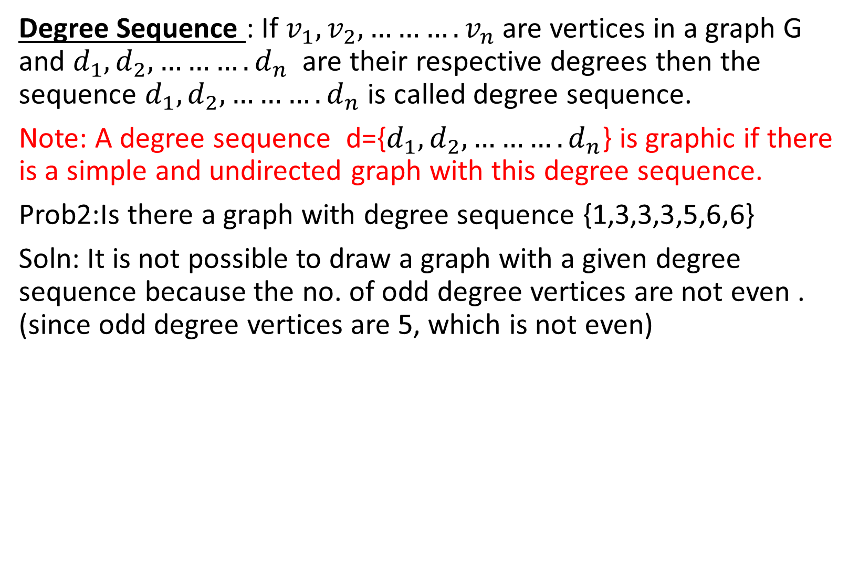
Degree Sequence : If $v_{1},v_{2},……….v_{n}$ are vertices in a graph G and $d_{1},d_{2},……….d_{n}$ are their respective degrees then the sequence $d_{1},d_{2},……….d_{n}$ is called degree sequence.
Note: A degree sequence d={$d_{1},d_{2},……….d_{n}$} is graphic if there is a simple and undirected graph with this degree sequence.
Prob2:Is there a graph with degree sequence {1,3,3,3,5,6,6}
Soln: It is not possible to draw a graph with a given degree sequence because the no. of odd degree vertices are not even . (since odd degree vertices are 5, which is not even)

Slide 36
Prob 3: Is there a simple non directed graph or determine the given degree sequence is a graph or not.
{2,3,3,4,4,5} Soln: No. of odd degree vertices are not even so there cannot be a simple graph
{2,3,4,4,5} Soln: Degree 5 means it should have 5 adjacent vertices which is not possible, so no simple graph.
{1,3,3,3} Soln: Not possible
{2,3,3,4,5,6,7} Soln: Not possible as degree 7 means it should have 7 adjacent vertices.
{1,1,3,3,3,4,6,7} Soln: Not possible

Slide 42
Path: In a non-directed graph G, a sequence ‘P’ of zero or more edges of the form {v0,v1},{v1,v2},{v2,v3},…….{vn-1,vn} or
v0-v1-v2-…..vn is called a path from v0 to vn. , where v0 is the initial vertex and vn is the terminal vertex of the path P.
1.In a path, vertices and edges may be repeated any no. of times
2. The no. of edges in a path is called length of the path.
3.A path of the length zero is called trivial path.

Slide 43
Open Path: A path in which initial and terminal vertices are distinct is called open path i.e v0≠vn.In the above example A-B-C-D is an open path.
2. Closed Path: A path in which initial and terminal vertices are same is called closed path i.e v0=vn. In the above example A , A-B-A ,
A-B-C-D-A , A-B-C-D-B-E-A are closed paths.
A trivial path is taken as a closed path.
3.A path ‘P’ is said to be simple if all the edges and vertices in the path are distinct. Ex: A-B-C-D, A-B-E-C-D

Slide 44
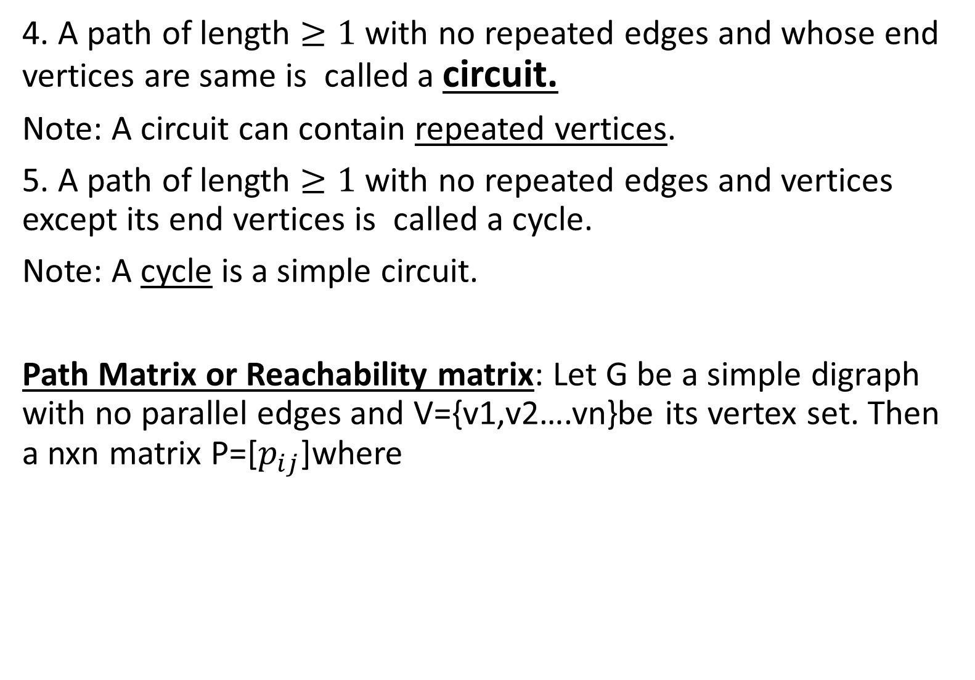
4. A path of length $≥1$ with no repeated edges and whose end vertices are same is called a circuit.
Note: A circuit can contain repeated vertices.
5. A path of length $≥1$ with no repeated edges and vertices except its end vertices is called a cycle.
Note: A cycle is a simple circuit.
Path Matrix or Reachability matrix: Let G be a simple digraph with no parallel edges and V={v1,v2….vn}be its vertex set. Then a nxn matrix P=[$p_{ij}$]where

Slide 45
Note: A path matrix only shows presence or absence of atleast one path between a pair of vertices. But it may not show all the paths that may exist.
Method for calculating path matrix:
Let G be a simple digraph with vertices.
Let A be adjacency matrix of graph G
Calculate

Slide 49
Euler Path: A Euler Path in a multigraph is a path that includes each edge of the multigraph exactly once and each vertex of the multigraph atleast once.
A multigraph is said to be traversible if it has Euler path.
Euler Circuit: A Euler Circuit is a Euler path whose end points are same (OR) A Euler path whose end points are same is called Euler Circuit.
Eulerian Graph: A multigraph is said to be Eulerian if it has Euler Circuit.

Slide 50
Thm: A graph with more than two odd degree vertices is not traversible.
Thm: A connected graph G is Eulerian iff each vertex of G has even degree .
Note: A connected graph with exactly two odd degree vertices is traversible (Semi Eulerian). A traversible trail may begin at one odd degree vertex and will end at the other odd degree vertex.
Thm: A connected graph G is traversible iff G has zero or exactly two vertices of odd degree.
The problem of drawing a graph on paper without lifting the pen or repeating any path can be done with the help of Euler’s path.

Slide 51
Ex: Traversible Multigraph:
Ex: Eulerian Multigraph
Note: Both G1,G2 are traversible but G1 is not Eulerian graph.

Slide 52
Prob: Which of the following are traversible, Eulerian or neither.

Slide 53
Problem: Show that the problem of Konigsberg is unsolvable.
Soln: The multigraph of the Konigsberg bridges is as follows
Deg(A)=5,Deg(B)=3,Deg(C)=3,Deg(D)=3
Since it has more than 2 odd degree vertices it is not traversible.

Slide 54
Prob:Find which of the following multigraphs have Euler paths, circuits or neither.
i) Soln:

