Slide 1
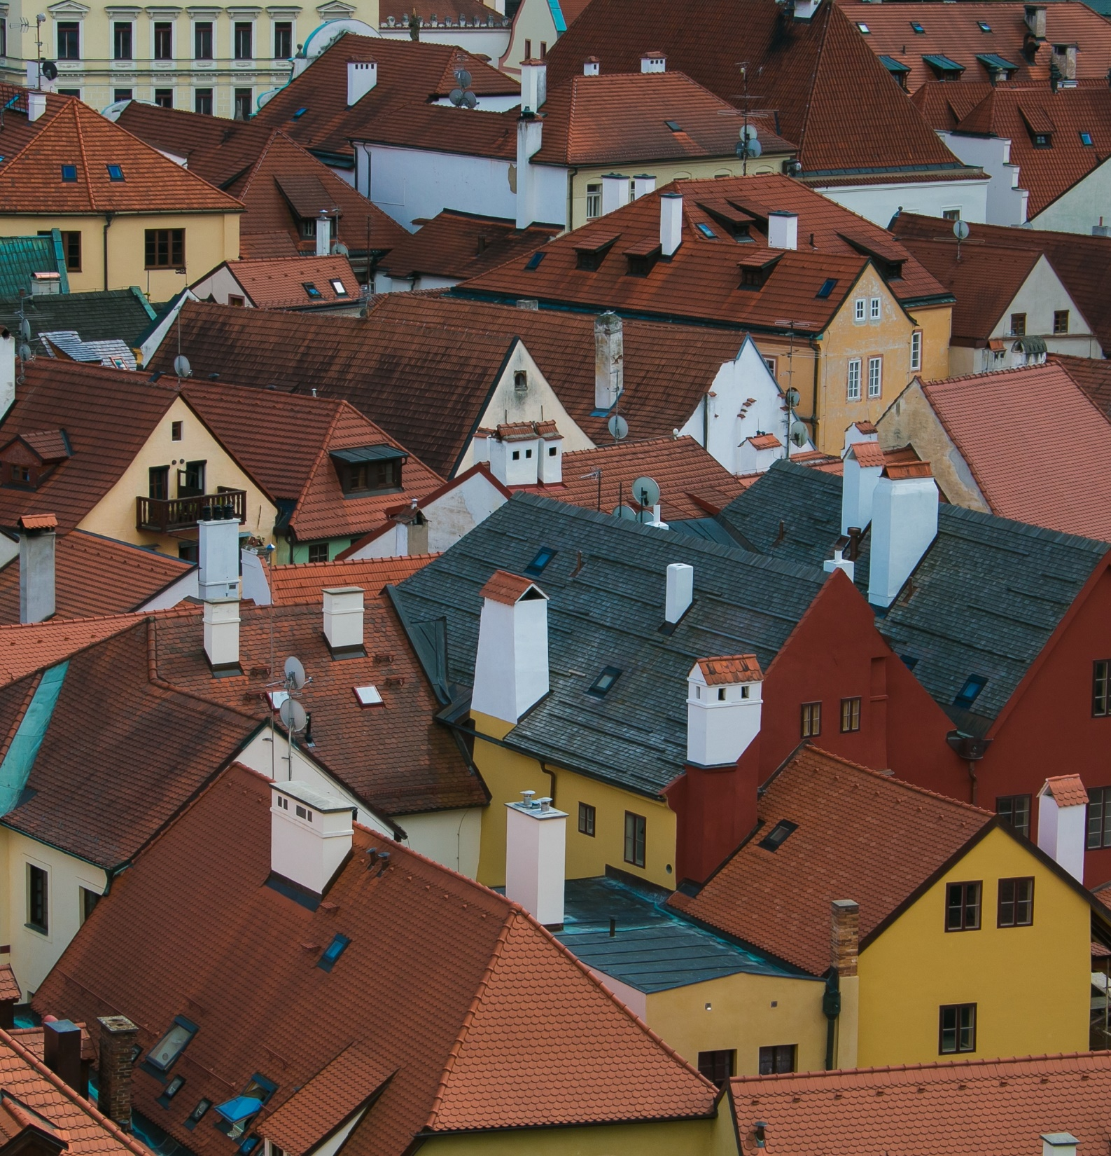

Power and Conflict Poetry Ozymandias
Presented by Olivia + Kiel Mitchell
Notes:
This is a header slide. It will be at the start of every video in this course. The only changes will be the name of the poem in light grey and a photo that matches the relevant poem on the right.

Slide 2
Agenda
Vocabulary check
Summary + Reading
Context
Quotation zoom and poetic techniques
Note taking and reflection
Notes:
This is an agenda slide. It will inform students of what is going to be discussed in the video. This slide will always come directly after the header slide. The agenda will always stay in this order for each poem to improve predictability.

Slide 3

Vocabulary
We need to know:
‘Trunkless’
Missing the body. Only the legs stand.
‘Ozymandias’
This is a translation of the name Ramsees II
‘Visage’
Face and its expression.
Notes:
This is the vocabulary slide. It will always come directly after the agenda slide and directly before the Summary + Reading slide so that the pupils fully understand any tricky or ambiguous phrasing that is important to the poem’s meaning. Only 3-4 main phrases should be chosen. This slide gives the pupils the best chance to understand the Summary + Reading part of the video.

Slide 4

Summary + Reading
This poem is all about….
Notes:
This slide will have a picture of the poem/relevant imagery on the right hand side and a simplified summary of the poem and its themes on the left. The summary should be read by the pupil and they should feel immediate clarity.

Slide 5

Context
Time period
The Victorian era was a time of [insert relevant context here]
Poet’s background
[insert name] grew up in […] and had a father who went to war.
Key Summary
-Unstable childhood
Father went to war
Known for dramatic monologues
Notes:
This is the context slide. It always comes directly after the Summary + Reading slide and directly before the zoom slides. It details the year the poem was written, and relevant context of the time period, of the author’s life and any further influences. The structure of this page may differ depending on the poet. Do not force context if it does not relate to the poem.

Slide 6
Delivering with confidence
“Two vast and trunkless legs of stone stand in the desert…”
Notes:
This is a zoom slide. It shows an important quotation from the poem. The voice over will discuss any poetic features included in the quote and their effects. This slide should be repeated 4-7 times with different powerful quotes that pupils could use in their exams.

Slide 7
Summary
Feature | Quotation | Impact
Alliteration | [insert relevant quotes] | Mimic sounds heard on battlefield
Simile | [insert relevant quotes] | Makes nature imagery more vivid
Symbolism | [insert relevant quotes] | Focuses attention on power of war
Anaphora | [insert relevant quotes] | Emphasis the point and mimics footfall of soldiers
Caesura | [insert relevant quotes] | Reiterates the unreliable narrator
Cyclical structure | [insert relevant quotes] | Reveals inevitability of death and loss of power
Notes:
This is a summary slide. It shows the quotations from the zoom slides alongside clear labelling of the feature used and the impact.

Slide 8
Last bits
Notes:
The Last bits slide is an optional slide to include any extra important information that does not fit the structure given.

Slide 9

Reflect…
Use our course materials to test your knowledge.
Notes:
This is the reflect slide. It always comes at the end and directs pupils to course materials.

