Slide 1
Knowledge Engineering for Robot Capabilities

Slide 2
Motivations
Robotics systems are coming to commercial use
Complexity of robotics systems for non-experts
Usage of robots as a platform, not as end product

Slide 3
Motivations
GOAL: a semi-automatic layer of knowledge engineering to make sense of the robotics systems
High-level robot capability representation is fundamental for multi-purpose multi-robot planning (or coordination)
This may lead to a required standardization (both in ROS and in designing robot capabilities)

Slide 4
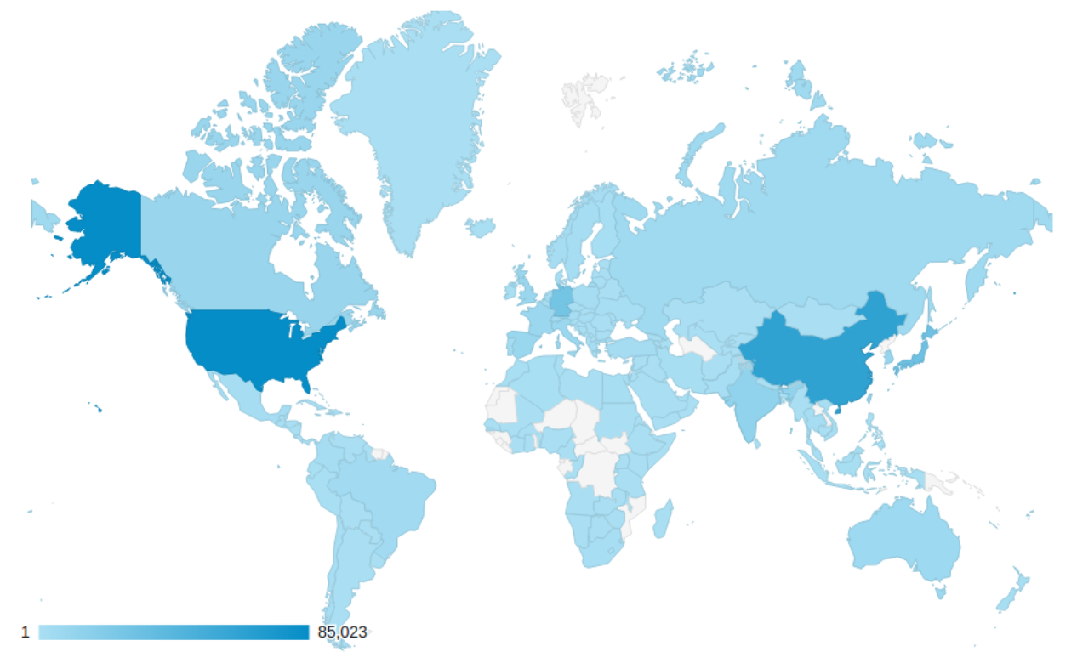
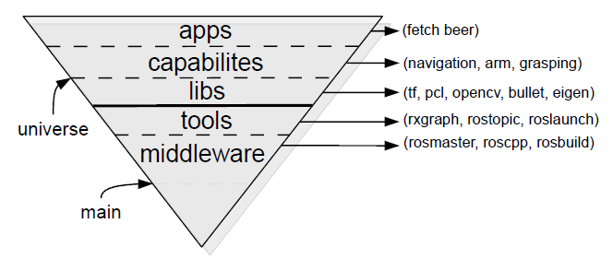
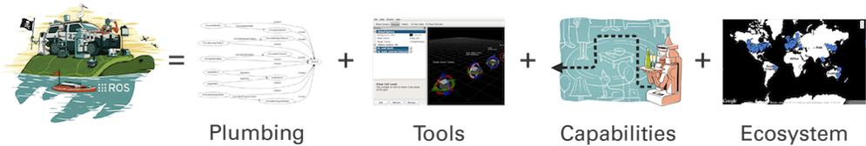
ROS: Robot Operating System
Middleware for robotics
Component-based
Publish-subscribe paradigm
Thriving community
Exploration tools

Slide 5
ROS Main elements
ROS component
Atomic element encapsulated in a single executable
Asynchronous communication based on messages exchanged on named channels
NODE
publish
TOPIC
subscribe
NODE
MESSAGE
Data type of the data exchanged on the channels
SERVICE
Synchronous request from a component to another
NODE

Slide 6
ROS Architecture
/joy
Joy.msg
joy_to_cmd
/cmd_vel
Twist.msg
Standard message
(teleoperation)
User developed component
Standard message
(robot control)
Joypad driver provided by ROS
Interface to the robot
joy_node
robot_driver
Architecture of a simple robot piloted directly by the user using a joypad

Slide 7
Robot Capability Ontology
Node
publishes/subscribesTo
Topic
communicatesThrough
offers/requests
Communication component
isA
isA
Subscriber
publishedIn/readFrom
Service
isA
ServiceClient
ServiceServer
isA
consumers
Publisher
defines
receives
creates
produces
Message
SrvMsgRequest
SrvMsgResponse
partOf
partOf
SrvMessage

Slide 8
Robot Capability Ontology
Sensing
Body Movement
Capability
Movement
Navigation
Representation
…

Slide 9
Robot Capability Ontology
Message
Capability
Sensing
/ImageRaw
Vision

Slide 10
Possible Evaluation
Use an engineering approach (no claim on the ontology)
e.g. how much the development time is reduced
e.g. how much does the automation work
An interface to the robot capabilities
Different robots do different things without a previous expertise
e.g. users have to give 3 tasks to 3 different robots through the same interface

