Slide 1


ENGINEERING CAPSTONE PROJECT – 1
Project Review-3
CloudNote AI: Cloud-Based Intelligent Video Note Extraction and Semantic Search Platform
Team No - 7
Roll No Name
2320030330 K. Mithilesh Reddy
2320030186 Nitin Tulugu
2320030348 Sargu Sai Chetan
Under the Guidance of
Dr. G. Neelima
Assistant Professor
Department of Computer Science and Engineering
KONERU LAKSHMAIAH EDUCATION FOUNDATION
31-10-2026
PRC-III
1
Notes:
Good morning. We present the third project review of CloudNote AI, a cloud-based platform that turns recorded lectures into searchable, verifiable notes. Team: K. Mithilesh Reddy, Nitin Tulugu and Sargu Sai Chetan, under the guidance of Dr. G. Neelima.

Slide 2
OUTLINE
1. Introduction
2. Problem Statement
3. Objectives
4. Literature Survey
5. Research Gap Identification
6. Innovation, Creativity, and Novelty
7. Feasibility and Project Plan
8. Existing Method
9. Proposed Method
10. System Architecture
11. Results & Discussion
12. Conclusion
13. References
31-10-2026
PRC-III
2
Notes:
This is the order of our presentation, following the PRC-III template.

Slide 3
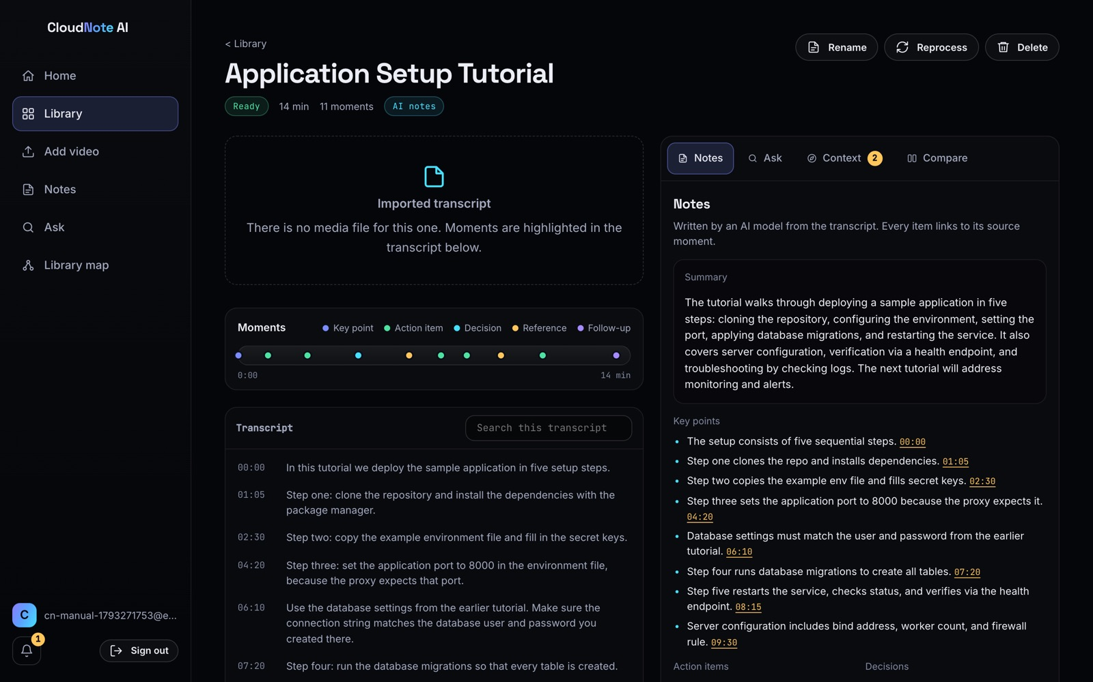
Introduction
Background: lectures, labs and meetings are now recorded, but a video cannot be skimmed. A fact said at minute 37 is effectively lost.
Importance: recordings depend on each other ("as we discussed earlier", "in the next video"), and AI summaries rarely show where a claim came from.
Problem solved: turn a personal library of recordings into notes and answers that always point back to the exact moment, and recover context that one recording leaves out.
Application: students revising lectures, MOOC learners, teams reviewing meeting and training recordings.
CloudNote AI: video page with AI notes (live)
31-10-2026
PRC-III
3
Notes:
Recorded learning is everywhere, but recordings cannot be skimmed and they refer to each other. CloudNote AI makes them searchable and verifiable.

Slide 4
Problem Statement
From the literature survey and the identified gaps: existing lecture-video tools work inside one video, and AI summaries of transcripts are hard to verify because they do not cite the moment they came from. No tool we surveyed detects when one recording refers to another, suggests where the missing explanation is, or remembers a reference whose explanation has not been uploaded yet.
Problem: design and deploy a secure, low-cost cloud platform that converts a personal library of recordings into timestamped notes and cited answers, and recovers cross-video context that individual recordings leave out.
Lost moments
No way to find what was said, when
Unverifiable AI
Summaries without sources
Dead-end references
"Earlier" / "next video" lead nowhere
Cost
Servers and AI are costly to run
31-10-2026
PRC-III
4
Notes:
The problem statement follows from the gap: tools stop at one video, and AI summaries are not traceable.

Slide 5
Objectives
1. Timestamped transcription
2. Verifiable notes and answers
Convert uploaded speech into timestamped moments (Amazon Transcribe); import SRT, VTT, JSON and text transcripts.
Summary, key points, actions and decisions linked to moments; answers only from the user's material with [n] citations and timestamps.
Measure: 11-s clip, upload to notes in under 30 s
Measure: uncited answers rejected, 100%
3. Cross-video context recovery
4. Secure, serverless, low-cost cloud
Detect backward and forward references (13 patterns), suggest sources, remember unresolved ones and notify when explained.
Cognito sign-in, JWT-protected API, per-user data isolation, infrastructure as code on AWS.
Measure: pattern tests pass; one notification per match
Measure: 0 cross-user leaks in live tests; cost near 0 USD idle
31-10-2026
PRC-III
5
Notes:
Four measurable objectives. Each has a check we report in the results section.

Slide 6
Literature Survey (1/6)
Existing methods, research gap and why our approach is needed: 18 papers (2020 onwards) in the prescribed format.
Sl No | Year | Authors | Title of the paper | Source (Journal / Conference) | Objective of the paper | Techniques Used | Dataset Used | Parameters Analysed | Research Inference | Research Gap | DOI of the paper
1 | 2023 | A. Radford, J. W. Kim, T. Xu et al. | Robust Speech Recognition via Large-Scale Weak Supervision (Whisper) | ICML 2023 | Robust multilingual speech recognition without fine-tuning | Encoder-decoder Transformer, weak supervision | 680,000 h of web audio | WER, zero-shot robustness | Large weakly supervised data gives robust ASR | Produces transcripts only; no notes, search or links between recordings | 10.48550/arXiv.2212.04356
2 | 2020 | A. Baevski, H. Zhou, A. Mohamed, M. Auli | wav2vec 2.0: A Framework for Self-Supervised Learning of Speech Representations | NeurIPS 2020 | Learn speech features from unlabelled audio | Self-supervised contrastive learning, Transformer | LibriSpeech, Libri-Light | WER with little labelled data | Good ASR from minutes of labelled speech | Model-level work; no application for learners | 10.48550/arXiv.2006.11477
3 | 2020 | A. Gulati, J. Qin, C.-C. Chiu et al. | Conformer: Convolution-augmented Transformer for Speech Recognition | Interspeech 2020 | Combine local and global modelling for ASR | Convolution + self-attention | LibriSpeech | WER | State-of-the-art WER on LibriSpeech | Accuracy focus; output still raw transcript | 10.21437/Interspeech.2020-3015
31-10-2026
PRC-III
6
Notes:
Speech recognition papers: they give accurate transcripts, which is our input, but stop at the transcript.

Slide 7
Literature Survey (2/6)
Sl No | Year | Authors | Title of the paper | Source (Journal / Conference) | Objective of the paper | Techniques Used | Dataset Used | Parameters Analysed | Research Inference | Research Gap | DOI of the paper
4 | 2020 | M. Lewis, Y. Liu, N. Goyal et al. | BART: Denoising Sequence-to-Sequence Pre-training for NLG, Translation and Comprehension | ACL 2020 | Pre-train a model for generation tasks such as summarisation | Denoising seq2seq Transformer | CNN/DailyMail, XSum | ROUGE | Strong abstractive summaries | Summaries carry no source links; can hallucinate | 10.18653/v1/2020.acl-main.703
5 | 2020 | J. Zhang, Y. Zhao, M. Saleh, P. J. Liu | PEGASUS: Pre-training with Extracted Gap-sentences for Abstractive Summarization | ICML 2020 | Pre-training objective tailored to summarisation | Gap-sentence generation | 12 summarisation datasets | ROUGE, low-resource results | Good summaries with few examples | Single-document; no timestamps or verification | 10.48550/arXiv.1912.08777
6 | 2020 | V. Karpukhin, B. Oguz, S. Min et al. | Dense Passage Retrieval for Open-Domain Question Answering | EMNLP 2020 | Retrieve passages with learned dense vectors | Dual-encoder BERT | NQ, TriviaQA, WebQ, TREC, SQuAD | Top-k retrieval accuracy, EM | Dense retrieval beats BM25 on QA | Needs GPU-trained encoders; not personal libraries | 10.18653/v1/2020.emnlp-main.550
31-10-2026
PRC-III
7
Notes:
Summarisation and dense retrieval: strong models, but no source links and heavy for small libraries.

Slide 8
Literature Survey (3/6)
Sl No | Year | Authors | Title of the paper | Source (Journal / Conference) | Objective of the paper | Techniques Used | Dataset Used | Parameters Analysed | Research Inference | Research Gap | DOI of the paper
7 | 2020 | O. Khattab, M. Zaharia | ColBERT: Efficient and Effective Passage Search via Contextualized Late Interaction over BERT | SIGIR 2020 | Fast, accurate neural passage ranking | Late interaction over BERT token vectors | MS MARCO, TREC CAR | MRR@10, latency | Near-BERT quality, much faster | Heavy index for a small per-user library | 10.1145/3397271.3401075
8 | 2021 | N. Thakur, N. Reimers, A. Rücklé et al. | BEIR: A Heterogeneous Benchmark for Zero-shot Evaluation of Information Retrieval Models | NeurIPS 2021 (Datasets & Benchmarks) | Test retrieval models outside their training domain | Benchmark of lexical, dense, re-ranking models | 18 datasets | nDCG@10 | BM25 is a strong zero-shot baseline | Supports our lexical (TF-IDF) default | 10.48550/arXiv.2104.08663
9 | 2020 | P. Lewis, E. Perez, A. Piktus et al. | Retrieval-Augmented Generation for Knowledge-Intensive NLP Tasks | NeurIPS 2020 | Ground generation in retrieved documents | Dense retriever + BART generator | NQ, TriviaQA, WebQ, MS MARCO, FEVER | EM, BLEU, ROUGE | Retrieval improves factual answers | Answers are not forced to cite; no timestamps | 10.48550/arXiv.2005.11401
31-10-2026
PRC-III
8
Notes:
Benchmarks and retrieval-augmented generation: grounding helps, but answers are not forced to cite.

Slide 9
Literature Survey (4/6)
Sl No | Year | Authors | Title of the paper | Source (Journal / Conference) | Objective of the paper | Techniques Used | Dataset Used | Parameters Analysed | Research Inference | Research Gap | DOI of the paper
10 | 2020 | K. Guu, K. Lee, Z. Tung et al. | REALM: Retrieval-Augmented Language Model Pre-Training | ICML 2020 | Add a learned retriever to pre-training | Latent knowledge retriever, MLM | NQ, WebQ, CuratedTREC | Exact match | Retrieval improves open QA | Large-scale training; Wikipedia, not user media | 10.48550/arXiv.2002.08909
11 | 2021 | G. Izacard, E. Grave | Leveraging Passage Retrieval with Generative Models for Open Domain QA (FiD) | EACL 2021 | Use many retrieved passages in one generator | Fusion-in-Decoder (T5) | NQ, TriviaQA | Exact match | More passages, better answers | No citation of which passage was used | 10.18653/v1/2021.eacl-main.74
12 | 2024 | N. F. Liu, K. Lin, J. Hewitt et al. | Lost in the Middle: How Language Models Use Long Contexts | TACL 2024 | Study where in a long context LLMs find facts | Controlled multi-document QA experiments | NQ-Open, key-value retrieval | Accuracy vs position | Facts in the middle are often missed | Motivates ranking and few passages (we send top 10) | 10.1162/tacl_a_00638
31-10-2026
PRC-III
9
Notes:
Fusion-in-decoder, long context and WebGPT: cite and rank carefully; we send only the top 10 moments.

Slide 10
Literature Survey (5/6)
Sl No | Year | Authors | Title of the paper | Source (Journal / Conference) | Objective of the paper | Techniques Used | Dataset Used | Parameters Analysed | Research Inference | Research Gap | DOI of the paper
13 | 2021 | R. Nakano, J. Hilton, S. Balaji et al. | WebGPT: Browser-assisted Question-Answering with Human Feedback | arXiv 2021 | Answer questions by browsing and quoting sources | GPT-3 + browsing + RLHF | ELI5, TriviaQA | Human preference | Quoted references make answers checkable | Web sources; not a user's own recordings | 10.48550/arXiv.2112.09332
14 | 2022 | J. Menick, M. Trebacz, V. Mikulik et al. | Teaching Language Models to Support Answers with Verified Quotes (GopherCite) | arXiv 2022 | Make LLM answers cite evidence | RLHF, quote extraction, abstention | NaturalQuestions, ELI5 | Supported and plausible rate | Abstaining when unsure improves trust | Large models; no media timestamps | 10.48550/arXiv.2203.11147
15 | 2023 | T. Gao, H. Yen, J. Yu, D. Chen | Enabling Large Language Models to Generate Text with Citations (ALCE) | EMNLP 2023 | Benchmark LLM answers with citations | Prompting and retrieval with citation evaluation | ASQA, QAMPARI, ELI5 | Correctness, citation recall/precision | Even strong LLMs often cite poorly | Supports our rule: discard uncited answers | 10.48550/arXiv.2305.14627
31-10-2026
PRC-III
10
Notes:
Citation and hallucination work motivates our rule that an uncited answer is never shown.

Slide 11
Literature Survey (6/6)
Sl No | Year | Authors | Title of the paper | Source (Journal / Conference) | Objective of the paper | Techniques Used | Dataset Used | Parameters Analysed | Research Inference | Research Gap | DOI of the paper
16 | 2023 | Z. Ji, N. Lee, R. Frieske et al. | Survey of Hallucination in Natural Language Generation | ACM Computing Surveys | Survey causes and fixes of hallucination | Literature survey and taxonomy | Many NLG benchmarks | Hallucination metrics | Grounding and verification reduce errors | Survey only; no deployed learner tool | 10.1145/3571730
17 | 2020 | M. Shahrad, R. Fonseca, Í. Goiri et al. | Serverless in the Wild: Characterizing and Optimizing the Serverless Workload at a Large Cloud Provider | USENIX ATC 2020 | Characterise real serverless workloads | Trace analysis, adaptive keep-alive policy | Azure Functions production traces | Invocation rate, cold starts, memory | Most functions run rarely: pay-per-use fits | Supports serverless design; cold starts remain | 10.48550/arXiv.2003.03423
18 | 2023 | E. Kasneci, K. Sessler, S. Küchemann et al. | ChatGPT for Good? On Opportunities and Challenges of Large Language Models for Education | Learning and Individual Differences | Assess LLM use in education | Literature review and position paper | N/A (review) | Opportunities, risks | LLMs help learners but need oversight | Calls for verifiable, source-grounded use | 10.1016/j.lindif.2023.102274
31-10-2026
PRC-III
11
Notes:
Serverless and education: pay-per-use suits our workload, and educators ask for verifiable AI.

Slide 12
Research Gap Identification
Research gap identification involves analysing existing literature to find limitations or unexplored areas. The gaps below define our research problem.
S.No. | Paper Title | Author Name(s) | Methodology / Model Used | Key Findings | Research Gap Identified
1 | Robust Speech Recognition via Large-Scale Weak Supervision | A. Radford et al. | Transformer ASR (Whisper) | Robust, accurate transcripts | Stops at the transcript: no notes, search or cross-video links
2 | Retrieval-Augmented Generation for Knowledge-Intensive NLP | P. Lewis et al. | Dense retriever + BART | Retrieval improves factual answers | Answers need not cite sources; no timestamps to verify
3 | Enabling LLMs to Generate Text with Citations | T. Gao et al. | Citation prompting and evaluation (ALCE) | LLMs frequently omit or misplace citations | Needs enforcement in the application, not only prompting
4 | Dense Passage Retrieval for Open-Domain QA | V. Karpukhin et al. | Dual-encoder BERT | Beats BM25 on open QA | GPU-trained index is heavy for small personal libraries
5 | Serverless in the Wild | M. Shahrad et al. | Production trace analysis | Most functions are invoked rarely | Cold starts; needs careful design for interactive apps
6 | ChatGPT for Good? LLMs for Education | E. Kasneci et al. | Review / position paper | LLMs help learners but need oversight | No tool links references between recordings and remembers missing explanations
31-10-2026
PRC-III
12
Notes:
Six papers that most directly define our gap. The last row states the core gap we address: cross-video context recovery.

Slide 13
Innovation, Creativity, and Novelty
Cross-video context recovery
Remembered missing explanations
Citation-enforced answers
Detects "as we discussed earlier" and "in the next video" with 6 backward and 7 forward patterns, suggests the recording that explains it, and links it on confirmation.
A reference with no source yet is remembered and re-checked after every upload. When a match appears, the user gets one notification.
Answers use only the user's transcripts and notes. Each claim cites [n] with a playable timestamp; an uncited reply is discarded.
Resilient, low-cost AI
Notes vs Video comparison
Library map and gaps report
Model chain Bedrock, OpenAI, Groq, Gemini, then extractive notes, so the product keeps working when one provider fails.
Compares the learner's own notes with the lecture and shows what was missed, with timestamps.
A dependency graph of recordings, a suggested watch order and a list of topics no recording explains, with labelled "Know more" explanations.
Novelty claim (hedged): among the tools we surveyed, we found none that detects references between recordings and remembers unresolved ones for later checking.
31-10-2026
PRC-III
13
Notes:
Our main novelty is cross-video context recovery with memory. We hedge the claim: we found no tool that does this, we do not claim none exists.

Slide 14
Feasibility and Project Plan
Feasibility | Assessment
Technical | Managed AWS services (Transcribe, Lambda, DynamoDB, Cognito, Bedrock) cover every component; built and deployed by a 3-member team
Economic | Pay-per-use serverless: AWS cost for Oct 2026 was about 0.00 USD (Cost Explorer); AI billed per request
Operational | Runs in any browser and on mobile; one-command deploy and teardown (infra/deploy.sh)
Legal / Ethical | Each user's data is private; AI output is cited or clearly labelled as general explanation
Project plan (weeks)
1
2
3
4
5
6
7
8
9
10
Problem study & literature survey
PRC-I
Requirements & architecture
PRC-I
Core engine (notes, search, references)
PRC-II
Web app & AWS deployment
PRC-II
AI chain, Ask & Know more
PRC-III
Testing, reports & paper
PRC-III
All phases complete; this review covers the PRC-III work.
31-10-2026
PRC-III
14
Notes:
The project is technically, economically and operationally feasible. The plan shows the work per review phase; all phases are complete.

Slide 15
Existing Method
Current systems: lecture-capture players and video platforms with auto-captions; separate AI chat tools that summarise a pasted transcript.
Algorithms and models: ASR (Transformer models such as Whisper), keyword search inside captions, abstractive LLM summarisation (BART/GPT-style).
Data and preprocessing: one video at a time; captions are cleaned and shown as text, with no segmentation into linked moments.
Architecture: player + caption track + optional chat assistant; no shared index across a user's recordings.
Evaluation: ASR is judged by WER and summaries by ROUGE; neither measures whether a learner can verify a claim.
Limitations: single-video scope; summaries and answers without citations or timestamps (hallucination risk); references to other recordings are dead ends; always-on servers or GPU indexes cost more for small libraries.
31-10-2026
PRC-III
15
Notes:
Existing approaches are good at transcripts and summaries of one video, but do not let the learner verify answers or follow references across recordings.

Slide 16
Proposed Method
New approach: one private, serverless library where every note and answer is tied to a timestamp, and recordings are linked to each other.
Algorithms: Amazon Transcribe ASR; segmentation into timestamped moments; TF-IDF retrieval (Titan embeddings when Bedrock is enabled); citation-enforced retrieval-augmented answers; 13 regex reference patterns with candidate scoring; extractive notes as fallback.
Models: LLM chain Amazon Bedrock → OpenAI GPT → Groq → Gemini; the first that answers wins.
Data and features: the user's own uploads (8 media formats, 500 MB) or transcripts (SRT, VTT, Transcribe JSON, text); features are TF-IDF term weights, cosine similarity and reference cues.
Workflow: upload → S3 → Transcribe → EventBridge → worker Lambda → notes, index, references → DynamoDB → web app.
Improvements: answers always cite moments; uncited replies rejected; per-user isolation; server time ~15 ms per API call; near-zero idle cost.
31-10-2026
PRC-III
16
Notes:
The proposed method grounds every output in a timestamp and links recordings, on a pay-per-use AWS stack with an AI fallback chain.

Slide 17
System Architecture/Proposed work Block diagram
INPUT
PREPROCESSING
FEATURE EXTRACTION
MODEL
OUTPUT
Video / Audio upload
8 formats, presigned PUT to S3
Amazon Transcribe
speech → timestamped words
TF-IDF index
term weights, cosine similarity
LLM chain
Bedrock → OpenAI → Groq → Gemini
AI notes
summary, points, actions, decisions
Transcript import
SRT, VTT, JSON, text
Segmentation
clean text → timestamped moments
Reference cues
6 backward + 7 forward patterns
Grounding & citations
top-10 moments, [n] enforced
Cited answers
answer + playable timestamps
Remembered references
re-checked after each upload
Extractive fallback
notes if every model fails
Context recovery
suggested sources, notifications, map
AWS SERVERLESS PLATFORM (us-east-1, one SAM / CloudFormation stack)
CloudFront + S3 (web app)
Cognito sign-in
API Gateway (JWT)
Lambda API + worker
EventBridge
DynamoDB (per user)
S3 media (private)
31-10-2026
PRC-III
17
Notes:
Input on the left: an upload or a transcript. Preprocessing turns speech into timestamped moments. Feature extraction builds the TF-IDF index and finds reference cues. The model stage uses the LLM chain with enforced citations, and falls back to extractive notes. Outputs are notes, cited answers and context recovery. Everything runs on the serverless AWS platform shown at the bottom. All shapes and arrows are editable.

Slide 18
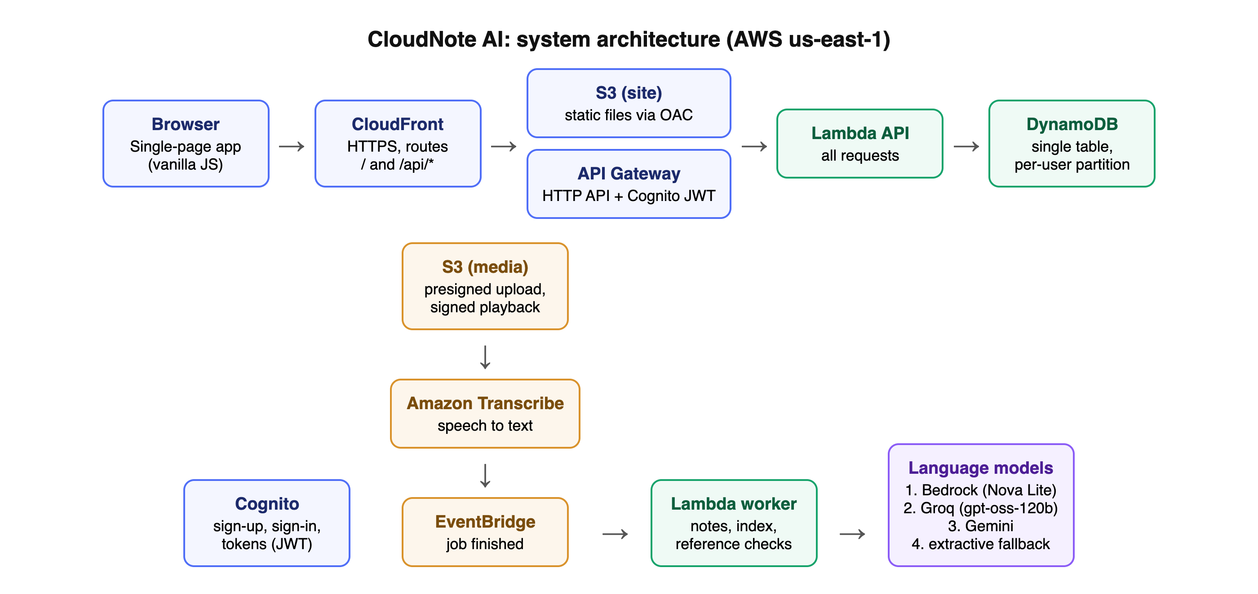
System Architecture: AWS Deployment View
Request path: CloudFront → API Gateway (Cognito JWT) → Lambda → DynamoDB / S3; processing path: S3 → Transcribe → EventBridge → worker Lambda → LLM chain
31-10-2026
PRC-III
18
Notes:
The deployed AWS view. CloudFront serves the app and routes the API; API Gateway checks the Cognito token; uploads go straight to S3; Transcribe and EventBridge trigger the worker.

Slide 19
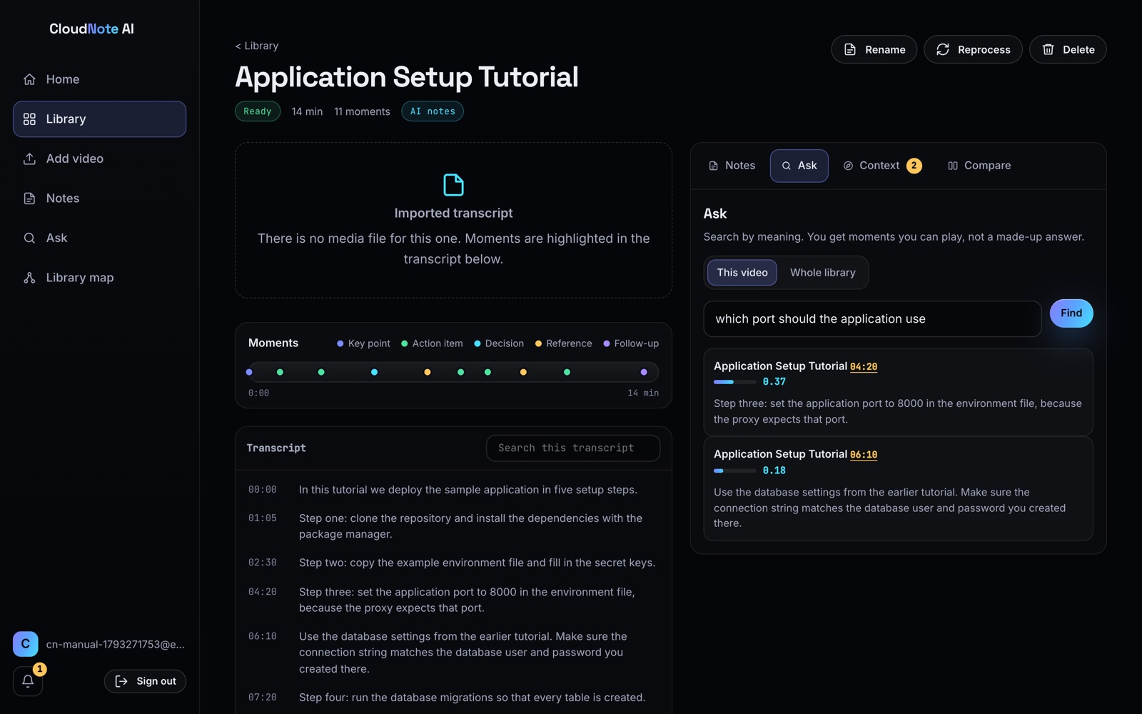
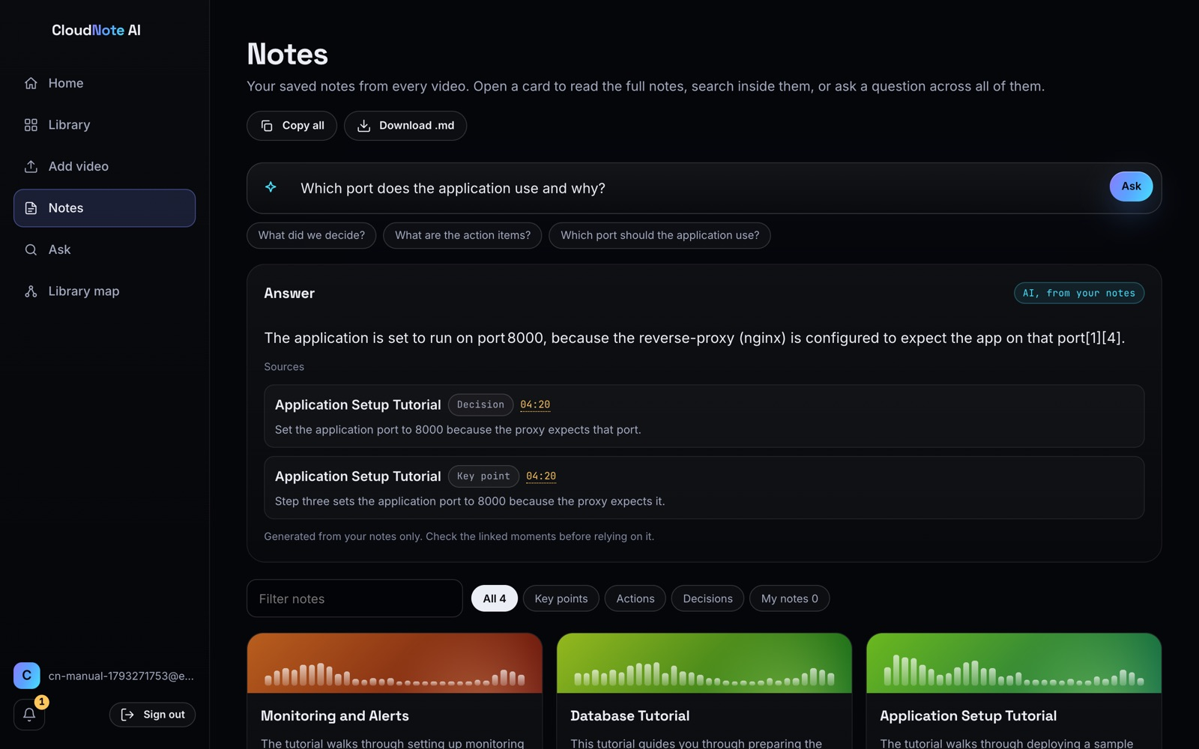
Results & Discussion (1/4): Implementation
Ask tab: question answered from the transcript, with timestamped moments
Ask your notes: answer with numbered citations
31-10-2026
PRC-III
19
Notes:
Screenshots from the live deployment. Asking 'what is DFS' gives an explanation from the transcript, and the cited moments are listed with timestamps such as 9:30, 12:10 and 15:36. Off-topic questions get no invented answer.

Slide 20
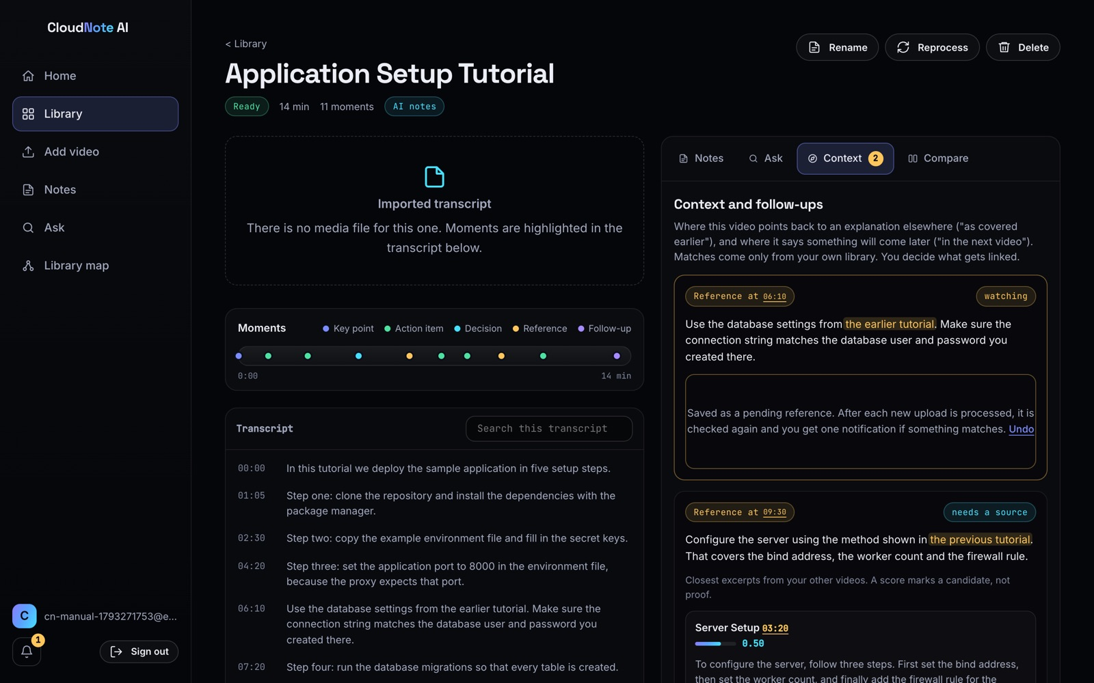
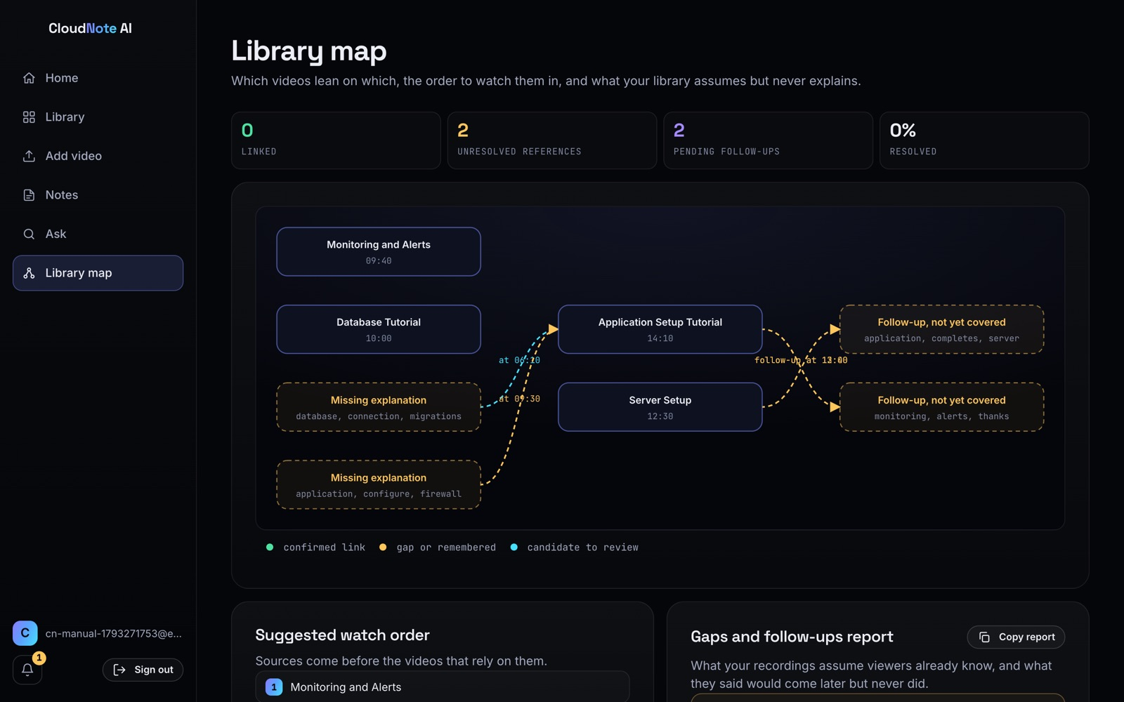
Results & Discussion (2/4): Context Recovery
Context tab: detected references and suggested sources
Library map: dependencies, watch order and gaps
31-10-2026
PRC-III
20
Notes:
References to other recordings are detected and linked; the library map shows dependencies and the gaps report.

Slide 21
Results & Discussion (3/4): Testing
102 / 102
tests passed, 0 failed
Security (live): cross-user access returns 404; unsigned S3 write 403; no token 401
Transcription (live): real clip transcribed and noted in 16.4 s
Grounding: uncited answers rejected; off-topic questions declined
Found and fixed on real AWS: 6 issues (packaging, IAM, plan, Bedrock quota, model retirement, citation formats)
31-10-2026
PRC-III
21
Notes:
59 automated tests and 43 checks against the live system all passed. We also list the six issues that only appeared on real AWS and how we fixed them.

Slide 22
Results & Discussion (4/4): Performance
Metric | Value
Lambda API median (server side) | 14.9 ms
Network floor India → us-east-1 | ~340 ms
11-s clip: upload → AI notes | 17.3 s
AI answer (median) | ~2.5 s
App JavaScript (gzip) | 47 KB
AWS cost, Oct 2026 | ~0.00 USD
Discussion: the server answers in about 15 ms; most user-visible delay is the round trip to the US region. Deploying in Mumbai (ap-south-1) would remove most of it.
31-10-2026
PRC-III
22
Notes:
Server time is about 15 ms; the rest is distance to us-east-1. Cost so far is close to zero because everything is pay-per-use.

Slide 23
Conclusion
Summary of the proposal
Next steps for the next evaluation phase
CloudNote AI is built and deployed on AWS, open for sign-up
Every note and answer points to a playable moment
References between recordings are detected, linked and remembered
Layered security verified live; 102/102 tests passed
Pay-per-use: near-zero cost so far
Measure reference-detection accuracy on real lecture series
Enable Bedrock and Titan semantic search when the quota is raised
Hindi and Telugu reference patterns
Shared course libraries for a class; MFA and WAF
Move to the Mumbai region; user study with students
31-10-2026
PRC-III
23
Notes:
To conclude, the system works end to end on AWS. Next we will measure accuracy on real lecture series, enable semantic search and support Indian languages.

Slide 24
References (1/2)
[1] Baevski, A., Zhou, H., Mohamed, A., & Auli, M. (2020). wav2vec 2.0: A framework for self-supervised learning of speech representations. Advances in Neural Information Processing Systems, 33. https://doi.org/10.48550/arXiv.2006.11477
[2] Gao, T., Yen, H., Yu, J., & Chen, D. (2023). Enabling large language models to generate text with citations. Proceedings of EMNLP 2023. https://doi.org/10.48550/arXiv.2305.14627
[3] Gulati, A., Qin, J., Chiu, C.-C., et al. (2020). Conformer: Convolution-augmented transformer for speech recognition. Proceedings of Interspeech 2020. https://doi.org/10.21437/Interspeech.2020-3015
[4] Guu, K., Lee, K., Tung, Z., Pasupat, P., & Chang, M.-W. (2020). REALM: Retrieval-augmented language model pre-training. Proceedings of ICML 2020. https://doi.org/10.48550/arXiv.2002.08909
[5] Izacard, G., & Grave, E. (2021). Leveraging passage retrieval with generative models for open domain question answering. Proceedings of EACL 2021. https://doi.org/10.18653/v1/2021.eacl-main.74
[6] Ji, Z., Lee, N., Frieske, R., et al. (2023). Survey of hallucination in natural language generation. ACM Computing Surveys, 55(12). https://doi.org/10.1145/3571730
[7] Karpukhin, V., Oguz, B., Min, S., et al. (2020). Dense passage retrieval for open-domain question answering. Proceedings of EMNLP 2020. https://doi.org/10.18653/v1/2020.emnlp-main.550
[8] Kasneci, E., Sessler, K., Küchemann, S., et al. (2023). ChatGPT for good? On opportunities and challenges of large language models for education. Learning and Individual Differences, 103, 102274. https://doi.org/10.1016/j.lindif.2023.102274
[9] Khattab, O., & Zaharia, M. (2020). ColBERT: Efficient and effective passage search via contextualized late interaction over BERT. Proceedings of SIGIR 2020. https://doi.org/10.1145/3397271.3401075
[10] Lewis, M., Liu, Y., Goyal, N., et al. (2020). BART: Denoising sequence-to-sequence pre-training for natural language generation, translation, and comprehension. Proceedings of ACL 2020. https://doi.org/10.18653/v1/2020.acl-main.703
31-10-2026
PRC-III
24
Notes:
Research papers from the literature survey, in APA format.

Slide 25

References (2/2)
[11] Lewis, P., Perez, E., Piktus, A., et al. (2020). Retrieval-augmented generation for knowledge-intensive NLP tasks. Advances in Neural Information Processing Systems, 33. https://doi.org/10.48550/arXiv.2005.11401
[12] Liu, N. F., Lin, K., Hewitt, J., et al. (2024). Lost in the middle: How language models use long contexts. Transactions of the ACL, 12. https://doi.org/10.1162/tacl_a_00638
[13] Menick, J., Trebacz, M., Mikulik, V., et al. (2022). Teaching language models to support answers with verified quotes. arXiv. https://doi.org/10.48550/arXiv.2203.11147
[14] Nakano, R., Hilton, J., Balaji, S., et al. (2021). WebGPT: Browser-assisted question-answering with human feedback. arXiv. https://doi.org/10.48550/arXiv.2112.09332
[15] Radford, A., Kim, J. W., Xu, T., Brockman, G., McLeavey, C., & Sutskever, I. (2023). Robust speech recognition via large-scale weak supervision. Proceedings of ICML 2023. https://doi.org/10.48550/arXiv.2212.04356
[16] Shahrad, M., Fonseca, R., Goiri, Í., et al. (2020). Serverless in the wild: Characterizing and optimizing the serverless workload at a large cloud provider. USENIX ATC 2020. https://doi.org/10.48550/arXiv.2003.03423
[17] Thakur, N., Reimers, N., Rücklé, A., Srivastava, A., & Gurevych, I. (2021). BEIR: A heterogeneous benchmark for zero-shot evaluation of information retrieval models. NeurIPS Datasets and Benchmarks. https://doi.org/10.48550/arXiv.2104.08663
[18] Zhang, J., Zhao, Y., Saleh, M., & Liu, P. J. (2020). PEGASUS: Pre-training with extracted gap-sentences for abstractive summarization. Proceedings of ICML 2020. https://doi.org/10.48550/arXiv.1912.08777
Other sources: documentation, textbook, software
Amazon Web Services. (2026). Amazon Transcribe developer guide. https://docs.aws.amazon.com/transcribe/
Amazon Web Services. (2026). Amazon Bedrock user guide. https://docs.aws.amazon.com/bedrock/
Amazon Web Services. (2026). AWS Serverless Application Model developer guide. https://docs.aws.amazon.com/serverless-application-model/
Manning, C. D., Raghavan, P., & Schütze, H. (2008). Introduction to information retrieval. Cambridge University Press.
OWASP Foundation. (2021). OWASP Top 10: 2021. https://owasp.org/Top10/
CloudNote AI source code (GitHub): https://github.com/kmithileshhhhh05/cloudnote-ai
CloudNote AI live system: https://d349qer3boe6fg.cloudfront.net
GitHub
31-10-2026
PRC-III
25
Notes:
Remaining papers plus documentation, the textbook and our source code. The QR code opens the GitHub repository.

Slide 26

THANK YOU
Live demo: d349qer3boe6fg.cloudfront.net
31-10-2026
PRC-III
26
Notes:
Thank you. We are happy to take questions or show a live demo; the QR code opens the live site.

