Slide 1

ENGINEERING CAPSTONE PROJECT - 1
FINAL PROJECT REVIEW
CloudNote AI: Cloud-Based Intelligent Video Note Extraction and Semantic Search Platform
TEAM / ROLL NO.
2320030330 - K. MITHILESH REDDY
2320030186 - NITIN TULUGU
2320030348 - SARGU SAI CHETAN
Under the Guidance of
DR. G. NEELIMA
Department of Computer Science and Engineering
KONERU LAKSHMAIAH EDUCATION FOUNDATION
31-10-2026
1
Notes:
Good morning. We are presenting the final review of our Engineering Capstone Project, CloudNote AI, a cloud-based platform for video note extraction and search. Team: K. Mithilesh Reddy (2320030330), Nitin Tulugu (2320030186) and Sargu Sai Chetan (2320030348), under the guidance of Dr. G. Neelima, Department of CSE. Today we show the system we built, deployed on AWS, and the measured results.

Slide 2

OUTLINE
CONTEXT
DESIGN
RESULTS
01 Introduction & Motivation
02 Problem Statement
03 Objectives
04 Literature Survey
05 Research Gap & Response
06 Proposed System
07 System Architecture
08 Data Design
09 Security Design
10 Workflow (Sequence)
11 Implementation & Stack
12 Module Demonstrations
13 Cloud Deployment
14 Testing & Results
15 Performance Results
16 Objectives Achieved
17 Conclusion & Future Scope
18 References
31-10-2026
FINAL REVIEW
2
Notes:
Our talk has three parts: the context and problem, the design of the system, and the results we measured on the live deployment.

Slide 3
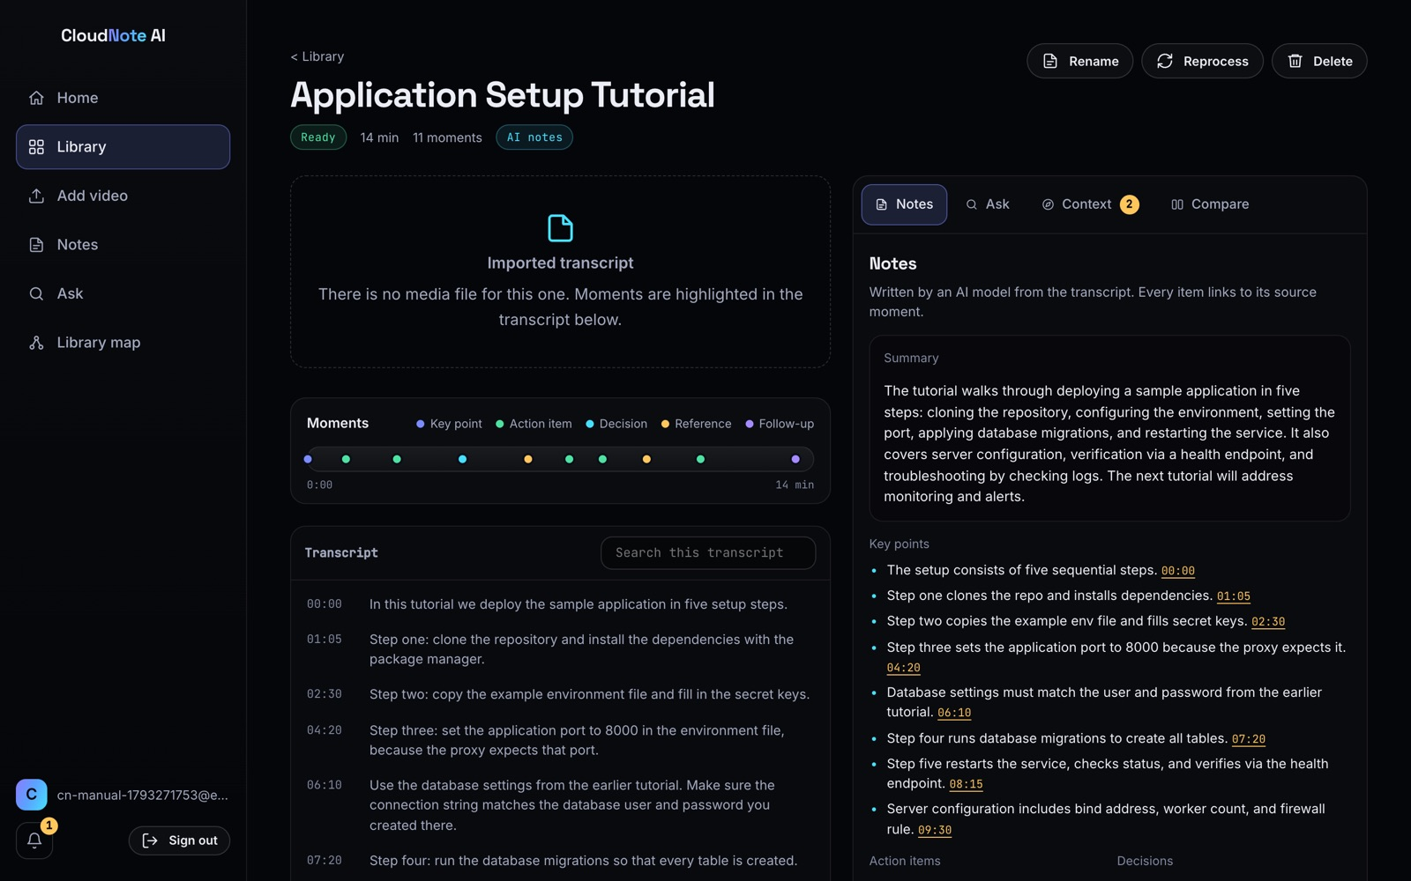
Introduction & Motivation
Theme: one private, cloud-hosted library that turns recorded lectures into verifiable notes and connects recordings that refer to each other.
Video is slow to consult: a fact said at minute 37 is effectively lost.
Recordings depend on each other: "as we discussed earlier", "in the next video".
AI summaries are hard to verify: no link back to the moment.
Students need: answers they can check, with timestamps.
Our approach: serverless AWS platform with transcription, cited answers and cross-video context recovery.
CloudNote AI video page with AI notes (live deployment)
31-10-2026
FINAL REVIEW
3
Notes:
Lectures are now recorded everywhere, but a video cannot be skimmed and recordings refer to each other. Our approach is a cloud platform that produces notes and answers that always point back to the exact moment.

Slide 4
Problem Statement
CURRENT CHALLENGES
PROPOSED RESPONSE
Scrubbing through long recordings
Untraceable AI summaries
References to other videos lead nowhere
Promised follow-ups never checked
Own notes never compared with the lecture
Servers and AI are costly to run
Timestamped transcription (Amazon Transcribe)
Notes linked to moments
Answers with citations and timestamps
Detected, suggested and remembered references
Notes vs Video comparison
Pay-per-use serverless AWS stack
→
Research question: How can a cloud platform turn a library of recorded lectures into searchable, verifiable notes, and recover the context that individual recordings leave out?
31-10-2026
FINAL REVIEW
4
Notes:
These are the challenges we started from, and on the right how the system responds. Our research question is shown at the bottom.

Slide 5
Objectives
01 Timestamped transcription
02 Verifiable notes
03 Grounded answers
Speech to timestamped moments; transcript import
Summary, points, actions, decisions linked to moments
Answers only from your material, cited, with timestamps
04 Context recovery
05 Secure serverless cloud
06 Honest evaluation
Detect, suggest and remember references between videos
Per-user isolation, authenticated API, IaC
Live tests, measurements, stated limits
31-10-2026
FINAL REVIEW
5
Notes:
These six objectives were set at the first review. We revisit them at the end.

Slide 6
Literature Survey (Key Papers)
Year | Authors | Focus / Method | Gap noted
2014 | Guo, Kim, Rubin | MOOC video engagement (6.9M edX sessions) | No cross-video navigation
2014 | Kim et al. | LectureScape: interaction-driven navigation | Single video; crowd data
2023 | Radford et al. | Whisper: robust speech recognition | Transcription only
2004 | Erkan & Radev | LexRank: graph centrality summaries | Less readable notes
1988 | Salton & Buckley | TF-IDF term weighting | Misses paraphrases
2019 | Reimers & Gurevych | Sentence-BERT embeddings | Needs embedding service
2020 | Lewis et al. | Retrieval-augmented generation | Not personal libraries
2023 | Gao et al. | LLM answers with citations (ALCE) | Citations often missing
2019 | Jonas et al. | Serverless computing (Berkeley view) | Cold starts, limits
Synthesis: strong building blocks, but no tool we found links references across recordings and remembers missing explanations.
31-10-2026
FINAL REVIEW
6
Notes:
We reviewed fifteen papers; the key ones are shown. Each provides a building block; none connects recordings to each other.

Slide 7
Research Gap → Our Response
# | Research gap | Implemented response in CloudNote AI
1 | Navigation aids stop at one video | Reference detection, suggested sources, confirmed links
2 | No memory for missing explanations | Remembered references re-checked after every upload
3 | AI notes and answers hard to verify | Citations enforced; every item has a playable timestamp
4 | Semantic search needs extra services | TF-IDF by default; Titan embeddings when Bedrock is available
5 | ASR and AI costly to operate | Serverless pay-per-use stack; free-tier AI fallback
Core gap addressed: cross-video context recovery, built, deployed and measured.
31-10-2026
FINAL REVIEW
7
Notes:
Each gap maps to a concrete feature we implemented.

Slide 8
Proposed System: Three Feature Modules
INGEST & NOTES
ASK & SEARCH
CONTEXT RECOVERY
Upload 8 media formats (500 MB)
Import SRT, VTT, JSON, text
Amazon Transcribe
AI notes with moments
Extractive fallback
Answer from the transcript + moments
Ask your notes with citations
Search one video or library
Know more explanations
Notes vs Video compare
Detect "earlier" / "next video"
Suggest sources
Remember and re-check
One notification per match
Library map and gaps report
Shared core: Cognito sign-in · per-user DynamoDB partition · REST API (28 endpoints) · model chain Bedrock → Groq → Gemini
31-10-2026
FINAL REVIEW
8
Notes:
The system has three feature areas on one shared, secure core.

Slide 9
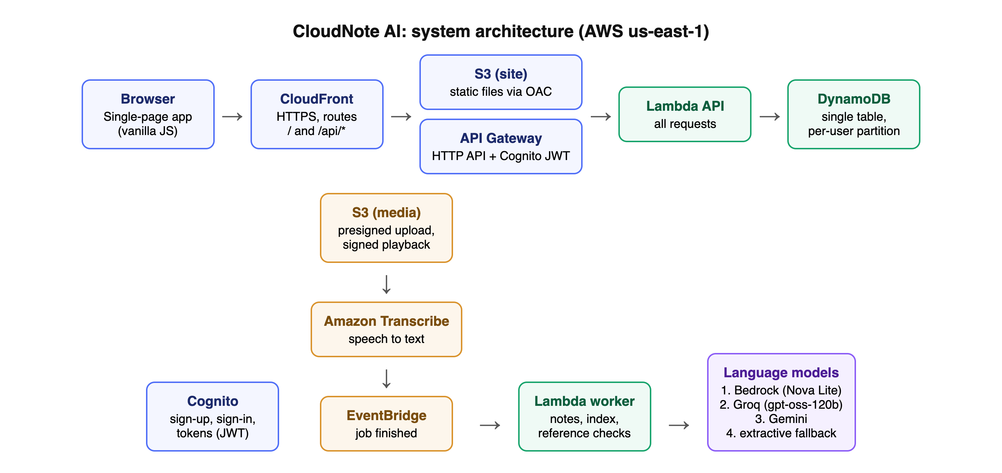
System Architecture (AWS, us-east-1)
Infrastructure as code: one AWS SAM / CloudFormation stack "cloudnote-ai" · infra/deploy.sh: build → package → deploy → publish
31-10-2026
FINAL REVIEW
9
Notes:
CloudFront serves the app from S3 and routes the API. API Gateway checks the Cognito token before Lambda runs. Uploads go straight to S3, Transcribe converts speech, EventBridge triggers the worker, and everything is stored per user in DynamoDB.

Slide 10
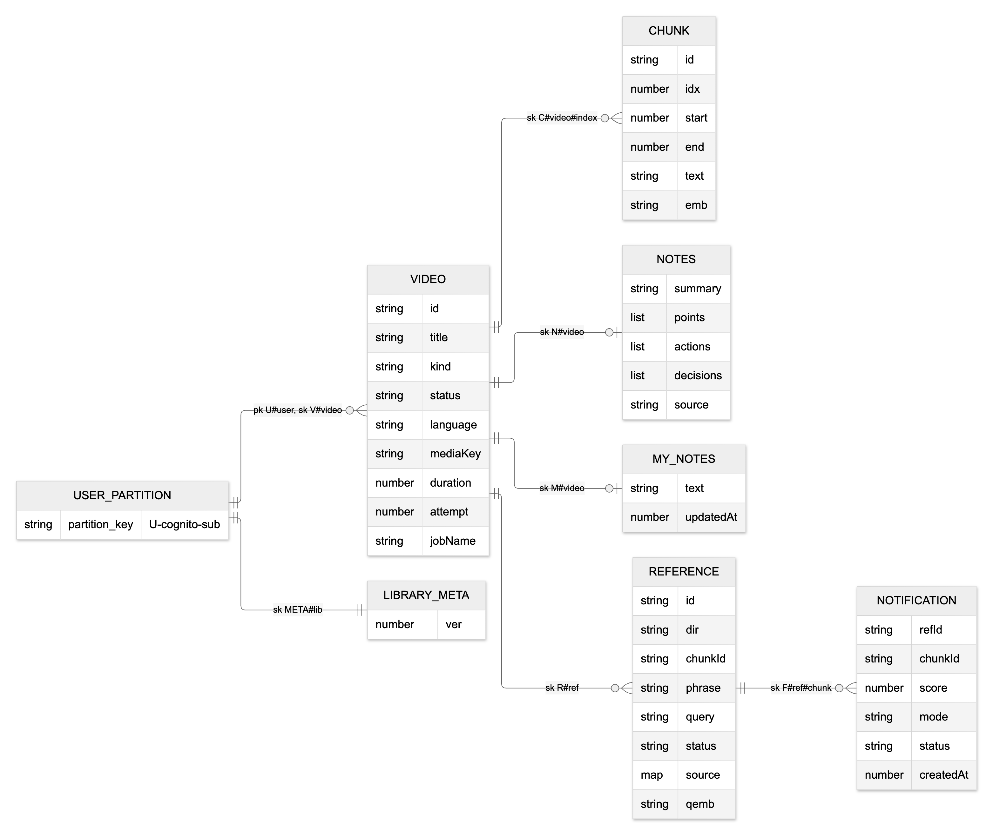
Data Design (DynamoDB Single Table)
DESIGN NOTES
pk = U#<Cognito user id>: isolation by design
sk prefixes: V#, C#, N#, M#, R#, F#, META#
On-demand billing, point-in-time recovery
Retained if the stack is deleted
Media in private, encrypted S3
31-10-2026
FINAL REVIEW
10
Notes:
All data lives in one DynamoDB table. Because the partition key is the user's id from the verified token, a user can never address another user's data.

Slide 11
Security Design
Layer | Control
Identity | Cognito; password policy; optional domain restriction
API access | JWT authorizer: 401 before any code runs
Isolation | Partition key from verified token
Storage | Private encrypted S3; presigned, expiring URLs
Transport | HTTPS only, HSTS, CSP, X-Frame-Options DENY
AI output | Citations enforced; labelled explanations
Least privilege | Per-function IAM policies
VERIFIED LIVE
43/43 live checks passed
Cross-user access → 404
Unsigned S3 write → 403
KNOWN GAPS
Open sign-up, no MFA
No WAF or alarms yet
Third-party AI while Bedrock is 0
31-10-2026
FINAL REVIEW
11
Notes:
Security is layered: identity, gateway authorisation, partition isolation, private storage, transport headers and grounded AI output. We tested each layer live.

Slide 12
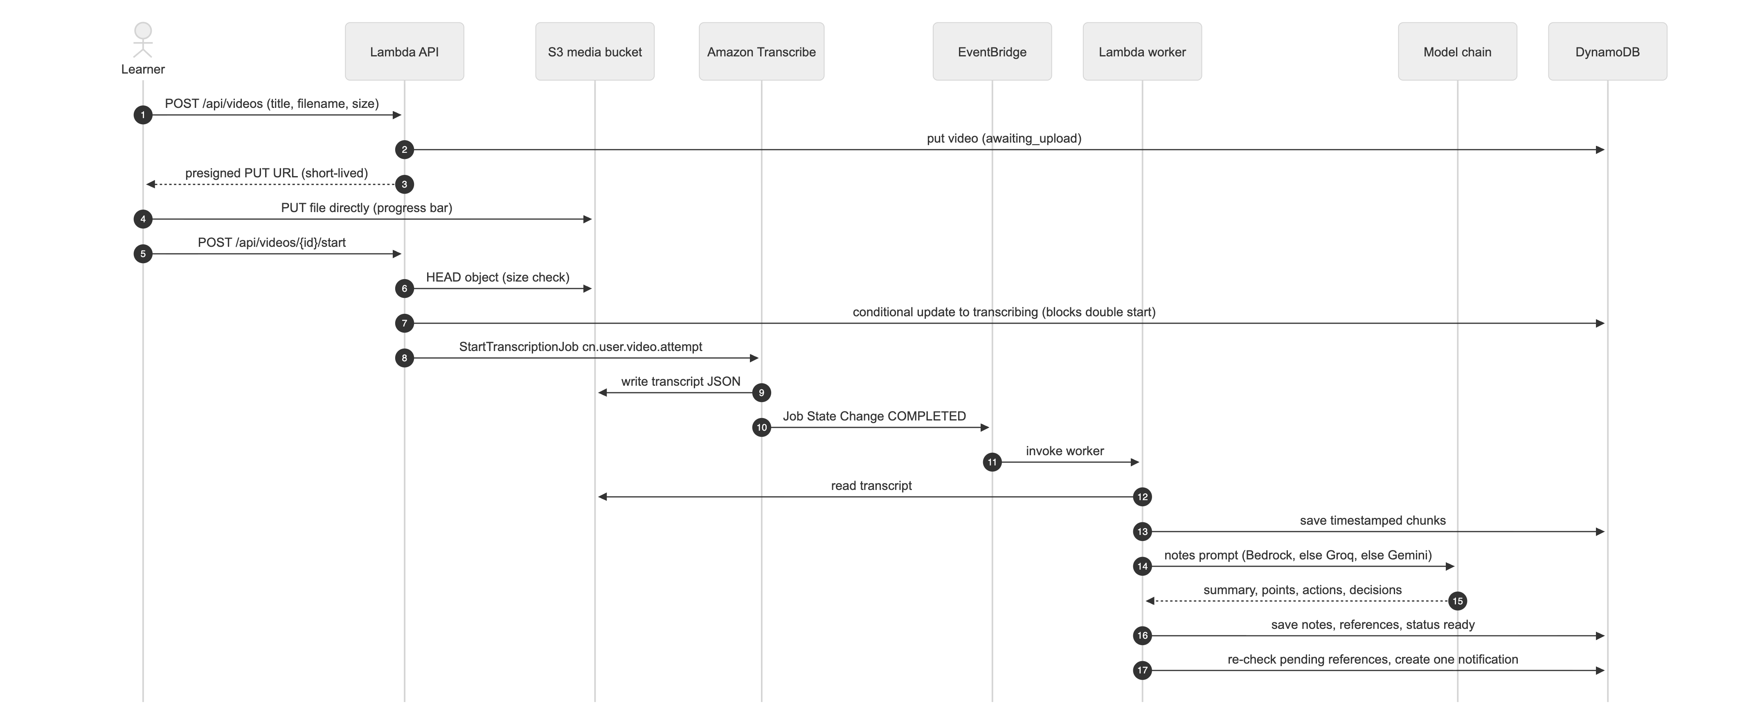
Workflow: Upload → Transcribe → Notes
Safe start: a conditional update reserves the video, so a double click cannot start two Transcribe jobs.
31-10-2026
FINAL REVIEW
12
Notes:
This sequence shows one recording from upload to notes, including the EventBridge trigger and the model chain.

Slide 13
Implementation & Technology Stack
FRONTEND
BACKEND
DATA & AI
CLOUD / DEVOPS
Vanilla JS SPA
esbuild
Responsive, Ctrl+K
Node.js 22 on Lambda
AWS SDK v3
Shared NLP engine
DynamoDB, S3
Transcribe
Bedrock / Groq / Gemini
CloudFront, Cognito
API Gateway, EventBridge
SAM / CloudFormation
28
102
13
~4,600
REST endpoints
tests passed (59 + 43)
reference patterns
lines of code
31-10-2026
FINAL REVIEW
13
Notes:
One language across the stack, all infrastructure as code, and 102 passing tests in total.

Slide 14
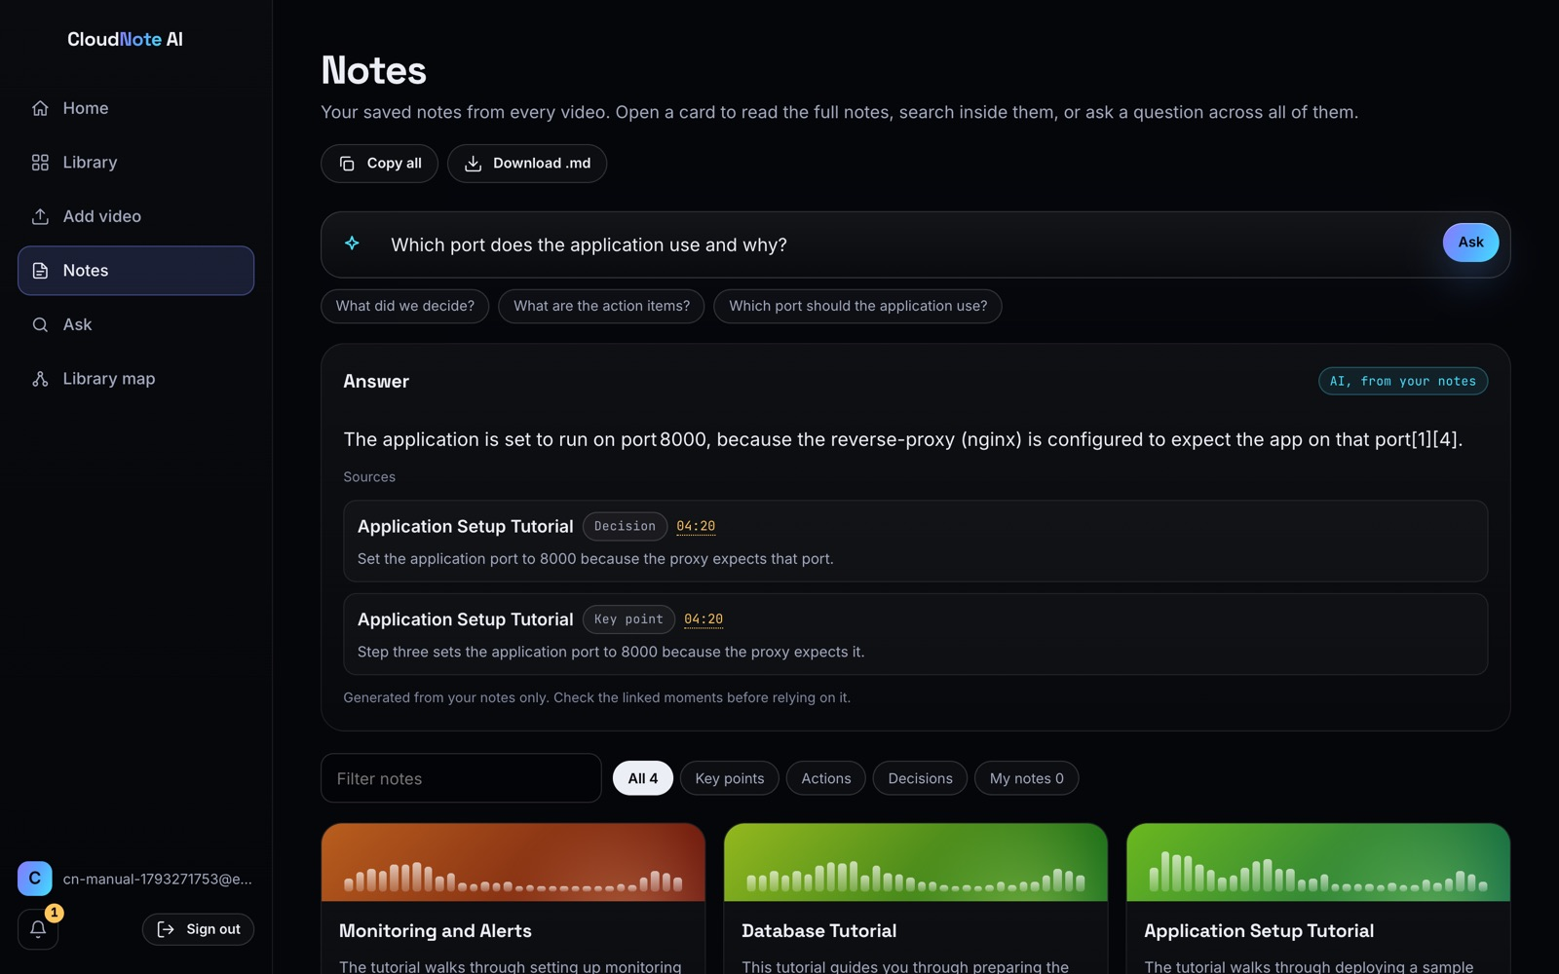
Module Demo 1: Notes & Answers
Video page: AI notes, moments timeline, transcript
Ask your notes: answer with citations
Also: Ask tab answers "what is DFS" from the transcript and lists the moments (9:30, 12:10, 15:36).
31-10-2026
FINAL REVIEW
14
Notes:
Every note links to its moment. Questions get an answer with citations and timestamps, and off-topic questions are declined.

Slide 15
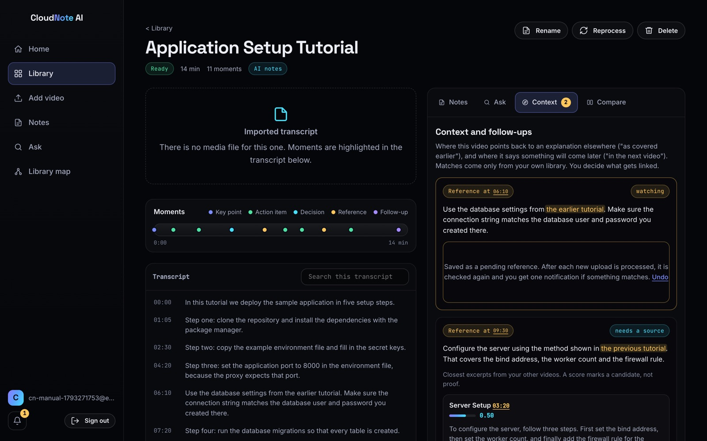
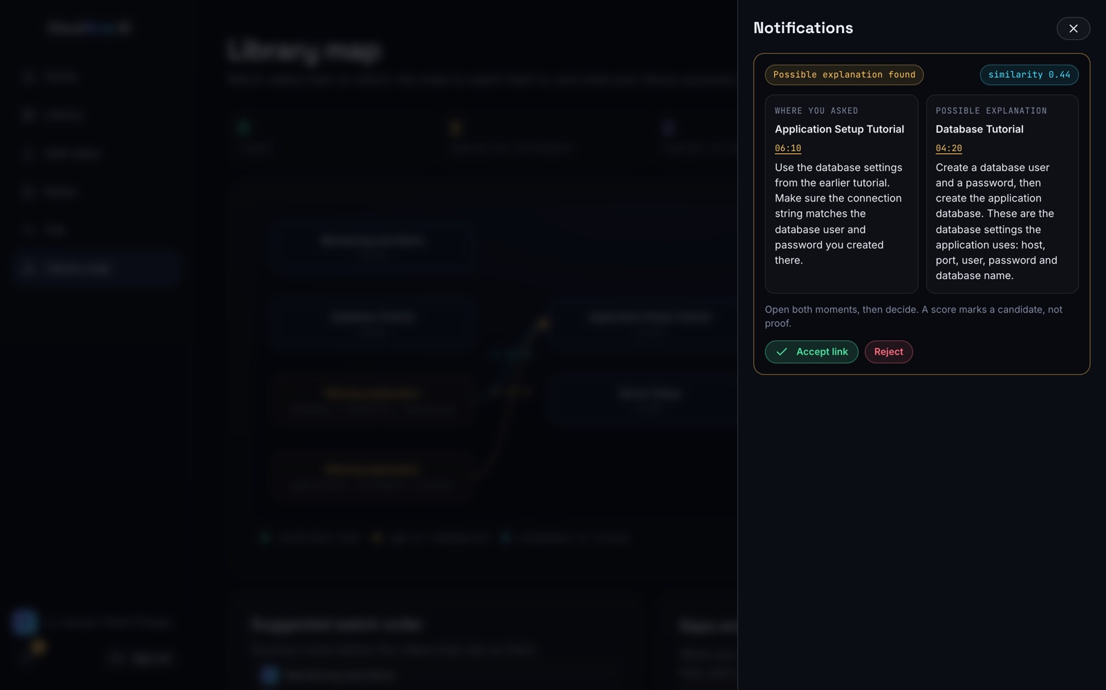
Module Demo 2: Context Recovery
Context tab: references and candidate sources
One notification when a remembered reference is explained
31-10-2026
FINAL REVIEW
15
Notes:
The Context tab lists references to other recordings with suggested sources. A reference with no source can be remembered; when a later upload explains it, the bell shows one notification.

Slide 16
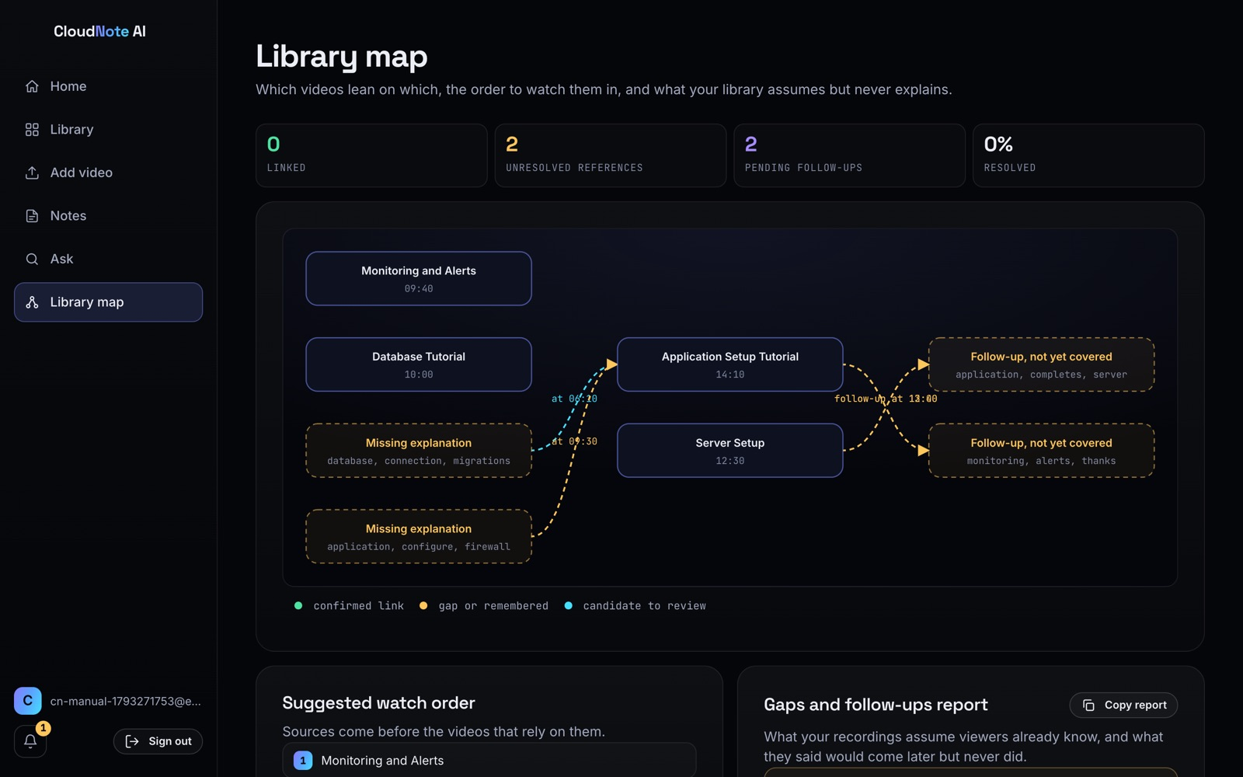
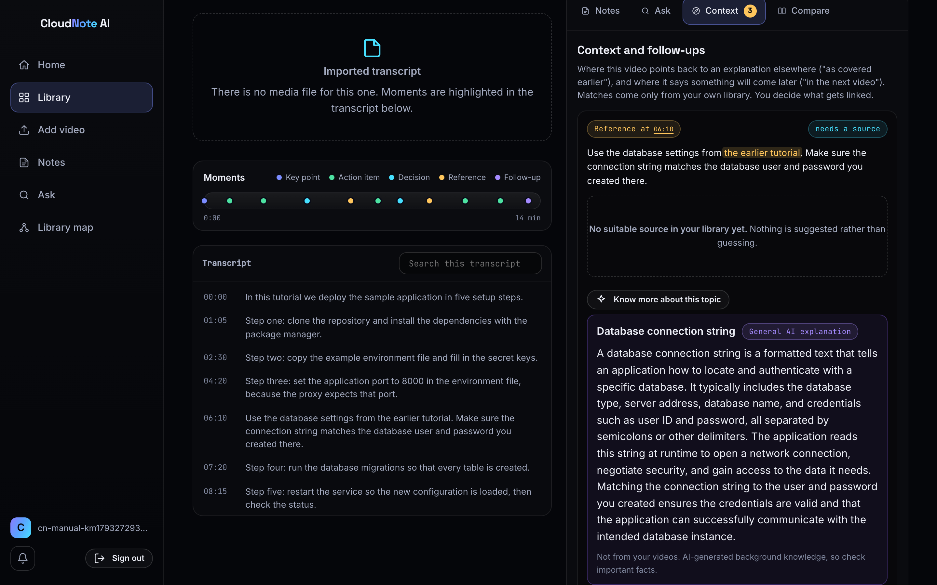
Module Demo 3: Library Map & Know More
Library map: dependencies, watch order, gaps
Know more: labelled general explanation
31-10-2026
FINAL REVIEW
16
Notes:
The map shows which recordings depend on which. When no recording covers a topic, Know more gives a clearly labelled general explanation.

Slide 17
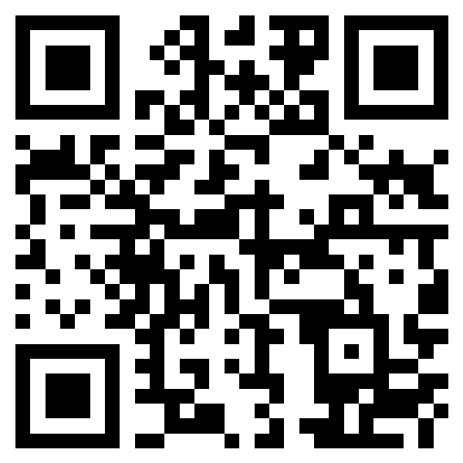
Cloud Deployment
Infrastructure as code: one SAM stack (cloudnote-ai)
Edge: CloudFront HTTPS, security headers, private S3 via OAC
Identity: Cognito + API Gateway JWT authorizer
Compute: Lambda API (1024 MB) and worker (1536 MB), ARM64
Data: DynamoDB on-demand with PITR; private S3 media
Speech: Transcribe + EventBridge
AI: Bedrock → Groq → Gemini fallback (Bedrock quota 0)
Region: us-east-1 (N. Virginia)
LIVE SYSTEM
d349qer3boe6fg.cloudfront.net
0.00 USD
AWS cost, Oct 2026
28
API endpoints
1
command to deploy
31-10-2026
FINAL REVIEW
17
Notes:
The whole system is one CloudFormation stack deployed with one command. Scan the QR code to open the live site.

Slide 18
Testing & Results
102 / 102
tests passed · 0 failed
DEFECTS FOUND & FIXED
6 issues seen only on real AWS (packaging, IAM, plan, quota, models, citations)
KNOWN LIMITATION
Reference accuracy on real lecture series not yet measured
31-10-2026
FINAL REVIEW
18
Notes:
59 automated tests and 43 live checks against the deployed system all passed.

Slide 19
Performance Results
14.9 ms
Lambda median (server side)
~340 ms
network floor India → us-east-1
17.3 s
11-s clip: upload → AI notes
~2.5 s
AI answer (median)
47 KB
app JS (gzip)
31-10-2026
FINAL REVIEW
19
Notes:
Server side the API takes about 15 milliseconds; most of what a user in India waits for is the round trip to the US region. Deploying in Mumbai would remove most of it.

Slide 20
Objectives Achieved
# | Objective | How it was achieved | Status
1 | Timestamped transcription | Transcribe + EventBridge; 4 transcript formats | Achieved
2 | Verifiable notes | Notes tied to moments; extractive fallback | Achieved
3 | Grounded answers | Citations enforced; answers with timestamps | Achieved
4 | Context recovery | Detect, suggest, remember, notify, map | Achieved*
5 | Secure serverless cloud | Cognito, JWT authorizer, per-user partitions, IaC | Achieved
6 | Honest evaluation | 102 tests, live timings, documented limits | Achieved
* accuracy on real lecture series is the next step
31-10-2026
FINAL REVIEW
20
Notes:
All six objectives were achieved. For context recovery the remaining step is to measure accuracy on real lecture series.

Slide 21
Conclusion & Future Scope
CONCLUSION
FUTURE SCOPE
Working, deployed platform on AWS
Notes and answers always point to a moment
Recordings linked; missing explanations remembered
Layered security, verified live
Zero cost so far; one-command deploy
Measure reference accuracy on real series
Bedrock + Titan semantic search
Hindi and Telugu reference patterns
Shared course libraries for classes
Mumbai region, MFA, WAF, alarms
User study with students
31-10-2026
FINAL REVIEW
21
Notes:
To conclude: the system works end to end on AWS. Next we will measure accuracy on real lecture series, enable semantic search and support Indian languages.

Slide 22

References & Thank You
[1] P. J. Guo, J. Kim, R. Rubin, "How video production affects student engagement," L@S, 2014.
[2] J. Kim et al., "Data-driven interaction techniques for improving navigation of educational videos," UIST, 2014.
[3] A. Radford et al., "Robust speech recognition via large-scale weak supervision," ICML, 2023.
[4] G. Erkan, D. R. Radev, "LexRank," JAIR, vol. 22, 2004.
[5] N. Reimers, I. Gurevych, "Sentence-BERT," EMNLP-IJCNLP, 2019.
[6] P. Lewis et al., "Retrieval-augmented generation," NeurIPS, 2020.
[7] T. Gao et al., "Enabling LLMs to generate text with citations," EMNLP, 2023.
[8] E. Jonas et al., "Cloud programming simplified: A Berkeley view on serverless computing," 2019.
THANK YOU
Source code (GitHub)
github.com/kmithileshhhhh05/cloudnote-ai
Questions?
31-10-2026
FINAL REVIEW
22
Notes:
Thank you. The source code is public on GitHub; scan the QR code. We are happy to take questions or give a live demo.

